Slide 1
Food poisoning fact files

Slide 2
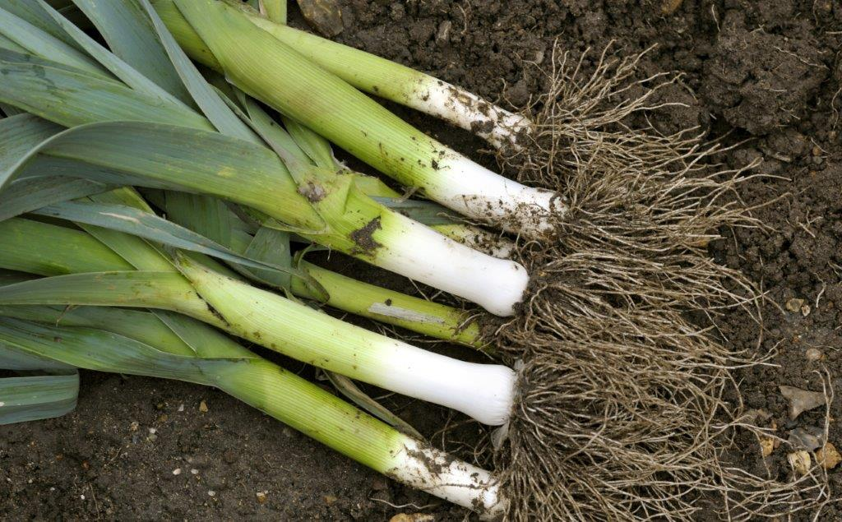
Bacteria - Clostridium botulinum
Sources
Fish and meat. Dust, soil and vegetables. Inadequately processed canned meat, vegetables and fish (faulty canning).
Signs and symptoms
Onset 12-36 hours. Voice change, double vision, drooping eyelids, severe constipation.
Death within a week or a slow recovery over months.

Slide 3
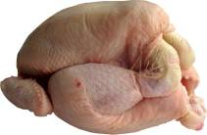
Bacteria – Campylobacter
Sources
Raw and undercooked poultry, unpasteurized milk, contaminated water.
Signs and symptoms
Onset 2 – 5 days (can be longer). Fever, headache and dizziness for a few hours, followed by abdominal pain.
This usually lasts 2 – 7 days and can recur over a number of weeks.

Slide 4
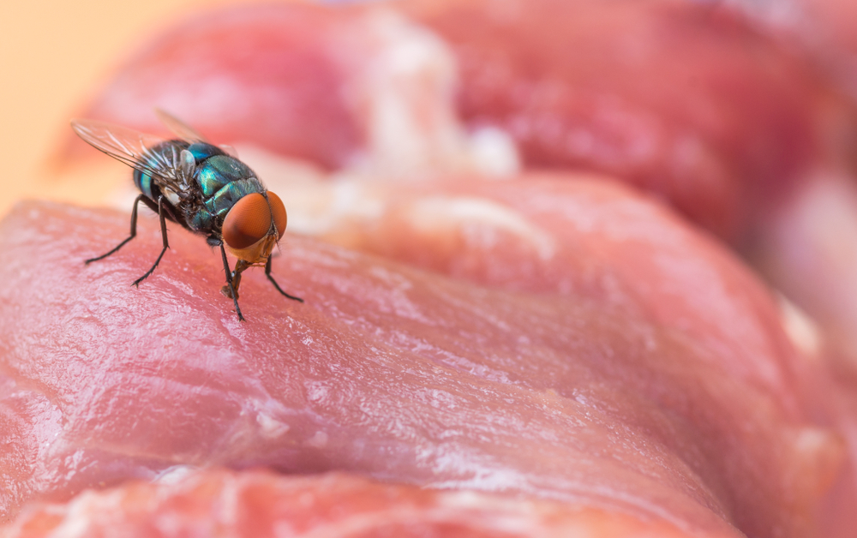
Bacteria - Clostridium perfringens
Sources
Animal and human waste. Dust, soil and vegetables. Raw meat. Insects.
Signs and symptoms
Onset 12-18 hours. Abdominal pain, diarrhoea and nausea.
This usually lasts 12 – 48 hours.
Clostridium perfringens forms spores.

Slide 5

Bacteria – E. Coli O157
Sources
Raw and undercooked meat and poultry. Unwashed vegetables. Contaminated water.
Signs and symptoms
Onset usually 3-4 days. Diarrhoea, which may contain blood, can lead to kidney failure or death.

Slide 6
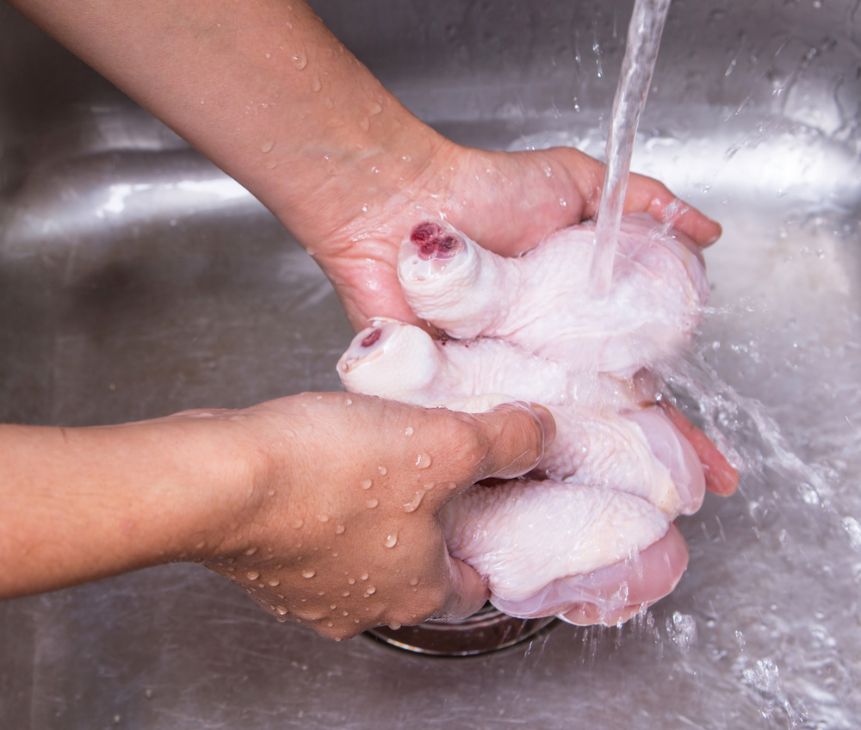

Bacteria – Salmonella
Sources
Raw meat, poultry and eggs. Flies, people, sewage and contaminated water.
Signs and symptoms
Onset 6-48 hours. Headache, general aching of limbs, abdominal pain and diarrhoea, vomiting and fever.
This usually lasts 1 – 7 days, and rarely is fatal.

Slide 7

Bacteria - Staphylococcus aureus
Sources
Humans: nose, mouth and skin. Untreated milk.
Signs and symptoms
Onset 1 – 6 hours. Severe vomiting, abdominal pain, weakness and lower than normal temperature.
This usually lasts 6 – 24 hours.

Slide 8
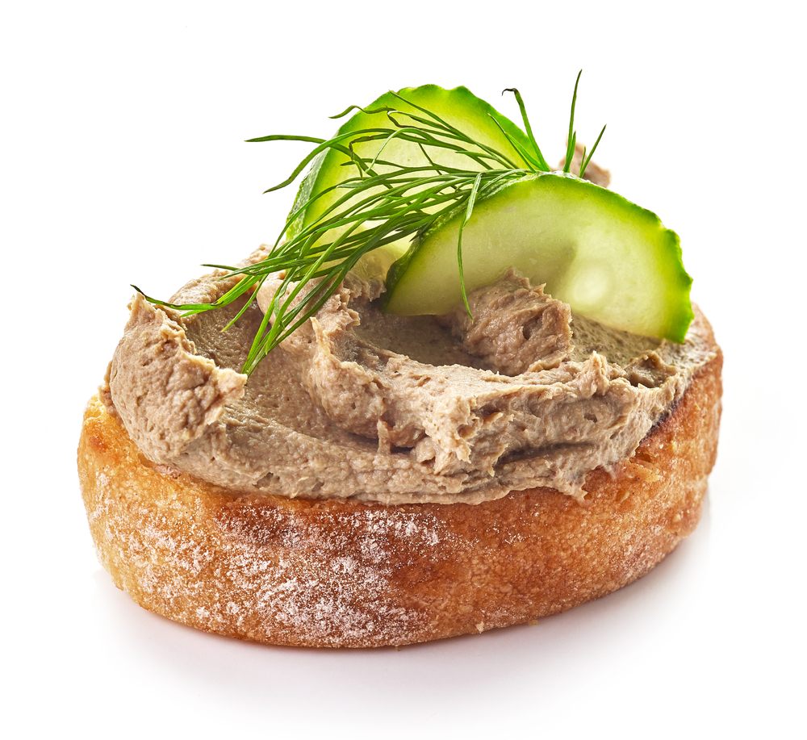
Bacteria – Listeria
Sources
Unpasteurised milk and dairy products, cook-chill foods, pate, meat, poultry and salad vegetables.
Signs and symptoms
Onset 1-70 days. Ranges from mild, flu-like illness to meningitis, septicaemia, pneumonia.
During pregnancy may lead to miscarriage or birth of an infected baby.

Slide 9
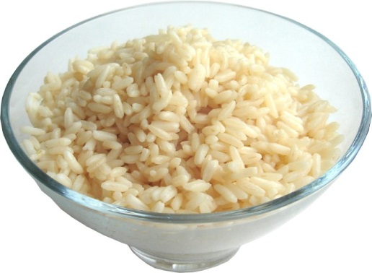
Bacteria - Bacillus cereus
Sources
Rice and cereals. Dust, soil and vegetables.
Signs and symptoms
Ranges nausea and vomiting and abdominal cramps and has an incubation period of 1 to 6 hours .
This usually lasts less than 24 hours after onset.
Bacillus cereus forms spores and releases toxins which cause illness.

Slide 10
Food poisoning fact files
For further information, go to:
www.foodafactoflife.org.uk
This science pack is one of a series of resources produced for the pHood Futures project, supported by the Royal Society of Chemistry.
This resource meets the Guidelines for producers and users of school education resources about food.

