Slide 1
Packaging and food waste – Waste Less, Package Smart
24/01/24

Slide 2

Packaging and food waste – Waste Less, Package Smart
Welcome!
The webinar will start at 4.30pm
Let us know who you are – type your name and organisation in the chat box.
Set your chat box to everyone.
Presenter: Anne Bencze
Whilst you are waiting:
What are the most commonly thrown away food items in the UK? Let us know what you think in the chat box.

Slide 3

Anne Bencze
Food & Packaging Technologist

Slide 4
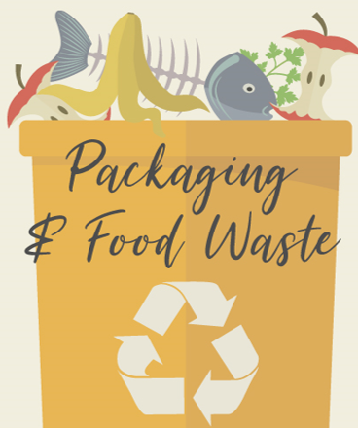

Slide 5
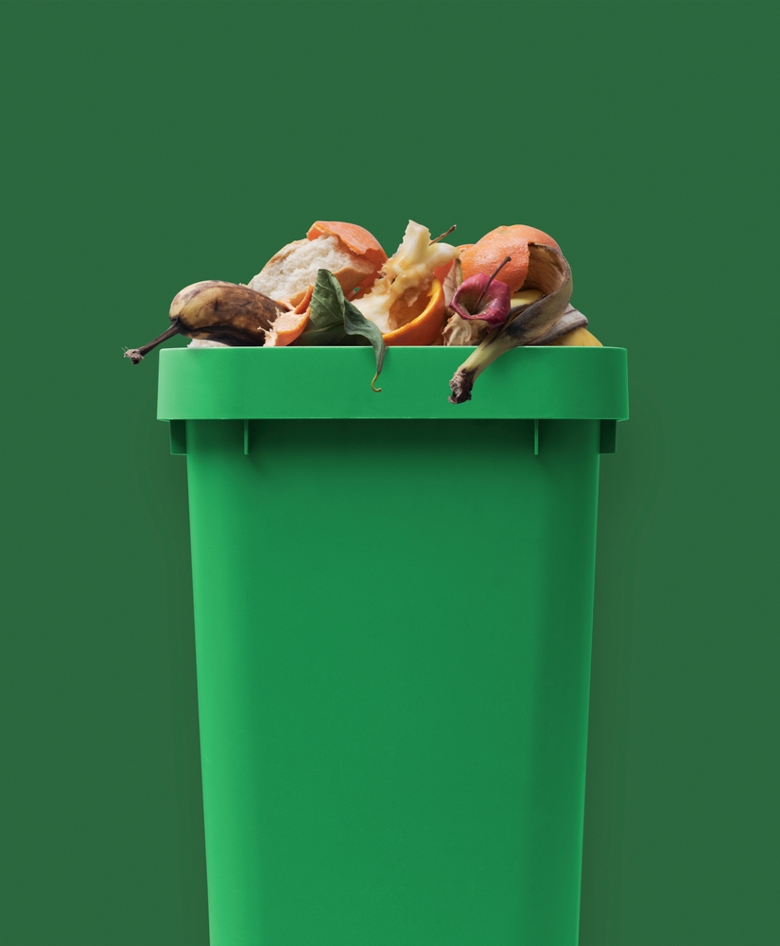
Food Waste and its Environmental Impact
Food waste has significant environmental implications, contributing to greenhouse gas emissions, the depletion of natural resources, and the loss of biodiversity
Approximately one-third of all food produced for human consumption is lost or wasted globally.
In the United Kingdom, households are responsible for 70% of all food waste – over 7 million tonnes

Slide 6
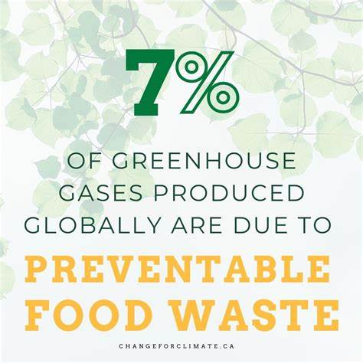
The Carbon Footprint of Food Waste
Food waste is responsible for approximately 7% of global greenhouse gas emissions.
If food waste were a country, it would be the third-largest emitter of greenhouse gases after the United States and China.

Slide 7
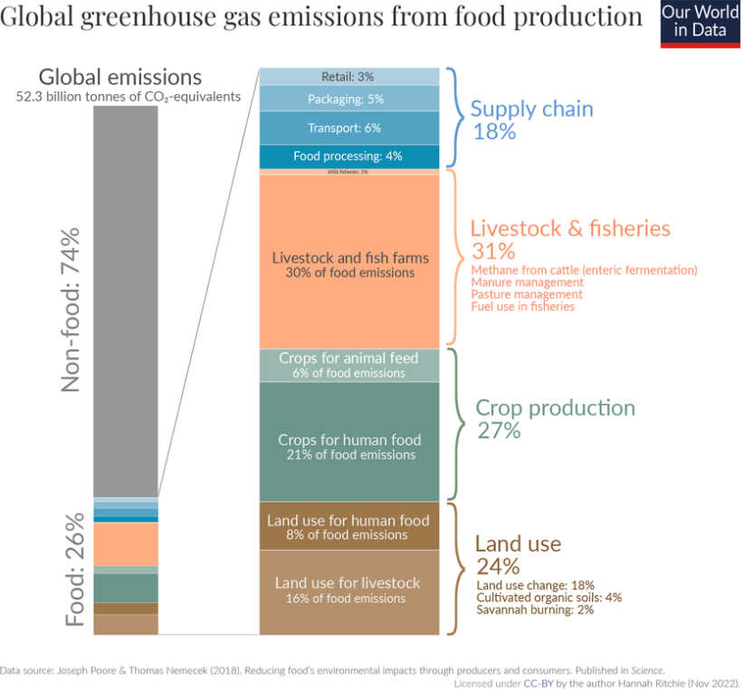
The Carbon Footprint of Packaging

Slide 8
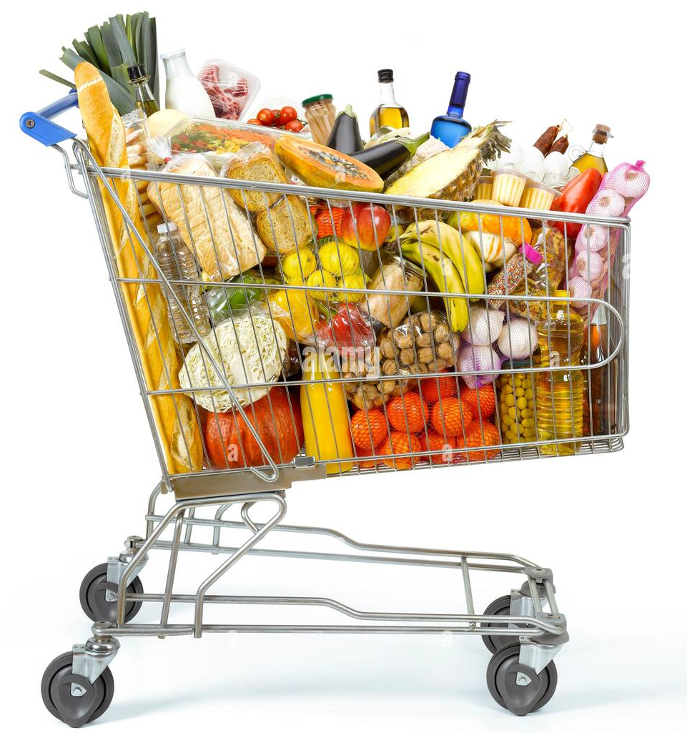
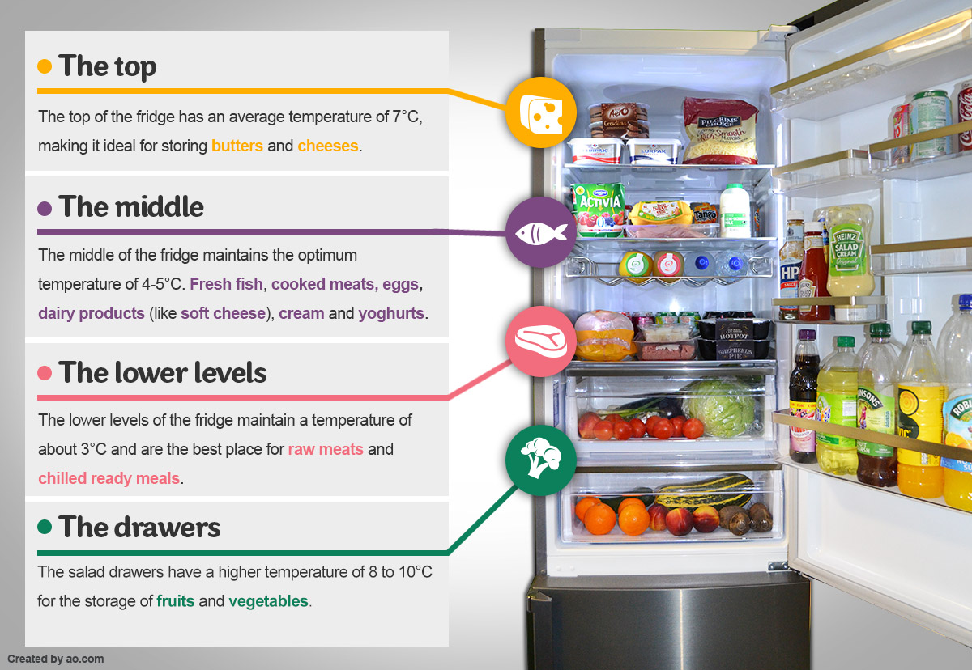
Consumer Behavior and Habits
Consumer behaviour and habits contribute to food waste:
  Buying more food than needed
  improper storage and handling
  confusion over expiration dates
Notes:
Packaging sample – Cheerios box

Slide 9
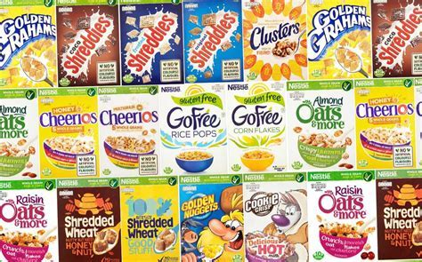

Too Good to Go Campaign

Slide 10

(not so) FUN FACT
If 25% of the food currently being lost or wasted globally was saved, it would be enough to feed 870 million people around the world
  in 2021, WHO reported there was 828 million affected by hunger

Slide 11

Food for Thought?

Slide 12


Slide 13



Slide 14
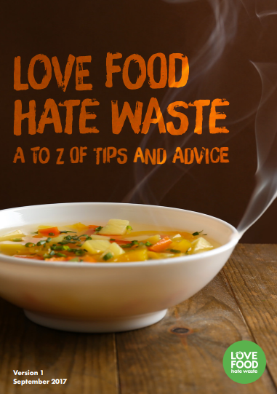
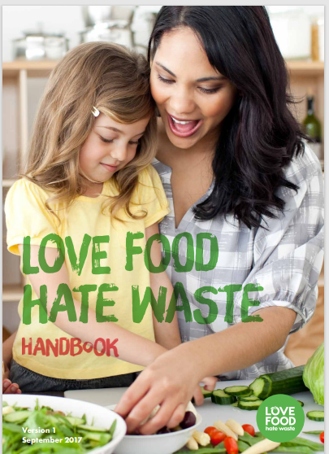

Slide 15
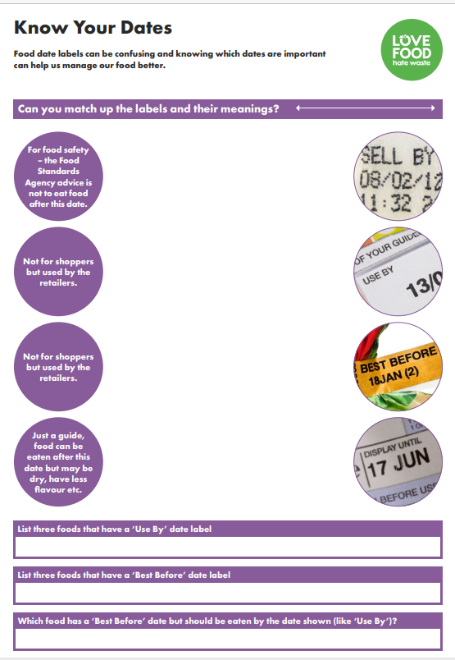
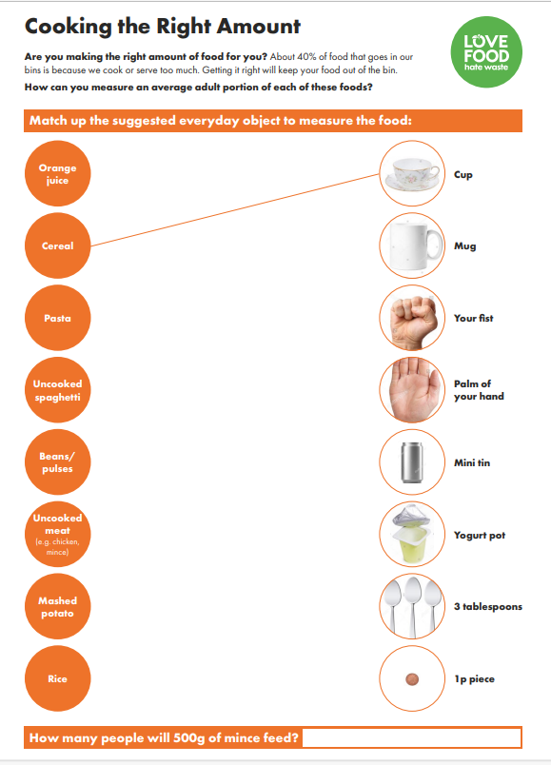
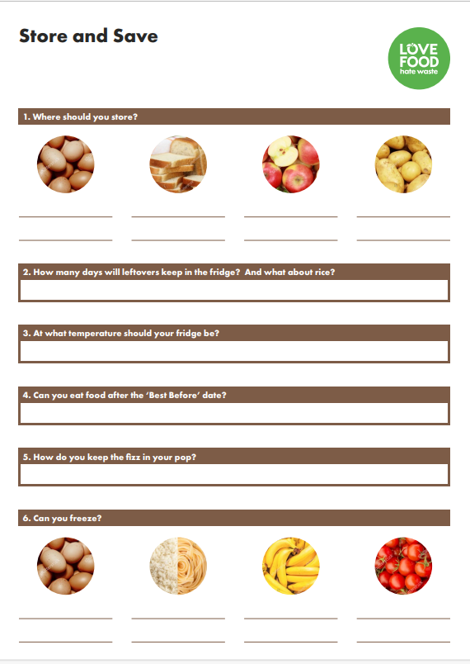

Slide 16
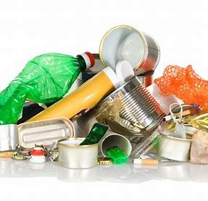
Definition of Packaging Waste
Packaging waste refers to the discarded materials used to protect, contain, or present products.
Packaging waste contributes to pollution and resource depletion.
It leads to increased energy consumption and greenhouse gas emissions during manufacturing and disposal processes.
Improper disposal of packaging waste can also contaminate soil, water, and wildlife habitats.
Notes:
Key words being Improper disposal
Increased education needed for disposal and also better infrastructure for handling the materials which are being recycled

Slide 17
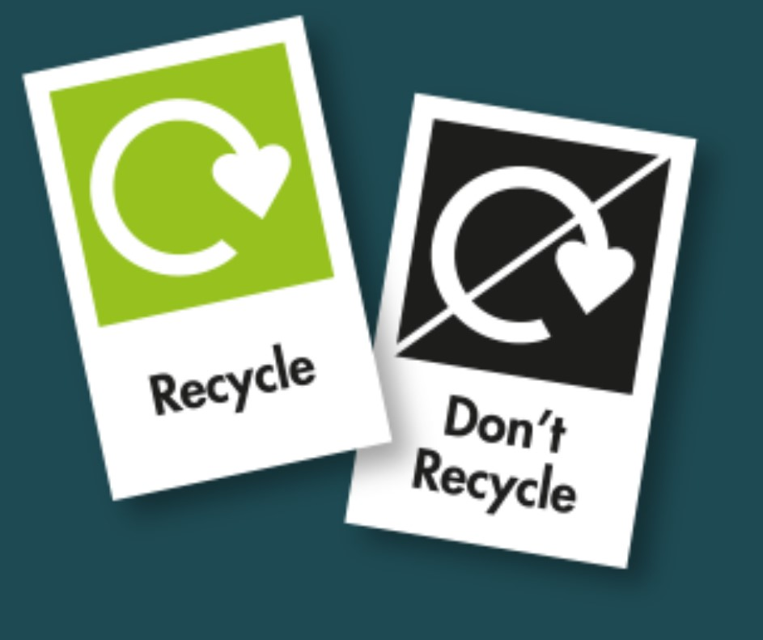
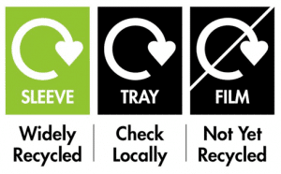
On-Pack-Recycling-Label (OPRL)
Producers will be required to label most packaging using the Recycle Now ‘swoosh’ and “relevant wording” by April 2026, a year later than initially proposed.
Plastic films and flexibles will need labels by 31 March 2027
About OPRL - OPRL

Slide 18
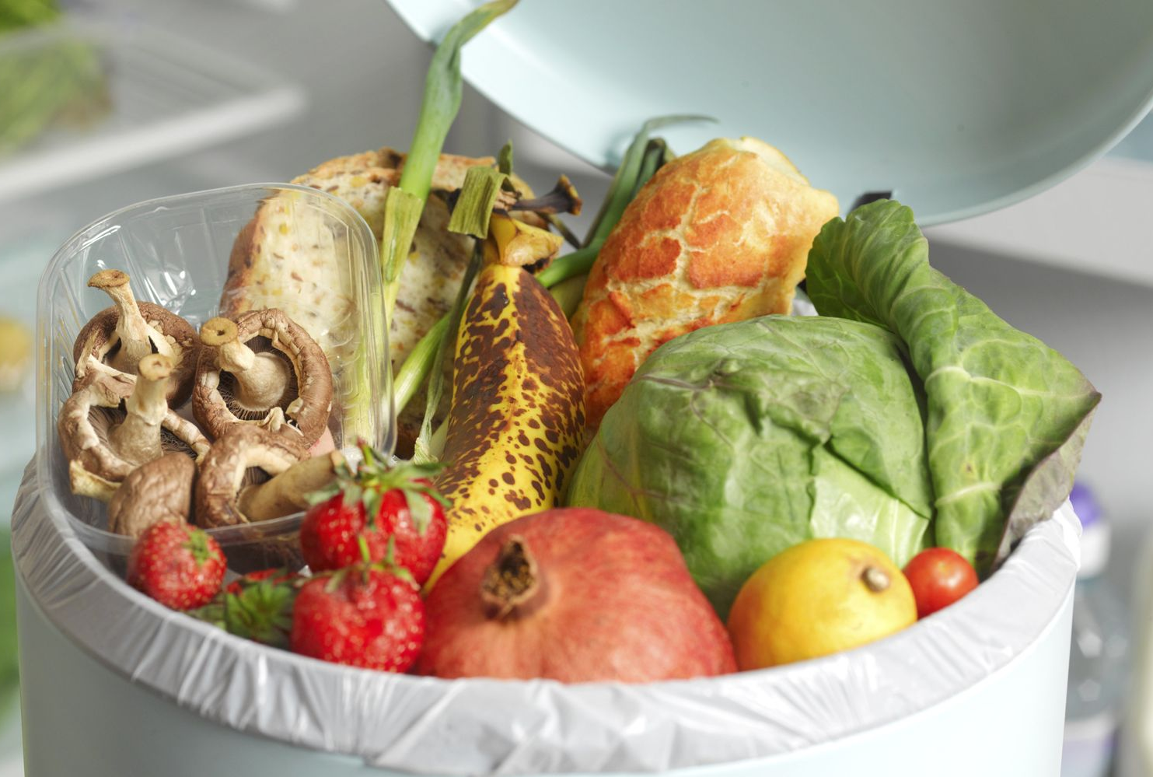
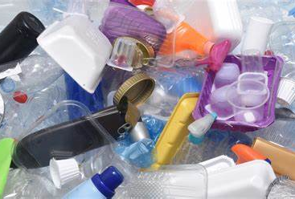
Food Waste or Packaging Waste
Are we solving one problem but creating another?

Slide 19
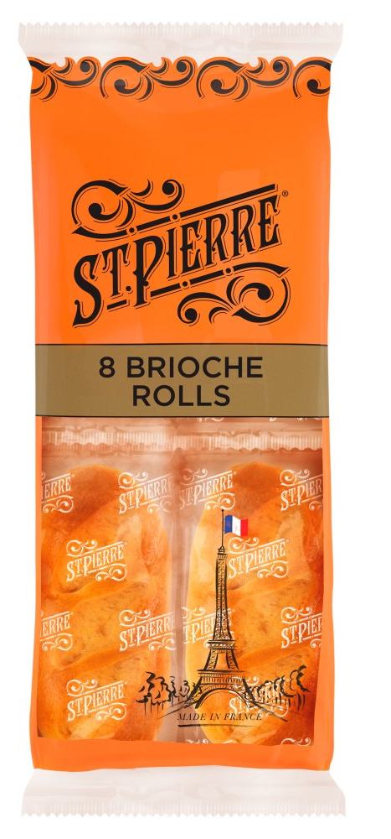
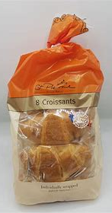
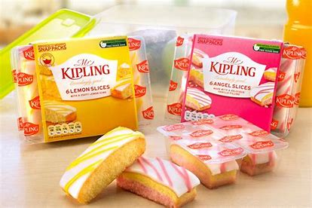

Slide 20
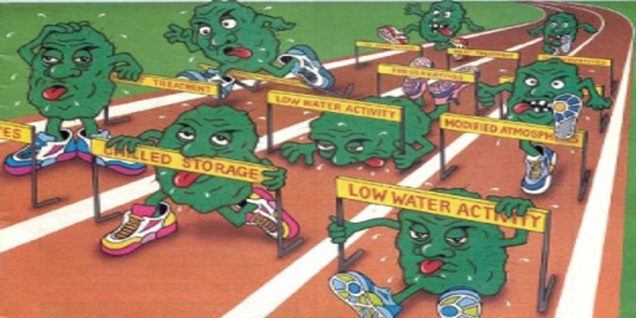
Methods to tackle Food spoilage - Microbiological Hurdles
In Food technology we use several different hurdles
    TOMCAT
      Temperature
      Oxygen
      Moisture
      Composition
      Acidity
      Time
Notes:
Educate students

Slide 21
Methods to tackle Food Spoilage - Packaging
Packaging functions – contain, protect, preserve, inform, sell, convenience with considerations given to cost & environment
Packaging can also be used
    MAP – Modified Atmosphere Packaging
    Canning
    Crisp packet
    Juice carton
    Individual portions to reduce food waste

Slide 22
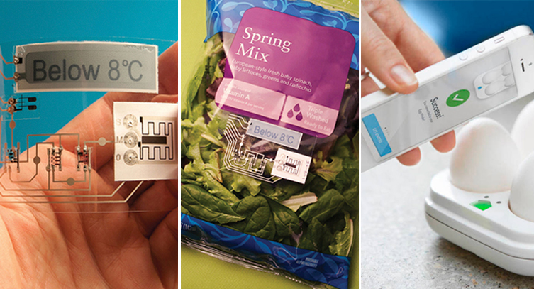

Technology and Innovations for Food Waste Reduction
Advanced packaging solutions to extend shelf life
Addition of sensors on / in packs
Notes:
Work with industry to develop packaging changes
Food samples

Slide 23
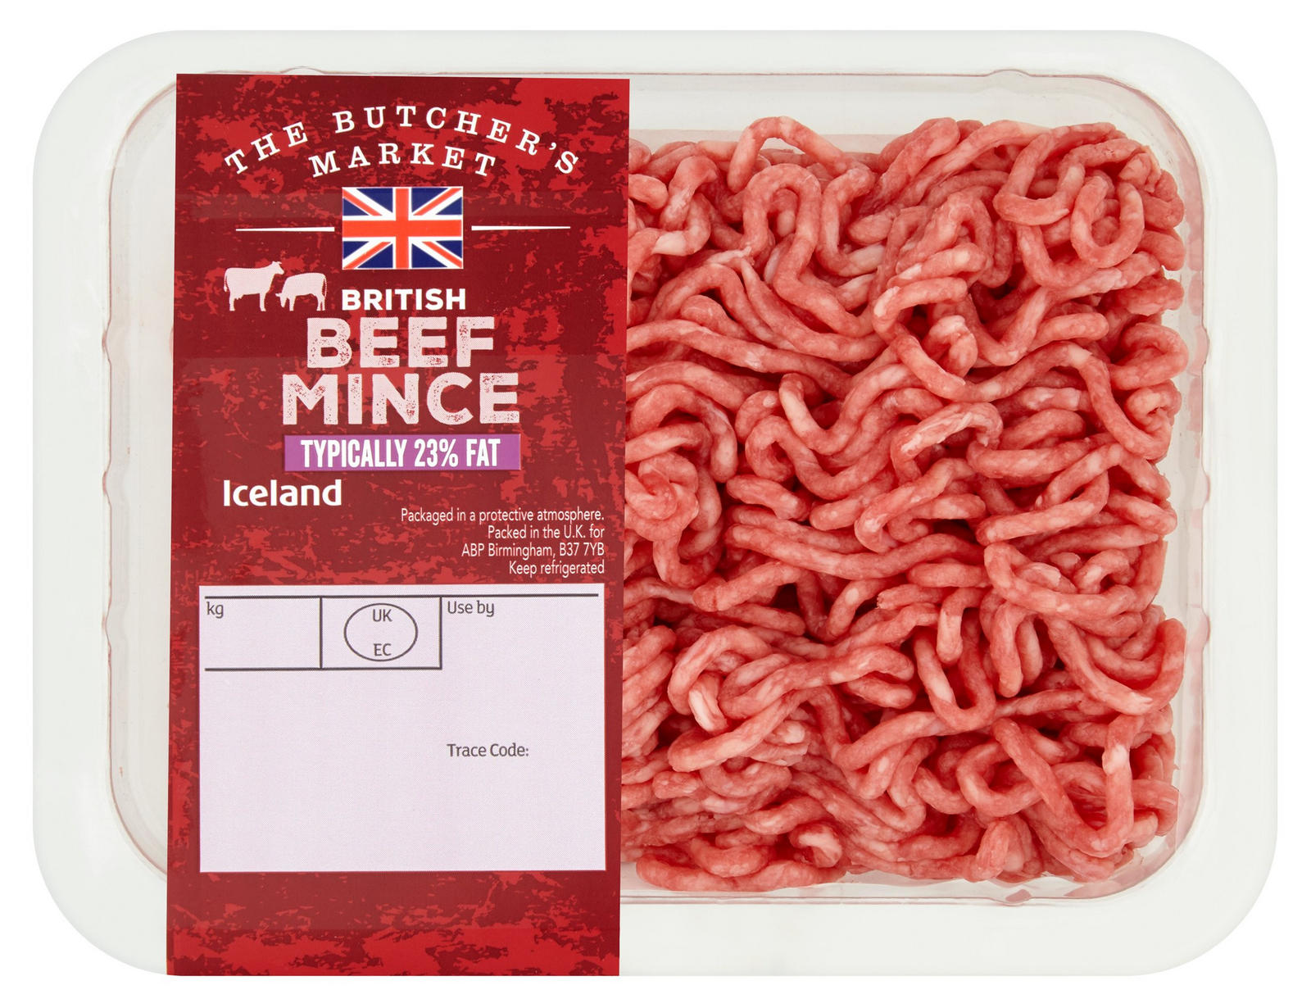
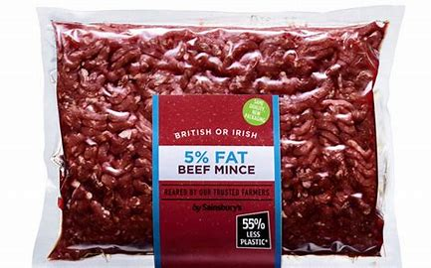
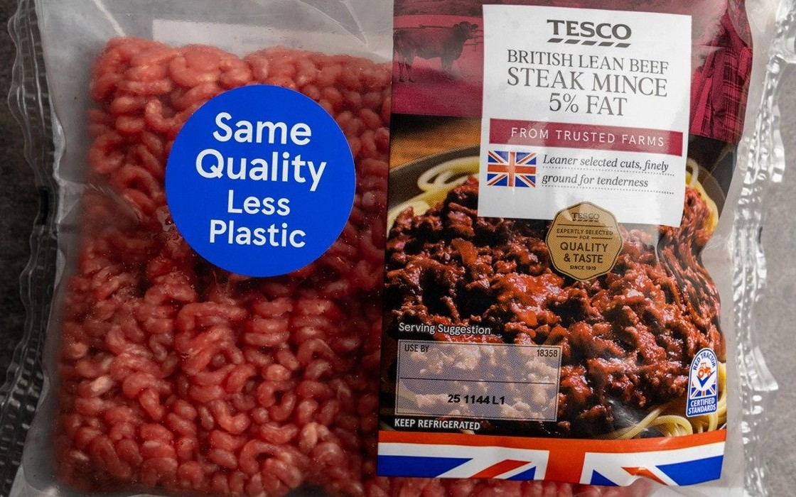
Reasons for change
Plastic reduction
Notes:
MAP packs of food
Vac pack mince form Sainsburys

Slide 24
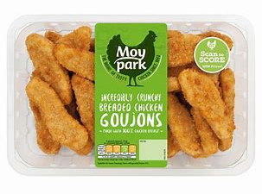
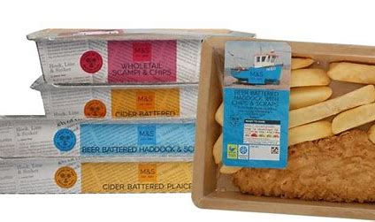
Reasons for change
Plastic reduction

Slide 25
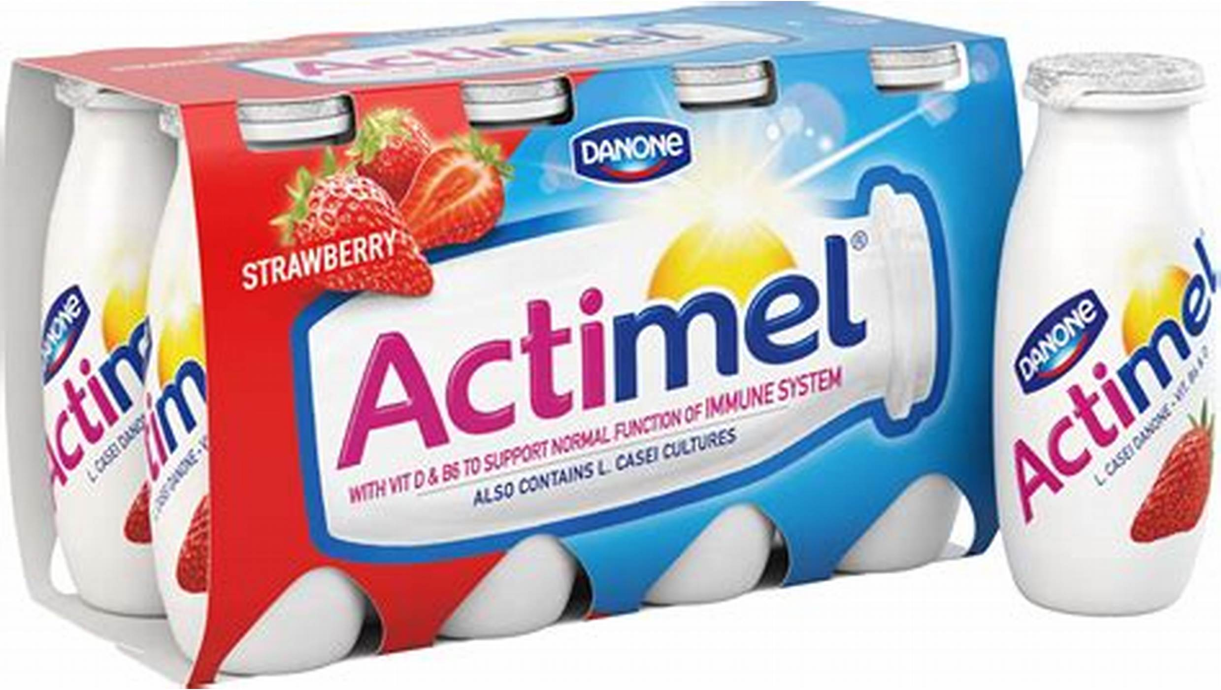
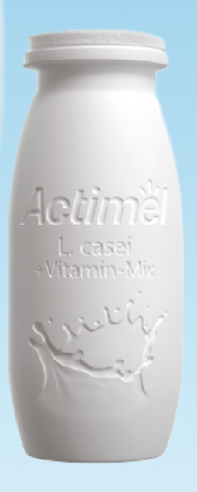
Reasons for change
Plastic reduction

Slide 26
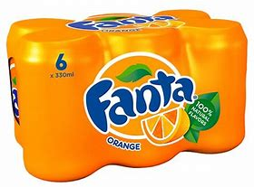
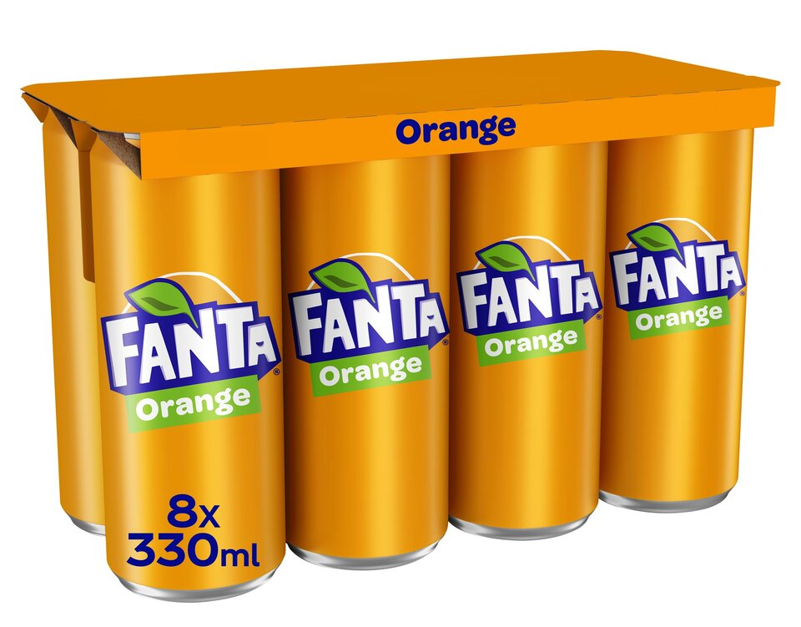
Reasons for change
Legislation – Plastic Packaging Tax

Slide 27
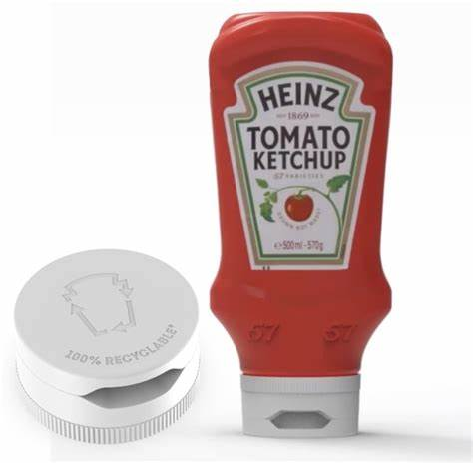
Reasons for change
Recyclability
Notes:
John Ryan and Matthew McIvor

Slide 28
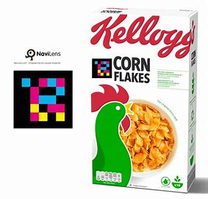
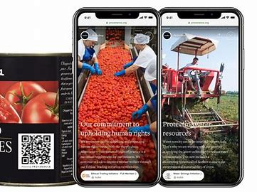
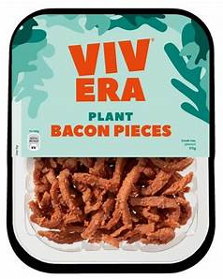
Reasons for Change
Addition of QR codes

Slide 29

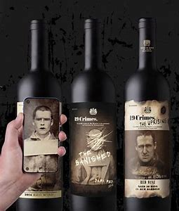
Technology and Innovations

Slide 30
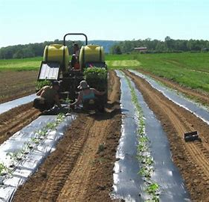
Case Study - Biodegradable Plastic
Researchers in Spain and Netherlands found 3,000 microplastics per gram of sediments in samples from ditches around agricultural fields
More than half of the microplastics came from the so called ‘biodegradable’ mulch foils
Notes:
Are biodegradable plastics really biodegradable?

Slide 31
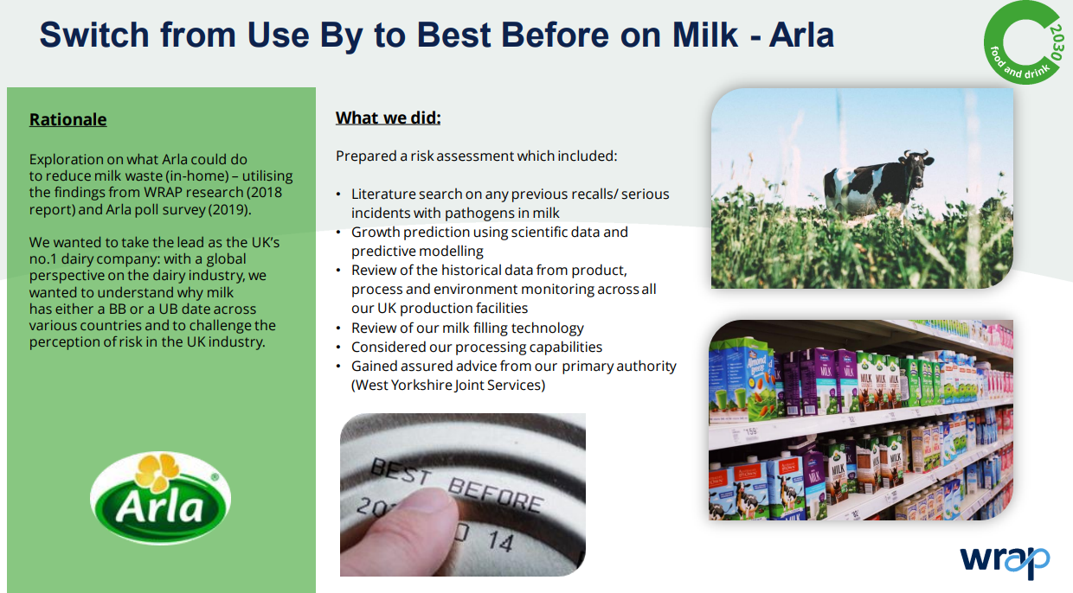

Slide 32
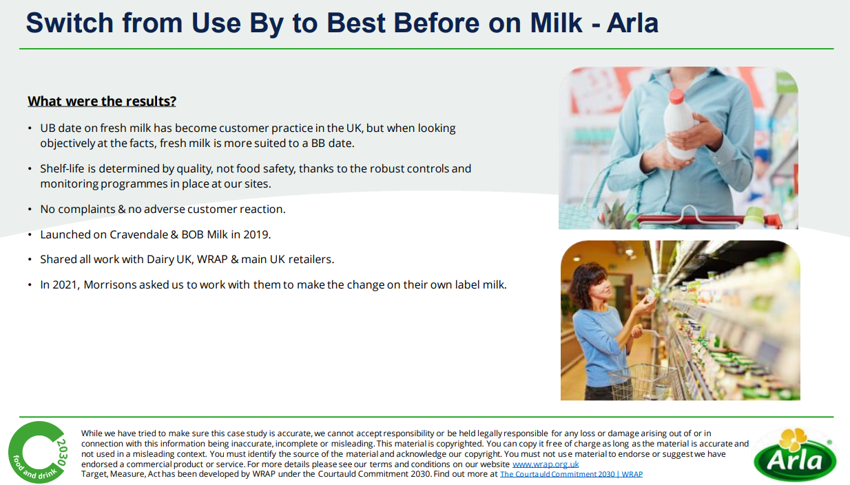

Slide 33


Contact
Anne Bencze
email: anne.bencze@daera-ni.gov.uk

Slide 34
What we will be covering
Food waste and packaging environmental impact.
On-pack recycling labels.
Methods to tackle food spoilage.
Recent developments and legislation in packaging to reduce plastic and improve recycling.
Links to Food – a fact of life resources.

Slide 35
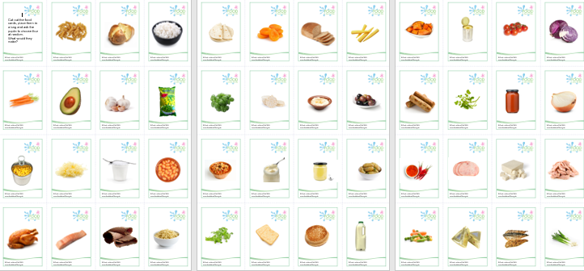
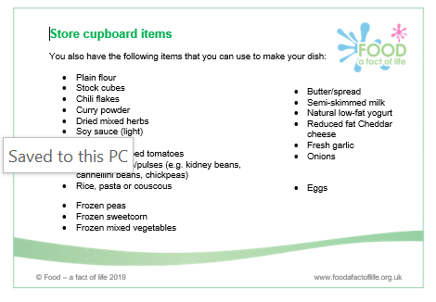
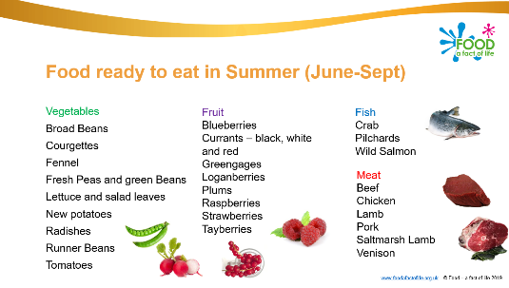
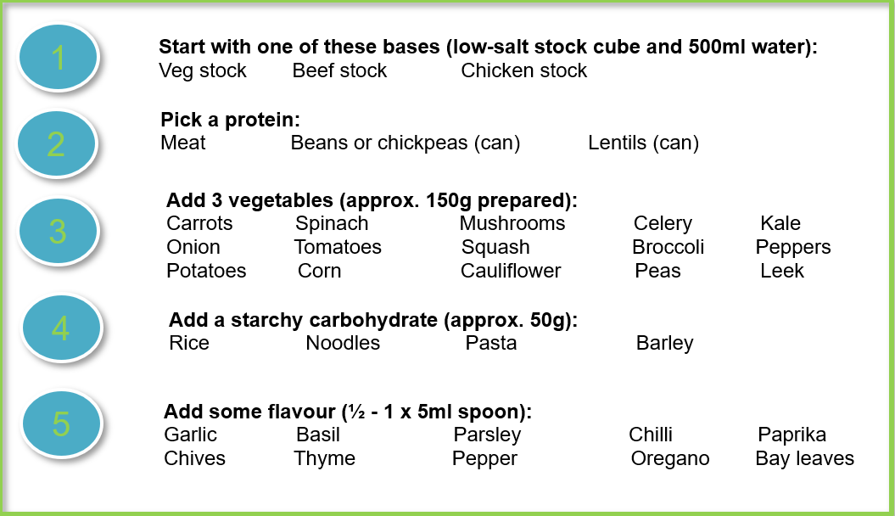
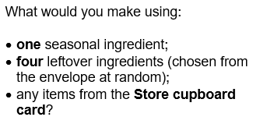
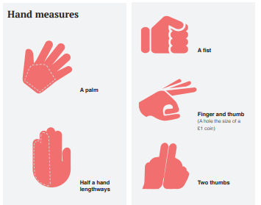
Teaching about reducing food waste
Food waste presentation and worksheet
Using leftovers presentation and activity
Get portion wise booklet
Super soup and flatbreads
Reducing waste, reducing costs
.

Slide 36
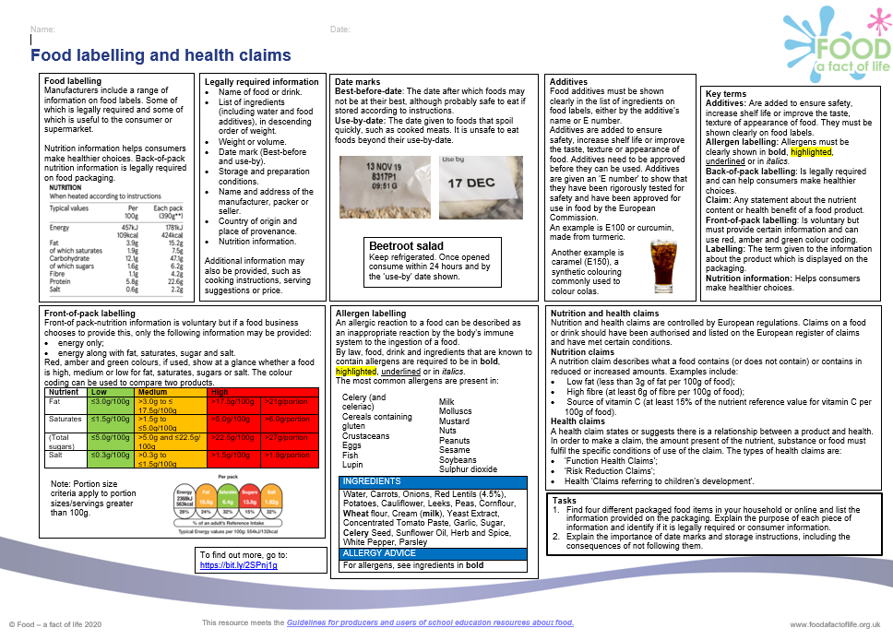
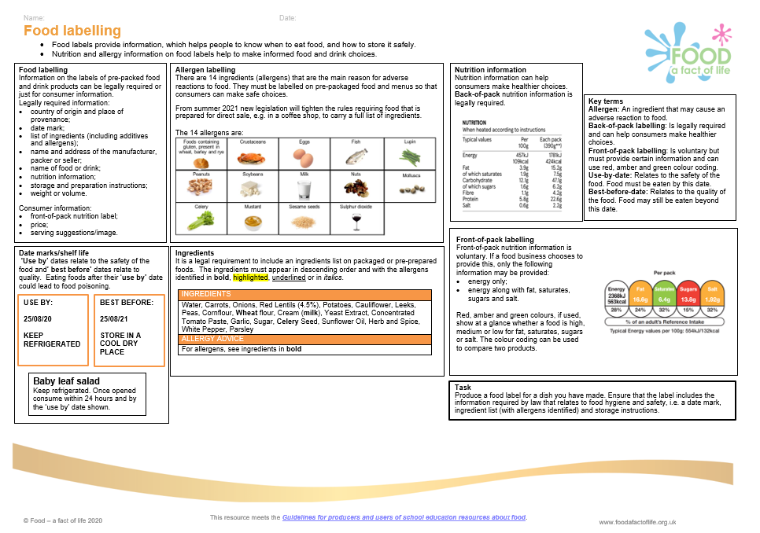
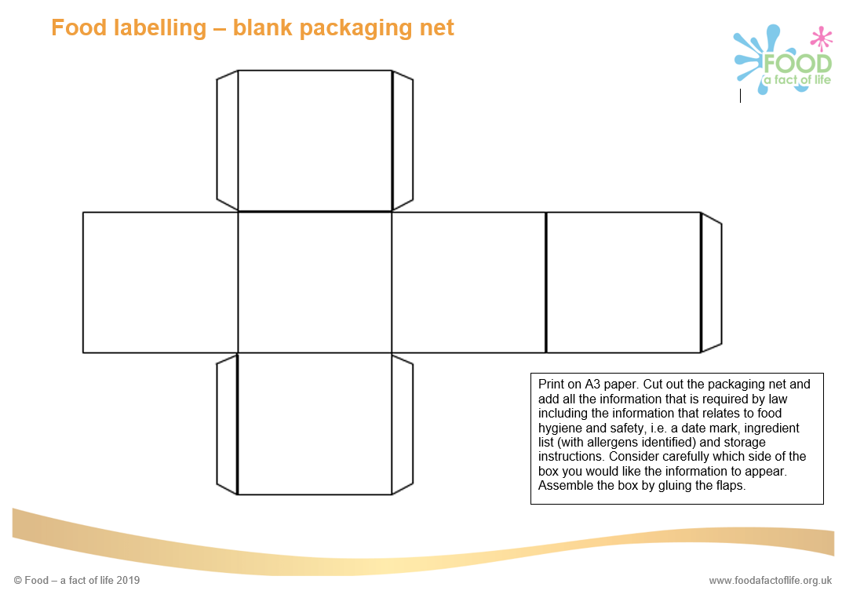
Teaching about food packaging and labelling
Food packaging presentation and worksheet
Modified atmosphere packaging presentation and worksheet
Food packaging quiz and answers
Blank packaging net
Food labelling resources 11-14 years and 14-16 years

Slide 37
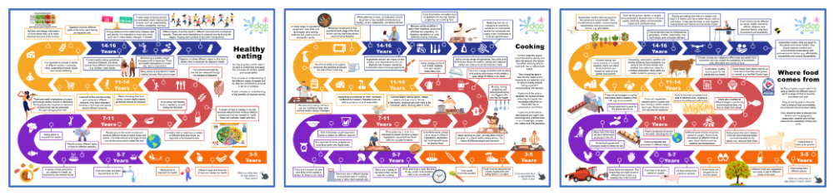
New! – FFL Roadmaps
Food - a fact of life is proud to present our very own roadmaps for the food curriculum. Each roadmap covers the key topics at each age phase, accompanied by our Key facts. Each Key fact shows progression on the topics as pupils move through each age phase. They are a visual guide to food and nutrition education from 3-16 years and are a way of representing what pupils should learn and the sequence. There are printable and interactive versions!

Slide 38
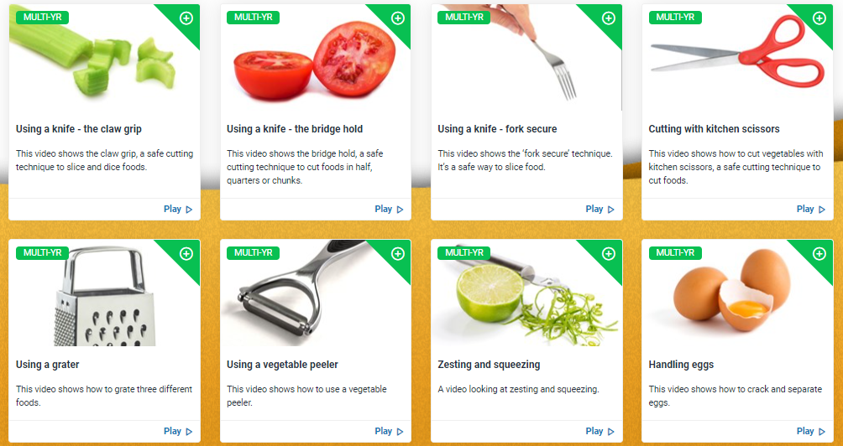
Supporting pupils with practical food skills
Peer-to-peer practical food skills videos. New!
These instructional videos cover getting ready to cook, using important pieces of kitchen equipment, knife skills, preparing different ingredients, cooking with heat and making simple sauces and dishes.
Teacher versions coming soon!
Practical food skills videos

Slide 39


Sources of information
EUFIC – how to reduce food waste at home
Guardians of Grub
IFST food waste fact sheet
Love Food Hate Waste
Western Riverside Waste Authority (food waste calculator, plate waste survey, information about engaging pupils in food and improving the dining experience)
WRAP
UKHarvest – education resources

Slide 40


Keep up to date with our free resources and training
Education News (monthly email update)
Sign up on the homepage: www.foodafactoflife.org.uk
PPD newsletter (find out about upcoming FFL training)
https://www.foodafactoflife.org.uk/professional-development/
Follow us on Twitter @Foodafactoflife
https://twitter.com/foodafactoflife
Keep in touch:
education@nutrition.org.uk
BNF news https://www.nutrition.org.uk

Slide 41
Packaging and food waste – Waste Less, Package Smart
For further information, go to:
www.foodafactoflife.org.uk
education@nutrition.org.uk

