Slide 1
Different dietary needs

Slide 2

Nutritional needs of specific groups
Nutritional needs can vary depending on a number of factors:
different life stages – childhood, adulthood, female (pre/postnatal, pre/post-menopausal), later adulthood;
medical conditions – diabetes (type 1 or 2), anaemia, lactose intolerance, coeliac disease;
culture – religious beliefs, vegans/vegetarians, lifestyle choices.

Slide 3
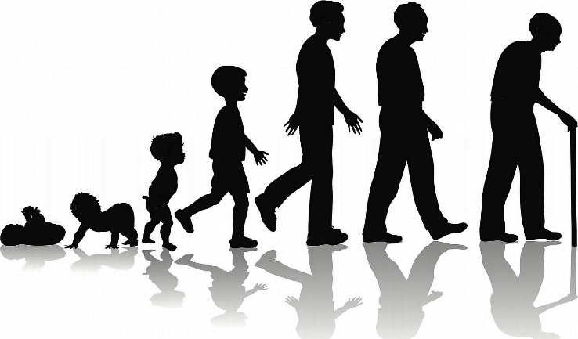
Nutritional needs at different life stages
The key stages in life include:
pregnancy;
infancy;
childhood;
adolescence;
adulthood.

Slide 4
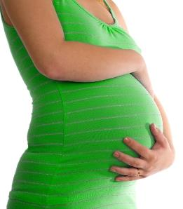
Pregnancy
A varied diet, providing adequate amounts of energy and nutrients, is essential before and during pregnancy.
The mother’s diet can influence the health of the baby. Having a healthy body weight is important.
Being underweight can make it more difficult to become pregnant and make it more likely for the baby to have a low birth weight, leading to a greater risk of ill health.
Being overweight increases the risk of complications, such as high blood pressure and diabetes during pregnancy.

Slide 5
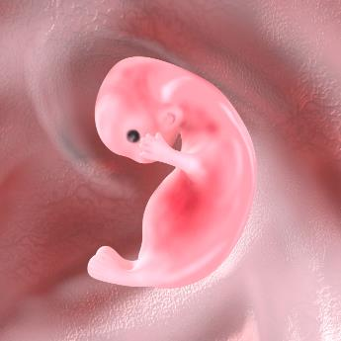
Early Pregnancy – folate/folic acid
Folic acid is a synthetic form of the B vitamin, folate.
Folate is needed for rapid cell division and growth of the foetus. It is particularly important during the first 12 weeks.
Folate is important for the development of the neural tube (the start of the brain and the spinal cord).
An adequate intake of folate is essential to protect against neural tube defects such as cleft palate and spina bifida.

Slide 6
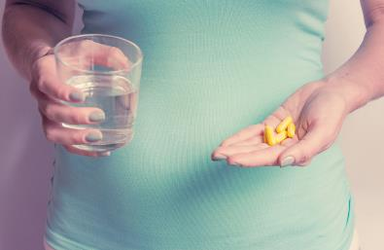
Early Pregnancy – folate/folic acid
Women who are pregnant or thinking of having a baby are advised to take a daily supplement containing 400 microgram (μg) folic acid daily.
This supplement should be continued for the first 12 weeks of pregnancy.
Folate is naturally found in oranges, bananas, green leafy vegetables, fortified breakfast cereals and bread.

Slide 7
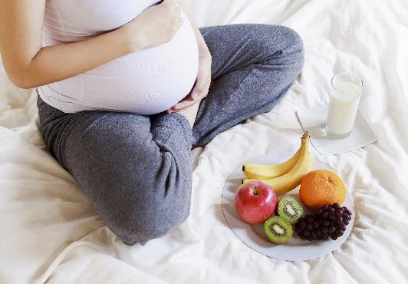
During pregnancy
During pregnancy, some extra nutrients are needed (mainly in the last three months) to:
help the development of the uterus, placenta and other tissues;
meet the needs of the growing foetus;
lay down stores of nutrients and energy (as fat) for the growth of the foetus and ready for breastfeeding.

Slide 8

Breastfeeding / lactation
The process of producing breast milk and delivering it to the baby is called lactation.
A mother who is breastfeeding requires extra energy and nutrients. There are also increased demand for nutrients, such as calcium, phosphorous, vitamins A and C.
Breast milk provides all the energy and nutrients a baby needs for growth and maintenance during the first 6 months of life.

Slide 9
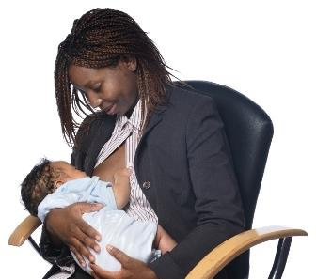
Breast milk
Breast milk provides special proteins, antibodies and white blood cells which help to protect the baby against infection.
In the first three days after birth, the mother produces a special form of breast milk called colostrum.
It contains less fat, more protein and is rich in antibodies, proteins that play a key role in the baby’s immune system.

Slide 10

Complementary feeding
At around 6 months, babies will start showing signs of wanting to try new foods. Solid foods can be gradually introduced in addition to breast milk or infant formula.
This is called complementary feeding. Solids must be semi-fluid and soft, since the baby has no teeth and cannot chew.
Complementary feeding too soon (before 4 months) can increase the risk of infections and allergies, as your baby's digestive system and kidneys are still developing.

Slide 11
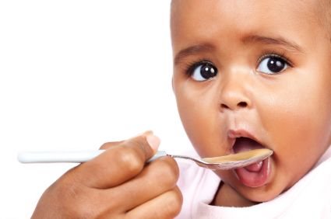
Complementary feeding
Infants under six months should not be given:
wheat or other cereals to avoid risk of a reaction to gluten, which results in coeliac disease;
eggs;
fish and shellfish;
soft and unpasteurised cheeses.
Throughout complementary feeding, babies should not be given foods with added salt. Sugar-containing foods and drinks (e.g. biscuits, some rusks, fruit juices) between meals should be limited.

Slide 12
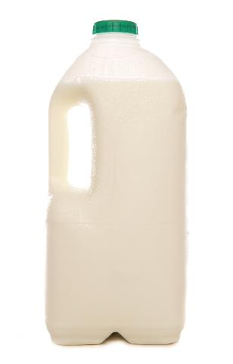
Complementary feeding
Supplements of vitamins A, C and D in the form of drops are recommended for children aged from 6 months to 5 years. This is particularly important if they do not eat a varied diet. For some, these are available free via the Healthy Start scheme.
Cows’ milk is not suitable as a drink before 12 months of age because it is low in iron but can be used in small amounts in cooking from 6 months.
Low-fat varieties of milk, as a main drink, are not suitable for babies and young children until at least 2 years of age.

Slide 13
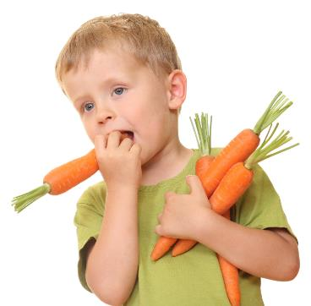
Childhood
The energy requirements of children increase rapidly because they:
grow quickly;
become more active.
Children have a higher energy requirement for their body size compared with adults.
They need foods that provide sufficient energy but are also rich in nutrients.
Foods should be eaten as part of small and frequent meals.

Slide 14
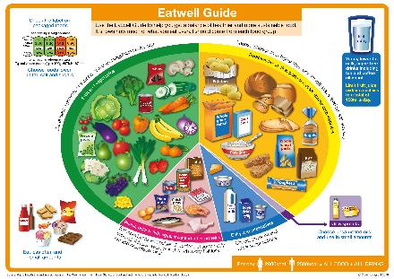
Childhood
Children’s diets from the age of 2-5 years should be based on the principles of the Eatwell Guide and include plenty of starchy carbohydrates, fruit and vegetables, and some protein and dairy foods.
Children should be encouraged to remain a healthy weight with respect to their height.
A healthy family lifestyle can help to maintain a healthy weight, such as being active together or sharing meals.

Slide 15

Childhood
Childhood is an important time for growth and development.
Children need a good supply of protein, and other nutrients including calcium, iron and vitamins A and D.
Children begin to take responsibility for their own food choices around this time.
It is therefore important to encourage them to eat a healthy, varied diet which is rich in fruit, vegetables and starchy foods.

Slide 16
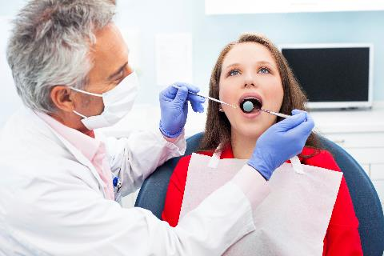
Dental hygiene
Dental hygiene is very important. Children should pay attention to dental hygiene and ways to prevent dental caries.
Teeth should be brushed twice a day, for at least 2 minutes at a time, with a fluoride-containing toothpaste.
If food and drinks high in sugar are consumed occasionally, this should be done at mealtimes and not in between meals.

Slide 17
Adolescence
Adolescence is a period of rapid growth and development and is when puberty occurs.
The demand for energy and most nutrients are relatively high.
Boys need more protein and energy than girls for growth.
Girls need more iron than boys to replace menstrual losses.
It is important to encourage an active lifestyle with a healthy, balanced diet during this time.
This is because good habits practised now are likely to benefit their health for the rest of their lives.

Slide 18
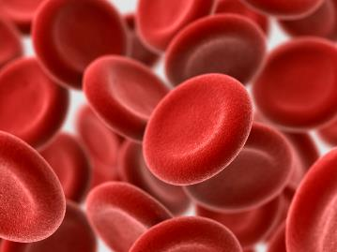
Adolescence – iron
Teenage girls and women require 14.8mg of iron each day.
Teenage boys need 11.3mg of iron daily but this reduces to 8.7mg for men aged 19 or over.
Iron from meat sources, is readily absorbed by the human body.
Did you know?
Vitamin C helps to absorb iron from non-meat sources, such as green leafy vegetables, nuts, pulses, dried fruits, wheat flour and breakfast cereals.

Slide 19
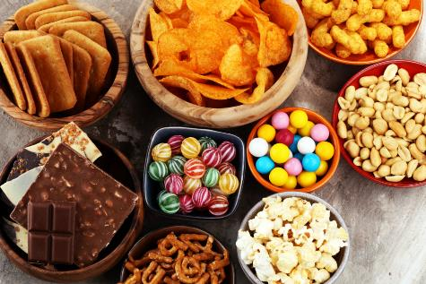
Adulthood
Nutritional requirements do not change much between the ages of 19 to 50 years, except during pregnancy and lactation.
On average, UK adults are eating too much saturated fat and salt from food, and not enough fruit and vegetables.
A poor diet can lead to diseases such as obesity, cardiovascular diseases, cancer and diabetes.

Slide 20

Adulthood
To reduce the risk of developing these diseases, it is important to:
eat a balanced diet;
eat plenty of fruit and vegetables;
drink alcohol in moderation;
stay active;
not smoke.

Slide 21
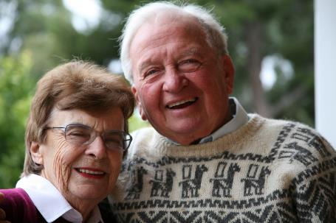
Older adults
Older adults is the term usually refers to people over the age of 65.
Requirements for energy gradually decrease after the age of 65 as activity level falls.

Slide 22

Older adults
To maintain good health, it is important that older adults:
enjoy their food;
keep active;
have adequate nutrient intakes.
It is also important they keep hydrated by drinking plenty of fluid. Even minor dehydration can lead to health problems.

Slide 23

Older adults
After menopause (when menstruation stops), women gradually lose bone strength.
Osteoporosis may occur when bones become weak, brittle and break easily. This may lead to fractures in the wrist, back and hip.
Older adults should have plenty of calcium intake from milk and dairy products, green leafy vegetables, beans, pulses, and products made from flour.
They should also remain active and have adequate vitamin D from foods such as oily fish, or through the action of sunlight on the skin. Adults over 65 years who are housebound should take a daily supplement of vitamin D as skin synthesis of this vitamin requires sunshine.

Slide 24



Medical conditions

Slide 25

Diabetes
Type 1 diabetes
The body does not produce insulin, as pancreatic cells which normally produce insulin are missing or damaged, so blood glucose levels remain high.
Treated by daily injections of insulin.
Type 2 diabetes
The body produces insulin in the pancreas, but it is insufficient to control blood glucose effectively. This is often because the body tissues are resistant to the action of insulin.
Type 2 diabetes can be controlled or improved by diet.

Slide 26
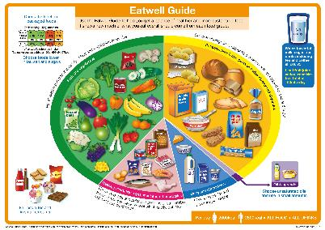
Type 2 diabetes
Most people with newly diagnosed type 2 diabetes are overweight or obese.
Prevention includes following a healthy varied diet, taking more physical activity, maintaining a healthy weight and avoiding weight gain (>5kg) in adult life.
Changing the diet and increasing physical activity help people to control blood glucose levels and also to help overweight people to lose weight.
People with type 2 diabetes should still follow the basic principles of the Eatwell Guide.

Slide 27
Iron deficiency anaemia
A lack of dietary iron depletes iron stores in the body, and this can eventually lead to iron deficiency anaemia.
Dietary iron is found in two basic forms; haem iron (from animal sources) or non-haem iron (from plant sources).
Haem iron is the most bioavailable form of iron – meaning it is absorbed better.

Slide 28
Iron deficiency anaemia
More than 2 billion people worldwide suffer from iron deficiency anaemia, making it the most common nutritional deficiency condition.
Teenage girls and women of childbearing age need more iron than males of the same age making them at increased risk of deficiency.
Symptoms can include tiredness and lack of energy; shortness of breath; noticeable heartbeats (heart palpitations) or pale skin.
Iron deficiency anaemia is usually tested by a full blood count (FBC) test.

Slide 29
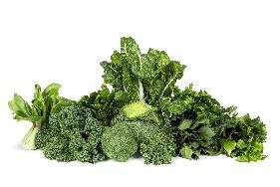
Sources of iron
Although meat is the most bioavailable source of iron, other good sources of iron include:
pulses, such as beans, lentils and peas;
nuts;
dried fruit, such as raisins;
dark-green vegetables, such as watercress, broccoli and spring greens;
wholegrains, such as brown rice and brown bread;
cereals fortified with iron.

Slide 30
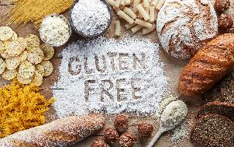
Coeliac Disease
Coeliac disease is an autoimmune disease caused by a reaction to gluten triggered by the immune system. There is no reason to cut out gluten in the absence of a gluten related disorder.
Cutting out gluten unnecessarily may have negative effects on the balance of the diet e.g. lack of wholegrain foods.
Coeliac disease is more difficult to clinically diagnose if a person has eliminated gluten from their diet.

Slide 31
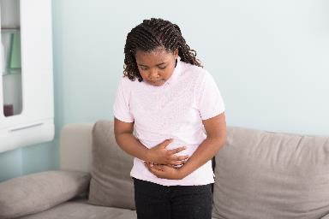
Lactose intolerance
Lactose intolerance is a common digestive problem where the body is unable to digest lactose (an enzyme found in milk). This isn't the same as a milk or dairy allergy.
Symptoms include flatulence (wind), diarrhoea, bloated stomach, stomach cramps and pains and feeling sick.
Advice to control the symptoms is to limit lactose containing foods and drinks including milk and some dairy products. People with lactose intolerance can often still consume small amounts of lactose without experiencing any problems.

Slide 32
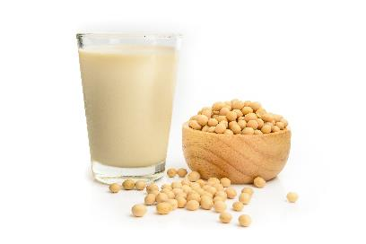
Lactose intolerance
Food and drink that does not usually contain lactose include:
soya alternative milks, yogurts and some cheeses;
alternative milks made from rice, oats, almonds, hazelnuts, coconut, quinoa and potato;
foods with the ‘dairy-free’ or ‘suitable for vegans’ signs;
carob bars.

Slide 33
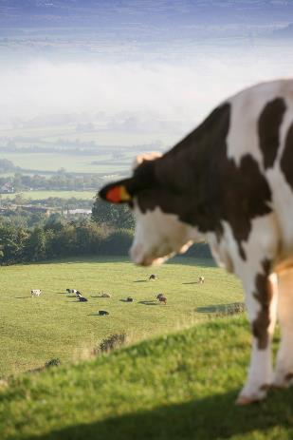
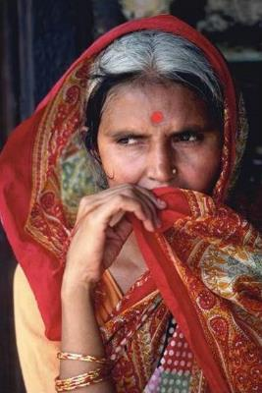

Culture

Slide 34

Religious beliefs
Around the world, people choose to eat or avoid certain foods depending on their religious belief.
These include:
to communicate with God (e.g. saying thanks and blessing);
to demonstrate faith through following religious rites concerning diets;
to develop discipline through fasting.

Slide 35
Religious beliefs – foods eaten or avoided
Religion | Pork | Beef | Lamb | Chicken | Fish
Islam | ✖ | Halal only | Halal only | Halal only | ✔
Hinduism | ✖ | ✖ | ✔ | ✔ | ✔
Judaism | ✖ | Kosher only | Kosher only | Kosher only | ✔
Sikhism | ✖ | ✖ | ✔ | ✔ | ✔
Buddhism (strict) | ✖ | ✖ | ✖ | ✖ | ✖
Seventh-day Adventist Church | ✖ | ✖ | ✖ | ✔ | ✔
Rastafari movement | ✖ | ✖ | ✖ | ✖ | ✖

Slide 36
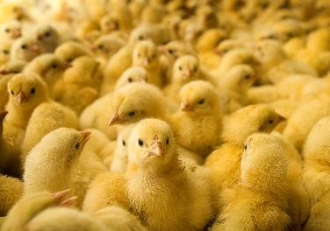
Vegetarians, vegans and other social concerns
Human welfare and fair trading, where growers or producers in developing countries are paid a good minimum price to cover their costs, can be a high concern for some people.
Animal welfare can also be a concern for some people. This can affect the choice between caged or free-range hens, or ‘dolphin friendly’ tuna.
In the UK there are a growing number of people following plant-based diets. These can include vegetarians and vegans.

Slide 37
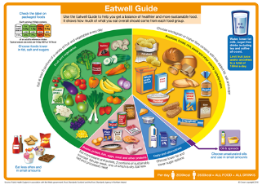
Healthy eating for vegetarians and vegans
Well planned vegetarian and vegan diets can be nutritious and healthy, they should still be based on the Eatwell Guide.
There are some nutrients of which it is likely they will come from different sources than in most diets. For example; protein, iron, calcium, vitamin B12 and omega-3 long chain fatty acids.
It is important to remember that removing meat from a diet alone is no guarantee of a healthier diet.

Slide 38
Organic food production

Slide 39
Different dietary needs
For further information, go to:
www.foodafactoflife.org.uk
This resource meets the Guidelines for producers and users of school education resources about food.

