Slide 1
Tasting

Slide 2
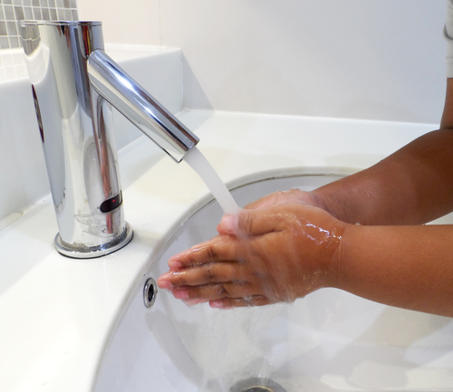
How to taste
Wash and dry your hands carefully.
Think carefully about the food you are tasting.
Use interesting words to describe what it is like.

Slide 3
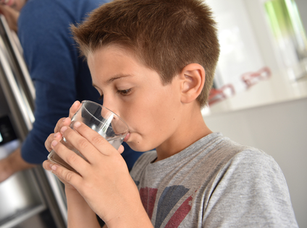
How to taste
Use a tissue if you need to remove a food from your mouth.
Have a sip of water between tasting different food, to clear your mouth.

Slide 4

How to use your senses
Use all your senses for tasting:
Eyes - look
Nose - smell
Hands - feel
Mouth – taste and feel

Slide 5
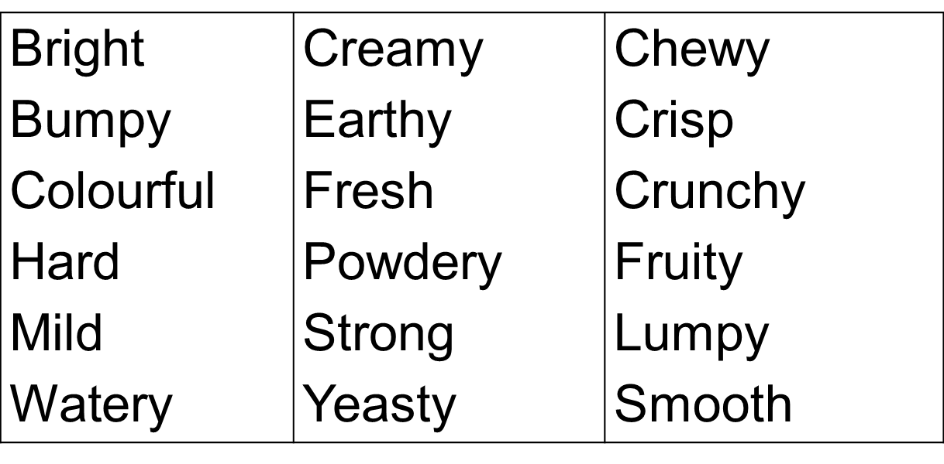
Word bank
Here are some words you could use to describe the food you taste.

Slide 6
Tasting
For further information, go to:
www.foodafactoflife.org.uk
This resource meets the Guidelines for producers and users of school education resources about food.

