Slide 1
Shortening

Slide 2
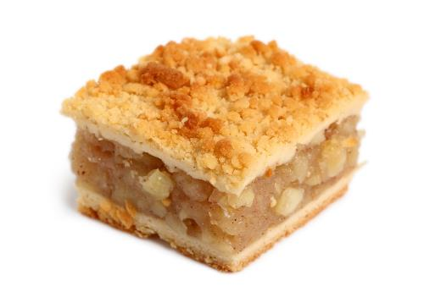
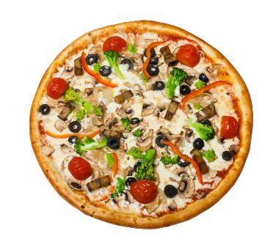
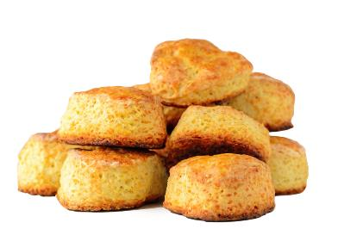
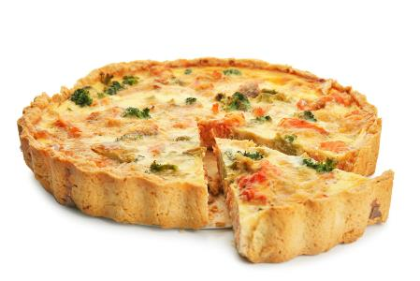
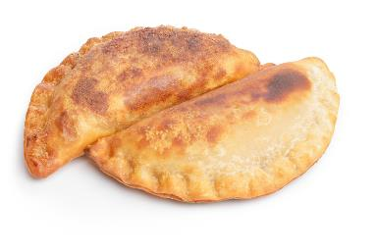
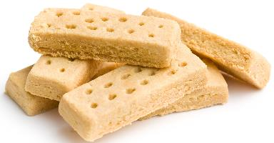
Examples
Shortening is used to make a crumblier and less elastic dough, for foods like these:
Crumble topping
Scone-based pizzas
Scones
Shortcrust tarts/quiches
Empanadas
Shortbread

Slide 3
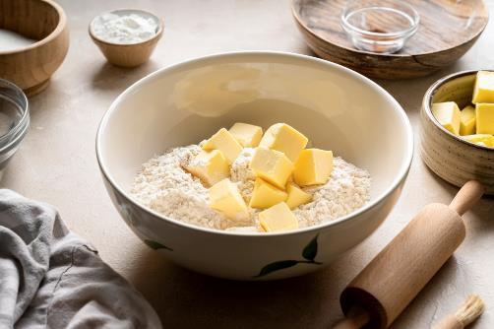
What is the shortening process?
Shortcrust pastry, biscuits and shortbread rely on fat to give them their characteristic crumbly, melt in the mouth texture.
The fat coats the flour particles, 'waterproofing' them. This reduces the amount of water that can be absorbed.
The proteins in the flour make gluten when they are mixed with water. Gluten is stretchy and elastic – too much will make a tough dough.
When the amount of water that can be absorbed is reduced, less gluten is developed and the mix is shortened.

Slide 4
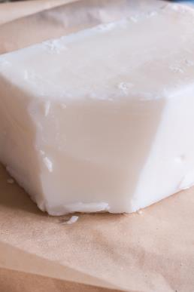
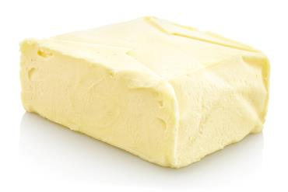
Using shortening fat
Fats such as pure vegetable fats or lard are suitable for shortening because of their low water content. White vegetable fat can be used as an alternative to lard.
Butter and spreads have a higher water content and therefore are not so good at shortening the dough.
Sometimes recipes use a combination of the two.
Hard baking fat or ‘block’ can be used instead of butter.
‘Shortenings’ get their name because they keep the strands of gluten ‘short’ in a dough or batter.

Slide 5
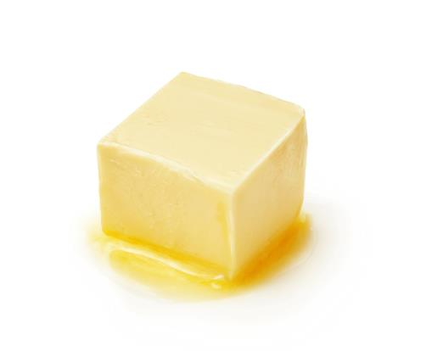
Plasticity
Plasticity is the ability for a solid fat to be shaped without breaking. This is useful for the ‘rubbing in’ method, because it allows the shortening (fat) to evenly coat the flour.
Plasticity occurs because fats contain a mixture of molecules that melt at different temperatures. Some of these molecules are liquid at room temperature and these help the fat to be shaped without falling apart.
Plastic fats are good at shortening as they coat the flour easily.
Notes:
Fats have plasticity they contain a mixture of different triglycerides. These different triglycerides all melt at different temperatures so fats gradually soften over a range of temperatures rather than melting at just one.
The more plasticity a fat has, the easier it is to spread.
Unsaturated fats tend to be soft or liquid at room temperature, while saturated fats tend to be solid meaning the more unsaturated fatty acids a fat or oil contains the more plasticity the fat or oil will have making it easier to spread.

Slide 6
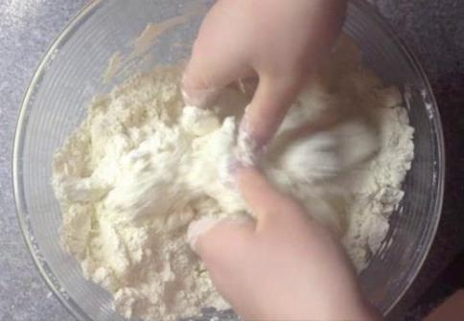
Rubbing in method
The rubbing in method is an important skill when making shortcrust pastry, scones and biscuits.
This process makes sure that the fat evenly coats the flour particles.
To 'rub in', mix the flour and chilled fat in a bowl. Then, gently rub the two together between the fingertips and thumbs.
The fat should be chilled so that it does not melt and remains in large particles.
Right click on the image above to watch a video demonstrating the rubbing in method.

Slide 7
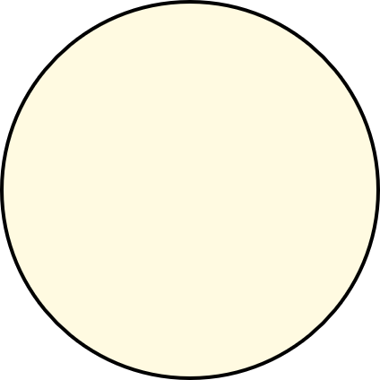

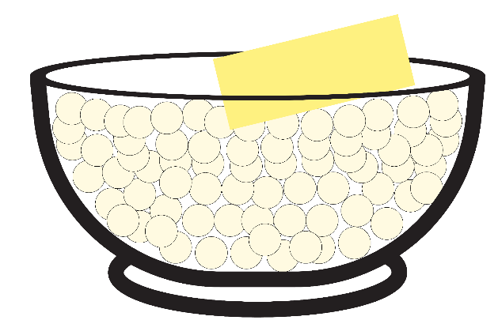
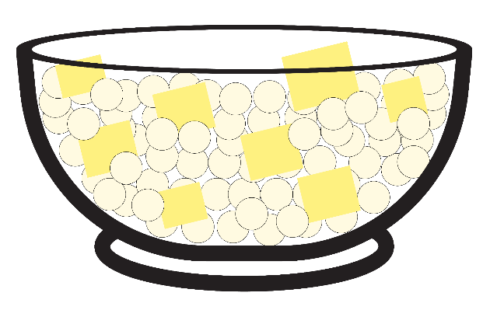
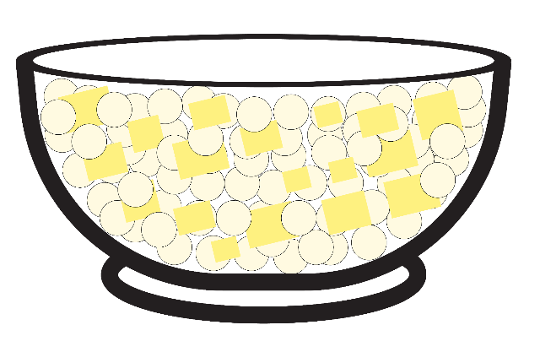
Rubbing in with shortening
Key:
Flour particles
Shortening (fat)
Chilled shortening (fat) is added to flour in a bowl.
The fat is broken up and the mixture is gently combined by hand.
As the fat and flour are combined, the flour particles are coated with fat.

Slide 8

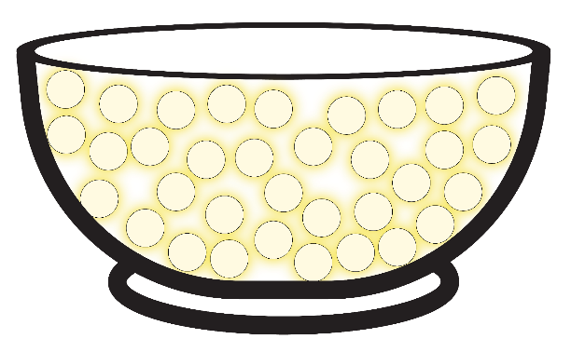
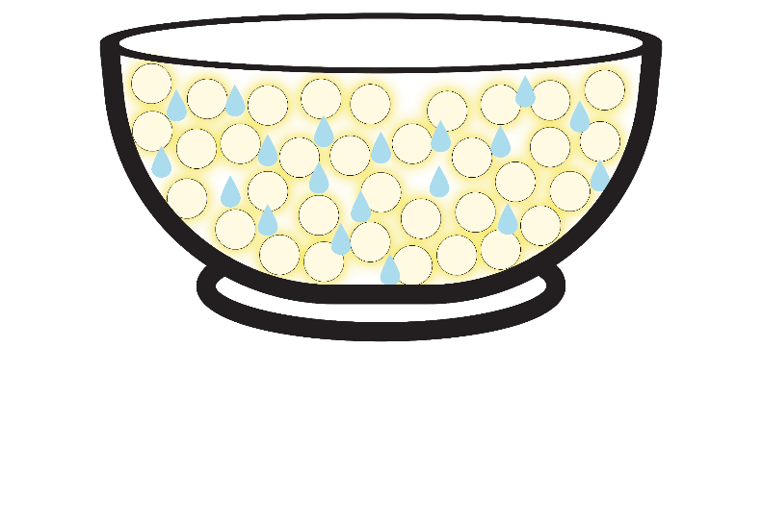
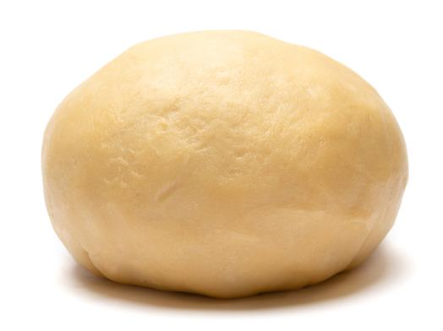
Forming a short dough
Key:
Flour particles
Shortening (fat)
Water
Once all the flour is coated with fat (and the mixture resembles breadcrumbs), rubbing in should be stopped.
Water is added to form a dough. The fat coating the flour particles reduces the amount of contact between the flour and water, reducing gluten development.
The dough can be shaped and is ready to use after chilling for 30 minutes.

Slide 9
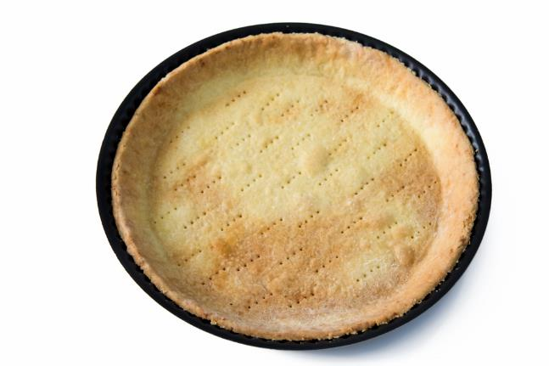
Shortcrust pastry
A simple shortcrust pastry can be made with shortening (fat), flour and water.
For shortcrust pastry, use twice as much flour as fat (2:1 ratio).
Use the rubbing in method to mix the flour and fat, until it resembles breadcrumbs.
Then add water (check the recipe for the amount) and mix together to make the dough.
This pastry case has been pricked with a fork. This lets the steam escape and stops it from puffing up during baking in the oven.

Slide 10
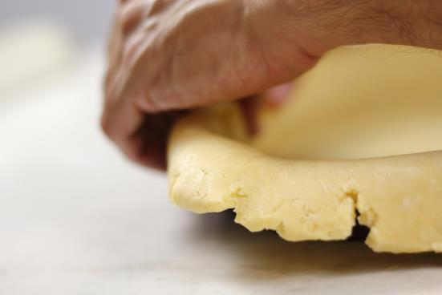
Pastry-making tips
Measure the flour, fat and water accurately to achieve the correct consistency of dough.
Make sure the shortening is chilled, so it does not melt during the rubbing in process.
Keep hands cool, use fingertips for rubbing in (they are the coolest part of your hands).
Do not handle the dough for too long, otherwise the fat may melt.
If time allows, wrap and chill the pastry before use.
Use baking/greaseproof paper to line tins or trays, to reduce sticking and make cleaning easier.

Slide 11
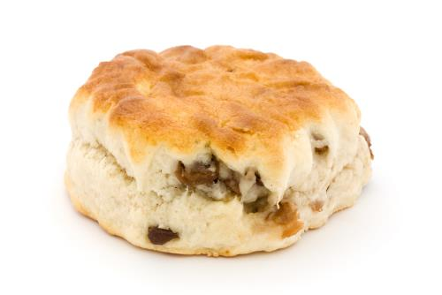
Scones
For scones, the final dough needs to be less crumbly and a little softer than for shortcrust pastry.
This means that the ratio of flour to fat is higher (3:1).
The rubbing in method is still used, but the higher amount of flour allows the dough to be more elastic than shortcrust pastry.
It is also important not to overwork scone dough, otherwise the gluten will develop too much, and the scones will be tough.

Slide 12
Applying the science
Shortening gets its name because of what it does to flour. Introducing fat into baked goods interferes with the formation of the gluten in the dough.
Less gluten makes a 'short' dough, giving a crumbly, rich flavour and texture.
Most recipes use a high proportion of fat to flour.
The origin of shortbread can be traced back to about the 12th Century when butter or lard was added to bread dough, hence the name shortbread.
It was not until the17th Century when sugar was added that it became more of a sweet biscuit.

Slide 13
Key words
Key word​ | Meaning​
dough | Mixture of flour and liquid with other ingredients, such as raising agents, shortening, sugar, salt, eggs, and flavourings, used to make baked products.
gluten | A mixture of two proteins (gliadin and glutenin), that makes dough ‘elastic’ and gives the final product structure. The more a dough is mixed, the more gluten is developed.
plasticity | The capacity of fats to soften and become liquid over a range of temperatures, which affects their suitability for a variety of uses, e.g., spreading.
ratio | A fixed proportion of one ingredient or ingredients relative to another, e.g., a 1:1 ratio contains equal parts of two ingredients.
rubbing in | The process of mixing flour and chilled fat by gently rubbing the two together between the fingertips and thumbs.
shortening (effect) | The effect caused when fat is rubbed into flour. The fat coats the flour particles, waterproofing them, and preventing gluten forming a structure, so creating a crumbly texture.
shortening (noun) | A fat that is rubbed into flour to ‘shorten’ a dough.

Slide 14
Teachers’ guide

Slide 15
Teaching about shortening:
Explain what shortenings (cooking fats) are and their characteristics
Explain why and how shortenings are used to reduce gluten development*
Give examples of products that require shortening
Describe and demonstrate the rubbing in method
Explain how different ratios of flour, fat and water produce the right dough for the product of choice
Discuss the characteristics of a shortened product – use sensory science to help
Carry out investigations/tests on the effect and use of shortening in recipes
*Teacher’s note: refer to materials on gluten formation for more information

Slide 16
Shortening – an overview
The following information is based on excerpts from the British Nutrition Foundation’s Functional Properties of Food course.
Shortenings are fats which are solids at room temperature and are used to modify the properties of foods such as shortcrust pastry. They work by disrupting gluten formation in dough (by preventing the flour absorbing as much water), meaning that the end product is less elastic and crumblier. They get their name because they keep the strands of gluten ‘short’ in a dough or batter.

Slide 17
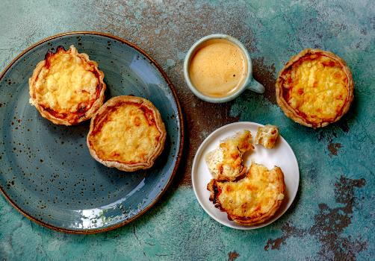
Where is shortening used?
Shortening is used in baked goods to varying degrees, including:
Breads – low amount of shortening
Cakes – moderate amounts of shortening
Shortcrust pastry – high amounts of shortening
The type of shortening selected can influence the final product.

Slide 18
Choosing the right shortening
Commercial shortenings (0% water content) tend to have very little flavour, so as not to overpower other flavours that may be present in the final product, and are usually white, imparting little colour to the product.
Butter (15-20% water content) has a more distinctive flavour and gives a richer, yellow colour to the final product. It gives a good flavour and mouthfeel in pastry and biscuits.
However, because butter has a higher proportion of short-chain fatty acids than commercial shortening, it may be absorbed into the flour more easily and result in ‘spread’ upon baking, causing the product to lose its shape.

Slide 19
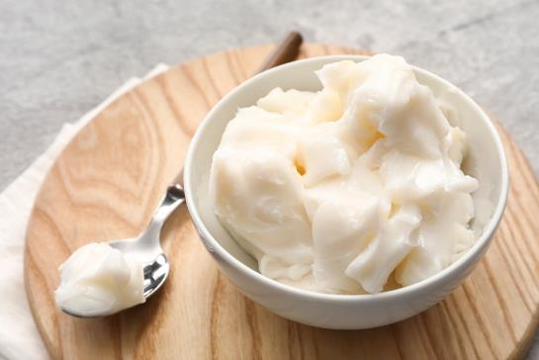
Choosing the right shortening continued
Baking fat (20-25% water content) can be used for pastry as it has a high melting point giving a crumbly texture.
Lard (2% water content) is also commonly used as shortening, it is pale in colour and has a milder flavour than butter. Often, butter is mixed with either lard or commercial shortening, to achieve a balance.
Low fat spread (up to 90% water) does not work well in pastry due to the high water content.

Slide 20
Plasticity
Plasticity is the ability for solid fat to be moulded without breaking apart. It is particularly useful for baked goods made using the ‘rubbing in’ method, as it allows for even coating of flour with fat, inhibiting gluten formation.
It is also useful for the ‘spreadability’ of butter at room temperature, or some other spreads straight from the fridge. The plasticity of the fat allows it to surround and coat the flour particles.
Plastic fats are good at shortening as they coat the flour easily.
Fats that are almost pure (e.g. lard) are most effective for shortening. Butter and baking fat are less efficient due to their water content.
Notes:
Fats have plasticity they contain a mixture of different triglycerides. These different triglycerides all melt at different temperatures so fats gradually soften over a range of temperatures rather than melting at just one.
The more plasticity a fat has, the easier it is to spread.
Unsaturated fats tend to be soft or liquid at room temperature, while saturated fats tend to be solid meaning the more unsaturated fatty acids a fat or oil contains the more plasticity the fat or oil will have making it easier to spread.

Slide 21
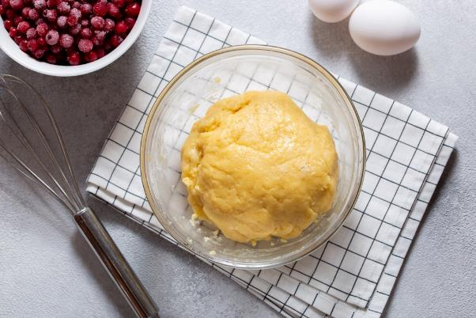
Working with shortening
When using shortening to create a product such as shortcrust pastry, it is important not to work the dough too hard and to allow it to rest between rollings.
This further prevents the gluten from forming long strands.
Dough that springs back when rolled may be overworked. When baked the pastry will 'shrink' back.

Slide 22
The rubbing in method
The rubbing in method is a key skill that makes use of shortening.
This method is commonly used in shortcrust pastry cases, scones, rock cakes and crumble toppings.
Rubbing in requires gently rubbing the chilled fat and flour between thumb and fingers, until the mixture resembles breadcrumbs.
The Rubbing in – pastry worksheet gives you more information on the method, as well as what can go wrong with the dough or the final product.

Slide 23
Talking about the science of shortening
During a demonstration, explain:
The function of fats in shortening
The function of gluten in flour*
The ratio of ingredients
How and why the fat is rubbed into the flour
What happens when the fat is incorporated
What happens when the water is added
Why the dough should not be over handled
What happens when the dough goes into the oven and is baked
*Teacher’s note: refer to materials on gluten formation for more information

Slide 24

Shortening - activities
Pupils, individually or in groups, could:
Make shortbread using the Shortening worksheet. This resource challenges pupils to make shortbread using different fats and oils and asks them to explain why they are different.
Learn about the ‘rubbing in’ method. This method allows the fat to fully coat the flour particles and is a good way to demonstrate shortening effects.
Use the Principles of pastry making resource to learn about how to make pastry successfully and use the worksheet to test their knowledge by filling in the blanks.
Teachers will need to decide on the level of complexity of the tasks chosen, depending on age, stage and need, and considering progression.

Slide 25
Shortening – investigating functional properties
Investigate the shortening properties of different fats when making shortcrust pastry.
Discuss with the pupils:
Key and command words.
The principles of a food investigation.
How to plan and carry out a food investigation.
The type of fats that could be used and compared.
The process/method that will be used.
The use of sensory evaluation to decide which is the best fat to use and why.
Investigation – fats in pastry

Slide 26
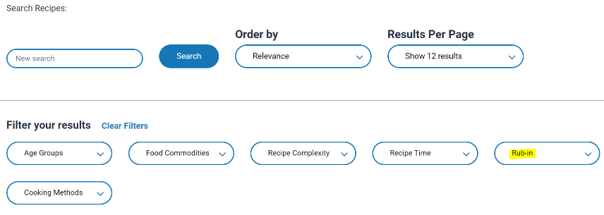

Shortening - recipes
The recipes below are useful ways to showcase the properties of shortening:
Orange shortbread
Tomato and basil tart
Cheesy scones
Fruit scones
Rocking rock cakes
Apple and sultana crumble
Scone based pizza and Pizza scones
When making these recipes, ask pupils about why they rub in the fat, and challenge them to explain why the final product is crumbly and inelastic.
Go to the recipes section and filter Food Skills by ‘Rub-in’ for more recipes.

Slide 27
Further supporting resources
Food – a fact of life
Functional properties of ingredients presentation and worksheet
Fats and their functional properties in food products presentation and worksheet
Dry heat presentation and worksheet
Food functions poster
Thinking pot questions - this activity is based on a scone based pizza using the rubbed-in method. However, this style of questioning can be adapted for different recipes.
Resources around food science can be found here: 11-14 years, 14-16 years
Further information, support and resources around functional characteristics of ingredients can be found here 11-14 and 14-16.
Ingredients - functional characteristics Knowledge Organiser 11-14
Teachers will need to decide on the level of complexity of the tasks chosen, depending on age, stage and need, and considering progression.

Slide 28
Further supporting resources
Food – a fact of life
Peer-to-peer practical food skills videos – rubbing in, forming a dough, rolling out
Recipe videos that demonstrate rubbing-in, forming and shaping a dough and use of the cooker (use of the oven) Cheese straws, Cornish pasties, Fruit scones
Year 7 lesson plan – savoury crumble
Year 8 lesson plan – fruit scones
Modifying a recipe – scone based pizza
Quick pizza lesson teacher's guide
Creative crumbles lesson teacher's guide
Fruit crumble worksheet
Vegetable crumble worksheet
Teachers will need to decide on the level of complexity of the tasks chosen, depending on age, stage and need, and considering progression.

Slide 29
Further support resources
External resources
Love Food Love Science (IFST) - useful information on fats and oils in shortening
Further information, support and resources around functional characteristics of ingredients can be found here 11-14 and 14-16.

Slide 30
Shortening
For further information, go to:
www.foodafactoflife.org.uk
This food science pack is one of a series of resources produced for the pHood Futures project, supported by the Royal Society of Chemistry.
This resource meets the Guidelines for producers and users of school education resources about food.

