Slide 1
Why did it go wrong?

Slide 2
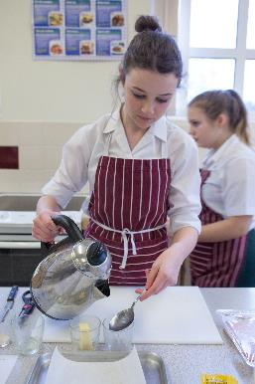
Avoiding mistakes
Recipes provide the information needed to make a successful dish.
Often they can be modified, but understanding the basic principles of the ingredients and method used is important.
Before cooking, think about:
The ingredients and their function – why are they used?
How to weigh and measure accurately.

Slide 3
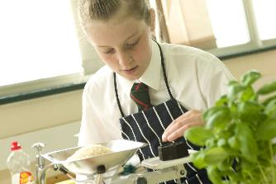
Why do things go wrong?
When the dish does not turn out as expected this might be for a variety of reasons. For example:
alternative ingredients were used that may not have the same functionality;
wrong weights and measures of ingredients were added;
the method was not followed accurately;
the size of baking tins/containers were changed;
the oven temperature and/or cooking method were changed.

Slide 4
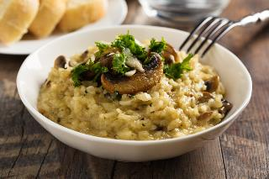
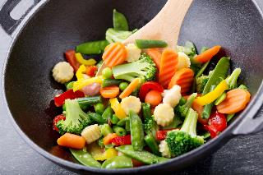
Why do things go wrong?
It is important to be aware of what could go wrong when making recipes such as bread, pastry and cakes. However, other dishes such as curries, risotto, stews and stir-fry recipes can also be unsuccessful due to:
too much seasoning, e.g. curry powder or salt, making a dish unpalatable;
too little seasoning, making the dish bland and uninteresting;
poor temperature control, e.g. risotto rice sticking to the bottom of the saucepan and burning;
not cooking for long enough, e.g. tough meat in stews or casseroles;
cooking for too long, e.g. soft vegetables in a stir-fry.
What other examples can you identify?

Slide 5
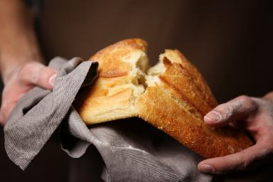
Bread making
There are certain characteristics that are associated with a good quality bread. It should have:
a uniform, golden-brown crust (some breads, such as wholemeal, will have a different finished colour);
a well-risen appearance, without being overinflated;
a light texture and a soft, tender crumb;
a moist mouthfeel;
a ‘nutty’ flavour, without the taste of yeast.

Slide 6
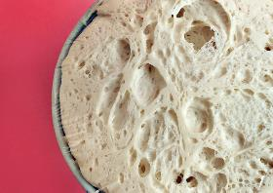
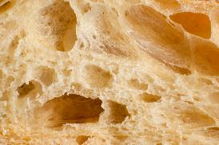
Bread making – what went wrong?
The use of different ingredients, incorrect method or handling and cooking temperatures can all affect the final loaf.
Some common problems are:
the bread has a coarse, open texture - the dough could have been too wet, over-proved or the oven temperature was not high enough;
the bread tastes sour and yeasty - too much yeast was used;
the bread has a dense, heavy texture – could be a number of reasons: the flour could have too low a protein (gluten) content, too much salt in the recipe, it was not kneaded enough, not left to prove for long enough, the yeast was destroyed by leaving the dough to rise in a place that was too hot.

Slide 7
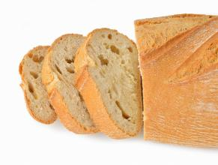
Bread making – what went wrong?
The dough collapsed when put in the oven - the dough was over-proved.
The crust has broken away from the loaf – this is sometimes called a ‘flying crust’. It is most likely caused by under proving.
The bread is holey - an uneven texture with large holes can be caused when the dough is not knocked back properly, or the dough has been left uncovered during rising. It can also be the result of over-proving, when too much gas is produced.

Slide 8
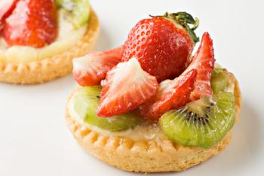
Pastry making
There are different types of pastry with different characteristics, e.g. shortcrust, flaky, rough puff. Good quality pastry should have:
an even, light golden-brown colour;
crispness (not soggy or doughy);
a short, tender, crumbly or flaky texture;
a good flavour.

Slide 9
Pastry making – what went wrong?
The use of different ingredients, modified weights of ingredients, incorrect method or poor handling, and cooking temperatures can all affect the final pastry.
Common problems include:
the pastry is very hard - not enough fat used or the fat hasn’t been mixed into the pastry well enough. The pastry may have been too wet or over handled;
the pastry is very crumbly - too much fat used or the pastry was over mixed. The pastry may be too dry and may not contain enough liquid to properly bind the fat and flour;
the pastry shrunk when baked - the pastry may have been overstretched when it was rolled out. It needs time to rest before rolling and baking.

Slide 10
Successful pastry making
Some key points for pastry making:
use the correct weight of ingredients according to the type of pastry being made;
select the correct ingredients. For example, the type of flour used should be appropriate as the gluten content will affect the finished pastry;
keep everything as cool as possible and do not over handle the pastry;
keep the amount of flour used on the rolling pin and surface to a minimum; otherwise the fat/flour proportions will change;
allow the pastry to rest in the fridge before rolling and before baking to help the pastry ‘relax’.

Slide 11
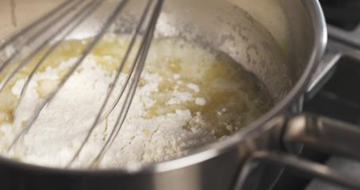
Sauce making
There are many different types of sauces each having their own characteristics. These include:
roux sauce – béchamel, velouté, espagnole;
reduction sauce – tomato sauce, gravy;
emulsion – hollandaise, mayonnaise;
blended sauce – custard.
The type and weight of ingredients used and the method is determined by the type of sauce being prepared.

Slide 12
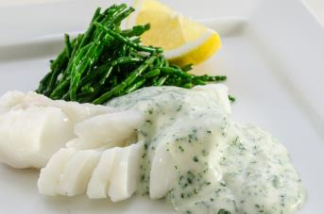
Roux sauces
The characteristics of good quality roux sauces are:
a smooth, glossy appearance;
the required consistency or thickness;
a good flavour.
Additional ingredients are often added to roux sauces to add extra flavour.

Slide 13
Sauce making – what went wrong?
Common problems with roux sauces include:
the sauce is too thick/thin - incorrect proportions of fat to flour and liquid have been used;
the sauce has a raw flour taste – the roux has not been cooked sufficiently;
the sauce is lumpy – there may be a number of reasons: the liquid was too hot when added, the liquid was added all at once, the sauce was not stirred/whisked continuously during cooking;
the sauce lacks flavour – insufficient seasoning or other ingredients added to the sauce.

Slide 14
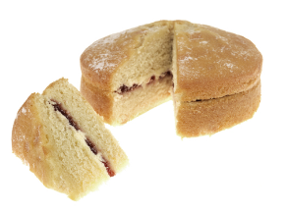
Cake making
There are four main methods of making cakes each having their own type and proportions of ingredients.
The main methods are:
rubbing in – rock cakes, fruit cake;
creaming – Victoria sandwich, fairy cakes;
whisking – Swiss roll, sponge flan;
melting – gingerbread, brownies.
There is also a quick method known as ‘all in one’ where all the ingredients are added and mixed at the same time. Extra raising agent is often added.
The main ingredients used are sugar, fat, flour, raising agent and eggs.

Slide 15
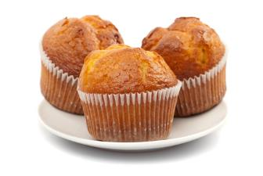
Cake making
There are certain general characteristics that are associated with good quality cakes. These are:
a uniform, golden-brown finish (some cakes such as gingerbread loaves will have a different finished colour);
a soft, light, uniform crumb;
tender, moist (not dry) texture;
a good flavour.

Slide 16
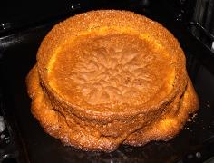
Cake making - what went wrong?
Common problems include:
the cake has a cracked, peaked top – too much raising agent added, cake tin was over-filled or too small, cake may have cooked too quickly (oven too hot, too near the top of oven);
the cake sank when it was baking – too much raising agent, over-creamed fat and sugar, over-beaten mixture after adding the egg, under-baked or the oven on too low a temperature;
the top of the cake is speckled - the use of too much sugar, or granulated sugar instead of caster sugar;
the cake is very dense – there was not enough air beaten into the mixture, eggs added too quickly causing curdling, not enough raising agent.

Slide 17
Why did it go wrong?
For further information, go to:
www.foodafactoflife.org.uk
This resource meets the Guidelines for producers and users of school education resources about food.

