Slide 1
Umami

Slide 2
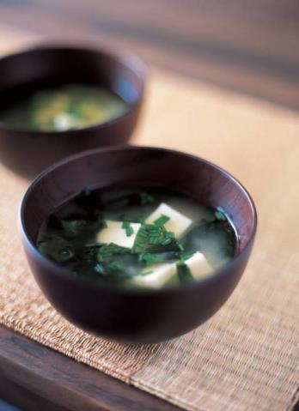
What is umami?
Umami is a savoury taste, often known as the fifth taste. It is a subtle taste and blends well with other tastes. Most people do not recognise the taste unless attention is especially drawn towards it.
After eating Cheddar cheese or tomatoes, there may be a ‘savoury’ taste lingering - this is umami.
Have you tasted umami?

Slide 3
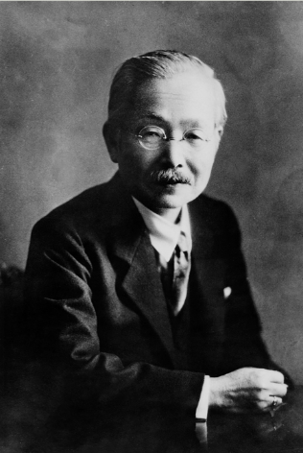
How was it discovered?
Umami was discovered by Dr Kikunae Ikeda, from Tokyo Imperial University, Japan, in 1908.
He undertook research into Dashi, a traditional Japanese stock made from kombu (kelp). His research lead to describing the savoury taste as ‘umami’.
He was sure that this taste was held in common by other foods with a savoury flavour, including those used in Western meals such as tomatoes and meat. Upon investigation it was discovered that these foods also had ‘umami’.

Slide 4
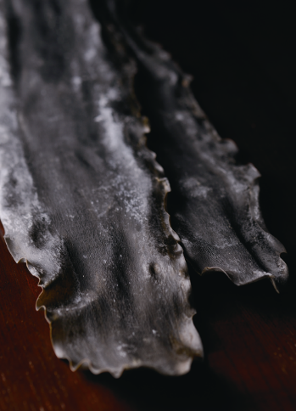
What is dashi?
Dashi is a traditional stock used in Japanese cooking. It has been used for over 1,000 years.
Dashi is made from dried kombu (kelp), katsuobushi (dried bonito – fish) or dried shiitake mushrooms.
Dashi means ‘boiled extract’.

Slide 5
How is dashi made?
Japanese stock, dashi, is the key element of the authentic Japanese cuisine. The recipe is simple and quick!
Ingredients
4cm x 4cm dried kombu (kelp)
600ml water
8g bonito flakes
Method
Make a few slits in the kombu and cook it in the water on a medium heat.
Remove the kelp just before it boils and add the bonito flakes.
Bring to the boil and strain.

Slide 6
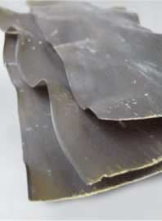
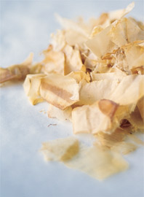

How is dashi made?
Kombu dashi, made without the bonito flakes, is vegetarian.
Vegetarian dashi can be made by soaking 2-3 dried shiitake mushrooms in 600ml for 1 hour. Drain and use.
kombu
bonito flakes

Slide 7
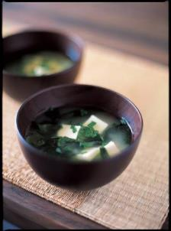
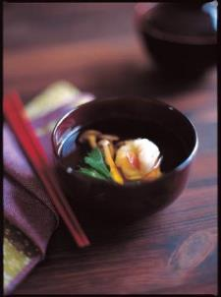
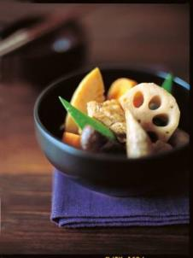
Umami in Japanese cuisine
Japanese miso soup
Clear Japanese soup with shrimp
Nishime

Slide 8
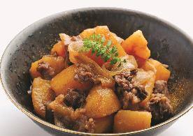
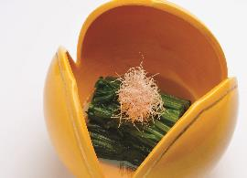
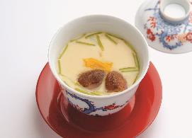
Umami in Japanese cuisine
Thinly sliced beef, potato and vegetable stew
Spinach in dashi sauce
Savoury egg custard

Slide 9
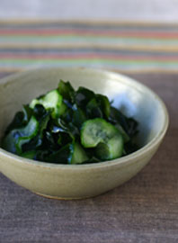
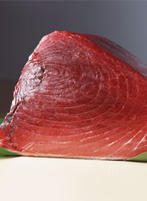
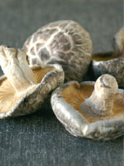
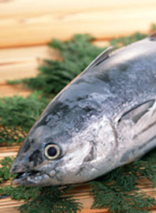
Umami in Japanese cuisine
Sea Vegetables – Wakame and Nori
Fresh tuna
Shiitake mushroom
Bonito

Slide 10

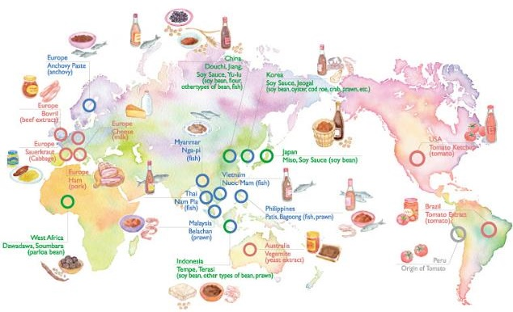
Umami around the world

Slide 11

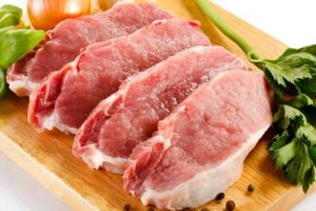
Familiar foods with a umami taste
These are foods which all have an umami taste:
tomatoes;
cured pork, e.g. ham, sausage, bacon;
cheddar cheese;
parmesan;
meat, e.g. beef;
anchovies;
yeast extract.

Slide 12

Cooking and umami
Several chefs around the world feature the umami taste in their cooking.
In the UK, Heston Blumenthal uses umami-rich Japanese ingredients in Western style preparation in order to deliver a umami hit. Other chefs include Claude Bosi and Sat Bains.
However, the umami taste can be delivered using familiar foods, such as yeast extract, Parmesan cheese, ketchup and tomatoes.
An umami-rich food is pizza – featuring tomatoes, Parmesan cheese and anchovies.

Slide 13
Summary
Umami is the 5th taste – it imparts a savoury flavour.
Umami was discovered by Dr Kikunae Ikeda, from Tokyo Imperial University, Japan, in 1908.
Umami tasting foods are found throughout the world.

Slide 14
Umami
For further information, go to:
www.foodafactoflife.org.uk
This resource meets the Guidelines for producers and users of school education resources about food.

