Slide 1
Rock cakes
Complexity: low - medium

Slide 2
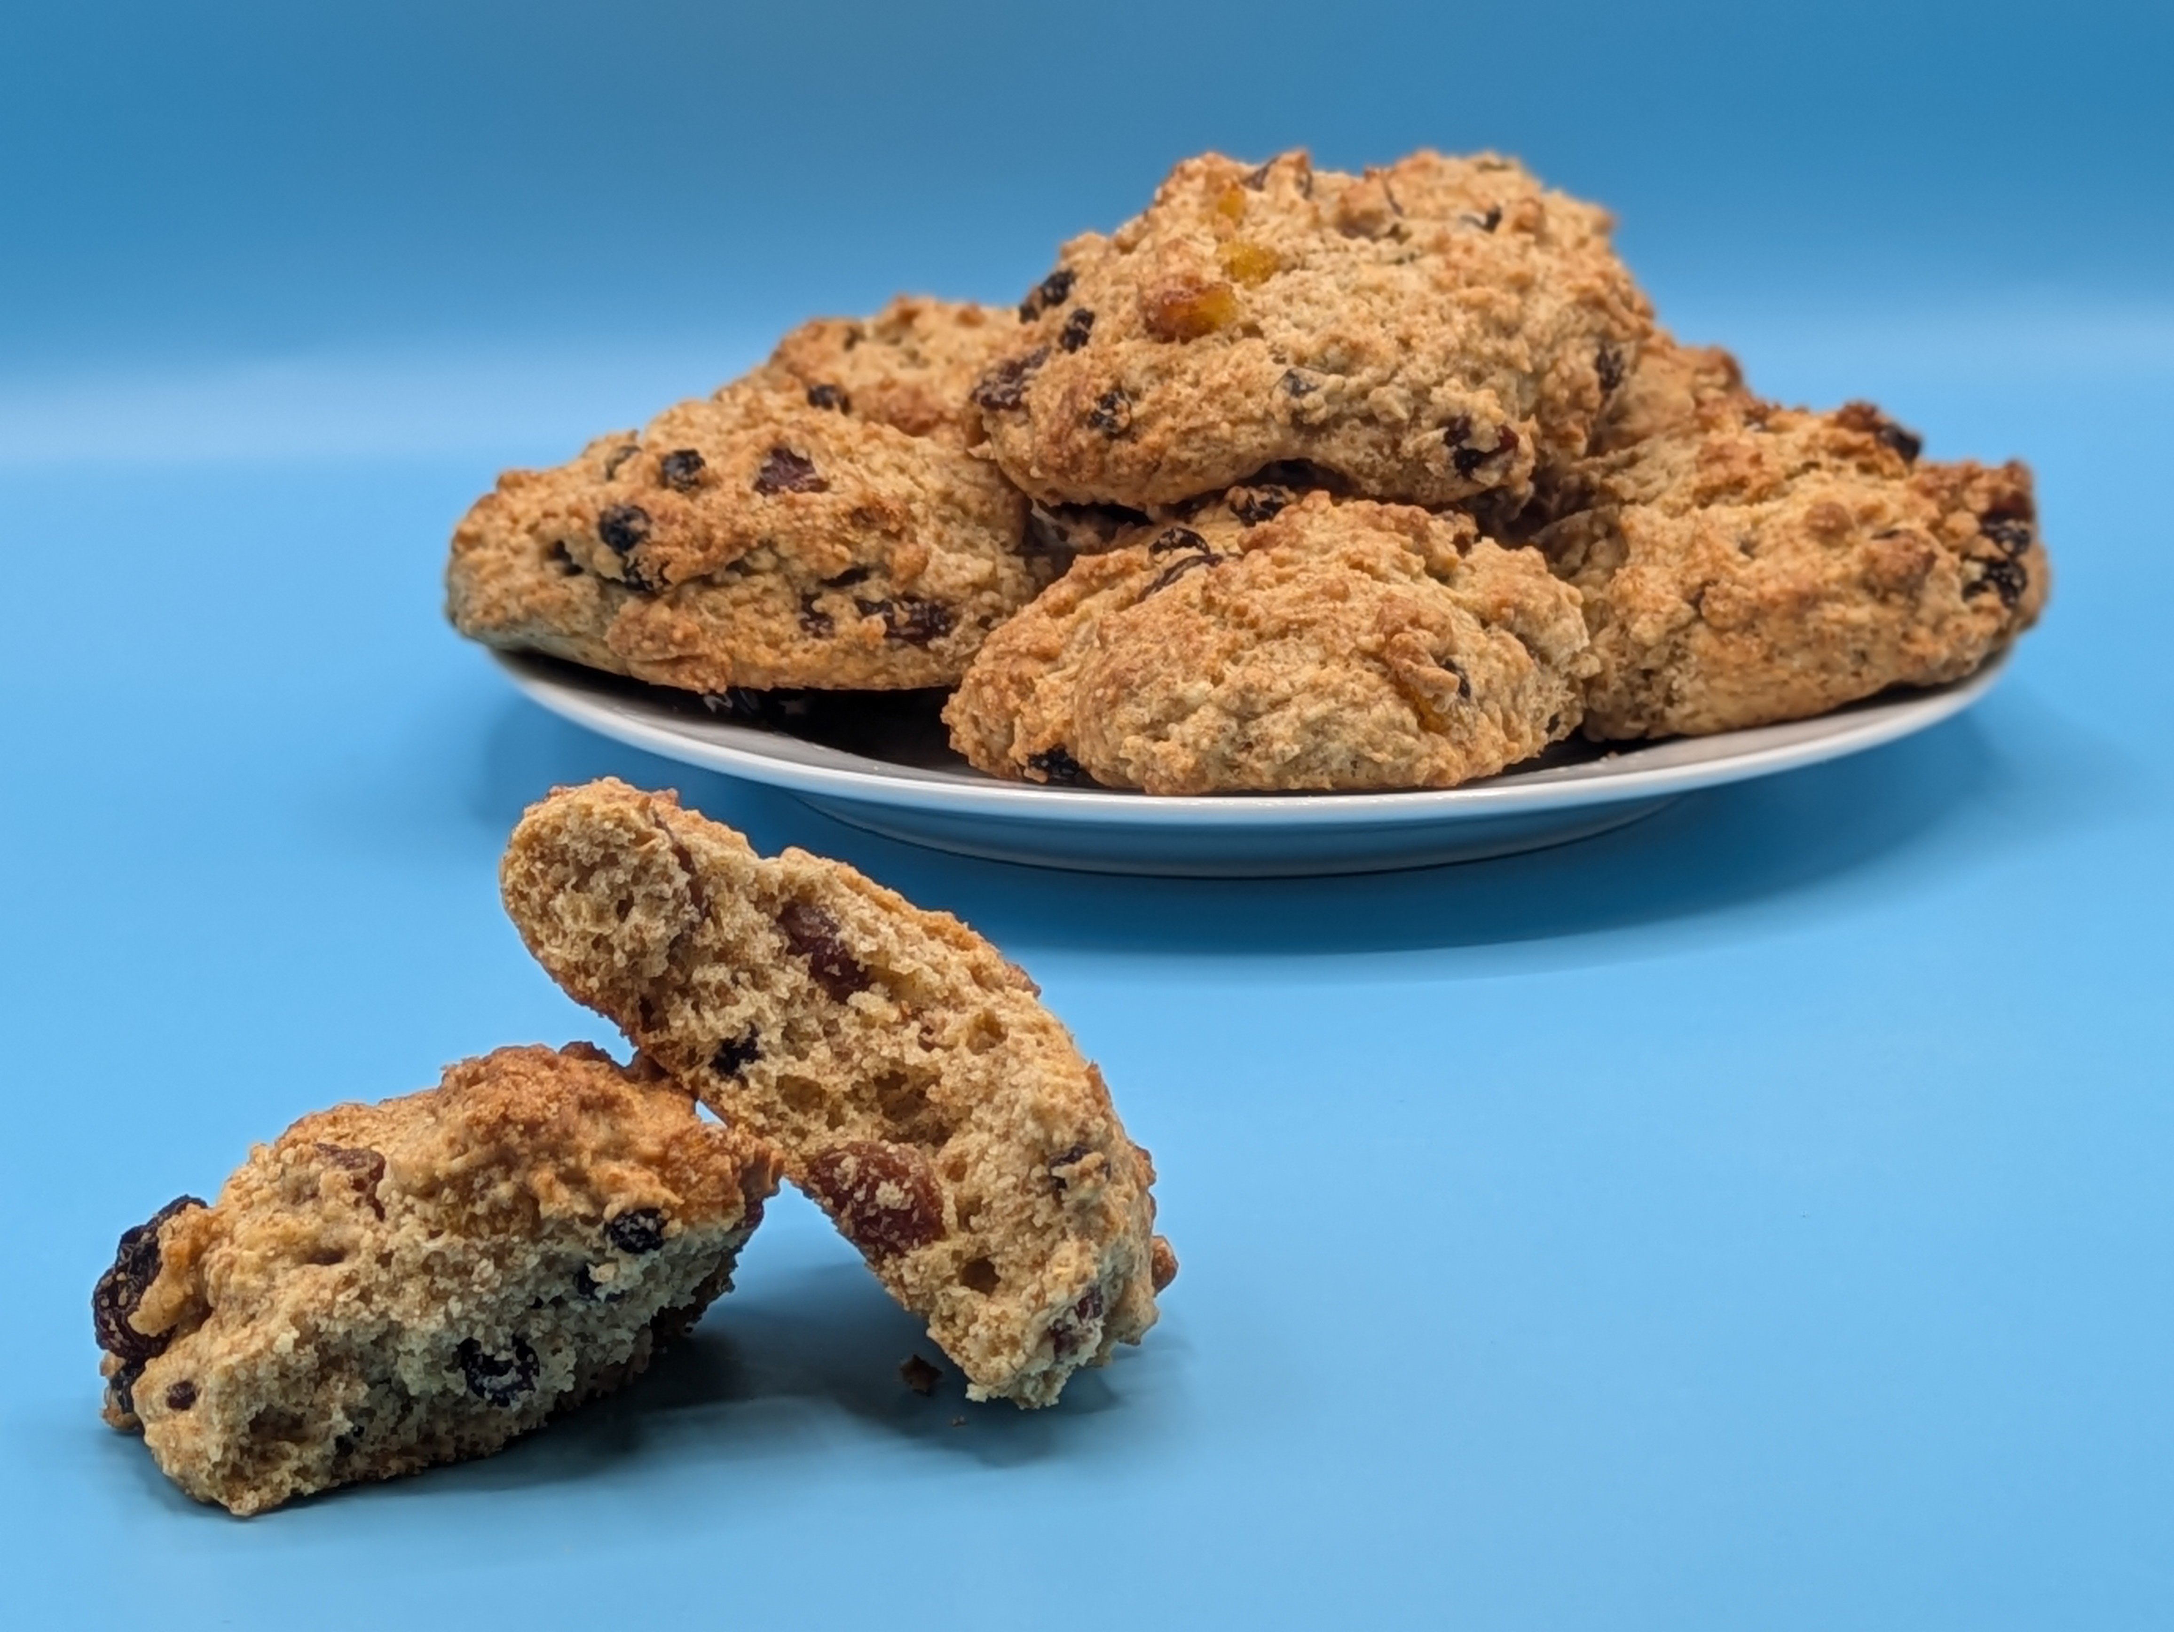
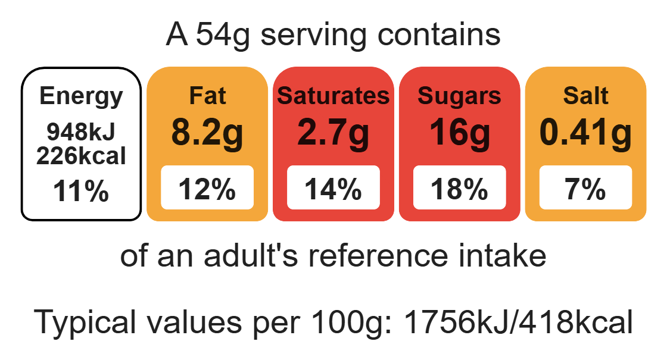
Nutritional analysis
Serves 8

Slide 3
Starter activity
Name three things to do when preparing for a practical.
Explain why you should use oven gloves when putting food in and out of the oven.
Explain why your oven should be pre-heated.

Slide 4
Example responses
Name three things to do when preparing for a practical.
Tie back hair, remove jumpers, roll up long sleeves, remove jewellery, wash hands, put on a clean apron.
2. Explain why you should use oven gloves when putting food in and out of the oven.
To prevent burning yourself. Remember when placing into the oven, the tray may be cold, however the pre-heated oven will be hot.
3. Explain why your oven should be pre-heated.
The oven should be pre-heated, so it is at the correct temperature ready to cook the rock buns.

Slide 5
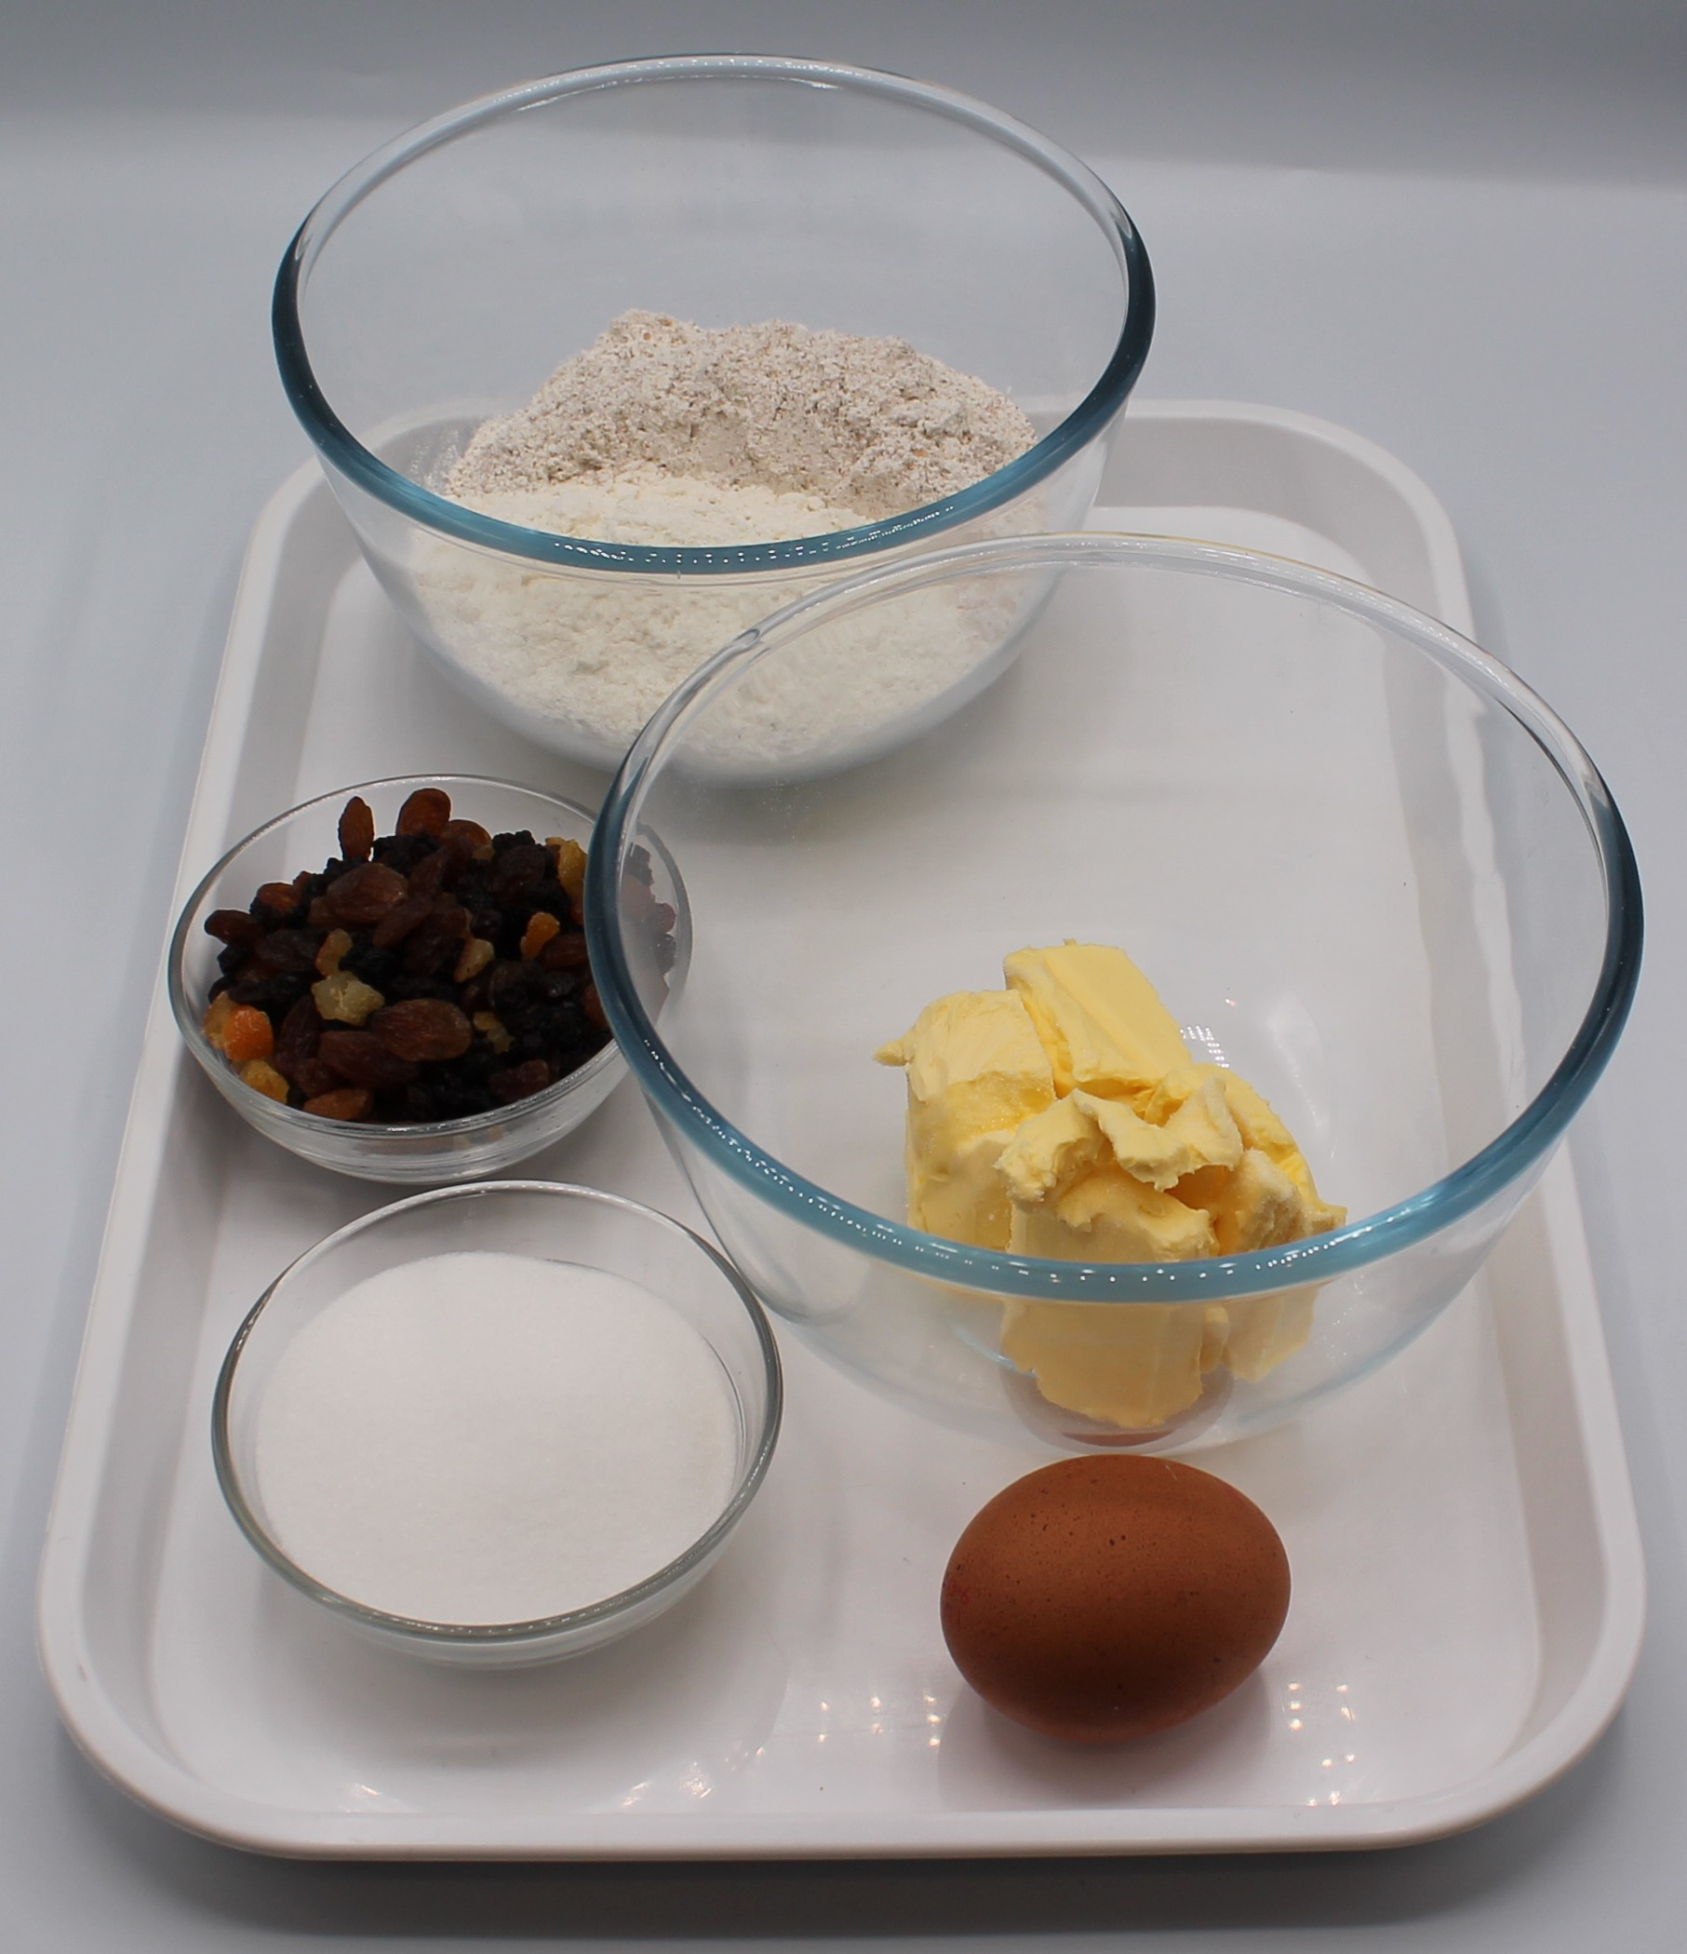

Ingredients (makes 8)
100g self-raising white flour
100g self-raising wholemeal flour
75g baking fat/ block
75g caster sugar
75g mixed dried fruit
1 egg
Check for any food allergy, intolerance, special dietary requirement or religious/cultural reasons for not handling or eating the ingredients in this recipe.

Slide 6
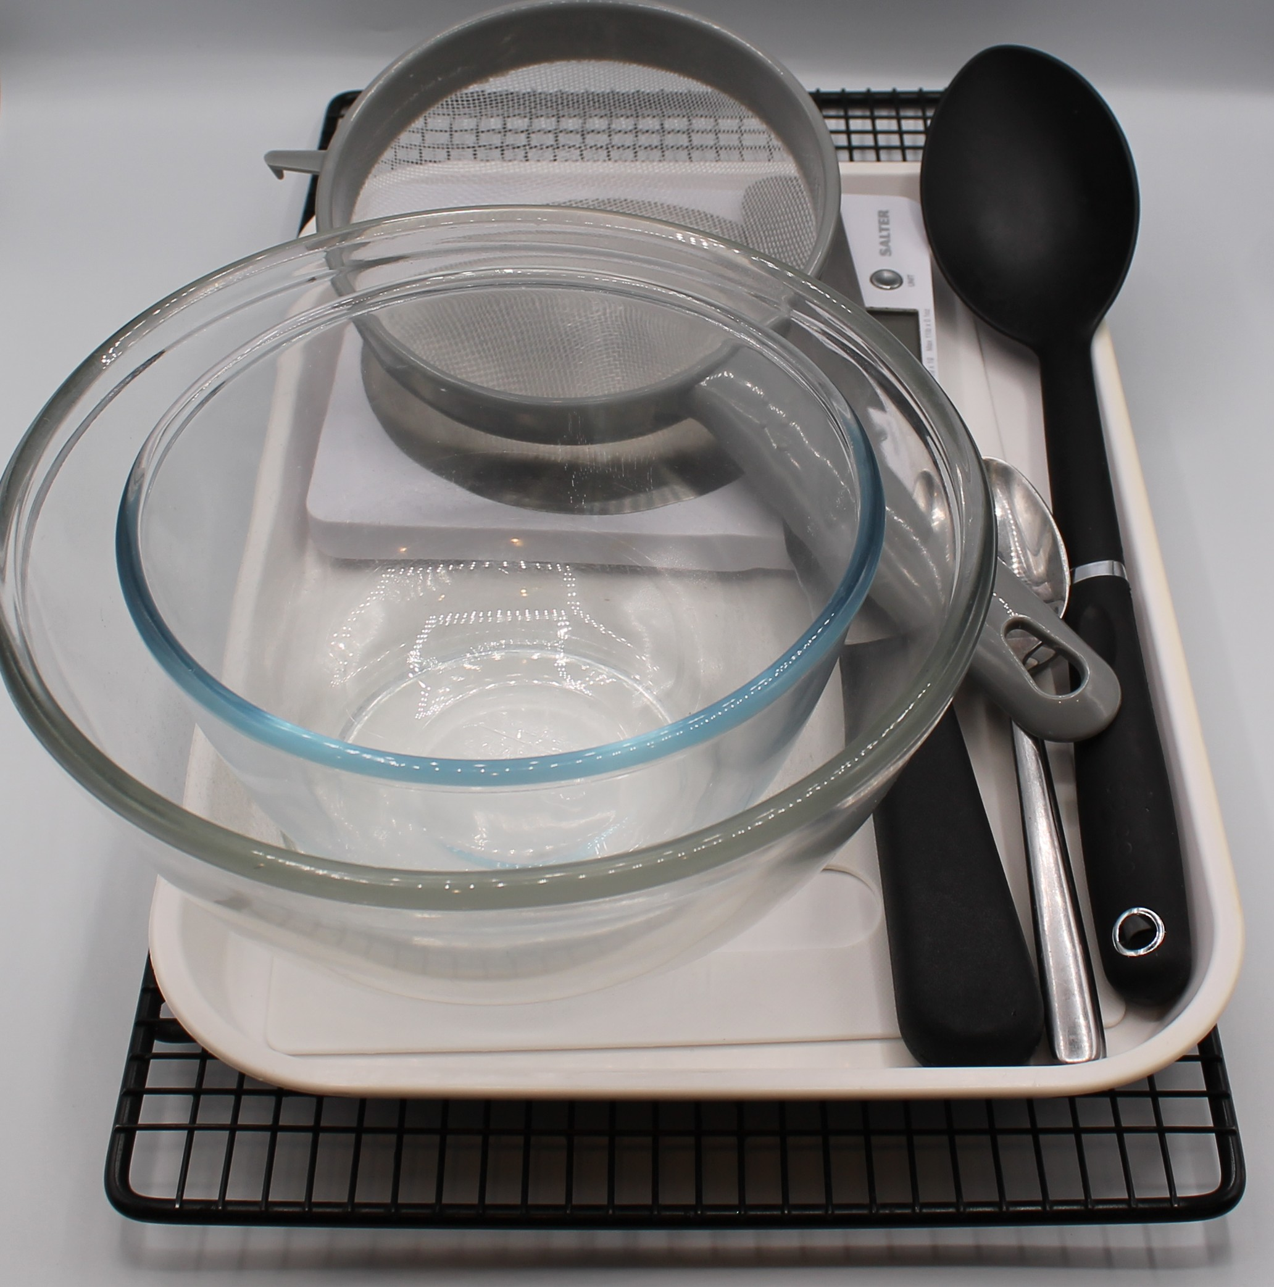
Equipment
Weighing scales
Sieve
Mixing bowl
Palette knife
Small bowl
Fork
2 metal spoons
Baking tray
Cooling rack

Slide 7
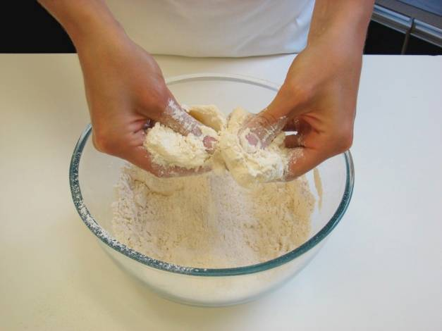
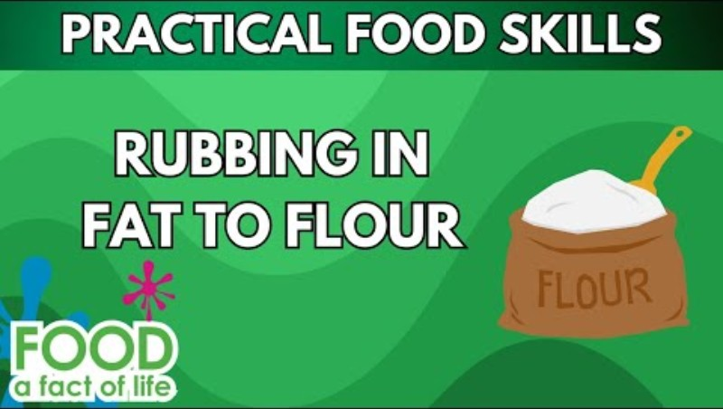
Food skills
Weigh
Sift
Rub-in
Mix
Stir and combine
Whisk
Portion/divide
Form and shape
Bake
Click below to watch how to rub-in

Slide 8
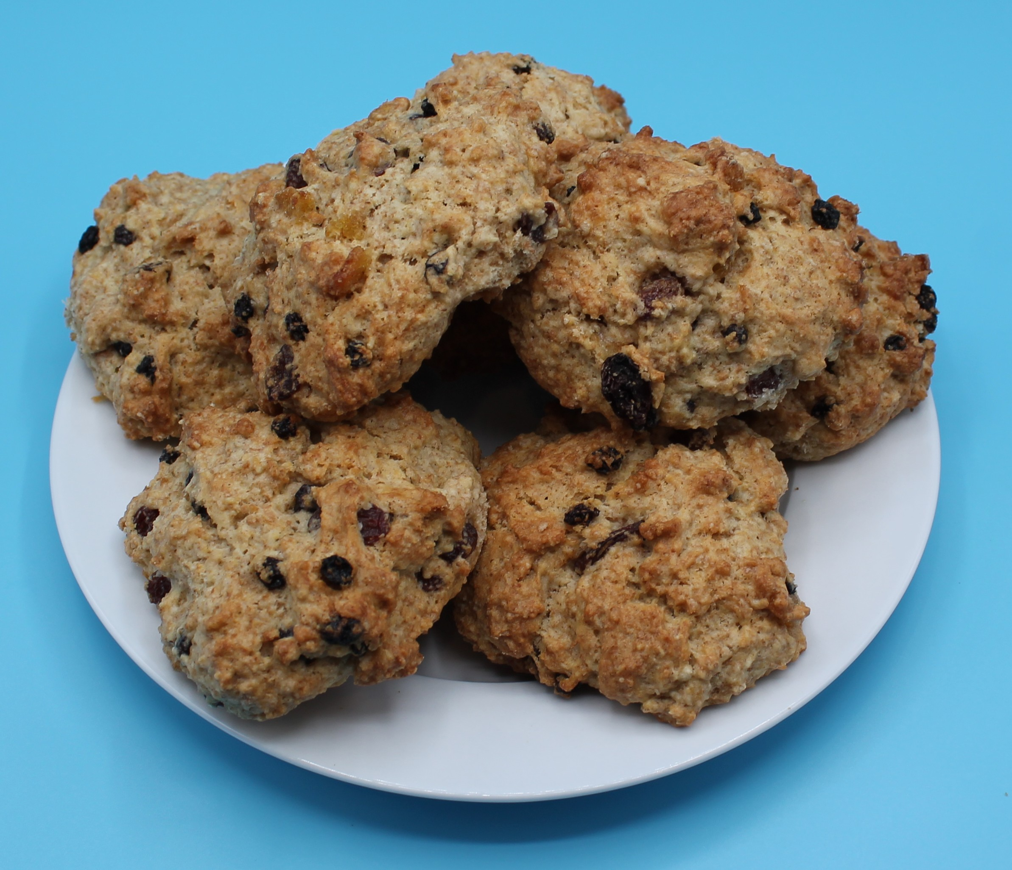
Method
Preheat oven to 220°C or gas mark 7.
Line or grease the baking tray.
Sift the flour into the bowl.
Using your fingertips, rub the fat into the flour until it resembles breadcrumbs.
Stir in the sugar and dried fruit.
Crack the egg into a small bowl and whisk lightly.
Make a well in the middle of the flour and carefully add the egg. Mix to form a soft, yet firm dough using the palette knife. Add a few drops of water or milk if the dough is too dry.
Using 2 spoons, divide the dough into 8 ‘rocks’ and place on the baking tray.
Bake for 12 – 15 minutes, until golden brown.
Allow to cool on a cooling rack.

Slide 9
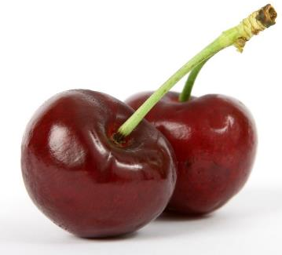
Top tips
Turn up the flavour: Use 50g of desiccated coconut or cherries instead of dried fruit.
Reduced food waste: Add leftover soft fruit such as blueberries or chopped strawberries.
Focus on fibre: Replace the white flour with 50g wholemeal flour for an extra fibre boost.

Slide 10
Food science
​Caramelisation
The sugar caramelises with the heat of the oven and turns golden brown.
Dextrinisation
The starch in the flour turns to dextrin, causing it to go golden brown under the application of dry heat.

Slide 11



Plenary
Evaluate how well you worked today and make comments on how you could improve next time.
 |  |  |  | Comments
Rubbing-in
Stir and combine
Portion/dividing
Baking

Slide 12

Example responses
 |  |  |  | Comments
Rubbing-in |  |  |  | My mixture mostly looked like breadcrumbs, there were a few lumps left. Next time I will make sure to rub all the fat into the flour.
Stir and combine |  |  |  | My sugar, fruit and egg were well mixed.
Portion/dividing |  |  |  | My rock cakes were different sizes. I need to portion/divide more accurately.
Baking |  |  |  | My rock cakes all cooked at different times as some were small and some were big. Next time I need to make sure they are all the same size and shape, so they cook accurately.

Slide 13
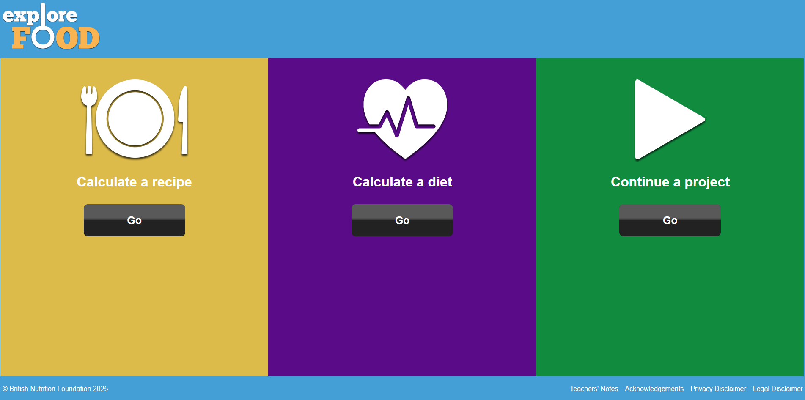
Looking for more…
Challenge your pupils to improve the nutritional content of the rock cakes.
Use Explore food our nutritional analysis tool to calculate the nutritional value of their rock cakes once they have made their changes.
If you are looking for an alternative recipe that uses the rubbing-in method but also challenges pupils to roll-out and shape and form using a cutter, why not try this lesson for scones from the Food – a fact of life Schemes of Work?

Slide 14
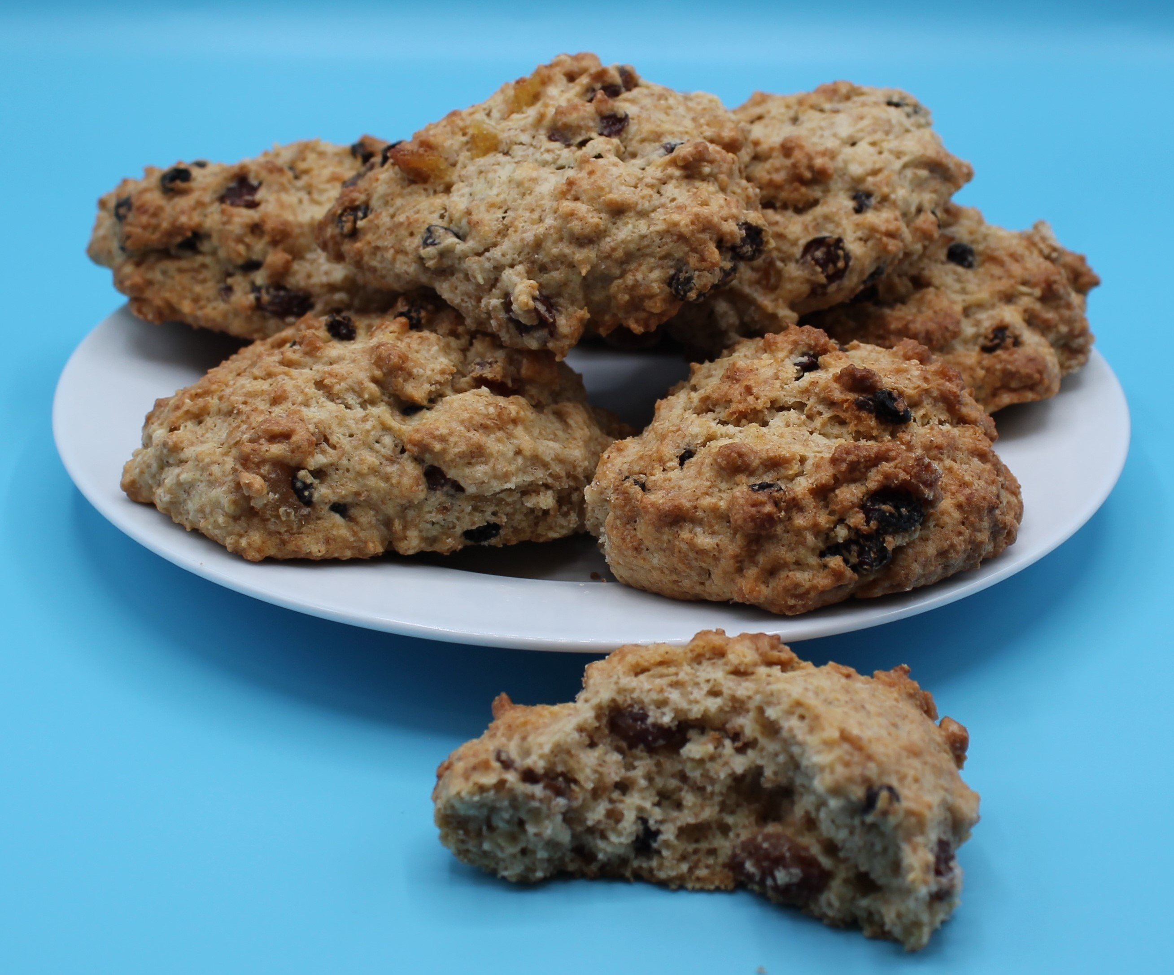
Rock cakes
For further information, go to:
www.foodafactoflife.org.uk
This resource meets the Guidelines for producers and users of school education resources about food.

