Slide 1
Gluten formation

Slide 2
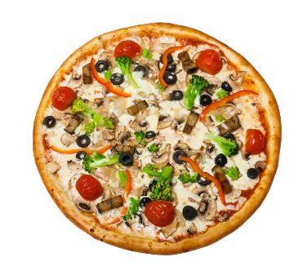
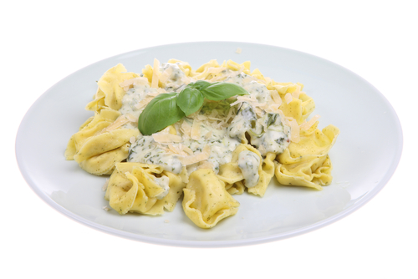
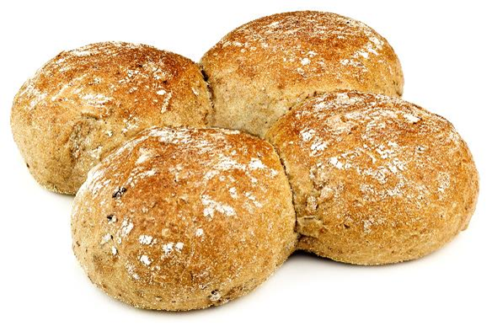
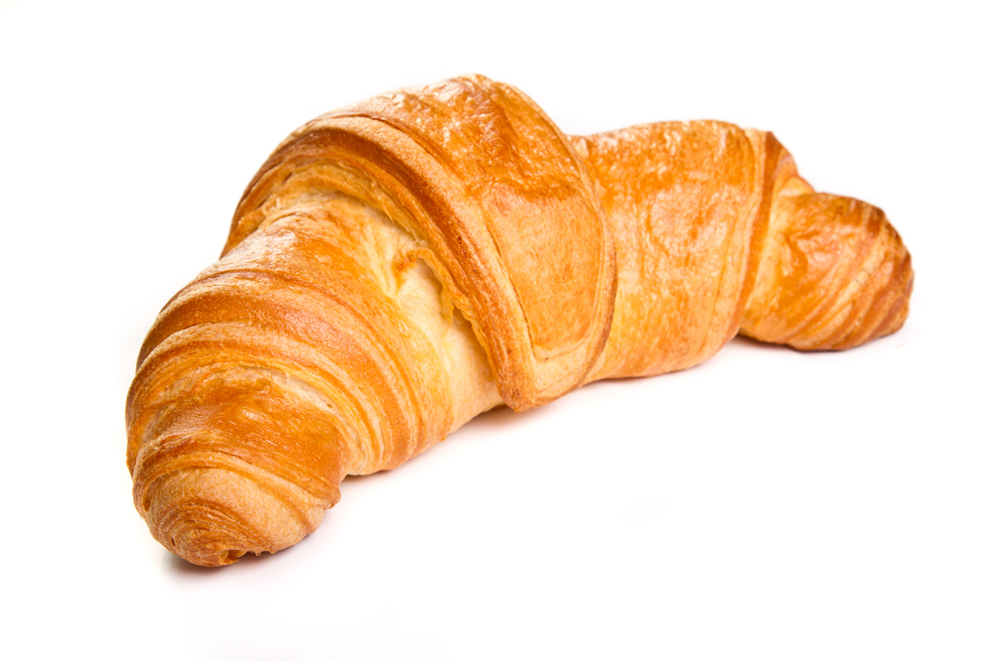
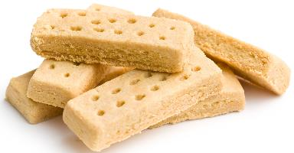
Examples
Gluten formation is important for forming dough, in foods like these:
Bread
Pizzas
Pasta
*Note: ‘short’ doughs like those used in shortbread have some gluten formation, but it is limited by adding shortening for a more crumbly texture.
Pastries
Shortbread*

Slide 3

Proteins in grains
When thinking about foods made with flour from grains, such as bread, cake or biscuits, carbohydrate might be the main thing that comes to mind.
But the flour that is used to make dough or pastry also contains proteins, which play important roles in the foods we make.

Slide 4
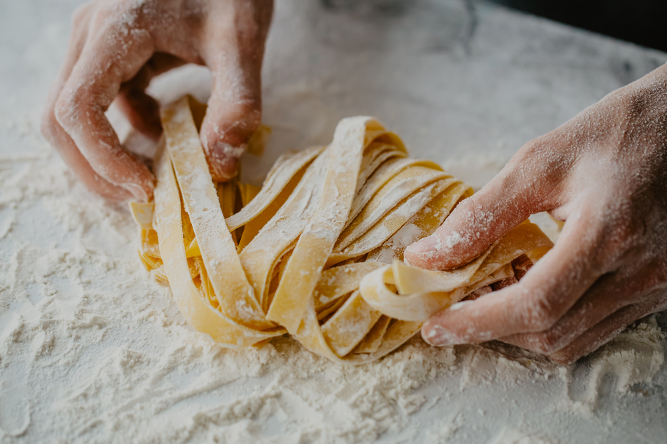
The ‘strength’ of flour
When looking at different types of flour in the shop, some are called ‘strong’ flours.
A flour that is strong contains more protein, so the foods made with stronger flours are more dense and more elastic.
For example, strong durum wheat flours are used to make pasta. This is so the pasta can be rolled thinly and cut, without breaking apart. Strong bread flours help to give bread a softer and chewier texture, and helps it rise properly.
Biscuits and cakes use weaker flours (plain or self-raising), so they are more crumbly and less elastic.

Slide 5
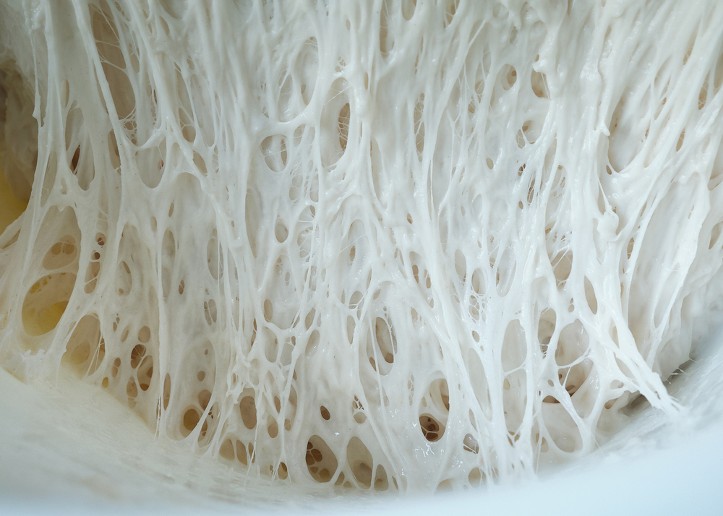
What is gluten?
Gluten is a mixture of two different proteins found in wheat, rye, spelt and barley grains.
When the two proteins in wheat (gliadin and glutenin) are combined with water, they can form a gluten structure.
Gluten forms the structure of many foods such as bread, pastry, cakes and pasta.
This picture shows the structure of gluten. When gluten is formed, it creates long, sticky, and elastic strands

Slide 6
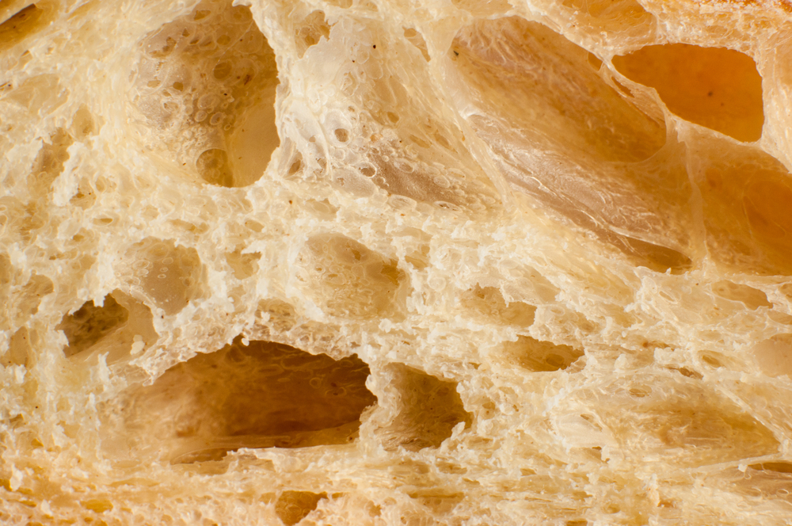
Example 1 - Bread
Bread is a typical example of strong gluten formation and development.
Look at the structure of bread, pictured here. The gluten forms a network that traps gas, forming pockets that expand further when the bread is baked.
Without proper gluten development, the bread will be flat and dense. This is because the gluten forms a structure that traps gasses as the bread rises. Without proper development, the gases can escape.

Slide 7
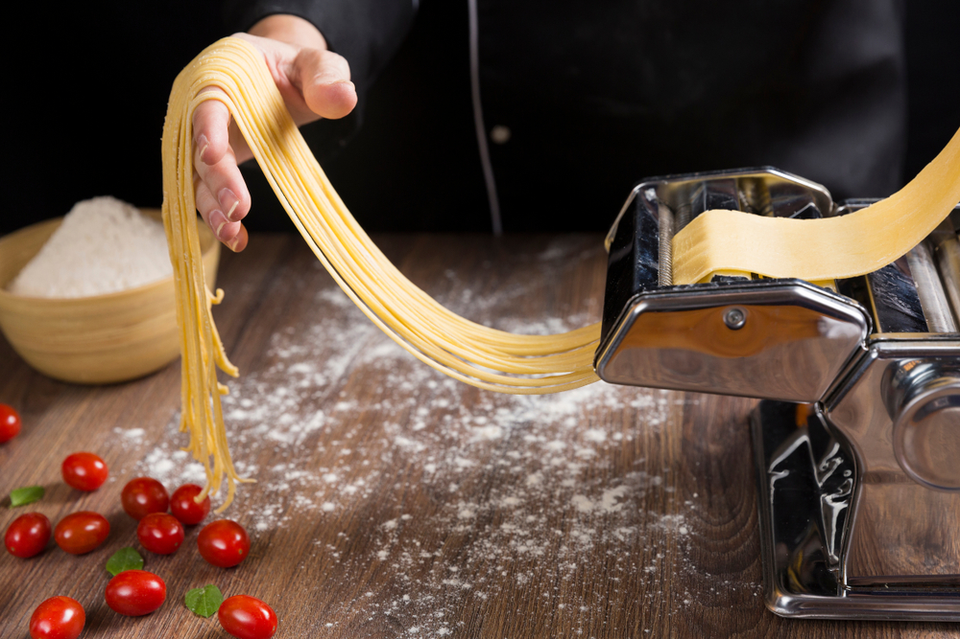
Example 2 - Pasta
Pasta uses a stronger flour. This is because pasta needs to be elastic and not brittle, so it can be rolled thinly without breaking.
Pasta and pizza flour is often also ground more finely. ‘00’ grade may be written on bags of flour used to make pasta and pizza. This signifies that the flour is ground extra finely. In pasta and pizza, this means a smooth texture with the right balance of chewiness and bite.

Slide 8
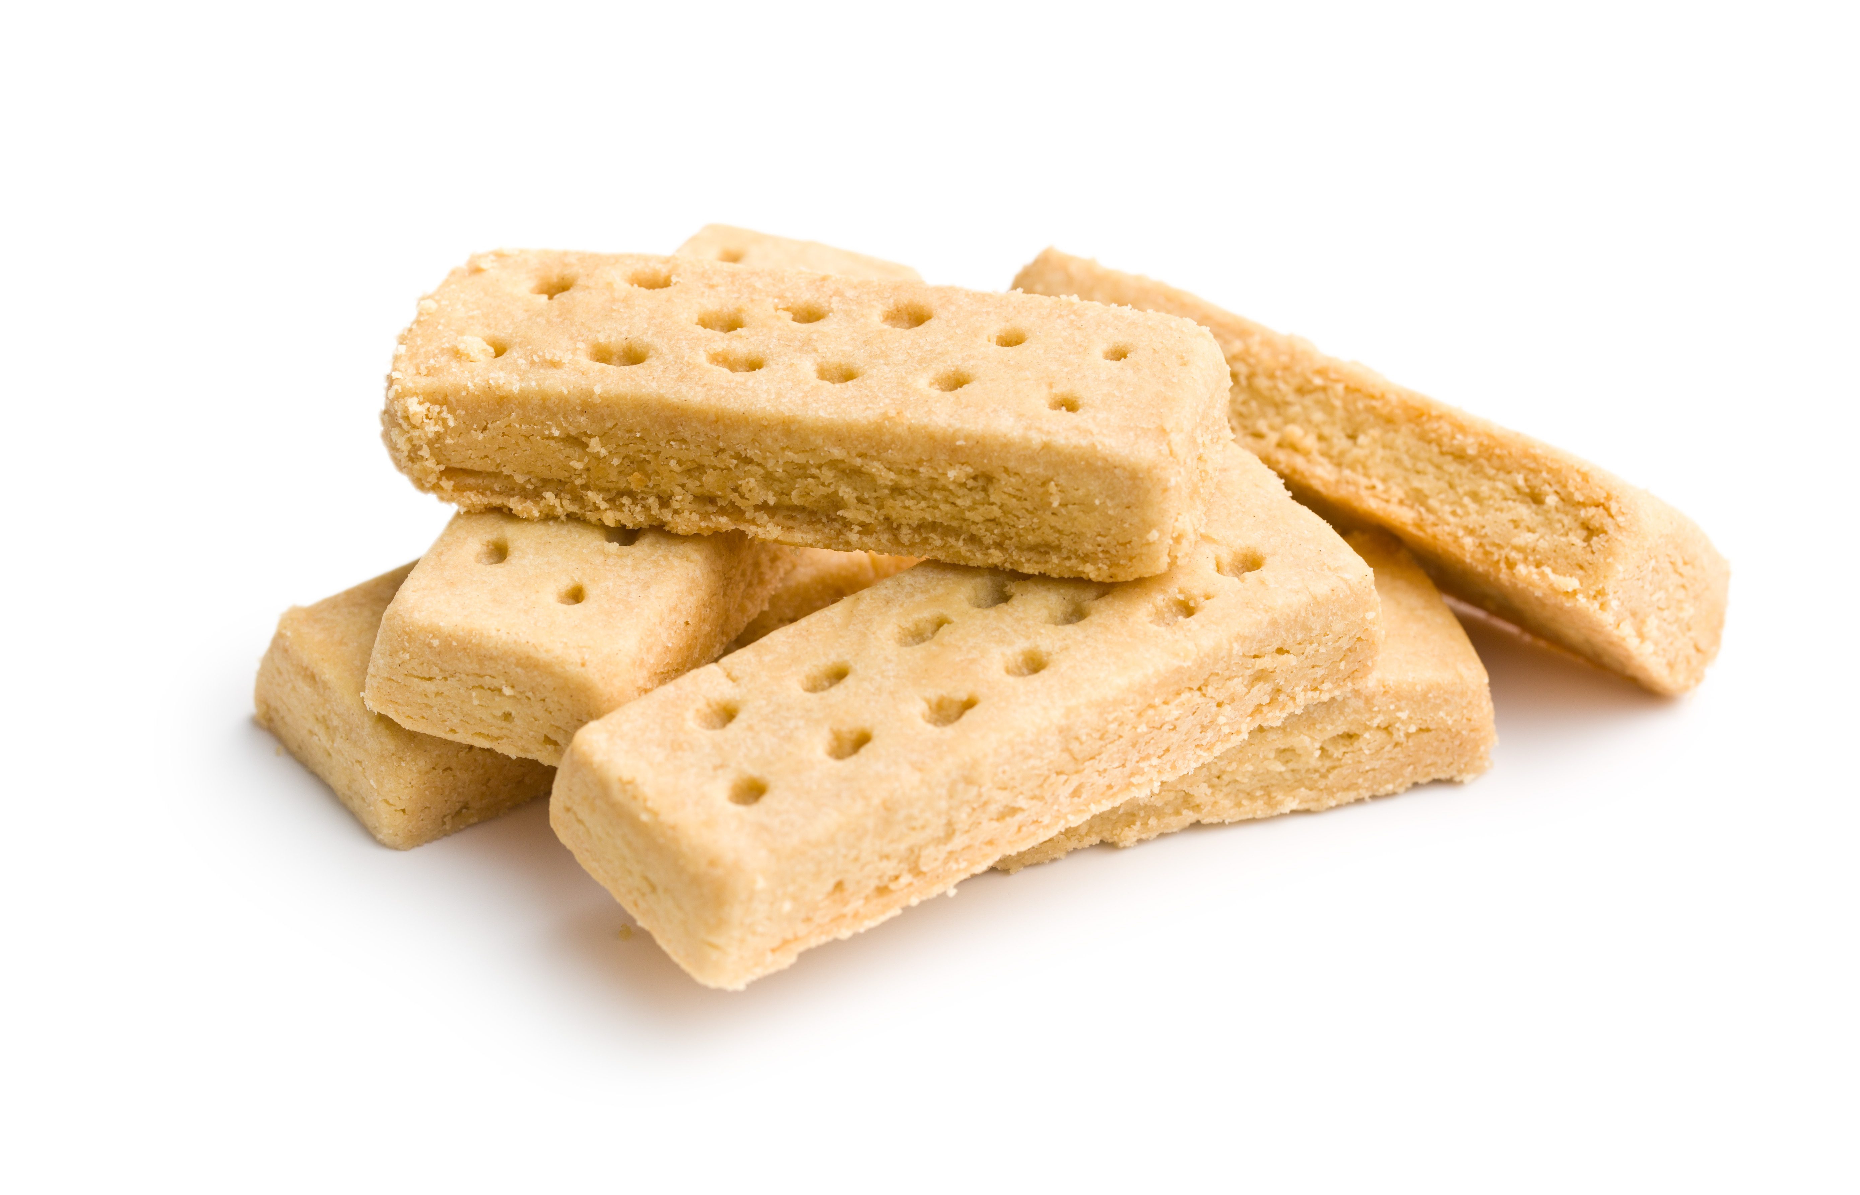
Example 3 - Shortbread
Shortbread uses weaker (lower gluten) flour (e.g. plain flour).
This is because the shortbread is designed to be crumbly and brittle, for the correct texture.
In addition, doughs used to make shortbread make use of ‘shortening’.
Shortenings are fats that coat the flour and prevent excess gluten formation.

Slide 9
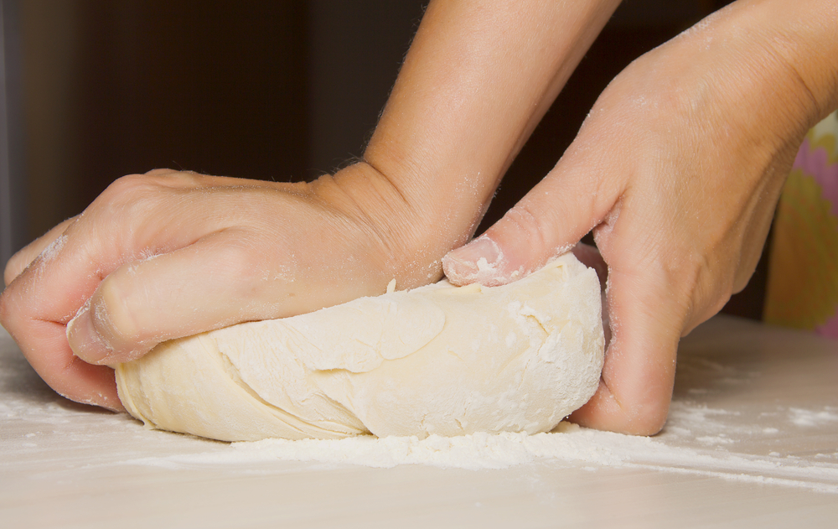
Gluten development – kneading bread dough
The strands of gluten in the flour need to be worked during the kneading process. This makes them stronger and more able to stretch. Kneading gives the dough plasticity.
When dough is kneaded, the force helps the gluten to develop into a ‘mesh’ structure that can trap gas and help the dough to rise properly.
If the gas can escape, the bread will collapse! That’s why kneading is so important.

Slide 10
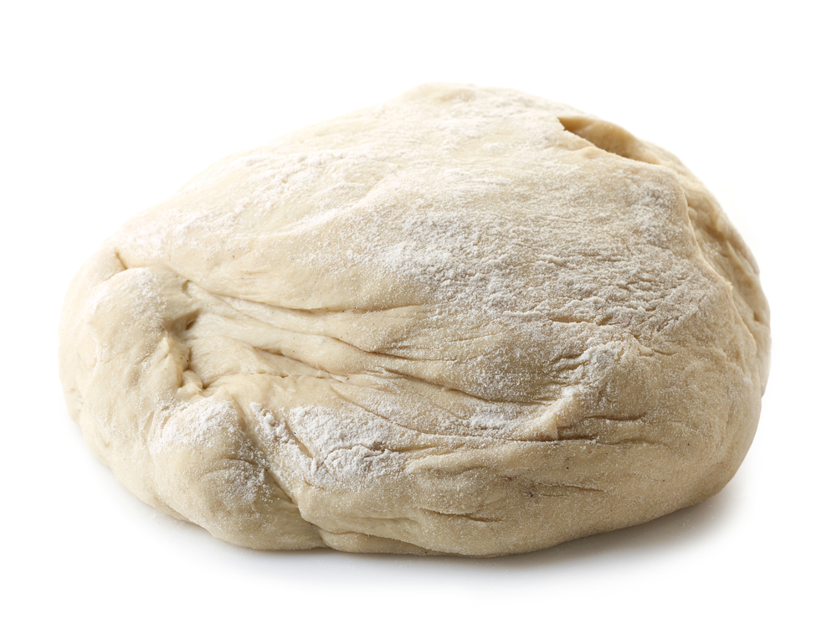
Proving - bread dough
Usually, dough is left to rest for a little time after kneading. This is called proving. Proving allows the yeast to produce carbon dioxide to help the dough rise.
The yeast is activated by moisture, warmth and oxygen in the dough, it feeds on the sugars in the flour to produce carbon dioxide. This process is called fermentation.
But this step also allows the gluten to ‘relax’ a little before the dough is baked. If the dough does not rest, the final product will can end up being tough and chewy.

Slide 11
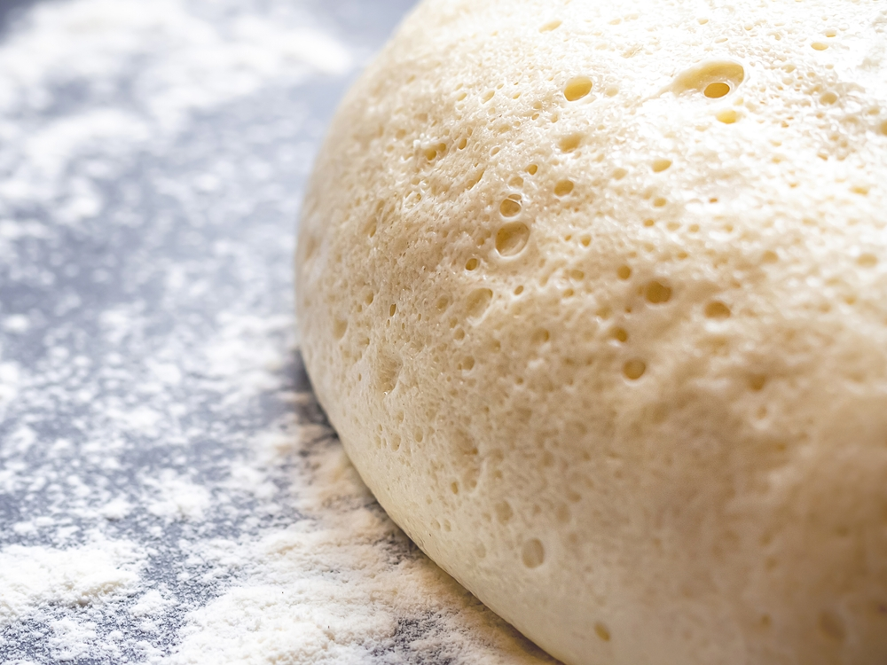
Baking the bread dough
During cooking the alcohol from the yeast fermentation and the water from the dough evaporate.
The steam expands and creates 'bubbles' in the dough. This is called oven spring.
The gluten firms up and the starch in the flour absorbs any remaining water.
The gluten and starch trap the bubbles and then harden during baking to create a risen product.

Slide 12
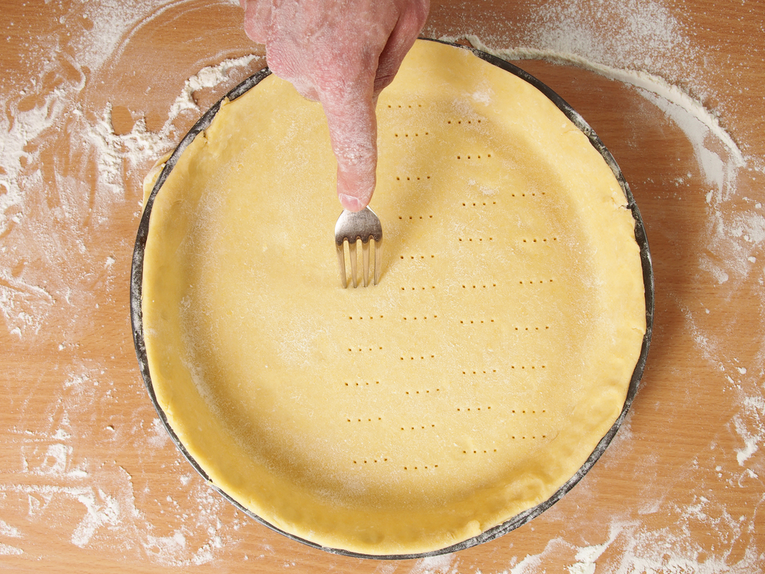
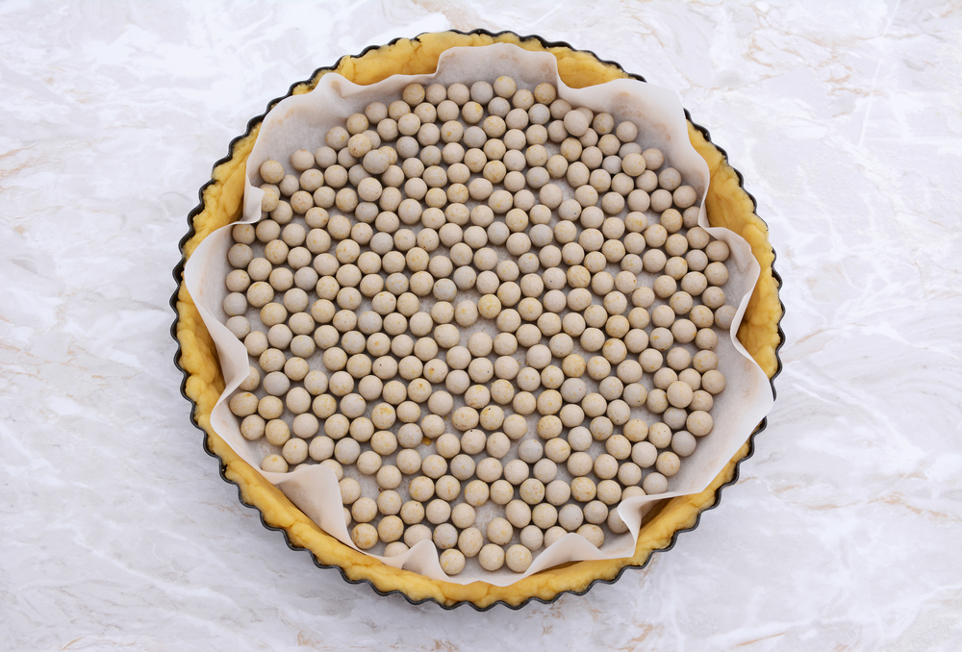
Pastry and gluten
The gluten content of flour is important in pastry making.
Shortcrust pastry needs a low protein (soft) flour to give a 'short' crumbly texture.
Pastries like flaky and choux need a stronger, high gluten flour so that the pastry can stretch and make layers during cooking.
Shortcrust pastry needs to be 'rested' before baking. This is to allow the stretched gluten to relax and go back to their original shape and size.
Without resting the gluten is stretched and when cooked the heat makes it shrink quickly changing the shape and finish of the pastry.
Pricking with a fork lets the steam escape and stops it from puffing up during baking in the oven. Using baking beans weighs the base down and also prevents puffing up.

Slide 13
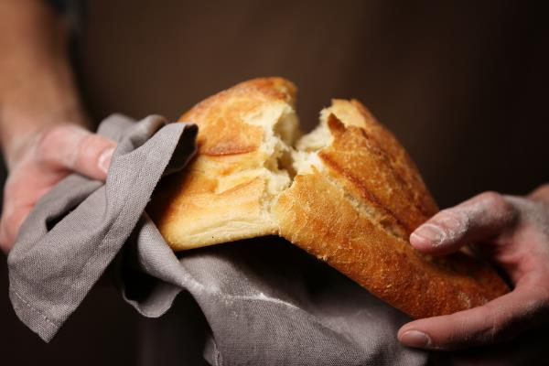
Applying the science - bread making
There are certain characteristics that are associated with a good quality bread. It should have:
a uniform, golden-brown crust (some breads, such as wholemeal, will have a different finished colour);
a well-risen appearance, without being overinflated;
a light texture and a soft, tender crumb;
a moist mouthfeel;
a ‘nutty’ flavour, without the taste of yeast.

Slide 14
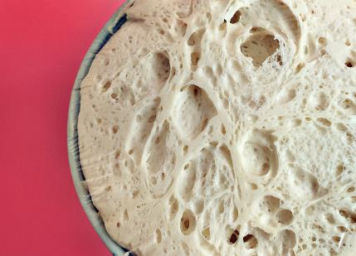

What went wrong and why?
Common problem | What could have gone wrong?
The bread has a coarse, open texture | The dough could have been too wet, over-proved or the oven temperature was not high enough.
The bread tastes sour and yeasty | Too much yeast was used.
The bread has a dense, heavy texture | Could be a number of reasons: The flour could have too low a protein (gluten) content, too much salt in the recipe, it was not kneaded enough, not left to prove for long enough, the yeast was destroyed by leaving the dough to rise in a place that was too hot.

Slide 15
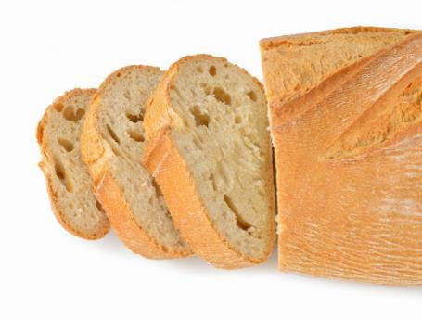
What went wrong and why?
Common problem | What could have gone wrong?
The dough collapsed when put in the oven | The dough was over-proved.
The crust has broken away from the loaf | This is sometimes called a ‘flying crust’. It is most likely caused by under proving.
The bread is holey | An uneven texture with large holes can be caused when the dough is not knocked back properly, or the dough has been left uncovered during rising. It can also be the result of over-proving, when too much gas is produced.

Slide 16
Key words
Key word | Meaning
fermentation (yeast) | The process by which alcohol and carbon dioxide are produced from sugars by yeasts, e.g., during breadmaking.
gliadin | A protein that makes up gluten (with glutenin). Gliadin is produced when wheat flour (or flour from other grains including rye and barley) is mixed with a liquid, usually water.
gluten | A mixture of two proteins (gliadin and glutenin), that makes dough ‘elastic’ and gives the final product structure. The more a dough is mixed, the more gluten is developed.
glutenin | A protein that makes up gluten (with gliadin). Glutenin is produced when wheat flour (or flour from other grains including rye and barley) is mixed with a liquid, usually water.

Slide 17
Key words
Key word | Meaning
plasticity | The capacity of fats to soften and become liquid over a range of temperatures, which affects their suitability for a variety of uses, e.g., spreading.
protein | A component of food that is made up of amino acids. There are many diverse types of protein with a range of functions, including enzymes that catalyse reactions and structural proteins that make up the tissues in our body.
proving | When dough is allowed to rest before baking. During this time, fermentation takes place causing the dough to rise.
shortening (effect) | The effect caused when fat is rubbed into flour. The fat coats the flour particles, waterproofing them, and preventing gluten forming a structure, so creating a crumbly texture.
shortening (noun) | A fat that is rubbed into flour to ‘shorten’ a dough.

Slide 18
Teachers’ guide

Slide 19
Talking about the science of gluten
During a demonstration, explain:
The function of gluten in flour
Types of flour and their uses, including gluten free
What happens when the water is added
Why and how the dough should be kneaded
Why the dough is proved
What happens when the dough goes into the oven and is baked

Slide 20
Teaching about gluten formation:
Explain what gluten is
Explain where gluten comes from
Explain how gluten is formed
Demonstrate how kneading aids in gluten development
Explain why dough should prove to allow gluten to relax and lengthen
Describe the different strengths of flour and what they are used for
Provide key examples of foods and recipes that rely on gluten for their structure, shape and texture
Discuss the characteristics of a product – use sensory science to help
Carry out investigations/tests on the effect and use of gluten

Slide 21
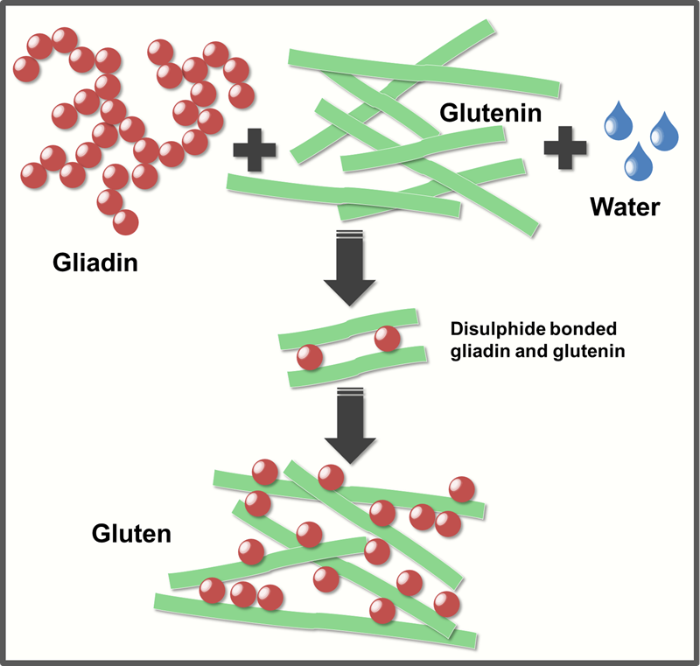
Gluten formation - overview
The following information is based on excerpts from the British Nutrition Foundation’s Functional Properties of Food course.
Gluten is formed from two classes of proteins, gliadins and glutelins, which are commonly found in grains, such as wheat, rye, and barley.
Gluten is vital when making bread, as it forms a supporting structure, which prevents the bread from collapsing and also provides an elastic (springy) and chewy texture in baked goods.

Slide 22
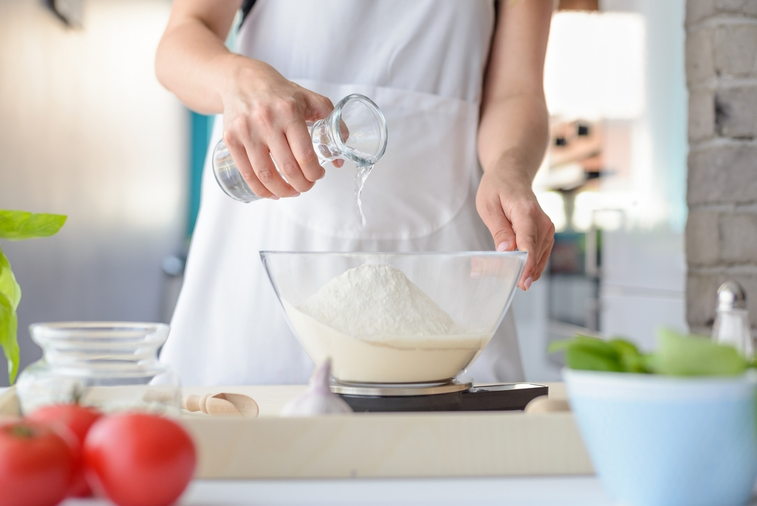
Gluten development
In order to form gluten, water needs to be mixed with the gliadin and glutelin proteins, resulting in a dough.
However, just adding water is not enough. In order to make gluten strong and long enough for a particular purpose, dough needs to be kneaded.
Kneading helps to spread the proteins into a 3D matrix, which is capable of holding the gas produced as bread ‘proves’.

Slide 23
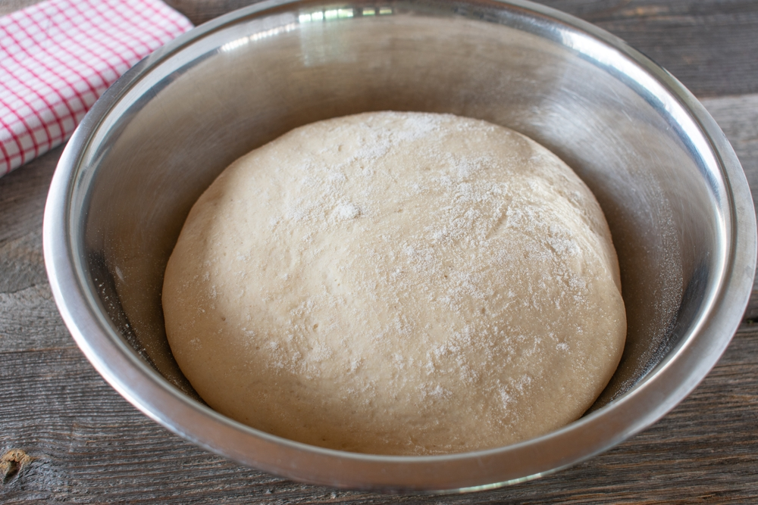
Resting dough
Dough is often left to rest for a little time after kneading, in order to partially reverse this change.
This prevents the final product from being excessively tough and chewy and also makes it easier to roll out.

Slide 24


Gluten free bread
Two wheat proteins (glutenin and gliadin) join to form gluten. It is then developed during kneading.
Gluten traps gas bubbles and allows bread to rise.
Non-wheat flours do not produce enough gluten, so the bread tends to be flat and have a dense crumb.
To help a 'sticky thickener/stabilizer ' such as xanthan gum is often added.
When mixed with water the gum becomes a thick and slimy gel that is strong enough to trap the gas bubbles. This helps the bread to rise.
Coeliac UK cross grain symbol
Note: rice, potato and cornflour do not contain gluten
Notes:
Purple colour coded knives and chopping boards are generally used for Gluten free products to prevent cross contamination.
Xanthan gum is a polysaccharide, a type of sugar that is made from a bacteria called Xanthomonas campestris, through a process of fermentation. Xanthan gum thickens food and other products, and also prevents ingredients from separating. It is vegan.

Slide 25
Flour strength
Particular types of flour are used in baking, depending on the properties required.
Stronger flours contain more protein, providing a denser, more elastic structure (e.g. strong durum wheat flours, which are used in pasta making).
Weaker flours contain less protein and are far less elastic - these are often used for biscuits and cakes, where elasticity is less desirable.

Slide 26
Gluten formation - activities
Pupils, individually or in groups, could:
Use the Gluten experiment to test different flours for their gluten content. Explain why different strength flours are suitable for different foods.
Use the Gluten formation worksheet to run a session in class with different strength flours and find out how much gluten is in each.
Making bread is a simple way for pupils to learn about the functions of the ingredients used and apply this to a product that is easily made in the practical classroom. Use The science of bread making information sheet and Bread making – the theory to support your practical demonstration of bread making.
Teachers will need to decide on the level of complexity of the tasks chosen, depending on age, stage and need, and considering progression.

Slide 27
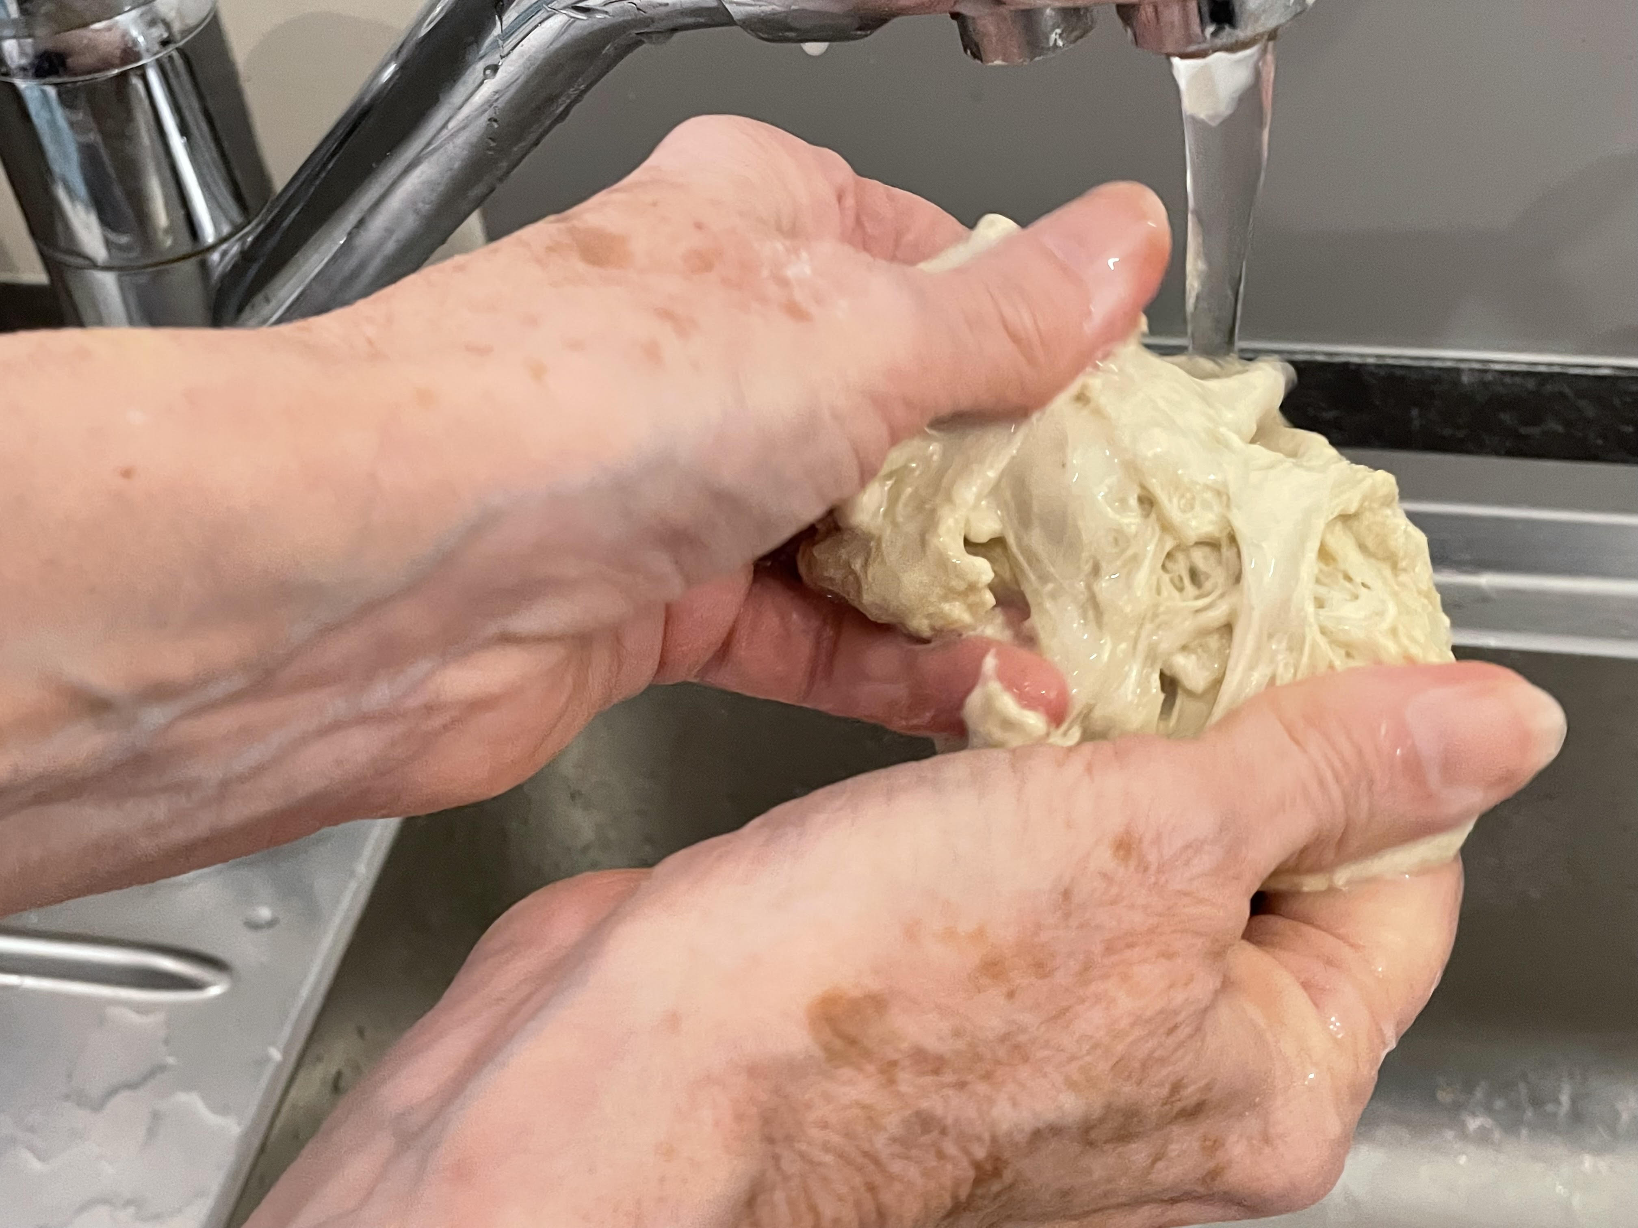
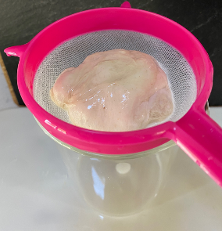
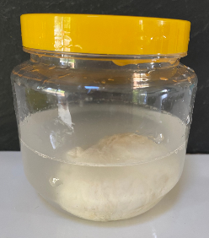
Activities and experiments – making gluten balls
Photographs courtesy of Barbara Monks @ https://thecookeryteacher.com/
What is the best way to make gluten balls?
Wash under running water
Wash in a large sieve
Wash in large plastic jar
Top tips
Use the technique best suited to your pupils.
If you are short of time, make up a batch of dough using the food mixer and dough hook
When baking the gluten balls, line the tray with non-stick/greaseproof paper
If the gluten is taken out of the oven too soon, it will collapse, as the protein has not coagulated fully

Slide 28
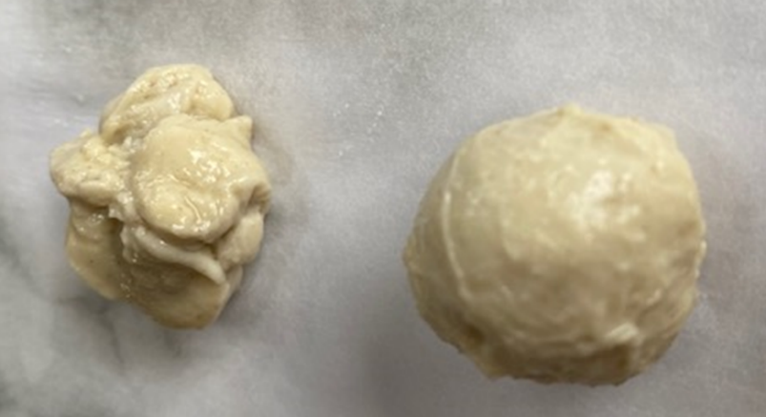
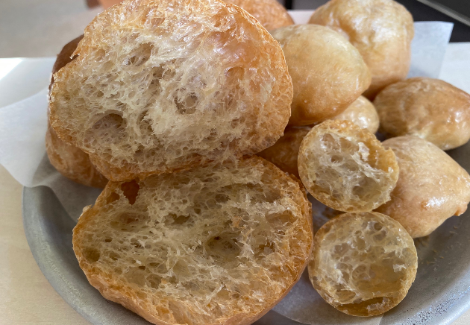
Gluten ball samples
Raw gluten
Baked gluten
Photographs courtesy of Barbara Monks @ https://thecookeryteacher.com/

Slide 29
Further supporting resources
Food – a fact of life
Baking bread presentation
Baking bread record sheet
Bread making – the theory fact sheet
Bread making experiment
Bread making fact sheet
Bread science lesson plan
Bread science worksheet
Dry heat presentation
Teachers will need to decide on the level of complexity of the tasks chosen, depending on age, stage and need, and considering progression.

Slide 30
Further supporting resources continued
The science of bread making teacher’s guide
The science of bread presentation
Types of bread presentation
Biological raising agents experiment
Gluten formation experiment
Resources around food science can be found here: 11-14 years, 14-16 years
Further information, support and resources around functional characteristics of ingredients can be found here 11-14 and 14-16.
Ingredients - functional characteristics Knowledge Organiser 11-14
Teachers will need to decide on the level of complexity of the tasks chosen, depending on age, stage and need, and considering progression.

Slide 31
Further supporting resources continued
External resources:
IFST - Protein formation
AQA video - Investigate the best type of flour for breadmaking
Resources around food science can be found here: 11-14 years, 14-16 years
Further information, support and resources around functional characteristics of ingredients can be found here 11-14 and 14-16.
Ingredients - functional characteristics Knowledge Organiser 11-14

Slide 32

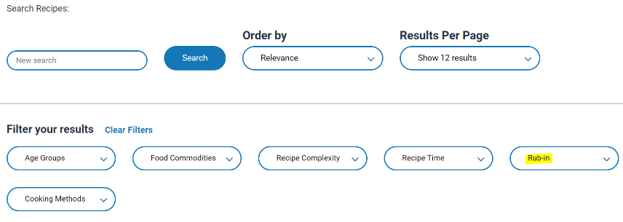
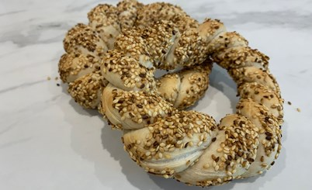
Gluten formation - recipes
The recipes below are useful idea for demonstrating gluten formation:
Wholemeal cottage loaf
Brilliant bread
Shortbread
ANZAC biscuits
Honey and walnut bread
Pizza wheels (yeast dough)
Hot cross buns
Go to the recipes section and filter Food Skills for more recipes.
Simit bread
Fruit plait
Pizza (yeast dough)
Chelsea buns
Naan bread
When demonstrating recipes, talk about the different types of flour and which recipes they would be most suitable for. Discuss gluten formation and the importance of kneading a dough.

Slide 33
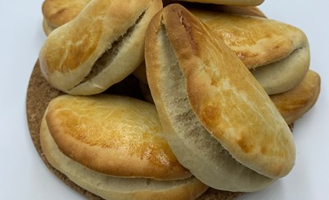
Gluten formation – quick recipes for shorter lessons
Quick bread buns
Quick Jamaican coco bread
Paska (Eastern European Easter bread)

Slide 34
Gluten formation
For further information, go to:
www.foodafactoflife.org.uk
This food science pack is one of a series of resources produced for the pHood Futures project, supported by the Royal Society of Chemistry.
This resource meets the Guidelines for producers and users of school education resources about food.

