Slide 1
Food skills, recipes and diversity African cuisines 01 March 2022

Slide 2
Housekeeping and overview
Turn off mobile phone (pop on vibrate)
You should have all your equipment and ingredients ready/handy
Get ready to cook!
Chat box – feel free to use to ask questions and share info/links and ideas
Camera on – we want to see your food skills
Help and direction (please don’t take as criticism!)
Feel free to ask questions and engage!
Feedback – it’s good to get your views!
Enjoy!
Good food hygiene and safety practices - are you ready to cook?
Long hair tied up.
Jumpers removed/long sleeves rolled up.
Nail varnish and jewellery/watches removed.
Thoroughly washed and dried hands.
Clean apron on.

Slide 3
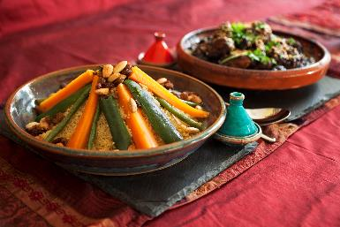
Welcome
As part of the British Nutrition Foundation’s work around a ‘modern, diverse food and nutrition education’ we asked students what was important to them about the recipes they cooked at school.
Students responded that they want dishes that are:
tasty, healthy, family/everyday recipes;
most significantly they want them to be dishes from around the world that are - modern, diverse and reflect different cultures.
The British Nutrition Foundation is grateful for the support from the All Saints Educational Trust for this work.

Slide 4


Introductions
A quick hello to the rest of the group!
@foodafactoflife

Slide 5
Session aims
During the session we will:
make two recipes from around the world that are new to Food – a fact of life;
use traditional ingredients and consider alternatives;
develop, acquire and secure practical food skills using recipes that are suitable and practical for schools and their budgets, promote healthier eating, reflect more global cuisine, and encourage dialogue around culture and inclusivity;
consider planning and implementing practical activities in the secondary classroom;
demonstrate good food hygiene and safety practices;
provide links to Food – a fact of life.

Slide 6
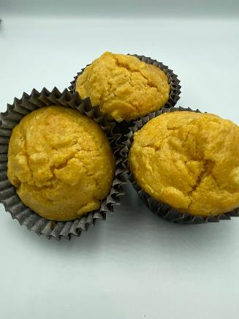
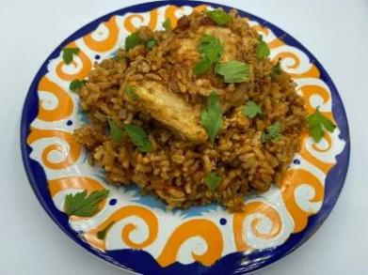
Programme
16.45 Registration
17.00 Welcome and introductions:
Please be prepared to introduce yourself in the chat box
17.10 Practical food skills, recipes and diversity
17.20 Mealie bread: activity and review
17.50 West African Jollof rice with chicken: activity and review
18.25 Review and next steps
18.30 Finish – evaluation, certificate and voucher

Slide 7
Diversity and inclusion in Schemes of Work
Know your pupils!
Know and understand the local community, e.g. what are the challenges that young people are facing?
Understand what young people (and their families) want to make in food lessons. Not just cakes though!
Ensure recipes and practical activities build on knowledge and skill.
Incorporate different flavours, ingredients and culinary techniques and experiences to widen young people’s understanding of food and cultures around the world.
Encourage pupils to share their personal experiences around food culture, ingredients and recipes with the class or school community.
Consider healthy, sustainable diets – nutrition.org.uk
Did you know?
Some food and drink-related traditions are currently recognised by UNESCO and its Representative List of the Intangible Cultural Heritage of Humanity

Slide 8
Context
Learning intent
Food skills
Lesson length
First … consider the following …
Remember pupil voice!
Then … choose recipes that pupils could make

Slide 9
Learning intent
What is the lesson for?
Aims: what will pupils be able to do? Broad terms. Apply knowledge to make informed decisions … Develop practical food skills …
Objectives: statements that define measurable outcomes. State the function of yeast in bread making; adapt and follow recipes; describe food hygiene messages
What do you want them to know/apply?
How will you know what they’ve learned? (Name, list, sort, describe, justify …)
What do you want them to be able to do?
How will they demonstrate this? (Chop, slice, grate, mix …)

Slide 10
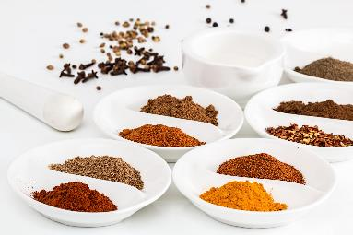
In the classroom
Consider the following:
time and budget available;
pupils - practical skills;
equipment available;
provision/availability of ingredients e.g. spices or herbs that may not be used often, vegetables that might not be readily available in your area;
involving the school/local community – there may be an ‘expert’ in a particular cuisine that could offer guidance and/or input to the lesson;
sharing the success of your pupils work through school social media, newsletters and special events such as open evening and options.

Slide 11
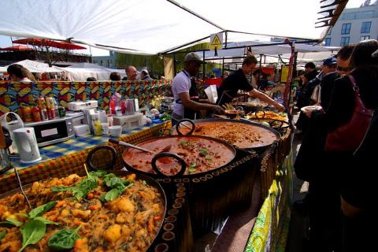
Generation Z and food culture
Globalisation has been changing the food we eat and the ways we eat those foods. But it is not new!
Food cultures are moving, and globalisation has made a wide range of cuisines more accessible.
Food culture is no longer tied down to where it originated from and can spread far and wide.
Trends:
Street food
Fusion food
Travel – trying wider variety of cuisines
Notes:
Gen Z = born in 1997 or later - makes up a quarter of all the people going out to eat – high spending power. Organics/sustainability/plant based all feature.
A strong theme in Gen Z eating habits is authenticity and exploring exciting flavours from all over the world. Some of this may come from growing up in the same households as Gen X and Millennial foodies.
Gen Z brought up as 'digital natives' - they see and experience food around the globe – heritage and authenticity are key words.
Food trade has played a significant role in the history of globalisation, as it has allowed for cultural exchange for thousands of years. From the transporting of spices along the Silk Road, to the potatoes being imported from the Andes to Ireland in 1589 by Sir Walter Raleigh.
e.g. Italian coffee culture – worldwide verses local culture e.g. snakes, spiders

Slide 12
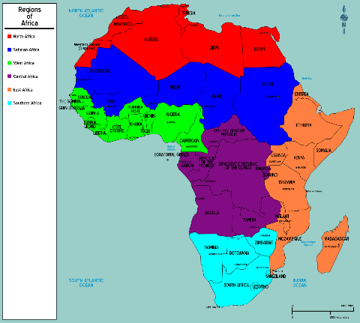
African cuisine
The African continent has 54 countries that all have their own unique culture and food determined partly by:
history of the region;
geography/topology;
climatic conditions.
The cuisines can be very broadly grouped into Central, Eastern, North, South and Western.

Slide 13
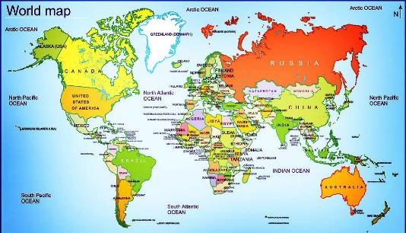
History
African cuisine has a long and complex history.
It is a blend of European, Asian and African cultures, and traditions.
There are many influences brought by traders, invaders and travellers from around the world.
For example:
Alegria, Tunisia and Morocco were all occupied by the French at different times.
The influence on their cuisine can be seen with baguettes a popular choice for breakfast.

Slide 14
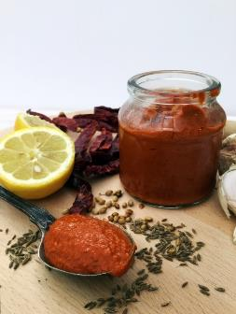
North Africa
North African cuisine is heavily influenced by regions around the Mediterranean Sea and is linked to ancient trade routes to Europe and India. Religious cooking and diet of Muslims and Coptic Christians also influenced North African cuisine.
Each region has its own seasonings. Some examples are:
Morocco's ras el hanout (or "head of the shop") includes 25 to 40 different ingredients, including cinnamon, black peppercorns, green cardamon, caraway, nutmeg and rosebuds. There are many different recipes!
Chermoula, a Moroccan marinade contains garlic, onions, mint, paprika and cumin.
Tunisia's harissa, a deep-red, hot table condiment with red chilies, cumin, garlic, tomatoes, vinegar and olive oil. Morocco and Algeria have milder versions.
Egyptians use baharat, which includes cinnamon, cumin, allspice and paprika, to season meats.
Notes:
North Africa was the crossroads of the early spice trade from the Far East to the West as well as from North to South. For example - caraway and saffron from the Arabs, mustard from the Romans, allspice and cayenne from the Americas, ginger from China, and cinnamon, black pepper and sugar from India, along with indigenous garlic and onions are all incorporated into north African cuisine.

Slide 15

West Africa
There is a diverse range of food and historical influences in the 16 countries that make up West Africa.
Although there are differences in counties the use of tomatoes, onions and chilli peppers as a base for many dishes is common.
Spices and herbs are used less in West Africa but the chilli pepper is used extensively.
Jollof rice (Benachin) is popular all over West Africa having originated in Senegal.
There are many recipe variations, but it is based on rice, tomatoes and tomato puree, onion and chilli peppers.

Slide 16
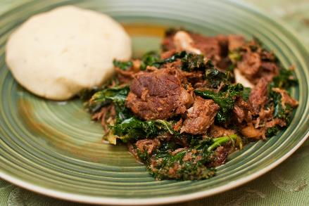
Central Africa
Central African cuisine is diverse and influenced by Portuguese and the Swahilis, a culture that is a combination of Yemeni, Bantu, Omani, and Indian.
The staple food in Central Africa consists of starches like cassava (also known as tapioca), potatoes, yams, and plantains.
Meat dishes (often goat and chicken) are often marinated and skewered, with thick sauces made with peanuts.
One of the famous dishes in the region is called fufu, made from fermented cassava. The mixture is used to make a soft dough and dipped into sauces or soups or eaten with stews.

Slide 17
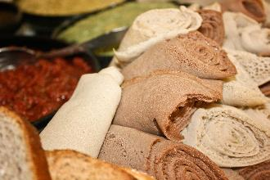
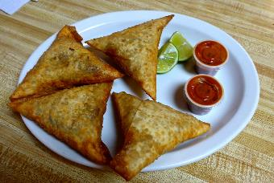
East Africa
East African cooking tends to focus on grains, slow-cooked stews, curries and dairy, which are flavoured with a variety of spices.
The cuisine is influenced by countries including Yemen, Oman and Egypt to the north as well as the Indian connection to the east.
A popular dish from Ethiopia is Injera, a fermented flatbread made with teff flour which is spongy, slightly sour and used as a sort of scoop to pick up other foods.
Sambusa are a popular Somali snack food similar to samosas and are often served at special occasions.
This Photo by Unknown Author is licensed under CC BY-NC

Slide 18
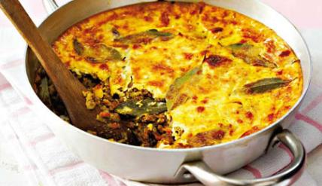
South Africa
South African cuisine is a unique fusion of many different external cultural influences. These include Dutch, French, Indian and Malaysian flavours and techniques.
One of the most significant influences is that of the Dutch that settled in South Africa in the 1600’s. They were joined by French Huguenots and German settlers which led to what is now known as Afrikaans style of cooking.
Another very important influence is that of the Malays who were brought to South Africa as slaves for the European settlers in the 17th, 18th and 19th centuries. A popular cuisine in the western cape known as Cape Malay.
Bobootie is a popular Cape Malay dish made with minced meat, simmered with spices, herbs and dried fruit, then topped with a mixture of egg and milk and baked until set.

Slide 19
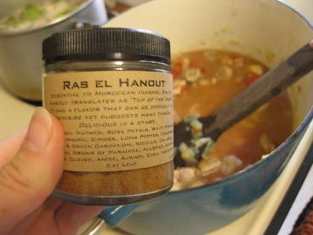
Ingredients
Check the list of ingredients for any potential allergens and consider alternatives. For more information on allergens.
Most Za'atar brands contain sesame seeds (an allergen) as an alternative use a blend of thyme, oregano and ground cumin.
Ras el hanout can be bought in supermarkets and is usually a blend of coriander, ginger, paprika, allspice, cardamon, mace, nutmeg, turmeric, cayenne, cloves, rose petals.
Harrisa is a hot paste which comes from the Maghreb area (NW Africa). It is made with chilli peppers, red pepper, garlic, coriander, cumin and fennel seeds plus lemon juice/vinegar and oil blended to make a paste.
Make up your own ‘spice mix’ for class use to save lots of individual jars that may not be used that often!
Notes:
The 14 allergens are: celery, cereals containing gluten (such as barley and oats), crustaceans (such as prawns, crabs and lobsters), eggs, fish, lupin, milk, molluscs (such as mussels and oysters), mustard, peanuts, sesame, soybeans, sulphur dioxide and sulphites (at a concentration of more than ten parts per million) and tree nuts (such as almonds, hazelnuts, walnuts, brazil nuts, cashews, pecans, pistachios and macadamia nuts).

Slide 20
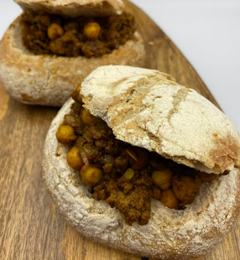
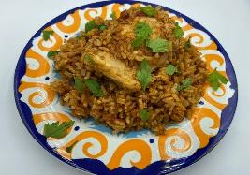
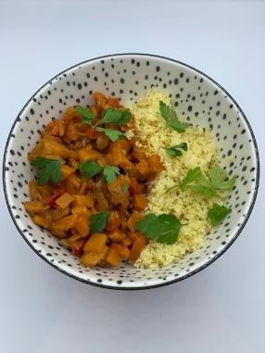
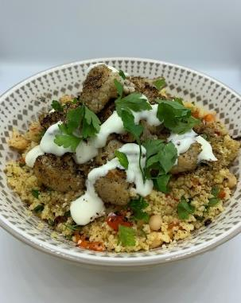
The recipes
Recipes that will be available on the Food – a fact of life website:
Algerian meatballs
Black bean and red pepper shakshuka
Bunny chow
Jollof rice with chicken
Mealie bread
Roasted vegetable and chickpea tagine
Vegetable tagine with couscous
North African style za’atar roast cauliflower and couscous salad
Notes:
Origins:
Algerian meatballs -
Shakshuka – North Africa (Morocco some dispute this as Yemen)
Bunny chow – South Africa
Jollof – West Africa (Gambia, Senegal, Ghana)
Mealie – South Africa
Tagine – Morocco

Slide 21

Mealie bread
Why are we doing this?
Learning in lesson: focus on skill/knowledge, not recipe.
Quick medium complexity recipe from a world cuisine that would work well in the secondary classroom.
Made and cooked within an hour, ideal for shorter lessons.
Demonstrates a wide range of basic food skills.
Uses ingredients that are easy to source, inexpensive and mostly stored at ambient temperatures.
Nutrition science: Starchy carbohydrates in the diet.
Food science: Chemical raising agents, the effect of cooking (coagulation, dextrinisation).
Maths: Weighing, measuring, dividing, time, temperature.
English: Reading and following a recipe, following written and verbal instructions.

Slide 22
Mealie bread
Ingredients
30g butter or reduced fat spread
2 eggs
340g can sweetcorn
120ml milk
180g plain flour
30g cornmeal
2 x 5ml spoons baking powder
30g sugar
1 x 5ml spoon salt
½ x 5ml spoon paprika
Method
1. Preheat the oven to 180°C or Gas mark 4. Grease the loaf tin, or line with
greaseproof paper, or place 8 muffin cases in a muffin tray.
2. Prepare the ingredients:
melt the butter or spread;
crack eggs and lightly beat with a fork;
drain the canned sweetcorn.
3. Place half the corn and milk in a blender or food processor and blitz until a coarse
mixture is formed.
4. Add the remaining corn and pulse the mixture 1 or 2 more times to leave most of the
corn kernels whole.
5. Place flour, cornmeal, baking powder, sugar, salt and paprika into the mixing bowl
and mix together.
6. Add the sweetcorn mix, melted butter/spread and beaten eggs to the flour mix and
combine until a thick mixture is formed.
7. Place the mixture in the loaf tin or divide evenly between the muffin cases.
8. Bake the loaf for 30-35 minutes or the muffins for 20-25 minutes.
Notes:
For a diary-free mealie bread - substitute the butter and milk with plant-based versions.

Slide 23
Mealie bread - review
Skills and knowledge developed and demonstrated | Practicalities in the secondary classroom | Alternatives – ingredients, cooking methods …
Practical food skills: weighing, measuring, melting, blitzing, mixing baking
Nutrition science: starchy carbohydrates in the diet
Food science: the effect of cooking: coagulation dextrinisation
Sensory science: testing, tasting and evaluation.
Maths: weighing, measuring, dividing, time, temperature.
English: reading and following a recipe, following written and verbal instructions.
Ingredients (purchase, storage, providing)
Equipment – blender/processor
Demonstration area
Baking (safe use of oven)
Dividing evenly between muffin cases
Different flours – e.g. wholemeal, seeded
Use 'polenta' instead of cornmeal
Alternative spices/herbs - chilli powder, cayenne pepper,
chopped fresh basil
Demonstrate the preparation of fresh corn on the cob
Gluten free – gluten free SR flour or cornmeal gives a denser texture
Steaming rather than baking
Notes:
Cornmeal v polenta –
Cornmeal is made by grinding dried corn kernels into one of three textures: fine, medium, and coarse.
Polenta is really a dish, not an ingredient, from northern Italy. It refers to a 'porridge' made from coarsely ground cornmeal. Polenta is usually made from yellow corn.

Slide 24

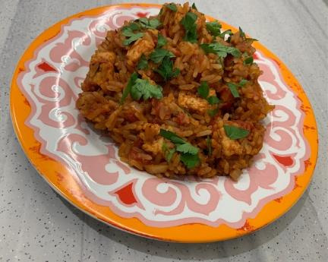
West African Jollof rice
Why are we doing this?
Learning in lesson: focus on skill/knowledge, not recipe.
Quick medium complexity recipe from a world cuisine that would work well in the secondary classroom.
Made and cooked within an hour, ideal for shorter lessons.
Demonstrates a wide range of basic food skills but can be extended to allow for differentiation.
Uses ingredients that are easy to source, inexpensive and stored at mostly ambient temperatures.
Nutrition science: Starchy carbohydrates and meat/alternative proteins in the diet.
Food science: Heat transfer, denaturation, Maillard reaction.
Maths: Weighing, measuring, time, temperature.
English: Reading and following a recipe, following written and verbal instructions.

Slide 25
West African Jollof rice with chicken
Ingredients
1 small onion
Spray oil
2 chicken thigh fillets
½ x 5ml spoon ground ginger
½ x 5ml spoon cinnamon
½ x 5ml spoon dried thyme
¼ x 5ml spoon cayenne pepper
Black pepper
150g easy cook white rice
1 x 400g can chopped tomatoes
1 x reduced salt chicken stock cube
1 bay leaf (optional)
Optional - 1 x 15ml spoon parsley for garnish
Method
1. Prepare the ingredients:
peel and chop the onion;
chop the parsley (if using).
2. Add the spray oil to a large saucepan and gently fry the onions and chicken fillets
for 5-6 minutes until the onions are soft and the chicken browned.
3. Remove the chicken and place on a plate.
4. Add the ground ginger, cinnamon, thyme and cayenne pepper to the pan. Season
with black pepper. Stir well and cook for 1 minute.
5. Add the rice and stir.
6. Add the canned tomatoes.
7. Crumble in the stock cube and add 200ml boiling water. Stir well.
8. Return the chicken to the pan.
9. Add the bay leaf, if using.
10. Bring to the boil and then reduce to a simmer.
11. Cook for 15 minutes until the rice is tender and the chicken cooked.
12. Remove the bay leaf.
13. Garnish with chopped parsley, if using, and serve.

Slide 26
West African Jollof rice - review
Skills and knowledge developed and demonstrated | Practicalities in the secondary classroom | Alternatives – ingredients, cooking methods …
Nutrition science: starchy carbohydrates and meat/alternative proteins in the diet.
Food science: heat transfer, denaturation, Maillard reaction.
Sensory science: testing, tasting and evaluation.
Maths: weighing, measuring, time, temperature.
English: reading and following a recipe, following written and verbal instructions.
Storing, handling and cooking raw meat
Hand washing
Safe use of the hob
Safe storage of cooked rice
Extend: joint a chicken
Different varieties of rice: use brown rice for added fibre – cook for 20-25 minutes
Use chilli powder (or fresh)
Smoked paprika gives extra flavour
Show the pupils fresh root ginger and how to prepare
Serve with traditional (Nigerian) sautéed plantain
Vegetarian - use vegetable stock cube and add tofu or meat substitute if required
Party rice – cook for longer to get a ‘crispy’ bottom

Slide 27

Food – a fact of life: How can we help?
Food – fact of life website.
Resources for 3 – 16 years.
Progressive approach.
Supporting teaching about healthy eating, cooking, where food comes from.
Curriculum compliant.
Tried and tested recipes.
My dashboard – store collections of recipes and resources in your own online area.
Personal and professional development (PPD) for teachers.
www.foodafactoflife.org.uk

Slide 28

Good practice guidance
Characteristics of good practice in teaching food and nutrition education in primary and secondary schools, as well as supporting pupils with additional needs.
Guides to help food and nutrition teachers across the UK to become even better teachers. The guides exemplify characteristics of good practice.
There are also free online training courses based on the ‘Characteristics’ guides.
https://www.foodafactoflife.org.uk/professional-development/ffl-training/

Slide 29
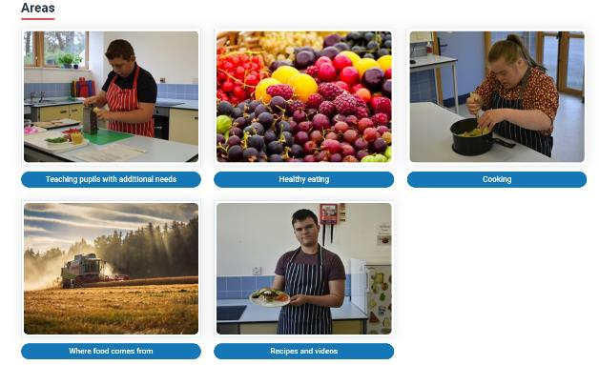
Resources to support pupils with additional needs
A framework and structure for teaching around the key themes of Healthy eating, Cooking and Where food comes from.
Nine key areas.
All resources fully editable.
Peer-to-peer recipe videos and recipes with Widgit© Symbols.
New! Resources to support developing skills for independent living.

Slide 30
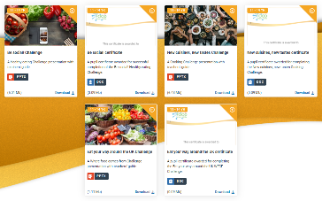
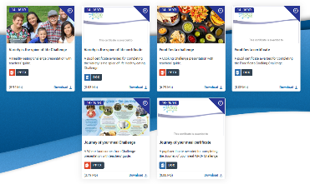
Challenge activities
The Challenges cover Healthy eating, Cooking and Where food comes from and provide a wide range of activities that teachers can select depending on their pupils’ needs, age and abilities, and the time available.
there are 12 Challenges developed to be used with nursery, primary or secondary pupils;
each Challenge presentation comprises:
slides to present the Challenge to the class, including images, information and questions/tasks to stimulate pupil discussion and planning;
a teachers' guide with opportunities for learning and a variety of pupil activities that can be completed individually or in groups.
11-14 years and 14-16 years

Slide 31
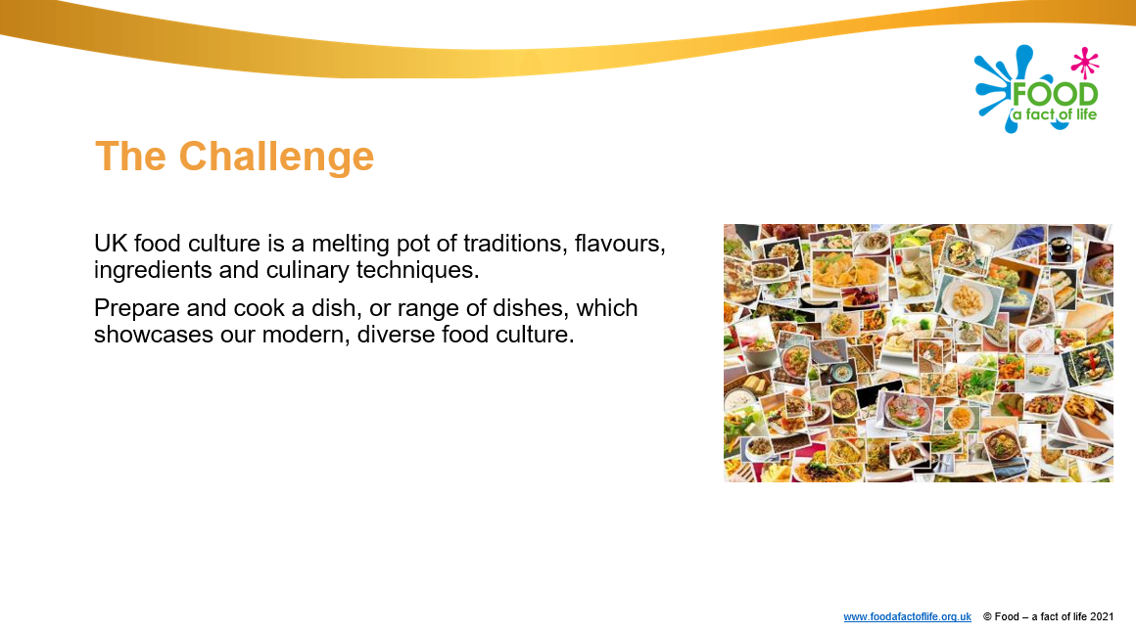
Diverse food culture Challenge
11-14 years and 14-16 years

Slide 32

Whole school support
Encouraging a whole school approach– food policies, provision, breakfast clubs and healthy lunchboxes.
Parental engagement activities and resources – breakfast, eat well, healthy lunchboxes, healthy hydration, physical activity and sleep.
Curriculum, qualifications and frameworks.
Guidelines for producers and users of school education resources about food.
BNF Healthy Eating Week 13-17 June 2022 Register now!
Careers in food.

Slide 33

Professional development
Training (conferences, workshops, webinars, online modular)
PPD Toolkit (primary and secondary) – your professional development, good practice, room design)
Teaching and learning – planning and teaching; teacher knowledge and skills; resources; curriculum
PPD newsletter – sign-up!

Slide 34
Other FFL resources
Classroom resources and activities | Teaching and learning | Personal and professional development (PPD)
Bread activity pack Fibre activity pack Harvest activity pack Knowledge organisers 11-14 and 14-16 Nutritional analysis Quizzes 11-14 Quizzes 14-16 Remote learning resources Videos – cooking Videos – where food comes from | Good food hygiene and safety practices Planning sheets Resources and presentations Resources to support UK examination specifications Schemes of Work Teaching and learning videos Practical food skill progression and complexity rating | FFL training PPD toolkit Schemes of Work and lesson planning – advice and support Teacher knowledge and skills
Links to resources that focus on topics covered in today’s workshop can be found in your joining instructions.

Slide 35
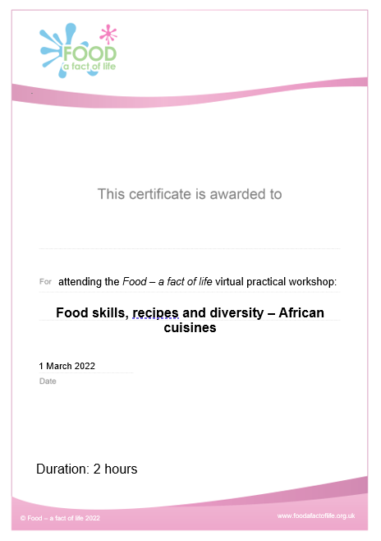
Last words ...
Review of training
Evaluation – a link will be sent to you. When completed …
Personalised certificate – will be emailed to you
Voucher – will be sent to you

Slide 36
Thank you for joining!
For further information, go to:
www.foodafactoflife.org.uk

