Slide 1
Fantastic fish – nutrition, preparation and cooking
22/02/23

Slide 2
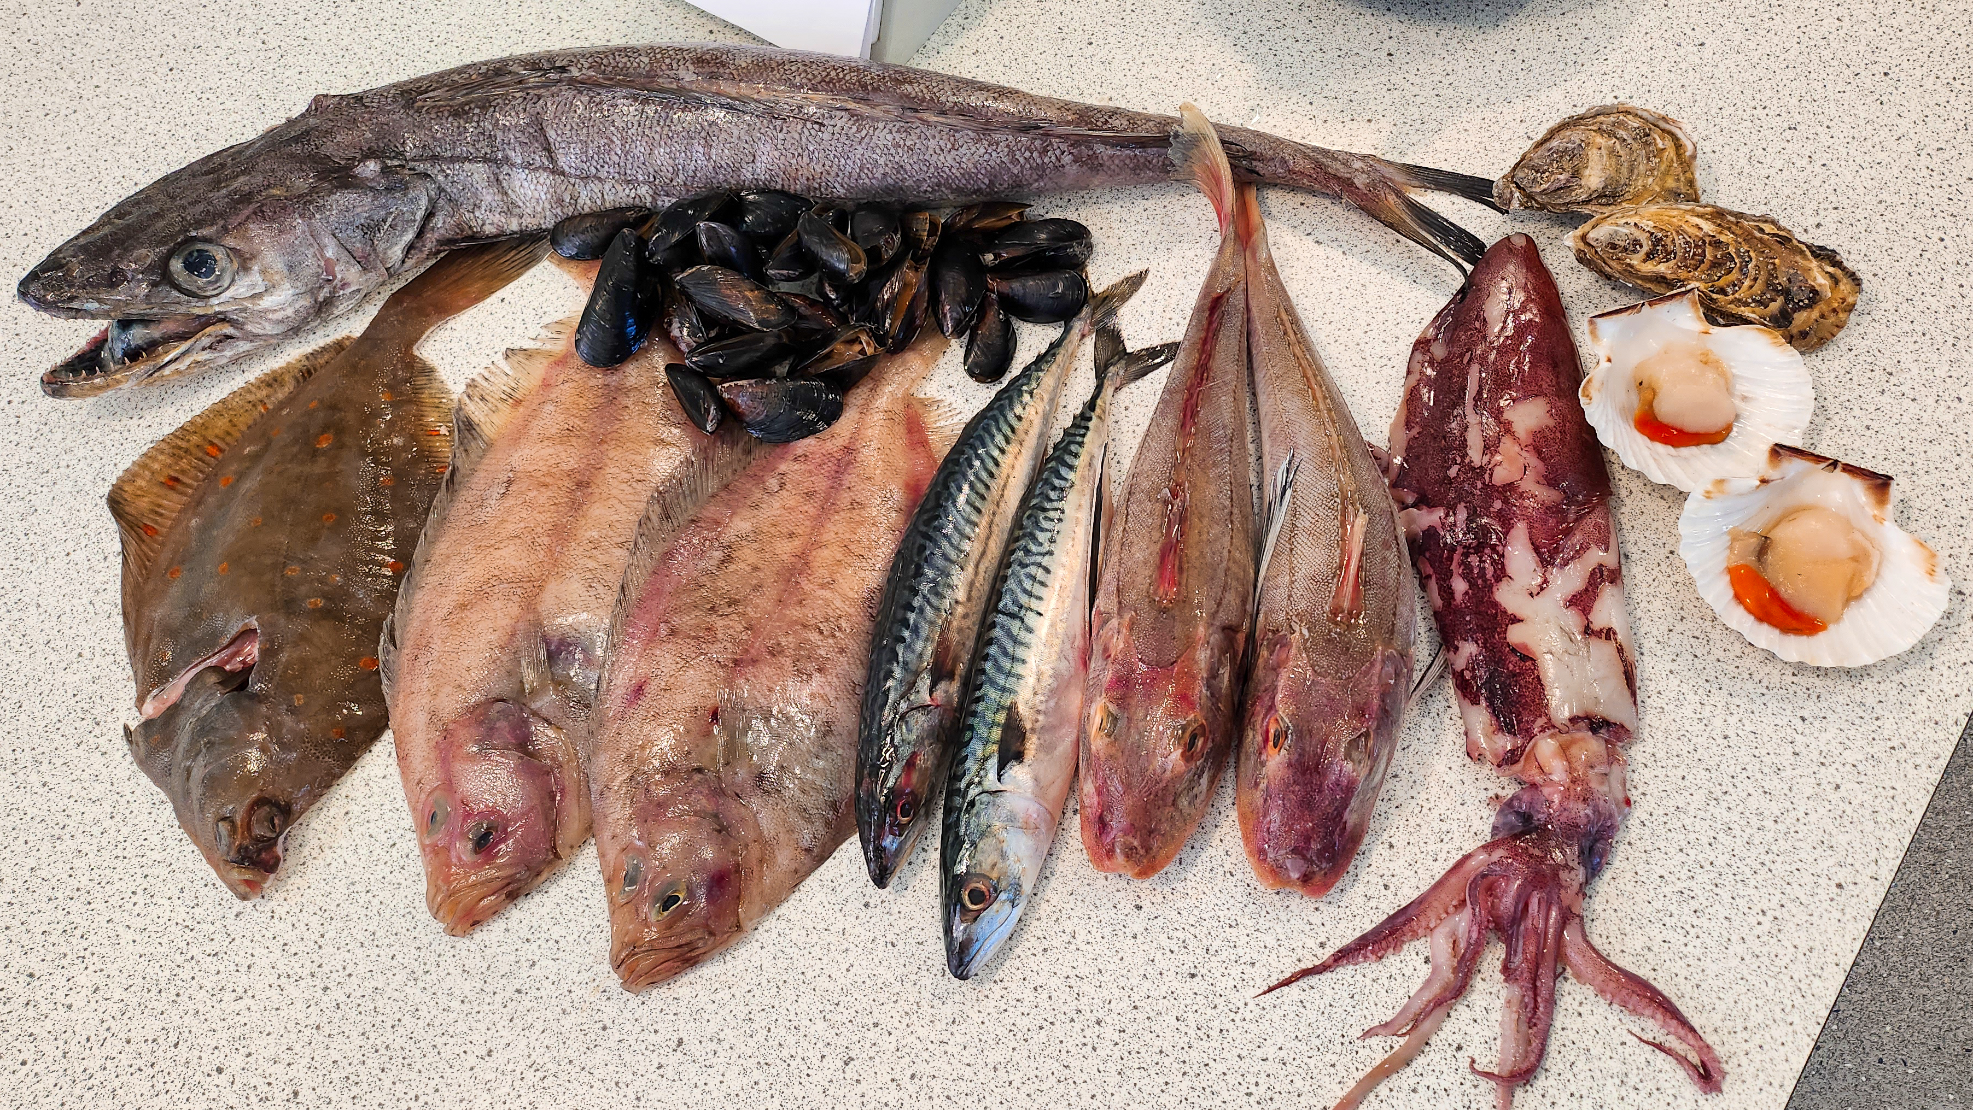
Covered in today’s webinar
The recommendations for eating fish and what counts.
The nutritional benefits of eating fish.
How much fish are we eating?
Types and varieties of fish and shellfish.
How can we eat fish and shellfish more sustainably?
Fish preparation and cooking.
Links to Food – a fact of life resources.
Sources of further information and support, including the free Fish Hero programme, supported by the Fishmongers’ Company Charitable Trust.

Slide 3
Fish and shellfish – nutrition and sustainability

Slide 4
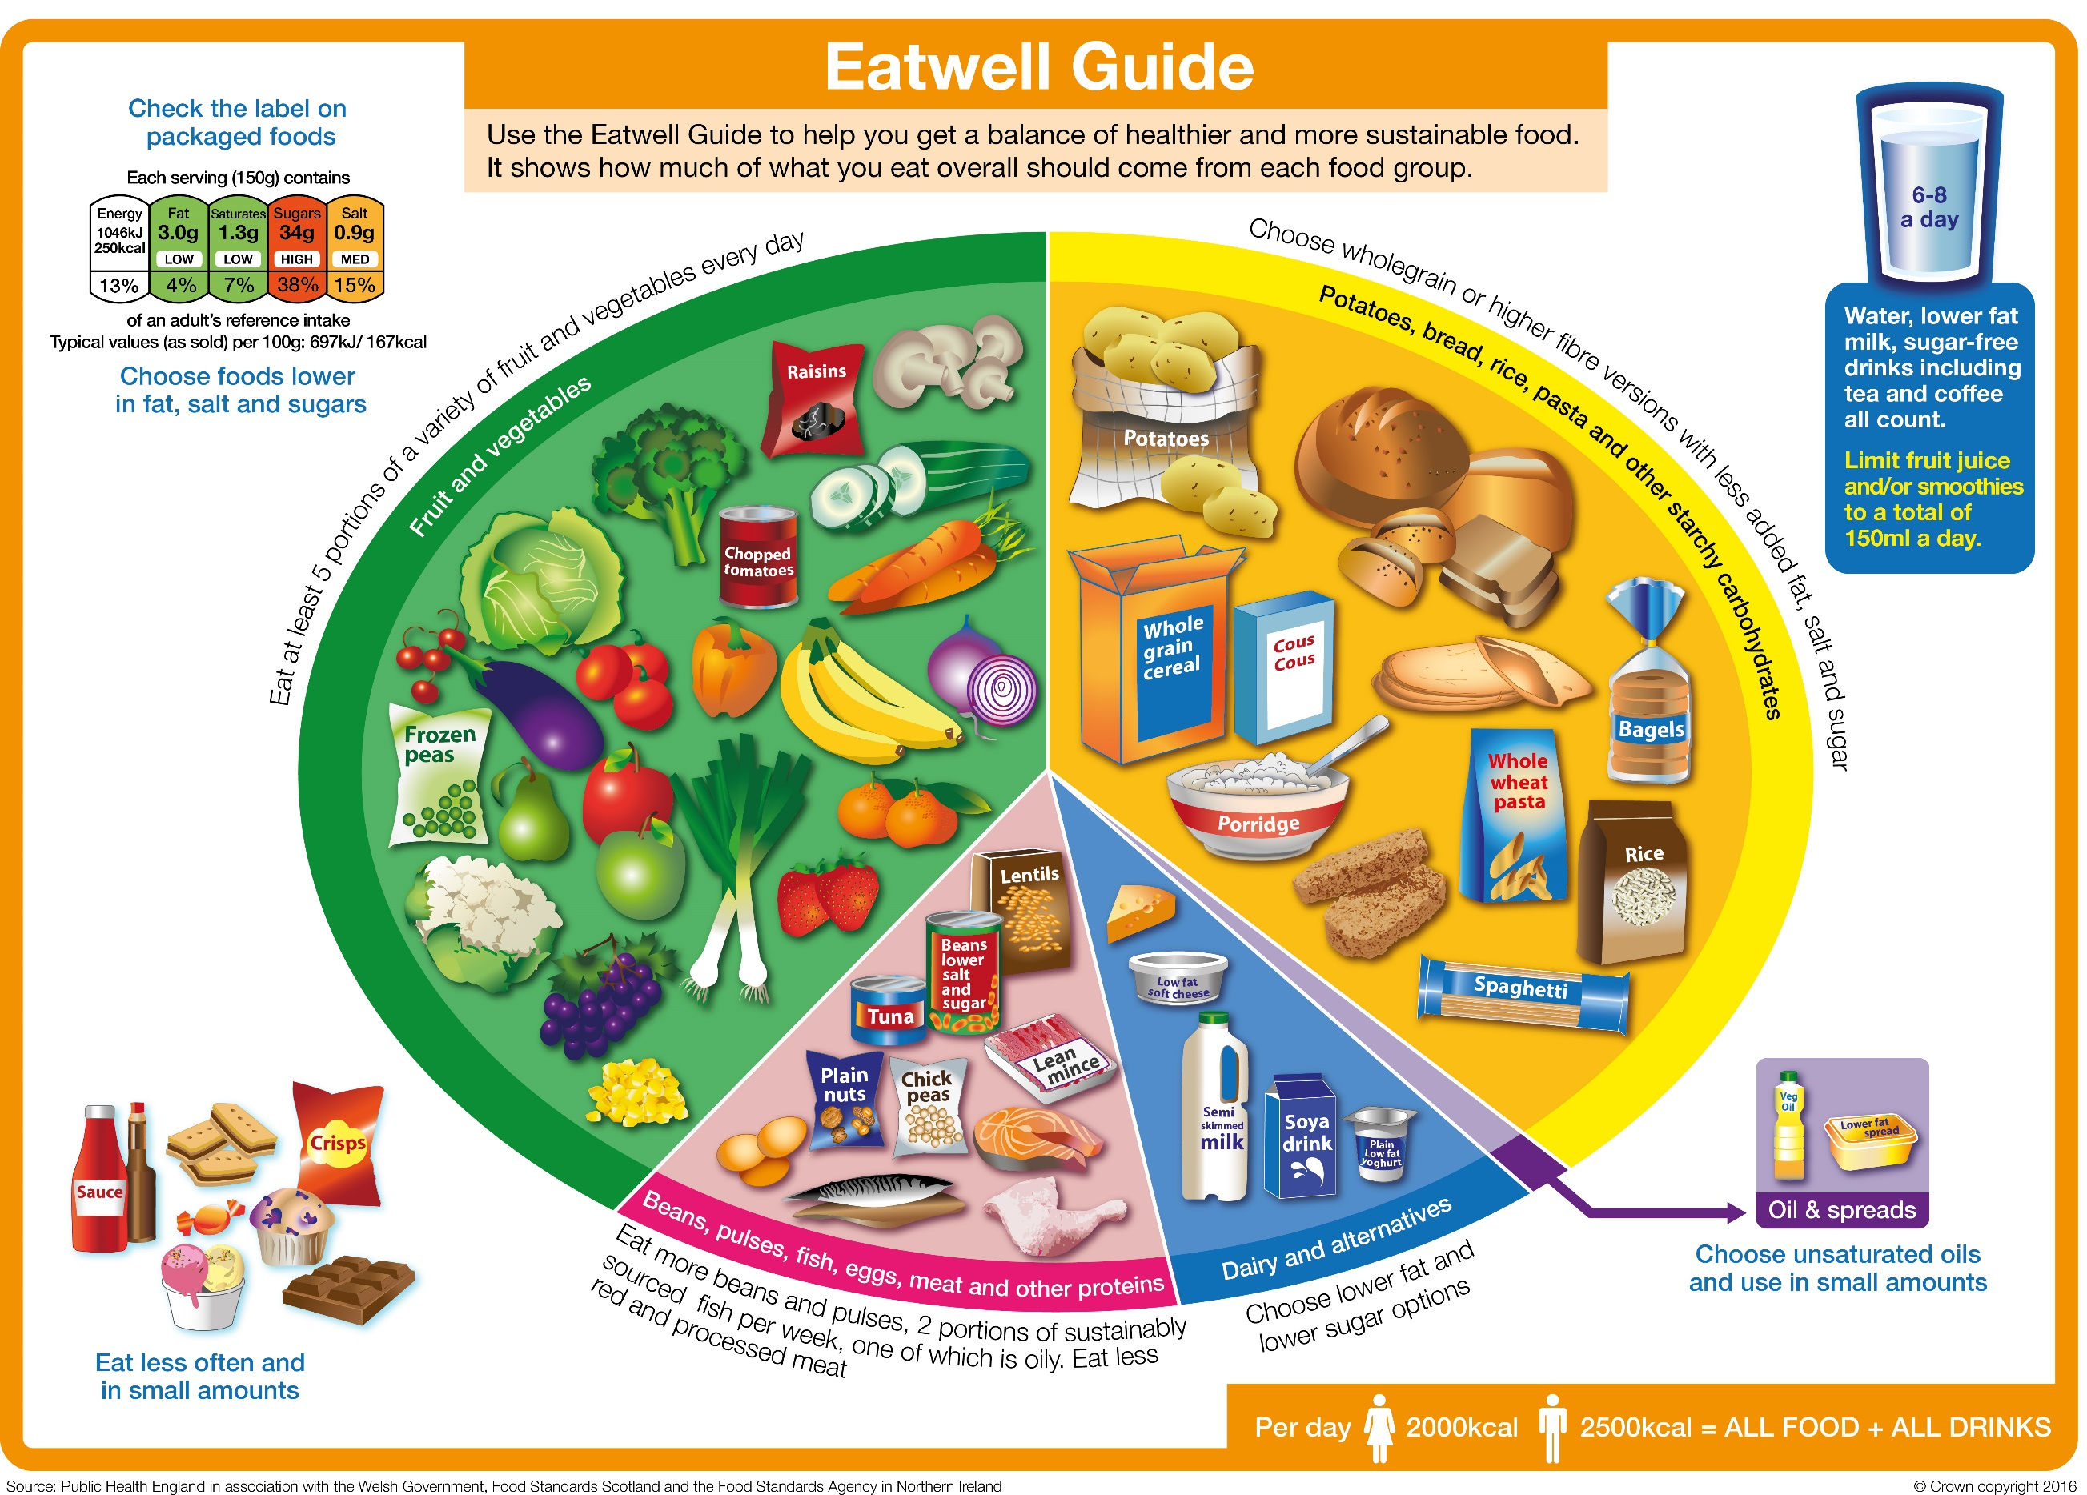
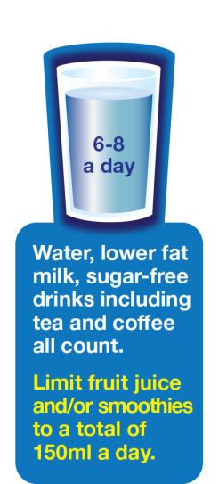
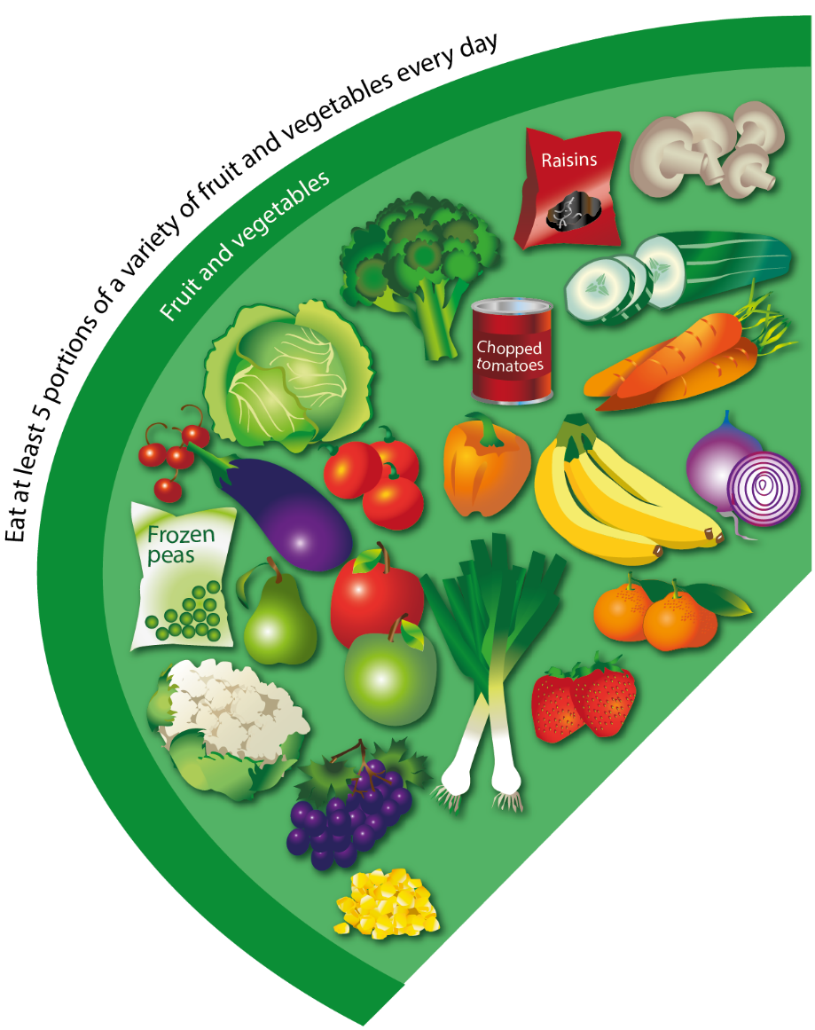
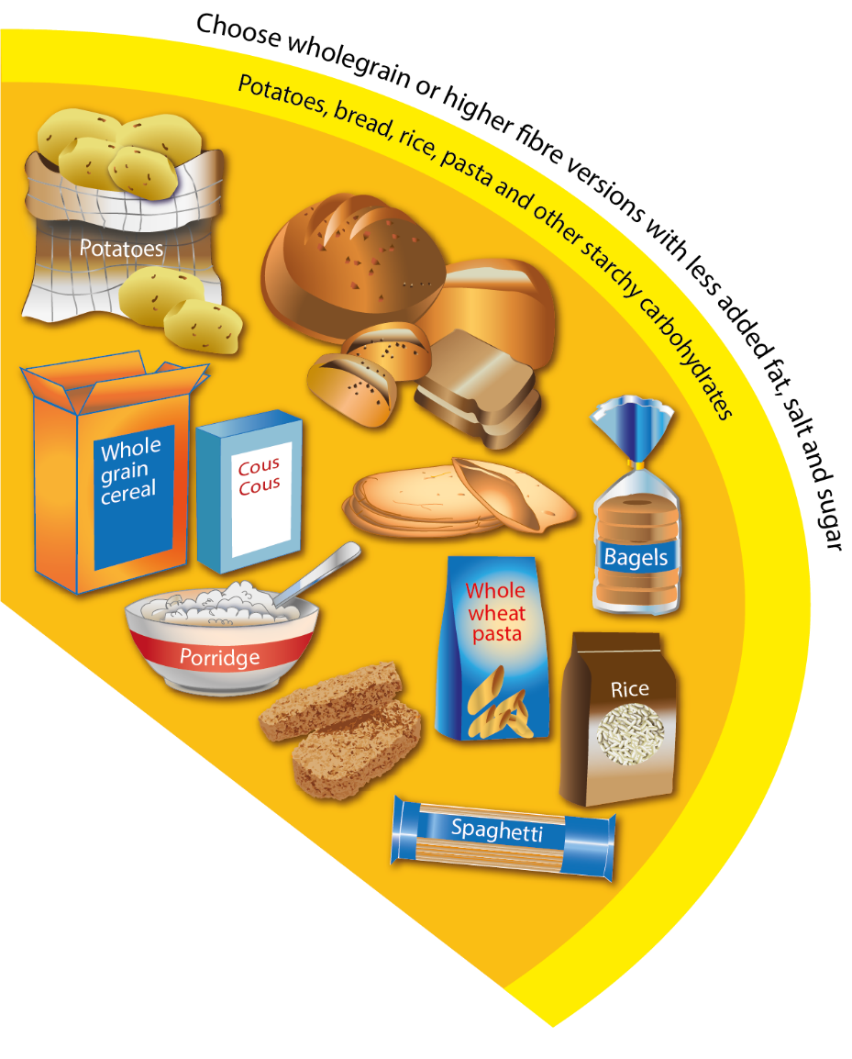
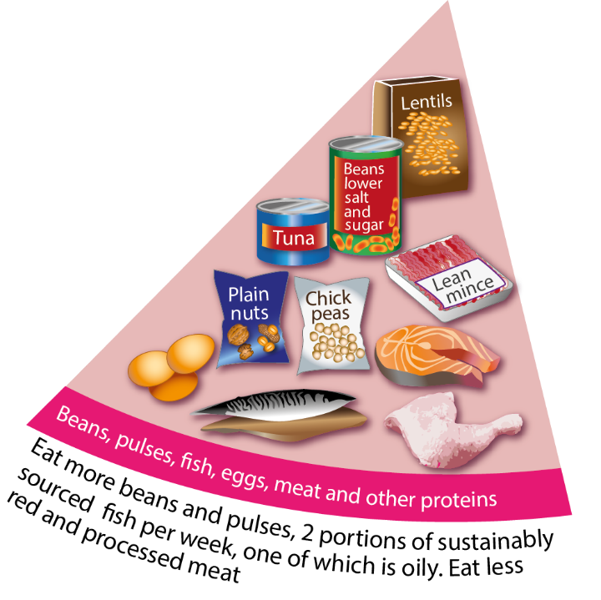
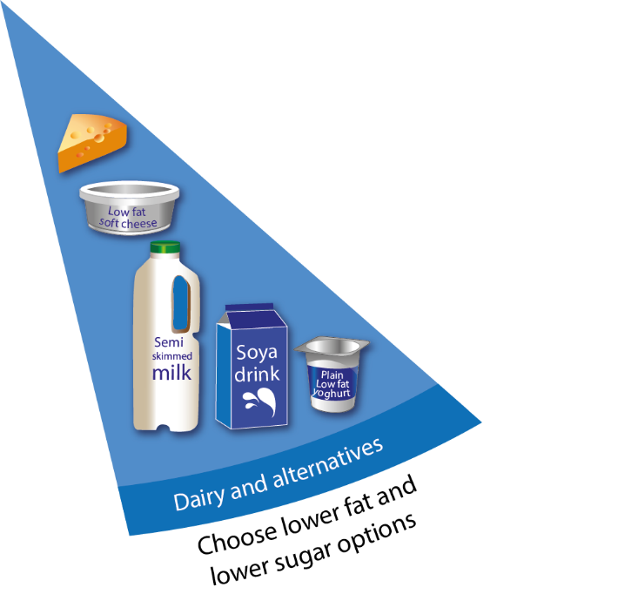
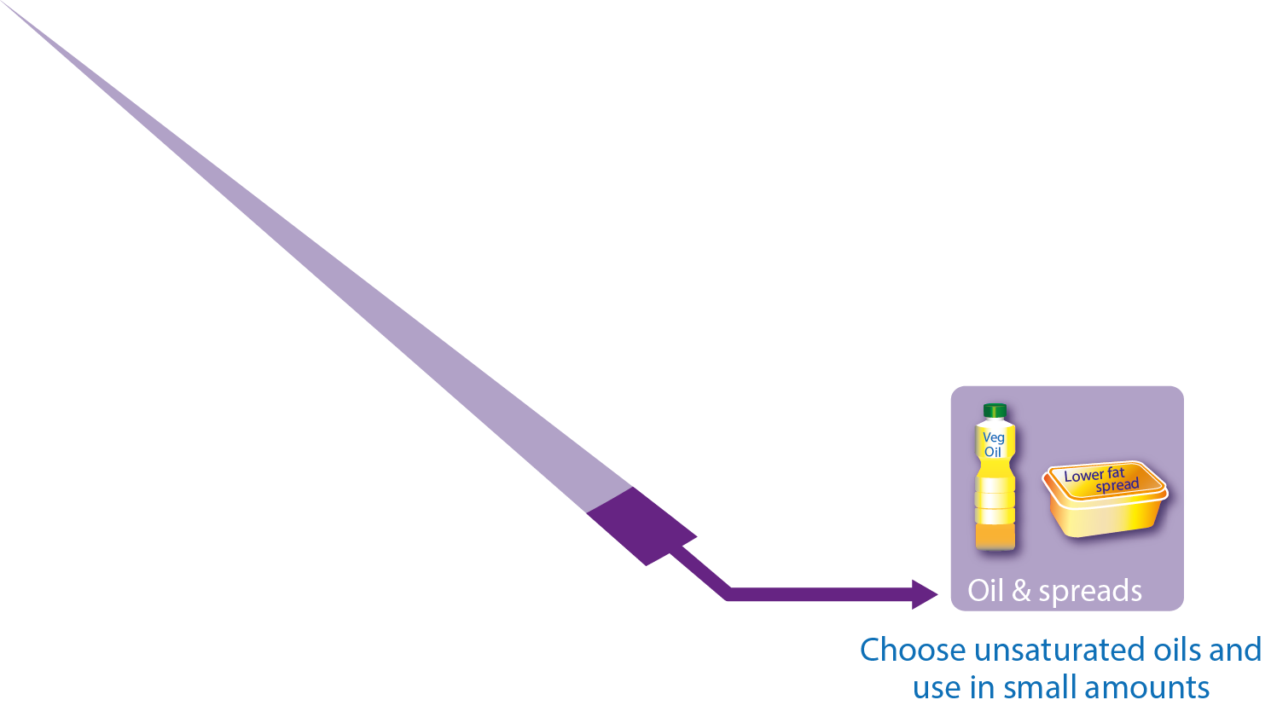
Fish in the diet
Fish is a popular food in many cultures, although many people in the UK do not consume as much fish as is recommended.
Eating a wide variety of fish and buying fish from sustainable sources can help to ensure there are enough fish to eat now and in the future.

Slide 5
Fish in the Eatwell Guide
Fish is in the Beans, pulses, fish, eggs, meat and other proteins food group in the Eatwell Guide.
Around one-sixth of the food that people consume should come from this group in the diet.
It is recommended to consume two portions (one portion is 140g) of sustainably sourced fish per week, one of which should be oily.

Slide 6
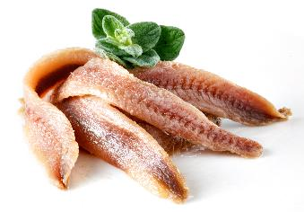
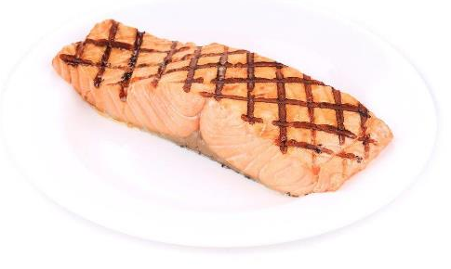
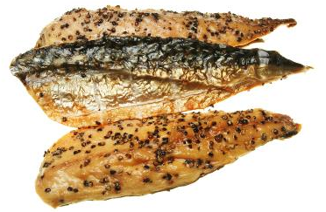
How much fish is eaten in the UK?
No age group in the UK currently meets the recommended intake for fish – low intakes of oily fish is a particular concern.
On average, UK adults eat 56g of oily fish per week and children (under 18 years of age) eat less than 20g per week¹.
¹ NDNS Year 9-11

Slide 7
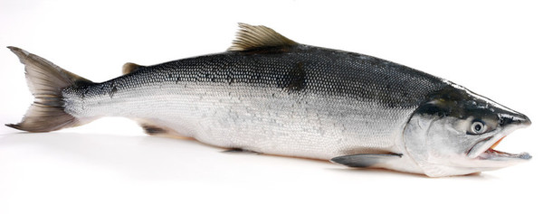
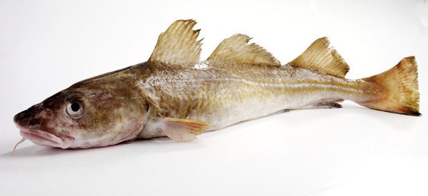
Nutrients provided by fish
Fish provides a range of nutrients, including:
Omega-3 fats (in some fish);
protein;
vitamin D (in some fish);
vitamins B3 (niacin), B6 and B12
selenium;
iodine.
This salmon is high in Omega-3 fats and vitamin D, as well as protein and some B vitamins
Cod is lower in Omega-3 and vitamin D than salmon, but still contains other nutrients and is also high in iodine

Slide 8
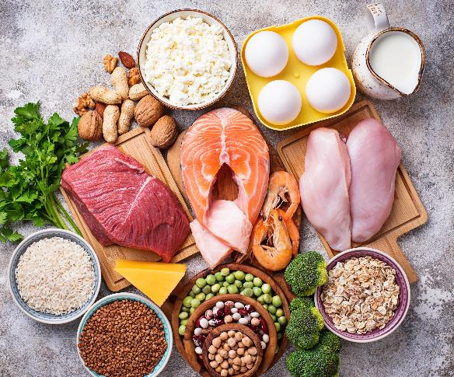
Protein
Fish is an important source of protein globally.
In addition, white fish are relatively lean sources of protein, and oily fish, whilst containing more fat, contain Omega-3 fatty acids and other unsaturated fats.
The Eatwell Guide recommends at least 2 portions of fish per week (140g per portion).
140g of baked fish provides around 60-70%* of the adult Recommended Intake for protein.
*Plaice = 59.6% Cod = 66.9% Salmon =70.6%

Slide 9
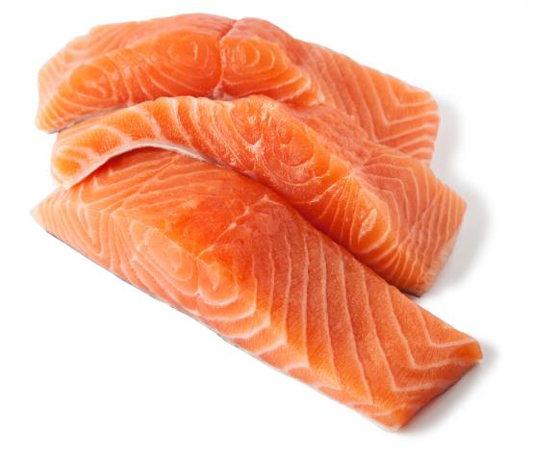
Omega-3 fatty acids
Oily fish, such as salmon or sardines, is high in Omega-3s fatty acids, which can help to maintain good heart health.
Most people need to eat more oily fish than they are currently consuming.
Salmon is an example of an oily fish, meaning it contains Omega-3
NHS Fish and shellfish nutrition

Slide 10
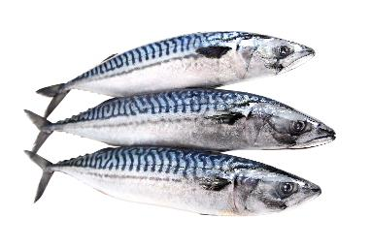
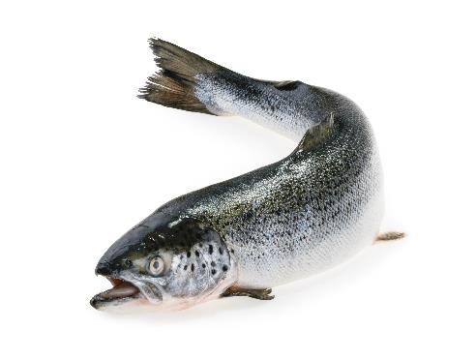
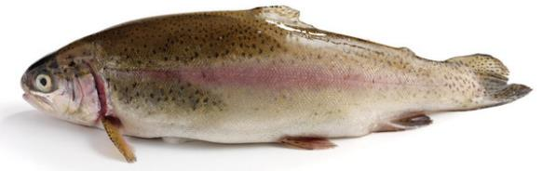
Fish containing Omega-3
Oily fish (contain Omega-3)
Herring
Mackerel
Salmon
Sardines
Sprats
Trout
Anchovies
Mackerel
Salmon
Rainbow Trout

Slide 11
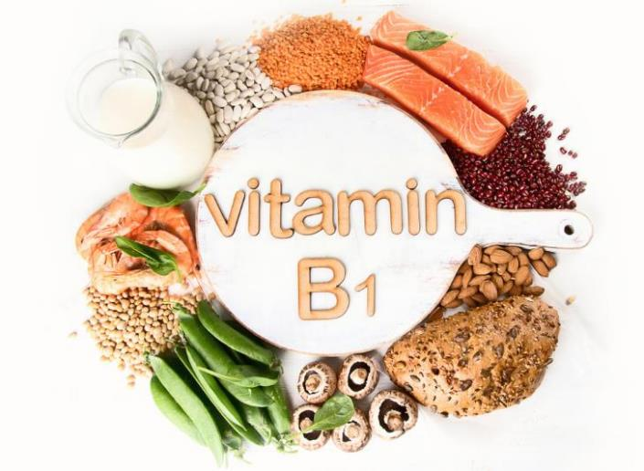
Vitamins in fish and shellfish
Fish and shellfish contain many vitamins and minerals.
Oily fish contain vitamin D, which helps maintain a healthy immune system, strong bones, muscles and teeth.
They also contain a mixture of B vitamins, which perform a number of important roles in the body. For example, vitamin B1 (thiamin), which can be found in salmon, helps keep the brain and heart working normally.
Fish provides B vitamins, such as vitamin B1 (thiamin).
BNF: Vitamins and Minerals
GB Register of Health Claims

Slide 12
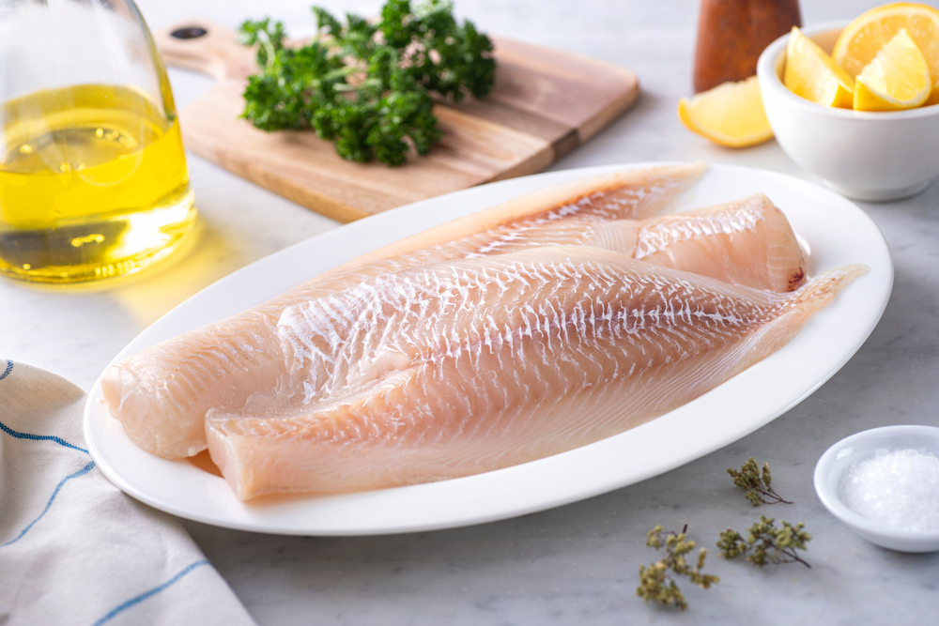
Minerals in fish and shellfish
Minerals in fish and shellfish include iron, zinc and copper, as well as iodine and selenium. Iodine helps with normal growth in children, while selenium helps to maintain hair and nails.
Iodine is higher in fish like haddock and cod, whilst selenium is higher in tuna, sardines and mackerel.
Fish can also provide some calcium (in small fish where bones are also eaten) and phosphorus.
BNF: Vitamins and Minerals
GB Register of Health Claims

Slide 13
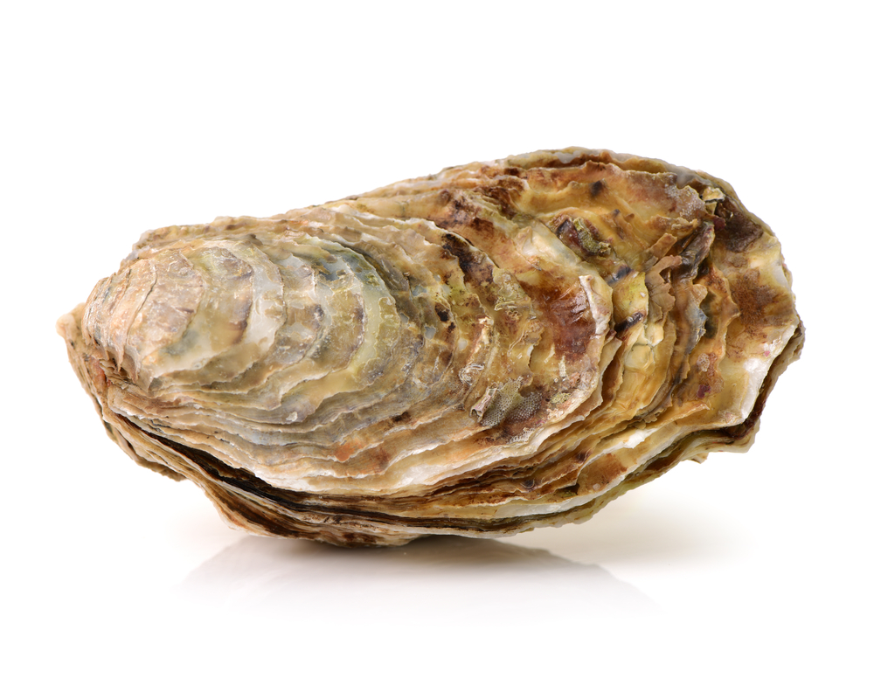
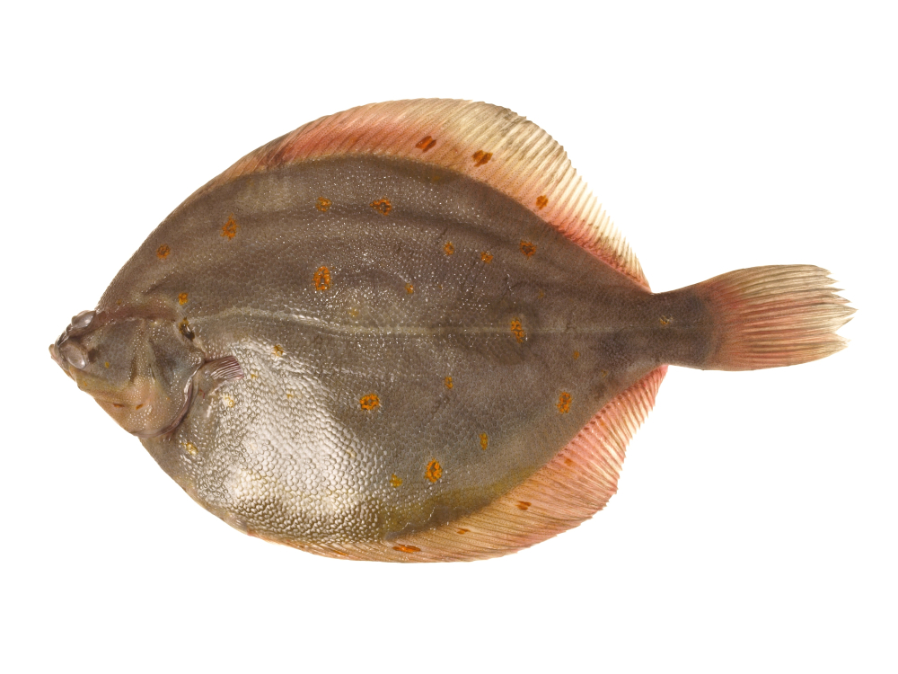
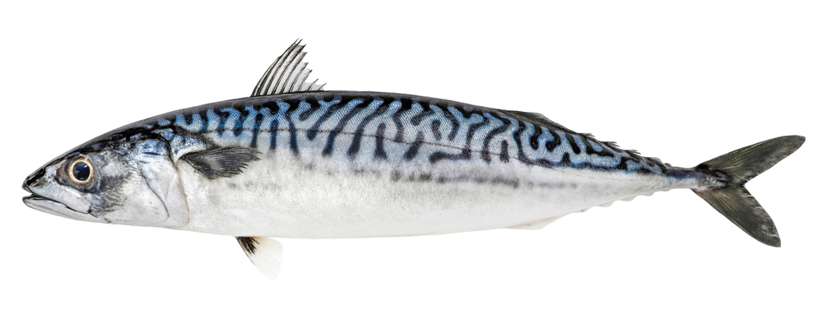
Examples
Oyster (weighed without shell)
Mackerel (grilled fillet)
Plaice (baked fillet)
High in
Source of
High in
Source of
High in
Source of
Protein
Vitamin B₁₂
Iron
Copper
Zinc
Selenium
Iodine
Vitamin D
Niacin (B₃)
Biotin (B₇)
Calcium
Manganese
Protein
Vitamin D
Niacin (B₃)
Vitamin B₁₂
Selenium
Omega-3
Riboflavin (B₂)
Vitamin B₆
Iodine
Potassium
Protein
Niacin (B₃)
Vitamin B₁₂
Biotin (B₇)
Selenium
Thiamin (B₁)
Vitamin B₆
Iodine

Slide 14

Sustainability
Globally, average per capita fish consumption has more than doubled during the last half a century, placing pressure on our seas and oceans.
80% of the seafood we eat in the UK comes from just 5 different species – cod, haddock, salmon, tuna, and prawns
The Marine Conservation Society’s Good Fish Guide can help us make more sustainable choices. It uses a traffic light sustainability rating, with the ‘best choice’ (green) given a ‘1’, and ‘fish to avoid’ (red) given a ‘5’.
For more details, see the ‘Plenty more fish in the sea?’ blog by Dr Simon Steenson on the British Nutrition Foundation website
Notes:
Cod – UK stocks are not currently at a sustainable level, but European hake is a more sustainable choice to cod, which has a similar meaty, flaky texture.
Tuna – there are lots of different types of tuna and their sustainability can vary. Why not try mackerel from the south-west of England, ideally caught by hook and line (check the label)? Mackerel is also a source of long-chain omega-3 fats thought to benefit heart health.
Prawns – prawns are farmed or caught all over the world, and some more sustainably produced options are available, but why not try UK rope-grown mussels instead? These are often considered one of the most environmentally sustainable choices you can make as they help clean the water as they grow and don’t need to be given any feed.
Salmon – stocks of Atlantic wild salmon are not in a good state, and farmed salmon may also be subject to environmental concerns although farmed salmon with organic or Aquaculture Stewardship Council (ASC) labels may be better. Farmed rainbow trout is widely available and has a similar texture to salmon, but a slightly stronger flavour (you might find you prefer this!).
Haddock – some sources can be more sustainable, such as haddock from the North Sea and Iceland. But if you fancy a bit of treat, you can also try Dover sole from the western English Channel (Cornwall) for something different.

Slide 15
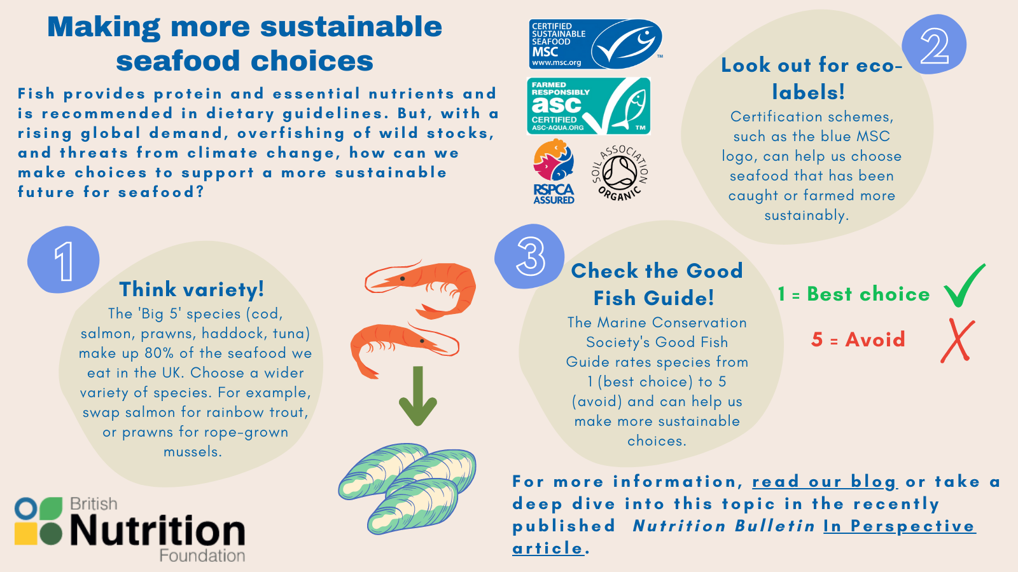

Slide 16
Fish intake – special considerations
For certain groups, there are maximum recommended quantities for certain types of fish:
Girls and premenopausal women should have no more than two portions of oily fish per week, and boys should have no more than 4 portions of oily fish as oily fish may contain more pollutants.
Those who are pregnant or trying for a baby should avoid shark, swordfish and marlin and eat no more than 4 cans of tuna or 2 tuna steaks per week, due to levels of mercury in the fish.
All other adults should have no more than 1 portion of shark, swordfish or marlin per week.
Pregnant women should thoroughly cook all fish and shellfish, avoiding raw shellfish or lightly cooked wild fish.

Slide 17
Fish intake – special considerations
For certain groups, there are maximum recommended quantities for certain types of fish:
Those who eat a large amount of fish should avoid eating too much sea bream, sea bass, turbot, halibut, rock salmon and brown crab meat, due to potential build up of pollutants.
Children under the age of 16 years should avoid eating fish such as shark, swordfish or marlin. This is because they may contain mercury which can affect a child's nervous system.
Avoid giving raw shellfish to babies and children to reduce their risk of getting food poisoning.

Slide 18
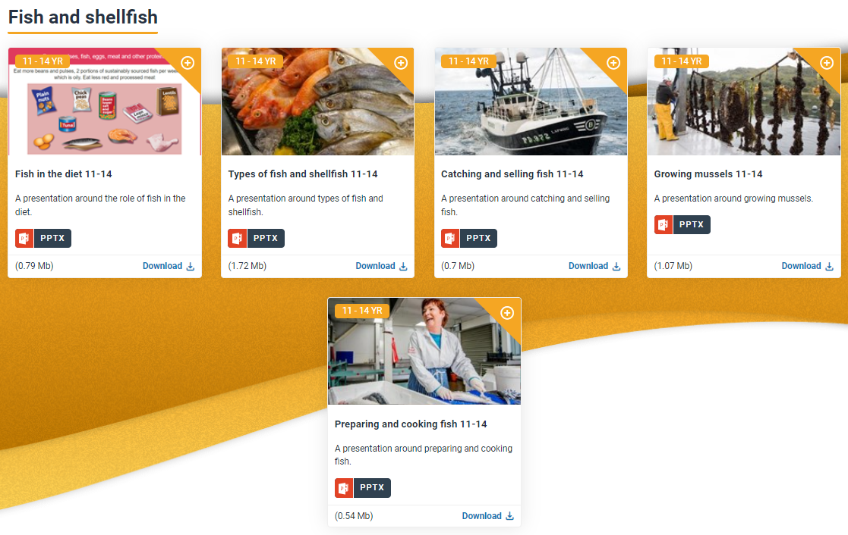
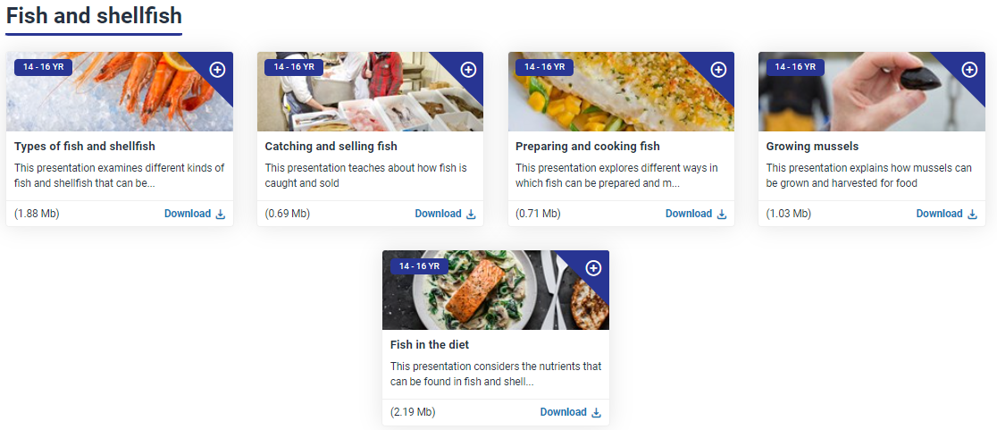
Resources – PPT presentations
11-14 fish and shellfish resources
14-16 fish and shellfish resources

Slide 19
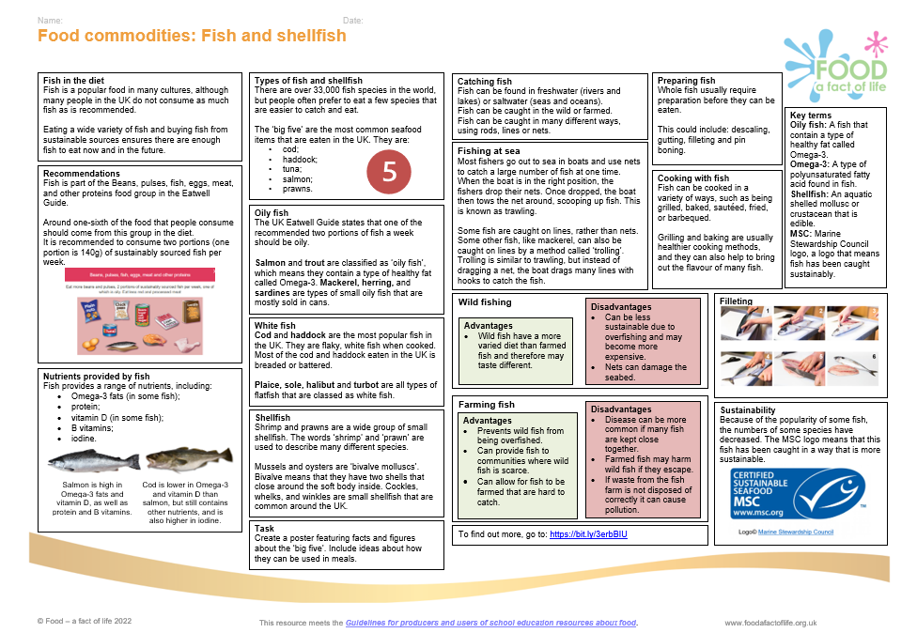
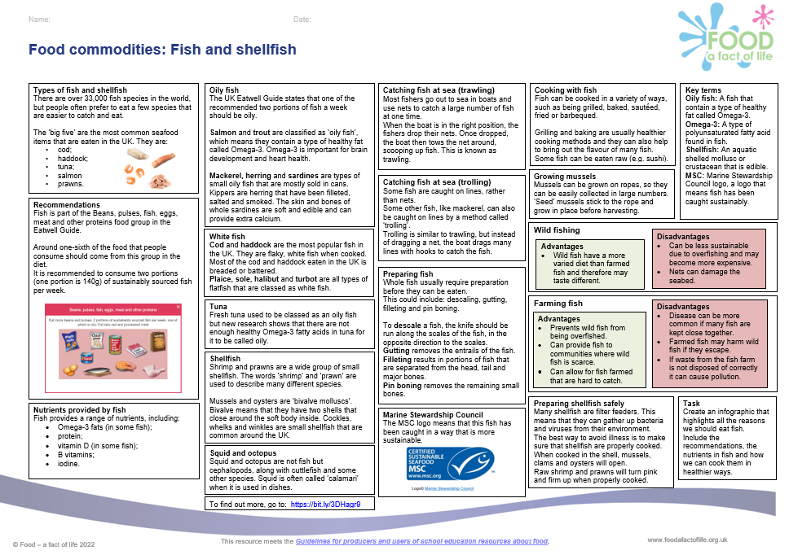
Resources – Knowledge organisers
11-14 Knowledge organisers
14-16 Knowledge organisers

Slide 20
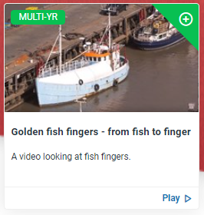
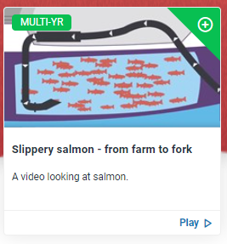
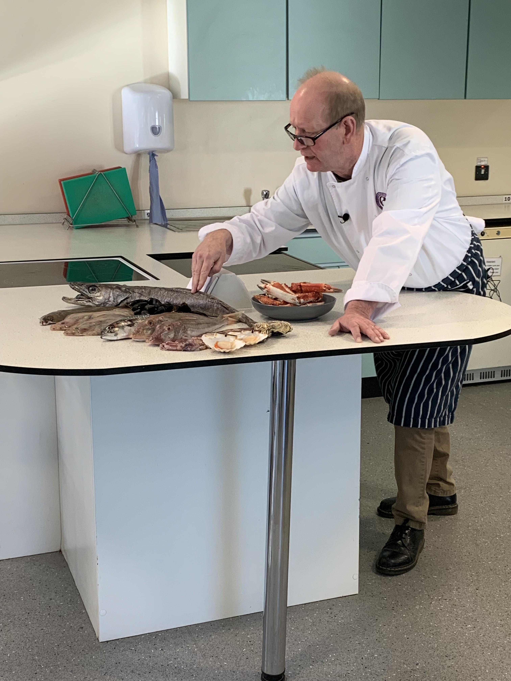
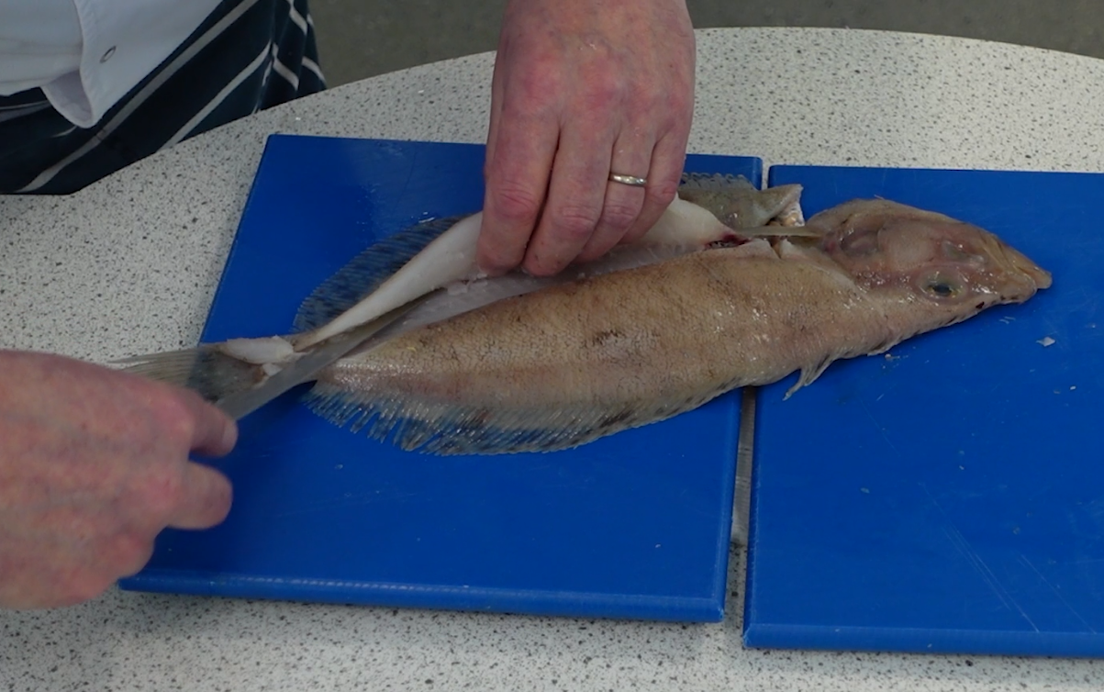
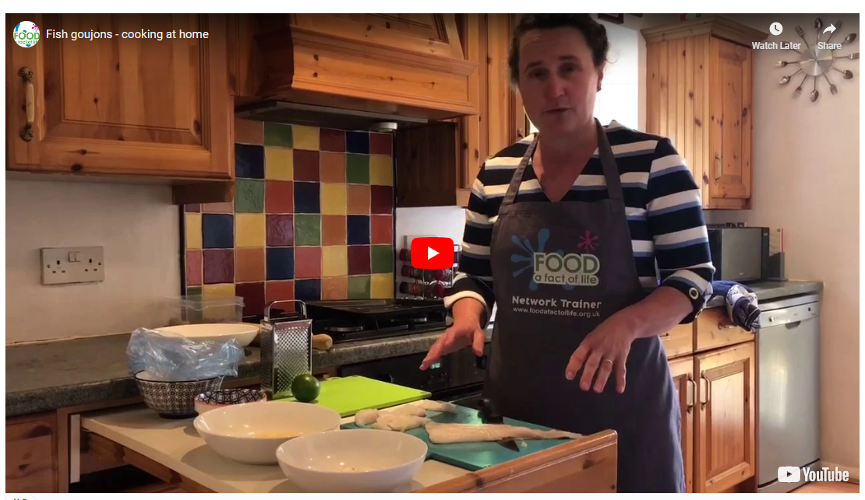
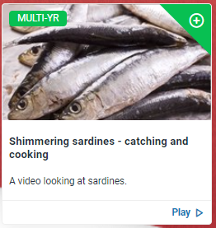
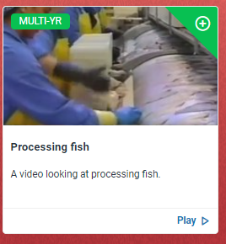
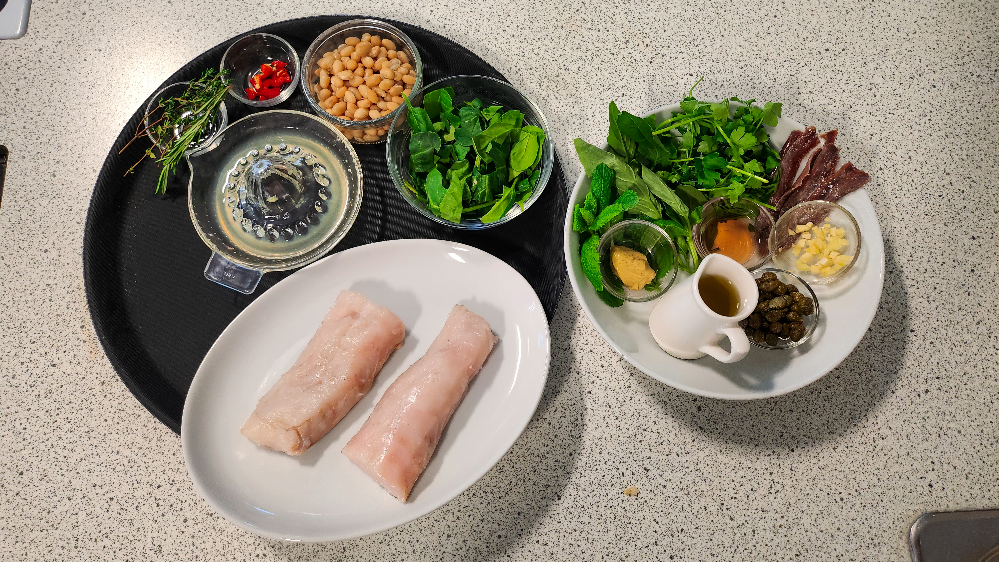
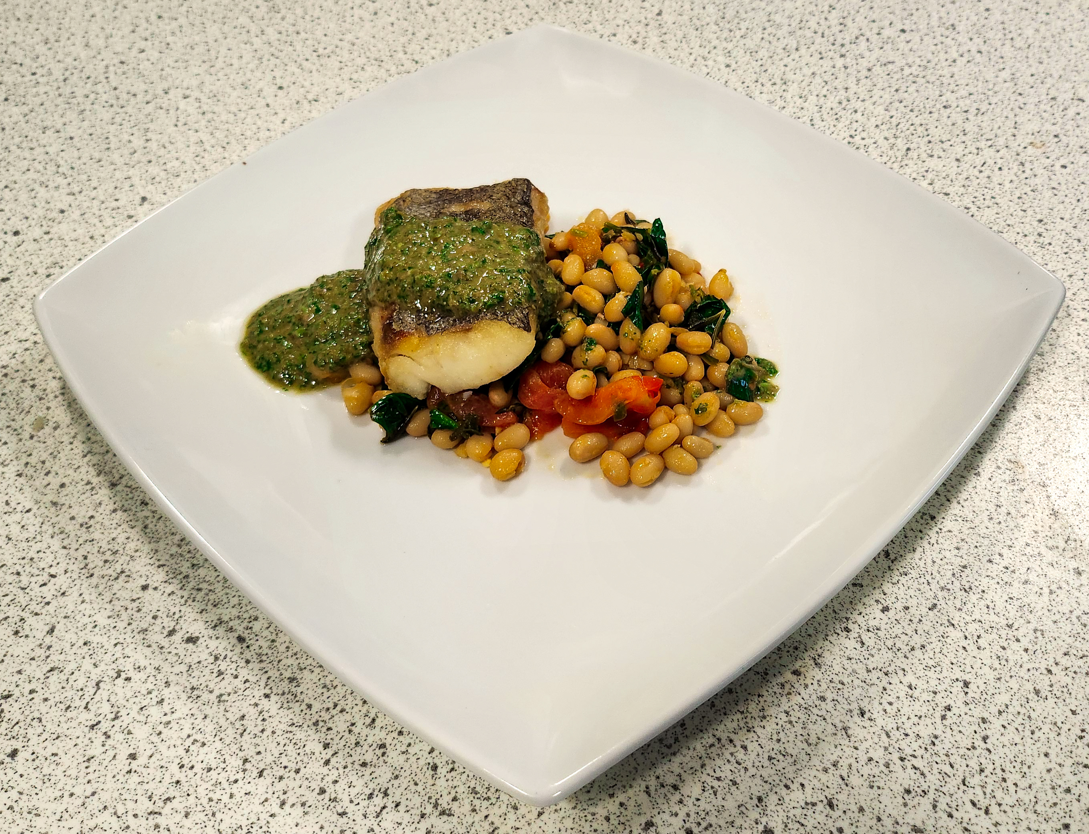
Resources – videos
Coming soon – fish classification, preparation and recipe videos!
Fish goujons interactive recipe video
Where food comes from videos

Slide 21
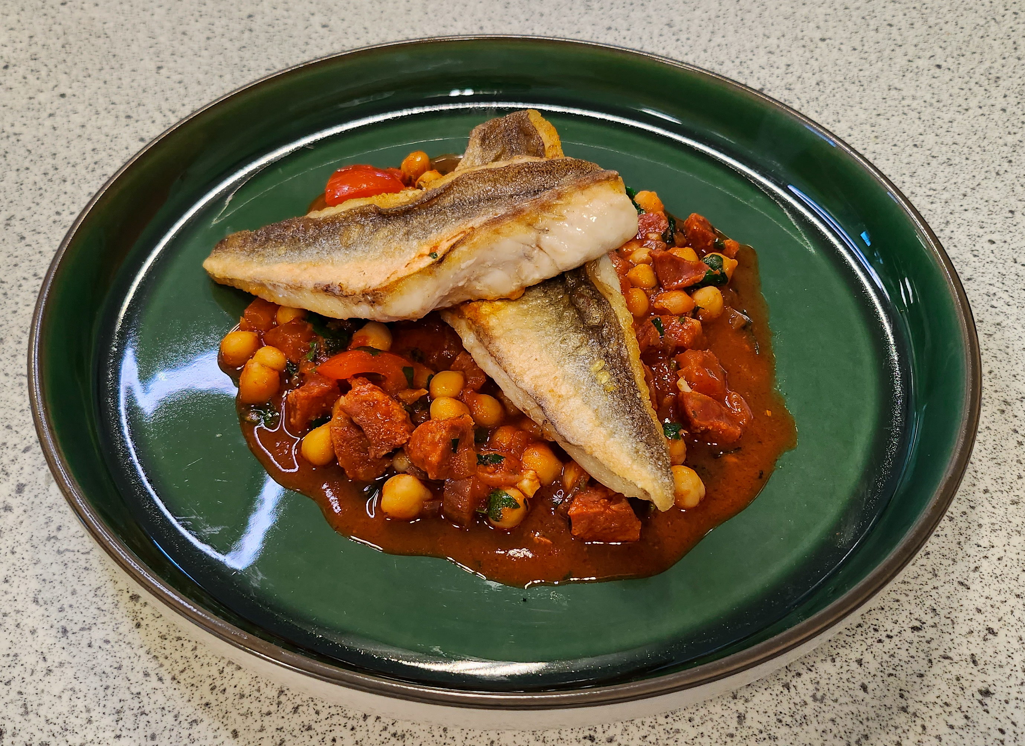
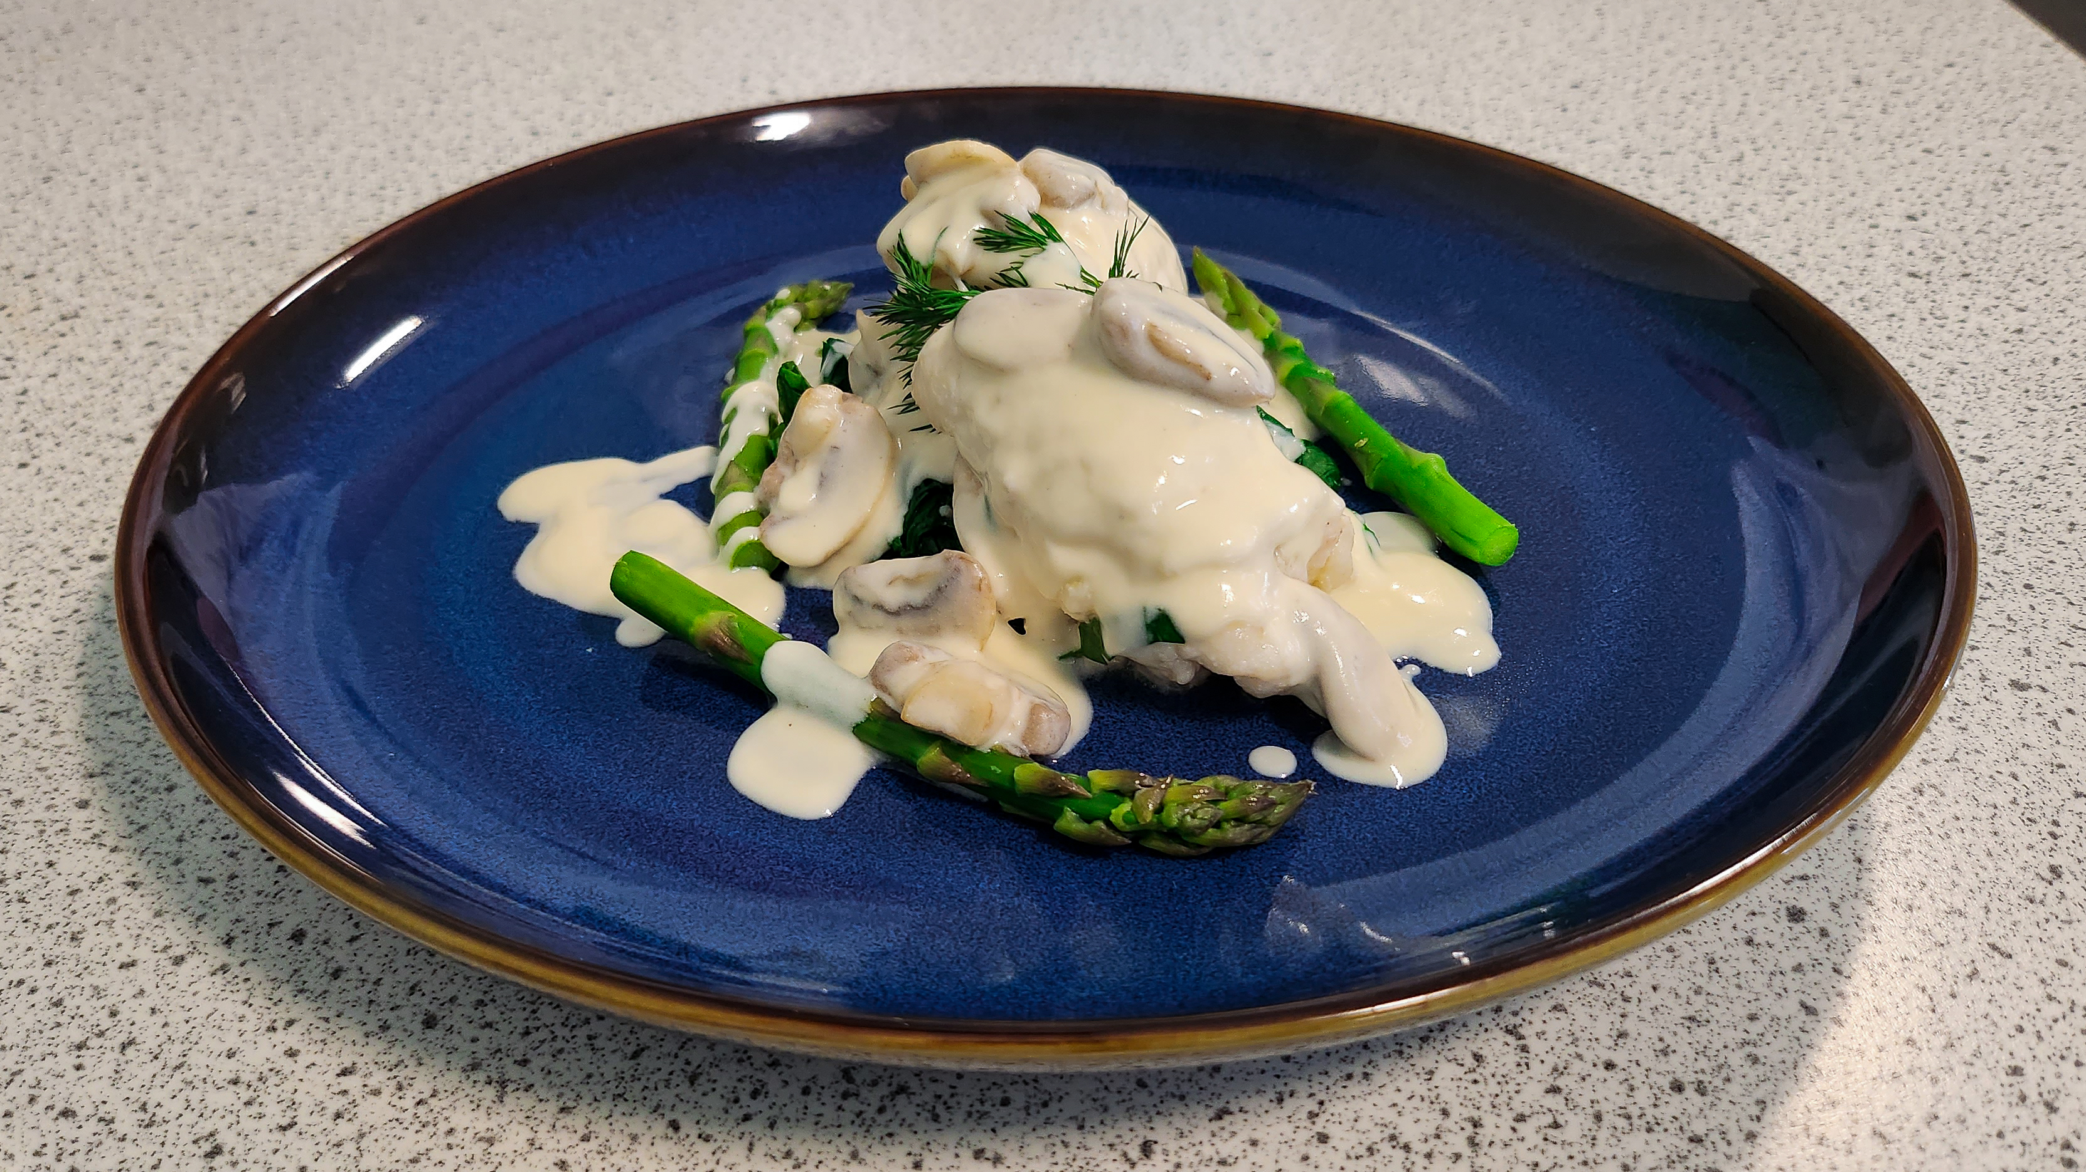
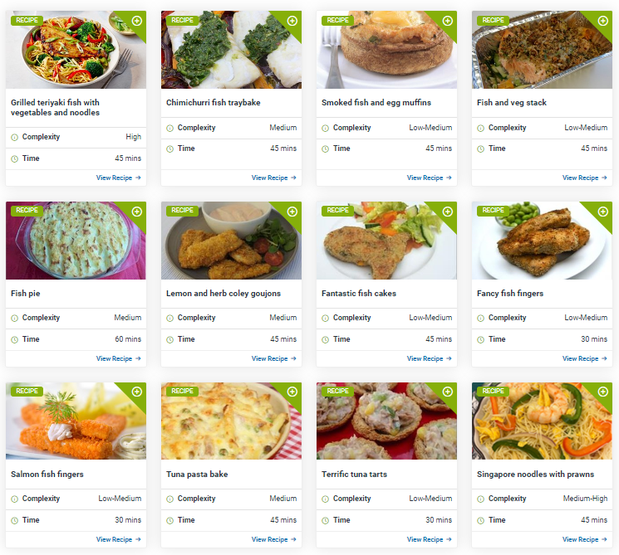
Resources - recipes
Pan fried gurnard with a chickpea and chorizo stew
Megrim with a creamy white wine sauce
FFL fish and shellfish recipes
Hake with haricot beans and salsa verde

Slide 22
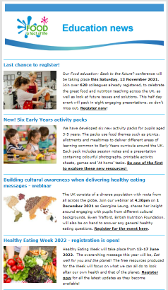
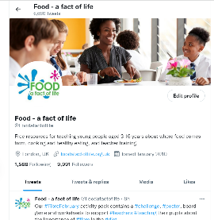
Keep up to date with our free resources and training
Education News (monthly email update)
Sign up on the homepage: www.foodafactoflife.org.uk
PPD newsletter (find out about upcoming FFL training)
https://www.foodafactoflife.org.uk/professional-development/
Follow us on Twitter @Foodafactoflife
https://twitter.com/foodafactoflife
Keep in touch:
education@nutrition.org.uk

Slide 23
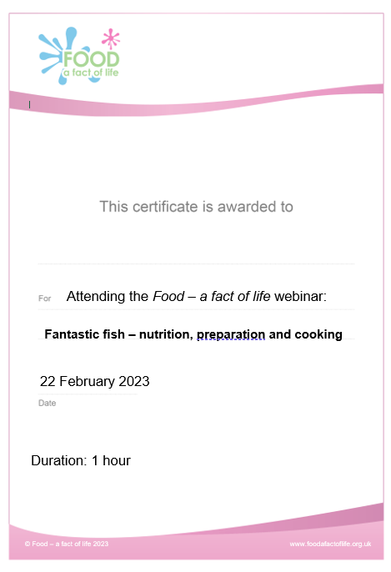
Thank you
Please complete the webinar evaluation. You should be automatically redirected to the evaluation when the webinar finishes.
Fantastic fish – nutrition, preparation and cooking
You will receive a link to the certificate once you have completed the evaluation. Please download the certificate, add your name and print it out for your records.

Slide 24
Fantastic fish – nutrition, preparation and cooking
For further information, go to:
www.foodafactoflife.org.uk
With thanks to Food Teachers Centre and the FISH (Fish in School Hero) programme, supported by the Fishmongers’ Company Charitable Trust.

