Slide 1
Food labels

Slide 2

Food labels display information to help people make choices.
This could include:
name;
size, e.g. weight;
where it is from;
how long it will stay fresh;
where to store it, e.g. in the freezer.

Slide 3

Labels also display nutrition information.
These labels show the energy and nutrients provided by the food.

Slide 4
Nutritional information
The nutrition information is displayed:
per 100g or 100ml;
per portion, e.g. half a pizza or 1 biscuit.
 | Per 100g | ½ a pizza
Energy (kJ) | 1101 | 1654
Protein (g) | 11.9 | 17.9
Carbohydrate (g) | 34.6 | 52
Fat (g) | 8.4 | 12.6

Slide 5
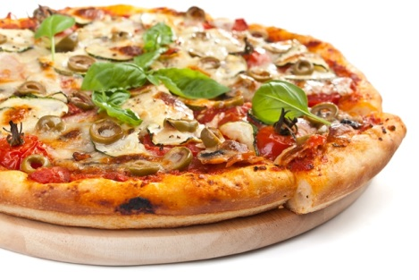
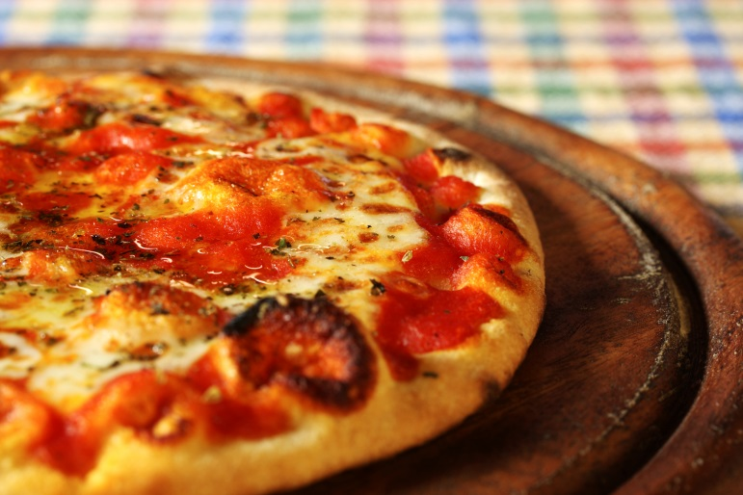
Nutrition information labels can be used to compare similar foods.
Two cheese and tomato pizzas, same weight.
Pizza 1
Pizza 2

Slide 6
What do these labels tell us?
 | Per 100g | ½ a pizza
Energy (kJ) | 1101 | 1654
Protein (g) | 11.9 | 17.9
Carbohydrate (g) | 34.6 | 52
Fat (g) | 8.4 | 12.6
 | Per 100g | ½ a pizza
Energy (kJ) | 924 | 1150
Protein (g) | 10.7 | 13.3
Carbohydrate (g) | 30.9 | 38.4
Fat (g) | 5.9 | 7.3
Pizza 1
Pizza 2

Slide 7
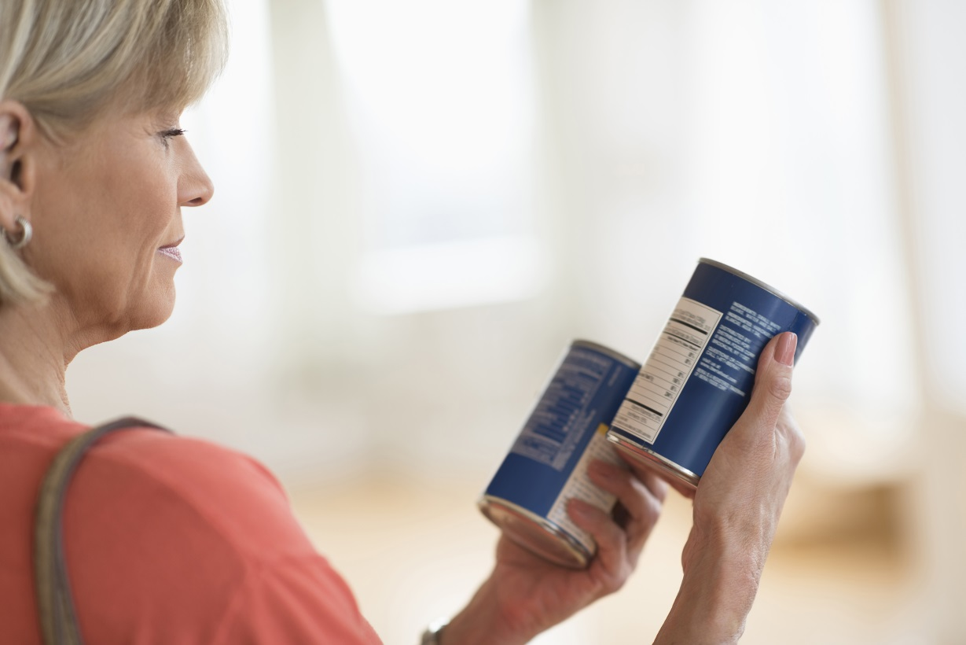
Nutrition labels
Look at the labels to help you make smart choices.

Slide 8
Food labels
For further information, go to:
www.foodafactoflife.org.uk
This resource meets the Guidelines for producers and users of school education resources about food.

