Slide 1
Demonstrating progression: Practical food skills and cooking with heat
Frances Meek, Education Services Manager
Claire Theobald, Education Services Manager

Slide 2
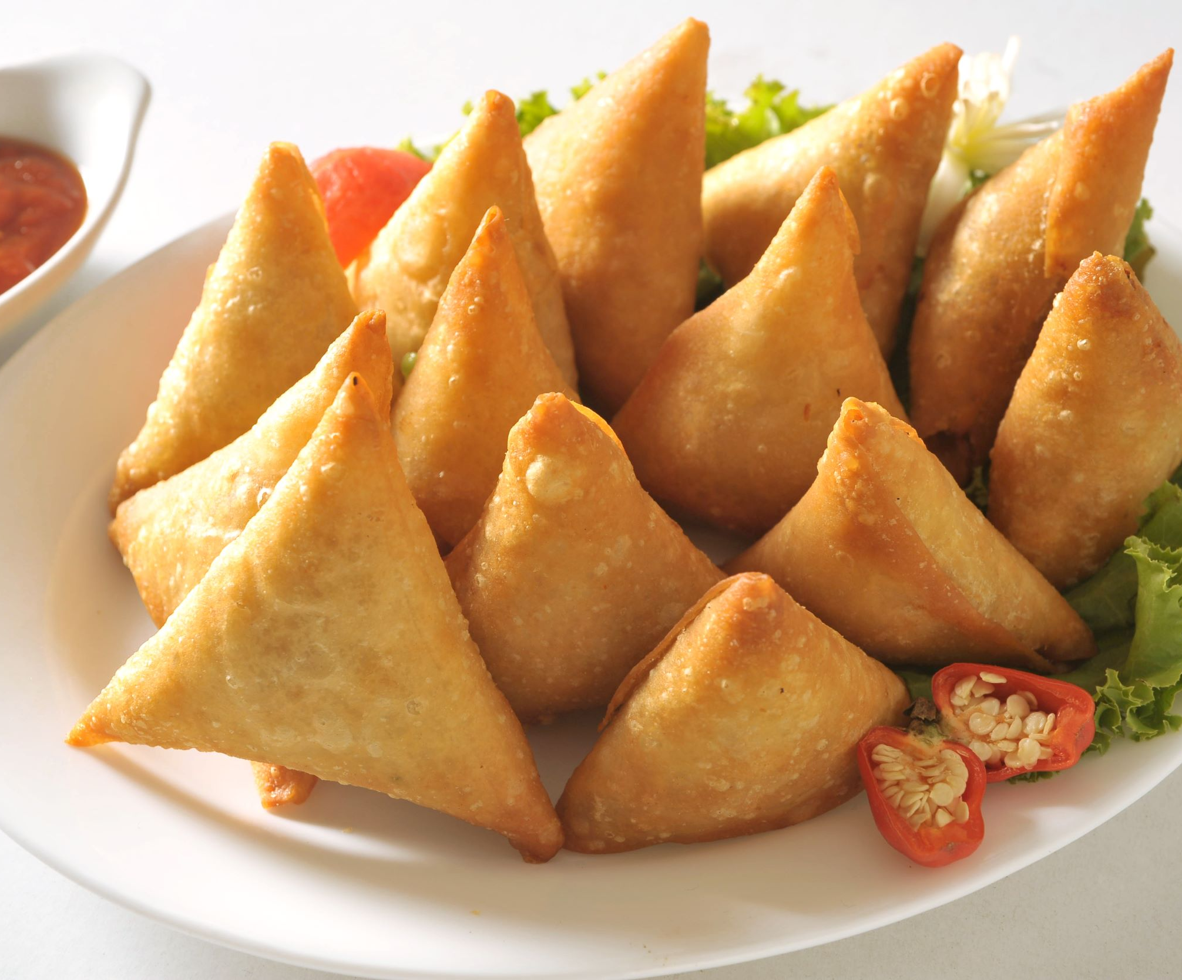
This session will cover
Progression in food and nutrition.
Demonstrating and evidencing progression of practical food skills.
Setting up practical food lessons (a reminder).
Teaching practical food skills (a reminder).
Ensuring good food hygiene and safety practices, particularly when cooking with heat.
Demonstrating lesson intent and progression through a ‘grab and go’ product.
Links to Food – a fact of life resources

Slide 3
Programme
16.15 Registration
16.30 Welcome
16.35 Progression in food and nutrition
Demonstrating and evidencing progression of practical food skills
17.15 Setting up a practical lesson (reminder)
The importance of good food hygiene and safety (reminder)
Mexican pockets demonstration
17.30 Making Mexican pockets
17.50 Wrap up and next steps

Slide 4
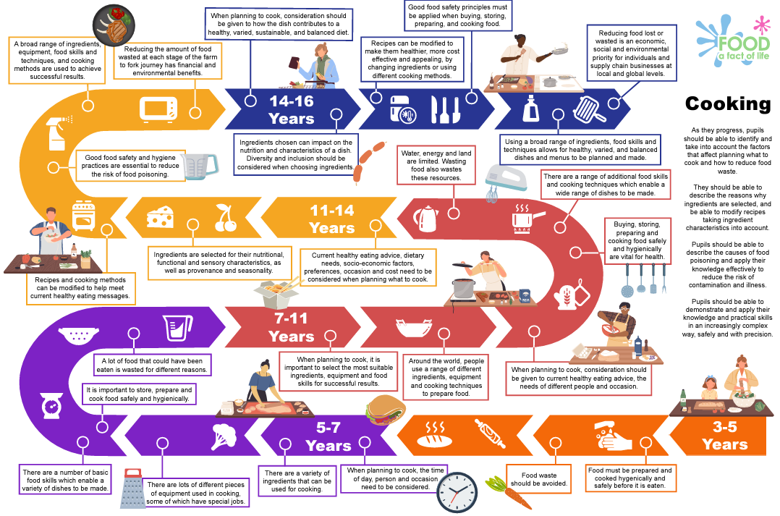
Progression in food and nutrition
Food Curriculum Roadmaps
Showcase the progressive, key learning that underpins the Food – a fact of life programme
3 x Roadmaps - healthy eating, cooking and where food comes from
Provide a visual journey of what pupils from age 3 to 16 years need to know about food
Print for planning file or display to show pupils their food learning journey
Interactive versions click straight through to ready-to-use lesson plans and resources

Slide 5
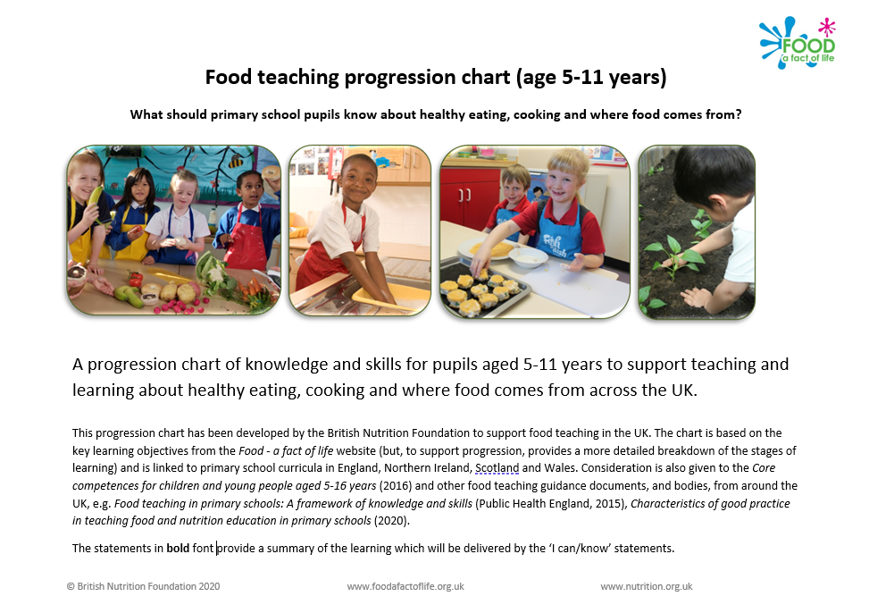
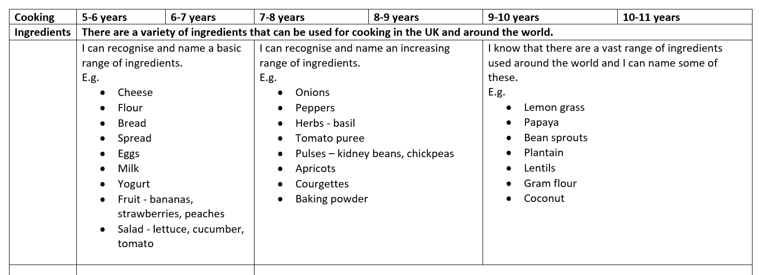
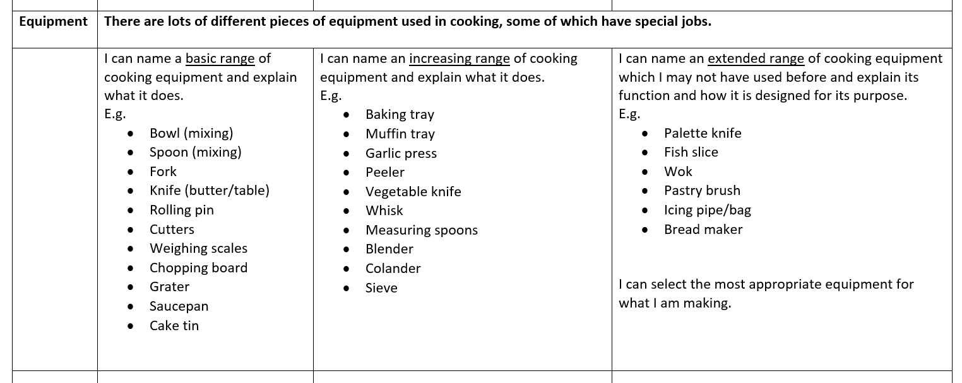
Progression in food and nutrition
Cooking section show progression across:
Ingredients
Tasting
Equipment
Skills
Hygiene and safety
Food teaching progression chart (age 5-11 years)

Slide 6
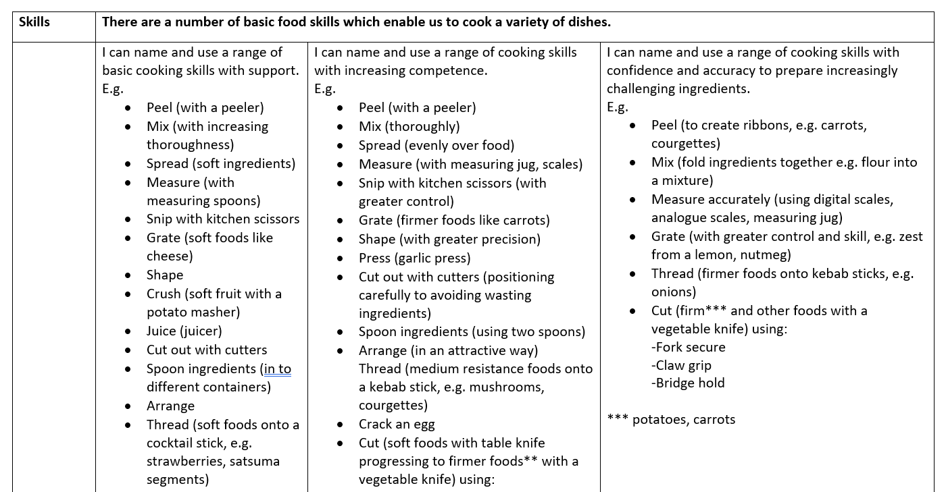
Food teaching progression chart (age 5-11 years)

Slide 7


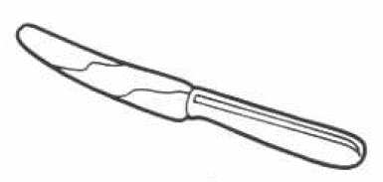
Adapting food activities
 | Reduce challenge | Increase challenge
Consider how to reduce or increase the challenge with the … Ingredients Equipment Food skills | Partly prepare (or weigh) ingredients advance Use softer foods and a table knife to ‘bridge’ and ‘claw’ Use a ‘fork secure’ (instead of claw grip) Keep to one ‘sharp’ equipment task per session, e.g. grater, vegetable knife Work in pairs, so one person is a ‘spotter’ | Allow children to follow the recipe themselves Let children wash and measure their own ingredients Using ovens and hobs independently Using sharp equipment independently

Slide 8
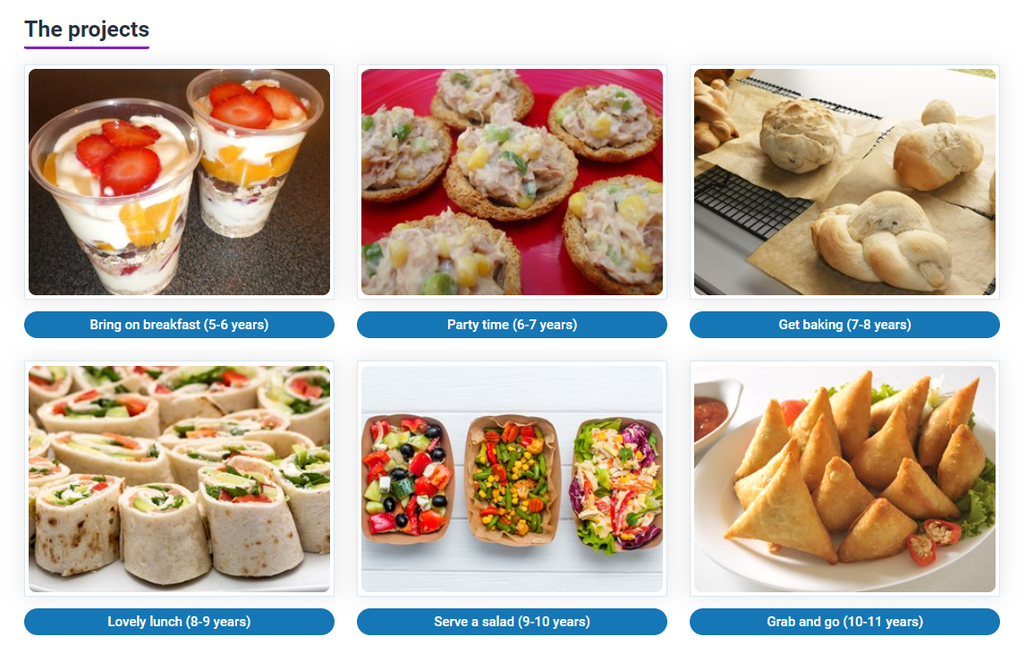
Demonstrating progression – practical food skills
Primary food projects
Six food projects to support a progressive approach to teaching and learning about healthy eating, cooking and where food comes from.
Each project includes:
Overview, objectives and curriculum links
six lesson plans
links to supporting resources on Food – a fact of life – worksheets, recipes, presentations.

Slide 9
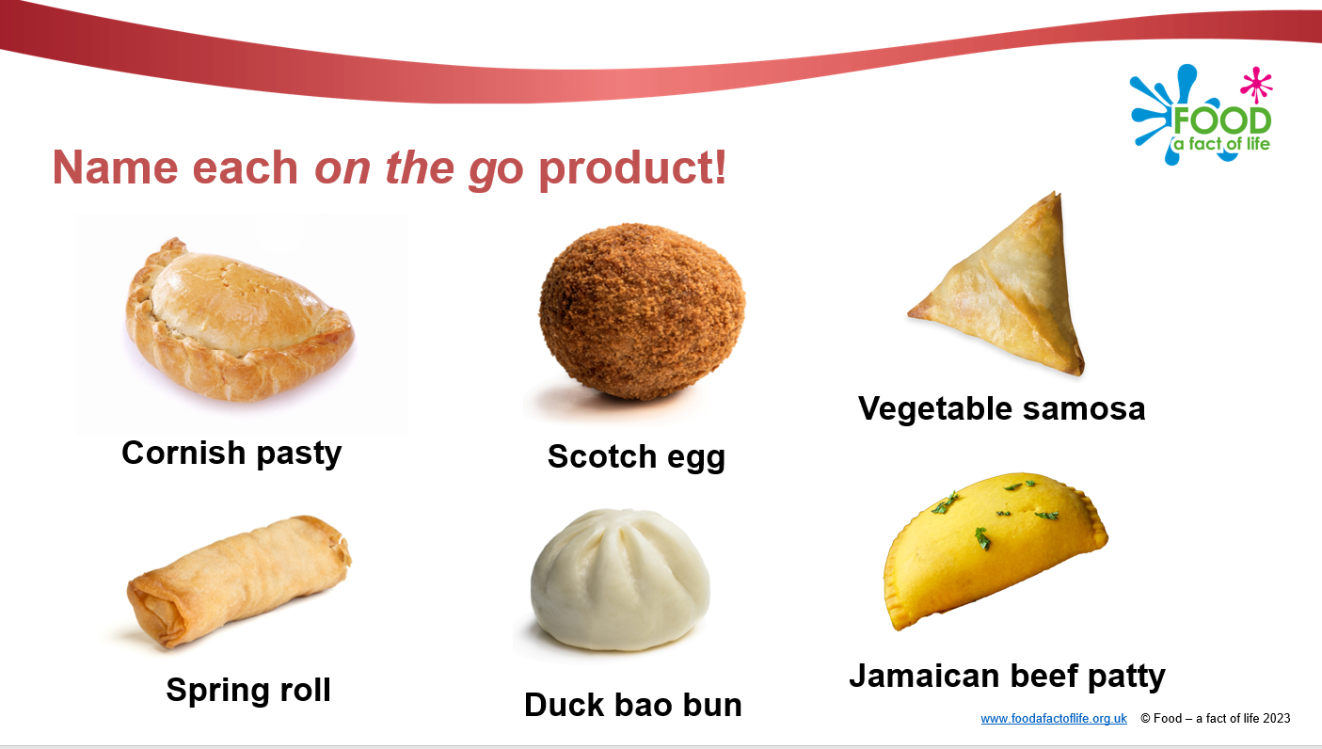
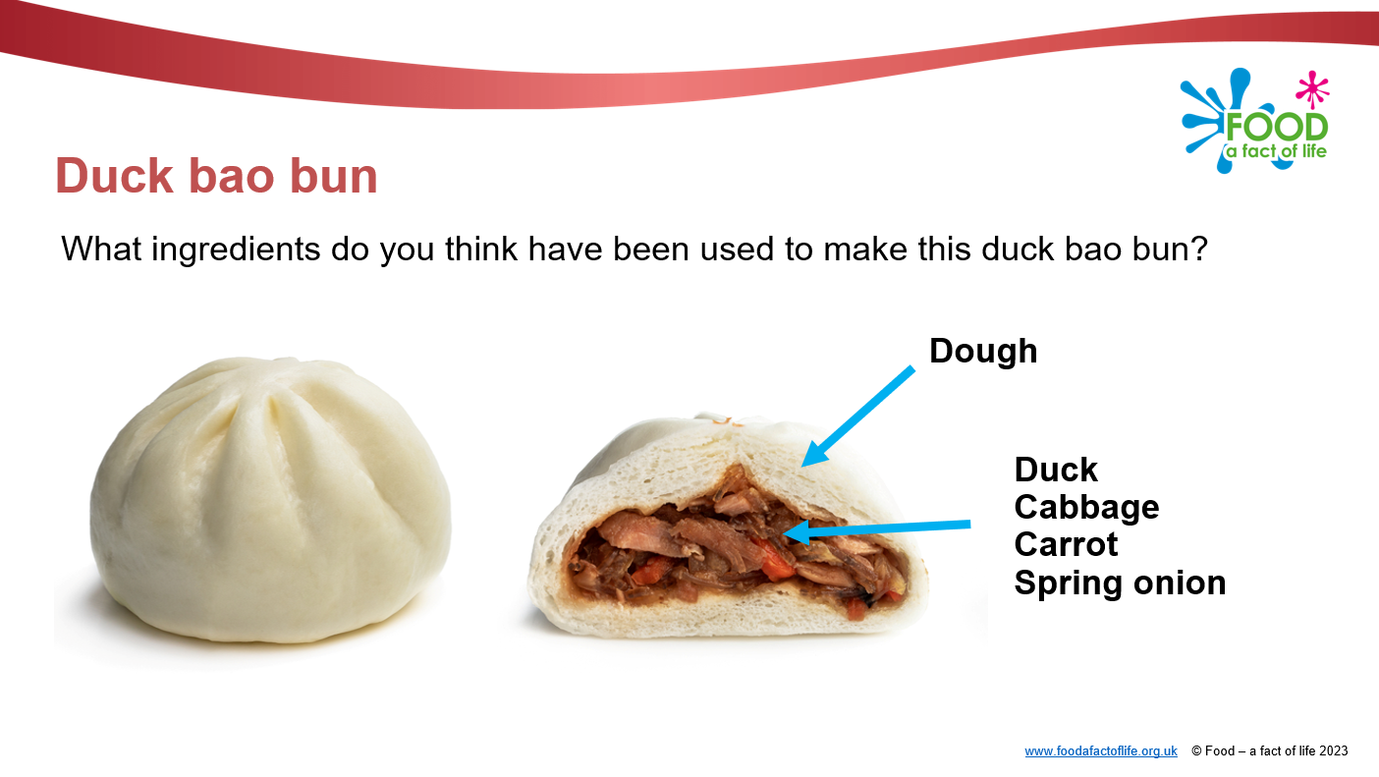
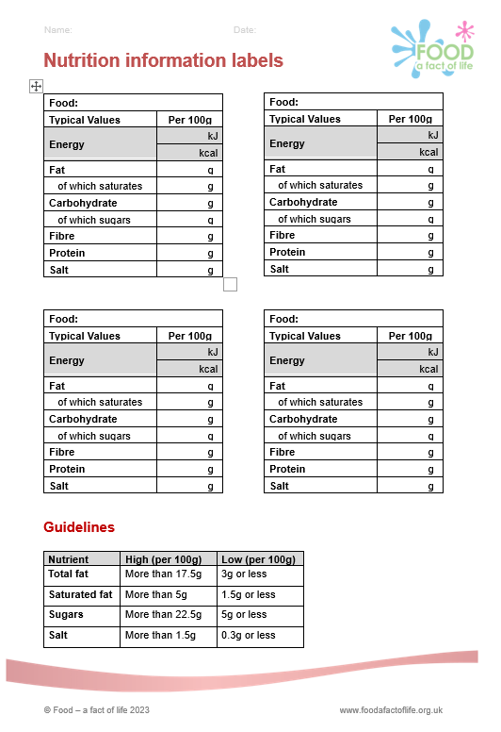
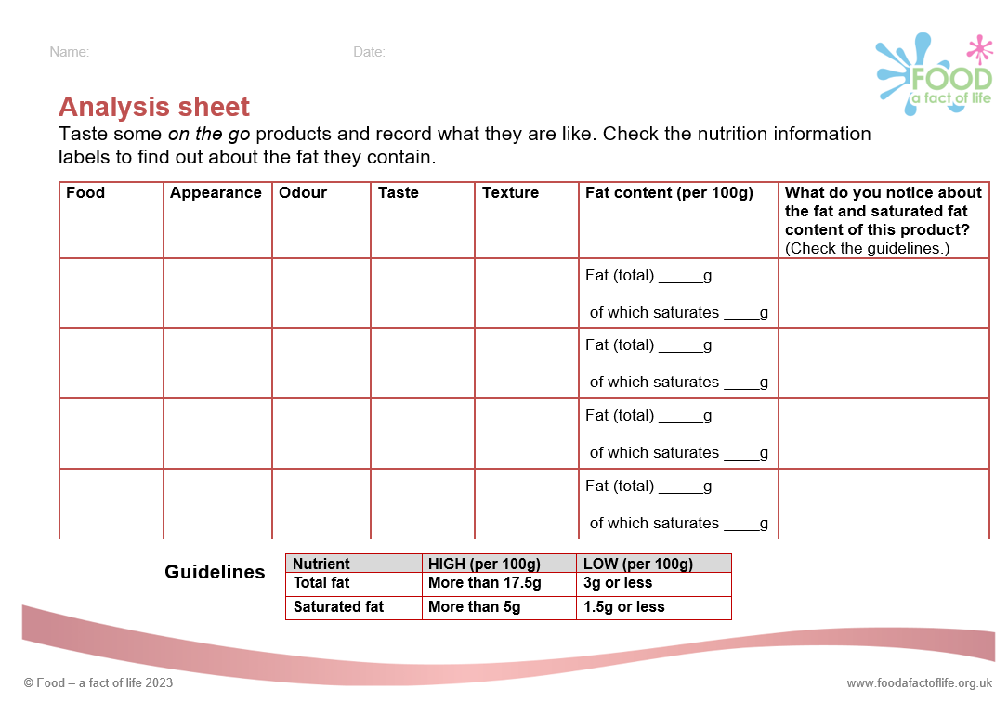
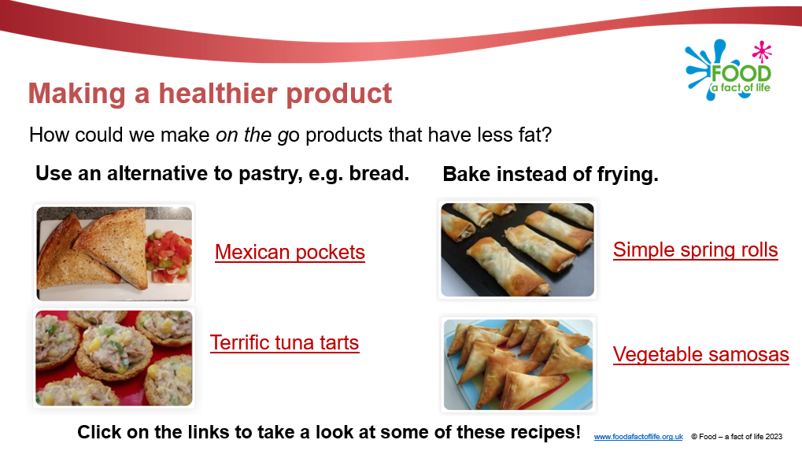
Grab and go!
This food project has been developed to help pupils investigate products to inform the designing and making of their own on the go product.
Pupils will:
learn about nutrients and how a healthy, varied diet (as shown by the Eatwell Guide) is needed to provide these
practise food preparation skills and cooking safely and hygienically
explore nutrition information labels and how they help us understand and make choices about what we eat (with a particular focus on reducing fat intake).
The learning in this primary project is delivered in the context of designing and making a healthier all in-one style product to be eaten on the go.

Slide 10
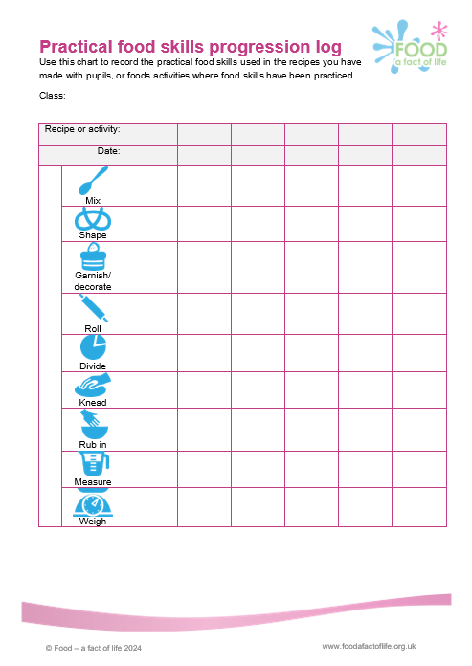
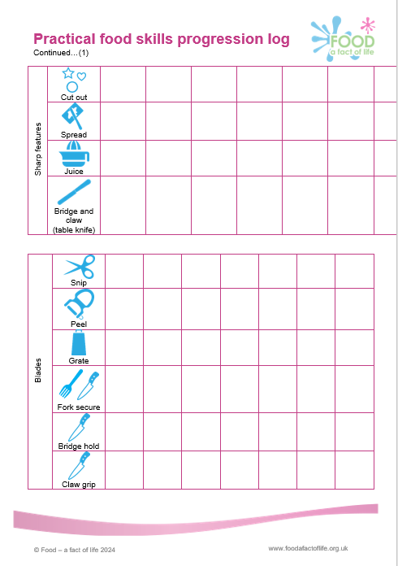
Evidencing progression
Planning documents
Food Curriculum Roadmaps
Food Teaching progression chart
Primary projects Schemes of work/learning and lesson plans
Progression logs coming soon!

Slide 11
Cooking with heat
Design and Technology: Cooking and Nutrition progression framework (National Curriculum Expert Group for D&T)
Across KS1 pupils should know:
how to prepare simple dishes safely and hygienically, without using a heat source;
how to use techniques such as cutting, peeling and grating.
Across KS2 pupils should know:
how to prepare and cook a variety of predominantly savour dishes safely and hygienically, including where appropriate, the use of a heat source;
how to use a range of techniques such as peeling, chopping, slicing, grating, mixing, spreading, kneading and baking.
In KS2 pupils should also know:
that recipes can be adapted to change the appearance, taste, texture and aroma.
Food teaching progression 5-11 years chart

Slide 12
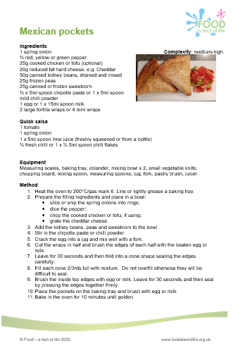
What are your learning intent/objectives?
An ingredient check letter has been sent home.
How will you organise the lesson?
What routines will you have in place?
Ingredients checked for allergens (especially packaged foods).
Equipment is appropriate for size of children’s hands.
Do you need separate equipment for pupils with allergies or intolerances?
Equipment is stored safely, that it is in working order, clean and ready to use (count knives and sharp tools out and in).
Ingredients and finished dishes are stored safely.

Slide 13
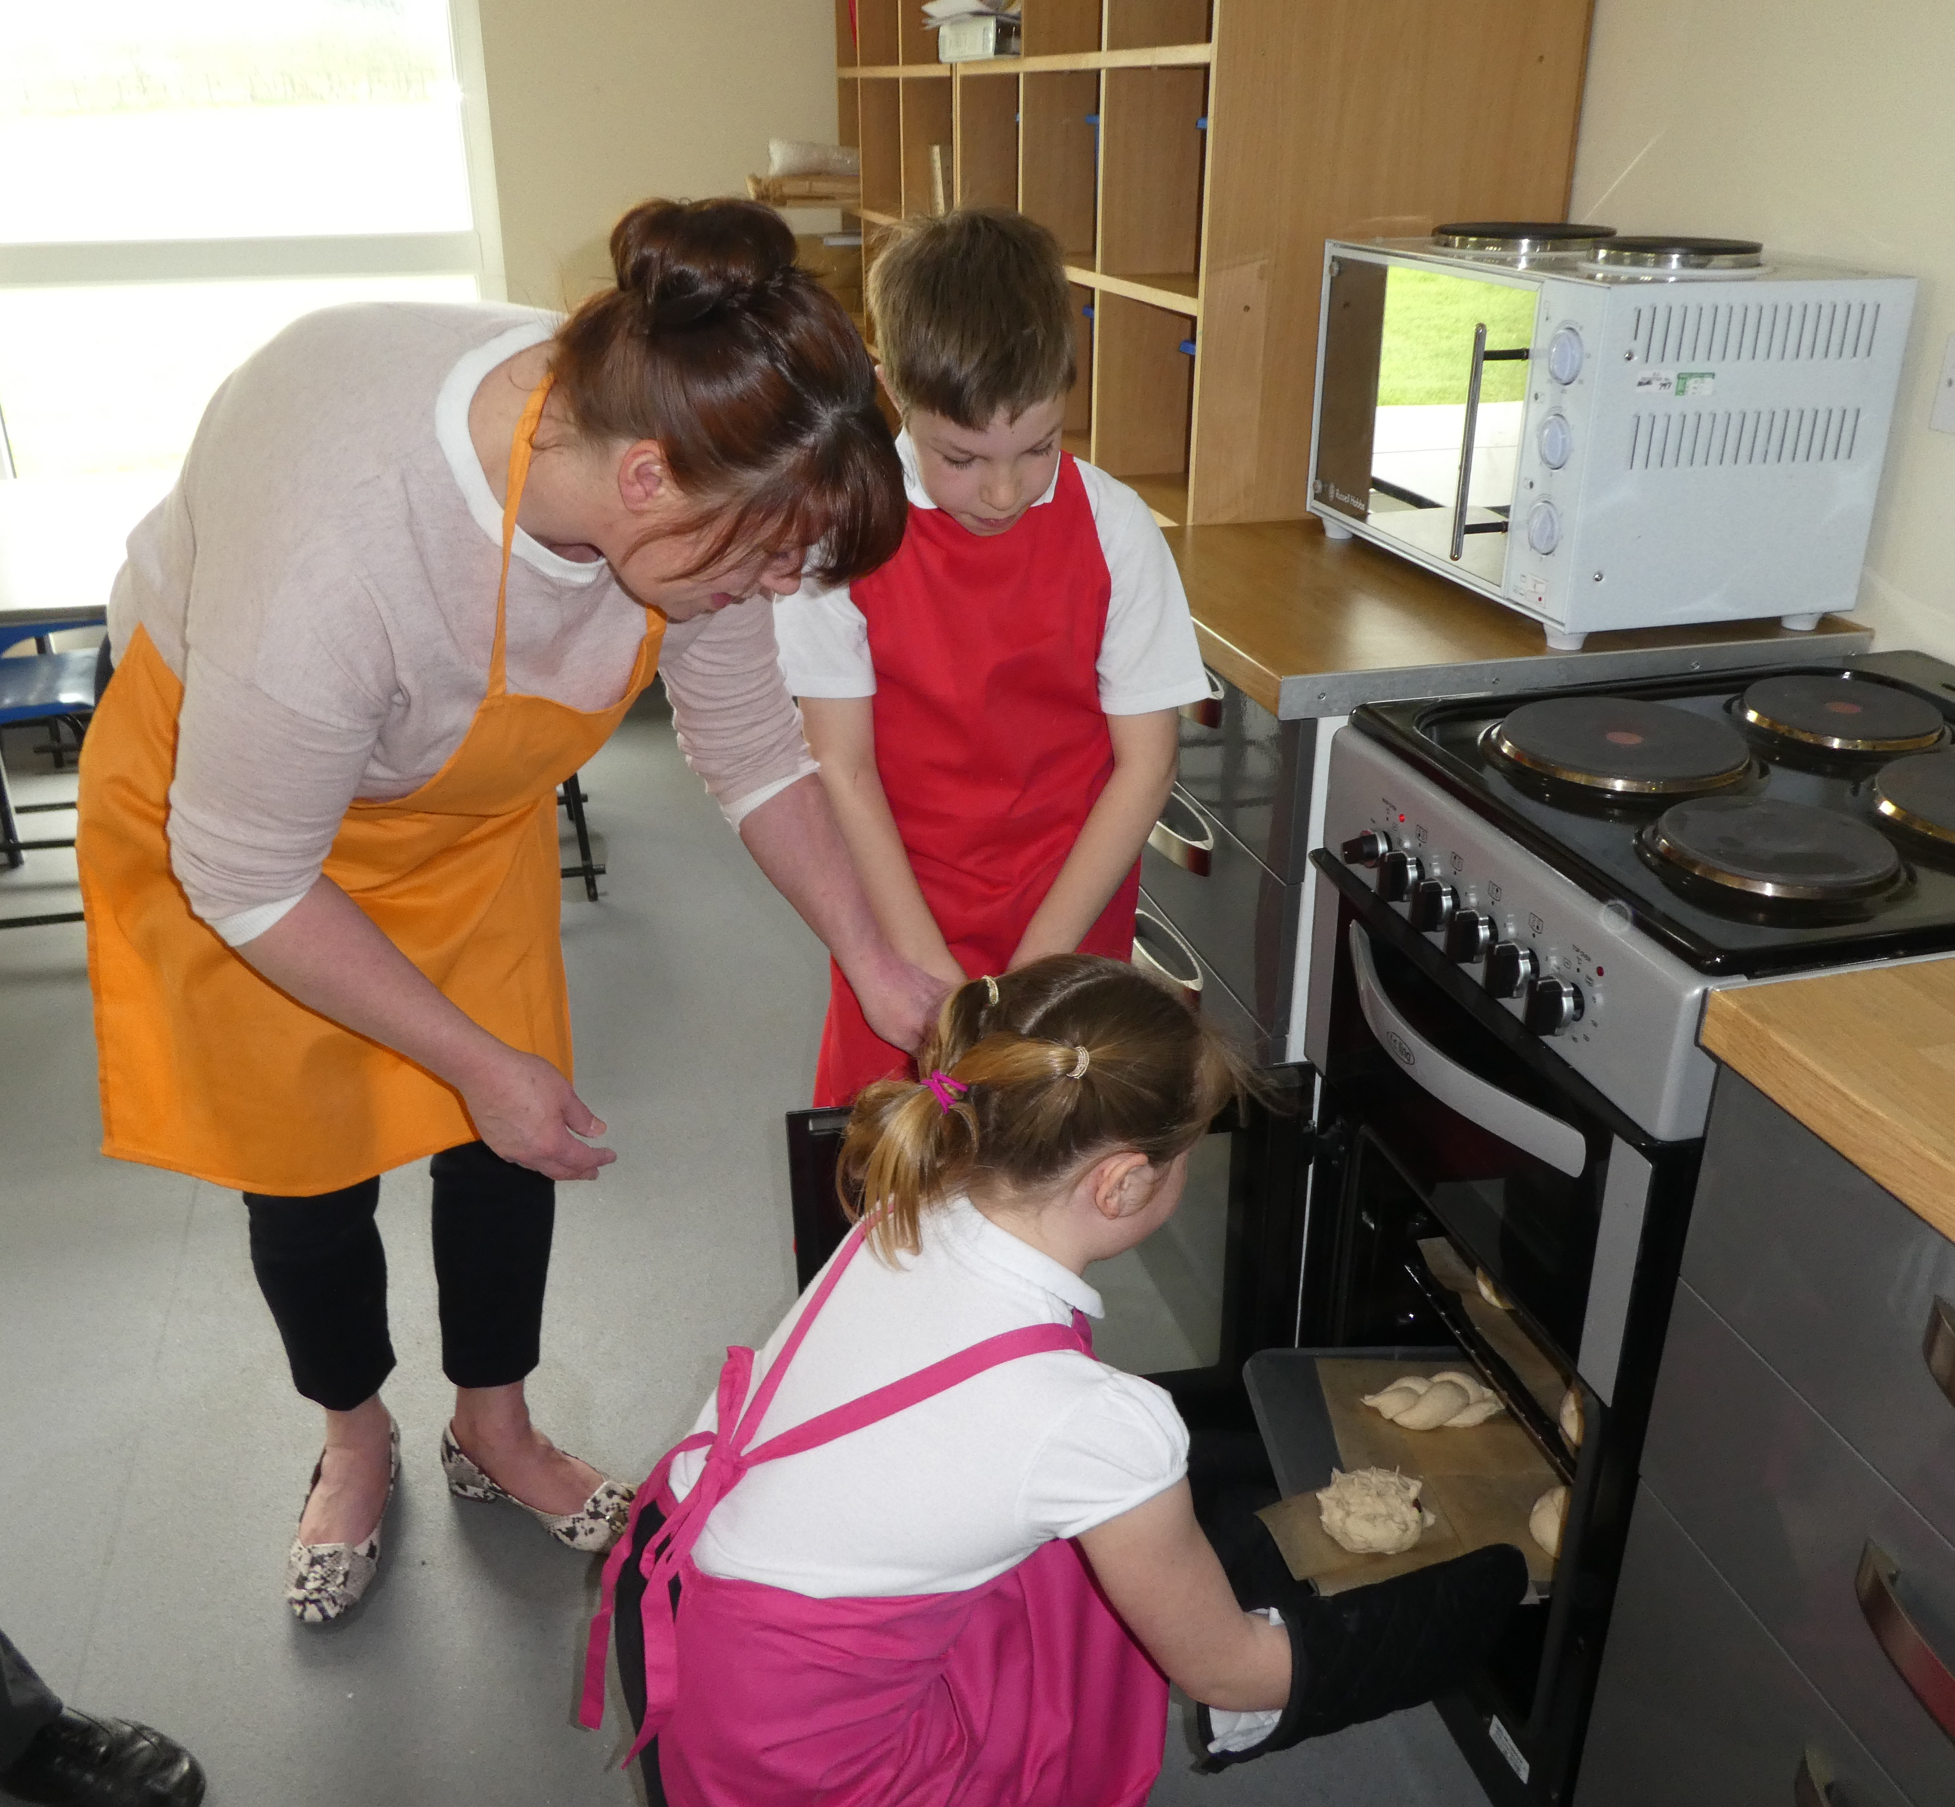
How to run practical food lessons in the primary school classroom
What is your learning intention/objective?
For children to able to:
get themselves ready to cook?
set up the classroom for a food activity?
practise the bridge and claw techniques to chop and slice?
use a range of kitchen equipment?
use a hob, oven or grill? (independently or with supervision)?
wash up?
Remember your focus – you don’t have to do it all in one lesson!

Slide 14
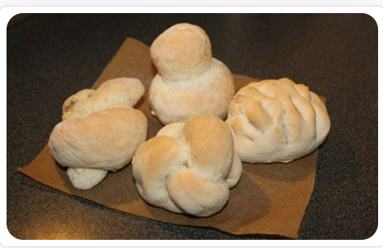
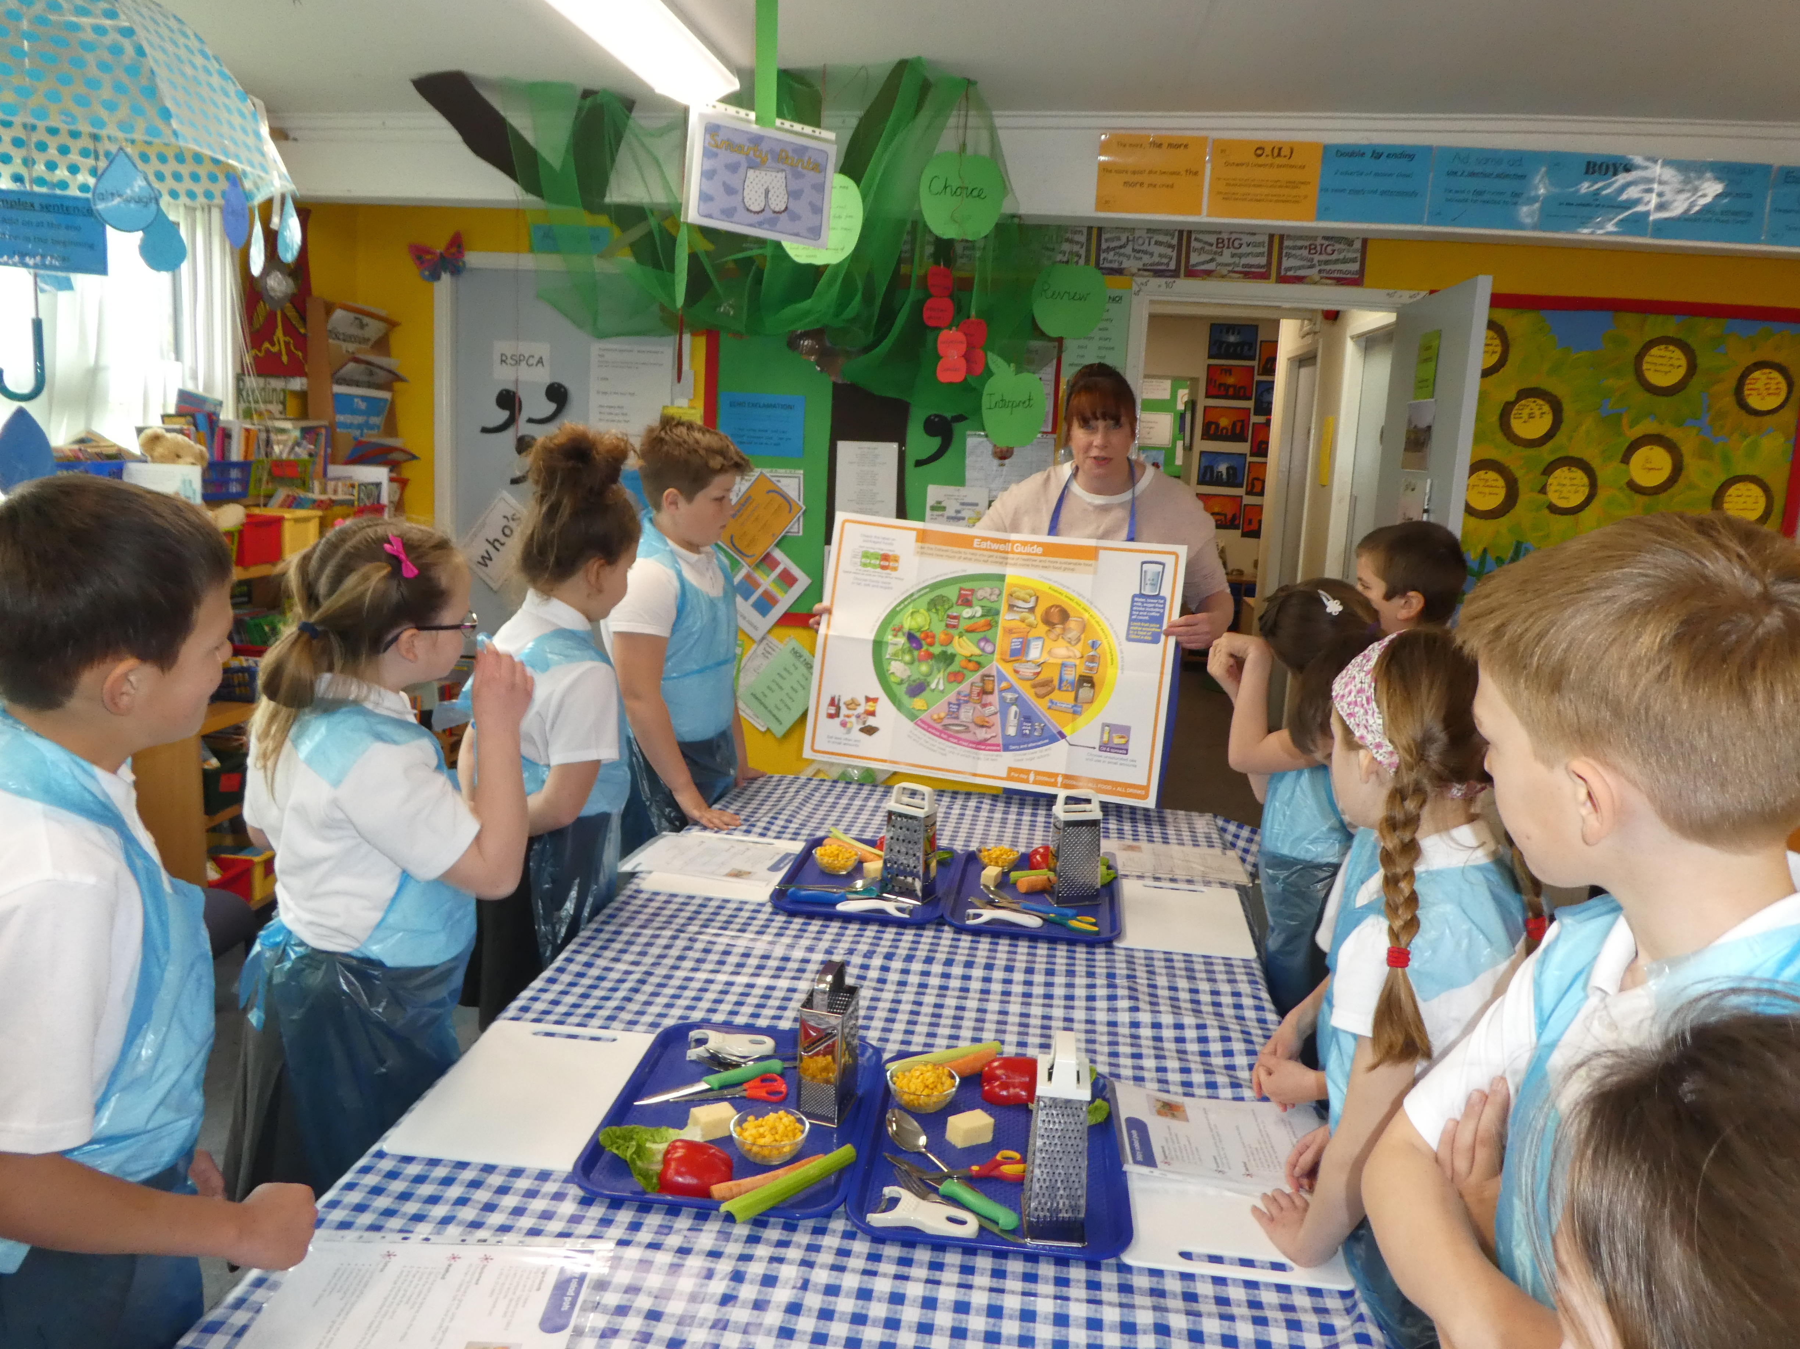
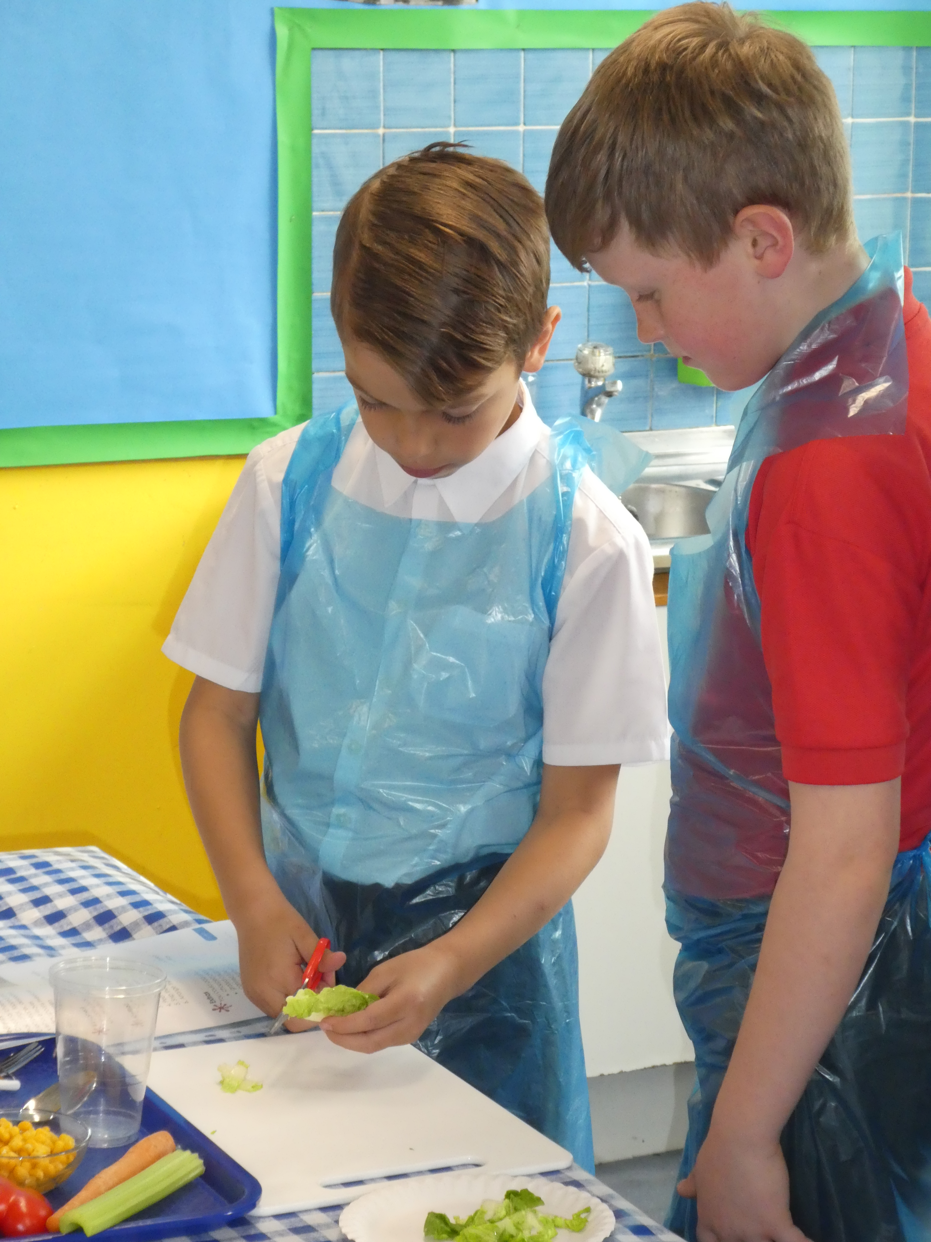
How to run practical food lessons in the primary school classroom
How will you organise the lesson?
Think about:
table/furniture layout?
individual or group work?
ingredients – partly prepared?
equipment – organisation, amount – group work, ‘spotters’?
demonstrating – how, where?
try it at home!
Organisation and preparation is key!

Slide 15
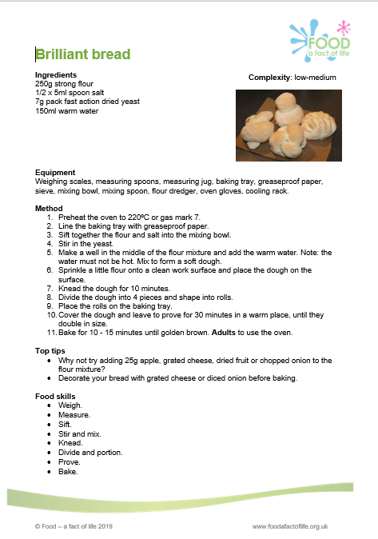
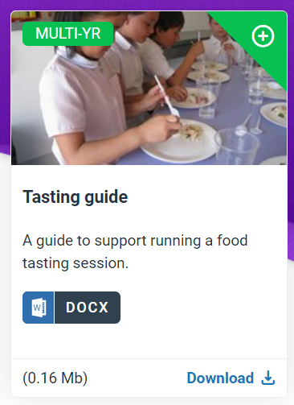
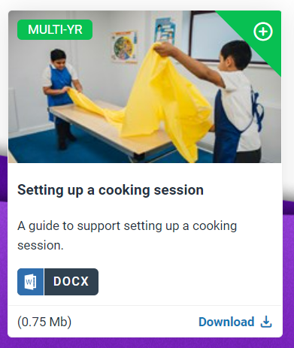
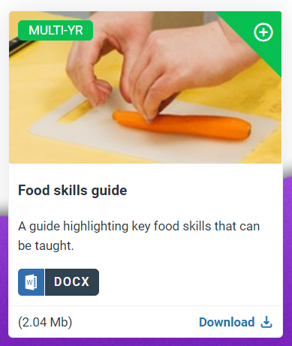
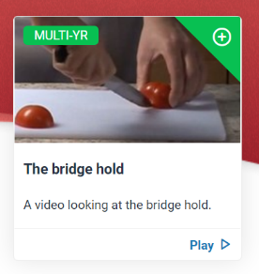
How to run practical food lessons in the primary school classroom
How will you organise the lesson?
Take a look at the guides, recipes and videos to help!

Slide 16
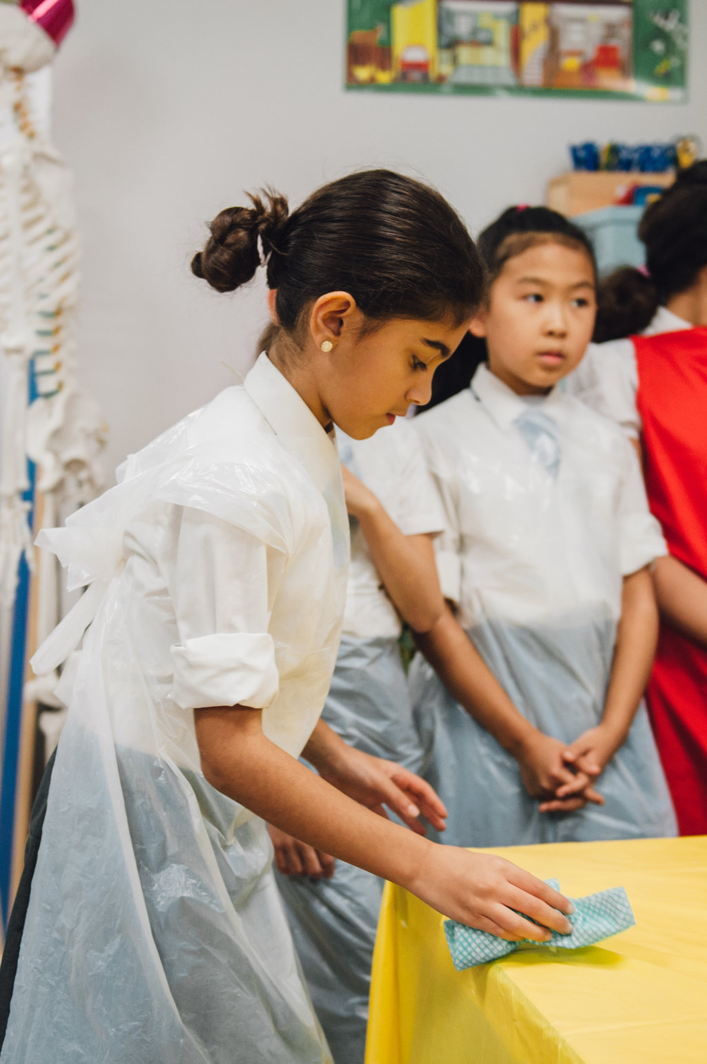
How to run practical food lessons in the primary school classroom
What routines and procedures will you have in place?
For:
getting pupils ready to cook, e.g. handwashing?
setting up, e.g. trays side of the room?
using sharp equipment, e.g. stay at the table?
tidying away, wiping tables, removing aprons?
washing up – where? rota?
food waste?
other adults?
Make sure everyone knows what they need to do!

Slide 17
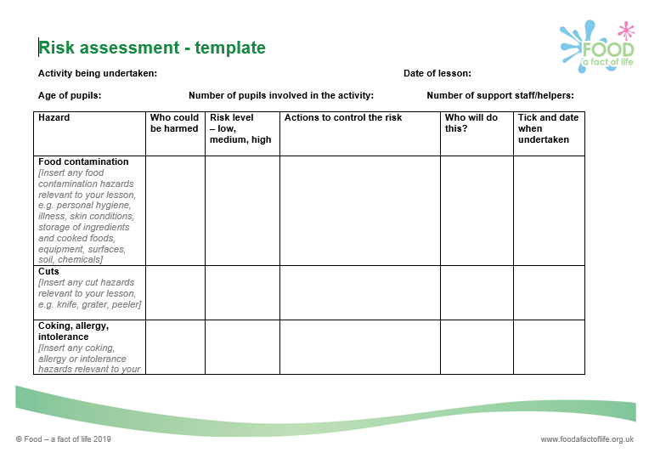
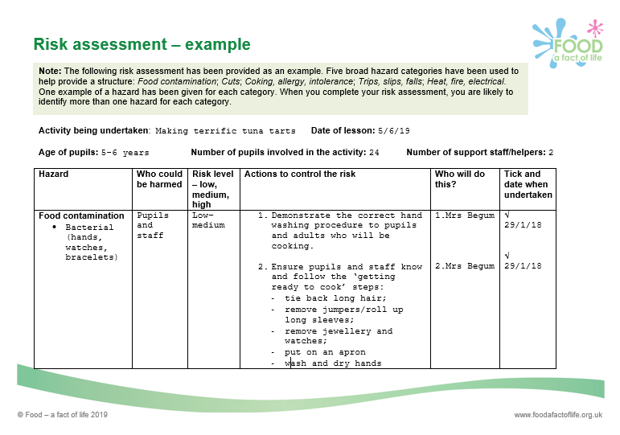
Why is good food hygiene and safety important?
To prevent food poisoning – pupils, parents and staff.
Teacher’s own indemnity.
Considerations:
Do you need a food hygiene and safety award/certificate?
Risk assessments – exemplars available on Food – a fact of life

Slide 18
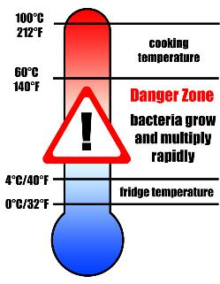
Storage of ingredients and finished dishes
Store all opened jars and bottles in the fridge and label with an ‘opened on’ or ‘use by’ date.
Cool cooked food quickly and store below 5°C within 90 – 120 minutes.
Check and record fridge temperatures regularly.
Clean fridges regularly with hot soapy water and a sanitising spray.

Slide 19


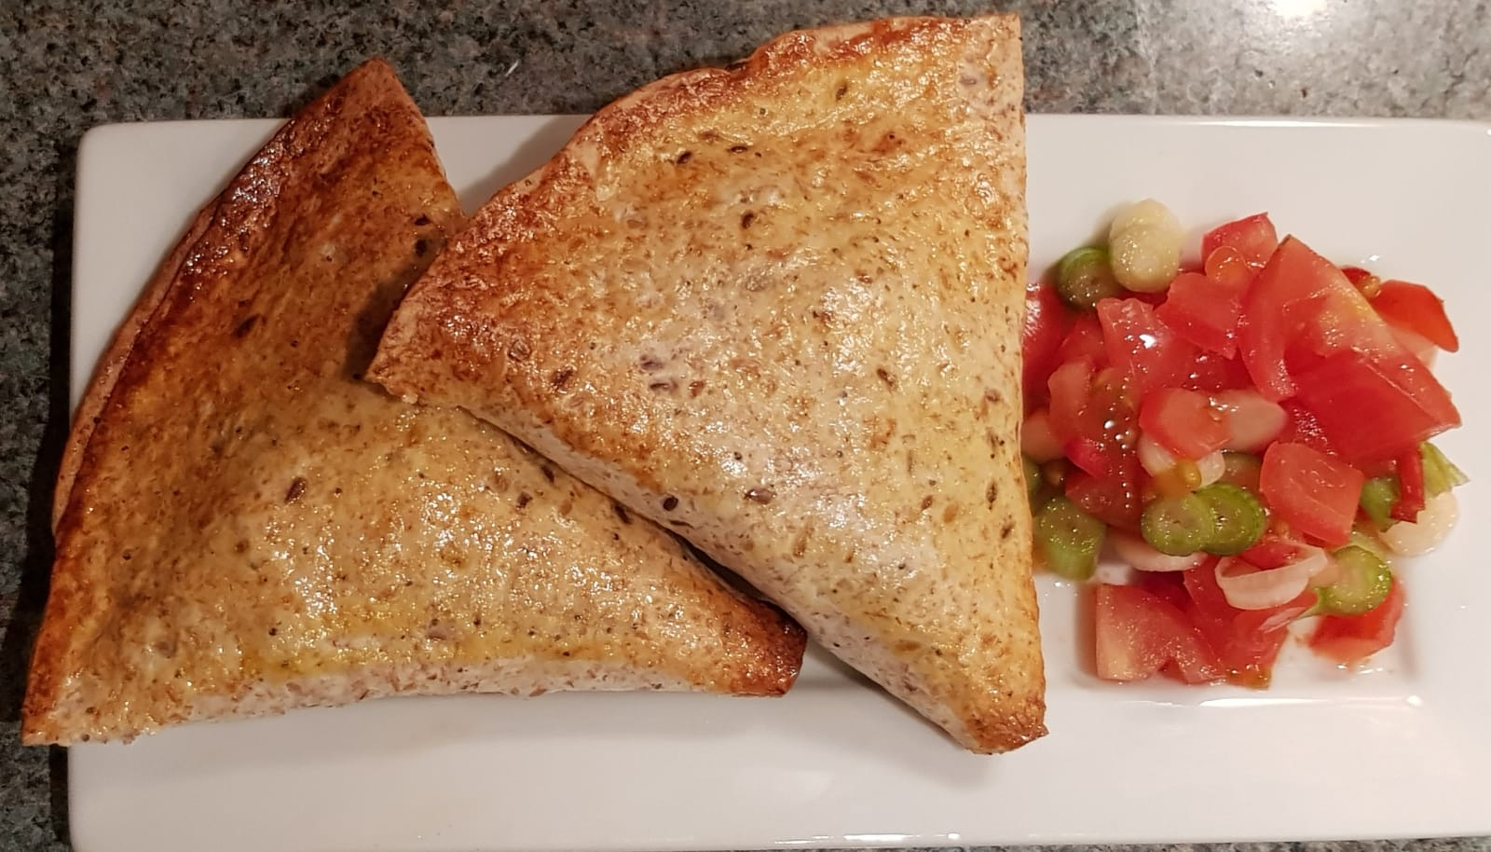






Mexican pockets
Why are we doing this?
Learning in lesson: focus on skill/knowledge, not recipe.
Demonstrates using an extended range of cooking equipment and skills with growing accuracy and confidence to prepare increasingly challenging ingredients:
  Weigh
  Chop, slice and dice
  Grate
  Mix, stir and combine
  Shape
  Glaze
  Bake
  Juice
  Demonstrates cooking with a heat source.
Quick recipe – under 1 hour. Can be made in pairs or groups.
Great for using up leftovers and easy to change/adapt ingredients.
Opportunity to develop descriptive vocabulary during tasting and testing, plus numeracy.

Slide 20
Mexican pockets
Method
Heat the oven to 200°C/gas mark 6. Line or lightly grease a baking tray.
Prepare the filling ingredients and place in a bowl:
  slice or snip the spring onions into rings;
  dice the pepper;
  chop the cooked chicken or tofu, if using;
  grate the cheddar cheese.
Add the kidney beans, peas and sweetcorn to the bowl. Stir in the chipotle paste or chilli powder.
Crack the egg into a jug and mix well with a fork.
Cut the wraps in half and brush the edges of each half with the beaten egg.
Leave for 30 seconds and then fold into a cone shape sealing the edges carefully.
Fill each cone 2/3rds full with mixture. Do not overfill otherwise they will be difficult to seal.
Brush the inside edges with egg. Leave for 30 seconds and then seal by pressing the edges together firmly.
Place the pockets on the baking tray and brush with egg.
Bake in the oven for 10 minutes until golden.
Ingredients
1 spring onion
½ red, yellow or green pepper
25g cooked chicken or tofu (optional)
20g reduced fat Cheddar cheese
50g canned kidney beans, drained and rinsed
25g frozen peas
25g canned or frozen sweetcorn
½ x 5ml spoon chipotle paste or 1 x 5ml spoon mild chilli powder
1 egg or 1 x 15ml spoon milk
2 large tortilla wraps or 4 mini wraps

Slide 21
Quick salsa
Ingredients
1 tomato
1 spring onion
1 x 5ml spoon lime juice (freshly squeezed or from a bottle)
¼ fresh chilli or 1 x ¼ 5ml spoon chilli flakes
Method
While the pockets are baking, prepare the salsa ingredients:
dice the tomato;
slice or snip the spring onion;
finely dice the fresh chilli;
squeeze the lime, if using a fresh lime;
2. Place all the ingredients in a small mixing bowl, add 1 x 5ml spoon of lime juice and mix well.

Slide 22
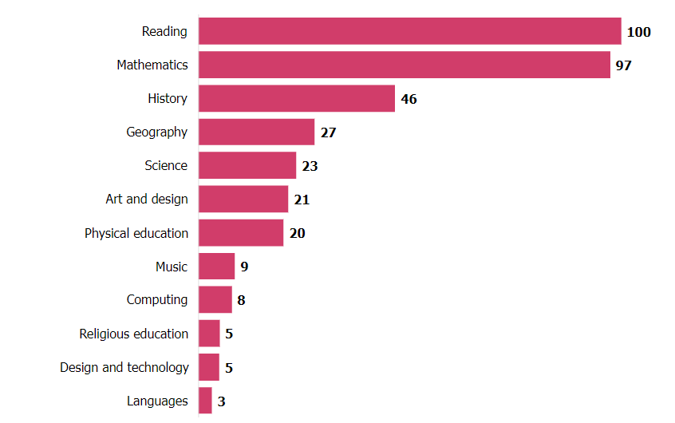
What to consider for a D&T Deep Dive
Ensure that a) the subject leader and b) all teachers are familiar with the NC Aims for D&T.
What is ‘unique’ about the D&T curriculum at your school (i.e. what topics / units / themes have you introduced specifically to meet the needs of your pupils?
What is pupils’ learning (over the course of their time at your school) building towards (by end of Y2 / Y6), including that of pupils with SEND? (How would you explain that the curriculum is ‘broad and balanced’)?
Are all teachers clear as to what they are assessing re: pupil’s learning (what criteria do you use to assess progress)?
Do have an example (or 2/3) to demonstrate pupil’s progress in an aspect of D&T?
Deep dive subjects in primary school inspections 2022/23 (percentages of inspections)
A P Associates
Resources to support teaching pupils with additional needs

Slide 23
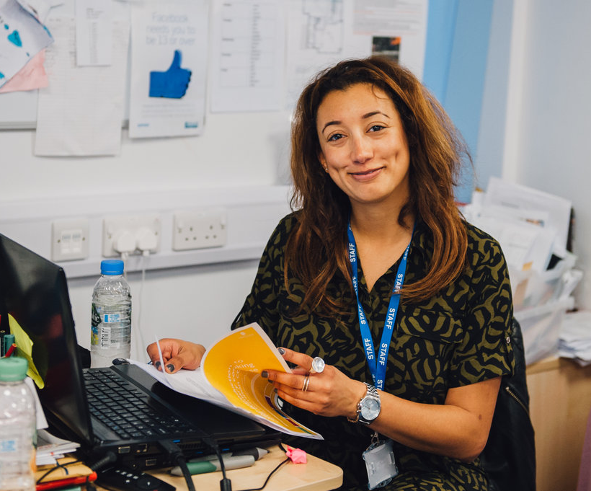
Further reading
The development and validation of age-appropriate children’s perceived cooking competence measures. Dr Fiona Lavelle
A critical review of children's culinary nutrition interventions, the methodologies used and their impact on dietary, psychosocial and wellbeing outcomes - Lavelle - 2
What to expect on a primary deep dive – some guidance for subject leaders
Inspecting the curriculum
The most common Ofsted deep Dive questions

Slide 24
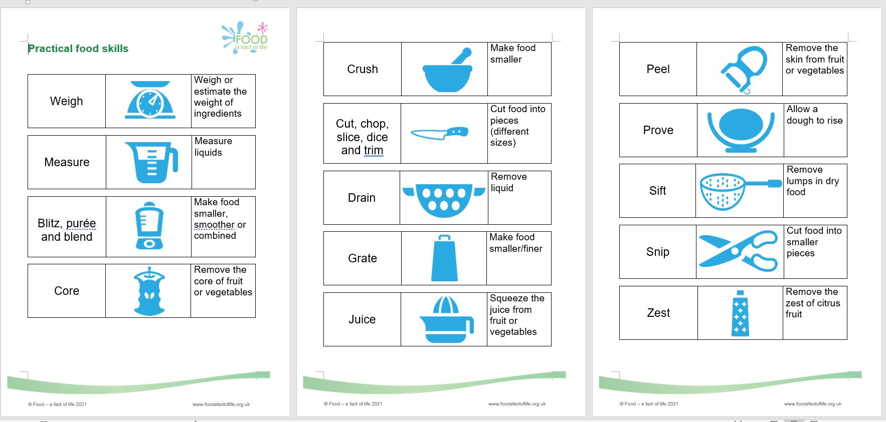
Practical food skills – pupil friendly version
https://www.foodafactoflife.org.uk/professional-development/ppd-toolkit/teaching-pupils-with-additional-needs/characteristics-of-good-practice-in-teaching-food-and-nutrition-education-to-pupils-with-additional-needs/#FSC

Slide 25
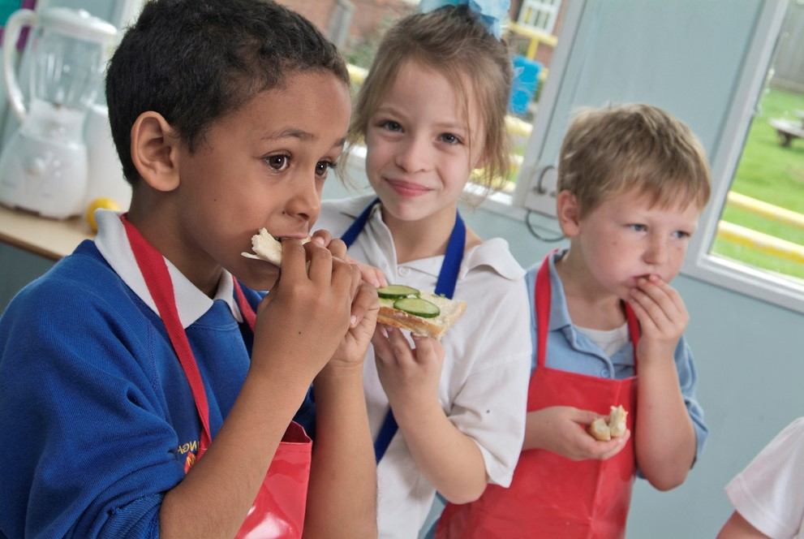
Future training events
One question you might be asked as part of an inspection is…
“How do you support new staff to develop the subject knowledge and pedagogical content knowledge needed to teach D.T effectively?”
The TPFN programme will help you answer and evidence this question!
Future training:
Tue 4 June 2024 – 4:30pm Cook-a-long - global recipes
Tue 9 July 2024 - 4:30pm Introducing our essentials online pack for food teaching in primary!
Remember that all webinars are recorded and can be found here.
Also don’t forget our INSET package – seven topical videos ideal for you and your colleagues.

Slide 26

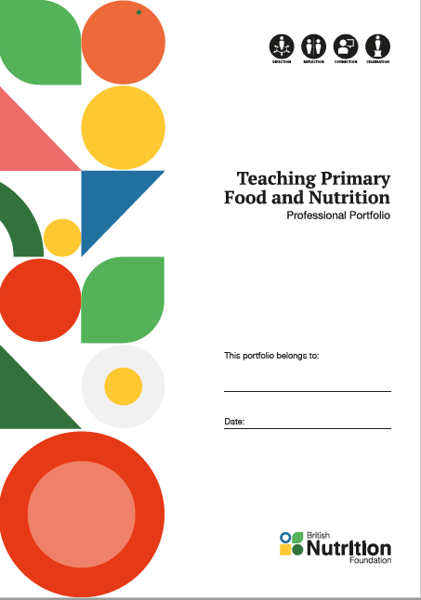
Teaching Primary Food and Nutrition (TPFN) professional development programme
To date…
600+ registrations
For primary school teachers, trainees and teaching assistants
To build practitioner confidence and competence in teaching food and nutrition
Supporting high quality food and nutrition lessons, and a whole school approach to food
Professional Portfolio (binder and booklet) for the first 1,500 registrants
Free training – webinars, virtual practical workshops, online courses and supporting resources
Supported by the All Saints Educational Trust
https://www.foodafactoflife.org.uk/teaching-primary-food-and-nutrition/

Slide 27

Thank you
Please complete the webinar evaluation by clicking on the link below:
Demonstrating progression: Practical food skills and cooking with heat
You will receive a link to the certificate once you have completed the evaluation. Please download the certificate, add your name and print it out for your records.

Slide 28
Thank you
For further information about TPFN training or to find recordings of previous webinars and workshops,
click here.

