Slide 1
Let’s eat well and stay healthy!

Slide 2
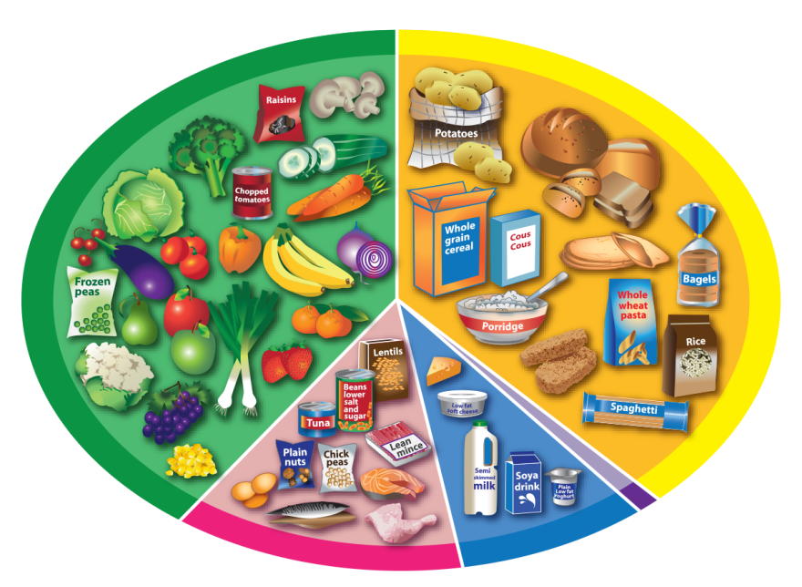

Let’s eat well and stay healthy!
6-8
a day

Slide 3
We need to eat different types of food to stay healthy.
What can you see here?

Slide 4
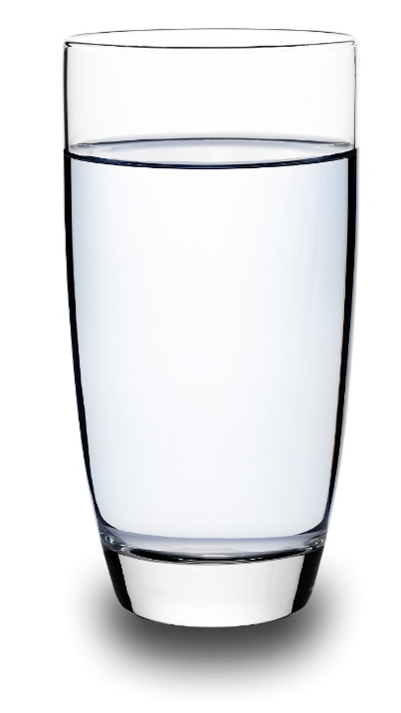
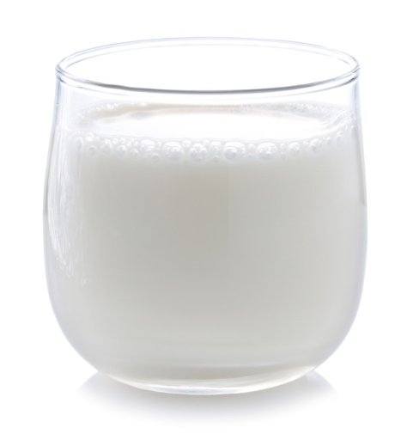
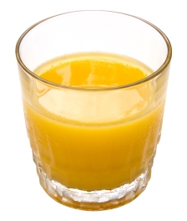
We need 6-8 drinks every day to be healthy.
What can you see here?

Slide 5
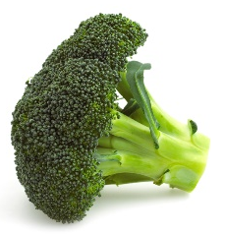
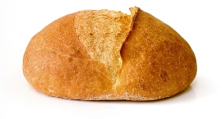
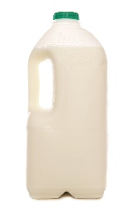
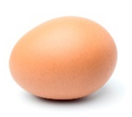
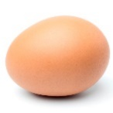
Can you find this food on the Eatwell Guide?
Broccoli
Bread
Milk
Eggs

Slide 6
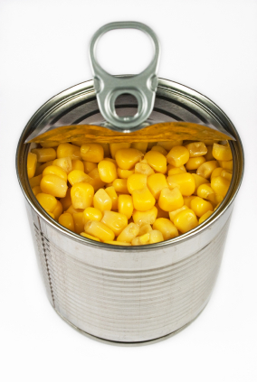
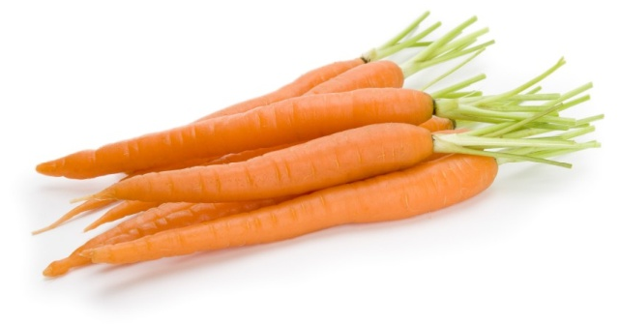
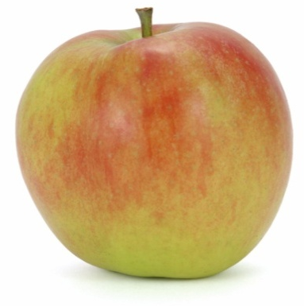
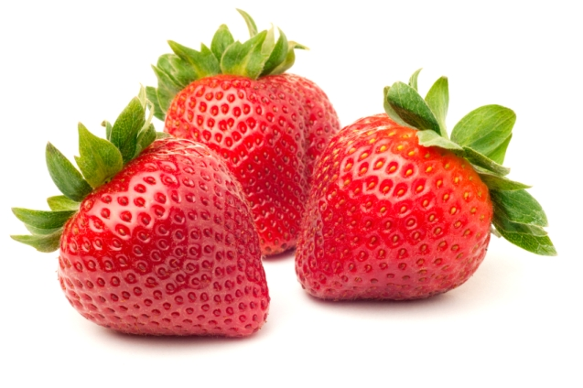
We need to eat lots of food like this.
Can you name five different vegetables?

Slide 7
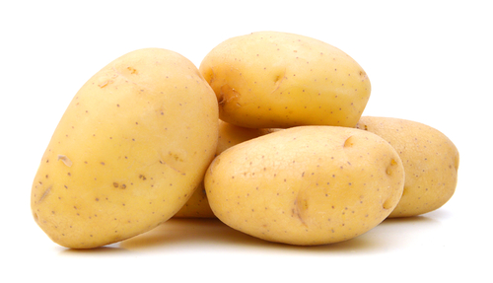
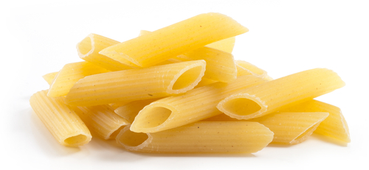
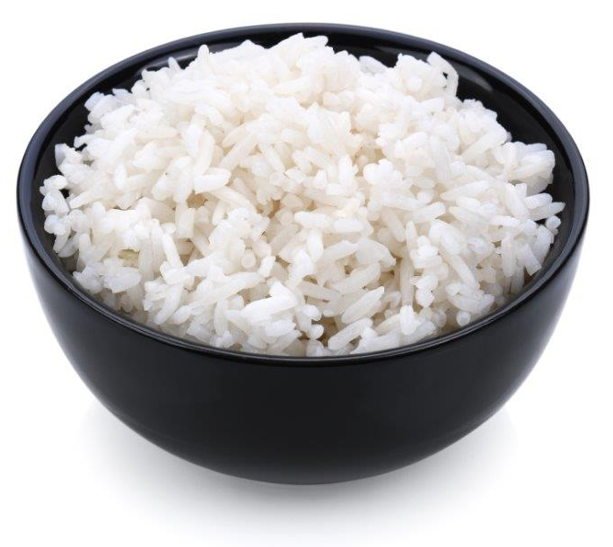
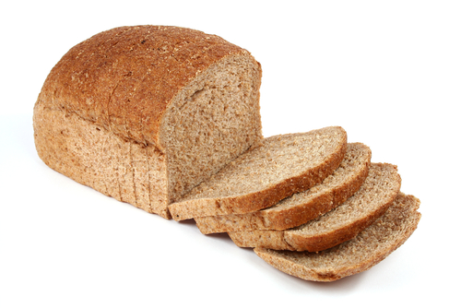
We need to eat lots of food like this.
Which of this type of food is your favourite?

Slide 8
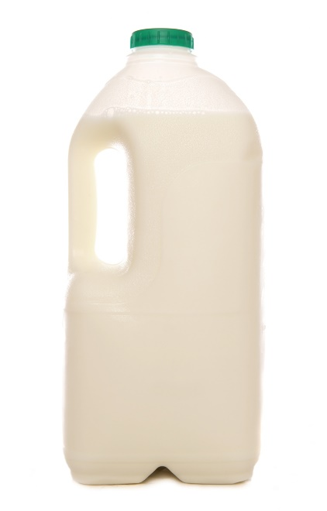
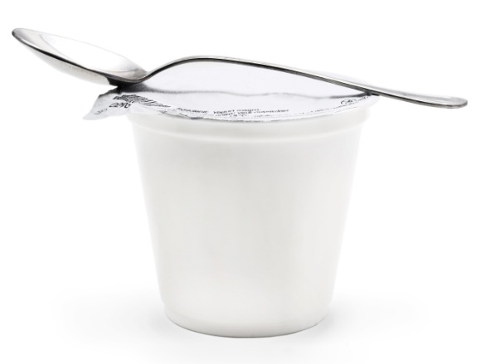
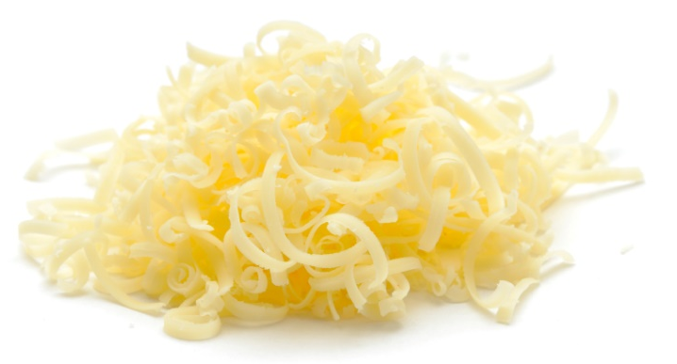
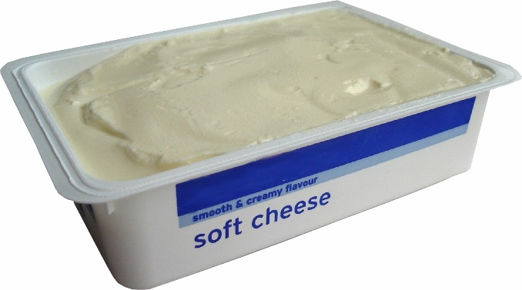
We need to eat some food like this.
Have you eaten any of this food today?

Slide 9
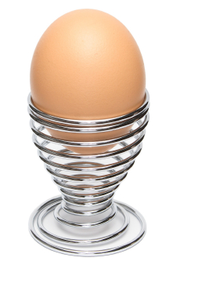
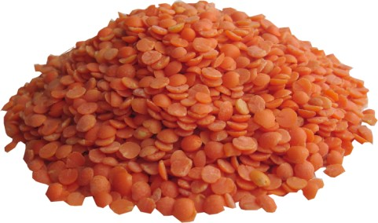
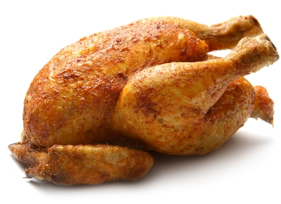
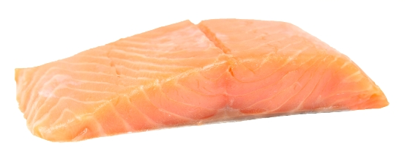
We need to eat some food like this.
What food can you see here?

Slide 10
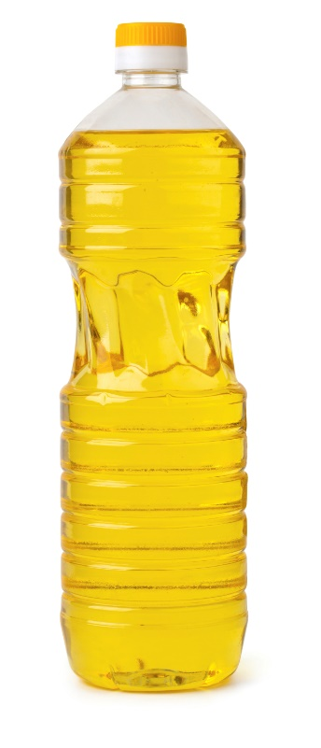
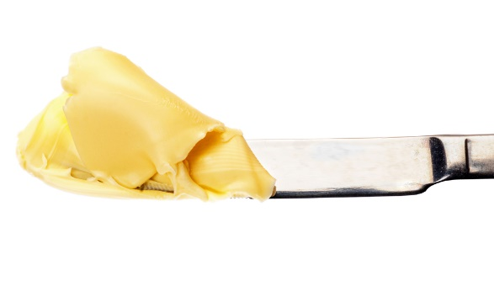
We only need a little of food like this.

Slide 11
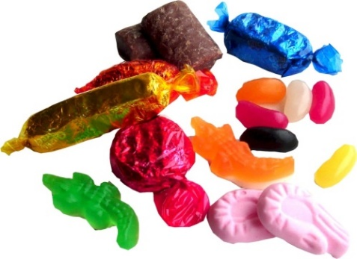
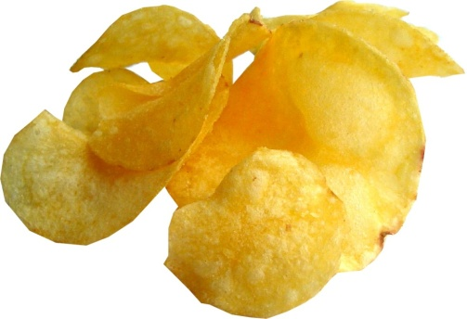
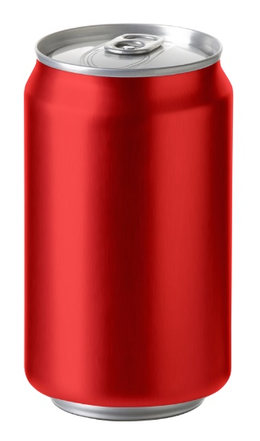

These types of food and drinks are not needed.
If you do have these, only have a little and just sometimes.

Slide 12
Do we need lots, some or a little of food like this?

Slide 13
Lots!

Slide 14
Do we need lots, some or a little of food like this?

Slide 15
Lots!

Slide 16
Do we need lots, some or a little of food like this?

Slide 17
Some!

Slide 18
Do we need lots, some or a little of food like this?

Slide 19
Some!

Slide 20
Do we need lots, some or a little of food like this?

Slide 21
A little!

Slide 22
Do we need food like this to be healthy?

Slide 23
Not needed!

Slide 24

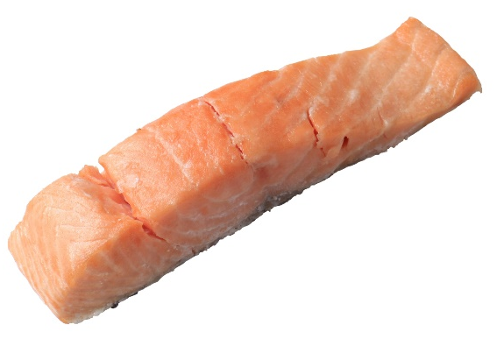

We need to eat different types of food and have plenty to drink to stay healthy.
What can you see here?

Slide 25
Let’s eat well and stay healthy!
For further information, go to:
www.foodafactoflife.org.uk
This resource meets the Guidelines for producers and users of school education resources about food.

