Slide 1
Food packaging

Slide 2
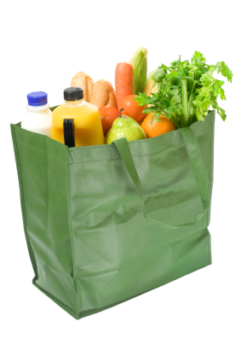
Information for the nation
Over the last 50 years the way we buy food has changed. In the past, some food items were usually sold ‘loose’ and taken home in a paper bag.
Due to advances in technology, most food items are now sold pre-packed.

Slide 3
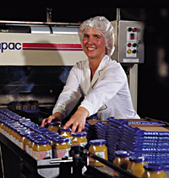
The purpose of packaging
The aims of packaging include:
prevent physical damage, e.g. from knocking, shaking or crushing;
prevent contamination from micro-organisms, pollution or vermin;
protect against dehydration or dampness;
protect the product’s nutritional and sensory characteristics;
keep the product in peak condition;
help to increase a product’s shelf life;
help reduce food waste.

Slide 4
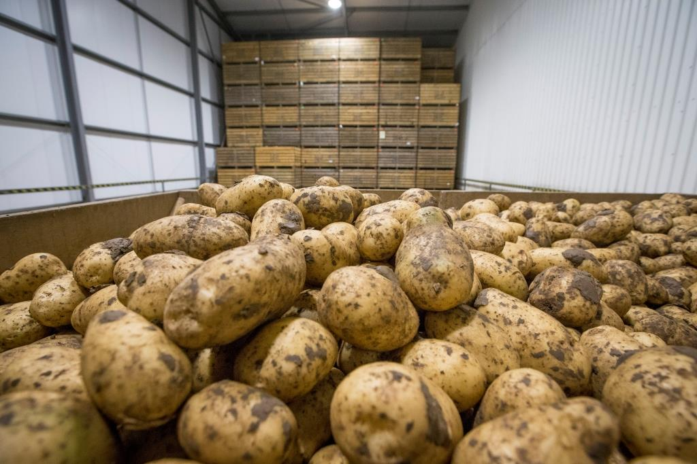
Protection
Food products often have a long journey from the initial manufacturer until finally being eaten by consumers. They must be stored in warehouses before being transported and distributed to retailers.
They are then likely to be stacked in more warehouses before being sold.
At all these stages the product may be damaged by careless handling or changes in storage conditions such as light, humidity and temperature.

Slide 5
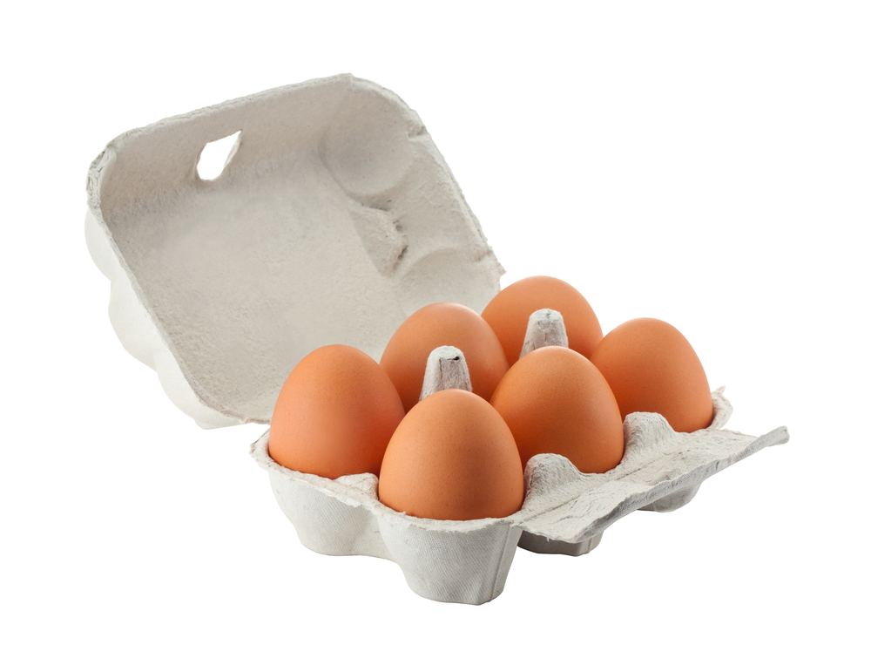
Protection
The aim of packaging is to contain the product and keep it intact.
This means that liquid products do not leak and that dry materials, such as flour, do not spill out.
It is sometimes necessary to design packaging that is shaped especially to contain a particular food, e.g. egg boxes, so that the product is held securely and well protected from damage.

Slide 6
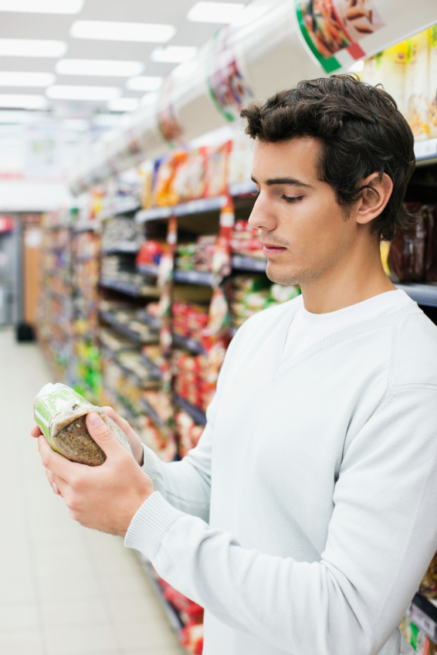
Labelling
Packaging is also designed to be visually stimulating and provide information about the product to help the customer.
The following information must be shown on the front of packaged foods:
the name of the food;
a ‘best before’ or ‘use by’ date (or instructions where to find it);
any necessary warnings – there must be appropriate warning on the label if food contains certain ingredients.

Slide 7
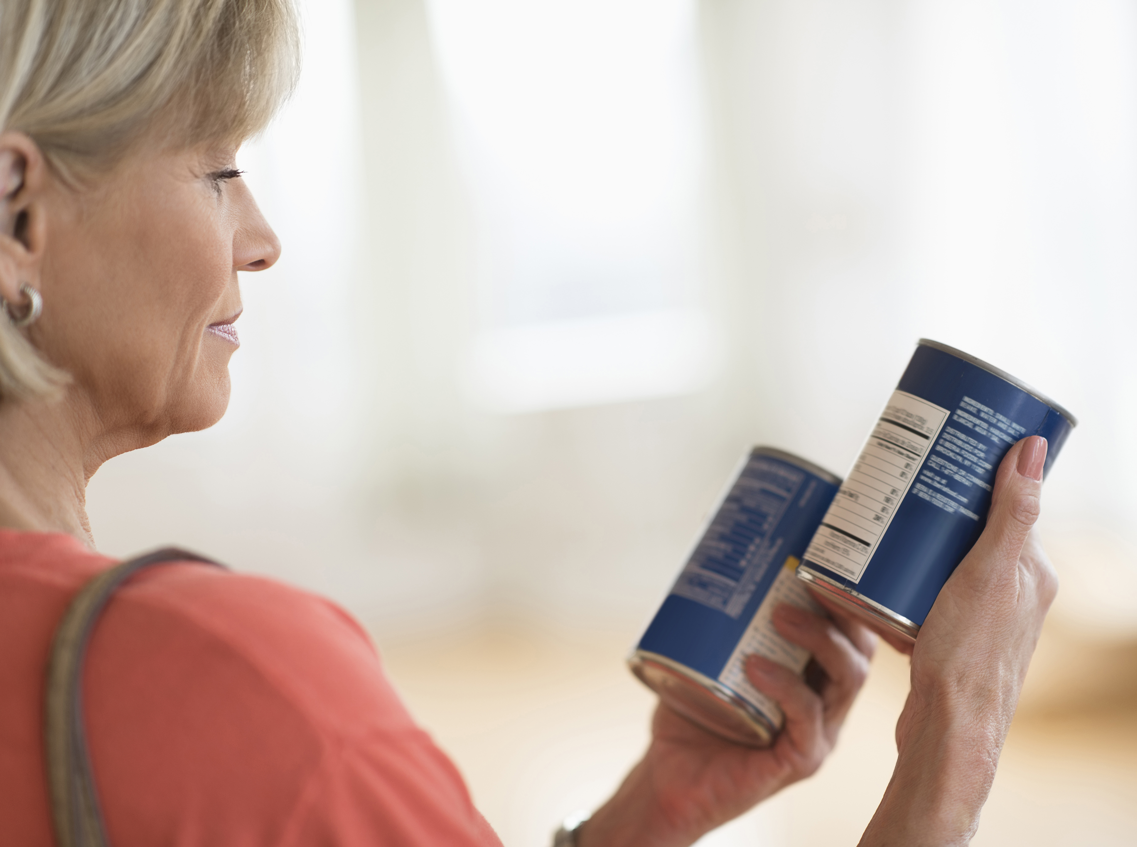
Back of pack labelling
The following information must also be shown but it can be on the front, side or back of the packaging:
a list of ingredients in descending order with allergens identified in bold, italics, underlined or highlighted;
the name and address of the manufacturer, packer or seller;
any special storage conditions;
instructions for use or cooking, if necessary;
the weight/volume (metric) (unless under 5g);
nutrition information.

Slide 8
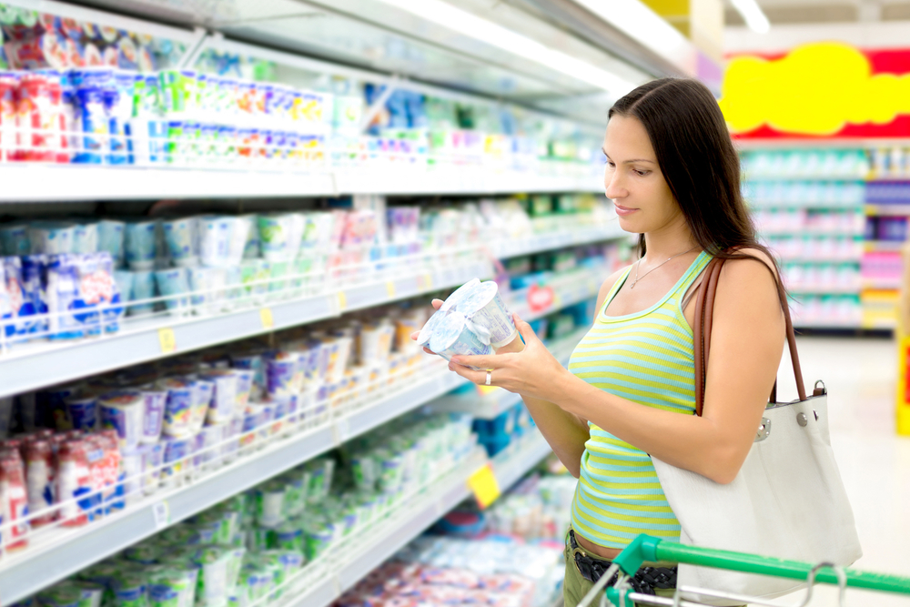
Labelling
Manufacturers must also show the following if they apply to the product:
a warning for drinks with an alcohol content above 1.2%;
a warning if the product contains GM ingredients, unless their presence is accidental or 0.9% or less;
a warning if the product has been irradiated (a preservation technique);
the words ‘packaged in a protective atmosphere’ if the food is packaged used a packaging gas.

Slide 9
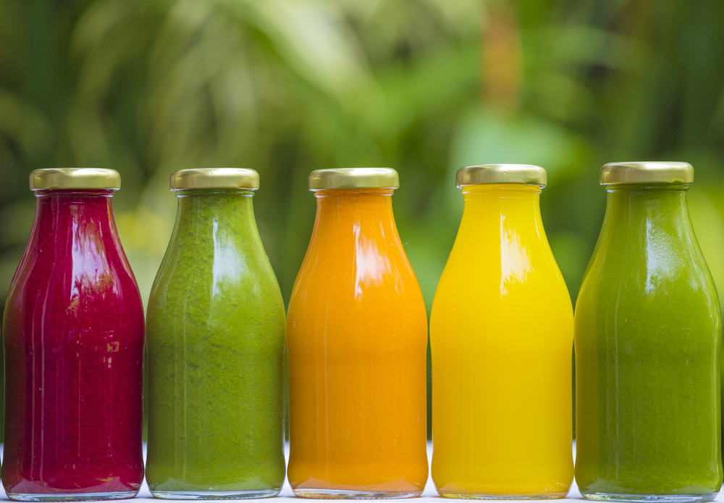
Labelling and package design
The overall design of packaging, from its shape to the style of writing used, indicate the type of product it contains and for whom it is intended.
It may also use ‘graphical’ tricks to give a sense of quality, e.g. that it has been hand made.

Slide 10
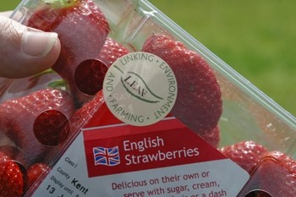

Consumer information
Food assurance schemes have been developed to compliment food legislation. They cover the food chain from farm to fork.
An example is the Red Tractor food assurance scheme. It covers:
cereals, oilseeds, pulses and sugar;
fruit, vegetables and salad;
milk;
chicken;
beef, lamb and pig meat.
Multi-ingredient products must contain at least 65% Red Tractor certified ingredients to be labelled as Red Tractor products.

Slide 11
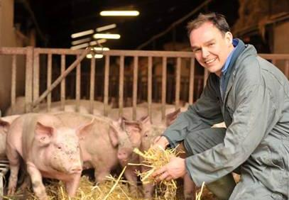
Consumer information
The Red Tractor logo can only be used to label ingredients from farmers, growers and food processors that have been inspected and certified to strict standards which cover:
food safety – makes sure your food is safe to eat;
animal welfare – makes sure animals have everything they need for a good quality of life;
environment – makes sure farmers protect the countryside by preventing pollution of watercourses, soil, air and wildlife habitat;
traceability – every part of the food supply chain is inspected to ensure food carrying the logo is accounted for and can be traced back to UK farms.

Slide 12
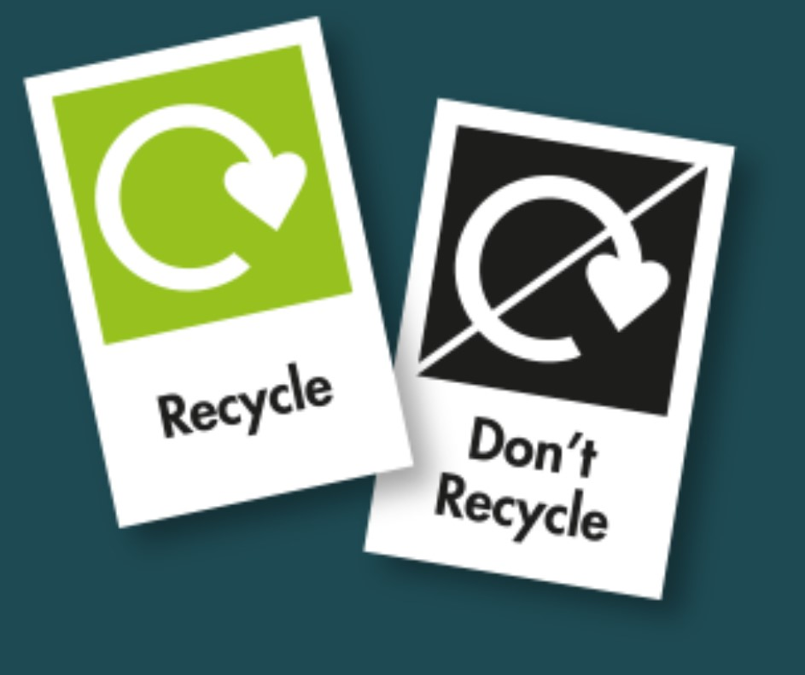
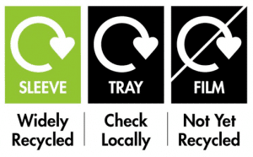
Consumer information
There is also forthcoming On-Pack-Recycling-Label (OPRL) to support consumers with information.
Producers will be required to label most packaging using the Recycle Now ‘swoosh’ and “relevant wording” by April 2026, a year later than initially proposed.
Plastic films and flexibles will need labels by 31 March 2027.
About OPRL - OPRL
Source – request image use

Slide 13
On-Pack-Recycling-Label (OPRL)
The OPRL labelling system takes account of the whole recycling. Where possible, they promote the use of two primary labels:
Recycle – 75% or more of UK local authorities collect this type of packaging through household recycling collections. It is then effectively sorted, processed, and sold as recyclate for use in new packaging or products.
Do Not Recycle – Fewer than 50% of UK local authorities collect this type of packaging through household recycling collections, and/or it is not effectively sorted, processed or sold as recyclate for use in new packaging or products.
About OPRL - OPRL
Source – request image use

Slide 14
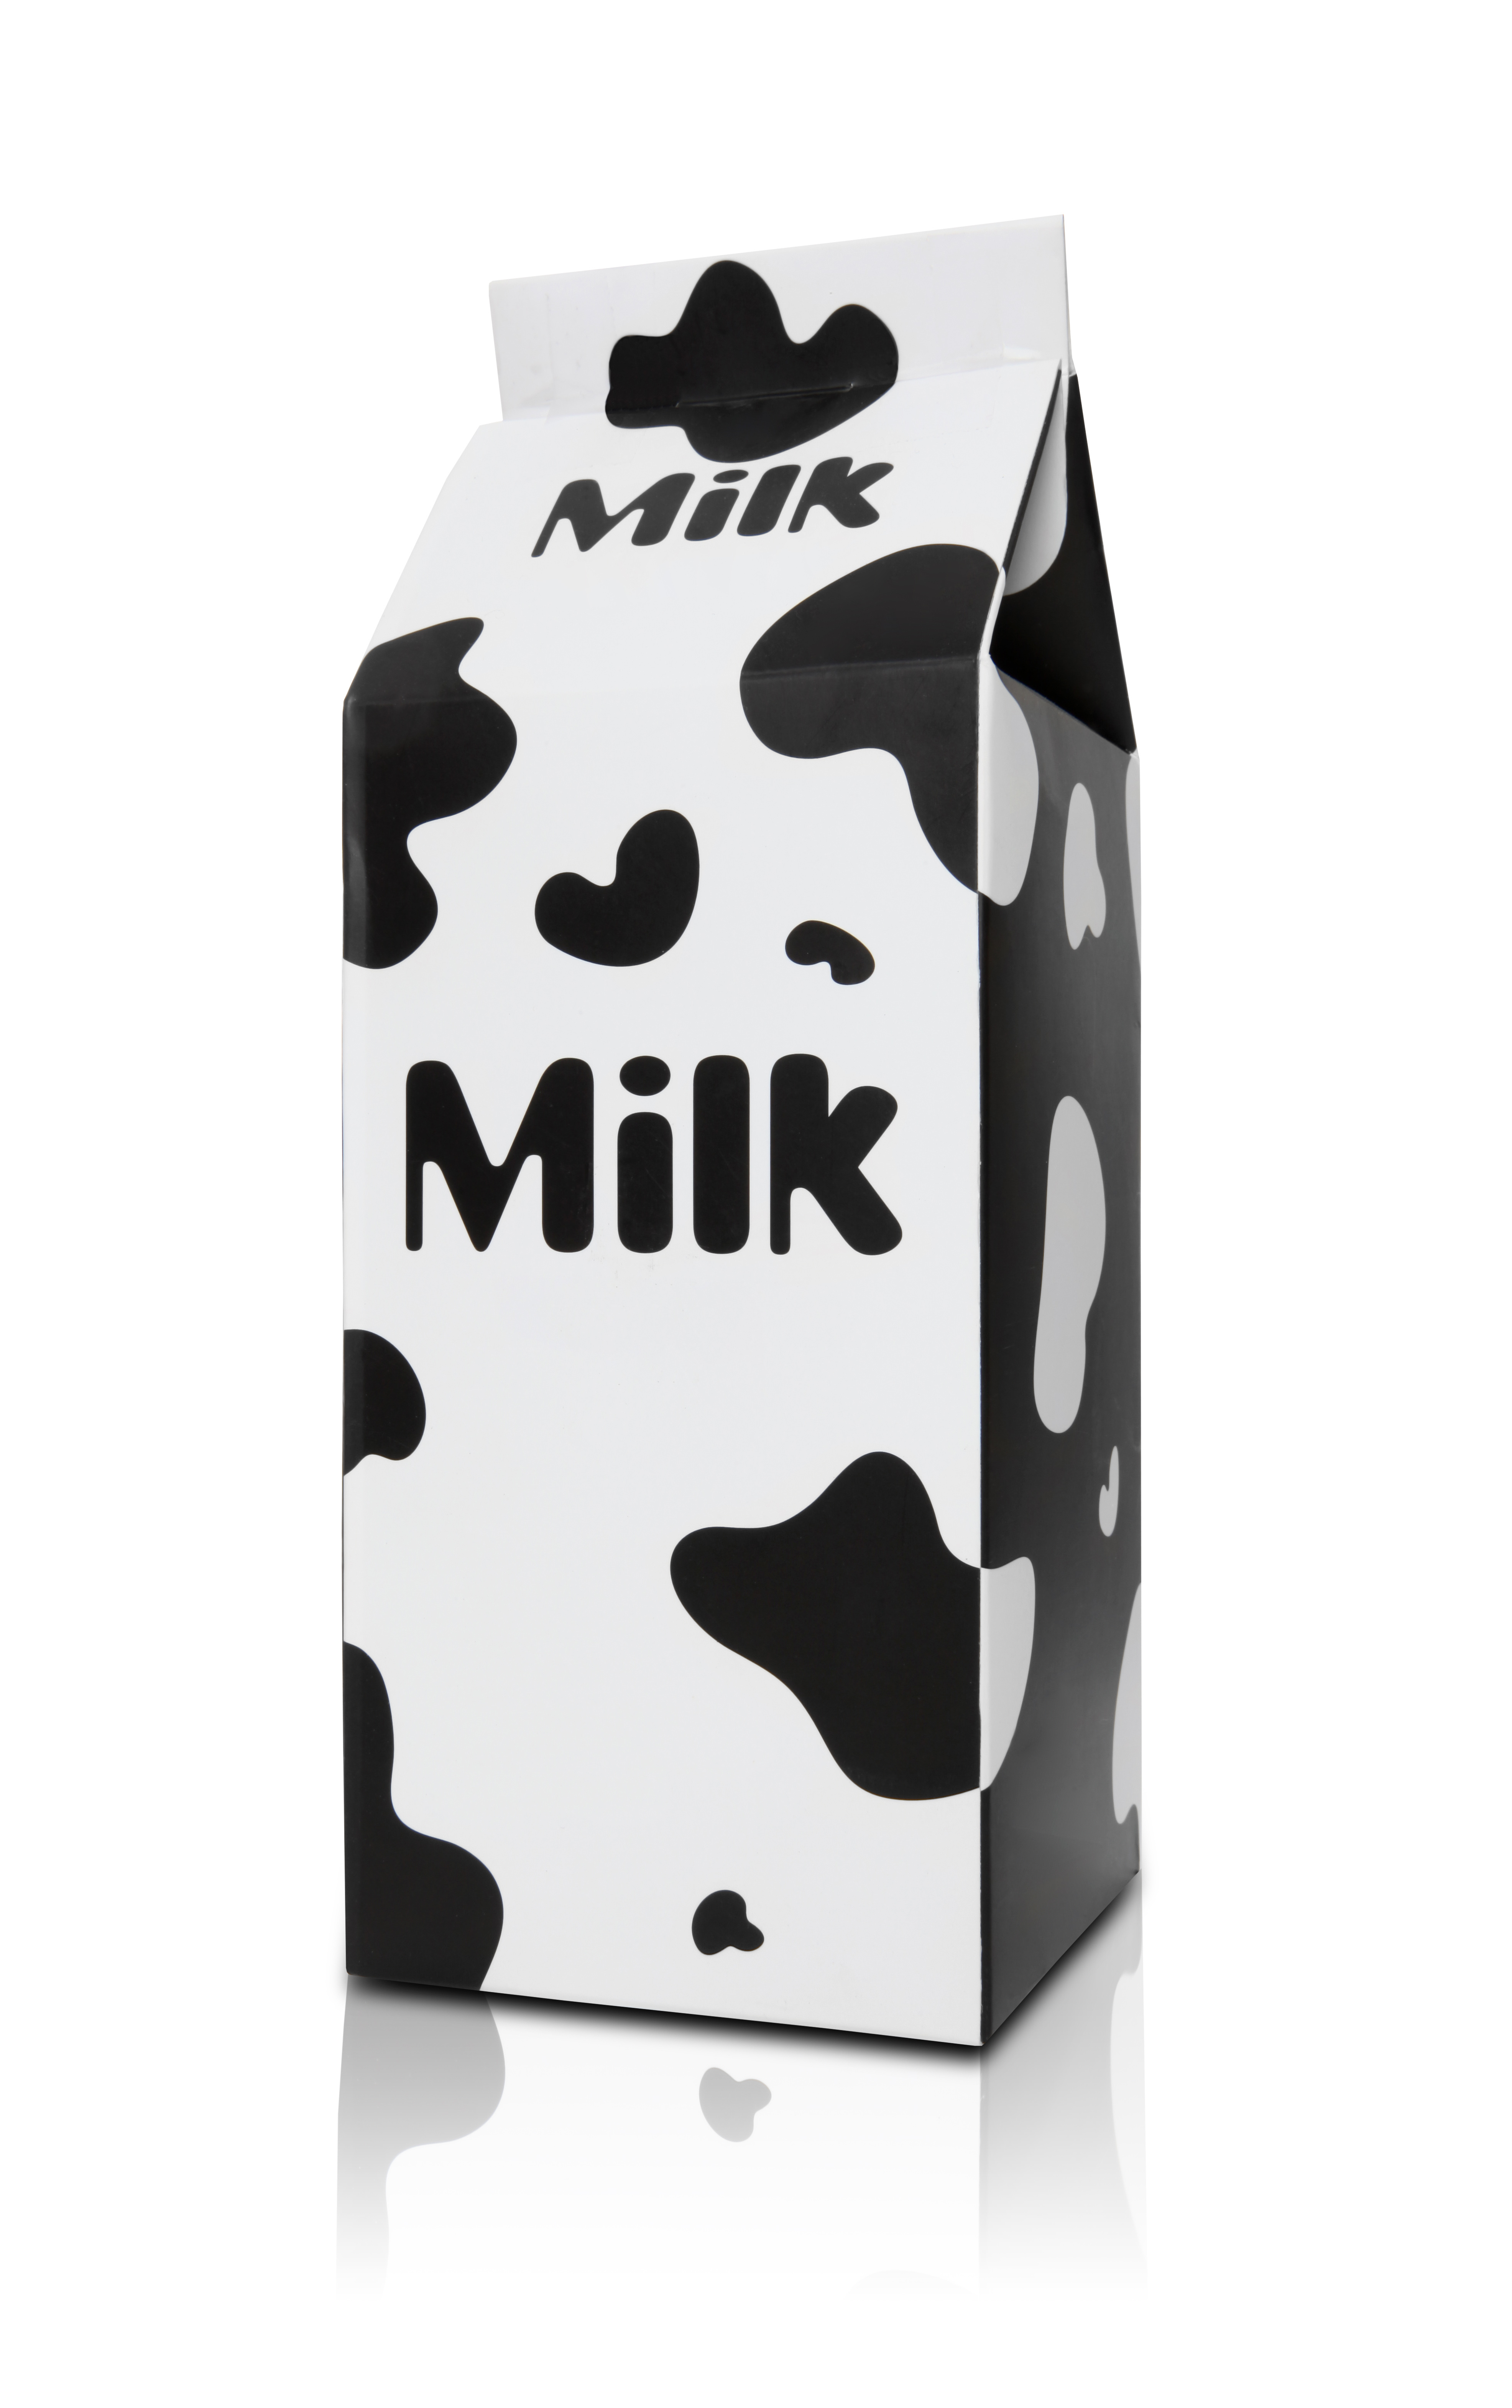
Packaging design
When designing packaging it is important to consider the following:
is it easy to handle and open?
is it a convenient shape, so it is easy to stack?
which colours will be used on the packaging?
what size of print should be used? (Can consumers read it easily?)
will it be economical to produce?
what about environmental considerations? (Will it be recyclable or does it make minimum use of natural resources?)

Slide 15

Packaging design
Increased rates of production during the last few decades have made it necessary to use different methods and materials to pack and protect food products.
However, other factors also determine the choice of materials used, especially in relation to food hygiene and safety. For example, the material must be suitable for the food, as some chemicals present in the food or packaging may react together.

Slide 16
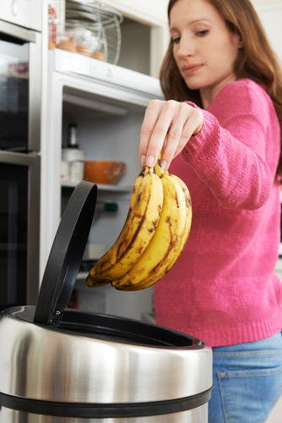
Packaging and food waste
Food packaging helps extend the shelf life of perishable items, reducing the likelihood of premature spoilage and waste.
Clear labelling and portion control packaging aid consumers in using appropriate amounts, reducing leftovers that might otherwise be discarded.
Additionally, airtight and resealable packaging options help maintain freshness, allowing consumers to store unused portions for later consumption, thus reducing overall food waste.

Slide 17
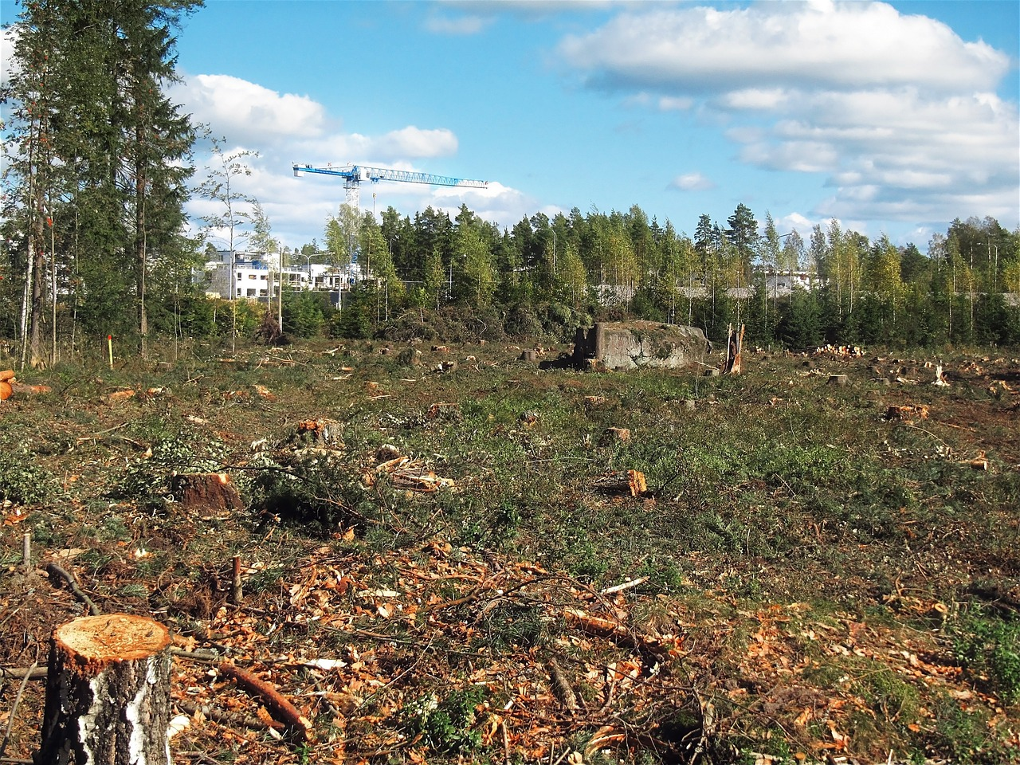
Food Waste and its Environmental Impact
Food waste has significant environmental implications, contributing to greenhouse gas emissions, the depletion of natural resources, and the loss of biodiversity.
Approximately one-third of all food produced for human consumption is lost or wasted globally.
In the United Kingdom, households are responsible for 70% of all food waste – over 7 million tonnes.
Source

Slide 18
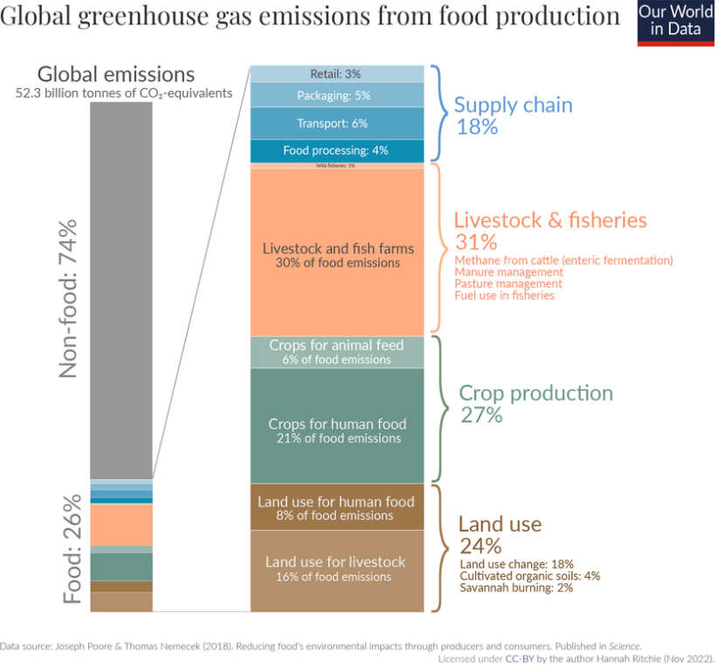
Food Waste and its Environmental Impact
Food waste is responsible for approximately 7% of global greenhouse gas emissions.
If food waste were a country, it would be the third-largest emitter of greenhouse gases after the United States and China.
Source – request image use

Slide 19
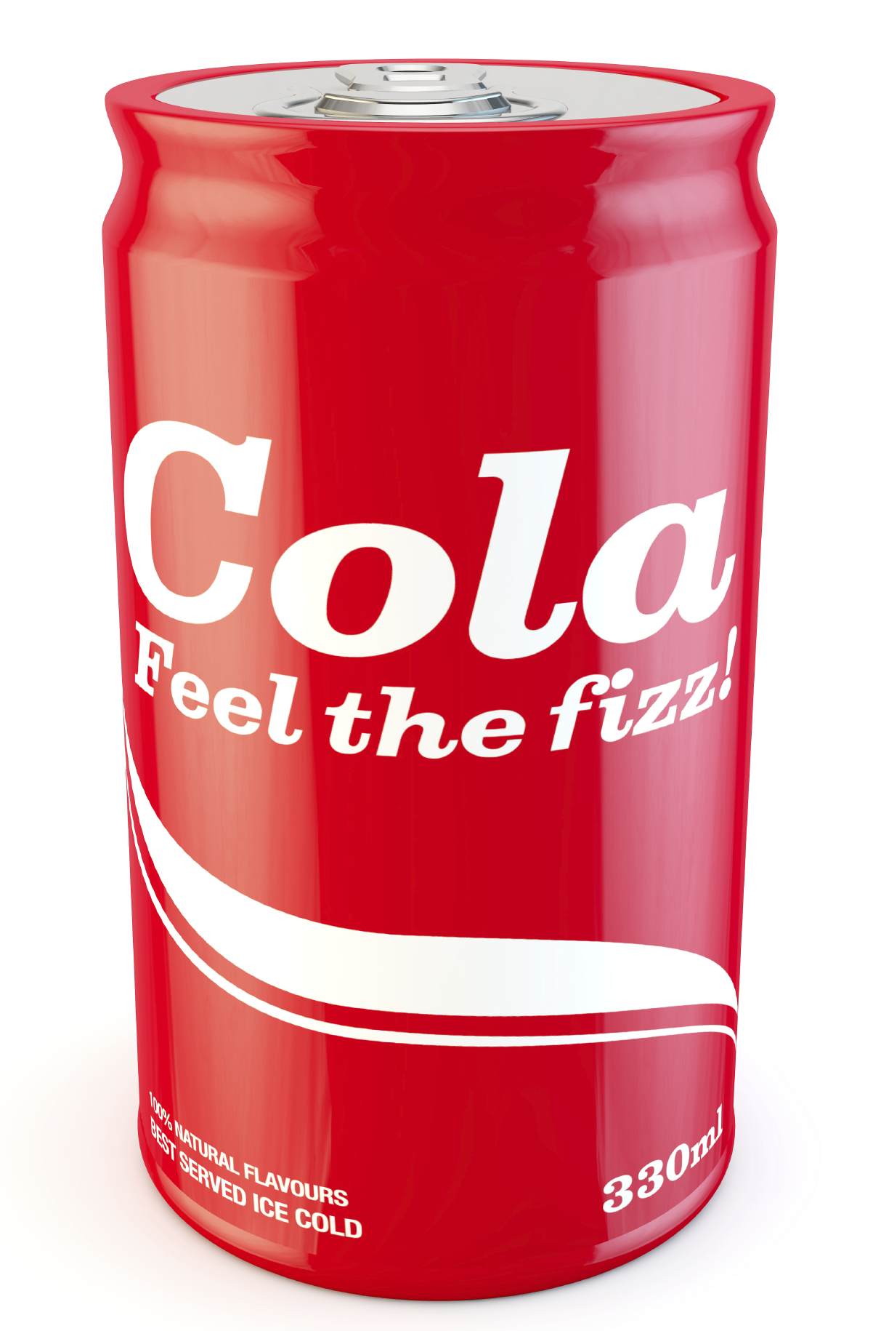
Example: Food cans
Cans were traditionally made from tin plate sheet, but now more commonly aluminium is used (for drinks).
The inside of the can is often sheet coated with lacquers to prevent the cans rusting and reacting with the contents, especially acidic foods.

Slide 20
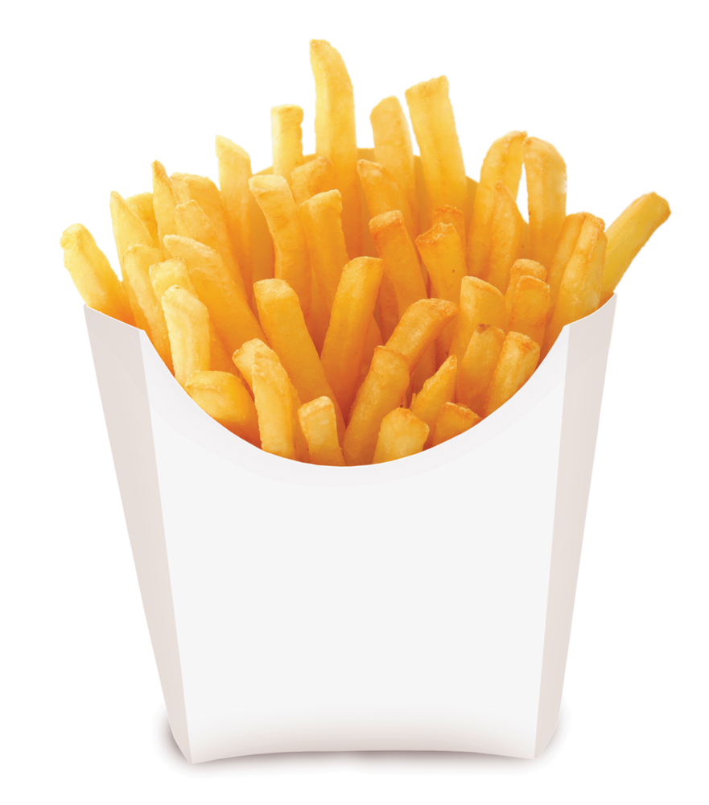
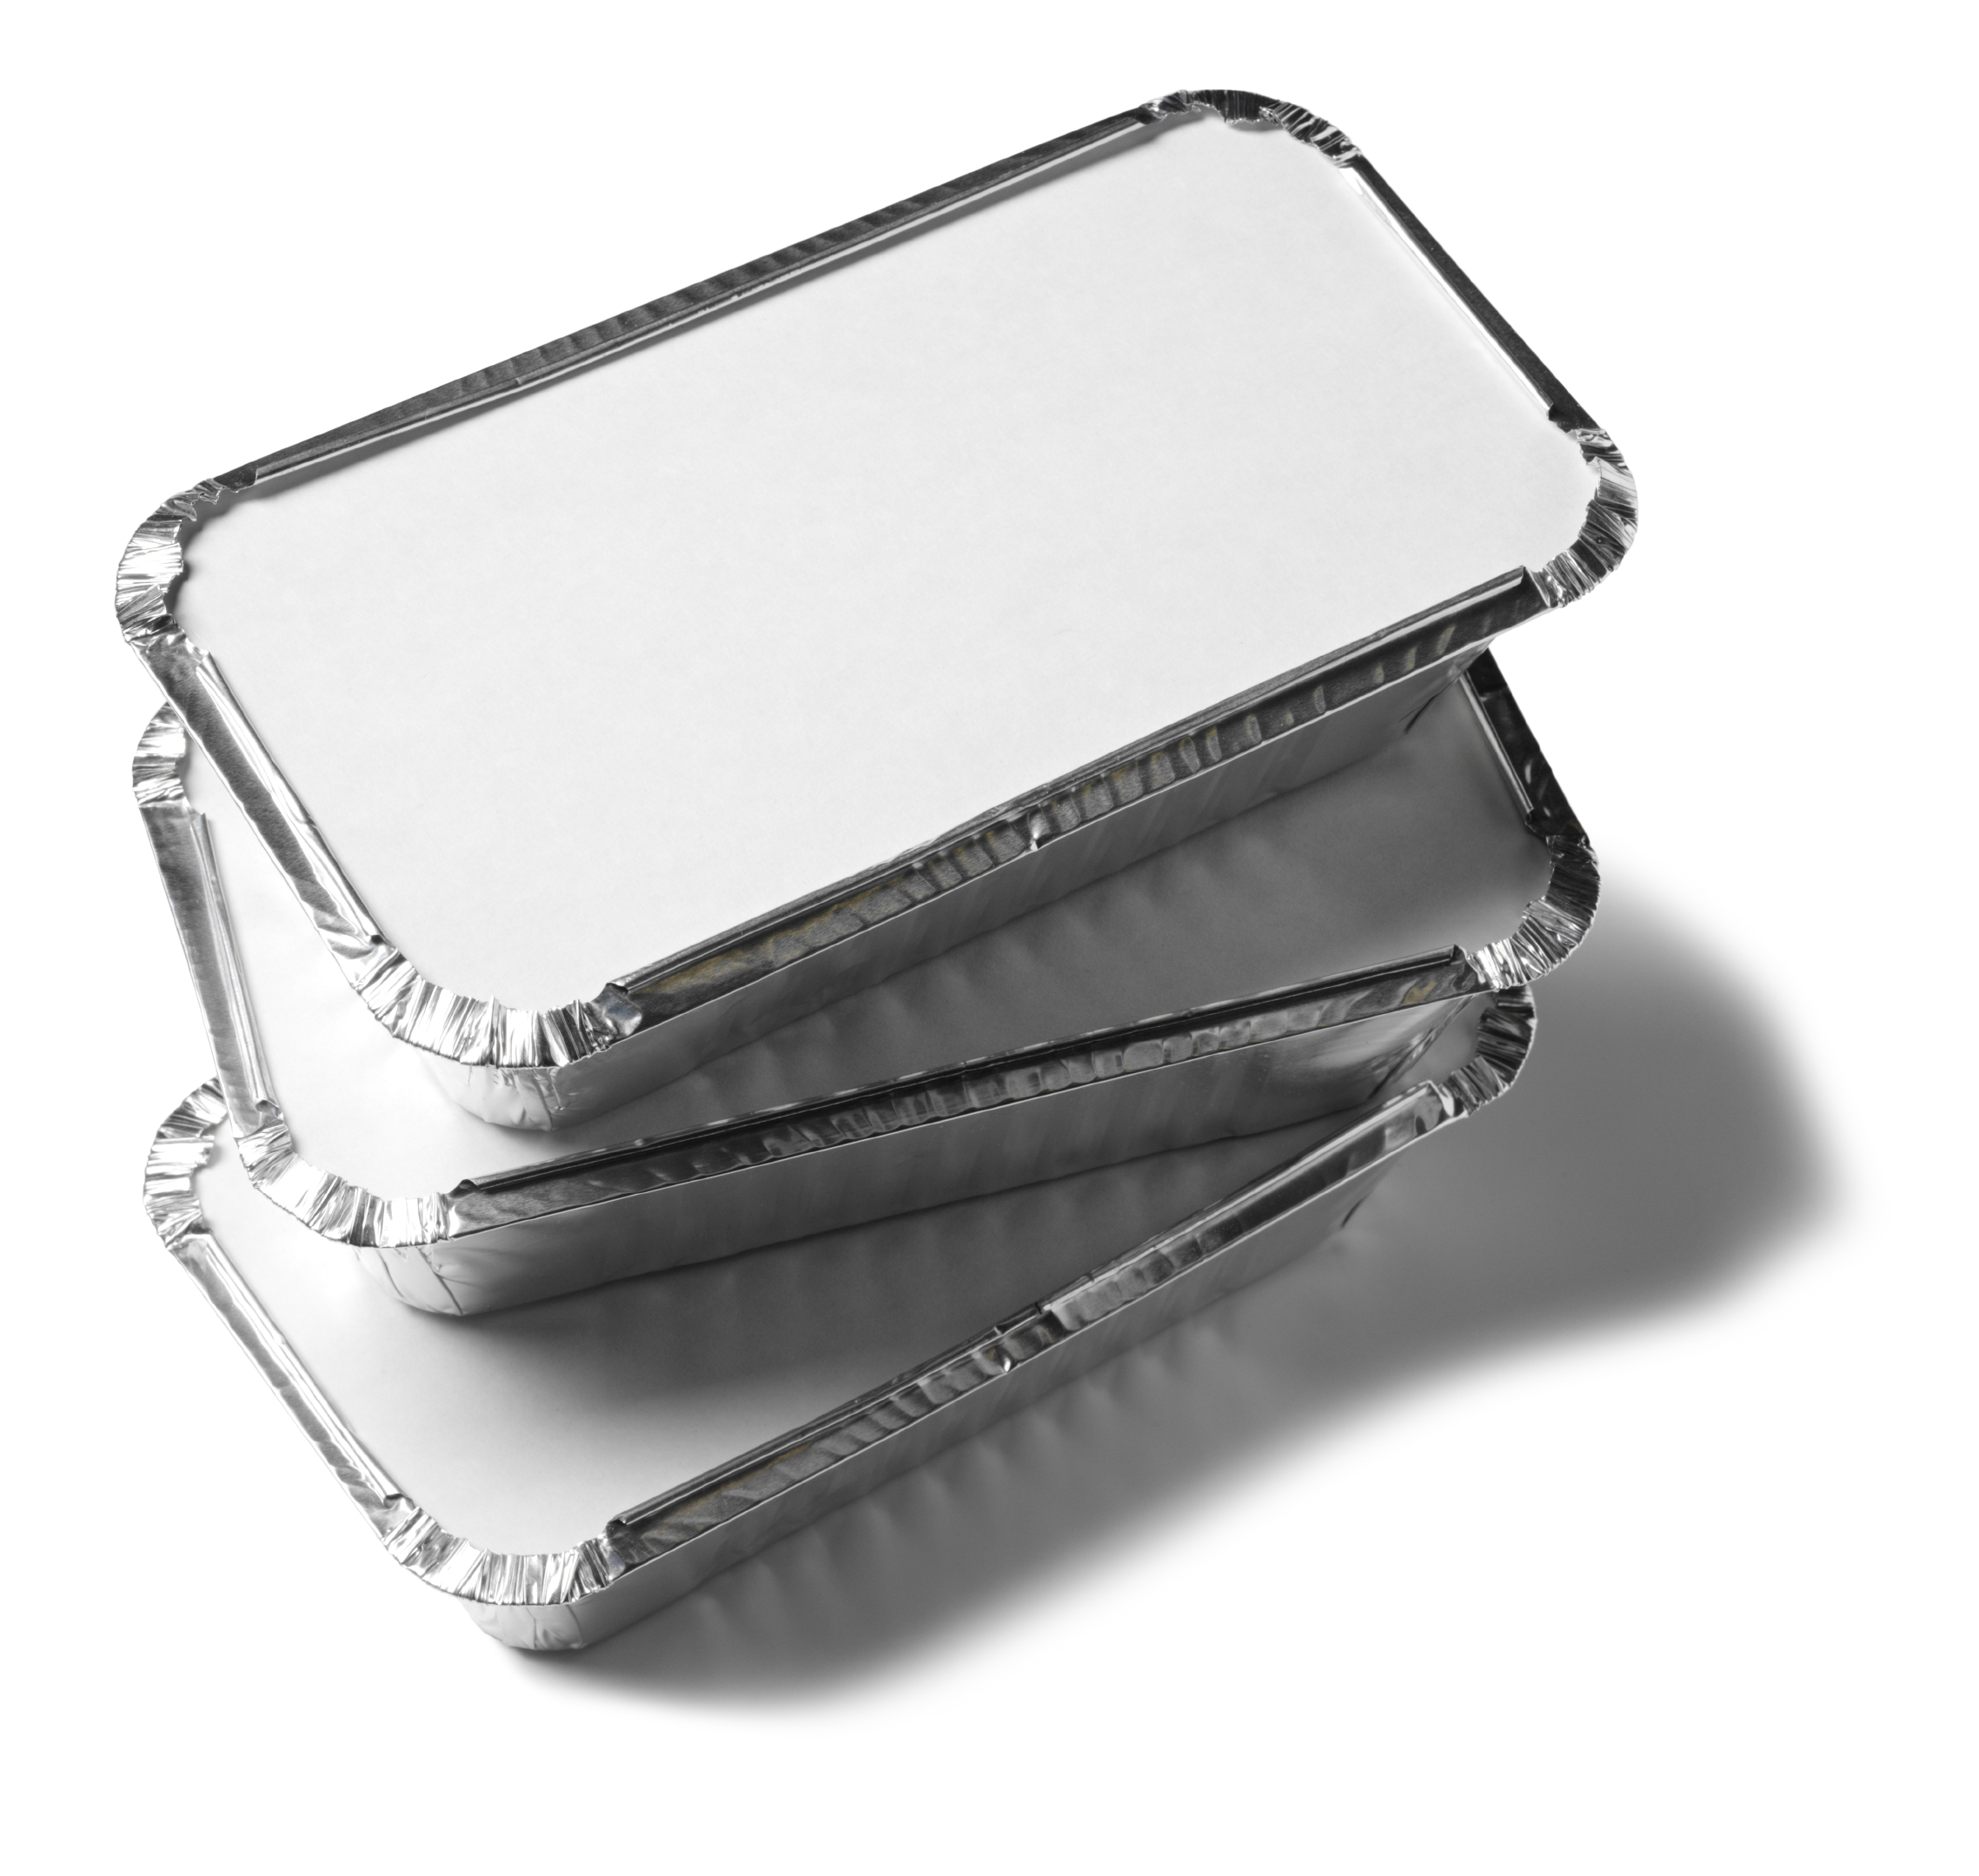
Example: Paper, board and foil
Paper, board and foil are commonly used to package foods. Board used for food packaging is often coated with a wax of polythene to prevent interaction with contents.
Most paper or board should be discarded before heating, but some products frozen on specially treated board may be cooked in microwave ovens.
Foil trays are suitable for both freezing and heating in conventional ovens.

Slide 21
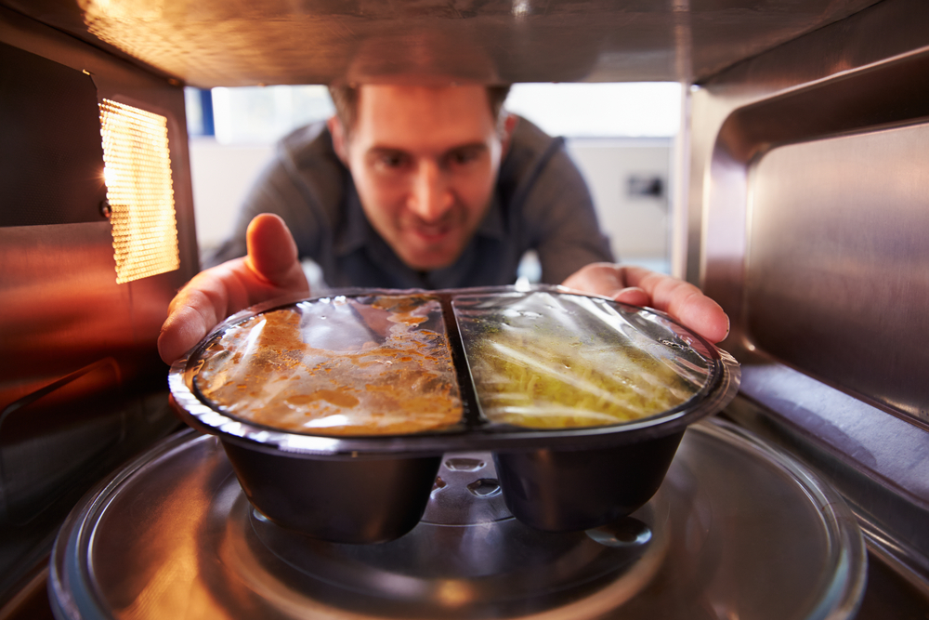
Examples: Plastics
Food packaging uses a wide range of both rigid and flexible plastic materials including:
polythene – low density is used as a film wrapping, resistant to water. High density is used for ‘boil-in-the-bag’ products;
polyamide (nylon) – provides a very good barrier to oxygen, so used for vacuum packaging, especially for foods containing fat (which can be susceptible to oxidation).

Slide 22
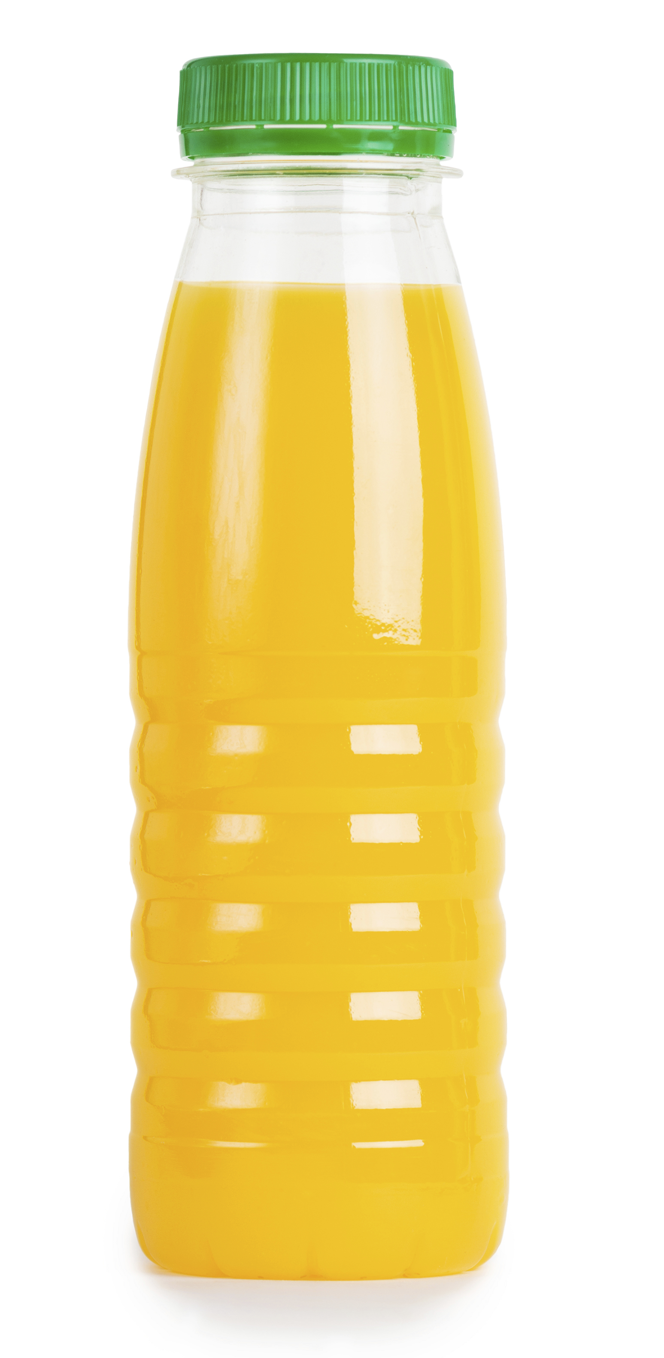
Examples: Plastics
More examples of plastic packaging include:
• polyethylene terephthalate (PET) rigid plastic bottles, light-weight, little risk of breakage and keep the fizz in carbonated drinks;
• polystyrene – expanded polythene used for trays and insulated containers to keep food products cold, e.g. ice cream and sorbets or hot, e.g. coffee, soup and burgers.

Slide 23
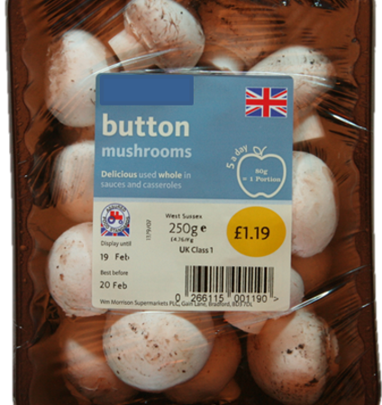
Example: Cellulose films
Cellulose films are used for different types of food packaging, because they have a range of characteristics such as different degrees of moisture proofing.
Some cellulose films are heat sealable.
They can be used, for example, as window patches in cartons.

Slide 24
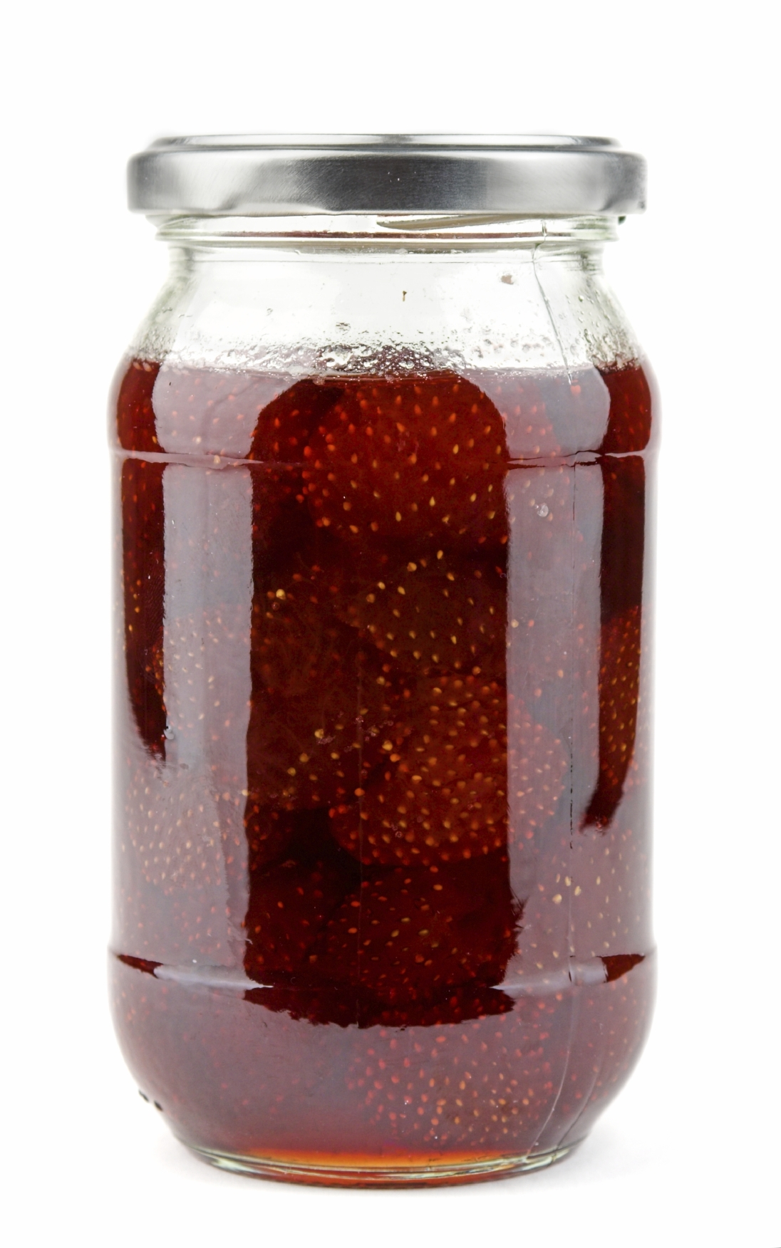
Example: Glass
Glass has been used for food packaging for a long time but tougher, light–weight containers, sometimes protected by a sleeve of expanded polystyrene have been developed more recently.
However, glass is still very popular and is used exclusively for many products, e.g. jars of jam.

Slide 25
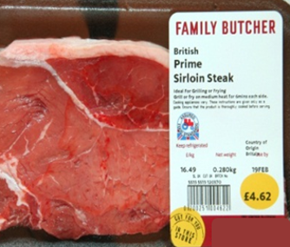
Example: Modified atmosphere packaging
Modified atmosphere packaging (MAP) is a technique used to lengthen the shelf-life of food products of minimally processed or fresh foods.
The air surrounding the food in the package is changed to reduce the activity of microorganisms. Meat, fish, fruits and vegetables often use the method during packaging.
Equilibrium modified atmosphere packaging (EMAP) is most commonly used for cut fresh-cut produce.

Slide 26
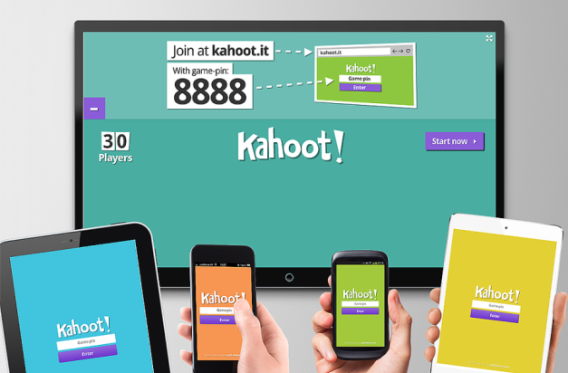
Quiz- Kahoot
Open the link below on the main screen and get students to log onto kahoot.it on their tablets or smartphones. They can then enter the code (that will come up on the main screen when you start the game) and their own nickname. They can then play along with the quiz choosing the multiple choice answers that correspond with the questions on the main screen. There will then be a leaderboard of the scores after each question and at the end.
https://play.kahoot.it/#/?quizId=fd7de58c-dc5f-4511-884e-f332a67e6c9a

Slide 27
Food packaging
For further information, go to:
www.foodafactoflife.org.uk
This resource meets the Guidelines for producers and users of school education resources about food.

