Slide 1
New product design and development

Slide 2
New product design and development
In recent years, key areas of new product development have been:
producing ‘convenience’ foods – in response to changing lifestyles;
providing products with altered nutritional content – following the increasing public interest in nutrition, diet and health, e.g. low-fat products;
increasing the variety of products available – to provide more choice;
producing ‘economy’ lines – to appeal to people on lower incomes;
appealing to the ‘luxury’ market – to attract more affluent customers of those who wish to give an impression of status;
developing products in line with tastes and preferences, e.g. different cuisines, veganism;
maintaining and improving product quality – to retain customer loyalty.

Slide 3

New product design and development
A ‘new’ product is simply one that has never been designed and made before. It may be a new flavour, a modification to a standard product, such as improvement, new pack size or cost reduction, or an addition to an existing range of products.
It has been argued that no design is totally original, and most designs are based on products which already exist.

Slide 4

New product design and development
‘Shrinkflation’ is now a food industry trend with, according to the Office of National Statistics, 206 unique products shrinking in size between September 2016 and June 2017.
Food manufacturers have started to offer less product for the same price to combat rising manufacturing costs.
Office of National Statistics

Slide 5
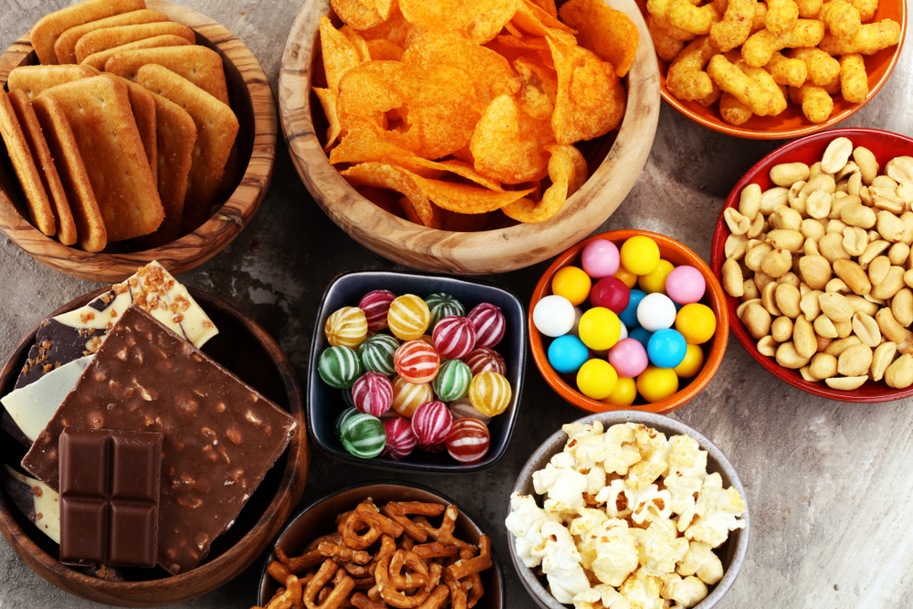
New product design and development
The failure rate for new products is around 90%, so companies invest large amounts of time and money in product design and carry out considerable research into what customers want. Most manufacturers have a number of different new products at various stages of development at any one time, so that all is not lost if a product fails.
Effective new product design allows a company to respond quickly to consumer trends and potentially gain a larger ‘market share’ by launching new products before their competitors.

Slide 6

New product design and development
One new product could eventually earn a company a great deal of money, so the details written in the ‘product specification’ are highly confidential.
When a company launches a new product it may protect their idea by a patent so that it cannot be copied identically by other manufacturers.

Slide 7

Why design new products?
Food manufacturers launch many new products every year. The aim of the company is for consumers to try their new product, like it and then continue to buy it.
A recent survey of UK food and drink businesses, found that 52% of the respondents expect future growth to come through new product development.
BDO Food and drink report 2018

Slide 8

New Product Design
Food products are developed:
in response to consumer trends and consumers’ needs and wants;
to stay in competition with other companies to increase profits;
to make use of up-to-date food processing technologies which give rise to new or more economical products;
to meet particular markets, such as economy or luxury products, or to create new markets;
in response to healthy eating initiatives such as reducing salt, fat or free sugars in food;
to produce ‘own brand’ copies of other manufacturers’ products;
to replace some products which have reached the end of their life cycle.

Slide 9
How do manufacturers get ideas for new products?
Manufacturers use many different methods to come up with ideas for new products. These may include:
looking at existing products – a company’s own, or their competitors’;
responding to suggestions, comments or consumers’ complaints, ethical or environmental concerns;
examining cultural and religious influences, including customs at festivals and celebrations;
eating out, visiting restaurants in the UK and other countries to sample authentic dishes;
pressure from government or health organisations to reformulate products and reduce the salt, fat or free sugars.

Slide 10
How do manufacturers get ideas for new products?
Other methods manufacturers use to get ideas include:
analysing trends in consumer eating and purchasing habits, carrying out market research to identify ‘gaps’ in the market;
designing products targeted at particular groups, e.g. children or vegetarians;
identifying fashions and fads;
using a popular theme, such as a blockbuster film or TV programme;
brainstorming sessions by individuals or teams;
responding to Government initiatives, policy or guidelines, e.g. reducing fat content;
modelling the nutrient content of a food product to meet a specific target, e.g. athletes.

Slide 11

How do manufacturers get ideas for new products?
Further methods manufacturers may use include:
exploring the potential of new and unusual ingredients such as those from other countries, novel foods, fat substitutes or synthetic sweeteners;
using new food processing techniques or developments in domestic technology, e.g. frozen meals and microwave ovens;
Eureka! Every now and then a designer has a bright idea while sitting on a train or in the bath.
The European Union approved additives from the Stevia rebaudiana plant in 2011, whereas it has been used in Japan as a sweetener for decades.

Slide 12

Considerations for new product design
There are a number of points that may be considered when the potential for a new product is being explored.
Key questions to ask include:
is there a need?
is the market ready?
is the market already saturated?
will it sell?
will it be profitable?

Slide 13

New product design and development
It is important to consider implications for the cost of the finished product (ingredient and processing costs) and whether suitable equipment is available.
Are there suitable ingredients with desirable characteristics?
Is there suitable technology to process the food?
Is it possible to mass produce?
Is there the equipment to make this product on a large scale in the factory or will new equipment be needed?

Slide 14

New product design and development
Development costs need to be calculated in order to work out trial and purchase prices.
Will the product be successful?
How much will the consumer pay for the product?
What is the overall cost of development?
What are the costs of it’s launch, advertising and distribution?
Consideration of UK legal standards is also necessary.
Does the product meet current UK food legislation standards?

Slide 15

Why do some new products fail?
Reasons for failure may include:
no difference between new and old product (50% failure);
tough competition;
unsatisfactory distribution (very popular);
rising cost of ingredients, production and packaging;
low profits;
ineffective advertising.

Slide 16

Why do some new products fail?
Other reasons for failure may also include:
poor, unattractive packaging;
food scares;
politics;
environmental concerns;
bad timing;
poor product positioning on shelf;
too innovative (ahead of its time).

Slide 17
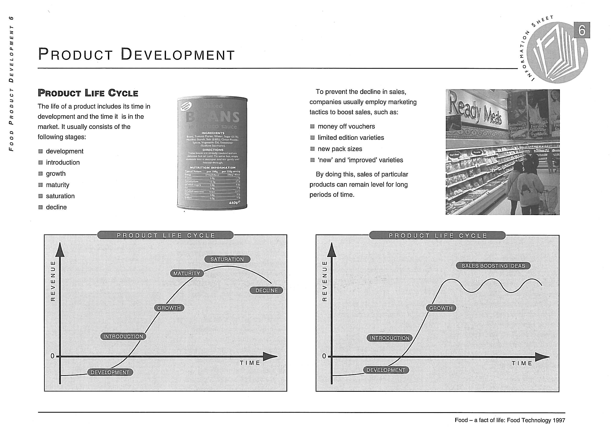
Product life cycle
The life of a product includes its time in development and the time it is in the market. It usually consists of the following stages:
development;
introduction;
growth;
maturity;
saturation;
decline.

Slide 18
Product development
To prevent a decline in sales, companies usually employ marketing tactics to boost sales, such as:
money off vouchers;
limited edition varieties;
new pack sizes;
‘new’ and ‘improved’ varieties.
By doing this, sales of particular products can remain level for long periods of time.

Slide 19

Government policy
The design and development changes in the food industry can also be driven by Government policy.
Recent examples include:
the sugar reduction programme;
the soft drinks industry levy (sugar tax);
the calorie reduction programme;
the plastic packaging tax.

Slide 20
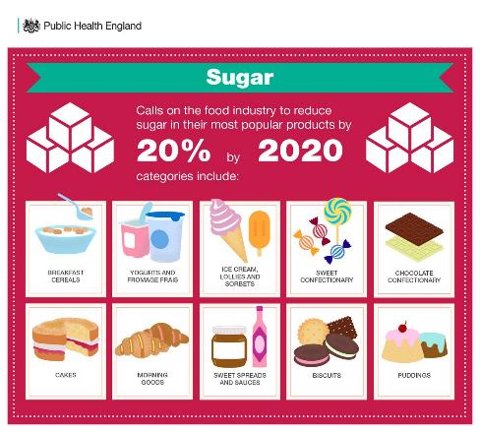
Sugar reduction programme
Public Health England’s sugar reduction programme is an example of why food and drink businesses develop new products.
In the first year of this work (August 2016 – August 2017), there were;
reductions in sugar levels in five of the eight categories targeted and;
three of the categories met or exceeded the initial 5% ambition set for the first year.
Sugar reduction: Achieving the 20%

Slide 21
Soft Drinks Industry Levy
The Soft Drinks Industry Levy (SDIL), commonly known as the 'sugar tax', applies to UK-produced or imported soft drinks containing added sugar. It is structured with a charge of £0.18 per litre for beverages containing 5g to 8g of sugar per 100ml and £0.24 per litre for those with over 8g of sugar per 100ml, with the primary goal of curbing sugar intake and addressing obesity concerns.
The Soft Drinks Industry Levy has seen;
sugar in the levied drinks reduced by 11%;
average calories per portion reduced by 6%;
a shift in volume sales towards lower sugar drinks (below 5g per 100ml) which are not subjected to the levy.
Sugar reduction: Achieving the 20%

Slide 22


Calorie reduction programme
The calorie reduction programme was introduced by Public Health England in 2018. This programme incorporated:
Estimates of the excess calories consumed by overweight and obese children and adults of different ages.
Plans for a programme of work with the food industry to reduce calories by 20% by 2024, in 15 savoury food categories using reformulation and /or reductions in portion sizes.
The launch of the One You campaign, Know your numbers, giving ‘a rule of thumb’ for adults on the calories to consume at main meals.
http://bit.ly/2FXzge9

Slide 23

Plastic Packaging Tax
The UK has introduced a new tax targeting plastic packaging manufactured or imported into the country that doesn't contain at least 30% recycled plastic.
This has an impact on new product design and development, as it encourages change within the industry.
Source: Introduction of Plastic Packaging Tax from April 2022 - GOV.UK (www.gov.uk)

Slide 24
Plastic Packaging Tax
This tax excludes packaging with 30% or more recycled plastic content or packaging not predominantly made of plastic by weight. Both filled and unfilled imported plastic packaging will be subject to the tax.
The policy aims to incentivise businesses to incorporate recycled plastic into packaging production, thereby boosting demand for recycled materials and encouraging higher levels of plastic recycling and waste collection, ultimately reducing landfill and incineration rates.
Source: Introduction of Plastic Packaging Tax from April 2022 - GOV.UK (www.gov.uk)

Slide 25
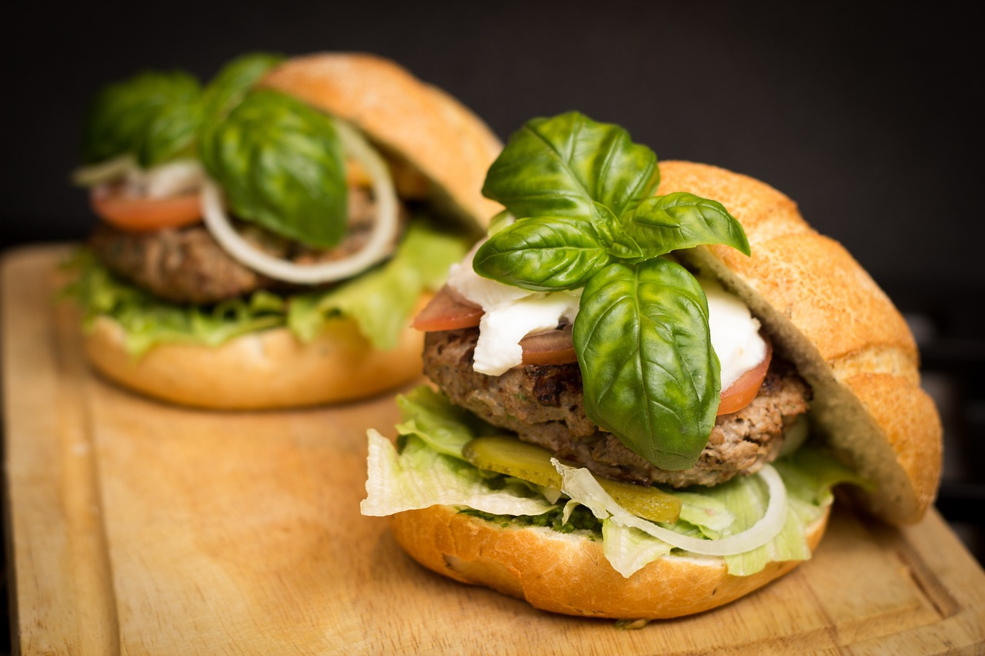
The future
Six key technology areas have been identified by the Food Standards Agency as the most likely to have an impact on the UK food system and food safety over the coming decade. These include new ways to produce and process food, like indoor farming and 3D printing, and finding creative uses for leftover parts.
There's also interest in alternative protein sources, like insects, and lab-grown meat. Advancements in Synthetic Biology are changing how we make food, especially with lab-grown meat. Both will help support the growing trend of reducing meat in the diet.
Food Standards Agency 2021

Slide 26

The future
Meanwhile, using genetics helps ensure food safety and can even tailor diets to individuals. On the packaging front, new ideas like smart, biodegradable, and reusable materials are being explored to keep food fresh and reduce waste.
Lastly, digital tools are becoming essential in the food industry for analysing data, making decisions, and tracking products throughout their journey from farm to table.
Food Standards Agency 2021

Slide 27
New product design and development
For further information, go to:
www.foodafactoflife.org.uk
This resource meets the Guidelines for producers and users of school education resources about food.

