Slide 1
UK Food

Slide 2
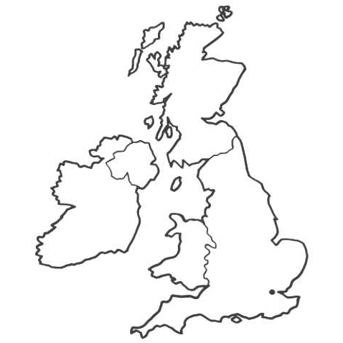
UK Food
Scotland
Lots of the food we eat comes from the UK.
The UK is England, Northern Ireland, Scotland and Wales.
Where do you live?
Northern Ireland
England
Wales

Slide 3
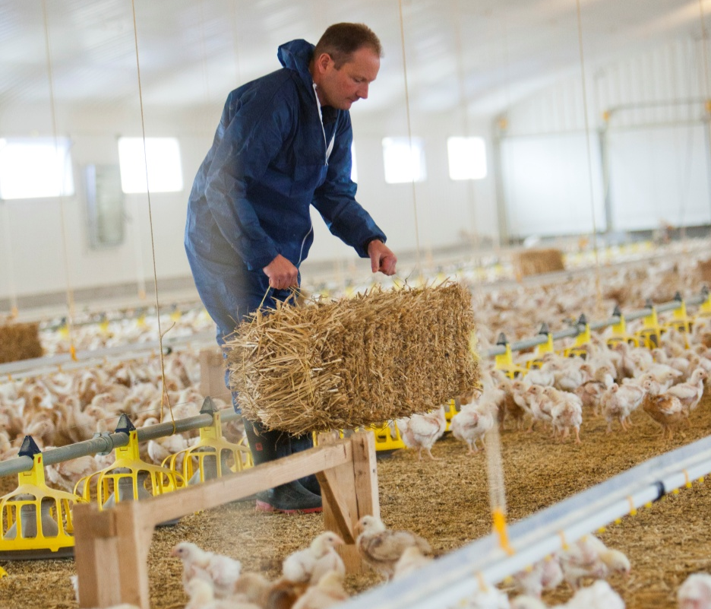
What can you see here?
Somerset
These are chickens being reared in England.

Slide 4
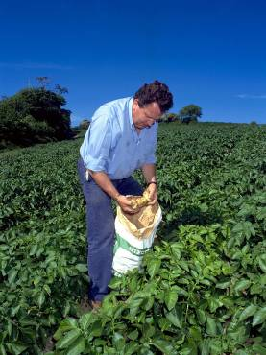
What can you see here?
Pembrokeshire
These are potatoes growing in Wales.

Slide 5
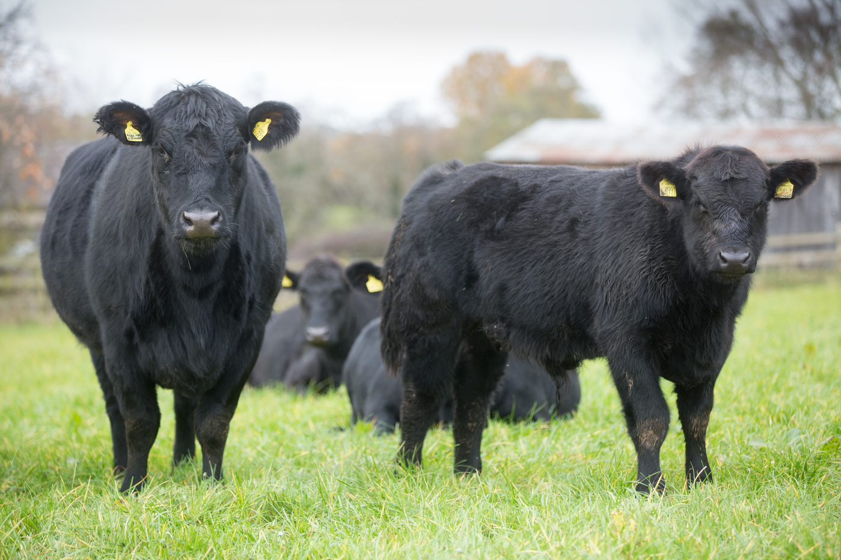
What can you see here?
Aberdeenshire
These are beef bulls being reared in Scotland.

Slide 6
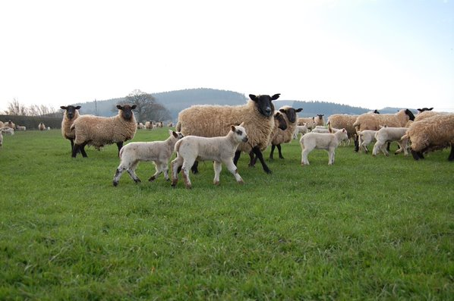
What can you see here?
Monmouthshire
These are lambs being reared in Wales.

Slide 7
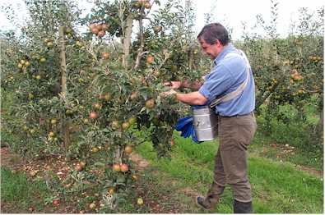
What can you see here?
Warwickshire
These are apples growing in England.

Slide 8
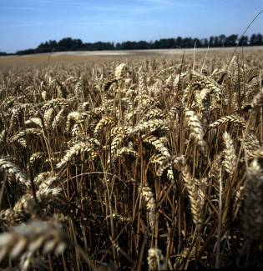
What can you see here?
County Down
This is wheat being grown to make soda bread in Northern Ireland.

Slide 9
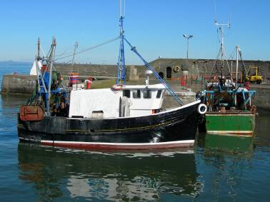
What can you see here?
Orkney
This is a boat going out to catch fish Scotland.

Slide 10
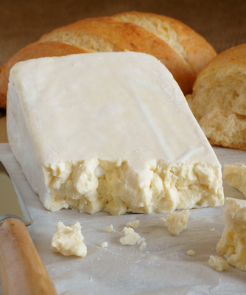
What can you see here?
Glamorgan
This is Caerphilly cheese which has been produced in Wales.

Slide 11
UK Food
For further information, go to:
www.foodafactoflife.org.uk
This resource meets the Guidelines for producers and users of school education resources about food.

