Slide 1
Veg out!

Slide 2
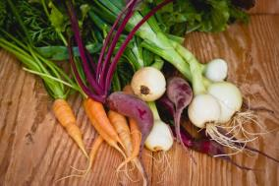

The challenge
Create a burger with fruit and vegetables to add colour, flavour and texture.

Slide 3
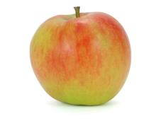

Why add fruit and vegetables?
Adding fruit and vegetables to a burger can provide:
Texture – crisp and crunchy celery
Colour – grated red apple with the skin left on
Flavour – fiery chillies
Aroma – sweet pineapple chunks.

Slide 4
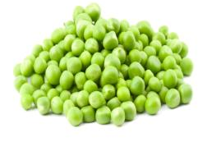
Why add fruit and vegetables?
Fruit and vegetables can also enhance the nutritional content of your burgers:
Fibre
Fibre is found in fruit and vegetables. Fibre can reduce your risk of heart disease, diabetes and some cancers, and also help with weight control. Fibre also helps to maintain a healthy gut.

Slide 5

Why add fruit and vegetables?
Vitamins
Fruit and vegetables provide:
Vitamin C, which is important for maintaining healthy body tissues
Vitamin A for the maintenance of normal vision, skin and the immune system.

Slide 6

Why add fruit and vegetables?
Minerals
Fruit and vegetables provide:
Folate, which is needed for the formation of healthy red blood cells and for the nervous system
Potassium, which helps maintain a healthy blood pressure and is also involved in the normal functioning of the nervous system
Magnesium, which helps maintain normal bones and teeth.

Slide 7
Get creative!
Using the food cards, make random combinations of up to three fruit and vegetables.
Do the mixtures of flavours, colours and textures appeal to you?
Ask a friend what they think.

Slide 8

Nutritional analysis
Task
Use the Gourmet Burger Builder to create a burger which includes the three fruit and vegetables that you have chosen. At this point, do not add any other ingredients to the burger mix or bread and toppings after the burger has been cooked.
Using the recipe provided, use a nutritional analysis programme, such as Explore Food (http://bit.ly/1qAP1e1), to analyse the nutritional content focusing on fibre, Vitamin C and Vitamin A.

Slide 9
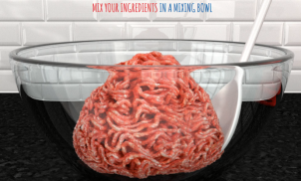
Nutritional analysis
Task 2
Re-create your chosen burger using the Gourmet Burger Builder and this time add your choice of bread and toppings.
Using the recipe and a nutritional analysis programme, produce a front and back of pack label for your burgers.

Slide 10
Create your burger
Step 1
Use the Gourmet Burger Builder to create your Veg out! burger.
Step 2
Make your Veg out! burger following the recipe.
Step 3
Take a photo and share your recipe on social media.

Slide 11
Veg out!
For further information, go to:
www.foodafactoflife.org.uk
This resource meets the Guidelines for producers and users of school education resources about food.

