Slide 1
Seasonality

Slide 2
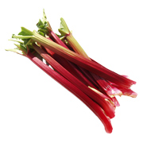
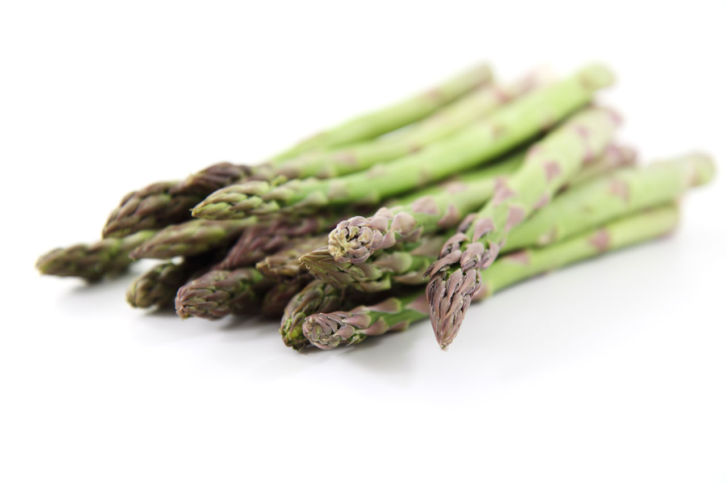
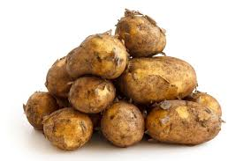
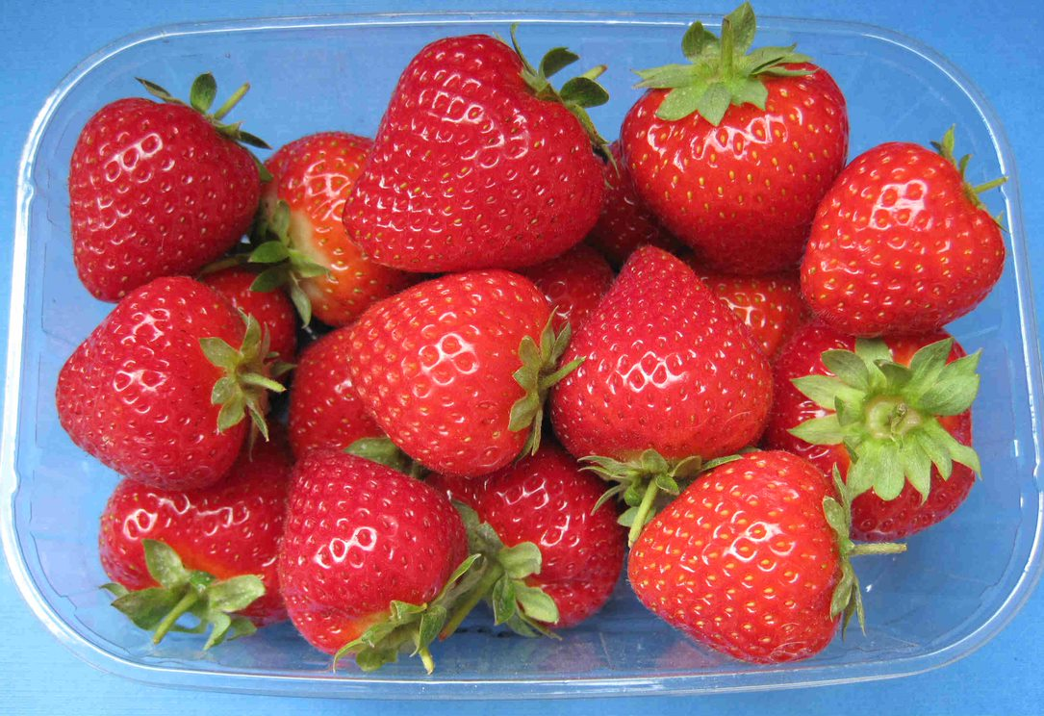
What is seasonality?
Fruit and vegetables naturally grow in cycles, and ripen during a certain season each year. When they are in season they are harvested.
We mostly think of fruit and vegetables as seasonal however, some fish and meat can also be seasonal.
There are advantages to buying and eating food that is in season. What are these?

Slide 3
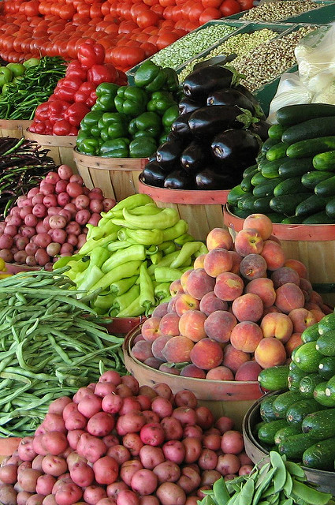
Seasonality – the advantages
Buying and eating food that is season means that it
is fresh;
has the best flavour, texture and colour;
has optimum nutritional value.
Other benefits include:
lower cost;
supporting local growers;
reduced energy needed to grow and transport the ingredients and food.

Slide 4
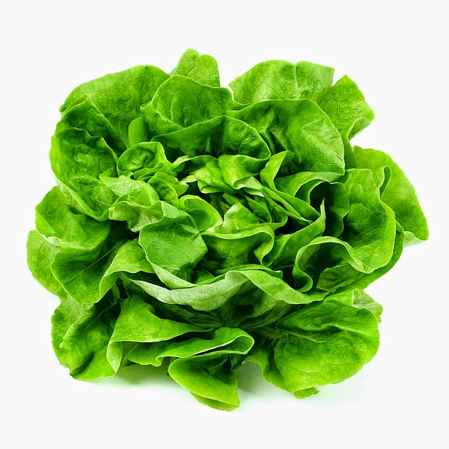
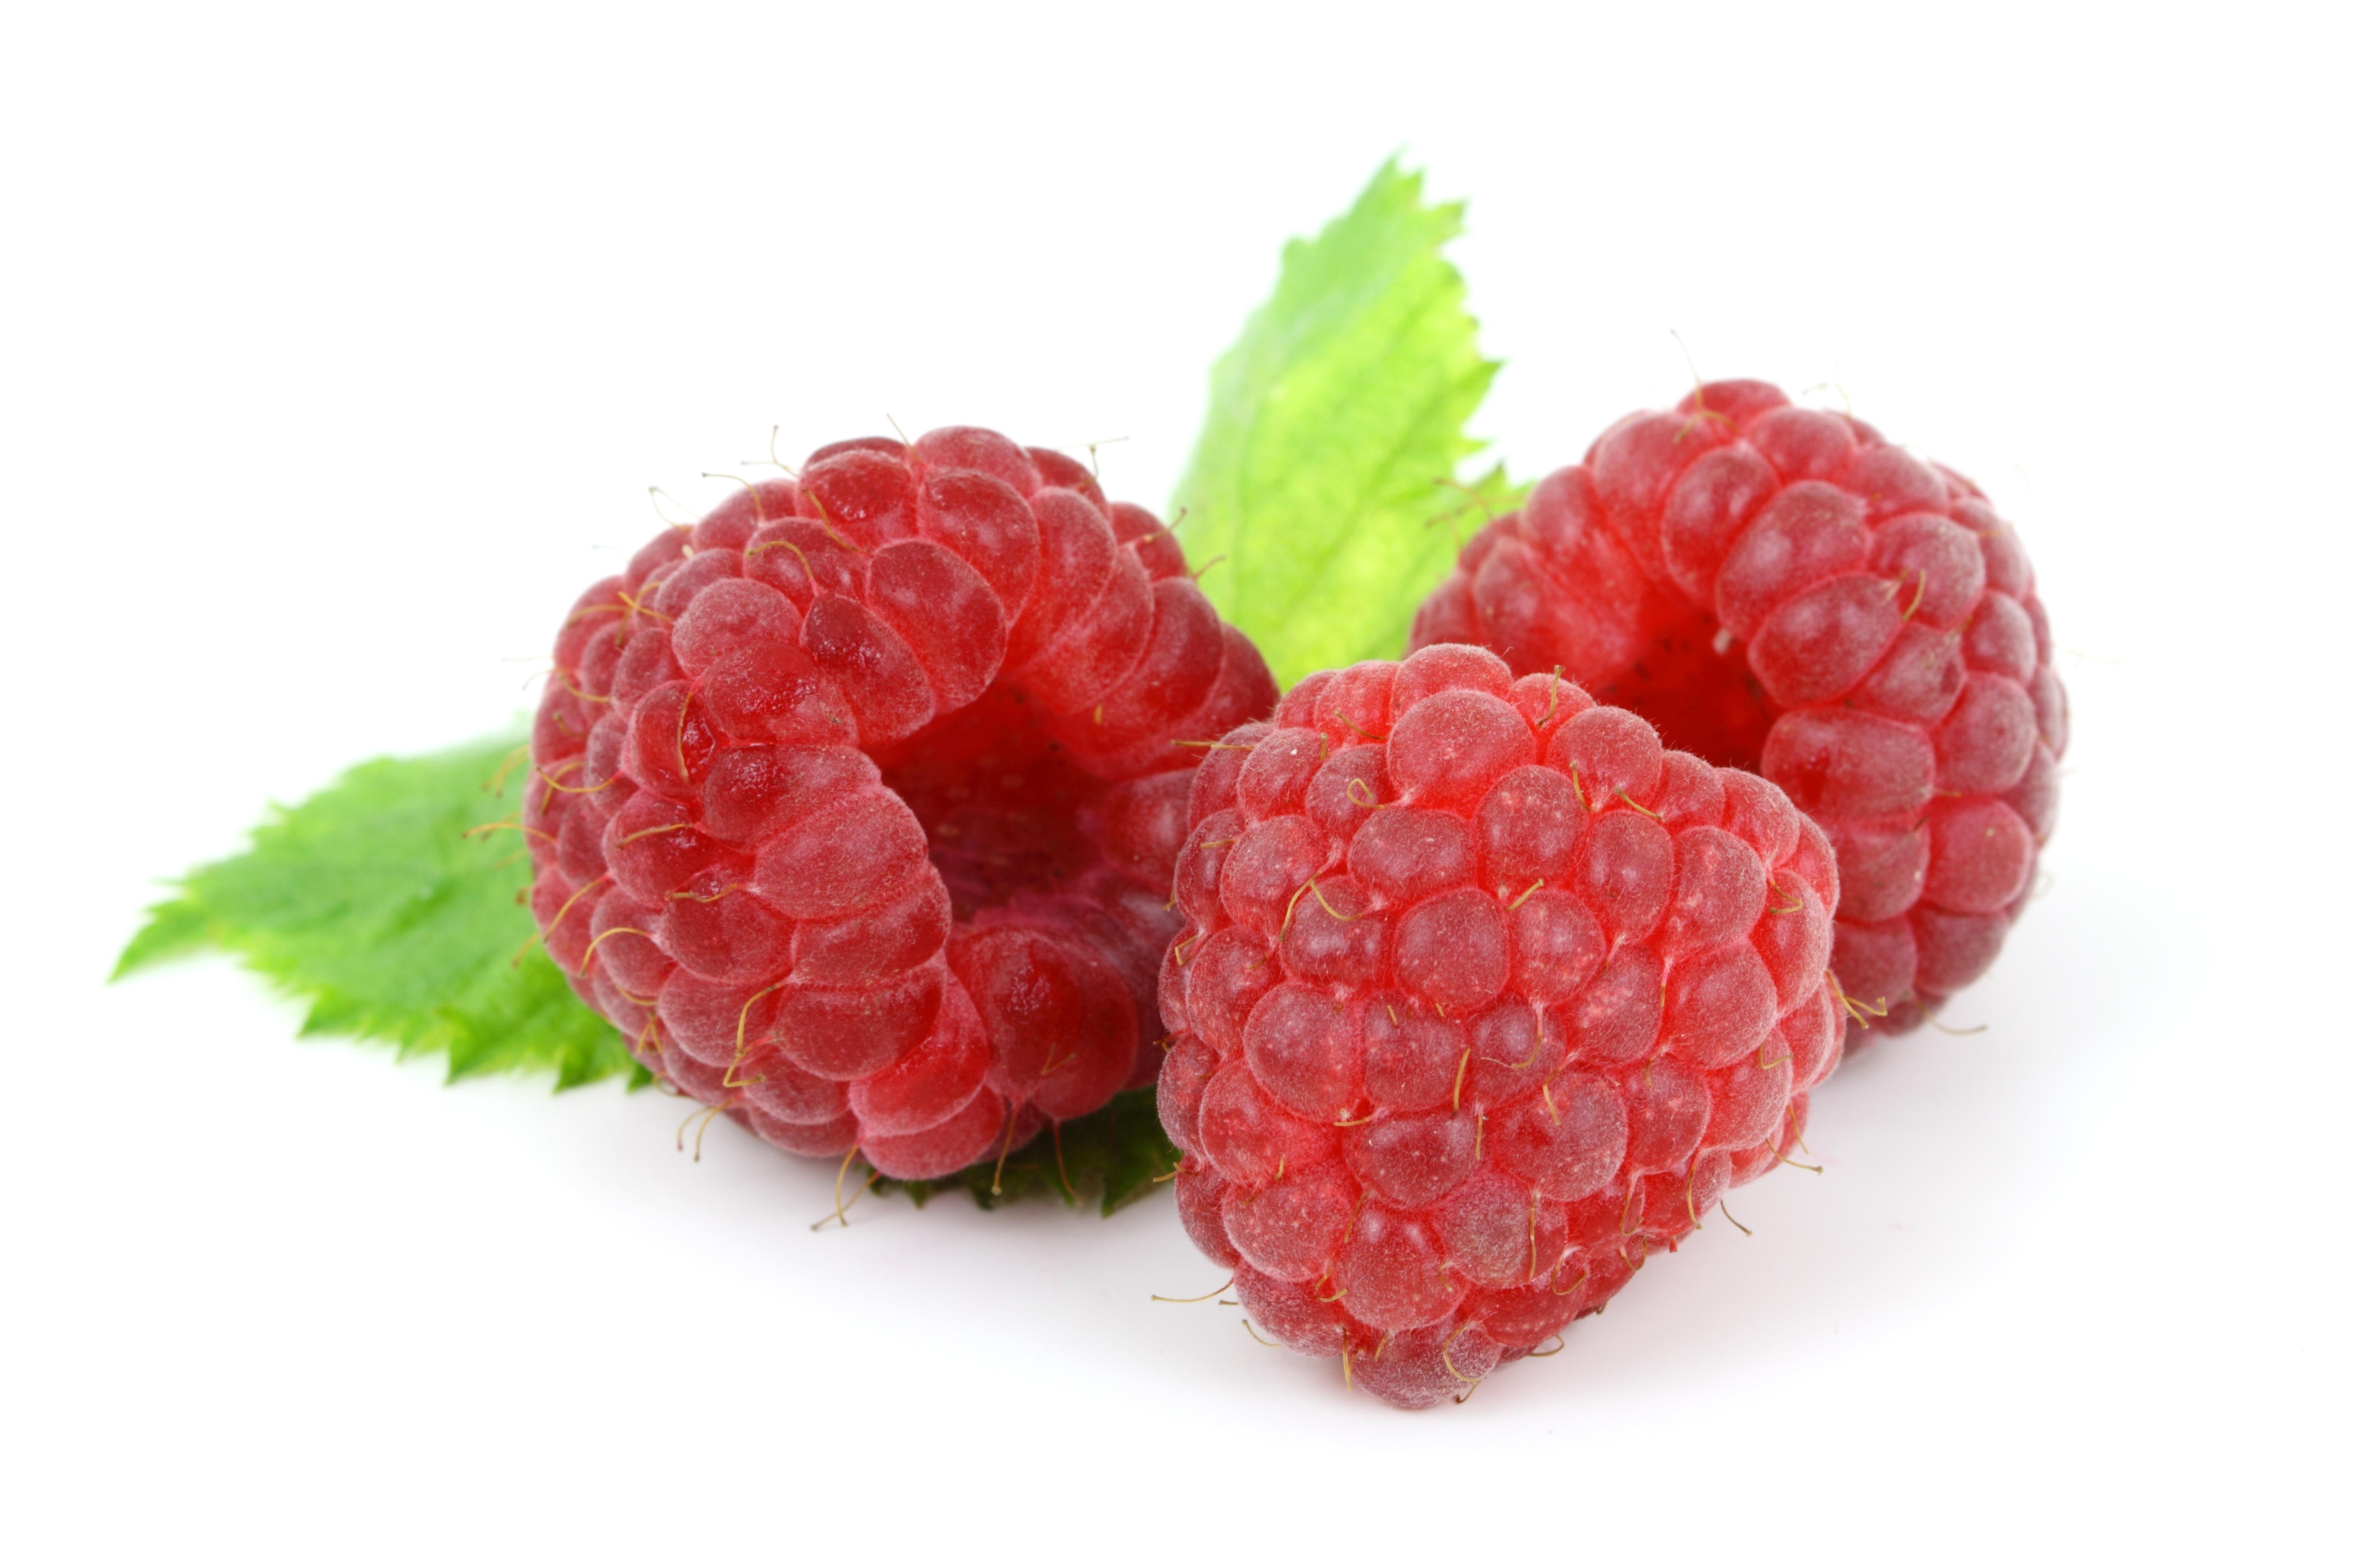
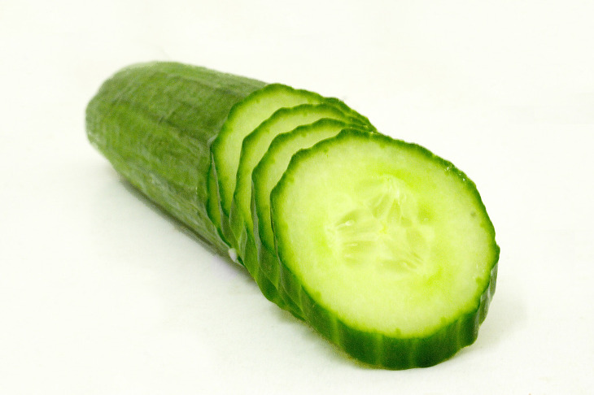
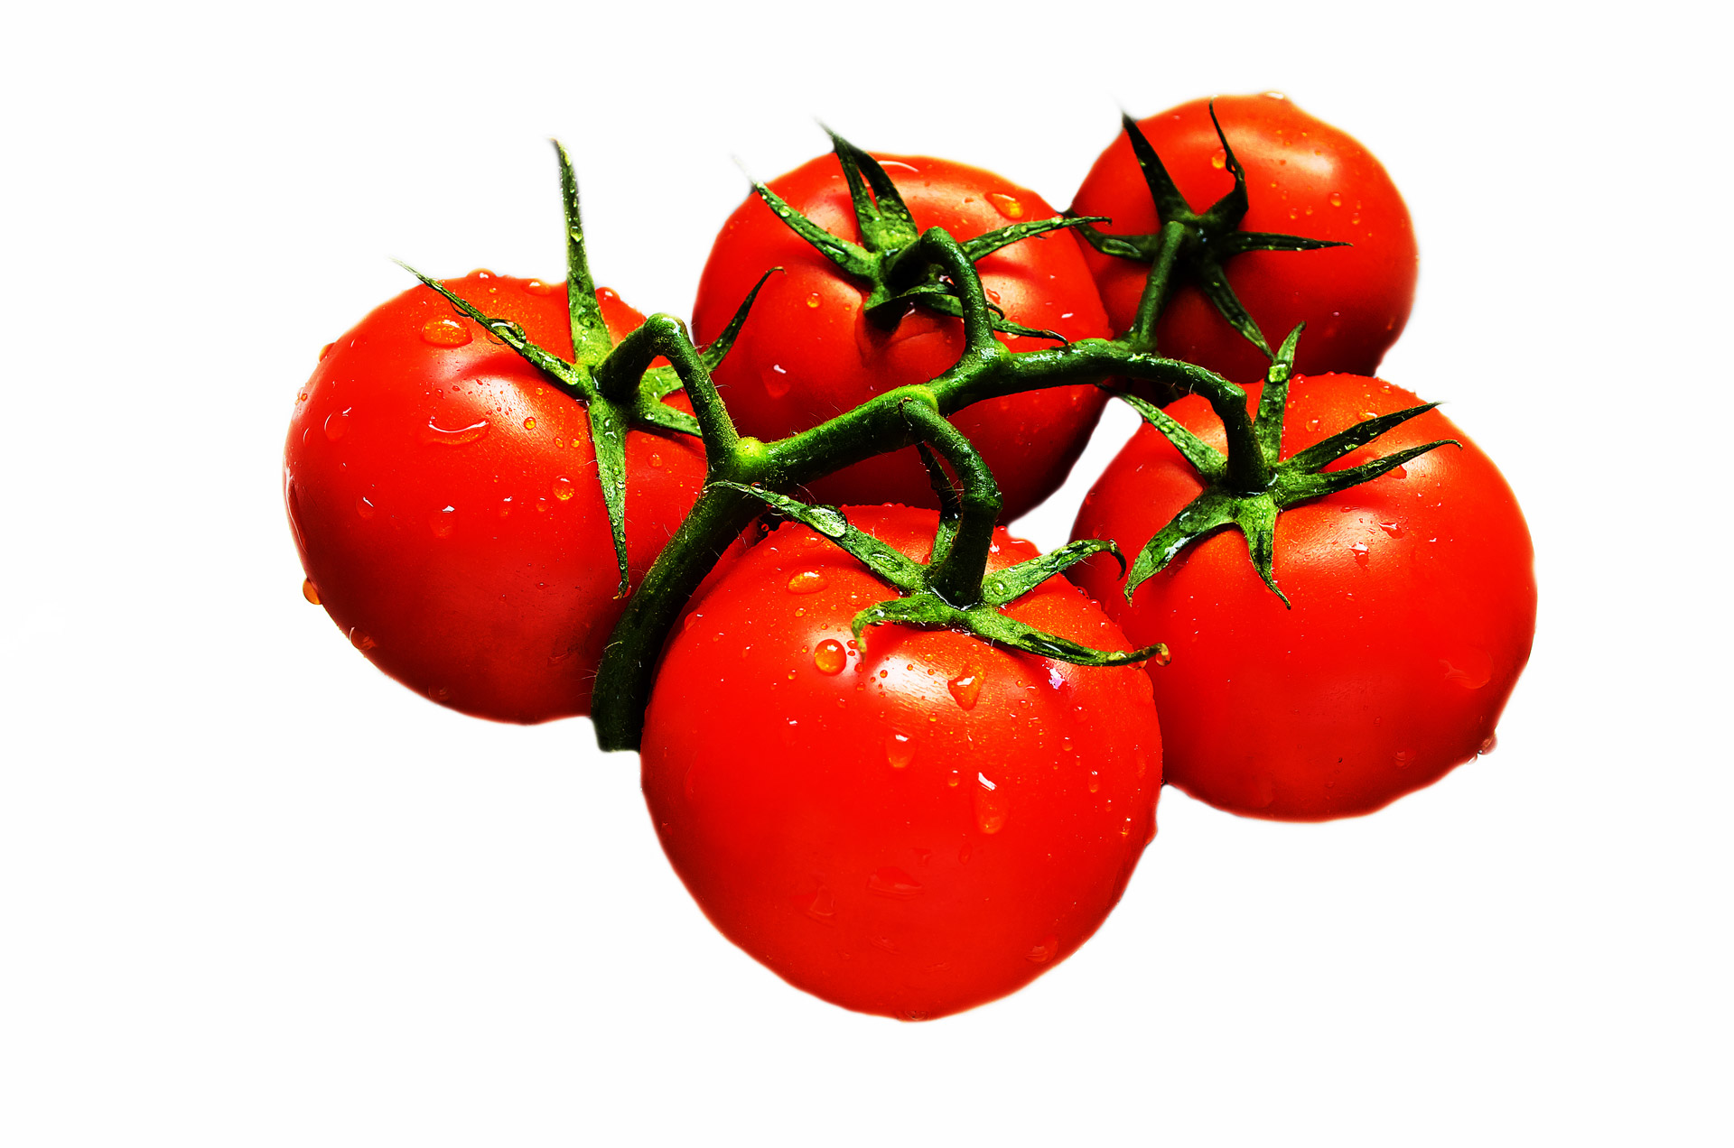
In season or not?
Consider the range of ingredients and food that is found in supermarkets. We expect, and take for granted, that the food is available all year round.
Consumers have become used to buying ingredients and food that are out of season in the UK.
This food is in season in the summer in the UK, yet we can buy them all year round.

Slide 5
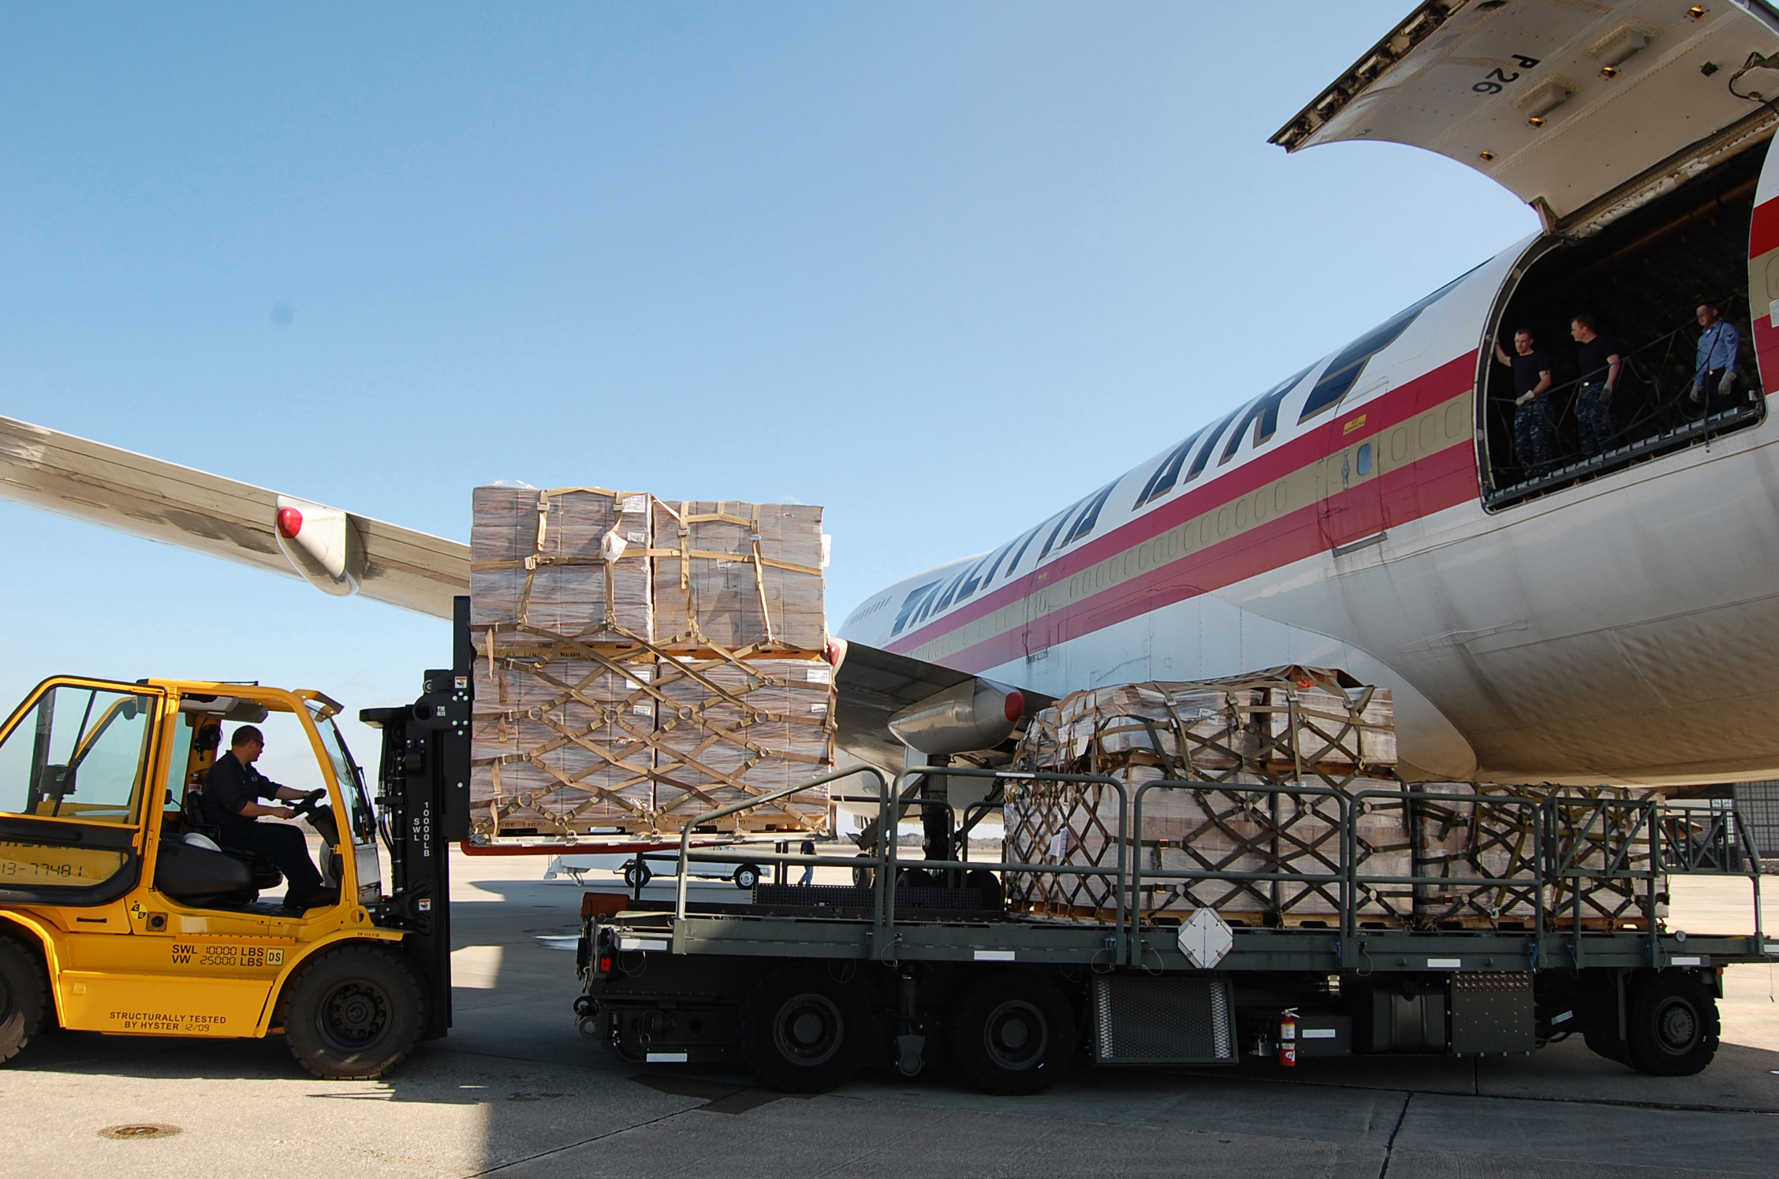
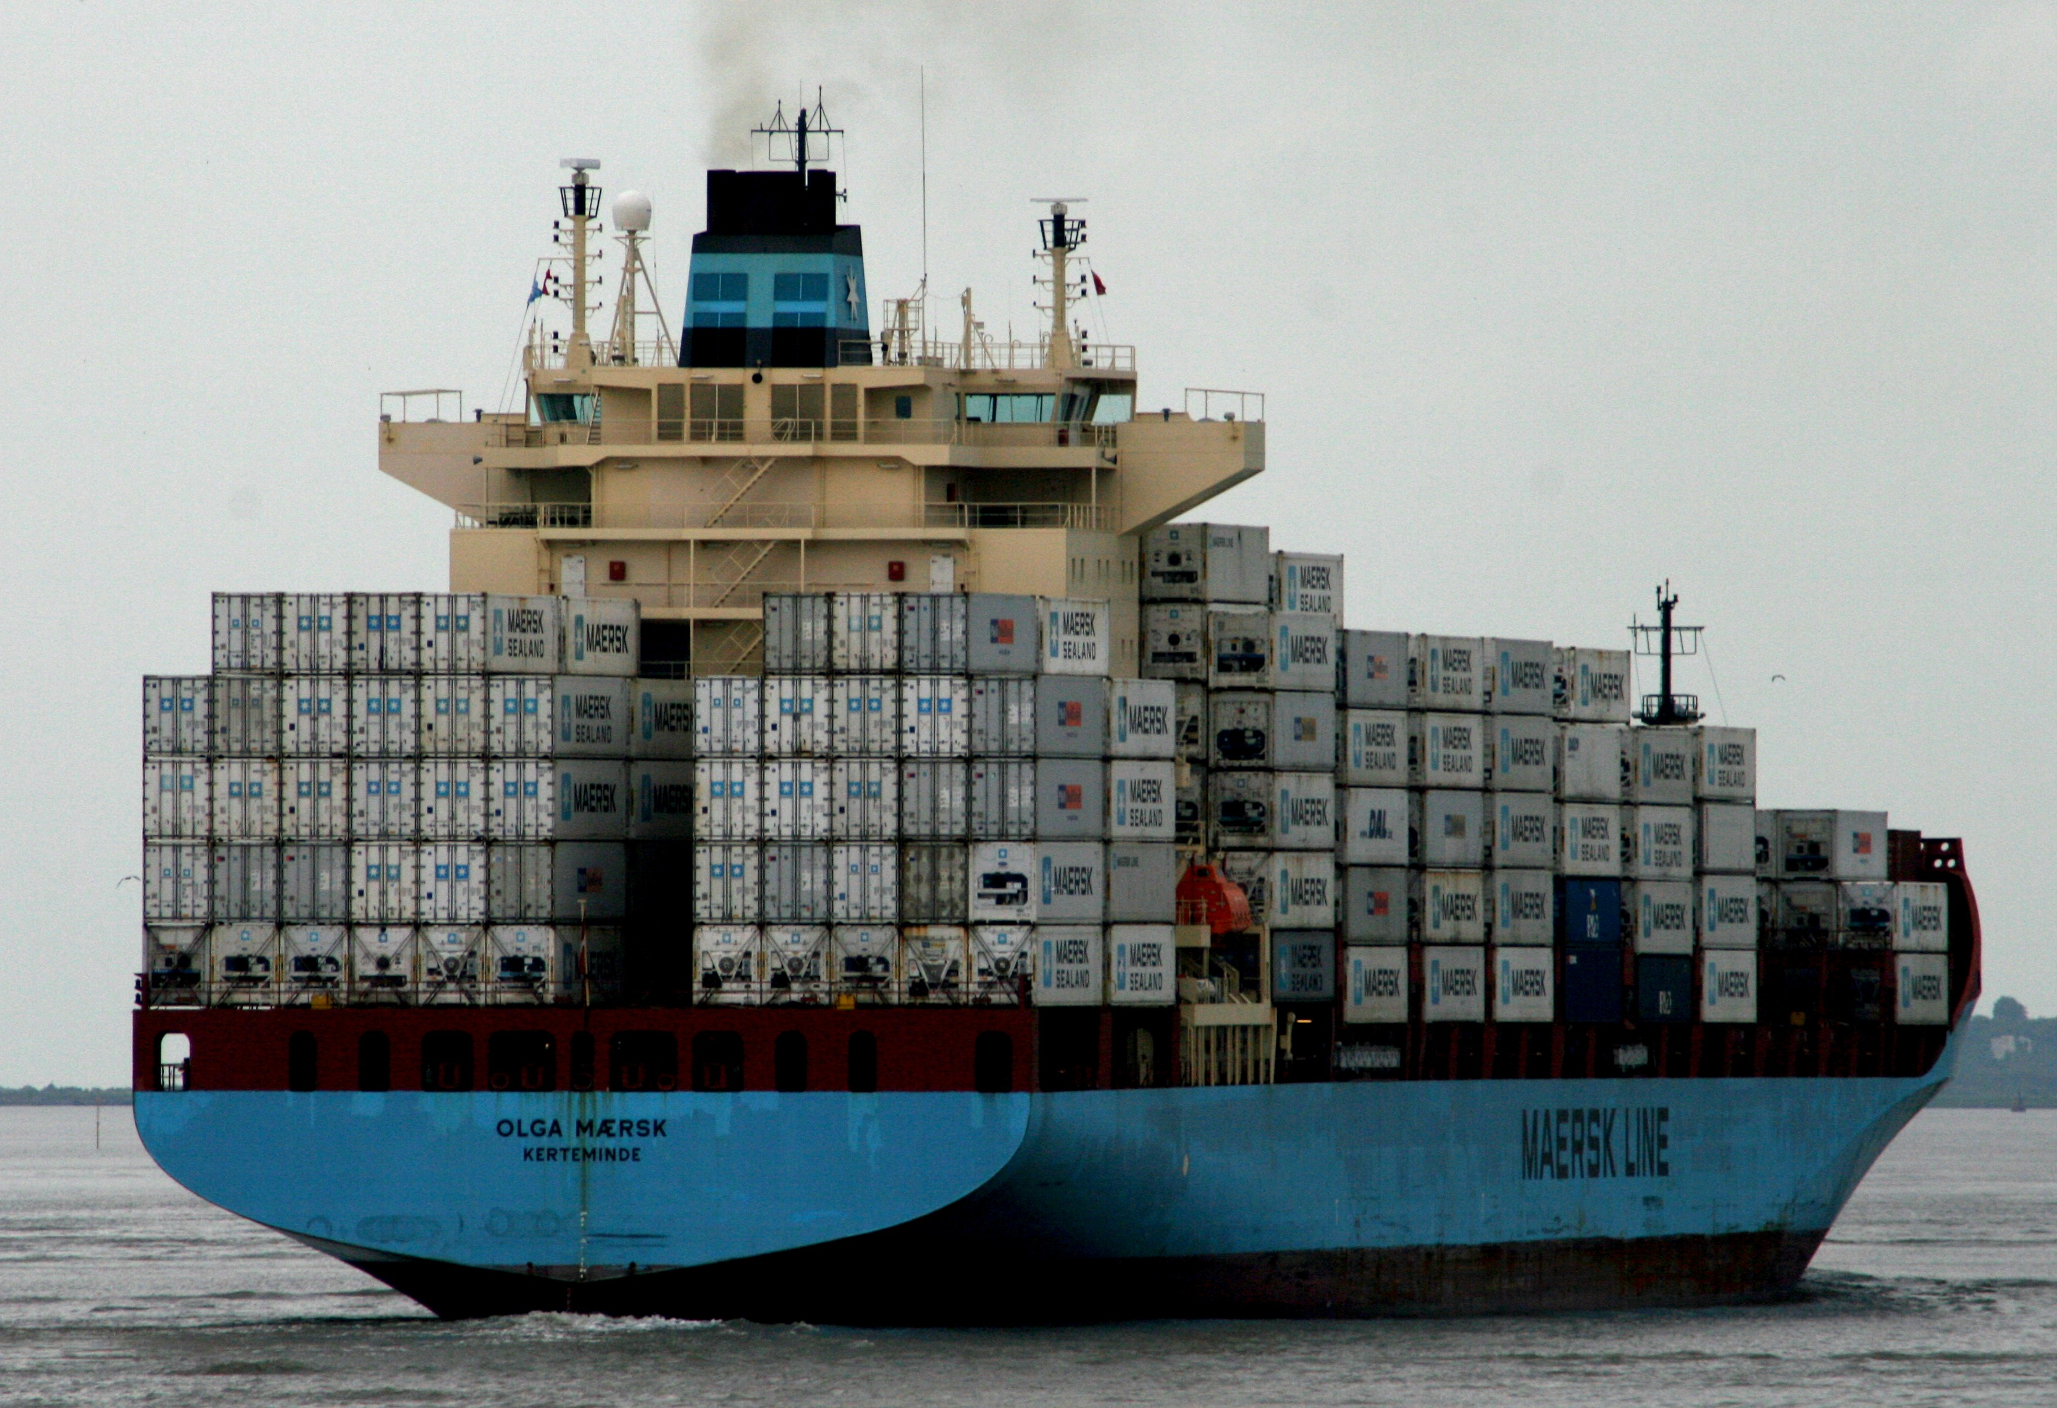
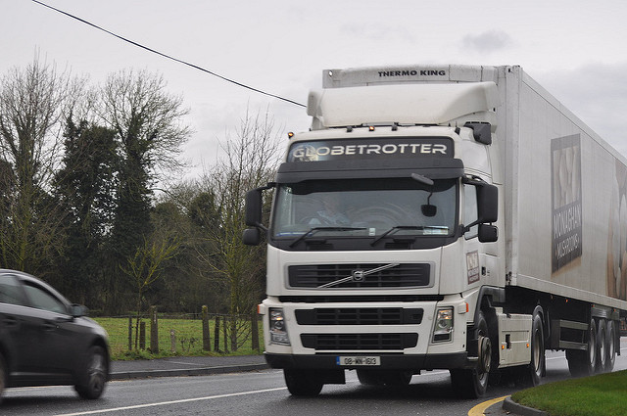
In season or not?
Ingredients and food are generally available throughout the year because they have been imported from other countries where they are in season at different times of the year.
This means that the ingredients and foods may have travelled a long way.
Why do you think some consumers are concerned about this?

Slide 6

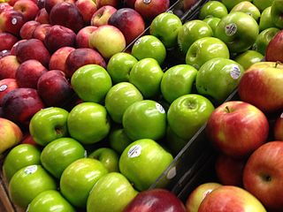
In season or not?
The UK imports about half of its food.
Some consumers are concerned about the origins of their food and the distance it has travelled. Reducing the distance can help lessen the impact.
How can consumers help lessen the distance food has travelled?

Slide 7
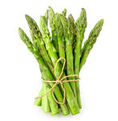
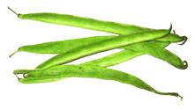
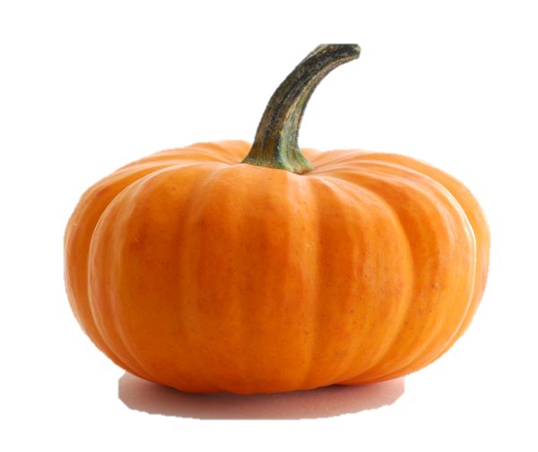
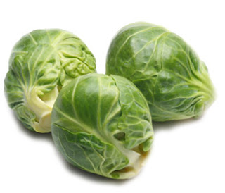
Seasonal food in the UK
As weather changes across the world so does the fresh foods that are available.
In the UK we have four distinct seasons with each offering a range of different foods.
Name five foods that are available in each of the seasons.
Remember that it is not just fruit and vegetables that are available during certain seasons.

Slide 8
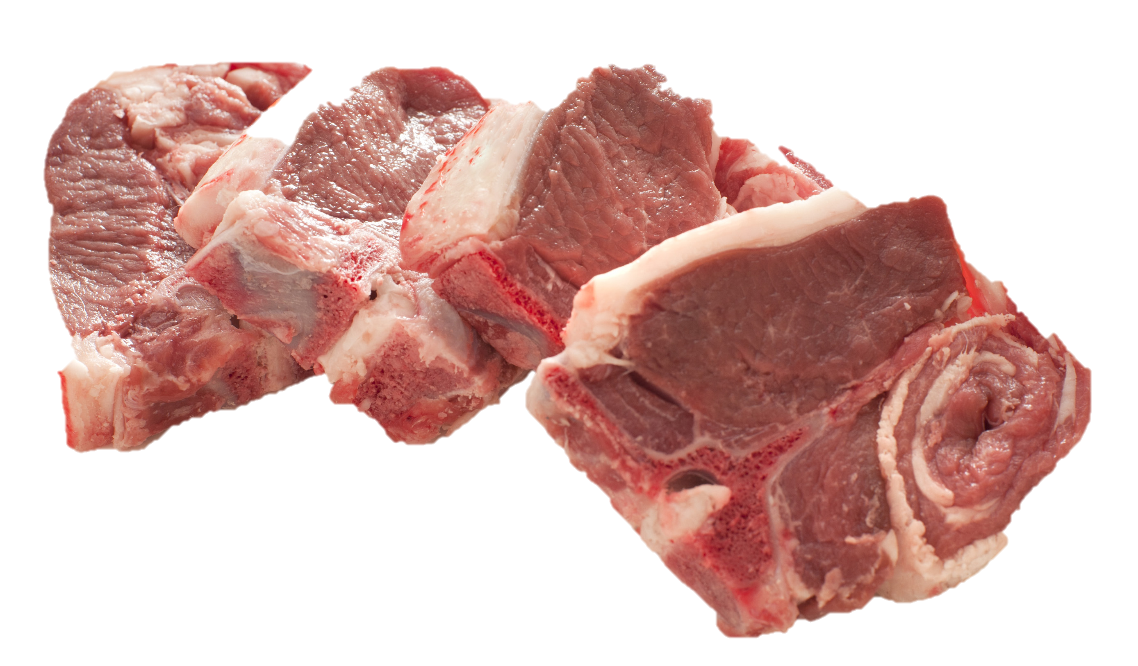
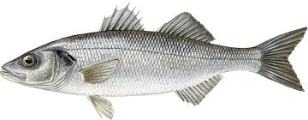
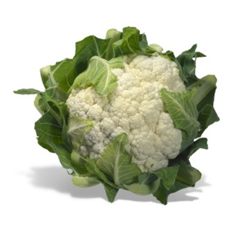
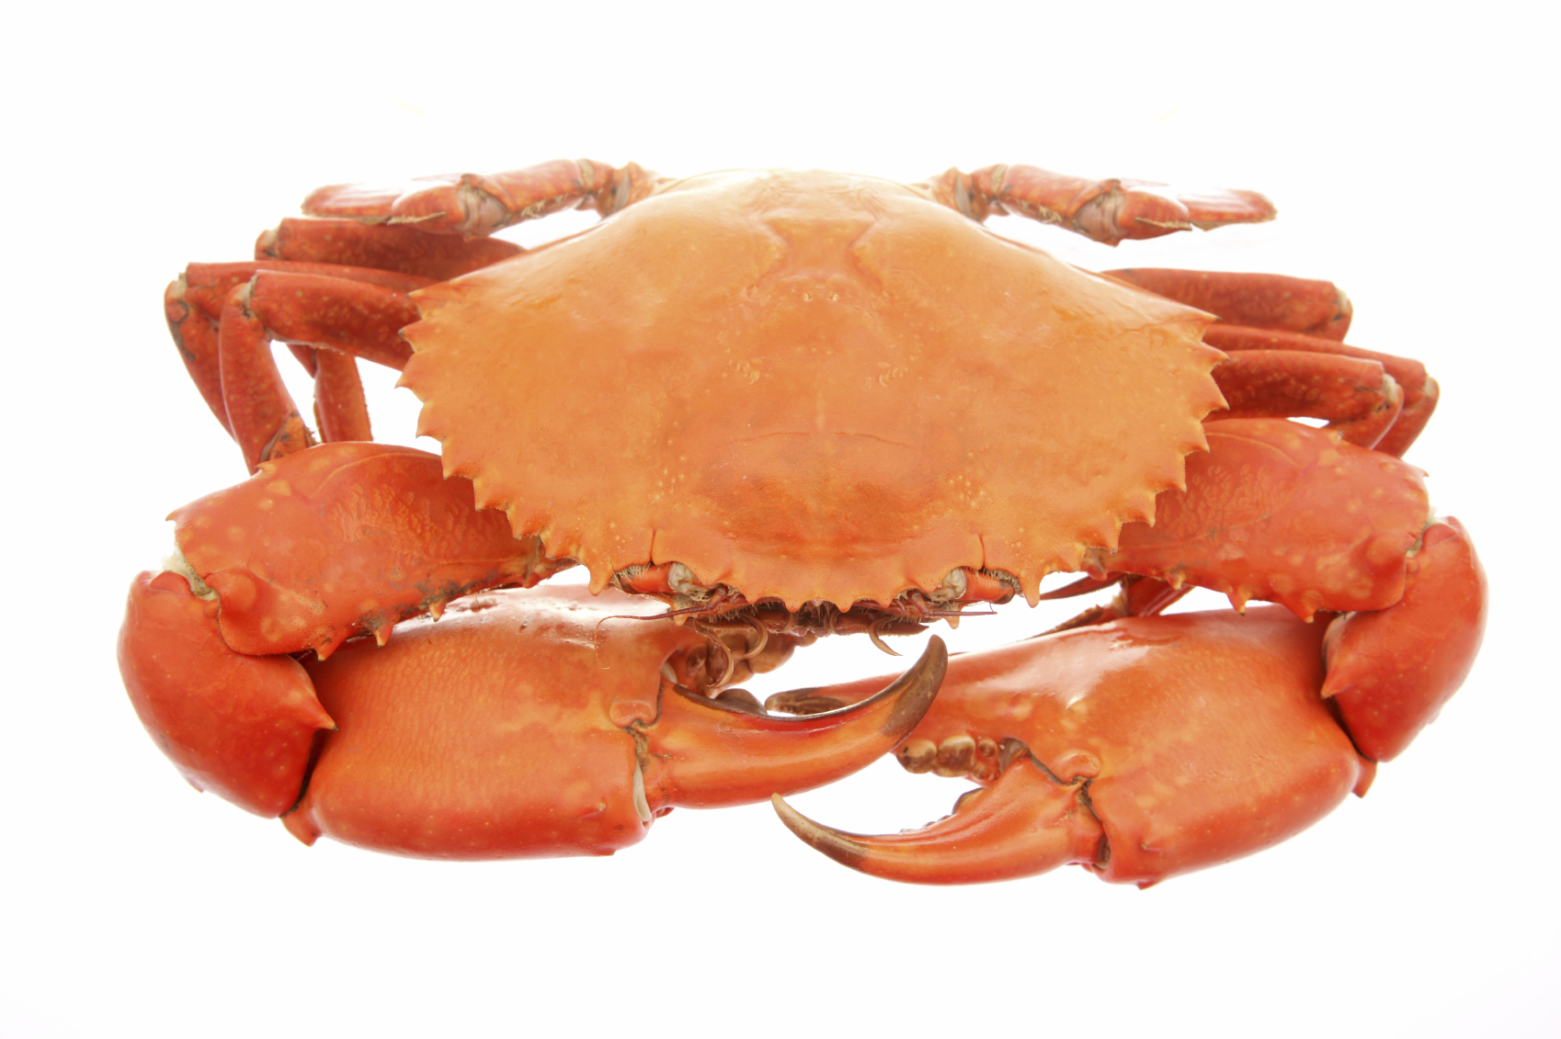
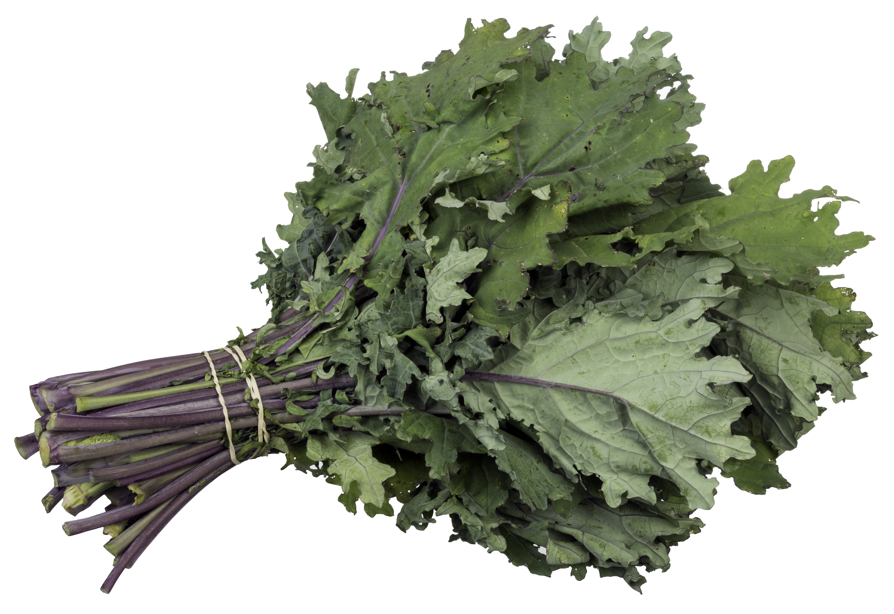
Food ready to eat in spring (March - May)
Fruit
Gooseberries
Rhubarb
Fish
Crab
Haddock
John Dory
Lobster
Mackerel
Monkfish
Prawns
Sea Bass
Sea Salmon
Trout
Turbot
Vegetables
Asparagus
Carrots
Cauliflowers
Celeriac
Curly Kale
Purple Sprouting Broccoli
Spinach
Spring Greens
Watercress
Meat
Beef
Chicken
Spring Lamb

Slide 9
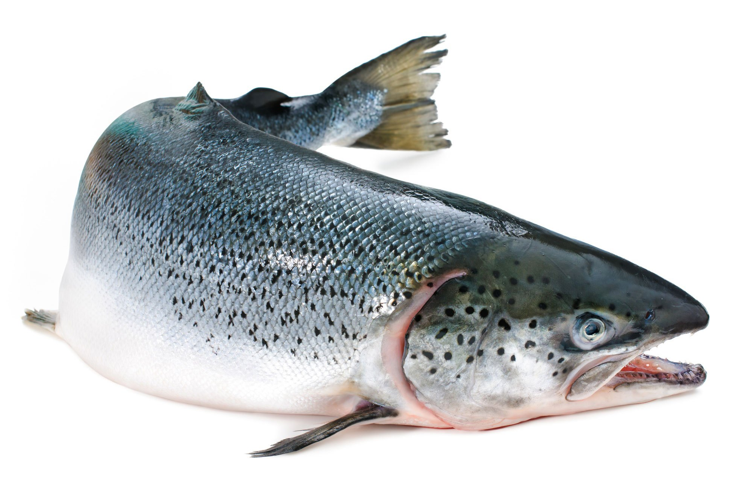
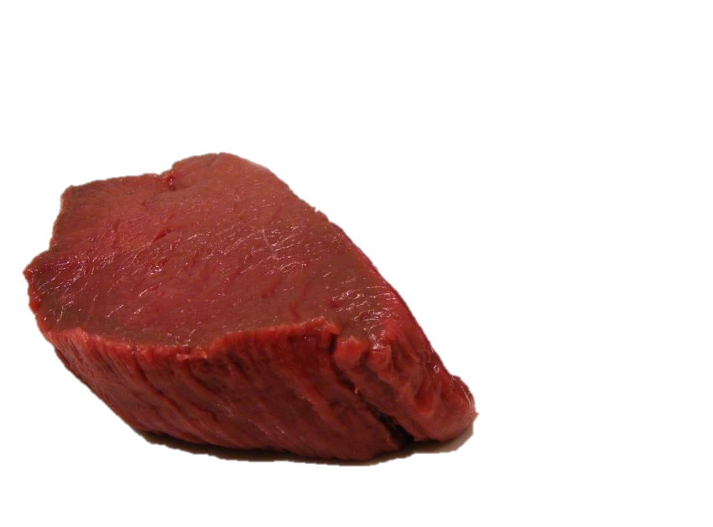

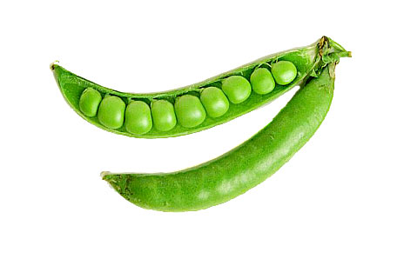
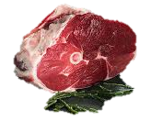
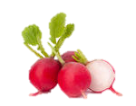
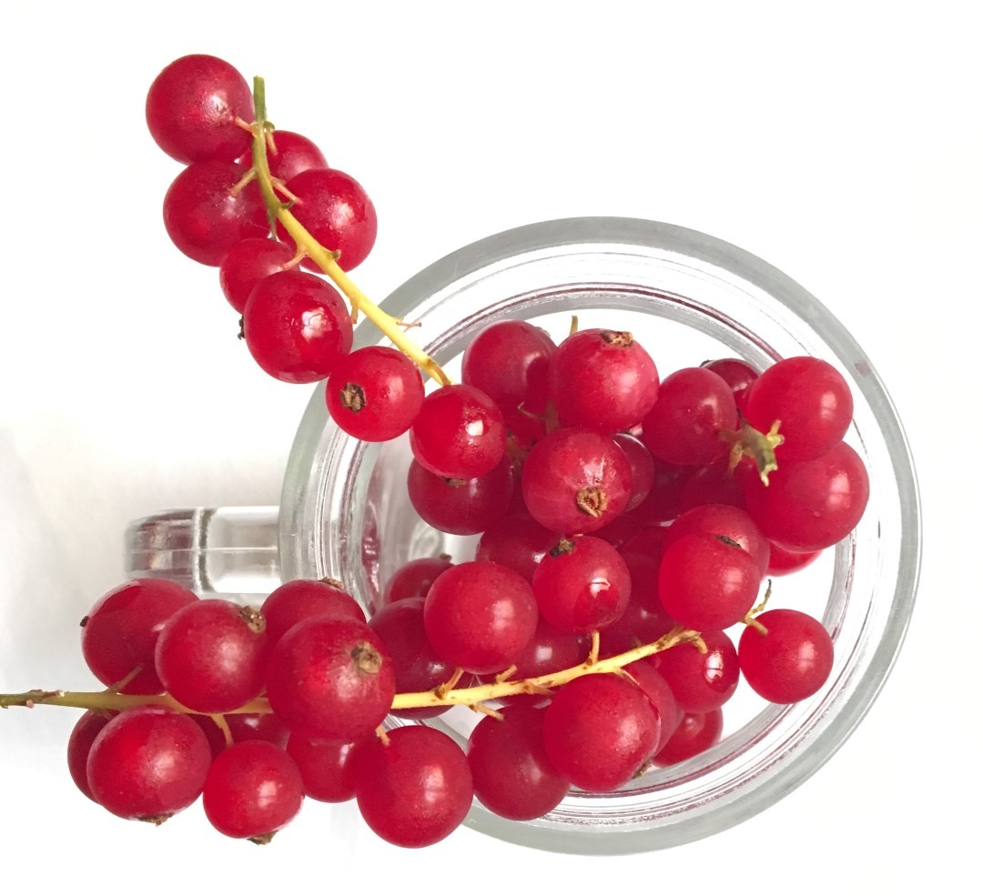
Food ready to eat in Summer (June-Sept)
Fruit
Blueberries
Currants – black, white and red
Greengages
Loganberries
Plums
Raspberries
Strawberries
Tayberries
Fish
Crab
Pilchards
Wild Salmon
Vegetables
Broad Beans
Courgettes
Fennel
Fresh Peas and green Beans
Lettuce and salad leaves
New potatoes
Radishes
Runner Beans
Tomatoes
Meat
Beef
Chicken
Lamb
Pork
Saltmarsh Lamb
Venison

Slide 10
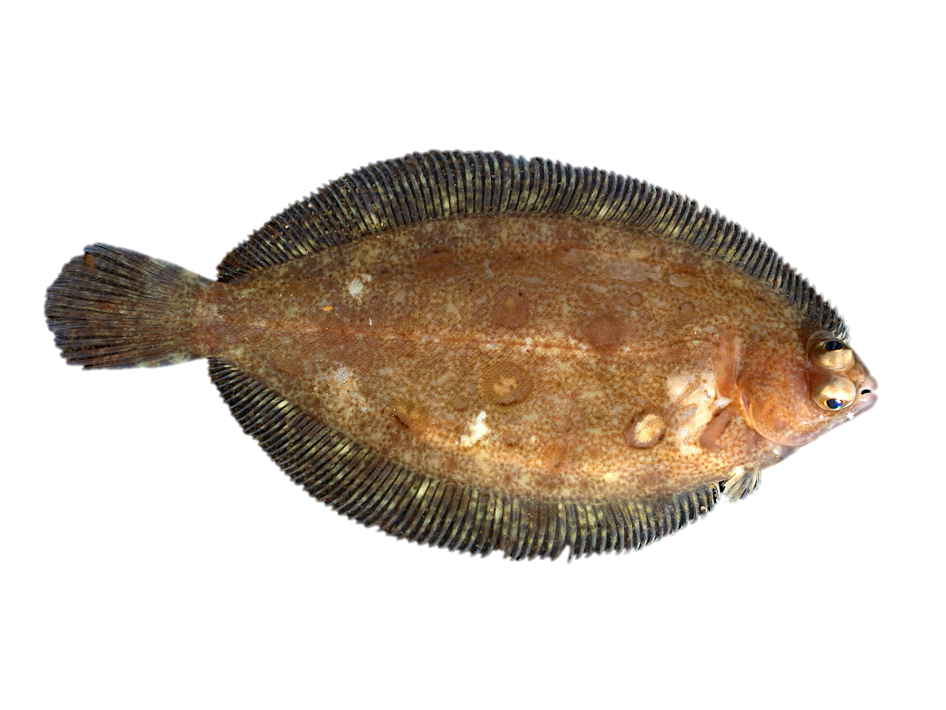
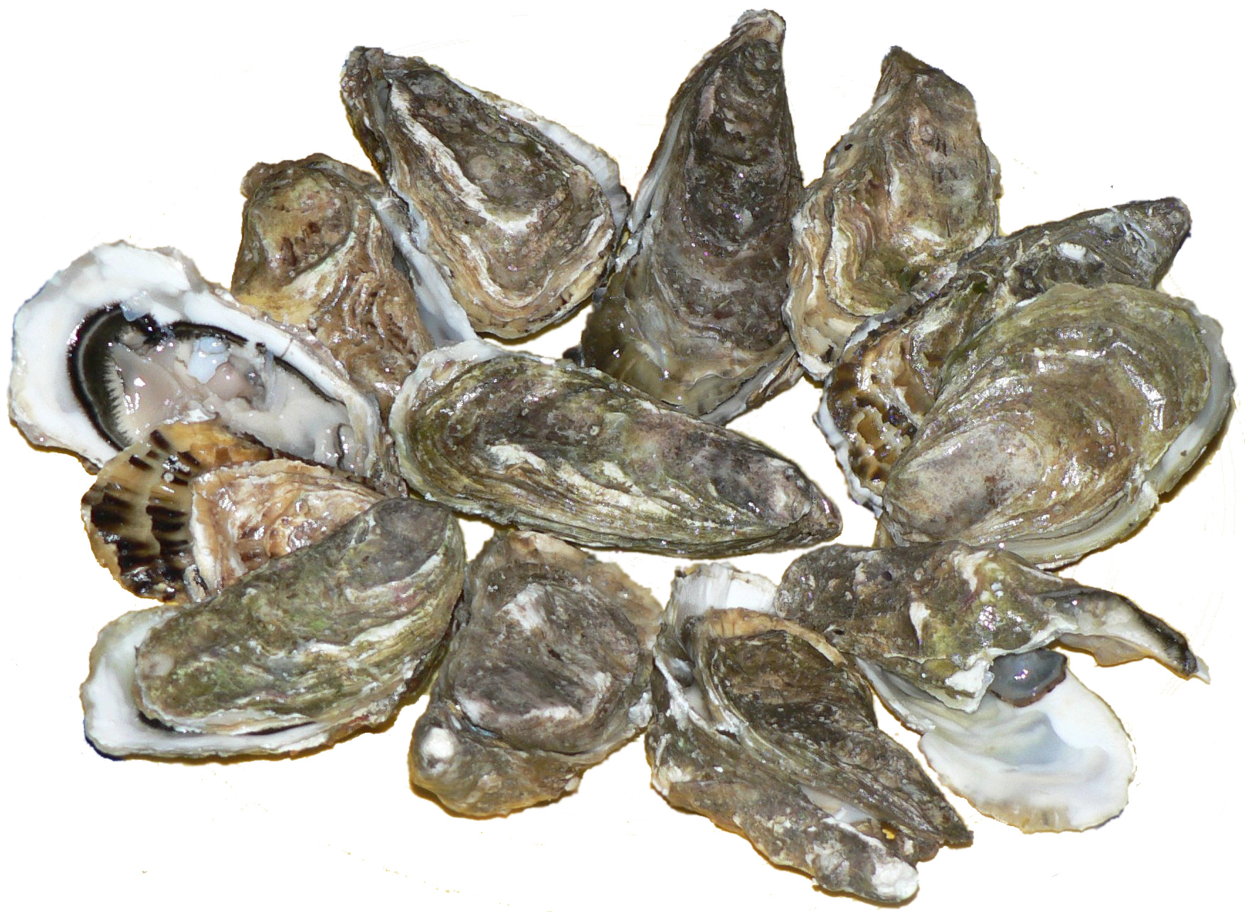
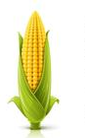
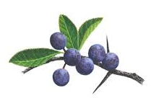
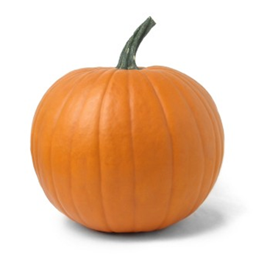
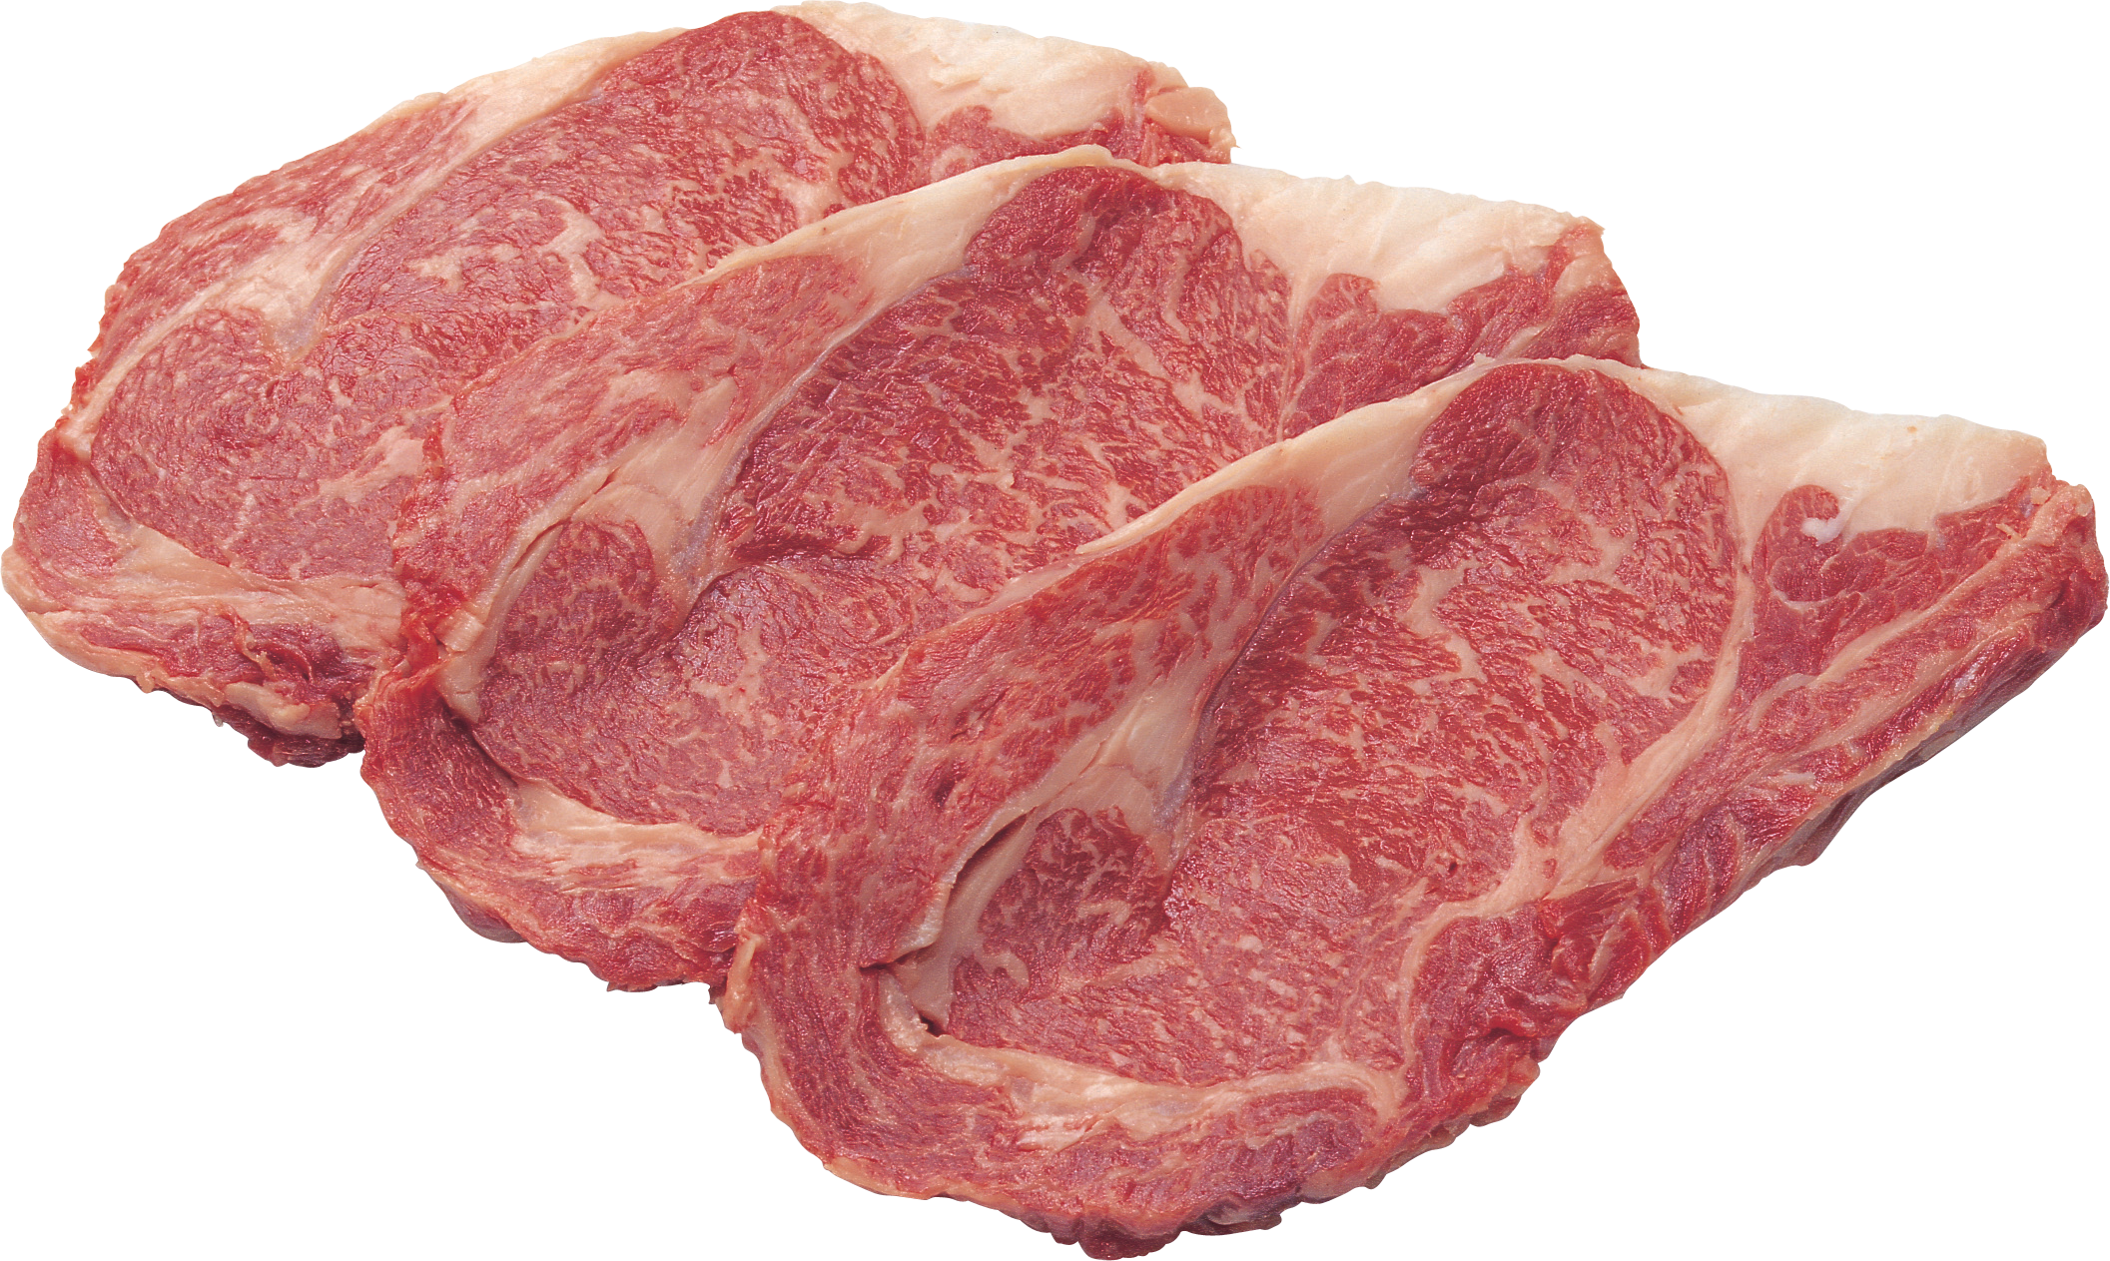
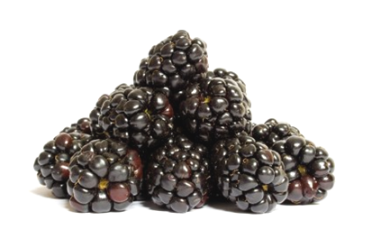
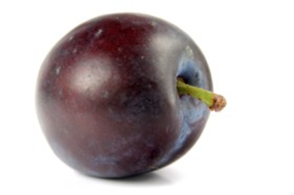
Food ready to eat in autumn (Oct - Nov)
Vegetables
Field Mushrooms
Lettuce
Marrow
Potatoes
Pumpkin
Rocket
Squashes
Sweetcorn
Watercress
Fruit
Apples
Blackberries
Damsons
Elderberries
Pears
Plums
Sloes
Fish
Brill
Dabs
Dover Sole
Flounders
Oysters
Skate
Meat
Chicken
Grouse
Heather-fed Lamb
Pork
Venison

Slide 11
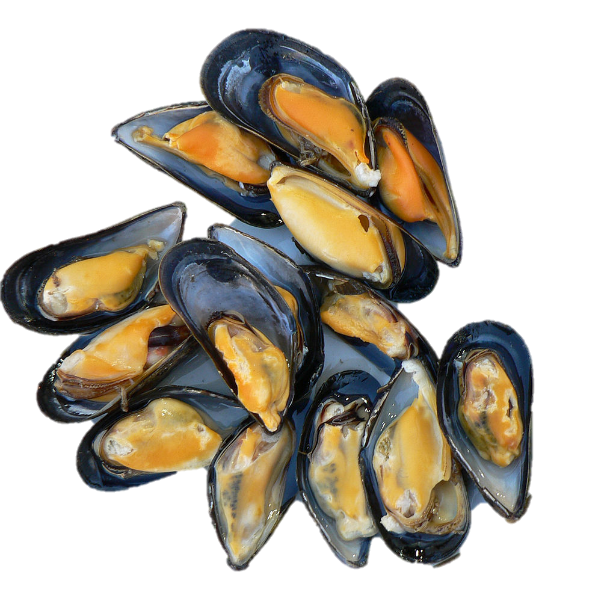
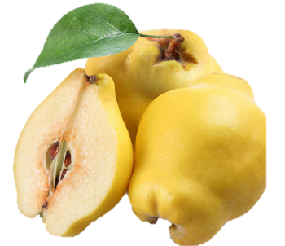
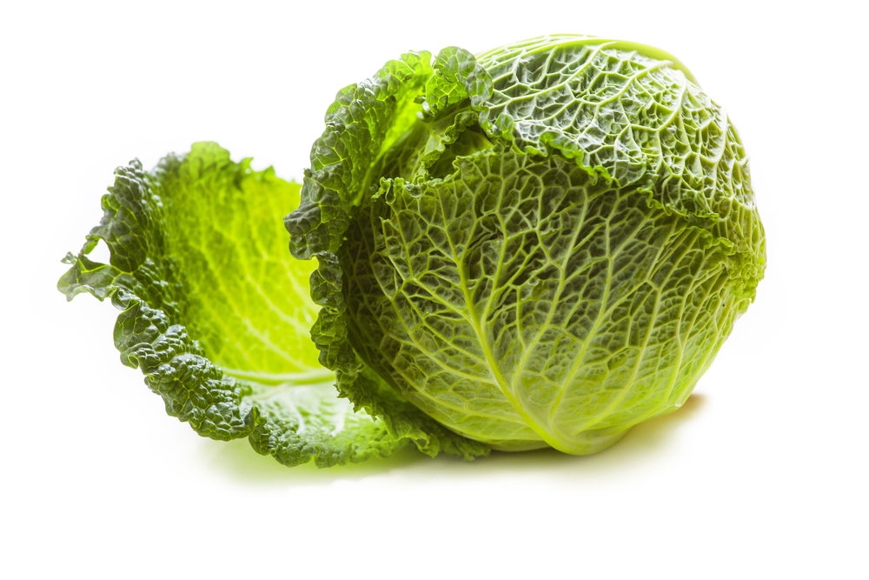
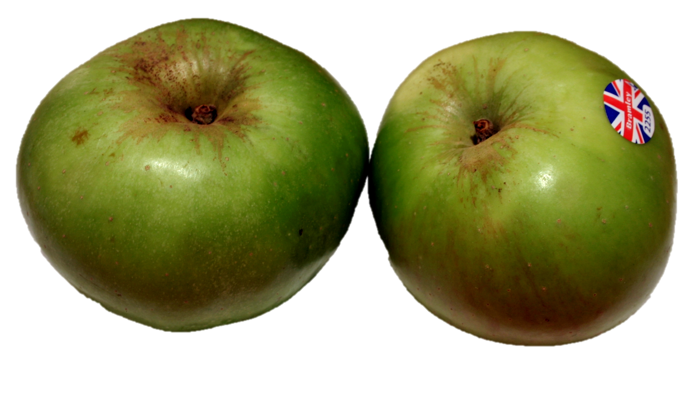
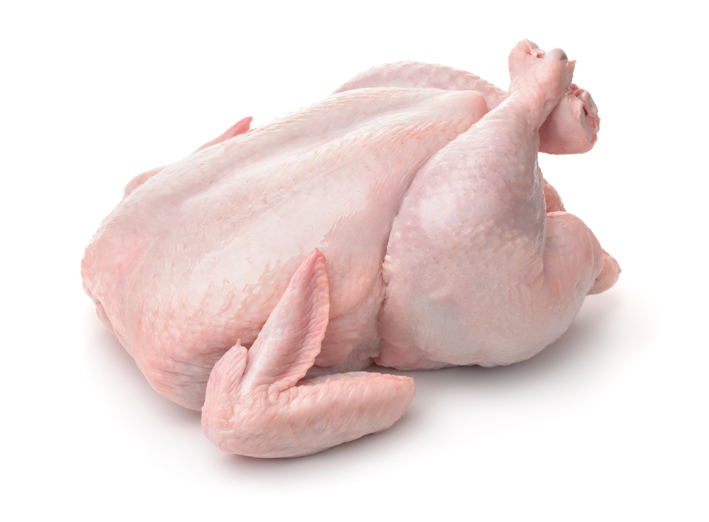
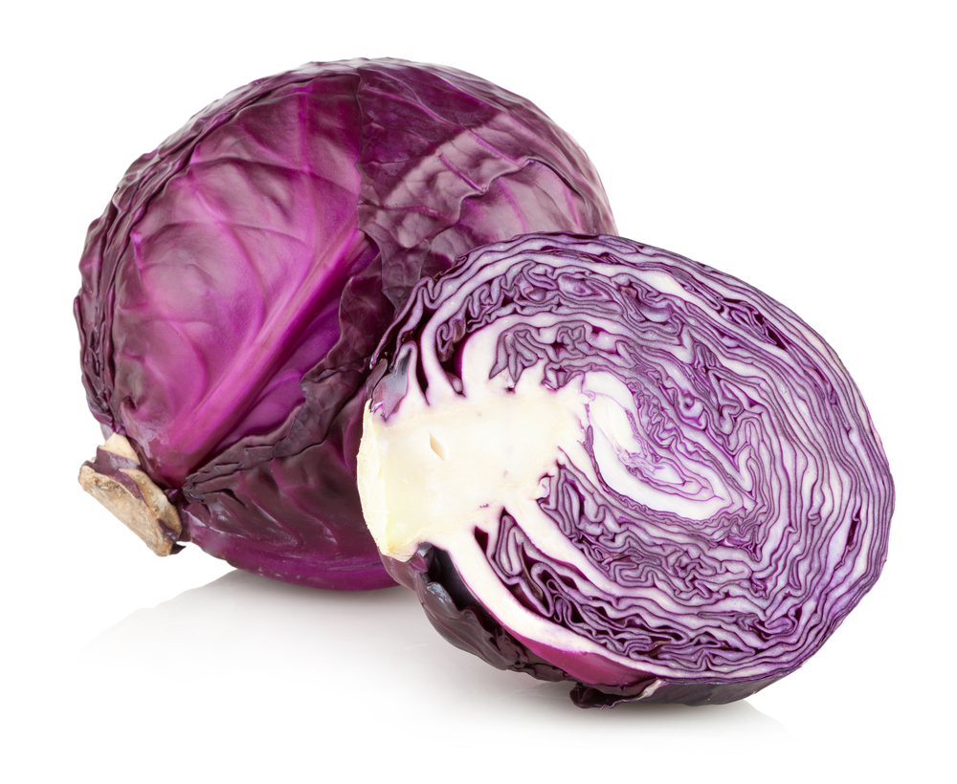
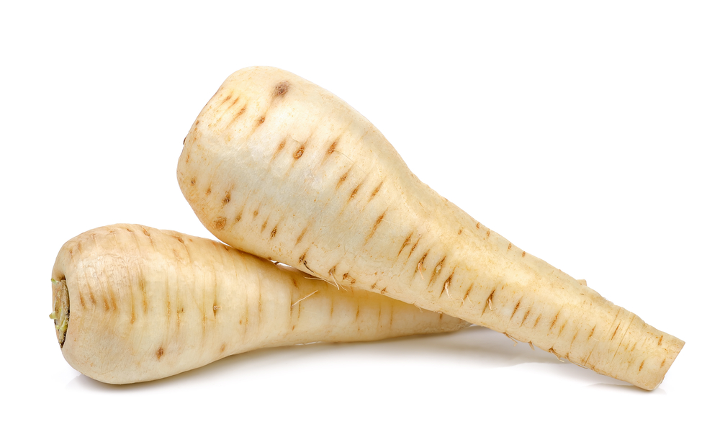
Food ready to eat in Winter (Dec – Feb)
Vegetables
Brussels Sprouts
Cabbage
Carrots
Cauliflower
Celeriac
Curly Kale
Fennel
Leeks
Parsnips
Potatoes
Red Cabbage
Swede
Turnips
Fruit
Apples
Pears
Quince
Fish
Grey Mullet
Mussels
Scallops
Meat
Chicken
Goose
Partridge
Pheasant
Turkey
Venison
Wild Duck

Slide 12
Seasonality
For further information, go to:
www.foodafactoflife.org.uk
This resource meets the Guidelines for producers and users of school education resources about food.

