Slide 1
Kitchen hazards

Slide 2
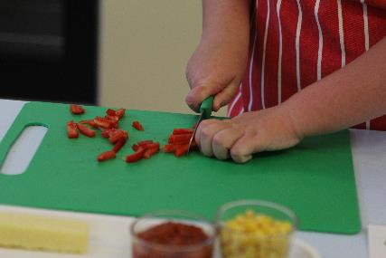
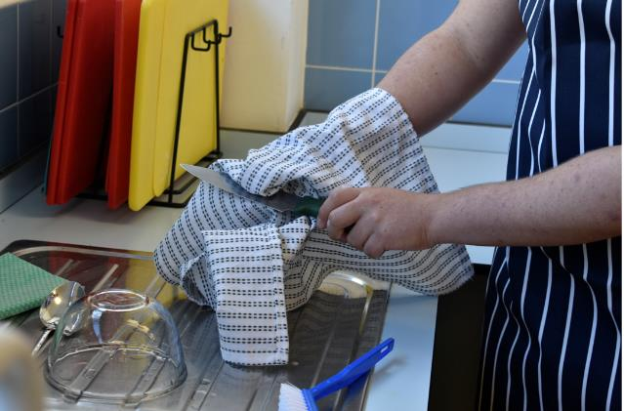

Sharp knives

Slide 3
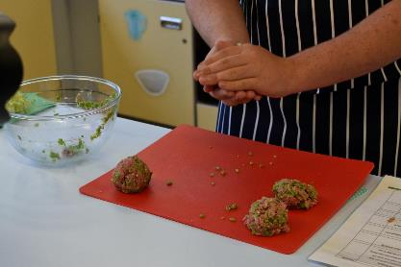
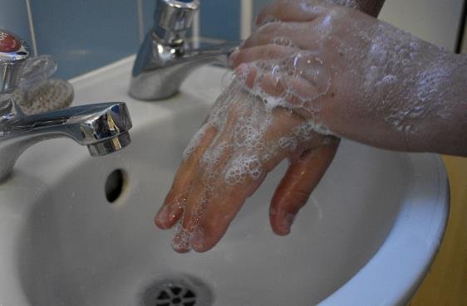
Raw meat

Slide 4
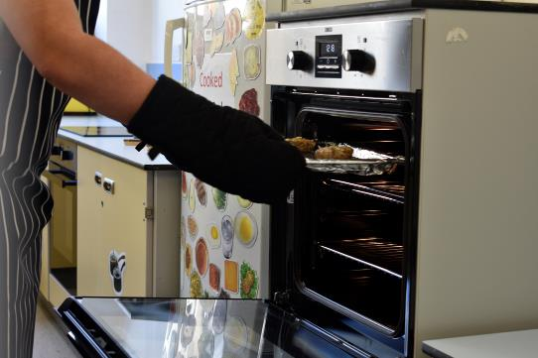
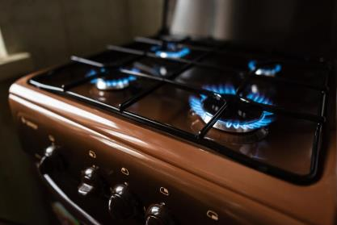
Be safe

Slide 5
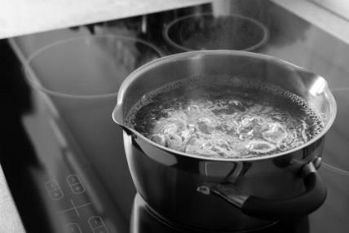

Be safe

Slide 6
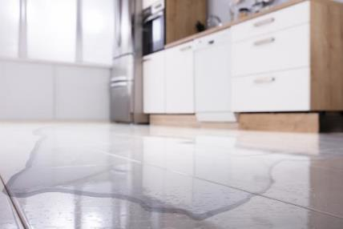
Be safe

Slide 7
Kitchen hazards
For further information, go to:
www.foodafactoflife.org.uk
This resource meets the Guidelines for producers and users of school education resources about food.

