Slide 1
Pasteurisation, sterilisation and irradiation

Slide 2
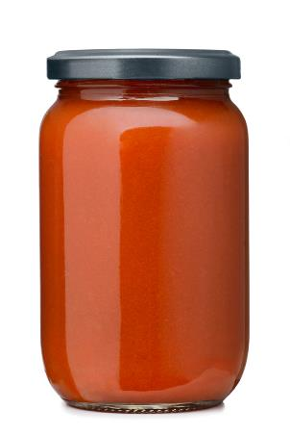
Extending shelf life
Food may have its life extended if sufficient heat is applied to kill micro-organisms and inactivate the enzymes present in the food. There are two main kinds of heat processing:
1) Pasteurisation – this extends shelf-life a little by killing most food spoilage organisms and pathogenic (disease causing) organisms;
2) Sterilisation – this is a more severe process which destroys all micro-organisms, and may change the organoleptic qualities of the product.

Slide 3
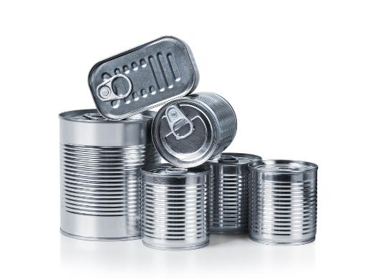
Packing
If the product is packaged before processing, the containers must be made of materials which will not be affected by heat, e.g. cans, glass bottles, foil parcels, plastics and special laminates.
They must also be completely air tight to avoid recontamination.

Slide 4
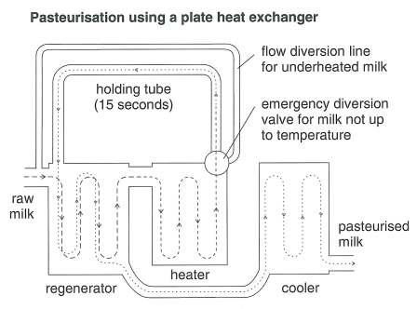
Pasteurisation
The two main forms of industrial pasteurisation are:
• batch pasteurisation – where the product is held in a specific temperature range for a long time (e.g. 63ºC for 30-35 minutes);
• high temperature, short time or HTST pasteurisation – where the product is heated to a higher temperature but for a shorter time (e.g. 72ºC for 15 seconds for milk) using a plate heat exchanger.

Slide 5
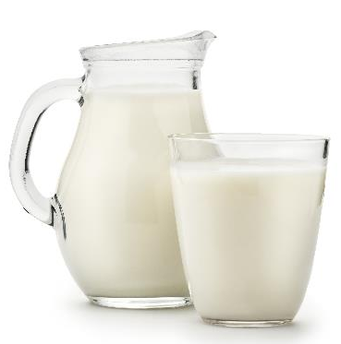
Milk pasteurisation
After the milk has been heated it is passed through a regenerator, which brings it into close contact with the cold raw milk pipe. The heat is recycled as the cold raw milk is warmed by close contact with the heated milk. This, in turn, is cooled. The time, temperature and pasteurisation method used differ according to the product being pasteurised in order to minimise chemical, physical and organoleptic changes (e.g. flavour and colour).

Slide 6
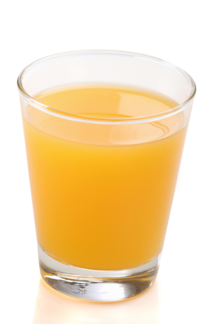
Factors affecting pasteurisation
Variables which affect the time and temperature at which the pasteurisation process is carried out include:
• food type;
• viscosity of the product;
• pH of the product;
• particle size;
• equipment used;
• method used.

Slide 7
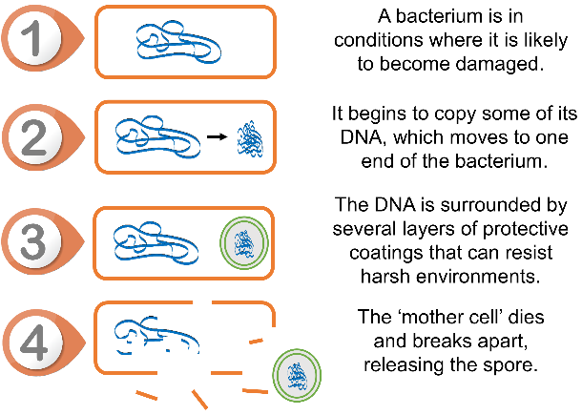
Sterilisation
This process uses a temperature in excess of 100ºC in order to destroy nearly all microorganisms present in a food. This is important because some microorganisms can form spores which have the ability to survive at high temperatures.
If the correct temperature is not reached there is the possibility that the spores will germinate and grow in the food, which could cause food poisoning.
Some organisms can survive the sterilisation process if not processed for enough time or at a high enough temperature (e.g. Clostridium botulinum).
How bacteria form protective spores

Slide 8
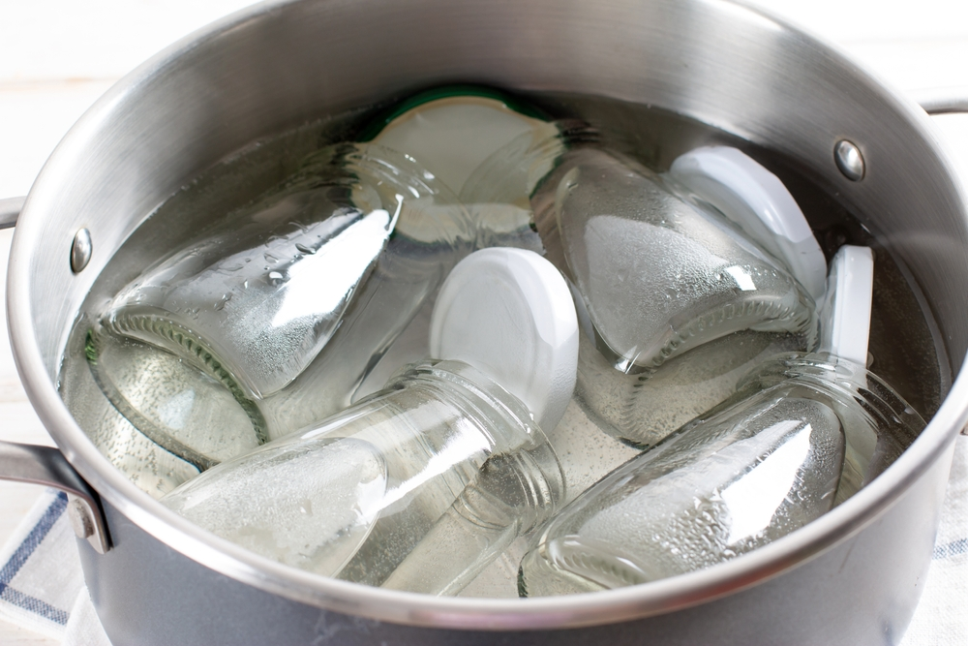
Factors affecting sterilisation
The application time and temperature depend on the following factors:
• micro-organisms present;
• properties of the food product;
• the products initial temperature;
• pH of the product;
• microbe count;
• the size/volume of the container, e.g. can.

Slide 9
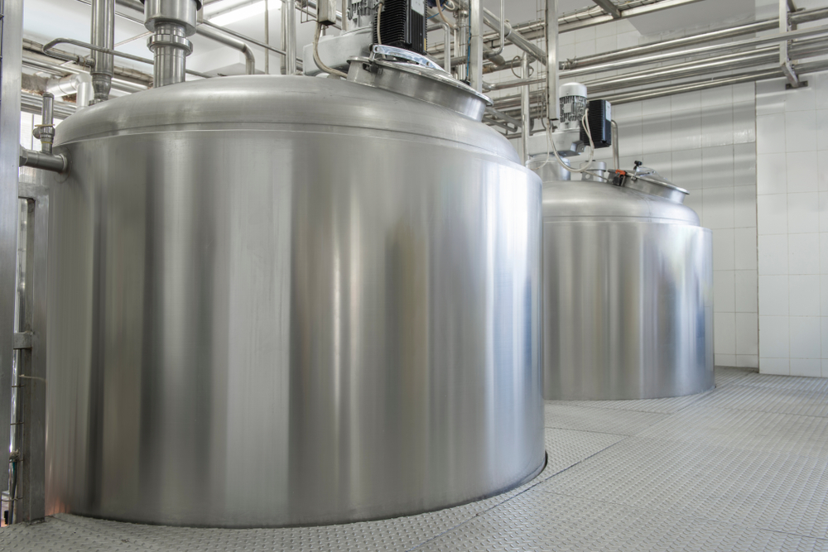
Sterilisation
The product is packed in air-tight containers either before or after heat treatment. If packaging follows heating, the containers must be sterilised before use and filled under aseptic conditions.
Sterilisation enables milk to be kept for 2-3 weeks unopened, but results in a burnt, caramelised flavour and browning.

Slide 10
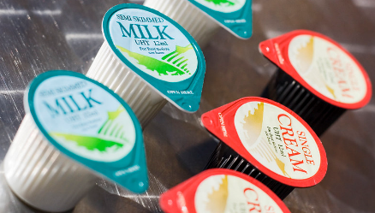
Ultraheat treatment or ultrahigh temperature (UHT)
UHT is a continuous process and the product is packaged after sterilisation into sterile containers. Typical temperatures and times specified for UHT treatment of milk are 130ºC – 150ºC for 1-3 seconds. As the product is moving continuously, high temperatures can be reached resulting in fewer chemical changes, but having the same sterilising effect. This kind of treatment allows milk to be kept at room temperature, until opened. Once opened, it must be refrigerated.

Slide 11
Results of UHT
The process results in increased retention of:
• nutrients - due to short time;
• colour - as there is no non-enzymic browning;
• flavour - as there is no non-enzymic browning;
• texture - since there is no denaturing of proteins.
UHT treatment was developed to kill or inactivate all micro-organisms without causing as much damage to the product as sterilisation. However, milk may taste cooked and could be slightly darker in colour.

Slide 12
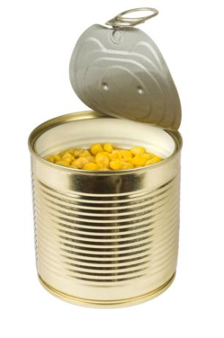
Canning sterilisation
Canning aims to destroy all microorganisms and their spores through the application of heat.
This is achieved by sterilising the food within air-tight containers to prevent re-contamination.

Slide 13

Irradiation
The process of irradiation produces an effect in food similar to pasteurisation.
Irradiation is used to:
• inhibit sprouting vegetables;
• delay ripening of fruits;
• kill insects and other pests;
• kill the micro-organisms which cause food spoilage or food poisoning.

Slide 14
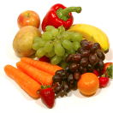
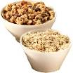
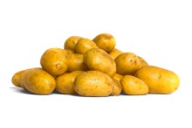



Irradiation in the UK
Current national regulations allow for the irradiation of seven categories of food: fruit, vegetables, cereals, bulbs and tubers, spices and condiments, fish and shellfish, and poultry.

Slide 15
Labelling
All foods, or ingredients of foods listed on the label, that have been irradiated, must be labelled as 'irradiated' or 'treated with ionising radiation'.
Irradiated food which is not pre-packed and is sold to be eaten immediately (e.g. in restaurants) must be marked or labelled on a menu, notice or ticket.

Slide 16
Irradiation concerns
In the UK there has been consumer resistance to irradiated foods stemming from issues of safety, high costs and concern that it could be used to clean up ‘dirty’ food. Some considerations include:
• safety of the workers producing the food – there must be rigorous safety checks in place at the processing plant;
• nutrient losses through processing - there are no significant changes to protein, carbohydrate, minerals or saturated fat. However, as with other types of preservation, some vitamin levels may be reduced.

Slide 17
Irradiation
Further considerations include:
• safety of the food being processed – some consumers fear that the food will become radioactive through the process. However, this is not possible as radioactive material never touches the food and the radiation rapidly dissipates after treatment;
• a need for clear labelling – as the process leaves no obvious signs to the consumer, inspector or retailer. Several detection tests have been developed which can be used to determine whether a food has been irradiated.
Food Standards Agency, 2017

Slide 18
Pasteurisation, sterilisation and irradiation
For further information, go to:
www.foodafactoflife.org.uk
This resource meets the Guidelines for producers and users of school education resources about food.

