Slide 1
Homemade burgers
Complexity: low - medium

Slide 2
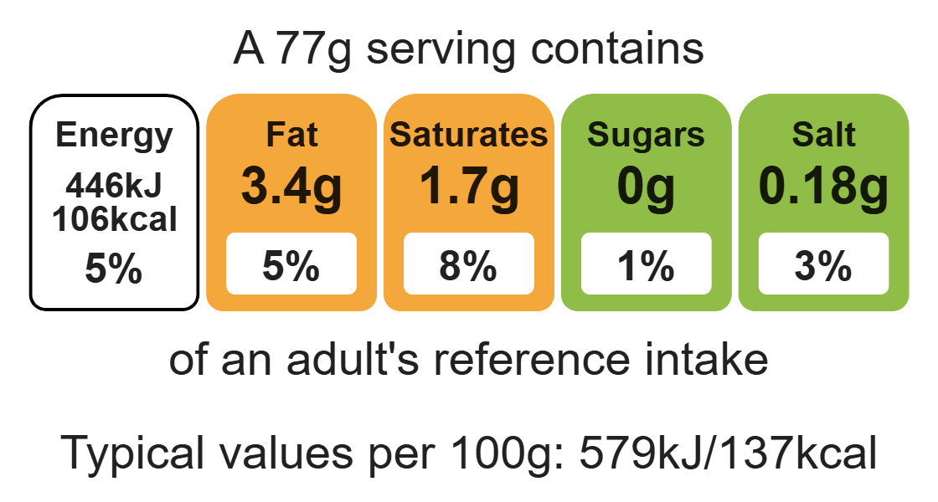
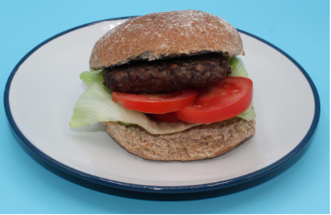
Nutritional analysis
Serves 5

Slide 3
Starter activity
Name…
3 ingredients that provide protein.
2 ingredients that provide carbohydrate.
1 ingredient that provides fat.

Slide 4
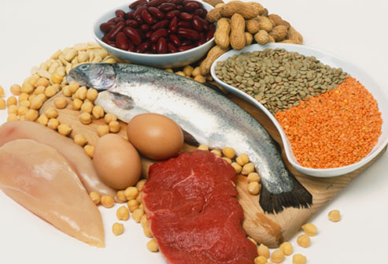
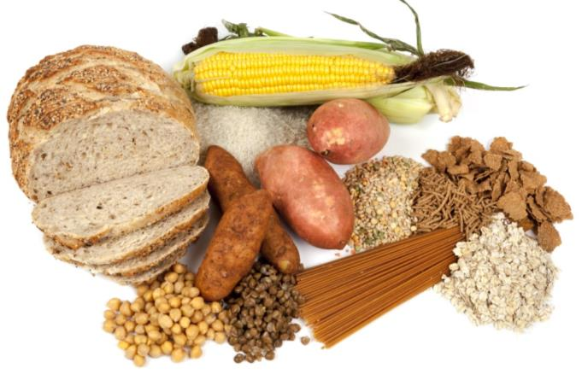
Example responses
3 ingredients that provide protein.
Chicken, pork, beans, eggs, cheese, fish, soya.
2 ingredients that provide carbohydrate.
Bread, rice, pasta, potatoes.
1 ingredient that provides fat.
Butter, oil.

Slide 5
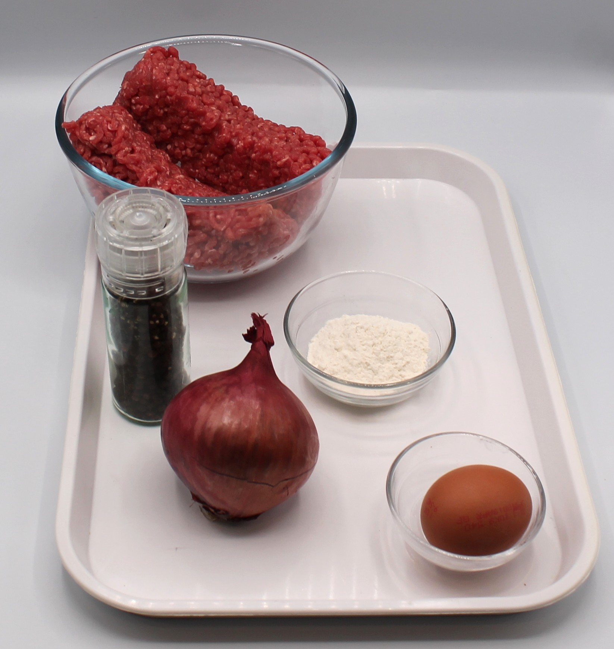

Ingredients (makes 5)
400g lean beef mince
1 red onion
Black pepper
Flour for dusting
Check for any food allergy, intolerance, special dietary requirement or religious/cultural reasons for not handling or eating the ingredients in this recipe.

Slide 6
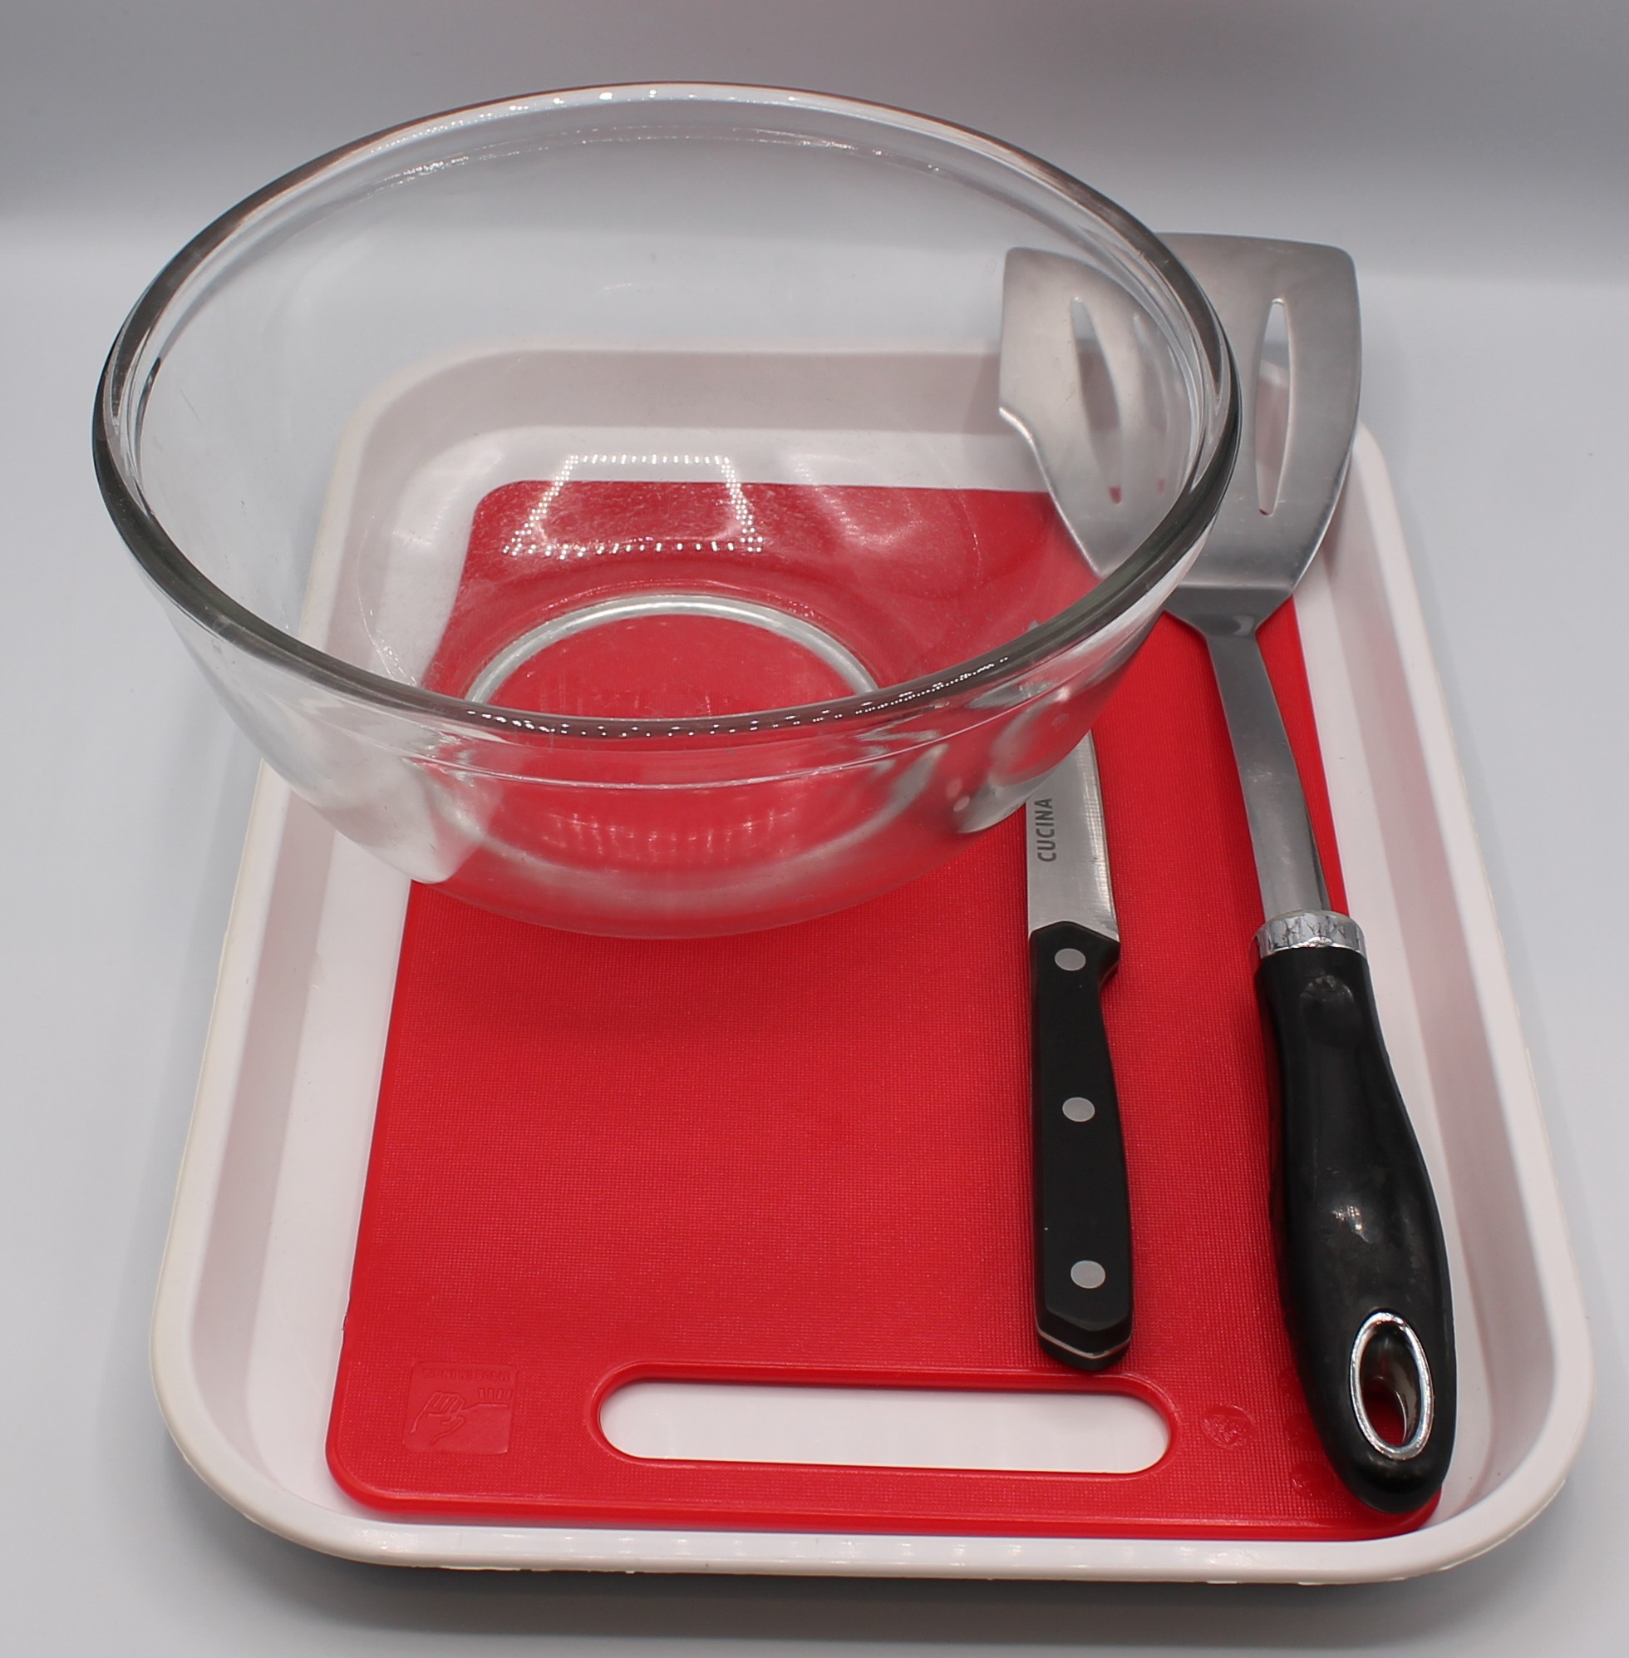
Equipment
Weighing scales
Mixing bowl
2 chopping boards
Sharp knife
Fish slice

Slide 7
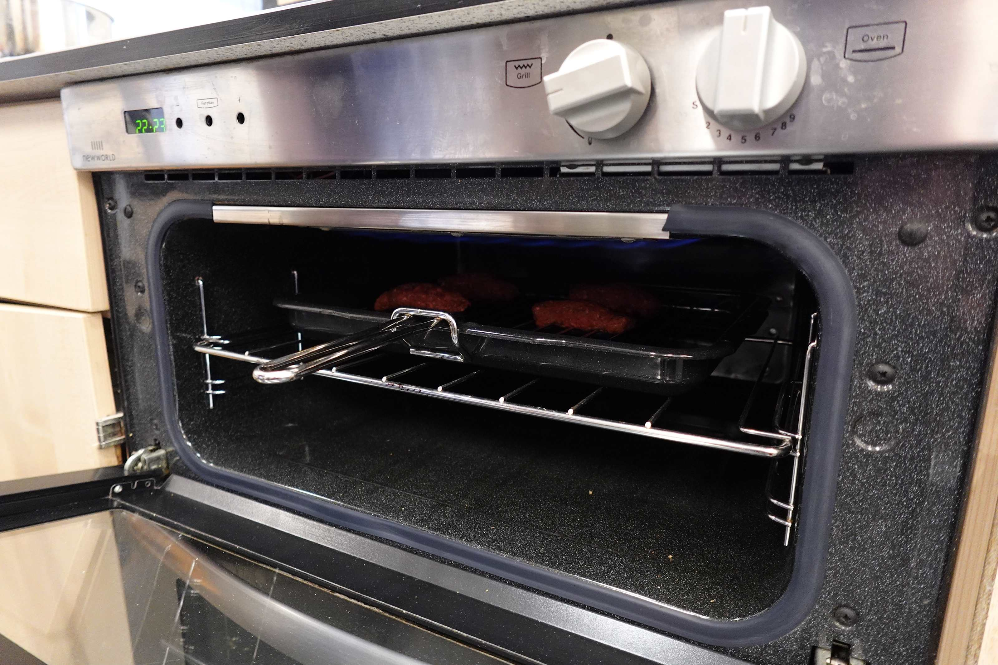

Food skills
Weigh
Portion/divide
Form and shape
Grill
Click below to learn how to use the grill safely

Slide 8
Method
Peel and finely dice the onion.
Mix the minced beef with the diced onions and black pepper.
Divide mixture into 5 balls. Dust hands in flour and flatten each ball into a burger shape. Thoroughly wash and dry hands after touching the raw meat.
Cook on the barbeque or under the grill until cooked throughout, about 5 minutes each side. Ensure no pink meat remains.

Slide 9
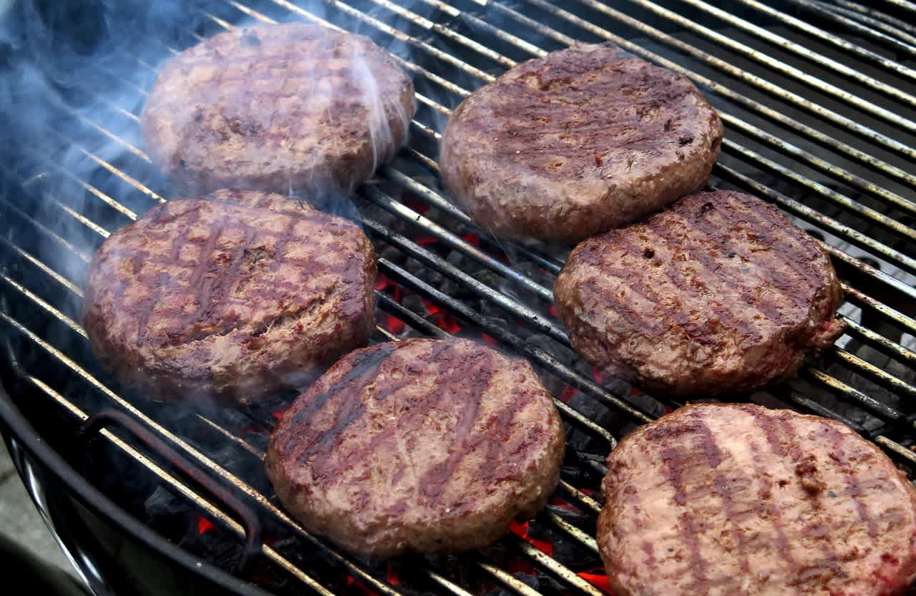
Food science
Maillard reaction
The beef mince is high in protein, the amino acids (from protein) and reducing sugars react and add to the colour and flavour of the burger.

Slide 10

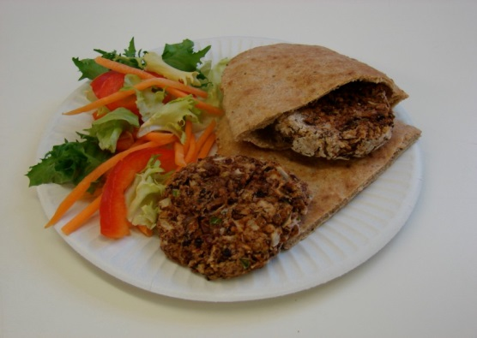
Top tips
Turn up the flavour: Try combining 1 chopped chilli, grated 3cm piece fresh ginger, 1 x 10ml spoon Worcester sauce and 1 x 10ml spoon curry powder for a blazing burger.
Vary your protein: Why not try lamb, pork or turkey mince?
For a vegetarian alternative: Use beans or halloumi.
Serving suggestion: Serve with a wholemeal bun and salad.
Transform your leftovers: Serve chopped leftover burgers with a tomato sauce on wholemeal pasta.

Slide 11
Plenary
Amy is a vegetarian – how can you adapt the recipe to meet her needs?
Sarah needs to add more fibre to her diet, how can she adapt the burger recipe to meet her needs?

Slide 12
Example response
Amy is a vegetarian – how can you adapt the recipe to meet her needs?
Use beans instead of meat in the burger.
2. Sarah needs to add more fibre to her diet, how can she adapt the
burger recipe to meet her needs?
Use a wholemeal bread bun, add salad, add sweetcorn to the burger.

Slide 13
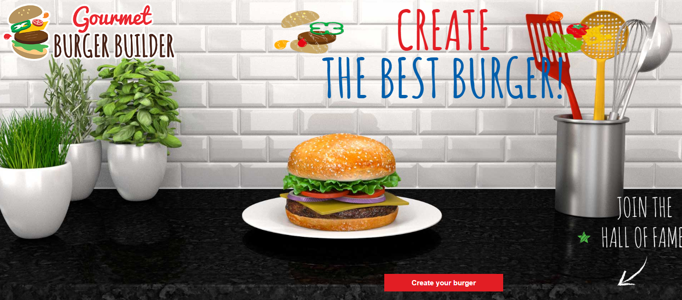
Looking for more…
Challenge your pupils to get creative and create their own burger using our Gourmet Burger builder interactive activity.
Check out our additional resources also including presentations, a recipe modification worksheet and a burger safety activity.
For an alternative recipe that uses similar practical food skills, why not try the kofta recipe in this lesson from the Food – a fact of life Schemes of Work?

Slide 14
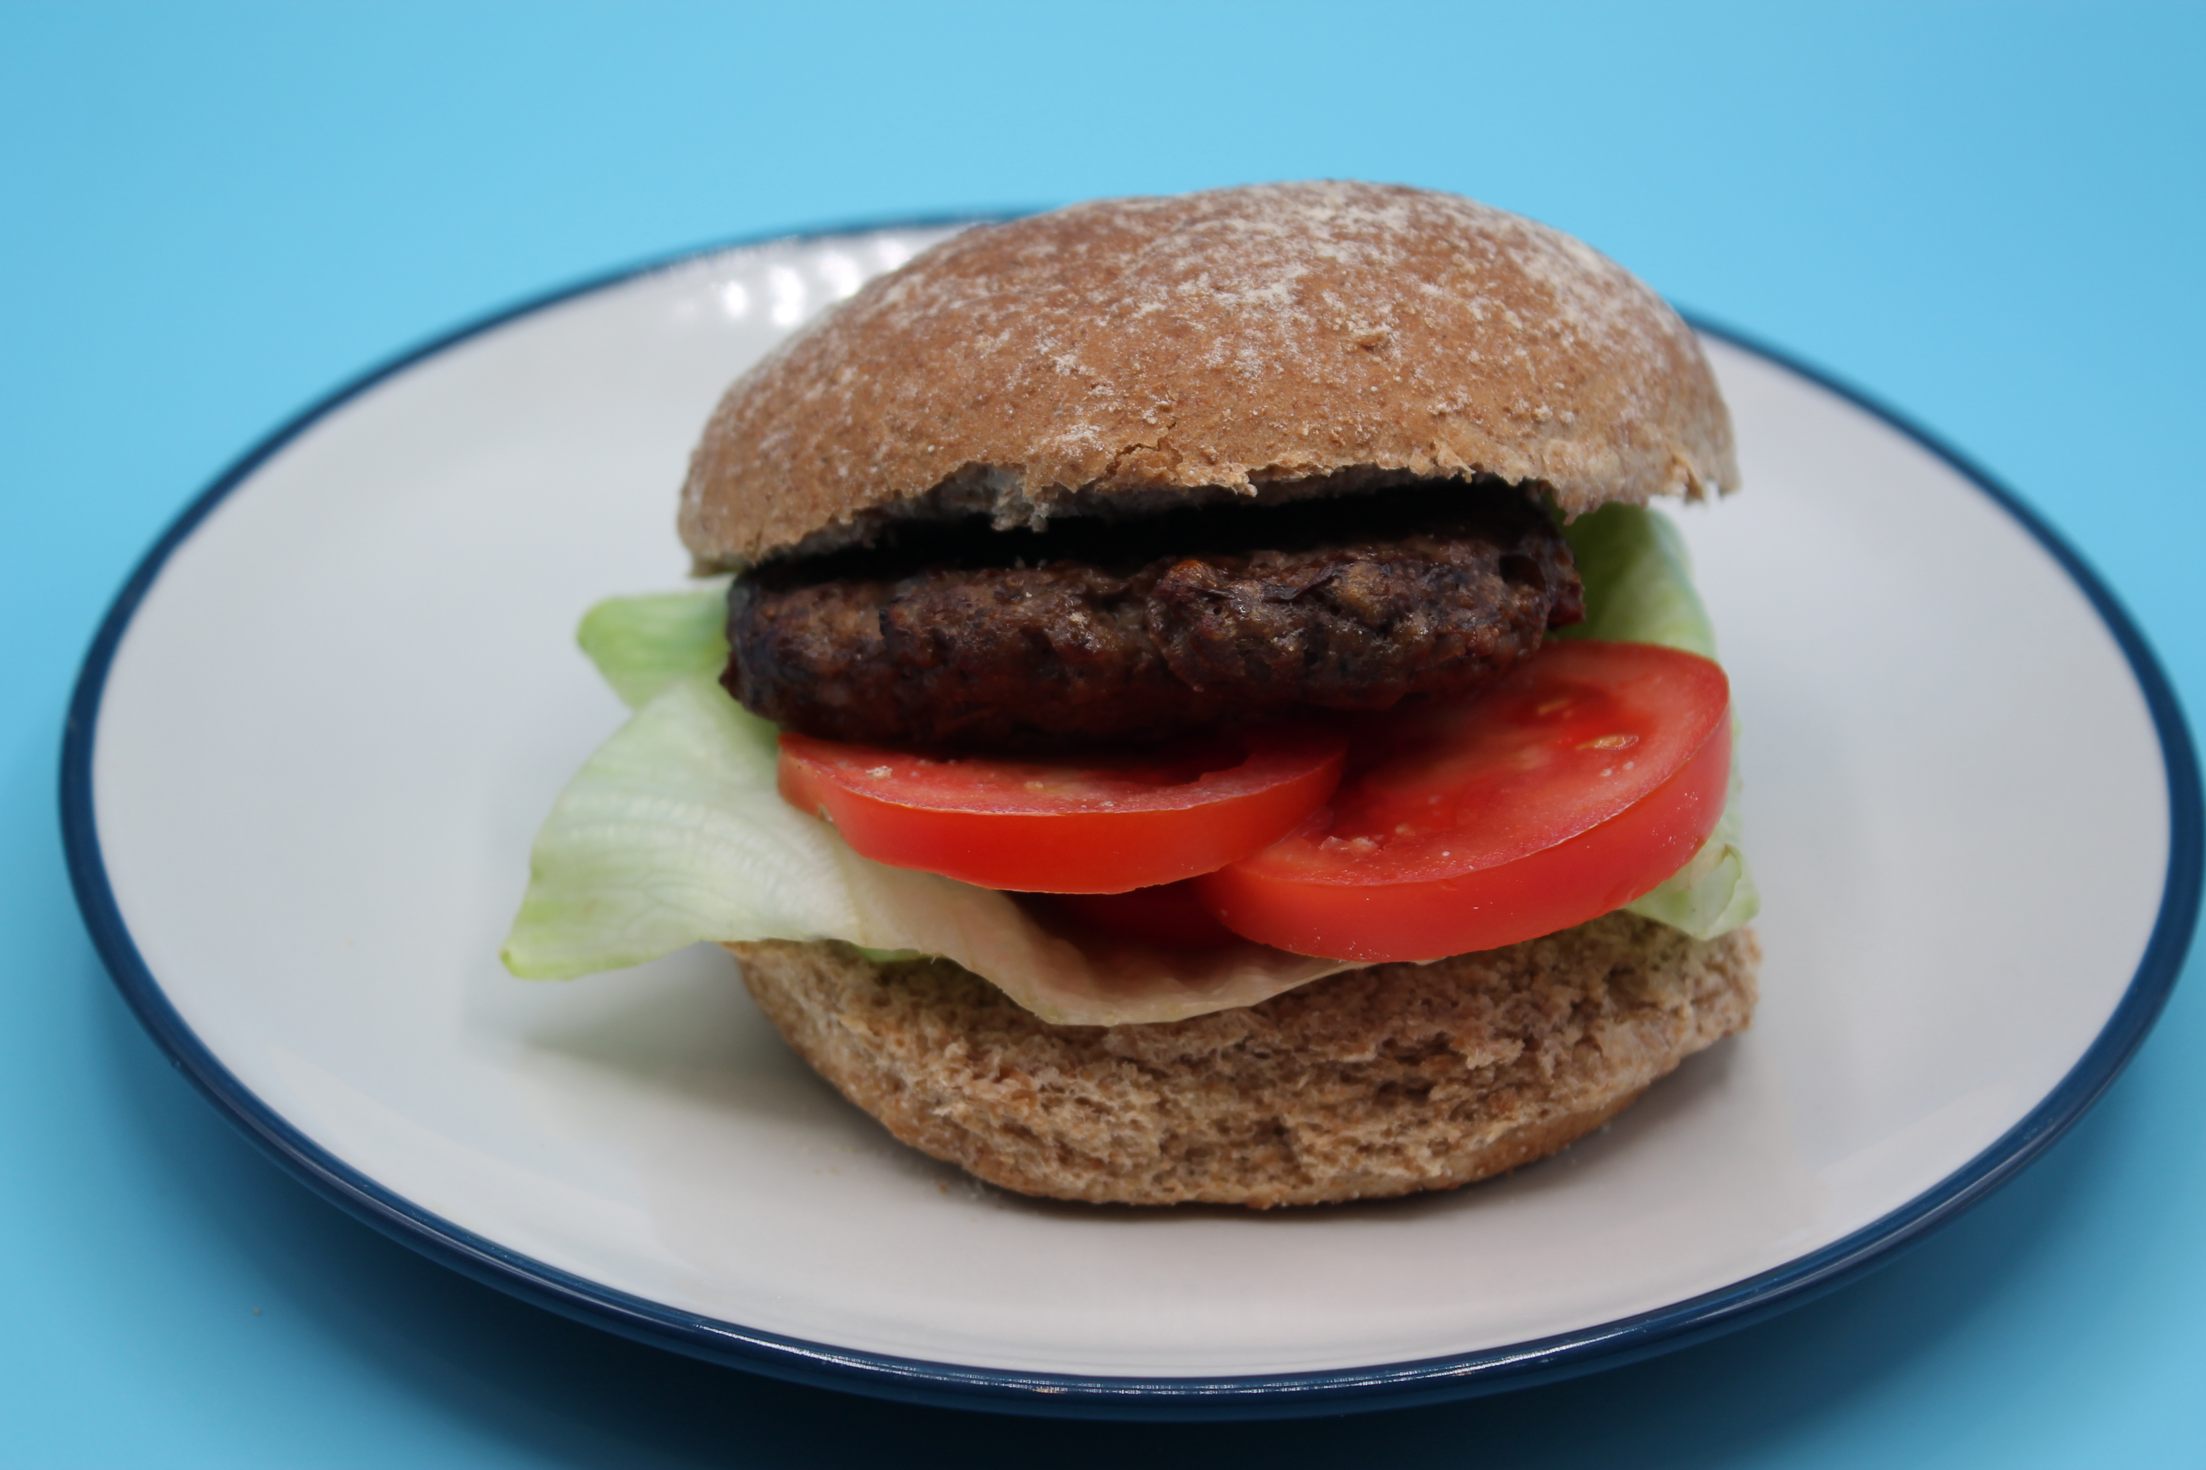
Homemade burgers
For further information, go to:
www.foodafactoflife.org.uk
This resource meets the Guidelines for producers and users of school education resources about food.

