Slide 1
Foams

Slide 2
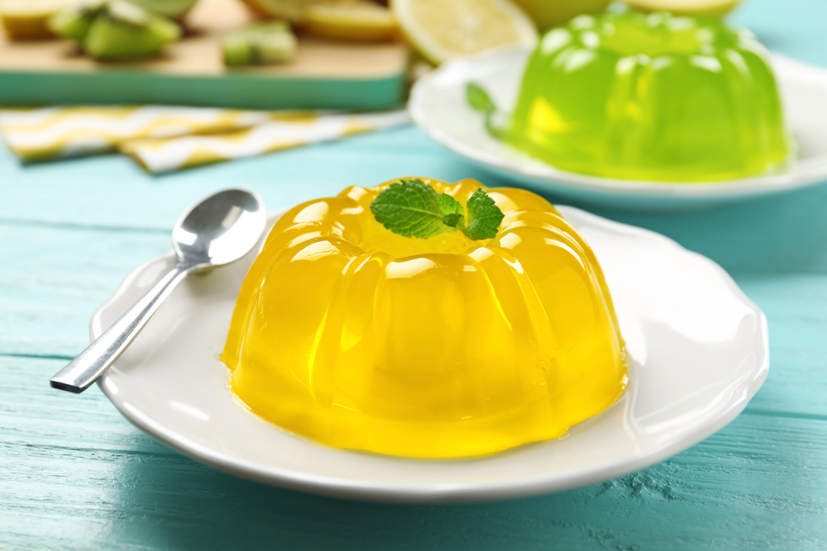
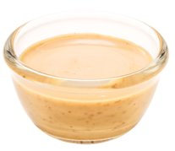
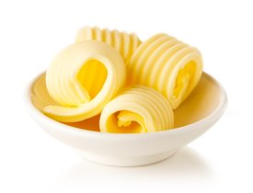
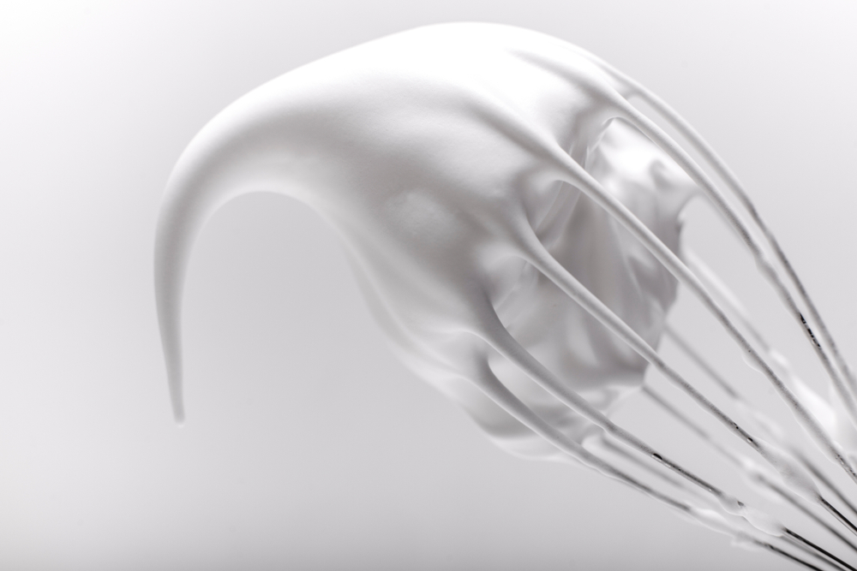
Introduction
Foams are one type of colloidal system.
There are many types of colloidal systems, depending on the state of the two substances mixed together.
Gels, sols, foams like egg white foam and emulsions such as butter are all types of colloids.
Foams are one type of colloidal system.
There are many types of colloidal systems, depending on the state of the two substances mixed together.
Gels, sols, foams like egg white foam and emulsions such as butter are all types of colloids.
Gel
Emulsion
Foam

Slide 3
The science of colloids
Colloids are formed when one substance is dispersed through another but does not form a solution.
The substance which is dispersed is known as the disperse phase and it is suspended in the continuous phase.
Egg white foam is an example of this. Air bubbles (disperse phase) are trapped in the egg white (continuous phase), resulting in a foam.

Slide 4
Main types of colloidal systems
System | Disperse phase | Continuous phase | Product
Sol | Solid | Liquid | Uncooked custard, unset jelly
Gel | Liquid | Solid | Jelly, jam, blancmange
Emulsion | Liquid | Liquid | Mayonnaise, milk
Solid emulsion | Liquid | Solid | Butter, baking fat/block
Foam | Gas | Liquid | Whipped cream, whisked egg white
Solid foam | Gas | Solid | Meringue, bread, cake, ice cream

Slide 5
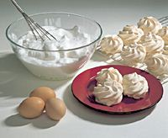
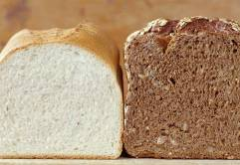
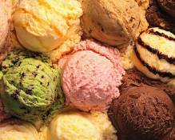
Foams – what are they?
Foams are composed of small bubbles of gas usually air dispersed in a liquid, e.g. egg white foam. As liquid egg white is whisked, air bubbles are incorporated.
The mechanical action causes proteins in the egg white to unfold and form a network, trapping the air.
If an egg white foam is heated, proteins coagulate, and moisture is driven off. This forms a solid foam, e.g. meringue.
Ice cream, bread and cakes are other examples of solid foams.

Slide 6
The science of foams
Egg white – proteins suspended in water
Egg whites are made up of water, protein, and small amounts of minerals and vitamins.
When eggs are beaten, air is introduced, and the proteins are denatured exposing their hydrophobic (water hating) and hydrophilic (water loving) ends of the protein.
The proteins place themselves between air and water forming bubbles with their hydrophilic chains pointing into the water and their hydrophobic chains in the air.
The proteins can also bond to one another side to side as crosslinks, which add to the stability of a foam.
Beating forms air bubbles (white) and proteins unfold
Air bubbles become smaller, hydrophilic areas of proteins point towards air bubbles, hydrophobic areas to water. This stabilises the foam.

Slide 7
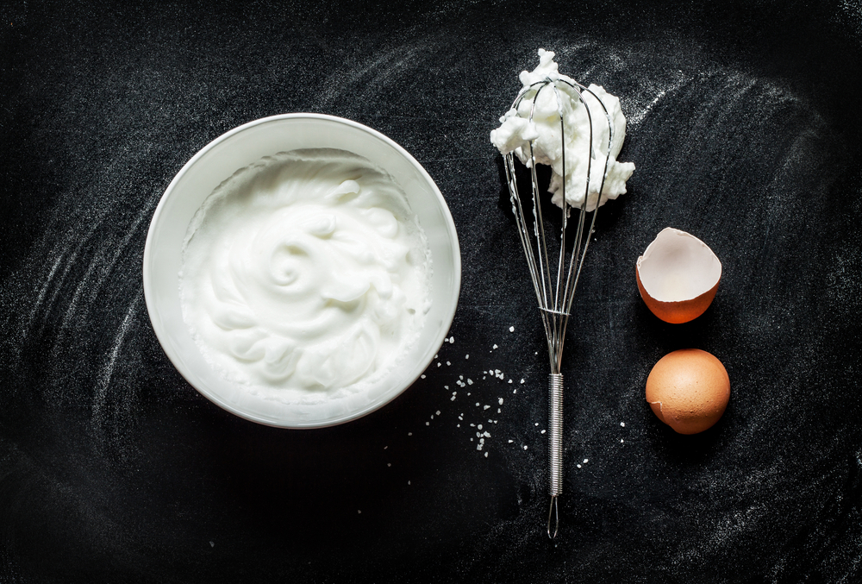
Making and stabilising foams
Why do foams collapse?
When whisked to form a foam egg whites increase in volume. Egg white can hold 7-8 times its own volume of air.
The egg white:
traps the air when whisked to create a gas in air foam;
protein stretches or unfolds and forms a film of protection around the air bubbles.

Slide 8
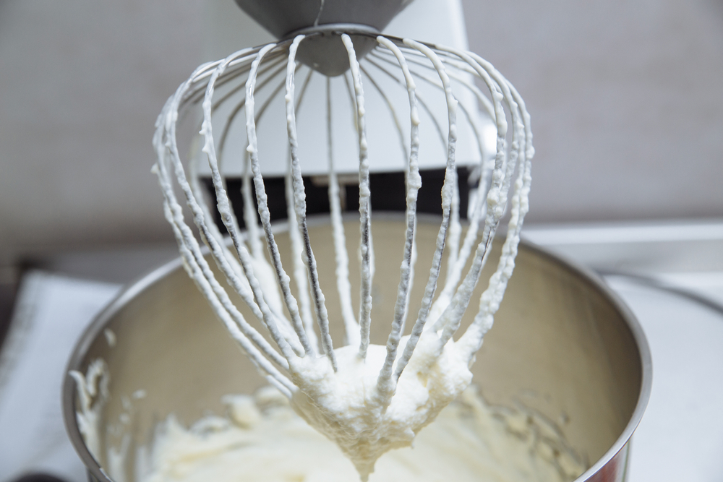
Making and stabilising foams
The collapse of less stable foams can be caused by the following:
Coalescence: if left standing, foam can lose its structure by two air bubbles merging with one another. The protein film that separates the two bubbles breaks and causes the two to come together and form one bubble – they coalesce.
Over whisking: if over whisked, egg white foam will start to collapse. This is caused by the denaturation* of the protein which causes loss of elasticity. The foam loses volume and becomes dry, dull and unstable.
*

Slide 9
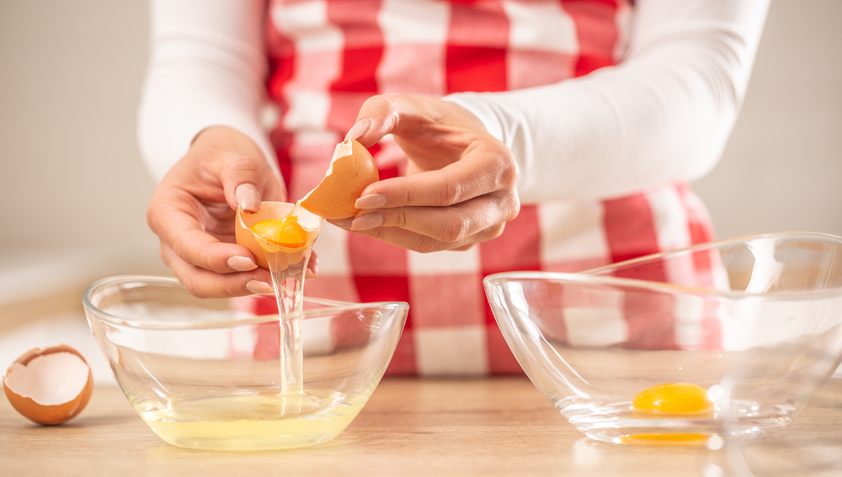
Making and stabilising foams
Traces of fat in mixture: fat molecules (often from traces of egg yolk) have both hydrophobic and hydrophilic parts and will compete with proteins in the foam.
Unlike proteins, fats don't bond to each other side to side to form cross links. Instead, they compete with protein molecules in forming bonds and prevent the protein from denaturing.
So, the addition of any fat (e.g. egg yolks) will interfere with the formation of egg white foam.
It is important to have clean, grease free tools and equipment when making an egg white foam.

Slide 10
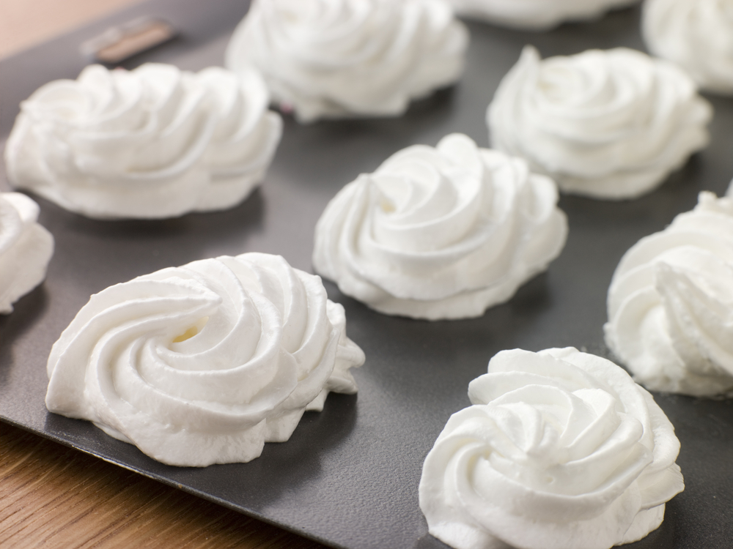
Questions
Fact 1. Egg whites at room temperature can be beaten to a foam more easily than cold egg whites.
Why is this?
Fact 2. Sugar is added to a foam to make meringue.
Does it make a difference?
Fact 3. Adding vinegar or other acid, helps to strengthen and stabilise the foam.
What is the science behind this fact?

Slide 11
Question 1
Fact 1. Egg whites at room temperature can be beaten to a foam more easily than cold egg whites.
Why is this?
Answer: Warmer egg whites will foam up better than cold ones from the fridge. This is because the proteins strands can move more at the higher temperature and are already starting to unfurl.

Slide 12
Question 2
Fact 2. Sugar is added to a foam to make meringue.
Does it make a difference?
Answer: Adding sugar at the beginning can double the time you have to whisk the egg whites to get a foam. Sugar will dissolve in the water (liquid) from the egg white. As a result, it increases the viscosity of the watery phase. The sugar molecules get in the way of the egg proteins. With sugar molecules in the way, it takes longer for the proteins to ‘find’ each other and form bonds.
When meringue is cooking, sugar helps keep it stable by bonding with water molecules and preventing them from escaping as water vapor. Delaying the evaporation of water from the foam helps keep the foam stable until it stiffens.

Slide 13
Questions
Fact 3. Adding vinegar or other acid, helps to strengthen and stabilise the foam.
What is the science behind this fact?
Answer: Adding vinegar (or any other acid) can make the foam less likely to become lumpy and collapse. They do this by donating positively-charged hydrogen ions to the egg white’s negatively-charged protein strands, which neutralises the meringue. This slows down the time it takes for the egg whites’ proteins to denature and allows more air to be incorporated before the meringue becomes over-beaten.

Slide 14
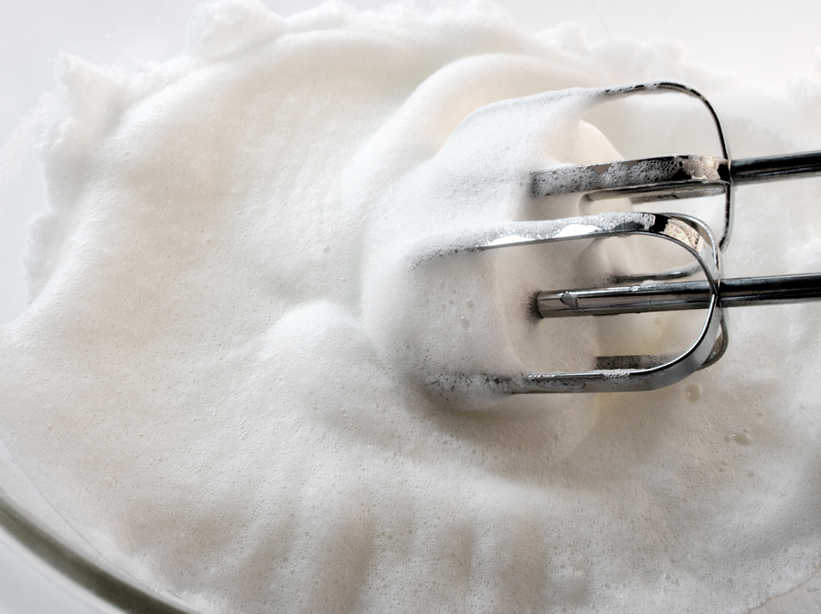
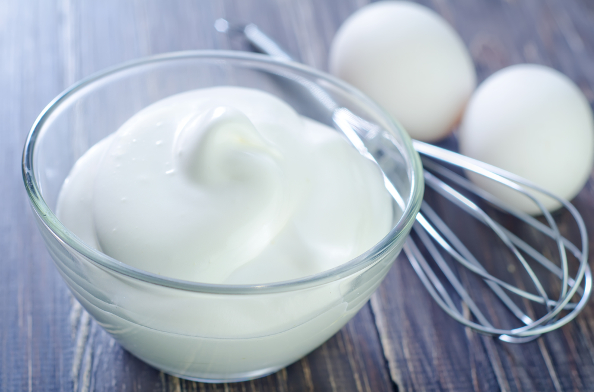
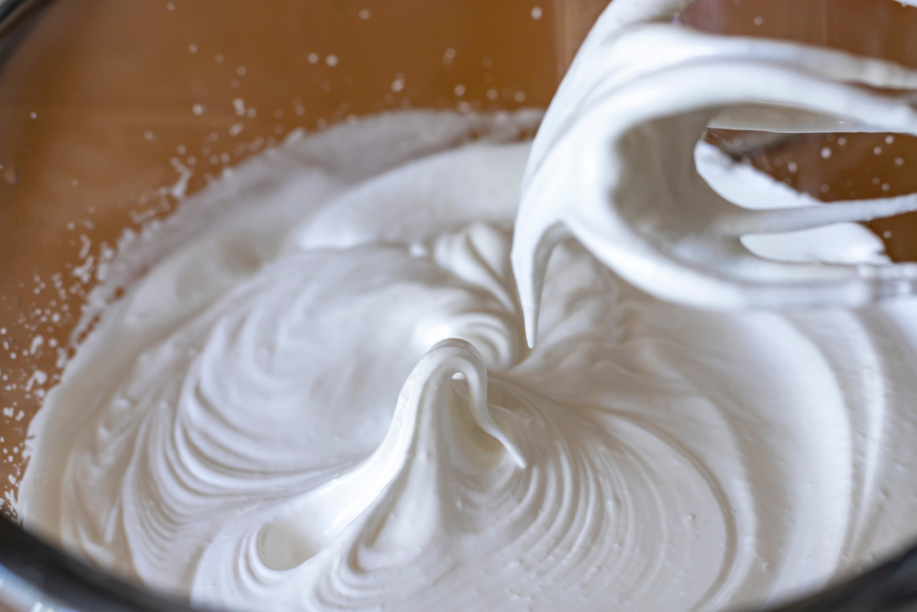
Applying the science
Slightly beaten
Egg white foams with large air bubbles.
Used for clarifying soups
Peak (rounded)
White, shiny, glossy foam. Small air bubbles. Liquid separates out easily.
Used for soft meringue pie topping
Peak (pointed)
White, fine foam, glossy and smooth. Very small air bubbles. Stable foam.
Combines easily into mixtures.
Used in meringues, souffles
Notes:
Clarifying - The protein coagulates in the hot liquid and rises to the surface (dragging with it any impurities. It then forms a frothy crust on the surface (called a raft) , which can be skimmed off, leaving a clear liquid in the pan.

Slide 15
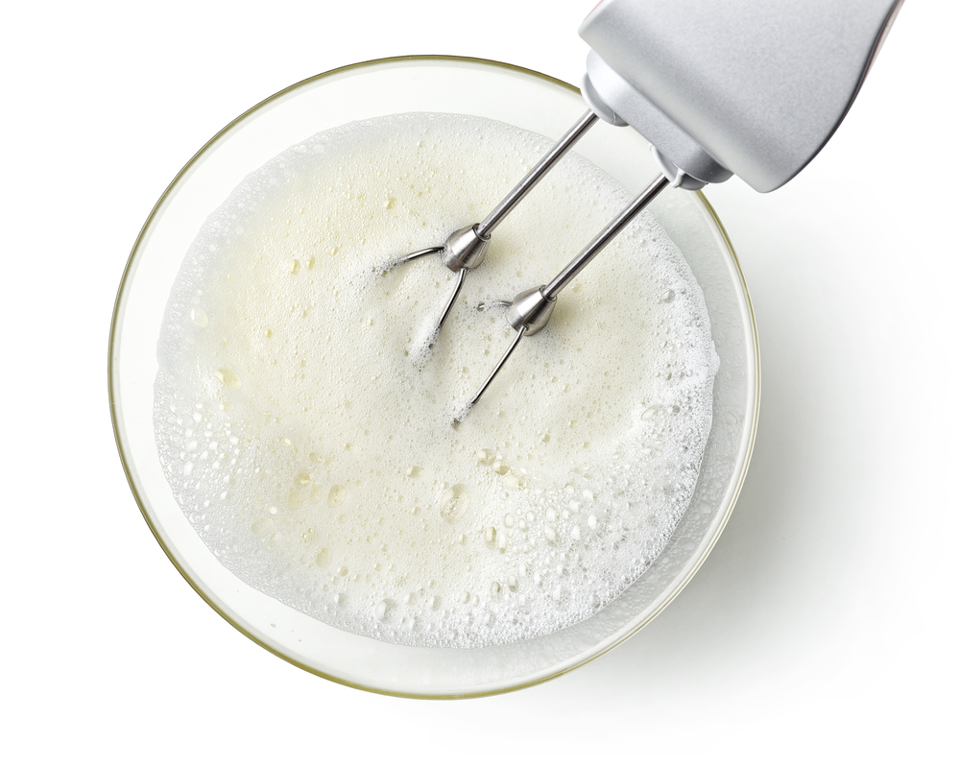
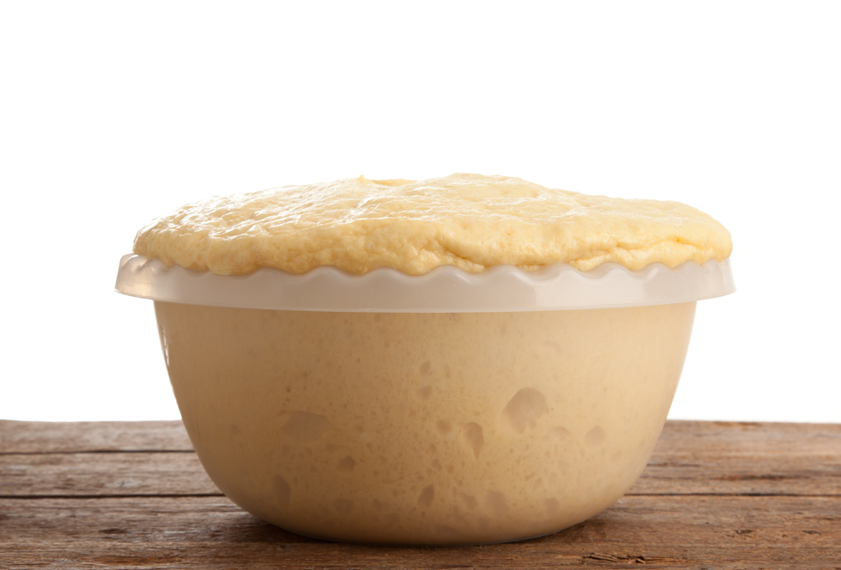
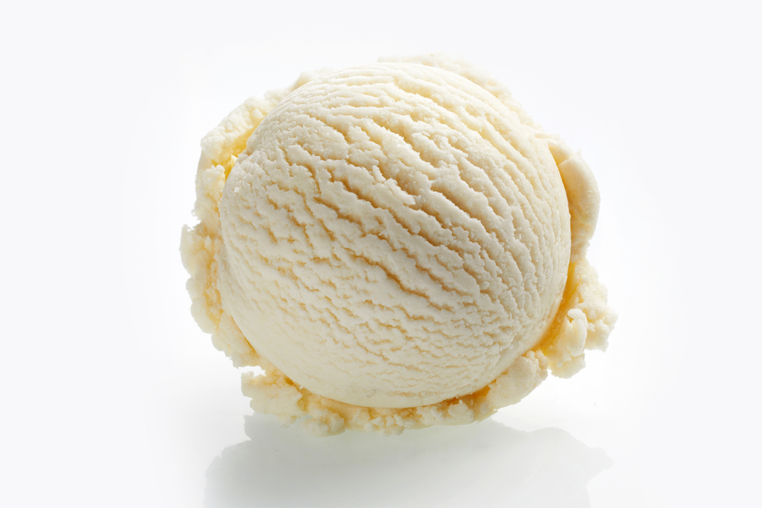
Applying the science
Beating egg whites incorporates air and denatures protein to form a stable foam that can be used in dishes (e.g. meringue).
Solid foams like bread and cakes can be formed by reactions that generate gas bubbles (e.g. yeast produces CO₂ to make bread rise).
Air makes ice cream softer and lighter, preventing it being overly dense.

Slide 16
Key words
Key word | Meaning
Foam | A colloid which has a gas dispersed in either a liquid, e.g., beaten egg white, or a solid, e.g., cake.
Colloid | A mixture which has one substance dispersed through another, but which does not combine to form a solution, e.g., milk, jam, or mayonnaise.
Aerate | Incorporate air into a mixture (e.g., beating egg whites)
Sol | A liquid colloid which has solid particles dispersed in a liquid, e.g., milk, pouring custard, gravy.
Coalescence | Coalescence is the process by which two or more droplets, bubbles or particles merge during contact to form a single droplet, bubble or particle (e.g. if an egg white foam is left to stand, the droplets will coalesce and the foam will collapse)

Slide 17
Key words
Key word | Meaning
Hydrophilic​ | ‘Water loving’ – tends to mix and/or form a solution with water, e.g., sugar.
Hydrophobic | ‘Water hating’ – tends not to mix and/or form a solution with water, e.g., oil.

Slide 18
Teachers’ guide

Slide 19
Teaching about foams:
Carry out investigations/tests on foam production and stabilisation.
Demonstrate and explain how a foam is produced.
Explain the science of making a foam.
Explain how egg white foams are stabilised.
Explain how and when foams are used in recipes.
Discuss the characteristics of products that incorporate a foam.

Slide 20
Foams – what are they?
When egg white is whisked air is beaten into the mixture. Initially:
The egg white is clear, flows easily, has large bubbles.
As whisking continues the proteins in the egg white begin to stretch/unravel.
The amino acids contain both hydrophilic and hydrophobic amino acids. When the protein is folded, the hydrophobic amino acids are in the centre away from the water and the hydrophilic are on the outside closer to the water.
When an egg protein is next to an air bubble, part of that protein is exposed to air and part is still in water. The protein uncurls so that its water-loving parts can be immersed in the water and its water-hating parts can stay in the air.
Once the proteins uncurl, they cross link with each other creating a network that can hold the air bubbles in place.

Slide 21
Foams – what are they?
As whisking continues the larger bubbles are broken down into very small bubbles.
They are surrounded by a film of egg white and trapped in the mixture forming a foam.
The action of whisking makes enough heat to slightly coagulate the egg protein giving some stability to the foam.
The foam becomes, white, opaque, stiff and glossy.
The stages in egg white foams are identified by their appearance:
- slightly beaten
- rounded peak
- peak

Slide 22
Applying the science
Slightly beaten
Egg white foams with large air bubbles.
Used for clarifying soups
Peak (rounded)
White, shiny, glossy foam. Small air bubbles. Liquid separates out easily.
Used for soft meringue pie topping
Peak (pointed)
White, fine foam, glossy and smooth. Very small air bubbles. Stable foam.
Combines easily into mixtures.
Used in meringues, souffles
Notes:
Clarifying - The protein coagulates in the hot liquid and rises to the surface (dragging with it any impurities. It then forms a frothy crust on the surface (called a raft) , which can be skimmed off, leaving a clear liquid in the pan.

Slide 23
Questions
Fact 1. Egg whites at room temperature can be beaten to a foam more easily than cold egg whites.
Why is this?
Fact 2. Sugar is added to a foam to make meringue.
Does it make a difference?
Fact 3. Adding vinegar or other acid, helps to strengthen and stabilise the foam.
What is the science behind this fact?

Slide 24
Question 1
Fact 1. Egg whites at room temperature can be beaten to a foam more easily than cold egg whites.
Why is this?
Answer: Warmer egg whites will foam up better than cold ones from the fridge. This is because the proteins strands can move more at the higher temperature and are already starting to unfurl.

Slide 25
Question 2
Fact 2. Sugar is added to a foam to make meringue.
Does it make a difference?
Answer: Adding sugar at the beginning can double the time you have to whisk the egg whites to get a foam. Sugar will dissolve in the water (liquid) from the egg white. As a result, it increases the viscosity of the watery phase. The sugar molecules get in the way of the egg proteins. With sugar molecules in the way, it takes longer for the proteins to ‘find’ each other and form bonds.
When meringue is cooking, sugar helps keep it stable by bonding with water molecules and preventing them from escaping as water vapor. Delaying the evaporation of water from the foam helps keep the foam stable until it stiffens.

Slide 26
Questions
Fact 3. Adding vinegar or other acid, helps to strengthen and stabilise the foam.
What is the science behind this fact?
Answer: Adding vinegar (or any other acid) can make the foam less likely to become lumpy and collapse. They do this by donating positively-charged hydrogen ions to the egg white’s negatively-charged protein strands, which neutralises the meringue. This slows down the time it takes for the egg whites’ proteins to denature and allows more air to be incorporated before the meringue becomes over-beaten.

Slide 27
Foams – investigating functional properties
Investigate the stability of egg white foams.
Discuss with the pupils:
Key and command words.
The principles of a food investigation.
How to plan and carry out a food investigation.
The process/method that will be used.
The use of sensory evaluation.

Slide 28
Colloidal systems and foams- activities
Food – a fact of life resources
Milk foam presentation and information sheet.
Protein foams worksheet.
Functions of colloidal systems in food products presentation
Functions of colloidal systems in food products worksheet
Ingredients - functional characteristics Knowledge Organiser 11-14
Colloids systems quiz and answers
External resources
IFST Protein: Foam formation

Slide 29
Further supporting resources
IFST Protein: stability of egg white foams experiment
Foams- recipes
Moussaka stuffed aubergine, topped with cheesy souffle sauce
Victoria sponge cake
Honey and walnut bread
Lemon cake with elderflower curd
Mealie bread
Wholemeal cottage loaf

Slide 30
Foams
For further information, go to:
www.foodafactoflife.org.uk
This food science pack is one of a series of resources produced for the pHood Futures project, supported by the Royal Society of Chemistry.
This resource meets the Guidelines for producers and users of school education resources about food.

