Slide 1
Scone-based pizza
Complexity: medium

Slide 2
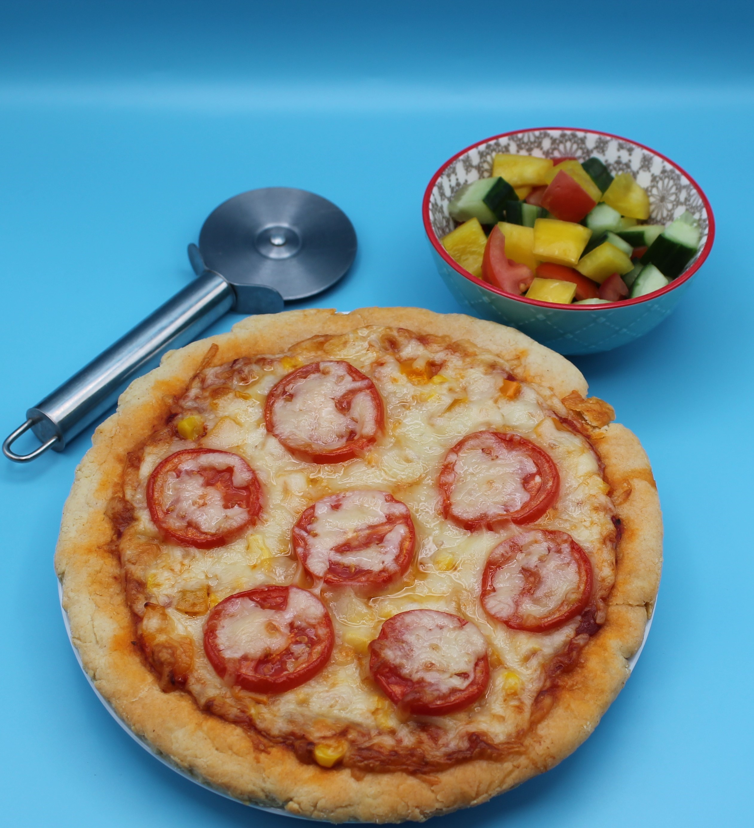
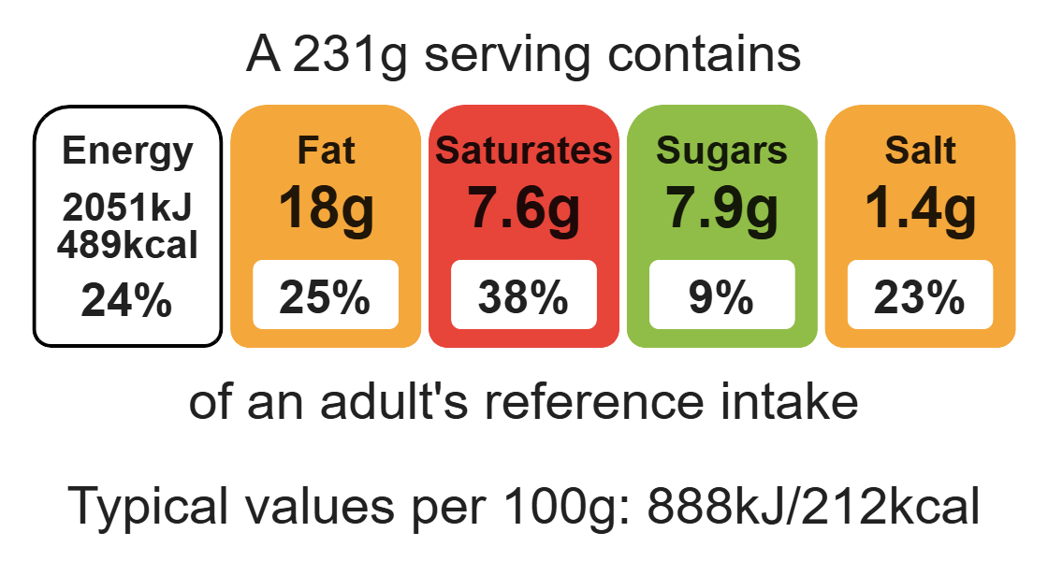
Nutritional analysis
Serves 2

Slide 3
Starter activity
Name three recipes that use the rubbing-in method.
Name three toppings which could be used on a scone-based pizza.
Explain how the fibre content of the scone-based pizza could be improved.

Slide 4
Example responses
Name three products that use the rubbing-in method.
Crumble, scones, shortcrust pastry, cheese straws.
2. Name three toppings which could be used on a scone-based pizza.
Peppers, reduced-fat cheese, tuna, sweetcorn, olives.
3. Explain how the fibre content of the scone-based pizza could be improved
Use wholemeal flour, use more vegetables with skins on e.g. peppers, mushrooms.

Slide 5
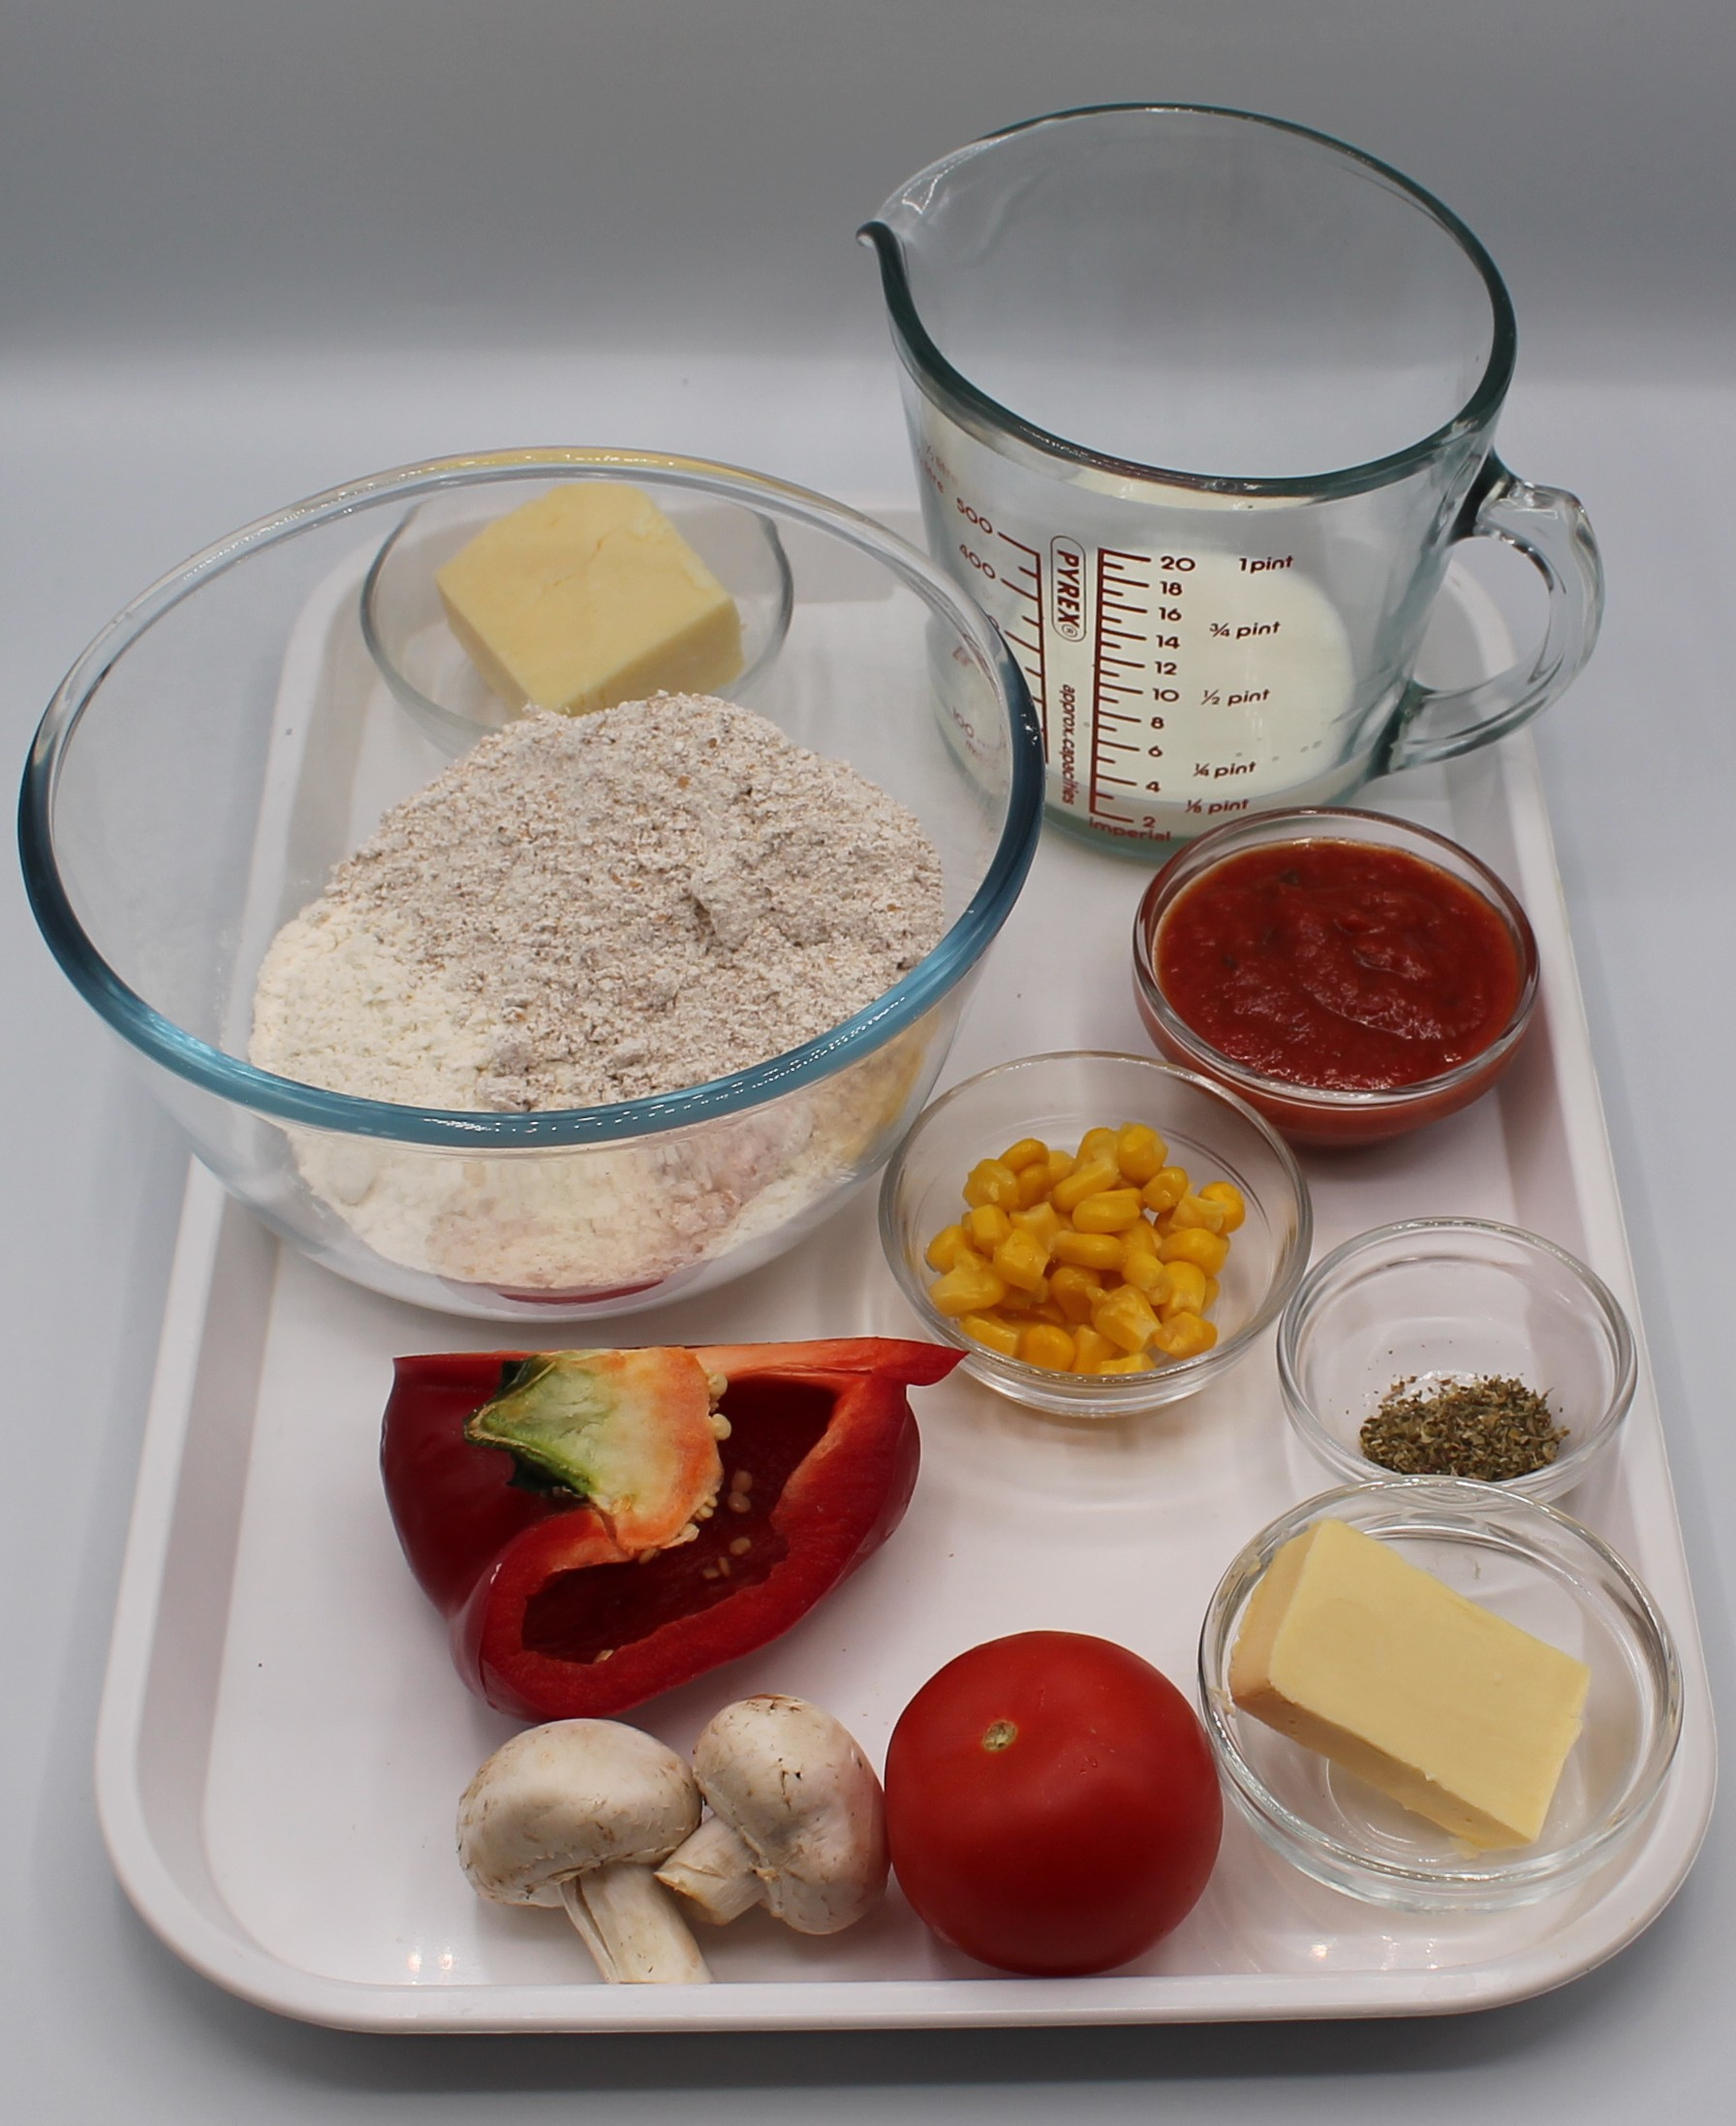

Ingredients (serves 2)
50g reduced-fat cheese, e.g. mozzarella or cheddar
2 mushrooms
1 tomato
½ pepper
75g self-raising white flour
75g self-raising wholemeal flour
25g baking fat/block
100ml semi-skimmed milk
2 x 15ml spoons of passata or tomato purée
25g sweetcorn
½ x 5ml spoon mixed herbs
Check for any food allergy, intolerance, special dietary requirement or religious/cultural reasons for not handling or eating the ingredients in this recipe.

Slide 6
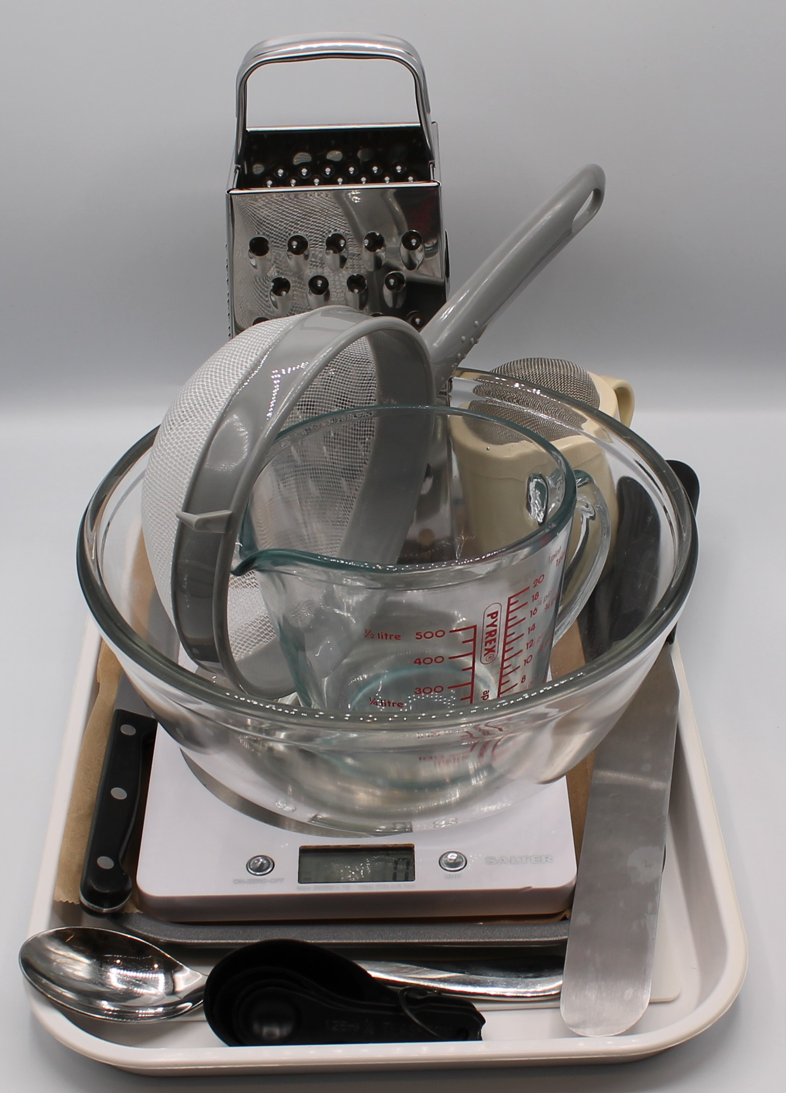
Equipment
Baking tray
Weighing scales
Chopping board
Grater
Sharp knife
Sieve
Mixing bowl
Measuring jug
Palette knife
Flour dredger
Metal spoon
Measuring spoons
Rolling pin (optional)

Slide 7
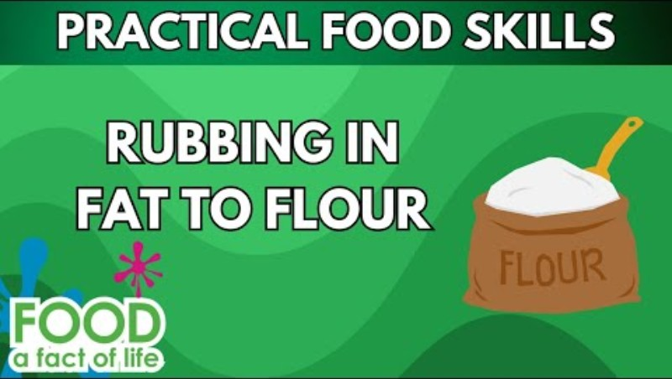
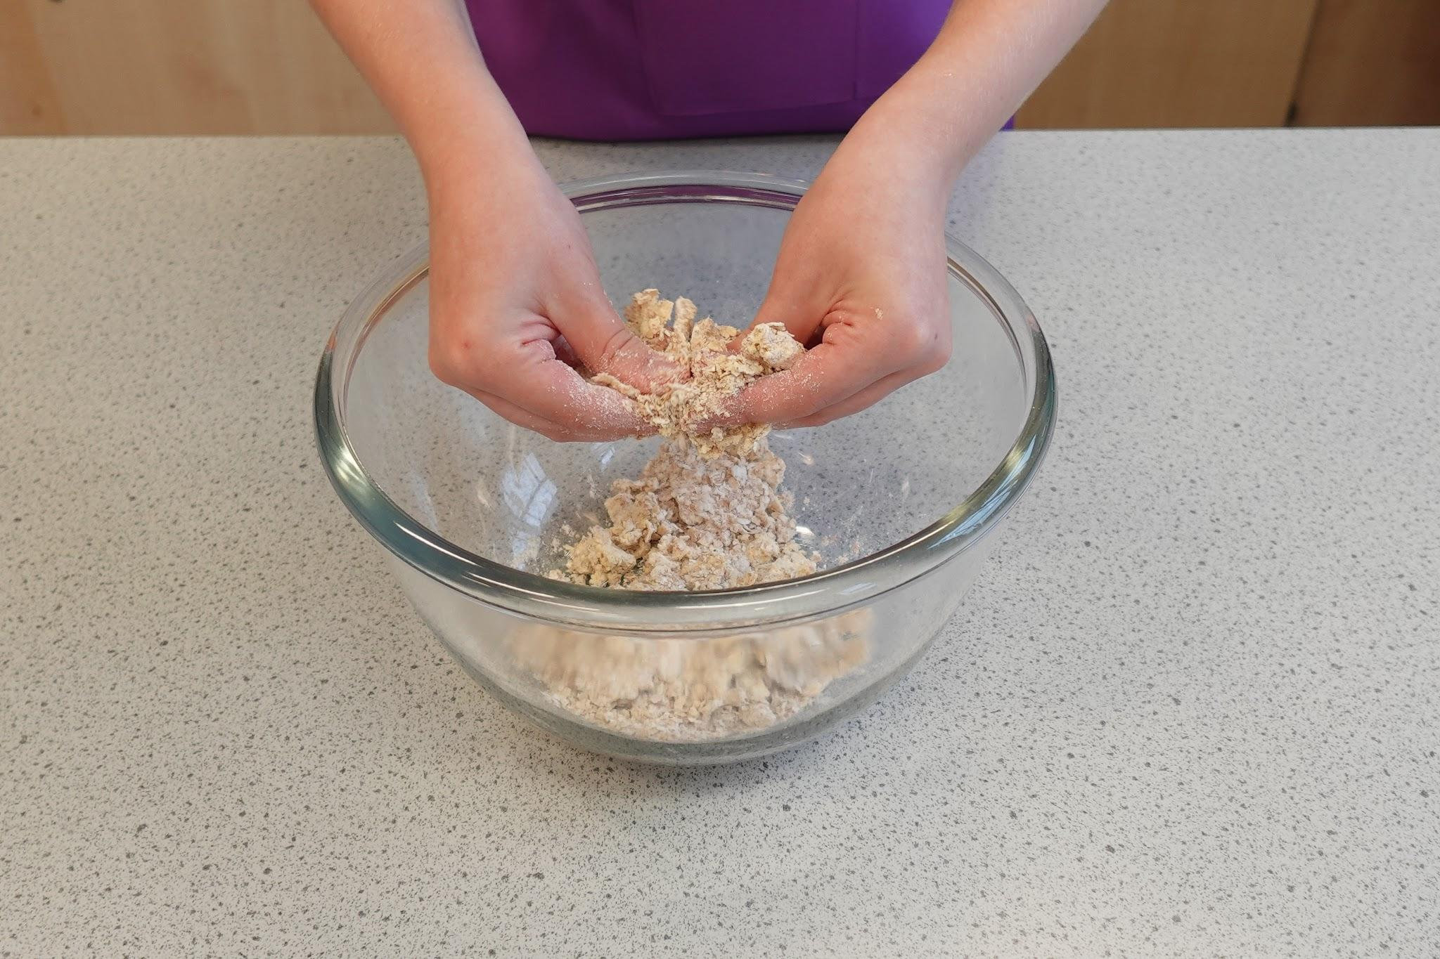
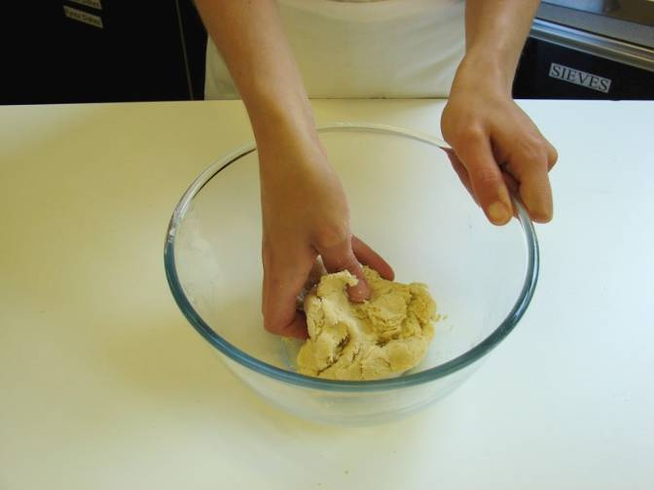
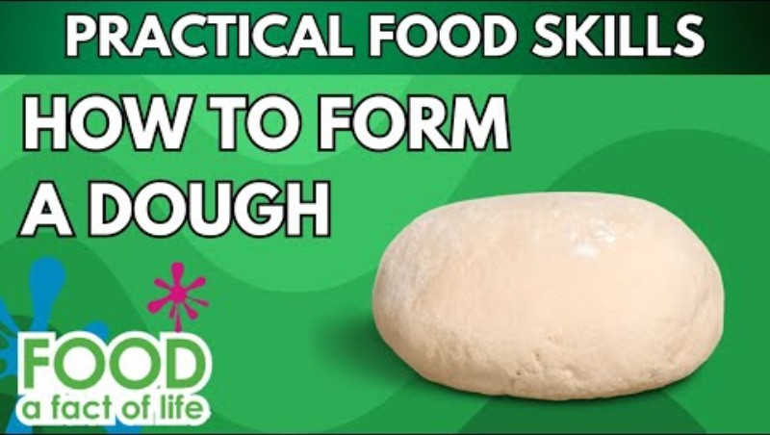
Food skills
Weigh
Measure
Grate
Cut
Chop
Slice
Dice and trim
Sift
Rub-in
Mix
Knead
Form and shape
Bake
Click below to watch how to rub-in
Click below to watch how to form a dough

Slide 8
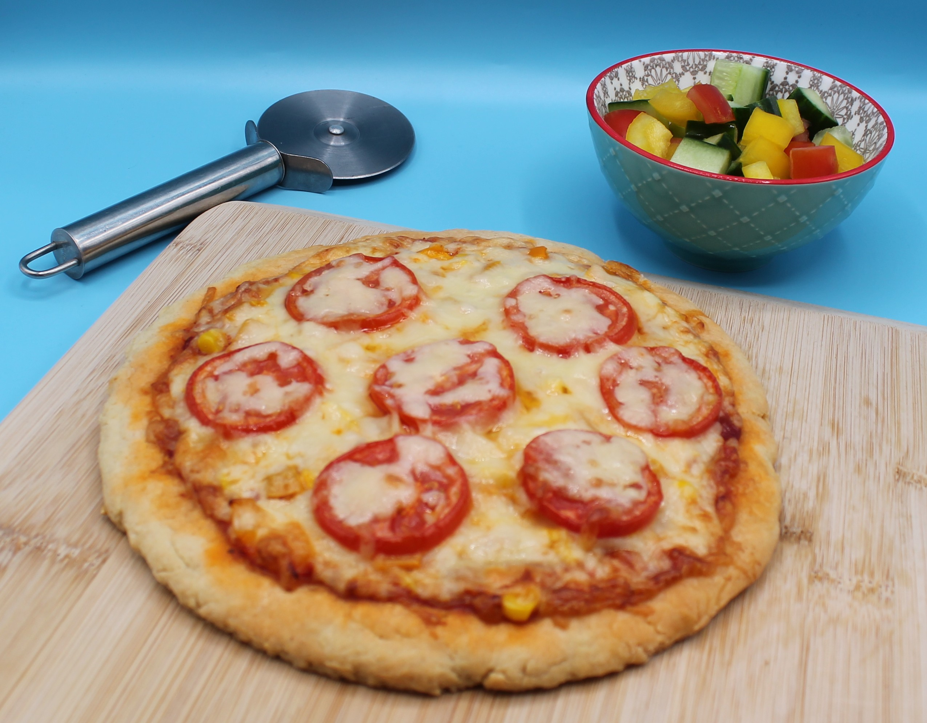
Method
1. Preheat oven to 200°C or gas mark 6.
2. Line a baking tray.
3. Prepare the pizza toppings;
grate the cheese;
slice the mushrooms;
slice the tomato;
deseed and dice the pepper.
4. Sieve the flour into the bowl.
5. Using your fingertips, rub-in the fat into the flour until it resembles breadcrumbs.
6. Make a well in the centre of the mixture. Gradually add the milk to the flour and mix to form a soft dough.

Slide 9
Method
7. Transfer the dough onto a floured surface. Knead lightly and roll into a circular shape, approximately 1.5cm deep.
8. Place the dough onto the baking tray.
9. Spread the passata sauce or tomato purée over the dough using the back of a spoon.
10. Arrange the mushrooms, tomato, pepper and sweetcorn over the base.
11. Sprinkle the cheese and herbs over the top of the pizza.
12. Place the pizza in the oven and bake for 10 – 15 minutes, until golden brown.

Slide 10
Top tips
Reduce food waste: Add leftover vegetables to your pizza.
Focus on fibre: Replace the white flour with 75g wholemeal flour for an extra fibre boost.
Turn up the flavour: Experiment with different toppings such as tuna, onion, pineapple or different types of cheese.

Slide 11
Food science
​Shortening
Scones use fat to give them their characteristic crumbly texture. The fats coats the flour particles and prevents them from absorbing water. This reduces the gluten development, which would cause the dough to become elastic.
Why does cheese melt and turn brown in an oven or under the grill?
Fats in the cheese soften and the water turns to steam, causing the cheese to melt and become gooey. It browns because of heat-triggered reactions between proteins and sugars in the cheese (known as the Maillard reaction).

Slide 12
Plenary
Evaluate five food skills and ways in which you worked.
Area | I need help |  | I can help others | Comments
Rubbing-in | ☆ ☆ ☆ ☆ ☆
Grating | ☆ ☆ ☆ ☆ ☆
Slicing | ☆ ☆ ☆ ☆ ☆
Forming a dough | ☆ ☆ ☆ ☆ ☆
Spreading | ☆ ☆ ☆ ☆ ☆

Slide 13

Example responses
Evaluate five food skills and ways in which you worked.
Area | I need help |  | I can help others
Rubbing-in | ☆ ☆ ☆ ☆ ☆
Grating | ☆ ☆ ☆ ☆ ☆
Slicing | ☆ ☆ ☆ ☆ ☆
Forming a dough | ☆ ☆ ☆ ☆ ☆
Spreading | ☆ ☆ ☆ ☆ ☆

Slide 14
Example responses
Evaluate five food skills and ways in which you worked.
Area | Comments
Rubbing-in | I used my previous skills of rubbing-in to help my accuracy.
Grating | I used the grater safely and correctly.
Slicing | I need to practice my claw grip as some of my slices were uneven.
Forming a dough | I did not add enough liquid and it was dry. I added more liquid.
Spreading | Most of my sauce and toppings were spread evenly. I need to take a little more care.

Slide 15
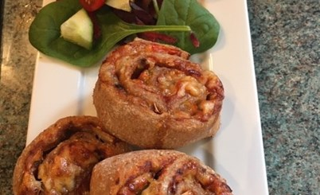
Looking for more…
Challenge your pupils to modify the recipe for the scone-based pizza using our recipe adaptation worksheet.
If you would like to challenge your pupils to make a more complex pizza recipe, why not use this lesson to make yeast dough pizza wheels from the Food – a fact of life Schemes of Work?

Slide 16
Scone based pizza
For further information, go to:
www.foodafactoflife.org.uk
This resource meets the Guidelines for producers and users of school education resources about food.

