Slide 1
Mealtime

Slide 2
Mealtime
Would you have the food or meals in these pictures for your breakfast, lunch, evening meal or as a snack?
Can you explain why?
Would you add anything to the food or meals to make them healthier?

Slide 3
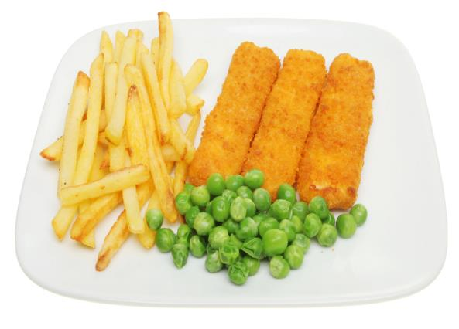
Fish fingers, chips and peas

Slide 4
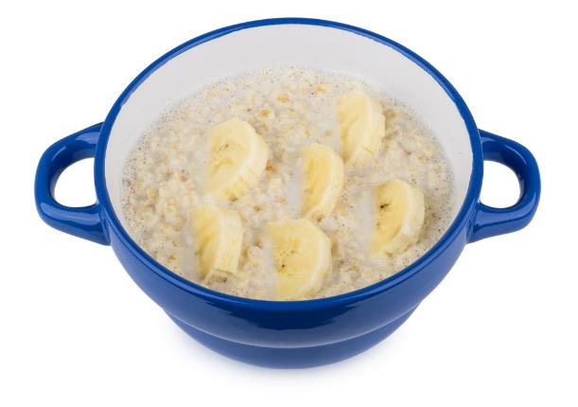
Porridge with banana

Slide 5
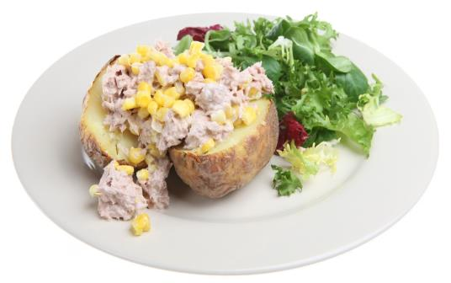
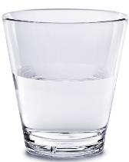
Tuna and sweetcorn baked potato, salad and water

Slide 6
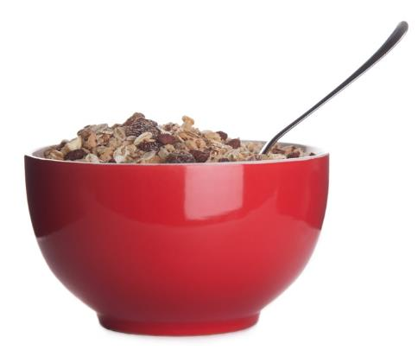
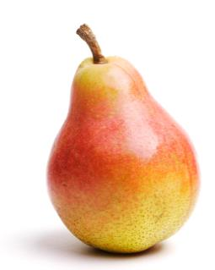
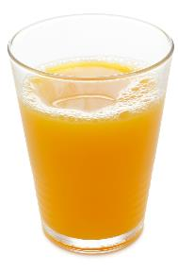
Muesli, pear and orange juice

Slide 7
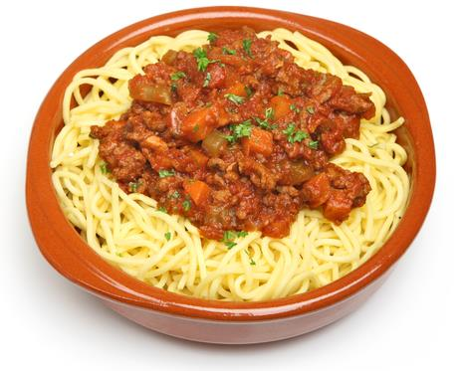
Spaghetti bolognaise

Slide 8
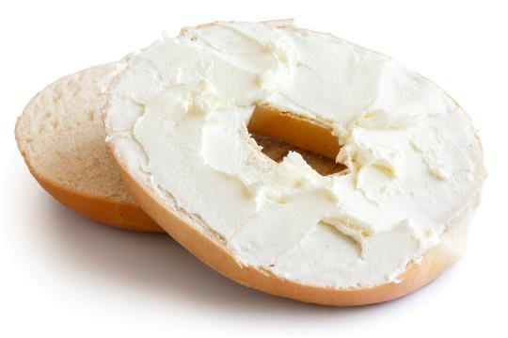
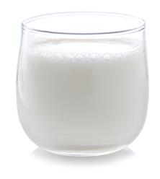
Bagel with soft cheese and milk

Slide 9
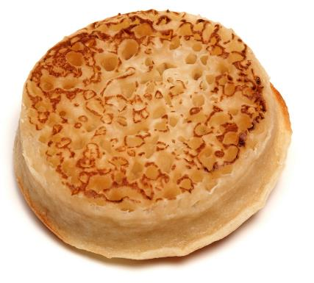
Crumpet

Slide 10
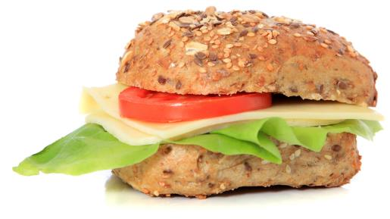
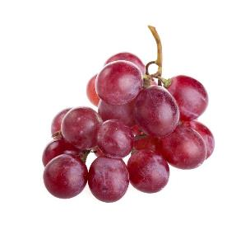
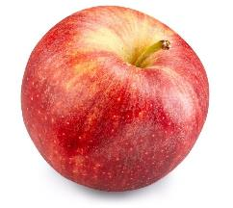
Cheese and salad roll, apple and grapes

Slide 11
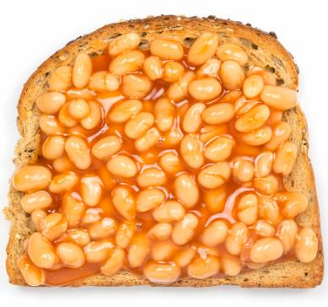
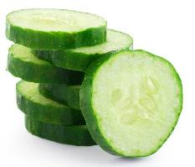
Beans on toast and cucumber

Slide 12
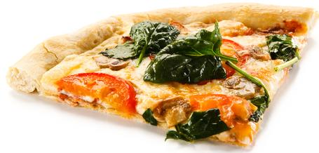
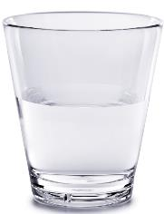
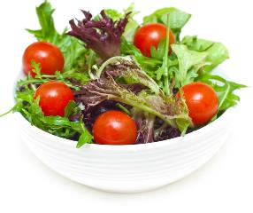
Vegetable pizza, salad and water

Slide 13
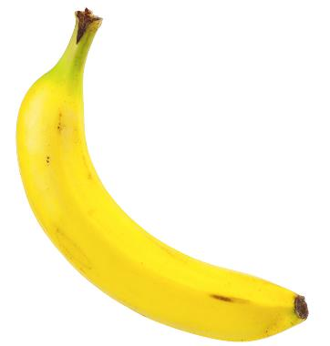
Banana

Slide 14
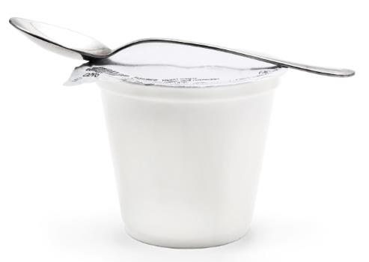
Yogurt

Slide 15
Mealtime
For further information, go to:
www.foodafactoflife.org.uk
This resource meets the Guidelines for producers and users of school education resources about food.

