Slide 1
Iron deficiency anaemia

Slide 2
Micronutrients
Micronutrients are needed in the body in tiny amounts. They do not provide energy, but are required for a number of important processes in the body.
There are two main groups of micronutrients:
vitamins;
minerals and trace elements.
Iron is an example of a mineral. Minerals are inorganic substances required by the body in small amounts for a variety of different functions.

Slide 3
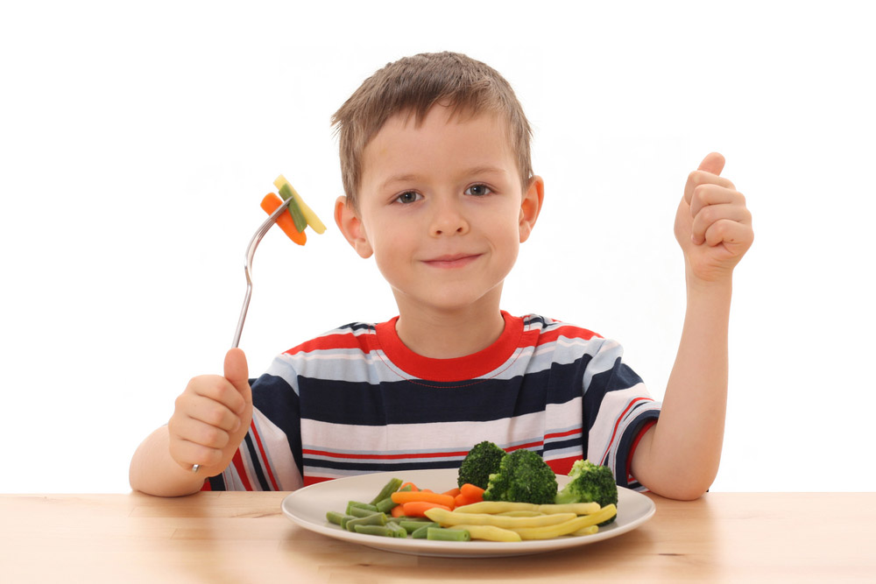
Iron (Fe)
Iron helps to make red blood cells, which carry oxygen around the body. It also helps the immune system to work and helps the brain to function normally.

Slide 4
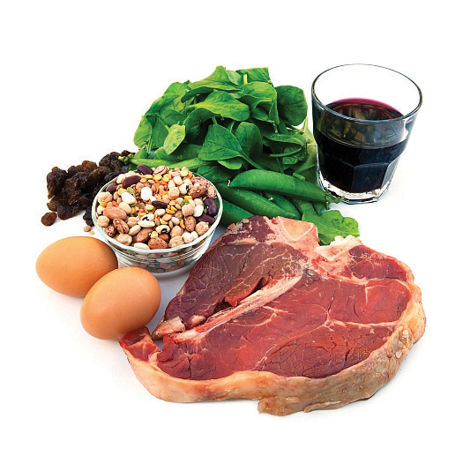
Iron (Fe) sources
Did you know?
There are two types of iron; one from animals sources (haem iron) and the other from plant sources, fortified foods and supplements (non-haem iron).
Haem iron is readily absorbed by the body. Vitamin C helps the absorption of non-haem iron when eaten at the same time.
Sources of iron include: offal, red meat, beans, pulses, nuts and seeds, fish (such as canned sardines and mussels), quinoa, wholemeal bread and dried fruit.

Slide 5

Iron (Fe)
Teenage girls and women of childbearing age need more iron than males of the same age, meaning they have a higher RNI.
Over half of teenage girls in the UK do not consume enough iron and intakes are also low in a large proportion of young women. A lack of iron may lead to iron deficiency anaemia.
Did you know?
More than 2 billion people worldwide suffer from iron deficiency anaemia, making it the most common nutritional deficiency.

Slide 6
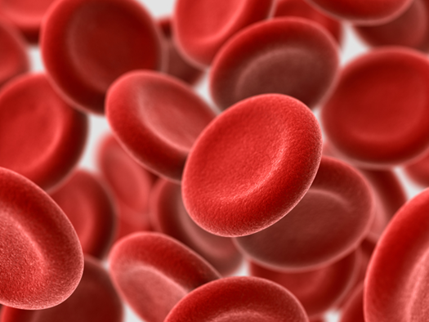
Iron deficiency anaemia
A lack of dietary iron depletes iron stores in the body and this can eventually lead to iron deficiency anaemia.
In particular, women of child bearing age and teenage girls need to ensure they consume adequate dietary iron because their requirements are higher than those of men of the same age.
Also, loss of blood due to injury or large menstrual losses increases iron requirements in the short term.

Slide 7
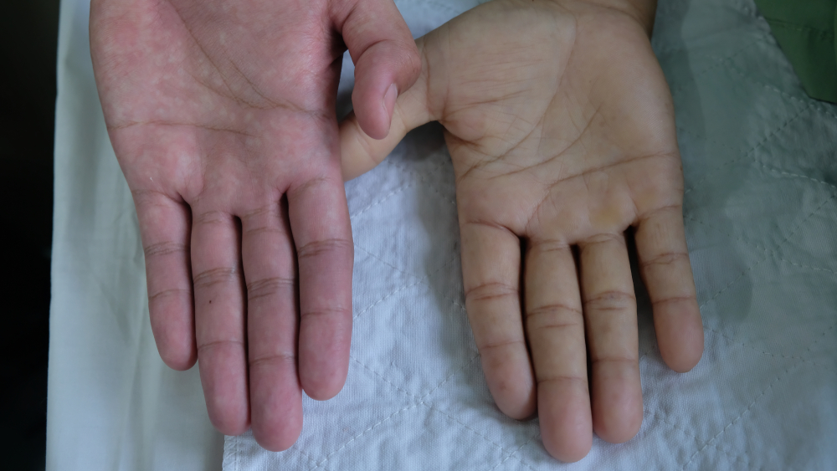
Iron deficiency anaemia
Teenage girls and women of childbearing age need more iron than males of the same age making them at increased risk of deficiency.
Symptoms of iron deficiency anaemia can include: tiredness and lack of energy; shortness of breath; noticeable heartbeats (heart palpitations) or pale skin.
Iron deficiency anaemia is usually tested by a full blood count (FBC) test.
NHS

Slide 8

Long term health problems
If iron deficiency anaemia is left untreated, it can increase illness and infection risk.
Severe iron deficiency anaemia may increase the risk of developing complications that affect the heart or lungs, such as an abnormally fast heartbeat or heart failure.
Pregnant women with severe or untreated anaemia also have a higher risk of complications before and after birth.
NHS

Slide 9
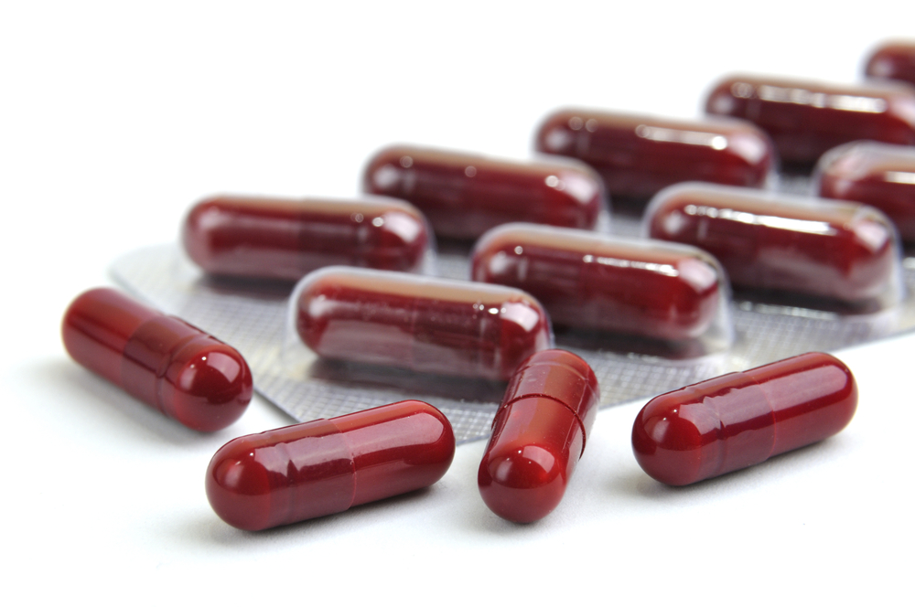
Iron deficiency anaemia treatments
The most common treatment for iron deficiency anaemia involves taking iron supplements. This is usually effective, and the condition rarely causes long-term problems.
After treatment, a patients will need to be monitored every few months to check whether their iron levels have returned to normal.
The underlying cause will also need to be treated to avoid developing anaemia again. This could include increasing the amount of iron in the diet.
NHS

Slide 10
Iron deficiency anaemia
For further information, go to:
www.foodafactoflife.org.uk
This resource meets the Guidelines for producers and users of school education resources about food.

