Slide 1
Fruity flapjacks
Complexity: medium - high

Slide 2
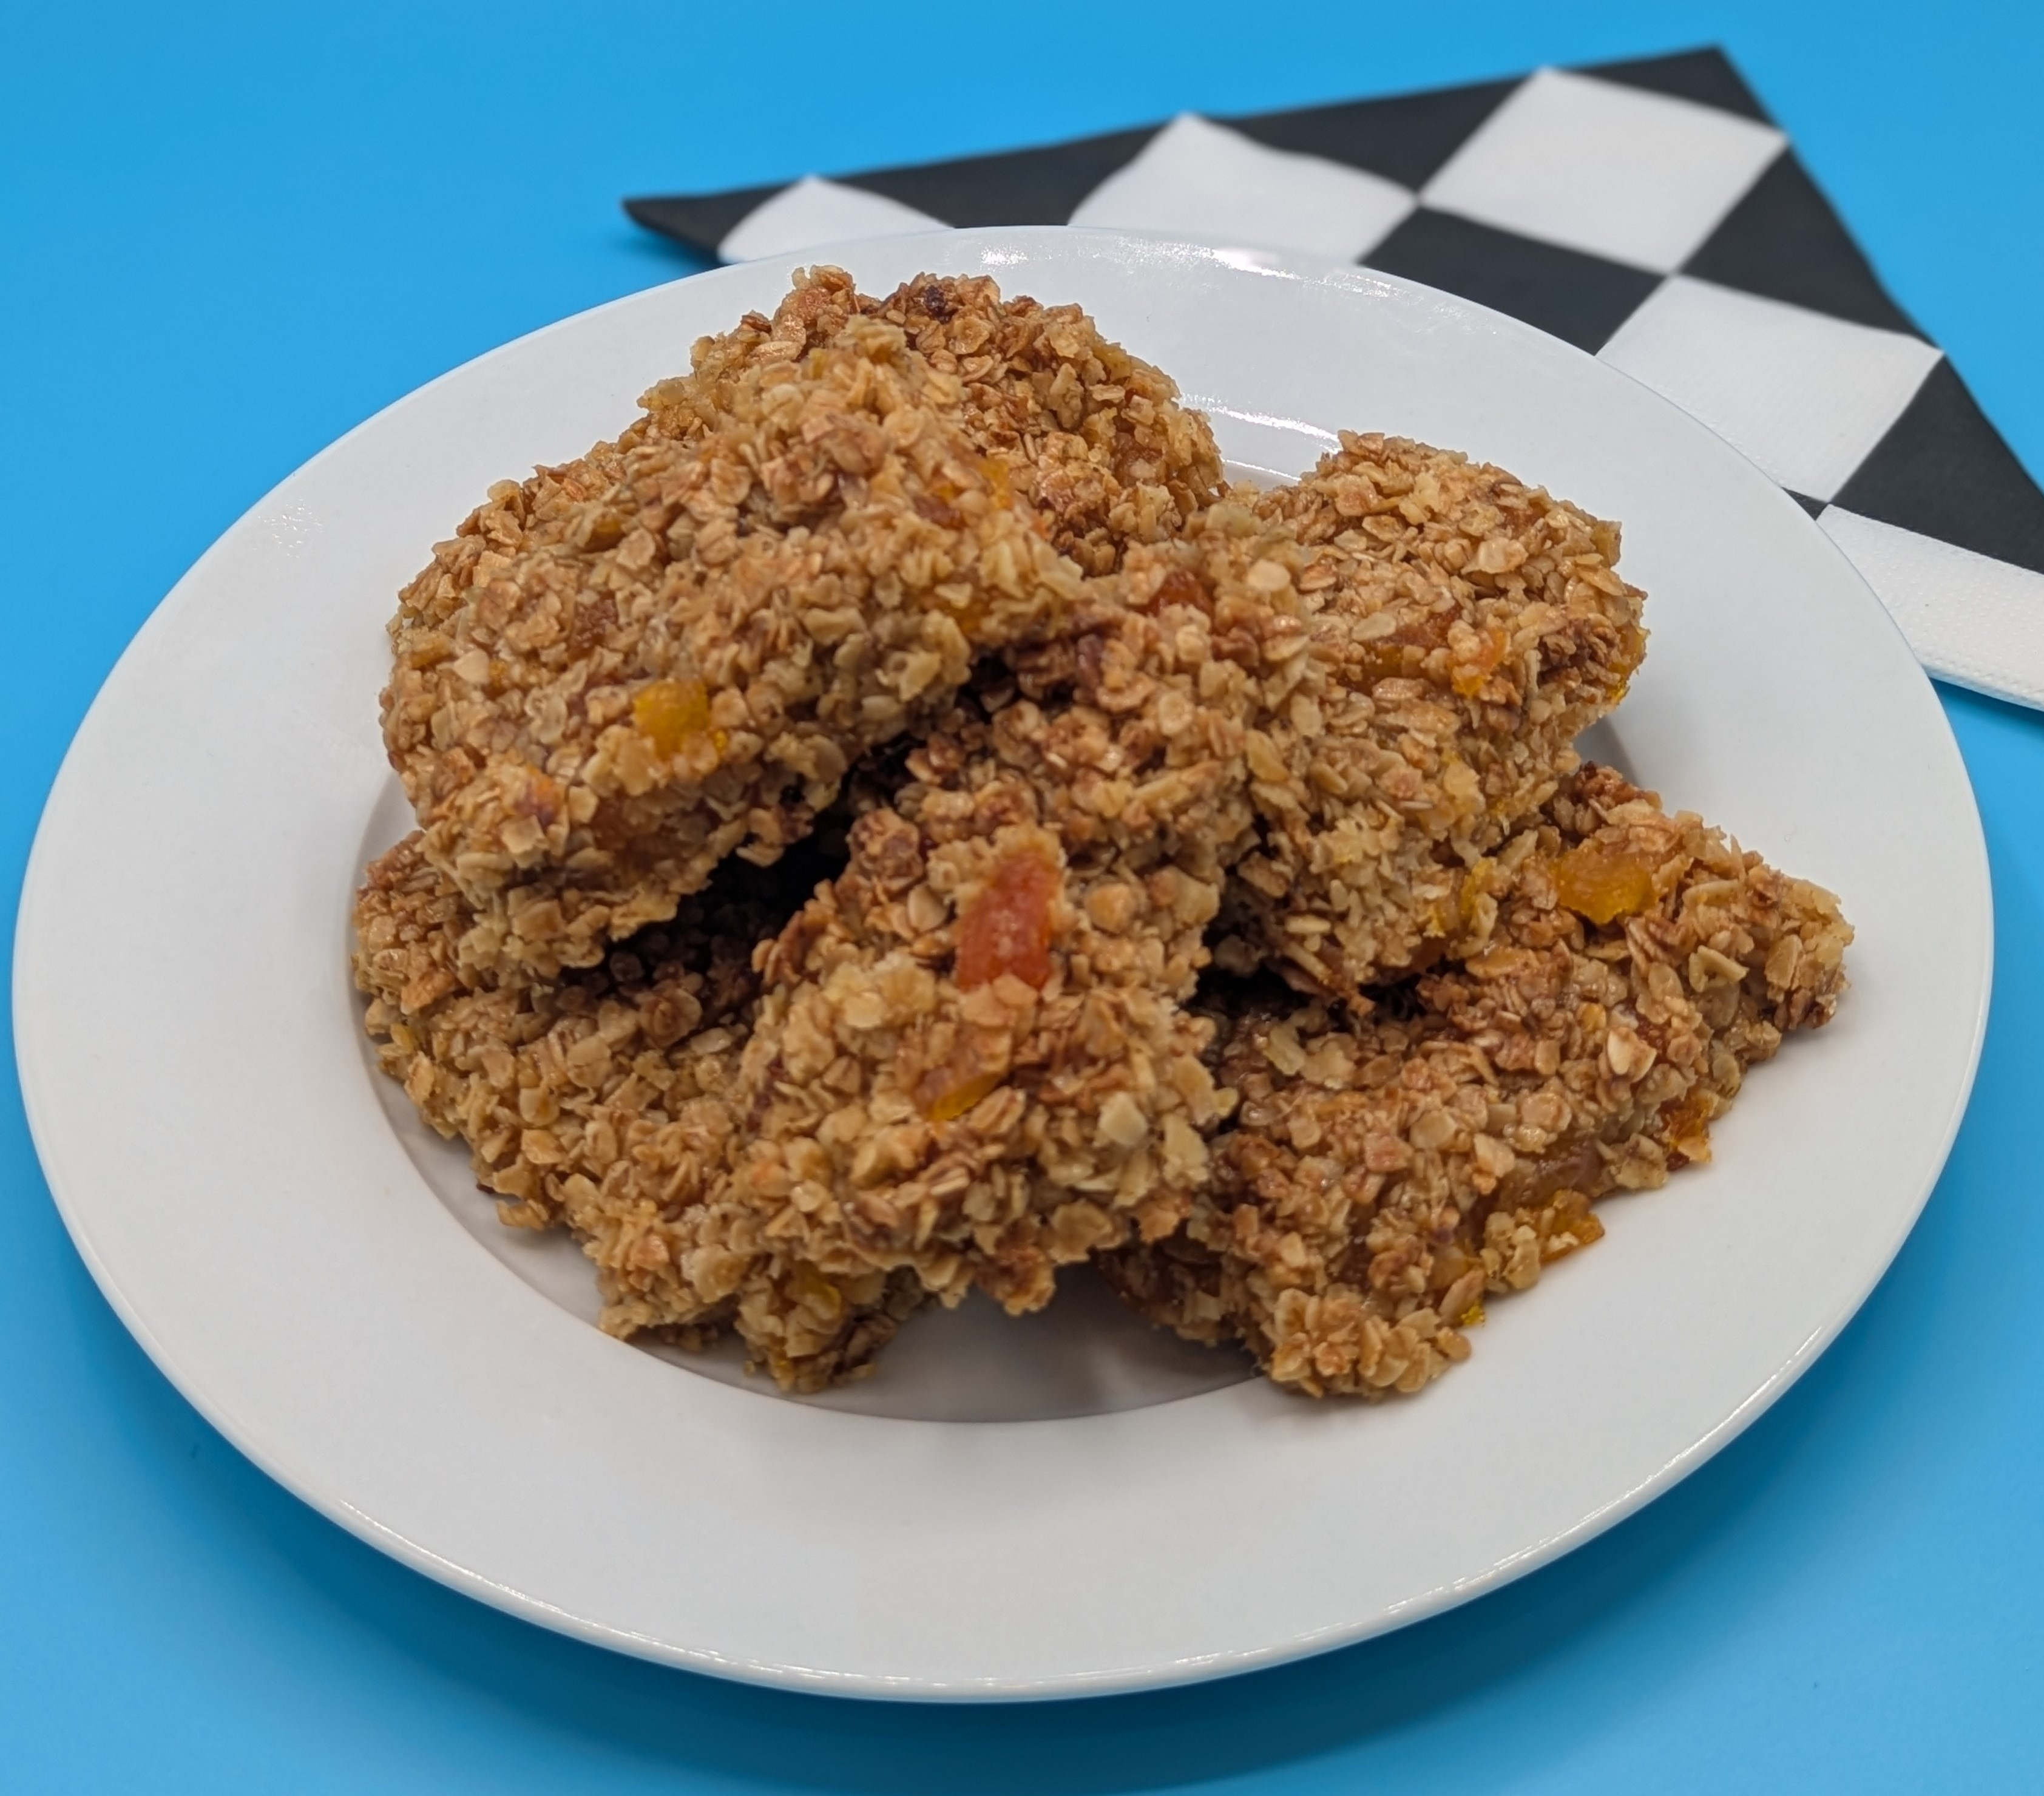
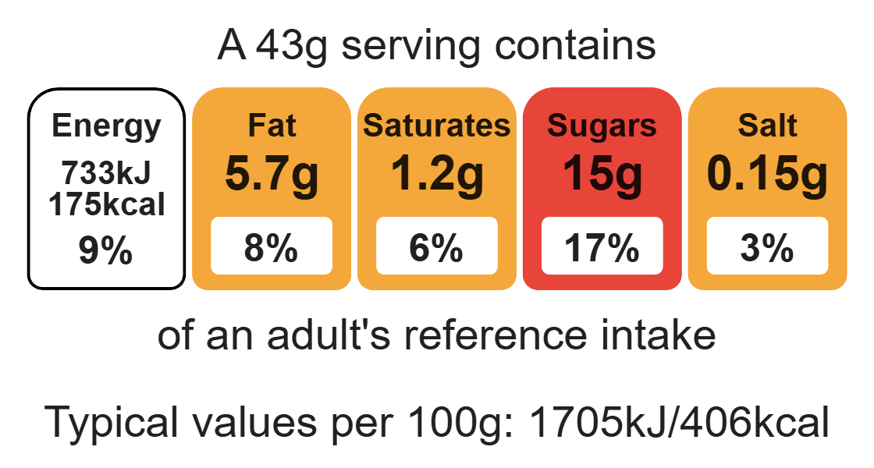
Nutritional analysis
Makes 8

Slide 3
Starter activity
State:
3 types of heat transfer
2 health and safety tips when using the hob
1 practical food skill that could be used to prepare fruit

Slide 4
Example responses
State:
3 types of heat transfer
  Convection, conduction, radiation.
2 health and safety tips when using the hob
Always keep pan handle to the side of the cooker. Use a wooden spoon as metal conducts heat.
1 practical food skill that could be used to prepare fruit
Peeling, slicing, coring

Slide 5
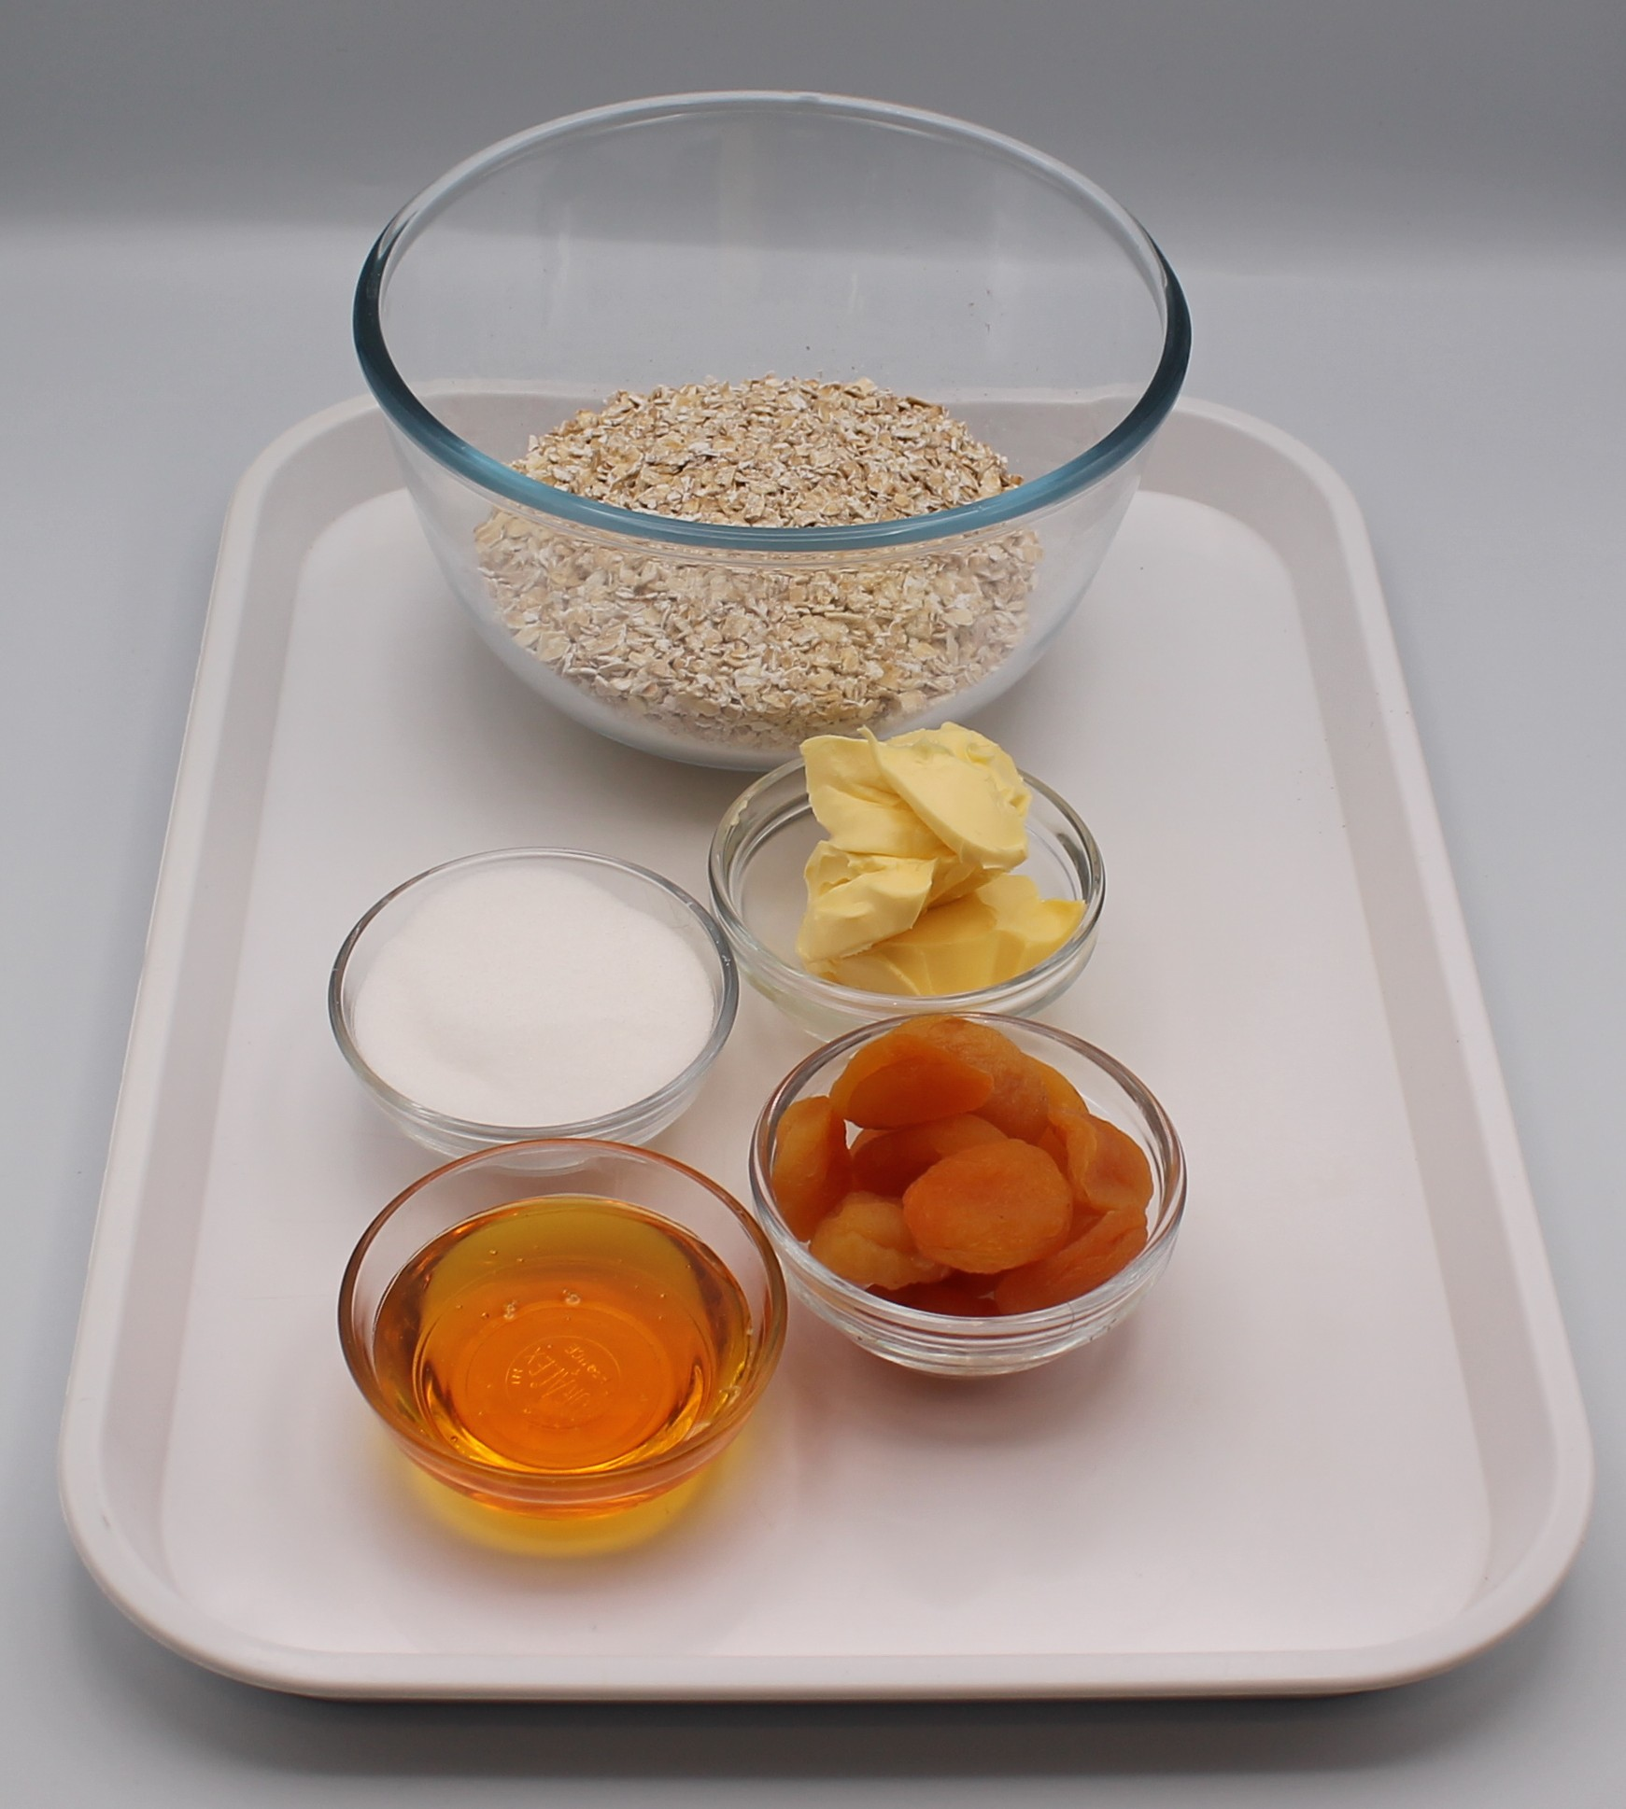

Ingredients (serves 8)
75g dried apricots
150g oats
50g caster sugar
50g reduced-fat spread
2 x 15ml spoons golden syrup
Check for any food allergy, intolerance, special dietary requirement or religious/cultural reasons for not handling or eating the ingredients in this recipe.

Slide 6
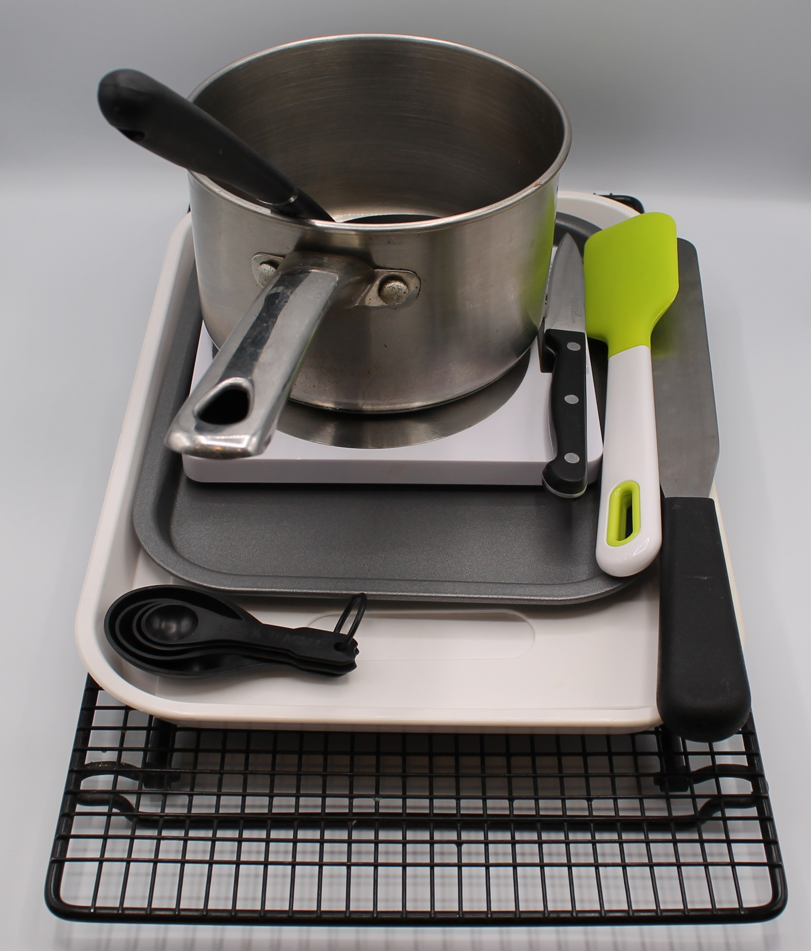
Equipment
Weighing scales
Baking tray
Chopping board
Sharp knife
Measuring spoons
Saucepan
Heat resistant spoon
Spatula
Palette knife

Slide 7
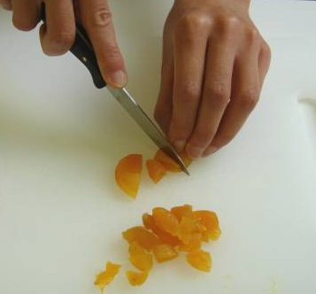
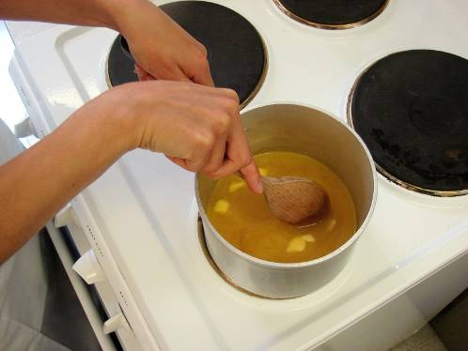
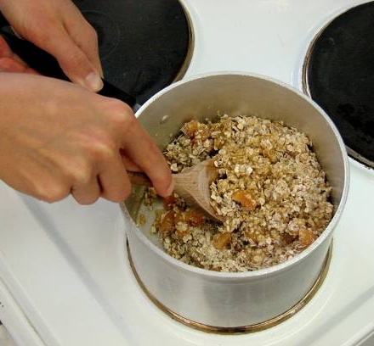
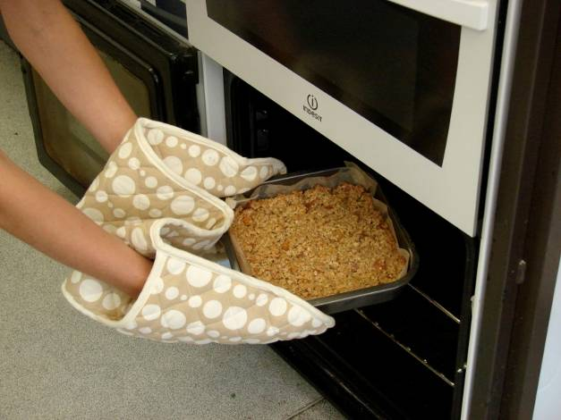
Food skills
Weigh
Measure
Cut
Chop
Melt
Simmer
Mix
Stir and combine
Bake
Portion/divide

Slide 8
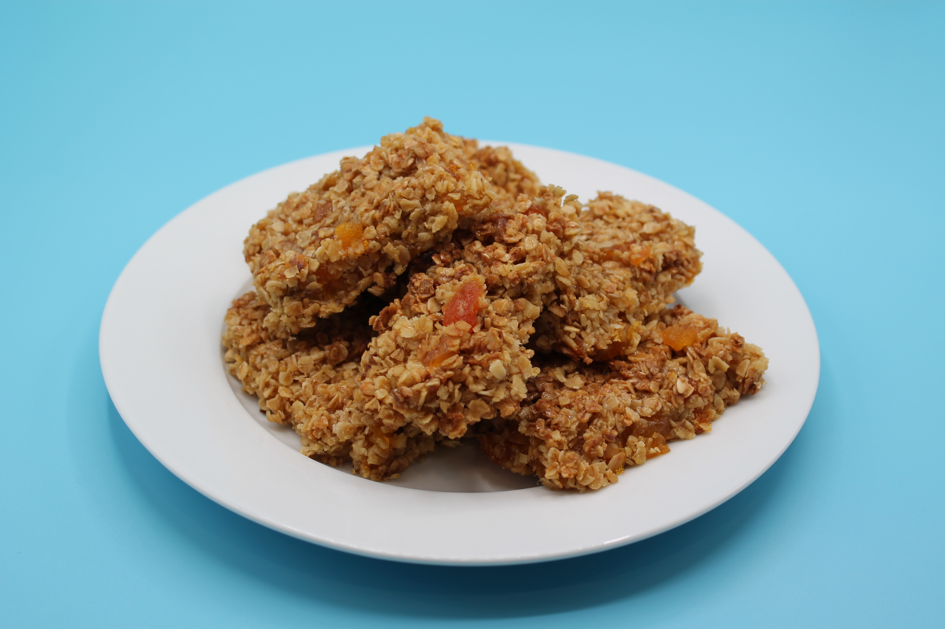
Method
Preheat the oven to 180°C or gas mark 4.
Line the baking tray.
Chop the apricots into small pieces.
Place the spread, sugar and syrup into a saucepan, stir and gently heat until it has melted.
Remove the saucepan from the heat and stir in the oats and apricots.
Pour the mixture into the lined baking tray.
Pat and flatten down the mixture in the baking tray, using the palette knife.
Bake for 15 - 20 minutes, until lightly browned.
Remove from the oven and carefully cut into ‘bars’ in the baking tray while hot.

Slide 9
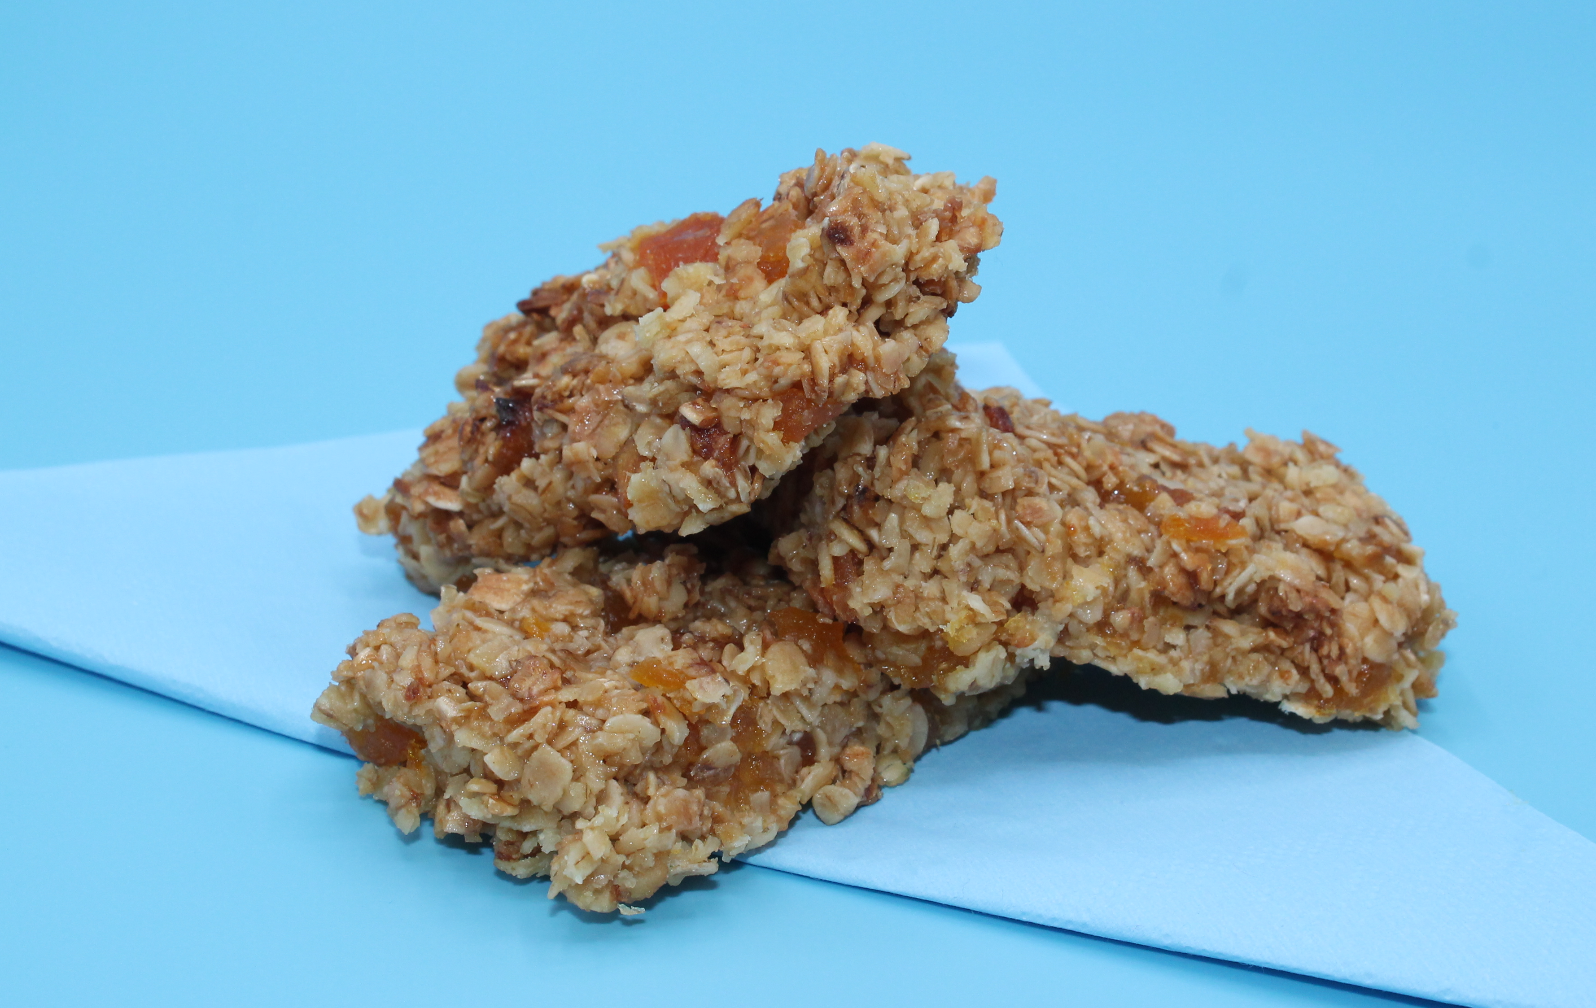
Food science
Caramelisation
The sugar and golden syrup caramelise when heated causing the flapjack to turn golden brown.

Slide 10
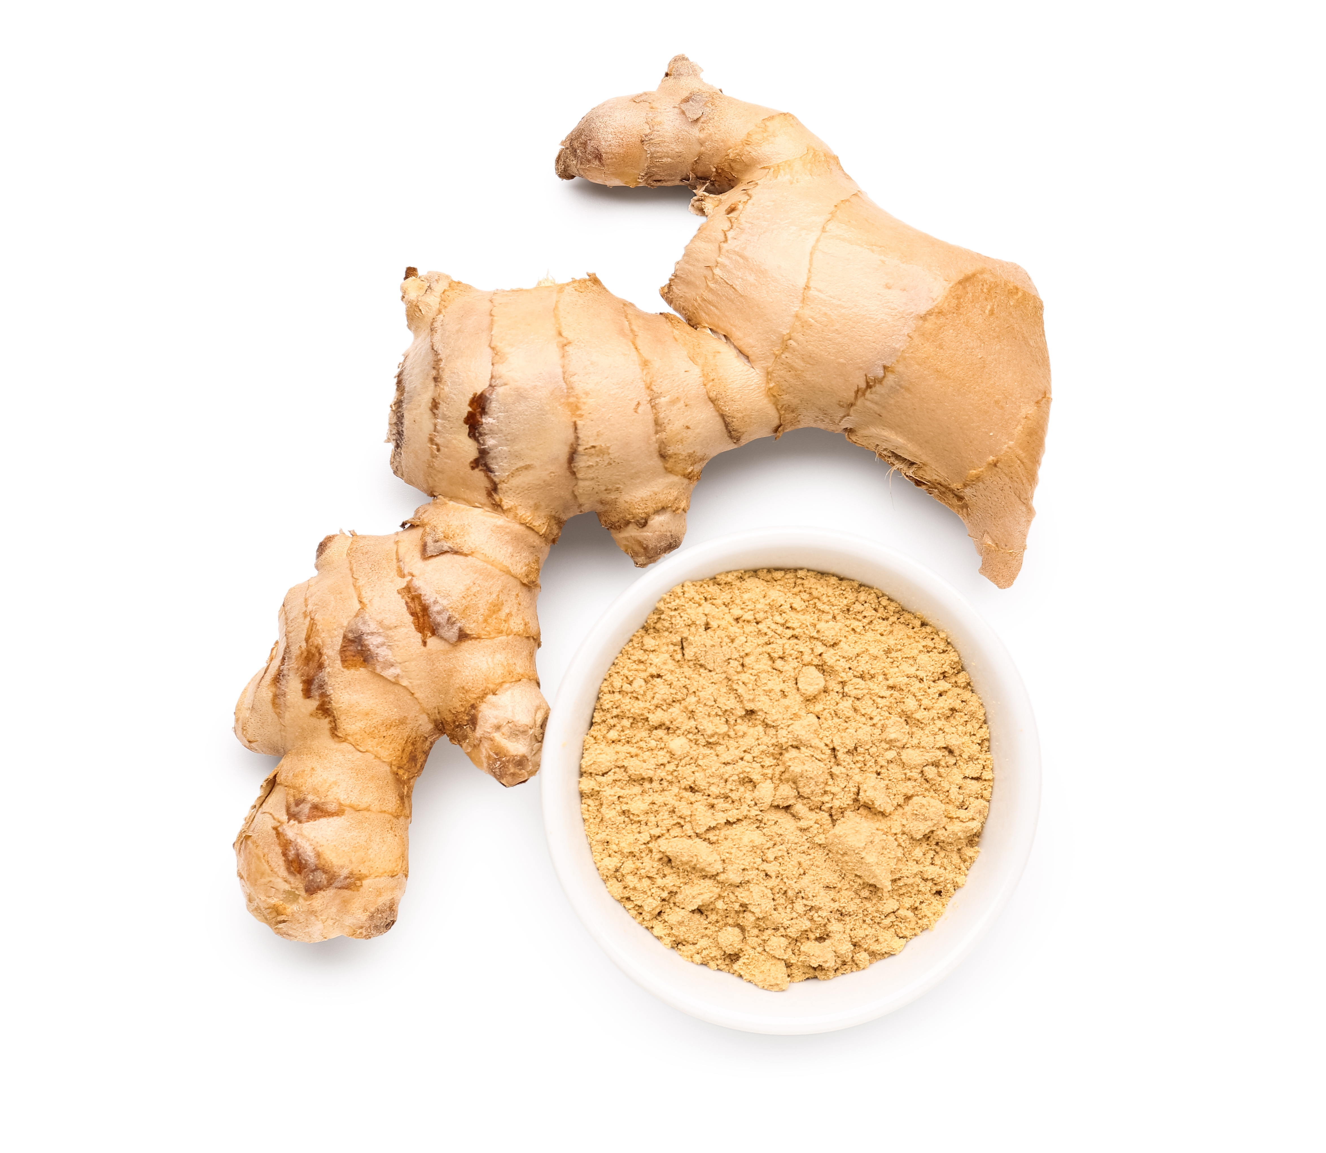
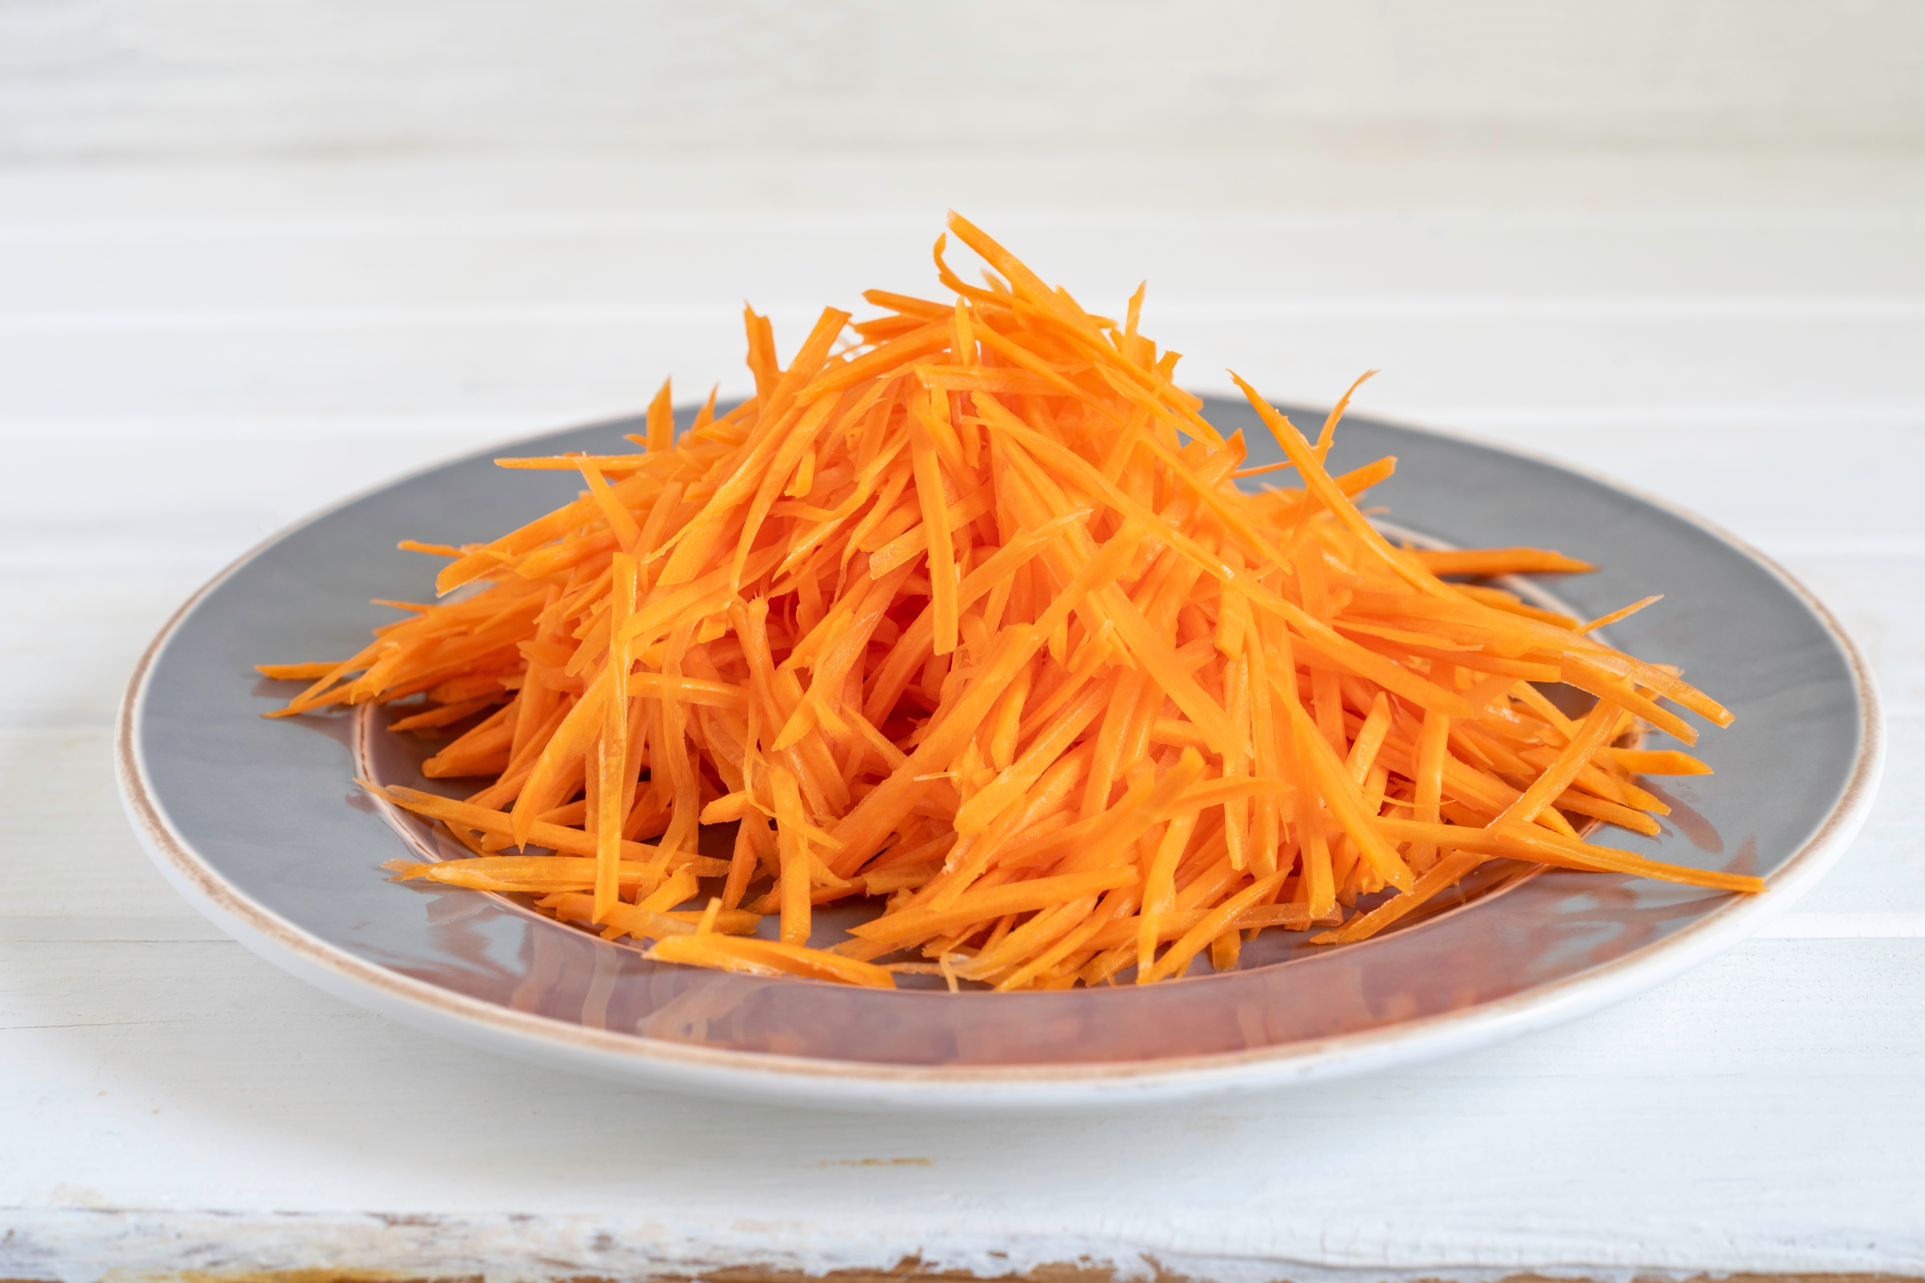
Top tips
Turn up the flavour: Try adding 75g sultanas, figs, mixed dried fruit or add 1 x 15ml spoon cinnamon, ginger or mixed spices to the oat mixture.
Reduce food waste: Add leftover grated fresh apple or carrot to the flapjacks.
Do not remove from tray until cool and firm.

Slide 11
Plenary
Name three skills used today when preparing the flapjacks.
Name the two methods of heat transfer used?
Which ingredient caused the flapjack to turn golden?

Slide 12
Example responses
Name three skills used today when preparing the flapjacks.
Weigh, measure, cut, chop, melt, simmer and boil, mix, stir and combine, bake, portion/divide.
2. Name the two methods of heat transfer used?
Convection and conduction
3. Which ingredient caused the flapjack to turn golden?
Sugar, golden syrup

Slide 13
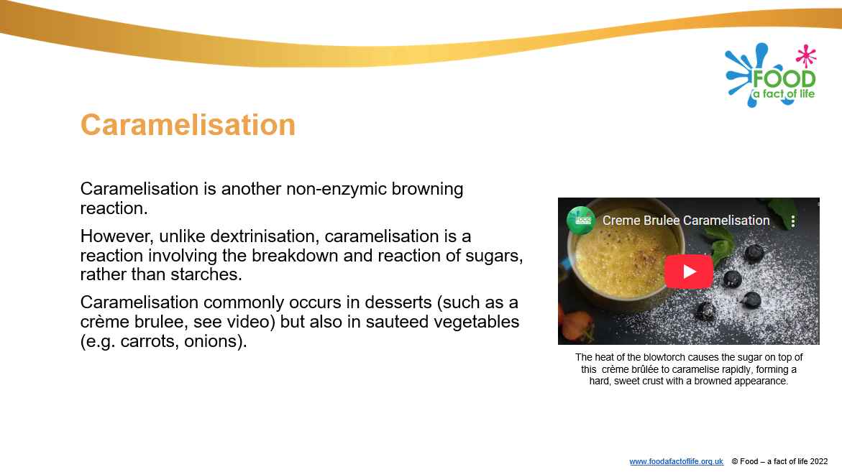
Looking for more…
This recipe support your pupils learning around non-enzymic browning and caramelisation.
Check out our presentation and a video to aid your explanations.
For more opportunities to use the melting method to make a dish, why not make mini carrot cakes? This lesson from the Food – a fact of life Schemes of Work has all you need.

Slide 14
Fruity flapjacks
For further information, go to:
www.foodafactoflife.org.uk
This resource meets the Guidelines for producers and users of school education resources about food.

