Slide 1
Bringing seasonality to life, using blueberries!
Frances Meek
Education Services Manager
British Nutrition Foundation

Slide 2
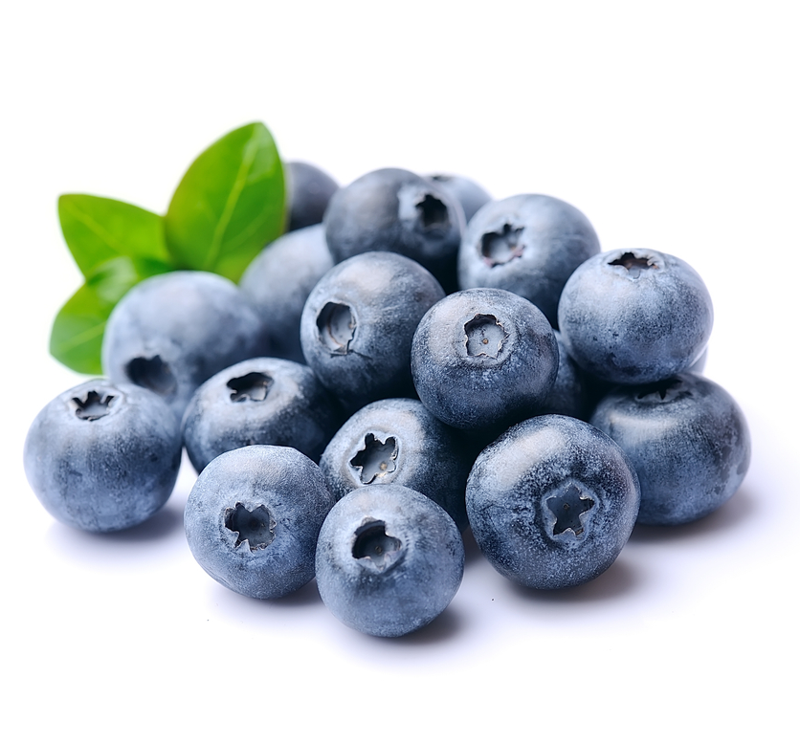
This session will cover:
The advantages of using food in season, but also how choosing only seasonal food might impact on food choice and use.
How to use foods, such as blueberries, as a case study to help pupils understand where food comes from and seasonality, including running a tasting session.
Links to Food – a fact of life resources.

Slide 3
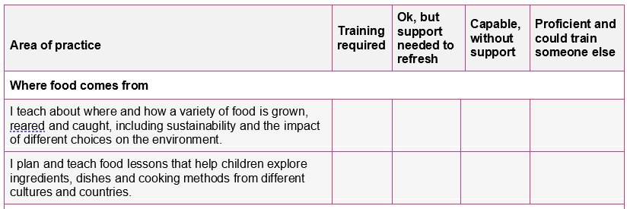
Your audit (completed with registration)
Where food comes from

Slide 4
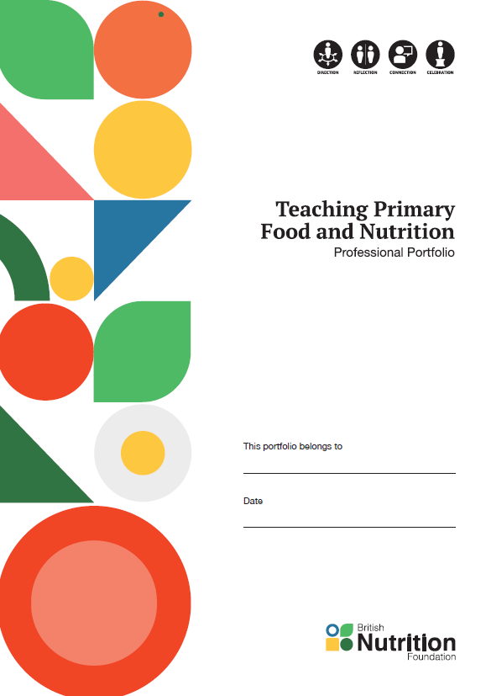
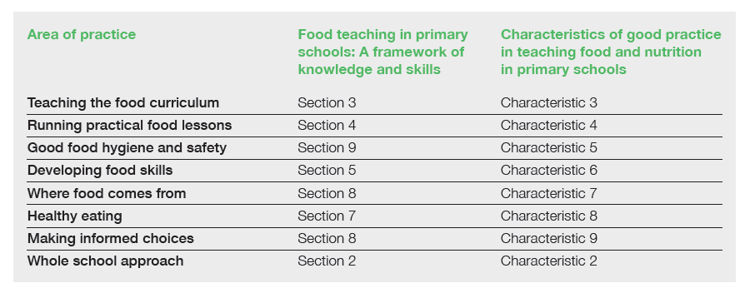
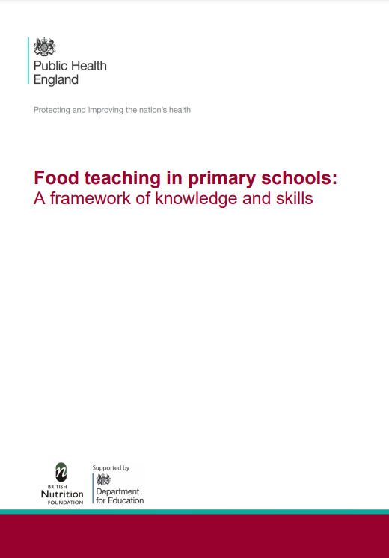

Where food comes from
Supporting documents
TPFN booklet, page 5

Slide 5
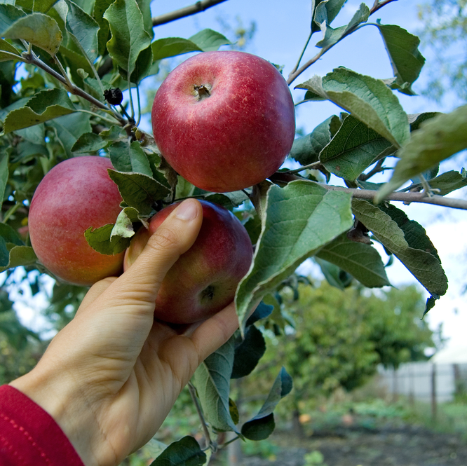
What is seasonality?
Fruit and vegetables naturally grow in cycles and ripen during a certain season each year. When they are in season they are harvested.
We mostly think of fruit and vegetables as seasonal however, some fish and meat can also be seasonal.
In simple terms, eating seasonally involves eating foods that are locally grown at the same time as you eat them.

Slide 6
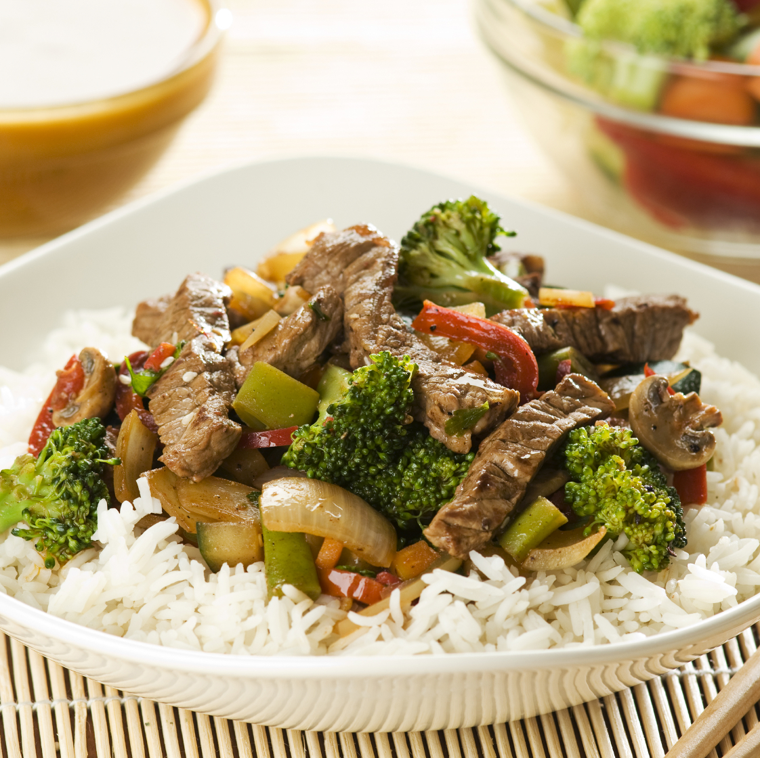
In season or not?
Consider the range of ingredients and food that is found in supermarkets. We expect, and take for granted, that the food is available all year round.
Consumers have become used to buying ingredients and food that are out of season in the UK.
Quick task
Think about your main meal yesterday. How many of the fruit, vegetables, meat or fish that you ate are currently in season in the UK?

Slide 7
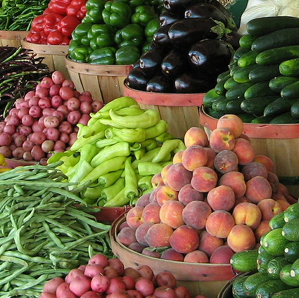
Growing the food we want in the UK
The UK food culture is a melting pot of traditions, flavours, ingredients and culinary techniques.
A lot of ingredients people want to cook and eat cannot be grown in the UK, due to climate and terrain, so these will need to be imported.
The UK imports over half of the food we need!

Slide 8
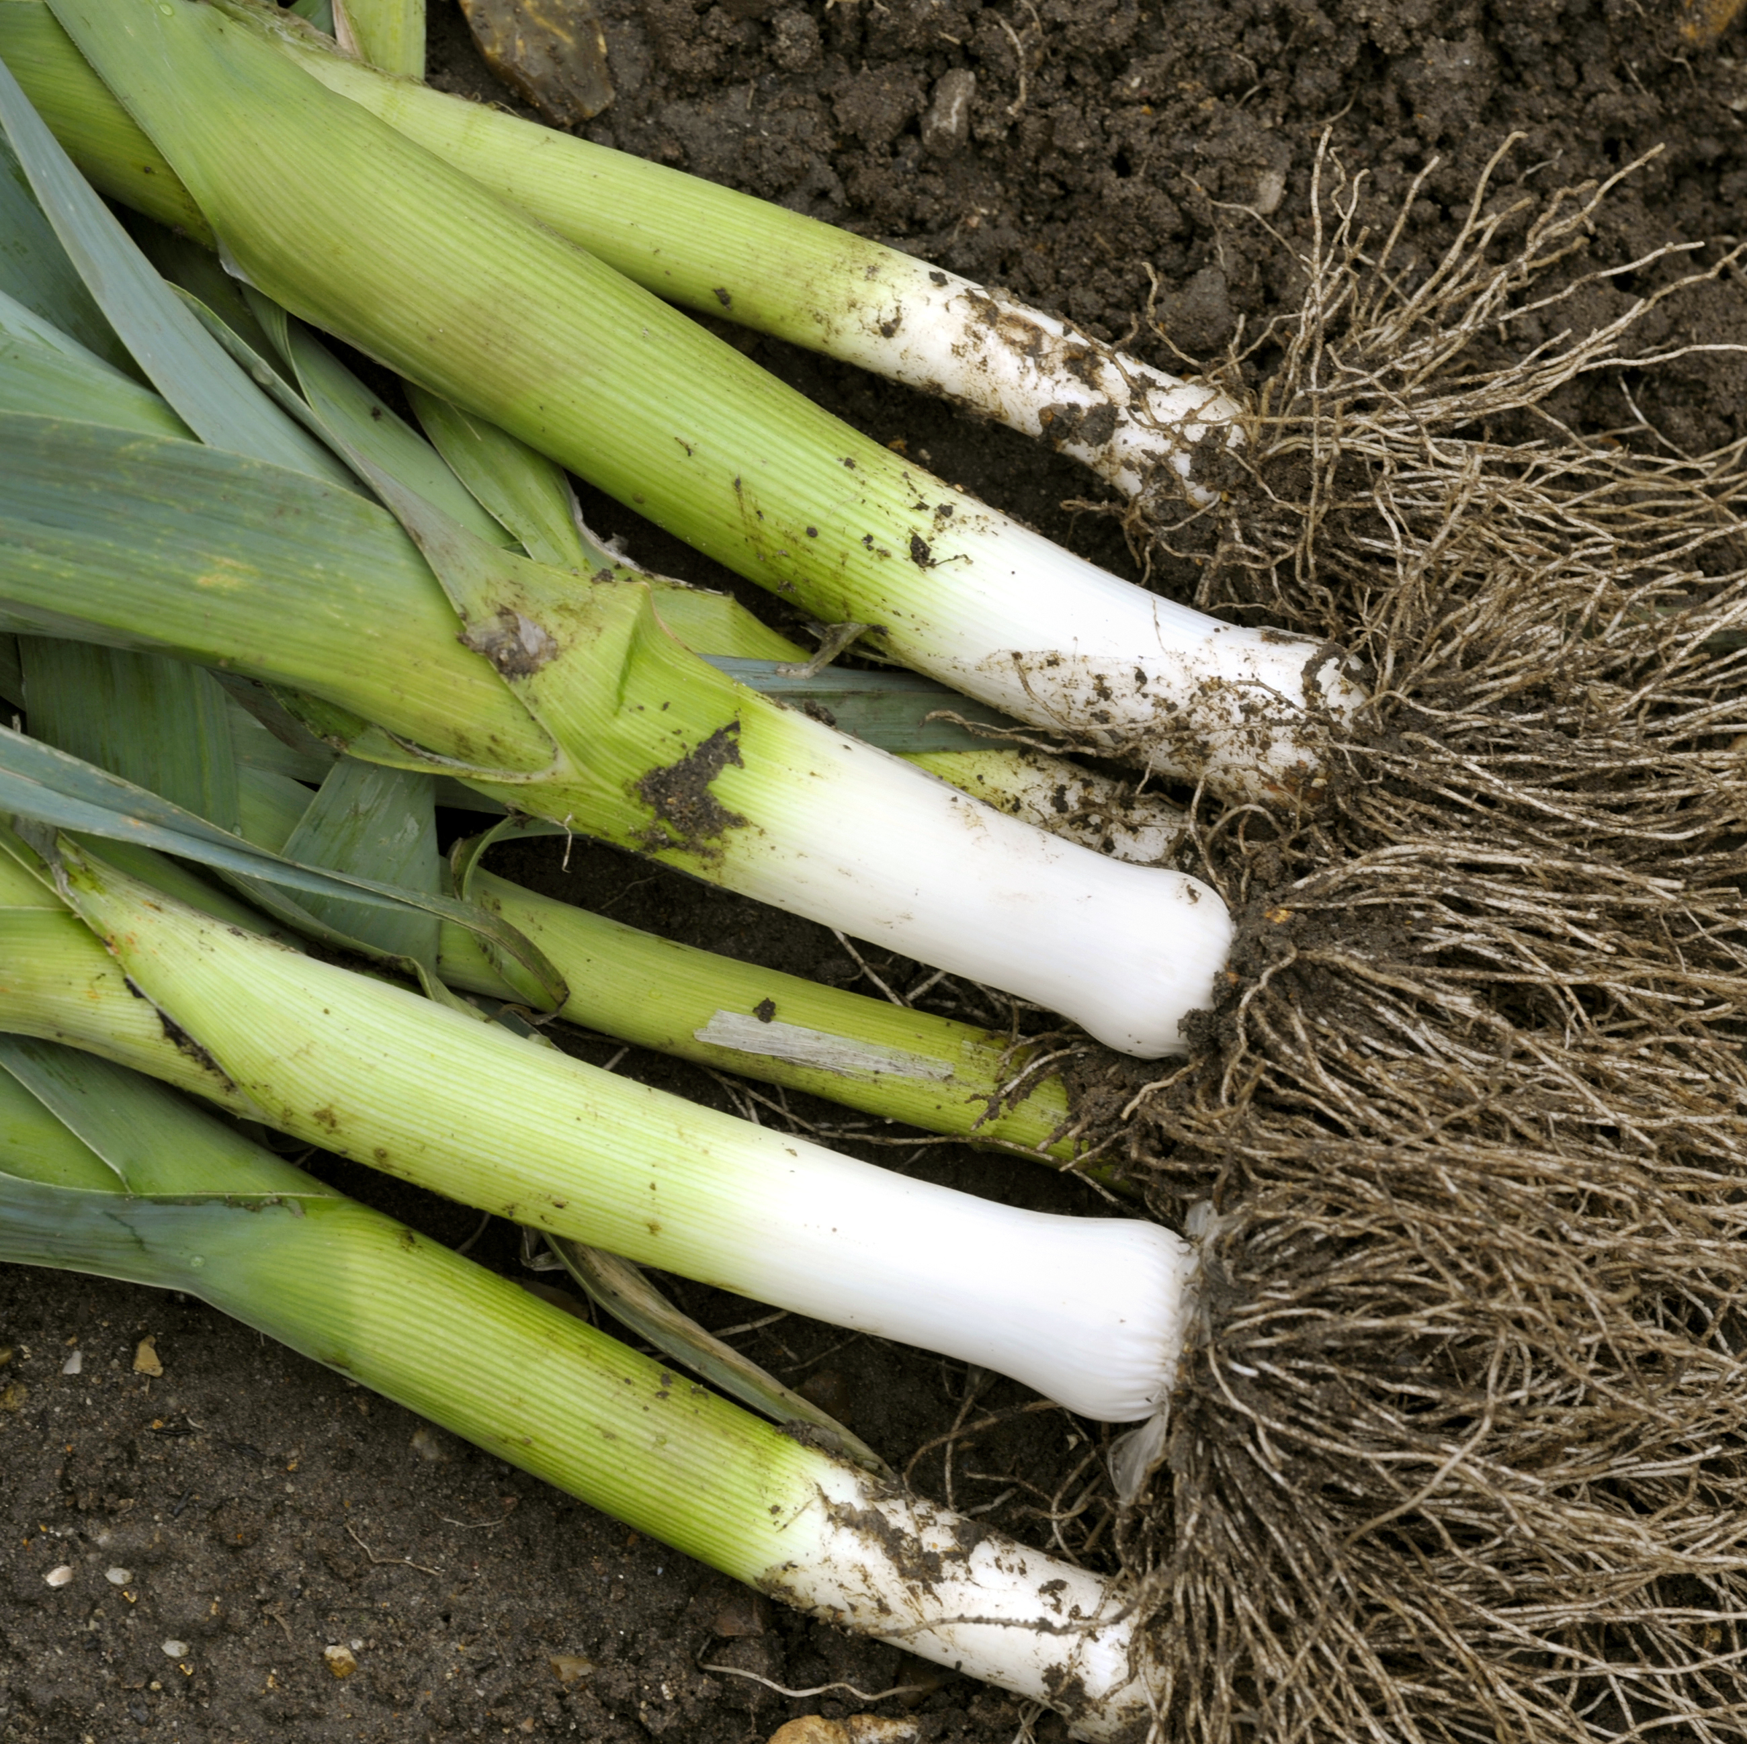
The benefits of eating seasonally
Buying and eating food that is in season means that it:
is fresh;
has the best flavour, texture and colour;
has optimum nutritional value.
Other benefits include:
lower cost;
supporting local growers and producers;
reduced energy needed to grow and transport the ingredients and food.

Slide 9
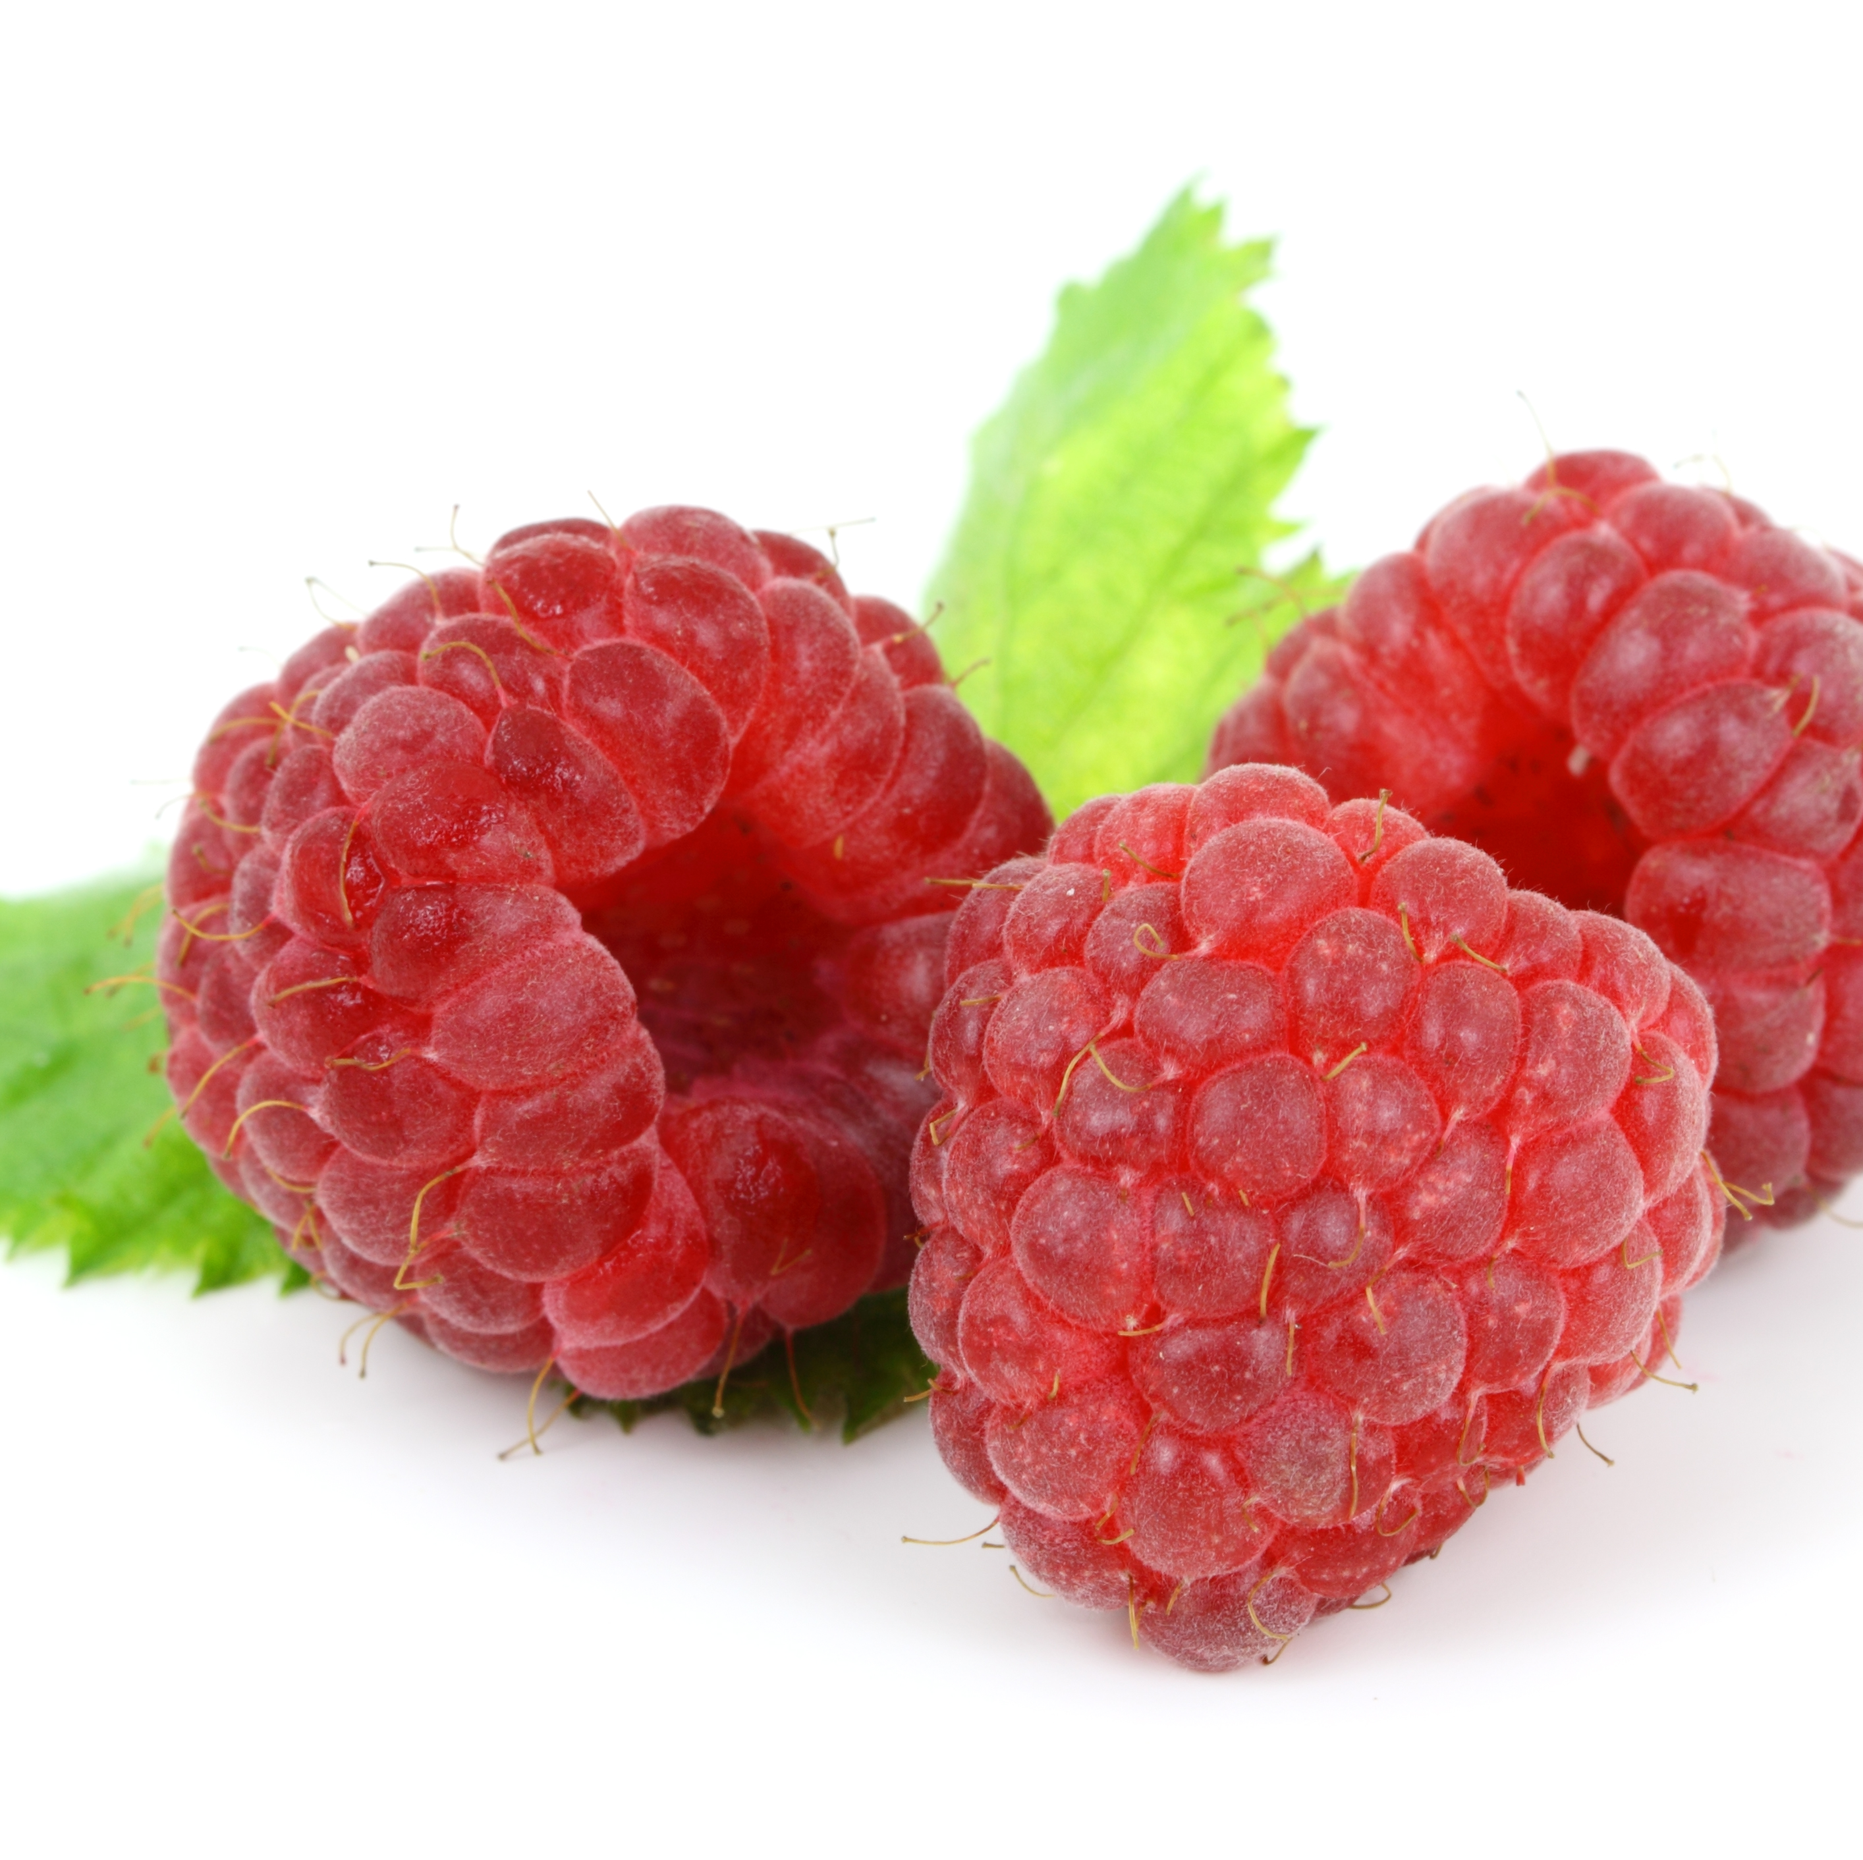
In season or not?
Disadvantages of eating seasonably are few and far between, but may include:
shopping may seem limited;
it may take more time to plan what you want to cook and eat.

Slide 10
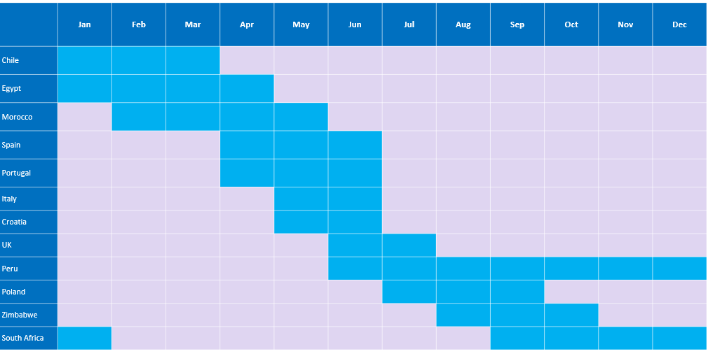
Blueberries – a case study
Blueberries are naturally in season in the UK in the summer, between June-September.
However, retailers can source blueberries from around 25 countries during the year; following the sun and ensuring that this berry is constantly available in the supermarkets.

Slide 11
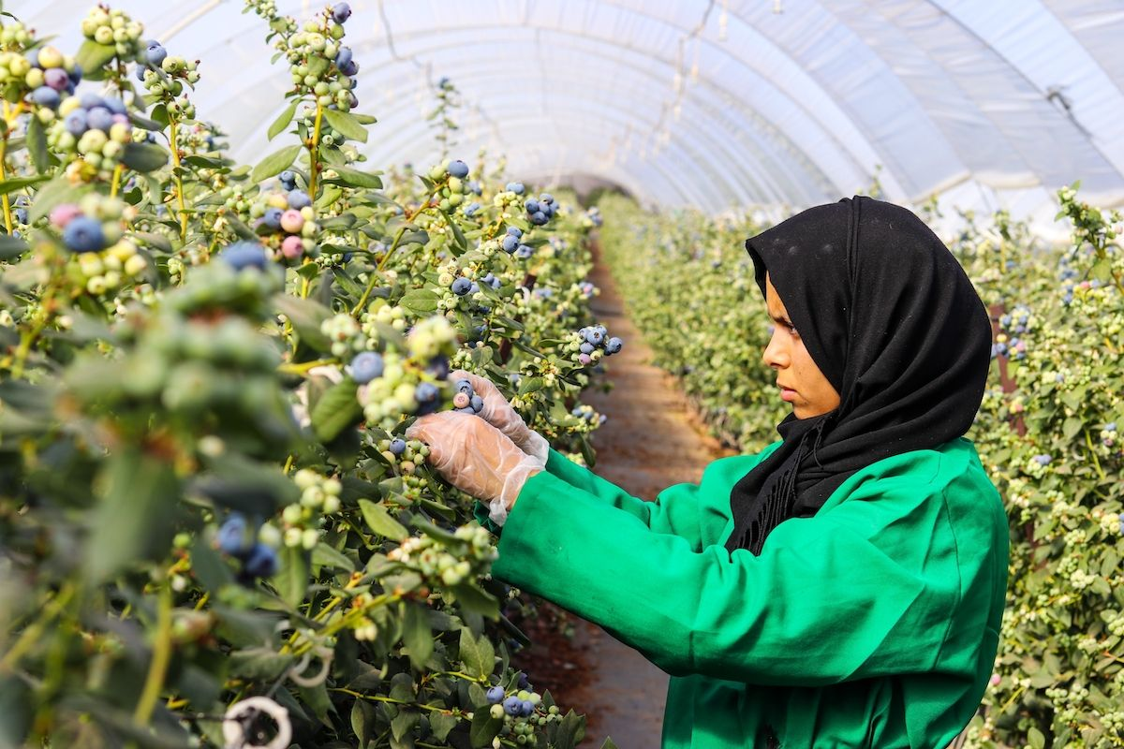
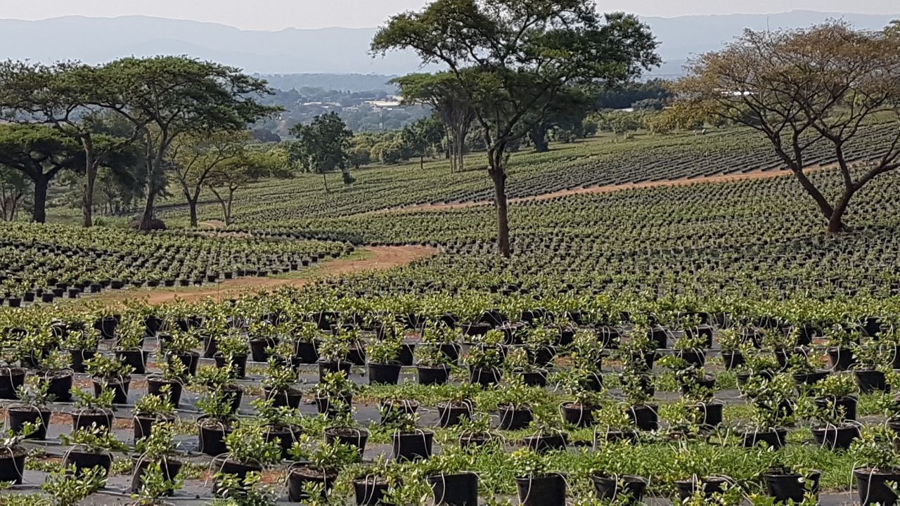
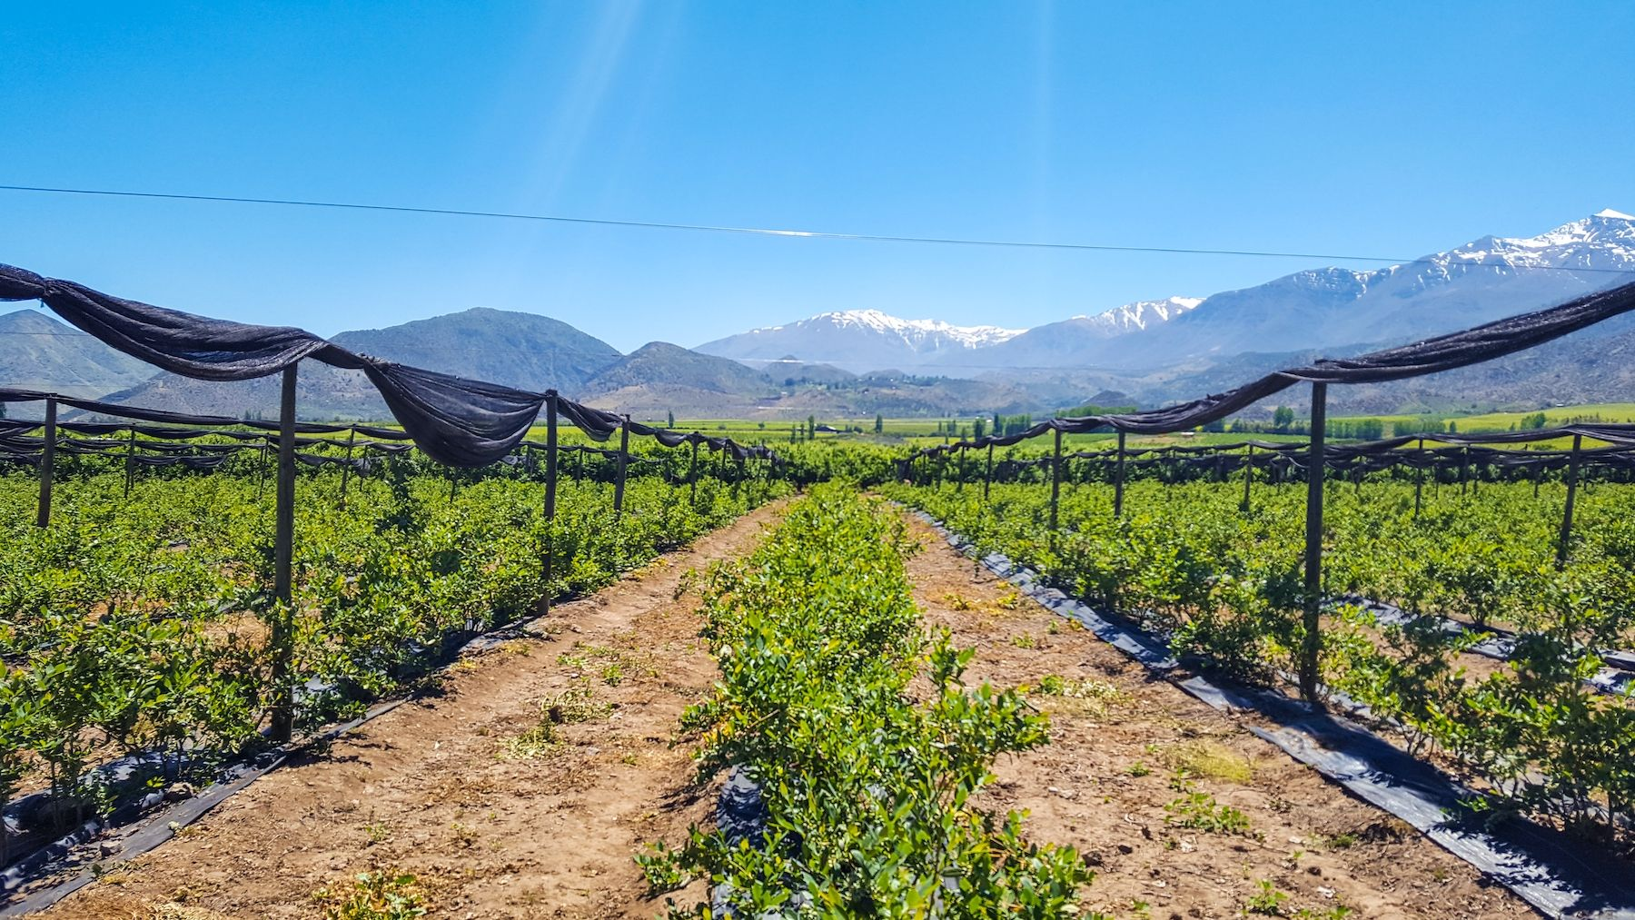
Growing blueberries around the world
Morocco
South Africa
Chile
Information and images kindly provided by BerryWorld

Slide 12
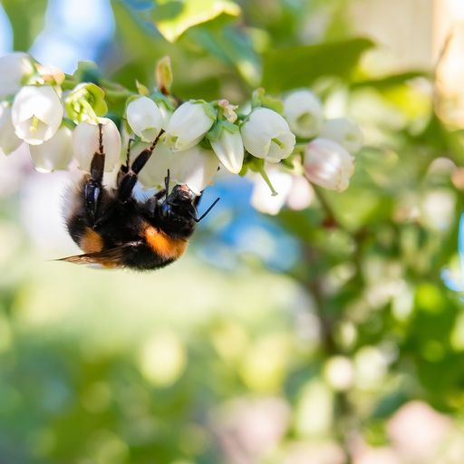
Blueberries – did you know?
Blueberries are called “star berries” by Native Americans because of the five points of the blueberry blossom which the ‘Great Spirit’ created.
Blueberries are grown under tunnels to protect them from rain and sun. Blueberries grow in clusters on a stalk and don’t all ripen at the same time.
Sometimes fruit on the bottom of the cluster might be ripe when some on top are still green.
Blueberries are all picked by hand to gather the best of the early fruit.
There are lots of blueberry varieties, which all mature at different times.
Information and images kindly provided by BerryWorld
Blueberry pollination

Slide 13
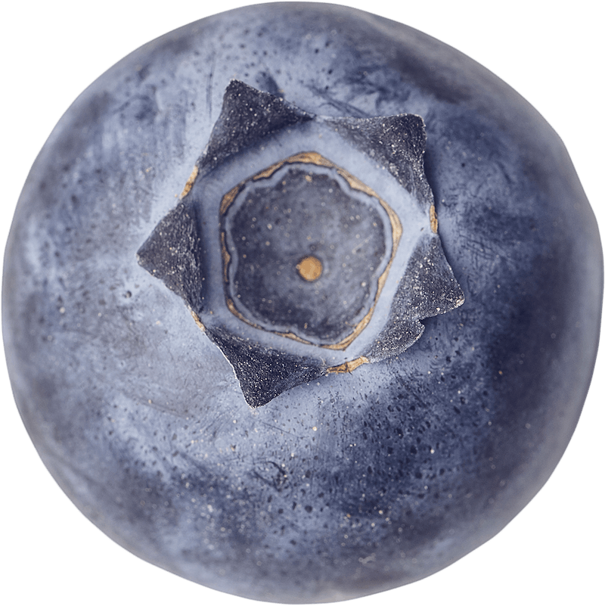
What to look for and how to serve?
When buying blueberries, look for plump, juicy, firm berries.
The colour should be a deep blue and you will notice a ‘silvery’ bloom on the skin, this is a perfectly natural and harmless part of the berry.
Blueberries are ready ripened when you buy them.
To keep blueberries fresh, chill between 2 and 4°C, but eat them at room temperature.
Information and images kindly provided by BerryWorld

Slide 14

Blueberry tasting
Blueberries can be a choking hazard. Depending on the age of your pupils, you may need to cut the berries in half or quarters before tasting them.
Use your senses and describe what blueberries are like. Complete the tasting chart provided with your results.
What do you want?
Full blue colour, with good bloom.
Characteristic blueberry aroma.
Firm with crisp and juicy texture.
Sweet and aromatic, balanced flavour.
What don’t you want?
Dull appearance, mould, collapsing fruit or free flowing juice. Green/ yellow/ red fruit (these are immature).
Off, mouldy or chemical smells/odours.
Mushy or grainy texture. Dry and wrinkly.
No flavour/bland or acidic taste.

Slide 15
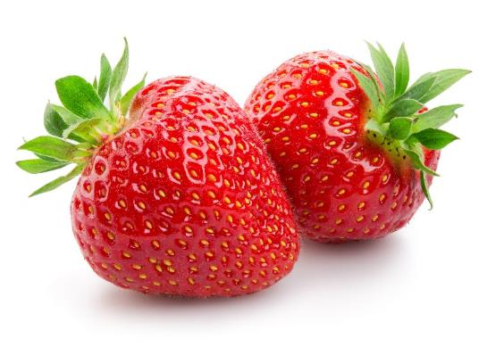
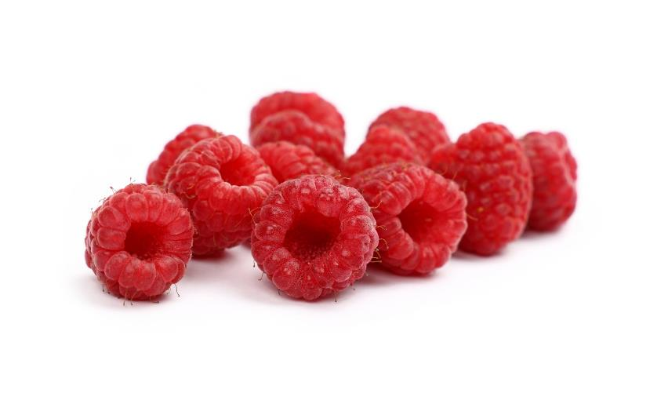
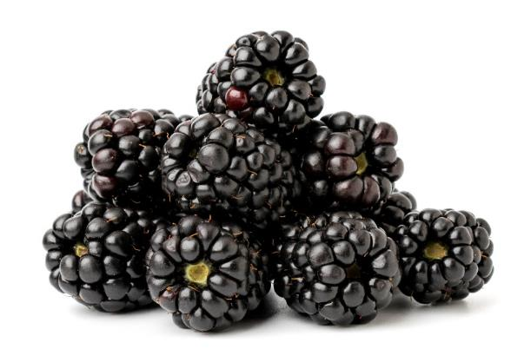
Other berry facts
The green bit on a strawberry that you throw away is called the calyx.
Strawberries need 336 hours of sunshine to ripen.
Raspberries have a hollow core in the middle whilst blackberries do not.
Each raspberry is made up of approximately 120 drupelets, tiny bead-like fruits each containing a seed.
Raspberries are perennial plants, meaning they live more than two years.
A raspberry contains 200 molecules that contribute to its distinctive flavour.
Blackberries are not berries, in a strict botanical sense, a blackberry is not a berry but a fruit made up of tiny 'drupelets'.
Information kindly provided by BerryWorld

Slide 16
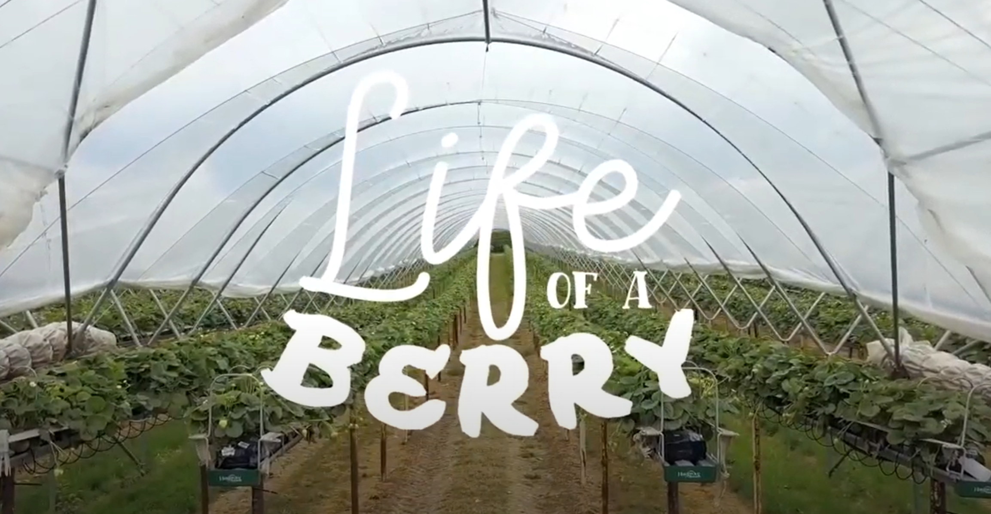
The life of a berry

Slide 17

The life of a berry

Slide 18
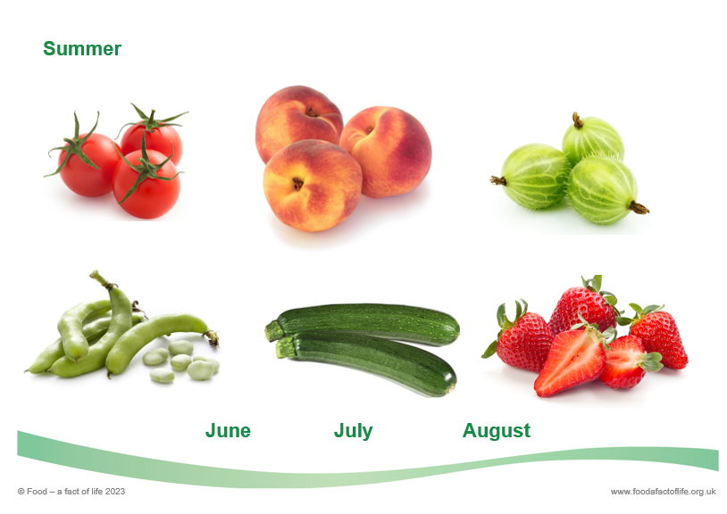
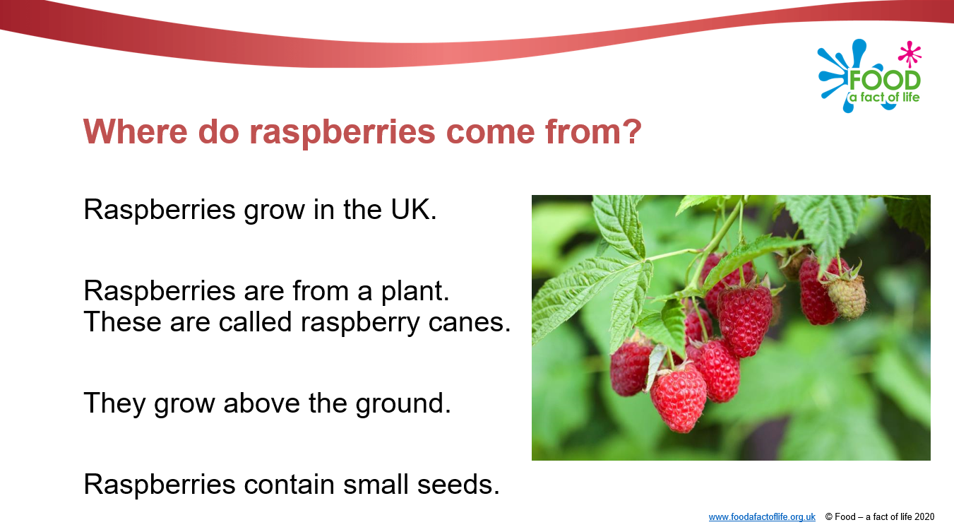
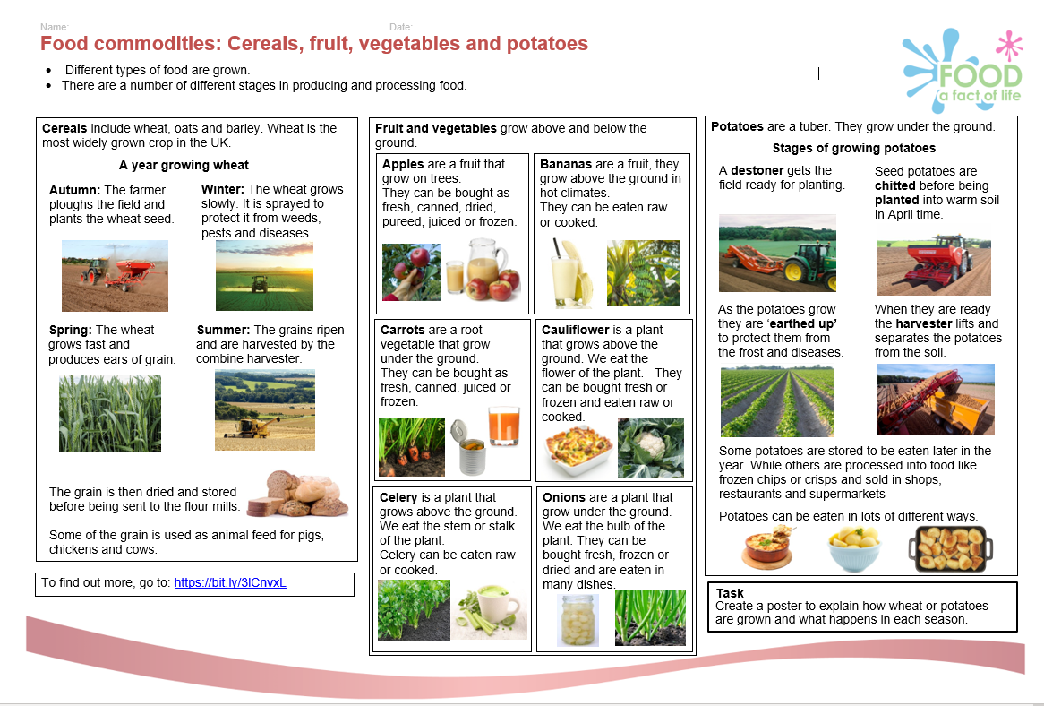
Food – a fact of life resources
Tasting guide and ingredient check letter
Seasons – session ideas for 3-5 years
Growing strawberries presentation – 5-7 years
Season cards – multi-year
Seasons presentation – 7-11 years
Eat the seasons worksheet – 7-11 years
Seasonal fruit and vegetables worksheet – 7-11 years
Seasonal food worksheet – 7-11 years
Food commodities: Fruit and vegetables presentations – 5-7 years and 7-11 years
Knowledge organisers – 5-7 years and 7-11 years

Slide 19
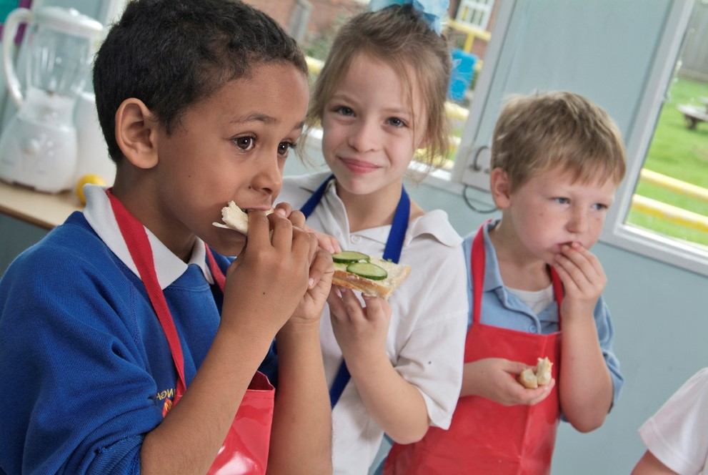
Future training events
Coming next…diary dates
Tue 27 Feb 2024 – 4pm
Ask an expert
Tue 12 March 2024 – 4pm
Engaging parents/carers & extra-curricular cooking
Tue 23 April 2024 – 4pm
Cooking with heat in primary 2
Tue 14 May 2024 – 4pm
Outside cooking!
Tue 4 June 2024 – 4pm
Cook-a-long - global recipes
Remember that all webinars are recorded and the 22/23 recordings can be found here.
Also don’t forget our INSET package – seven topical videos ideal for you and your colleagues.

Slide 20
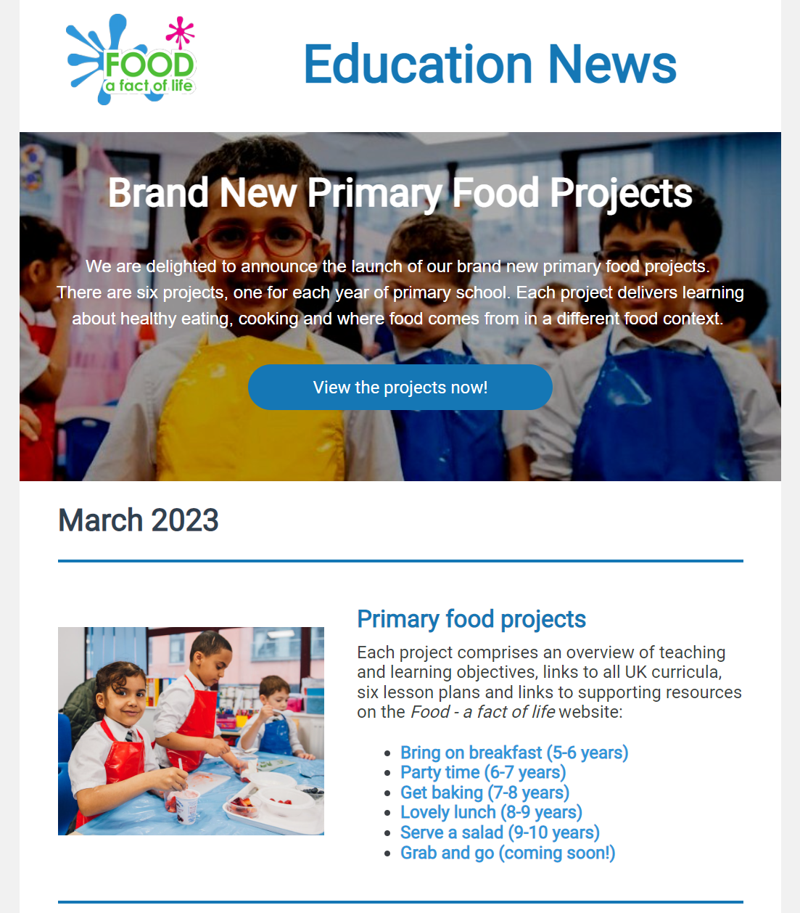
Keep up to date with our free resources and training
Education News (monthly email update)
Sign up on the homepage: www.foodafactoflife.org.uk
Follow us on Twitter @Foodafactoflife
https://twitter.com/foodafactoflife
Keep in touch: education@nutrition.org.uk
Do you know anyone who would find the TPFN programme useful?
They can view this introductory presentation and then register for free!

Slide 21
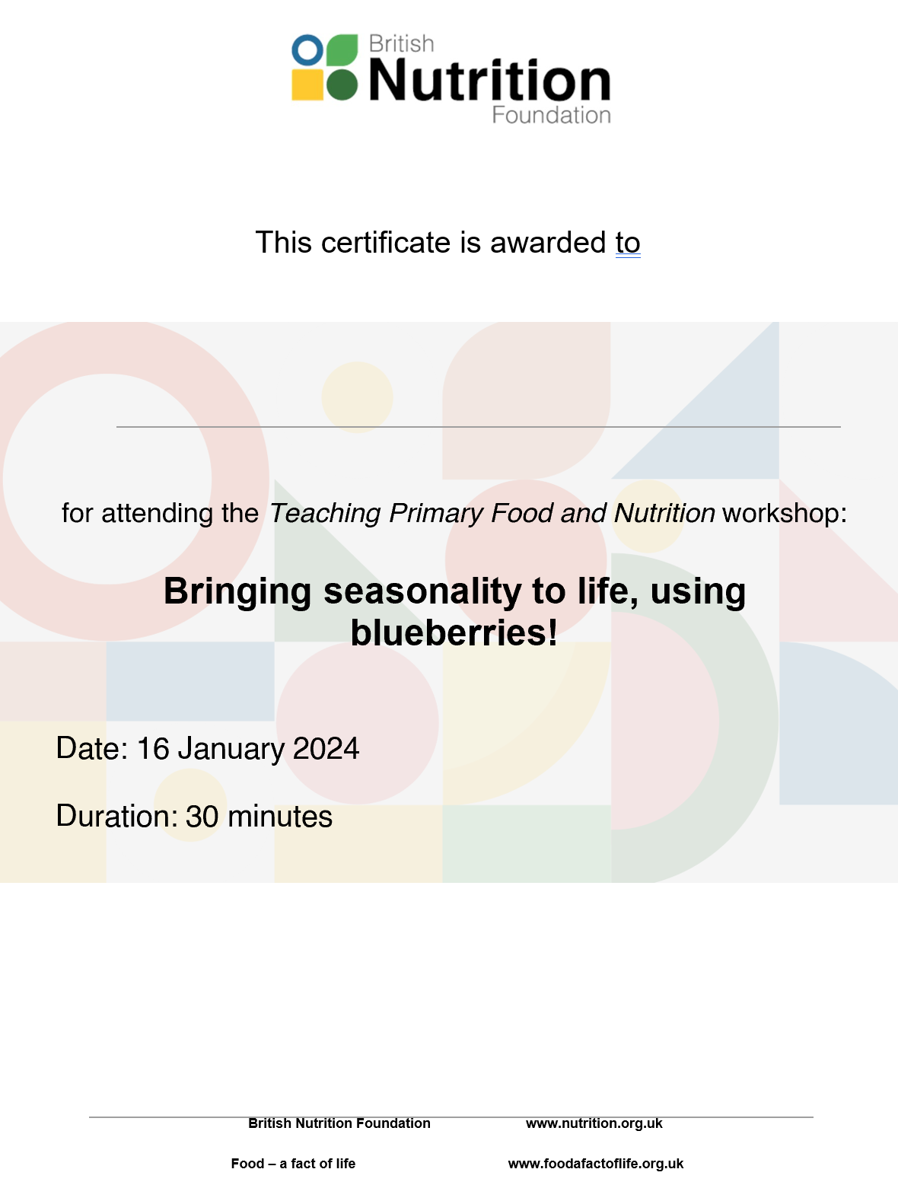
Thank you
Please complete the webinar evaluation. If you are watching a recording of this webinar, you will find a link to the evaluation at the end of the PPT presentation in the Where food comes from area of the TPFN training page.
Bringing seasonality to life, using blueberries!
You will receive a link to the certificate once you have completed the evaluation. Please download the certificate, add your name and print it out and file in your TPFN portfolio!

Slide 22
Thank you!

