Slide 1
The benefits of physical activity

Slide 2
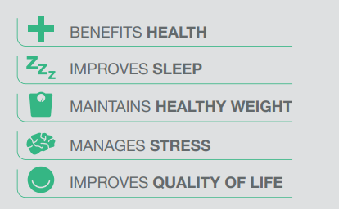
The benefits of physical activity
Everybody, regardless of age, shape, size and ability needs to become more active every day. We should all be moving more.
An active life is essential for physical and mental health and wellbeing.
Gov.UK: Start active, stay active infographics

Slide 3
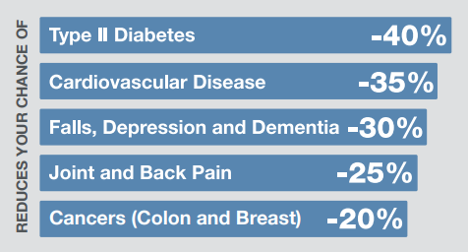
Physical activity and chronic disease risk
Regular physical activity can help decrease our risk of cancer and type 2 diabetes, and conditions like obesity, hypertension and depression.
According to the NHS, physical activity can reduce your risk of heart disease, stroke, type 2 diabetes and cancer by up to 50% and lower your risk of early death by up to 30%.
Gov.UK: Start active, stay active infographics

Slide 4
Physical activity and chronic disease risk
It is medically proven that people who do regular physical activity have lower risk of:
coronary heart disease and stroke;
type 2 diabetes;
bowel cancer;
breast cancer in women;
early death;
osteoarthritis;
hip fracture;
falls (among older adults);
depression;
dementia.
https://www.nhs.uk/live-well/exercise/exercise-health-benefits/

Slide 5

Physical activity and mental health
Physical activity does not just reduce the risk of chronic diseases.
Research shows that physical activity can also boost self-esteem, mood, sleep quality and energy, as well as reducing your risk of stress and depression.

Slide 6
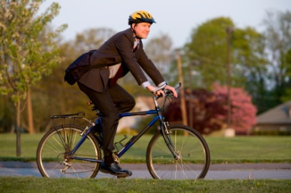
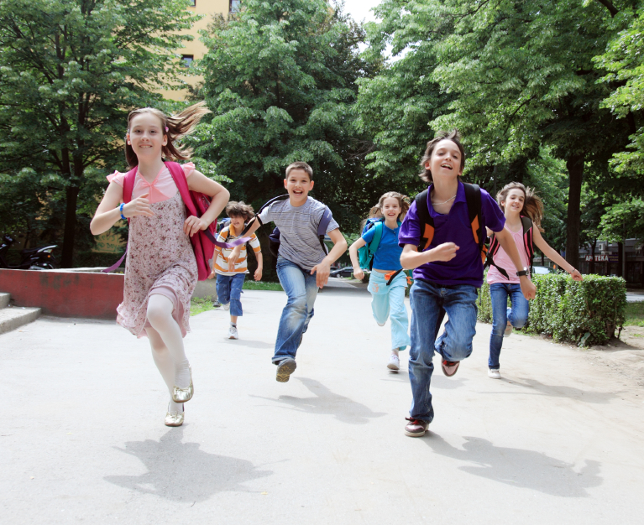
How active are we?
67% of adults were considered active (as per government guidelines).
47% of children and young people were meeting the current physical activity guidelines.
Statistics on Obesity, Physical Activity and Diet 2021

Slide 7
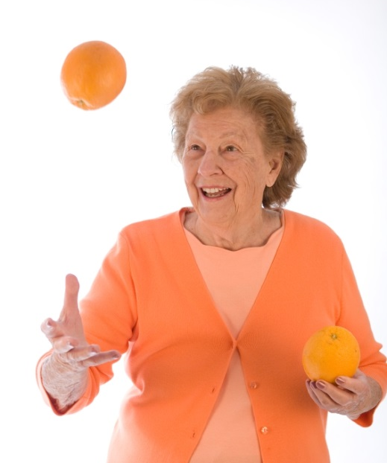
Activity for all ages
Being active at every age increases quality of life and everyone’s chances of remaining healthy and independent.
Whatever your age, there's strong evidence that being physically active can help you lead a healthier and happier life.

Slide 8
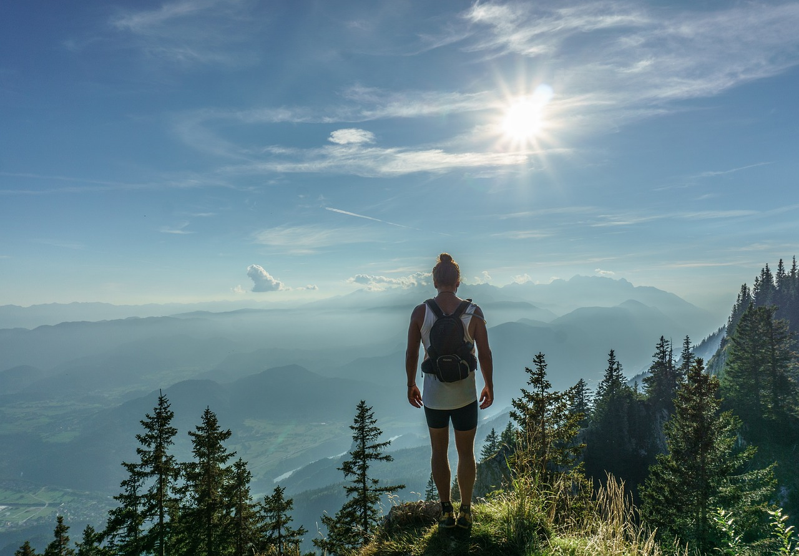
Physical activity guidelines
For activity to be effective for our health and wellbeing, not all activity has to be classed as vigorous activity.
There are many different activities that can count towards the recommendations.
Physical activity guidelines are in place for both children and adults and can be found in the Physical activity guidelines presentation.

Slide 9
The benefits of physical activity
For further information, go to:
www.foodafactoflife.org.uk
This resource meets the Guidelines for producers and users of school education resources about food.

