Slide 1
Heat transfer (heat exchange)

Slide 2
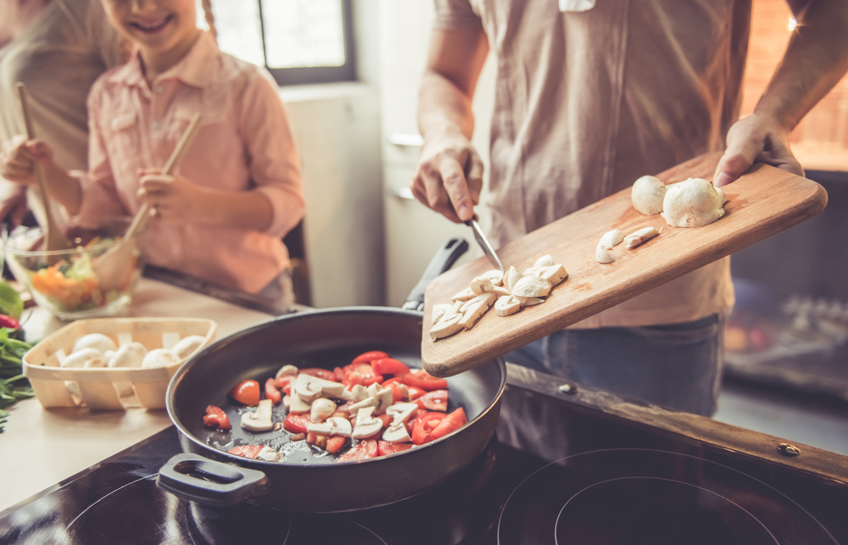
Introduction
Applying and removing heat is an important part of food preparation. Many foods need to be cooked to be safe to eat and palatable.
Additionally, to keep foods for longer, many need to be chilled or frozen, requiring the removal of heat.
Whether heat is being applied or removed, the heat must be transferred to or from somewhere else.

Slide 3
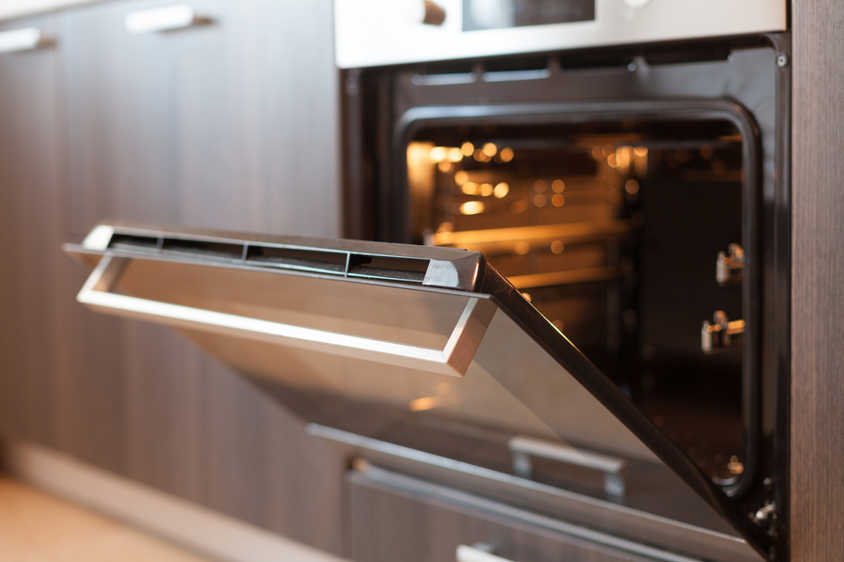
Applying heat
The application of heat in the preparation of a food or mixture may:
improve digestibility;
improve appearance, flavour, odour and texture;
increase the availability of nutrients;
prevent spoilage;
increase keeping qualities.

Slide 4
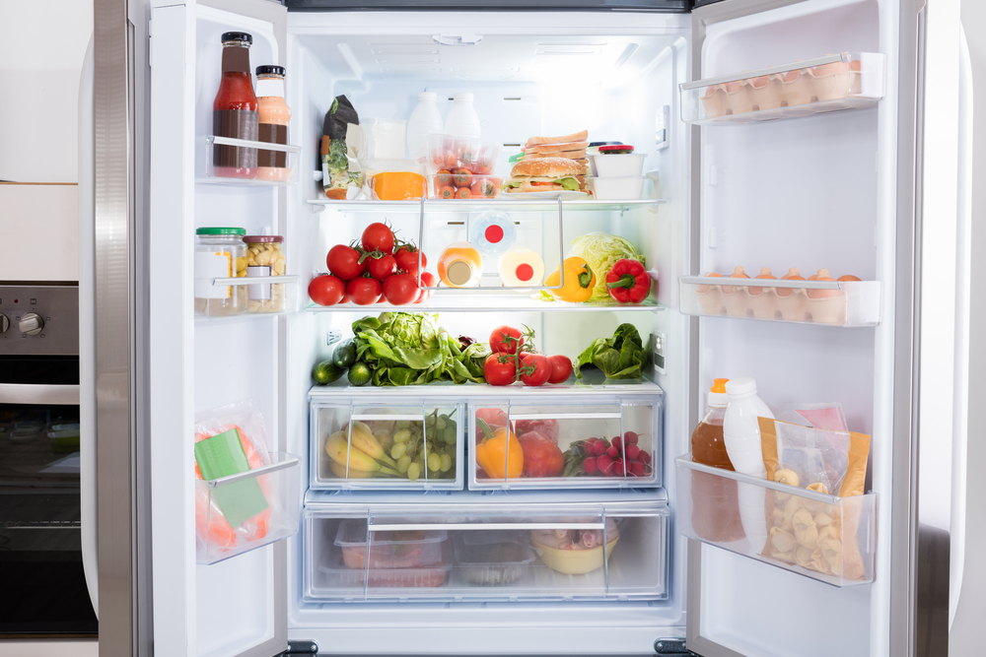
Removing heat
The removal of heat, or cooling of foods, may:
modify appearance and texture, e.g. formation of ice crystals;
prevent spoilage, i.e. slow down growth of micro-organisms;
increase keeping qualities, by preventing spoilage;
aid processing, e.g. tempering chocolate.

Slide 5
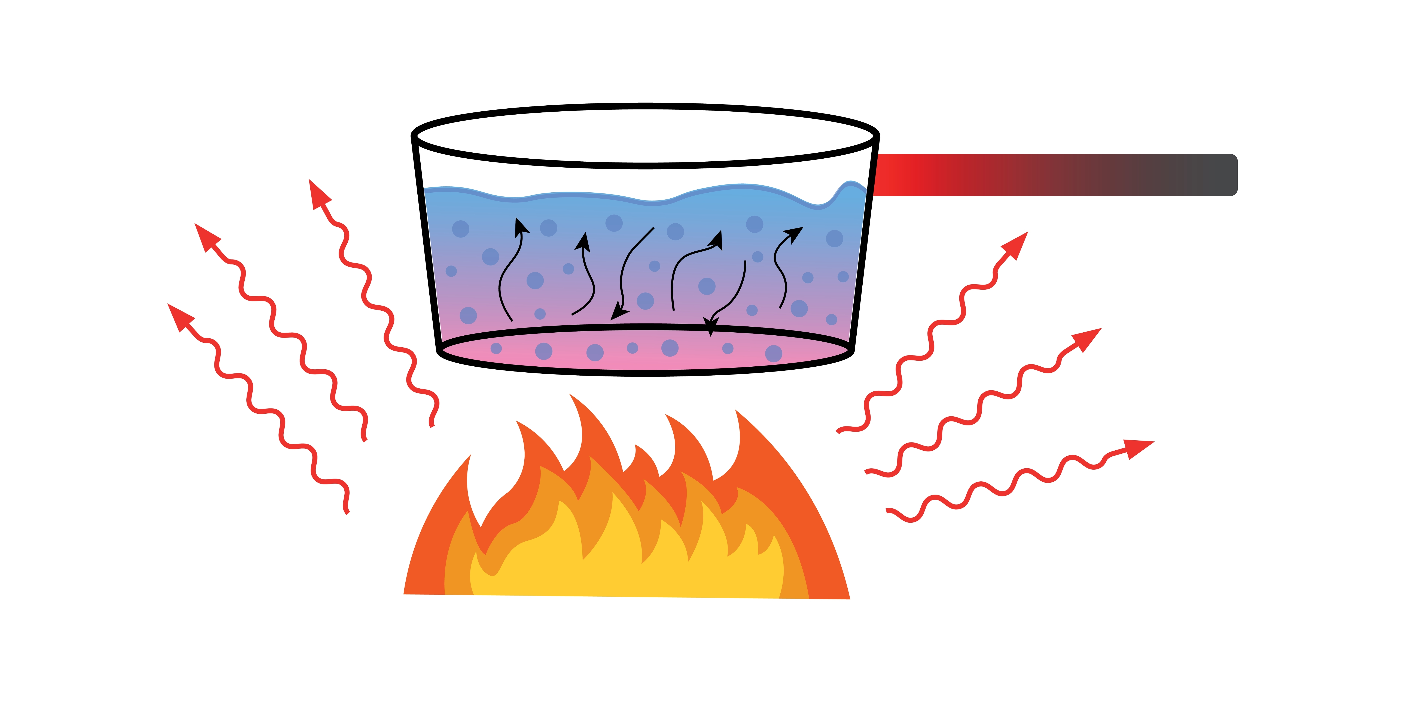
Methods of heat transfer
The transfer of heat to or from particular foods is important in food preparation and storage (e.g. cooking and cooling).
As a food is heated, its molecules absorb energy and vibrate more vigorously. The faster they move, the higher the temperature of the food rises.
If heat is removed, the molecules become less active, reducing the food’s temperature.
Heat can be transferred in three ways:
conduction;
convection;
radiation.

Slide 6
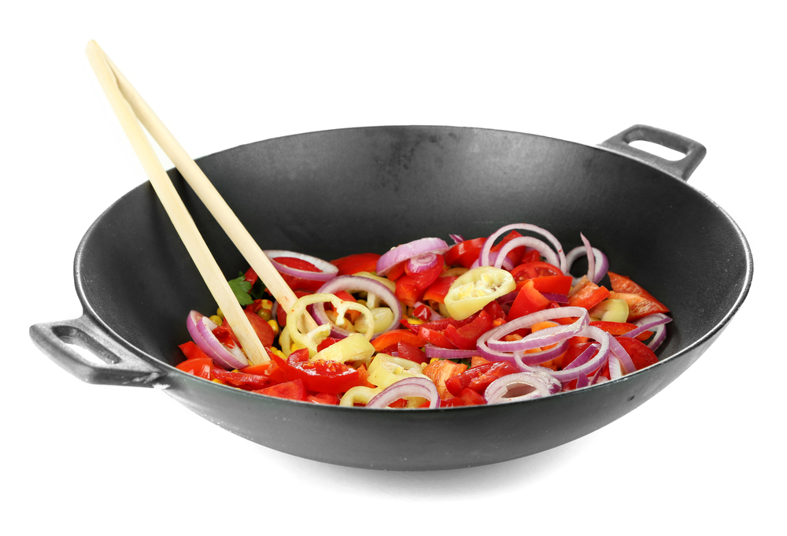
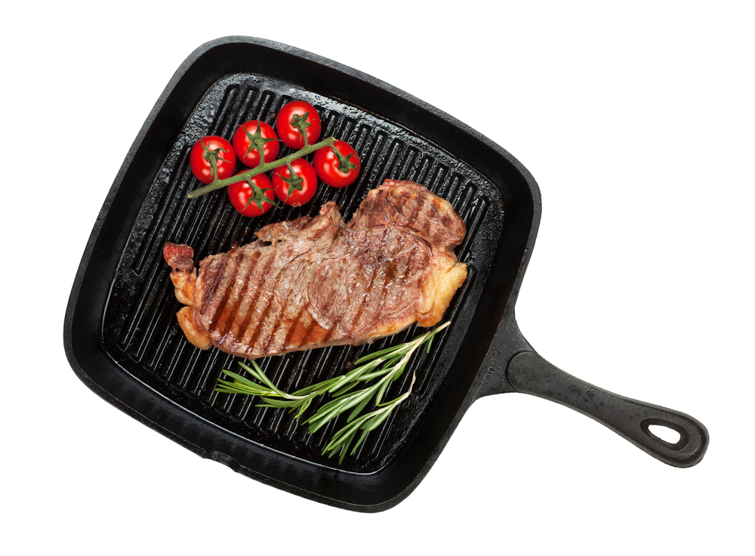
Conduction
Conduction is a type of heat transfer that results from atoms in a material heating up (making them vibrate faster) and colliding with other atoms - passing energy on.
When cooking food, conduction is the transfer of heat by direct contact with foods on a surface. For example:
stir-frying vegetables in a wok (applying heat);
pasteurising milk in a plate heat-exchanger (applying heat);
making ice cream (removing heat).
Stir-frying vegetables relies on conduction from the metal of the wok to the raw vegetables
Similarly, pan frying a steak relies on conduction from the pan to the meat

Slide 7
Convection
When gases (such as air) or liquids (such as water) are heated, the molecules become more energetic. This makes them move around more quickly.
Because of this, the molecules move further apart, making them less dense. This causes them to rise.
Cooler liquid or gas falls to take its place. This in turn becomes heated and rises up, creating moving ‘convection currents’.

Slide 8
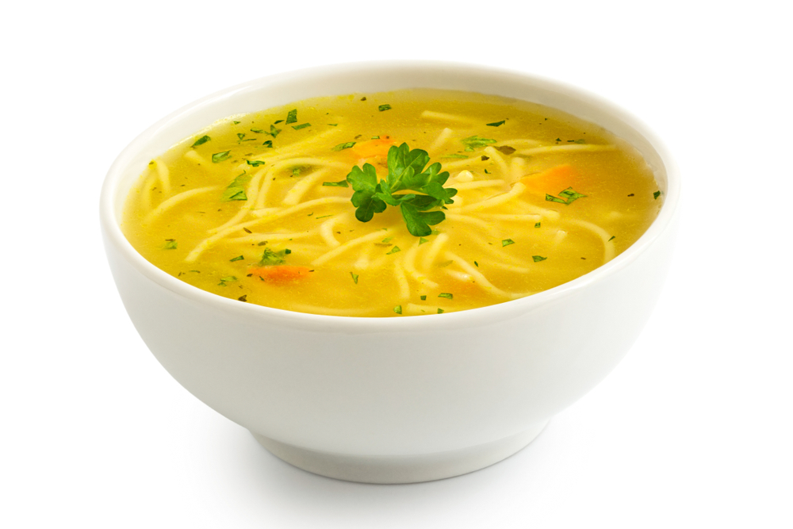
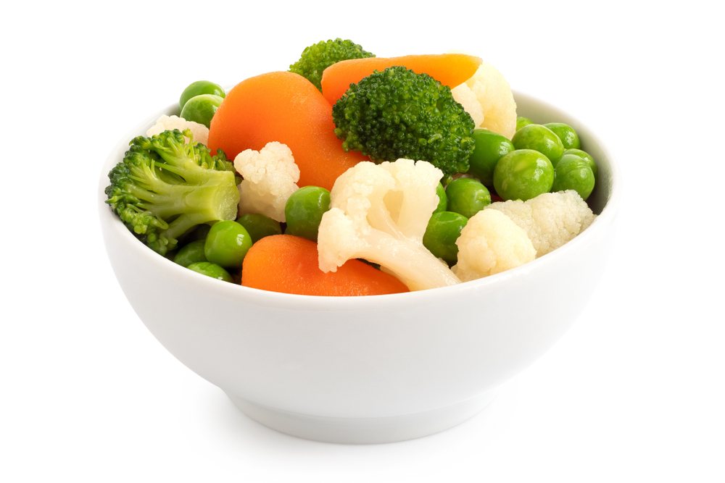
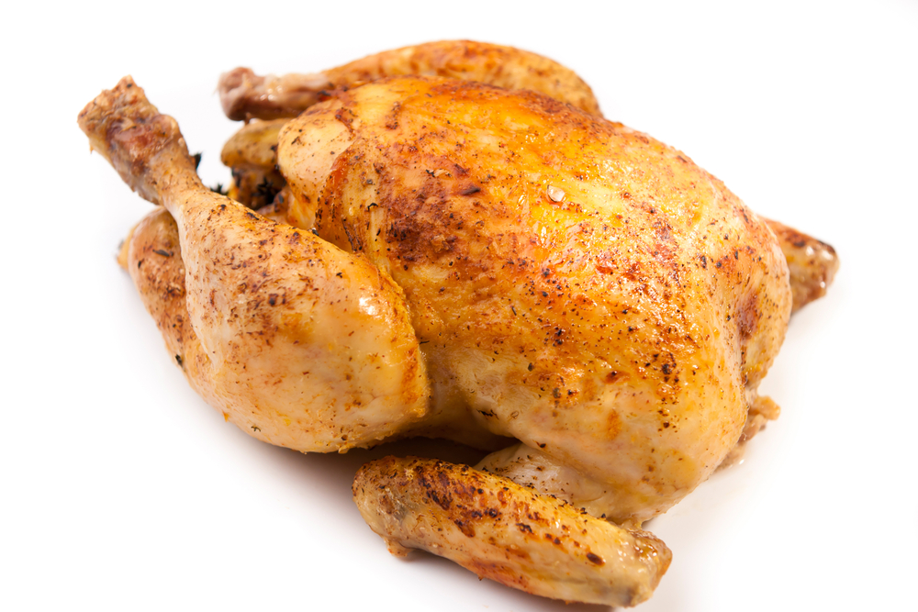
Convection
Food which is placed in such a liquid or gas (usually in an enclosed space) becomes cooked.
This happens because heat from convection currents is transferred from the air or liquid to the outside of the food, then gradually to the centre, via conduction.
Convection does not occur in solids, as the particles are not able to move as freely.
Soup is cooked via convection of liquid
Steamed vegetables are cooked via convection of heat from steam generated from boiling water
Convection ovens use convection to move air around the oven and heat food more evenly, such as this roast chicken

Slide 9
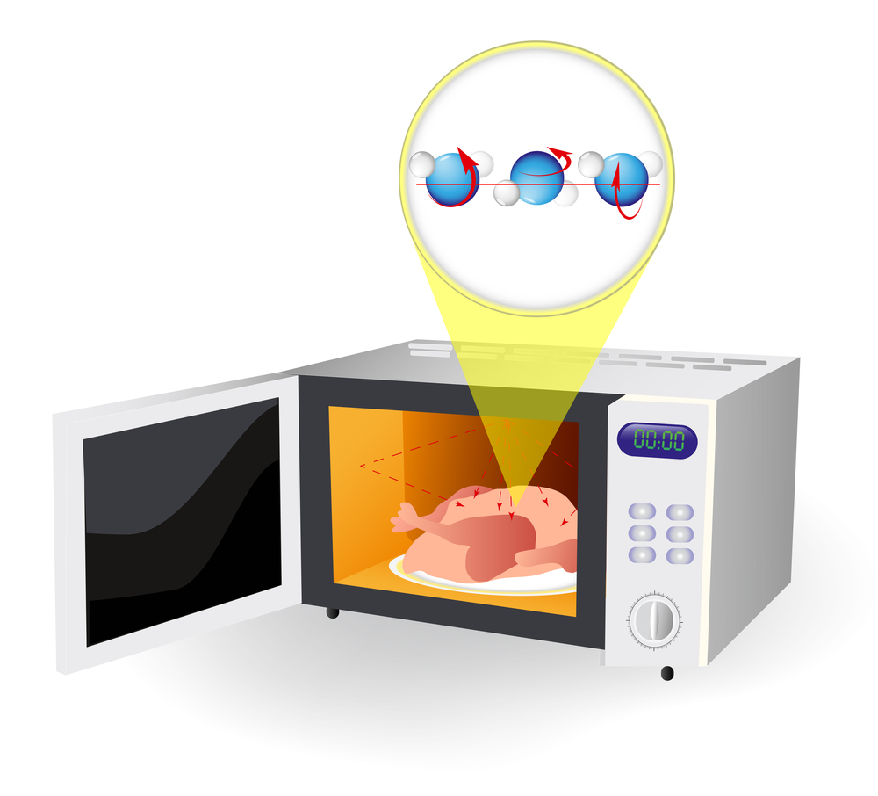
Radiation
Radiation is energy in the form of rays. The rays pass through the air until they come into contact with the food. Some are absorbed while others are reflected.
Grilling involves the use of infra-red heat rays created by gas flames, charcoal or glowing electric elements.
Microwaves are electromagnetic radiators of high energy and short wavelengths. They quickly heat anything containing water, by causing the water molecules to oscillate (vibrate), which produces heat.
Sun drying is a traditional method of using the sun’s rays to preserve food.
Microwaves radiate energy onto food and cause the water molecules to vibrate, generating heat

Slide 10
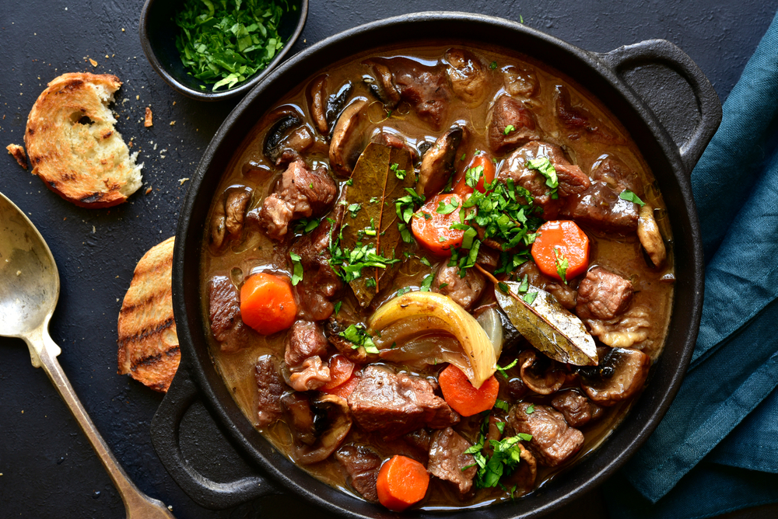
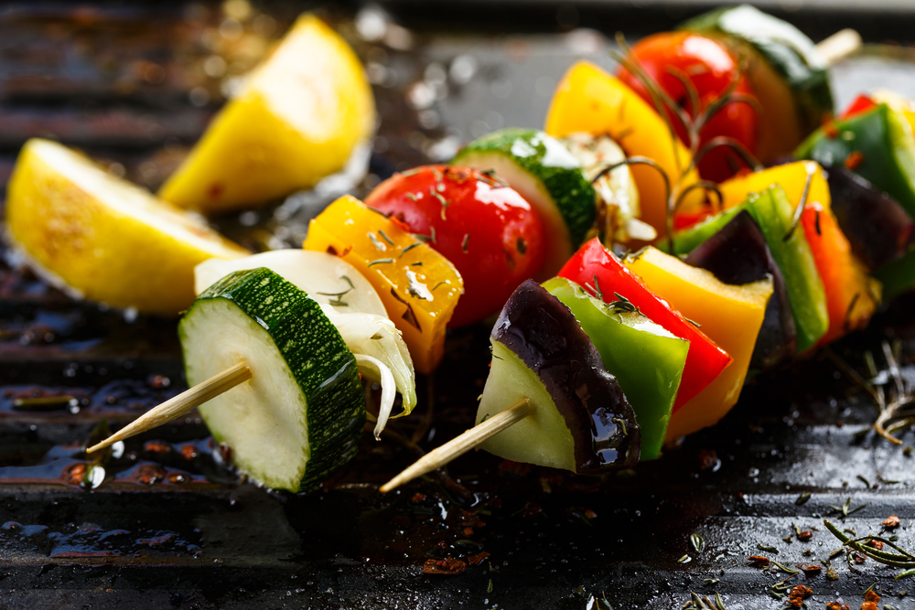
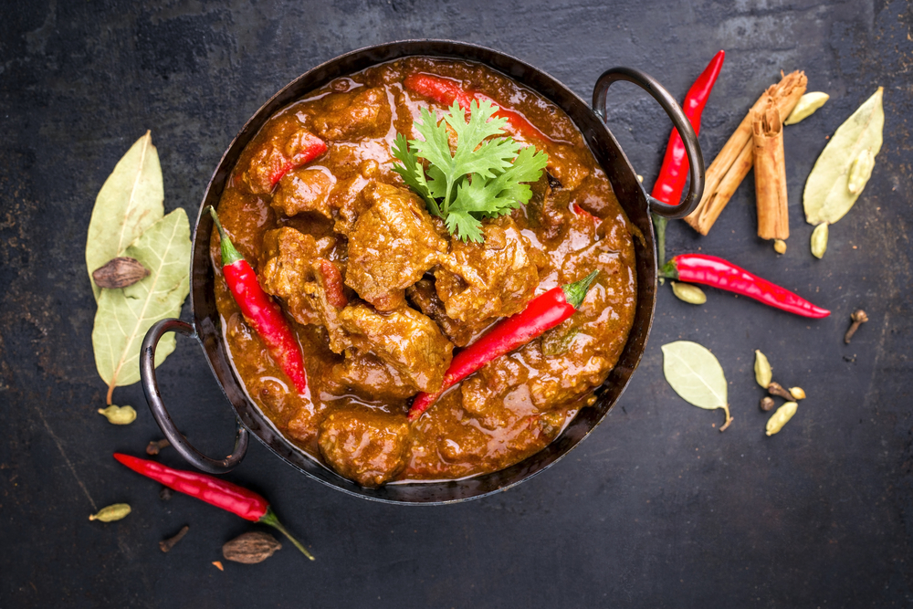
Applying the science
One or more methods of heat transfer may be used when cooking different dishes:
Beef casserole
Vegetable kebabs
Lamb Rogan josh
Method of heat transfer: conduction (frying pan, oven dish and food itself) and convection (liquid in the oven).
Method of heat transfer: conduction (saucepan and food itself) and convection (liquid).
Method of heat transfer: radiation (surface) and conduction (centre).

Slide 11
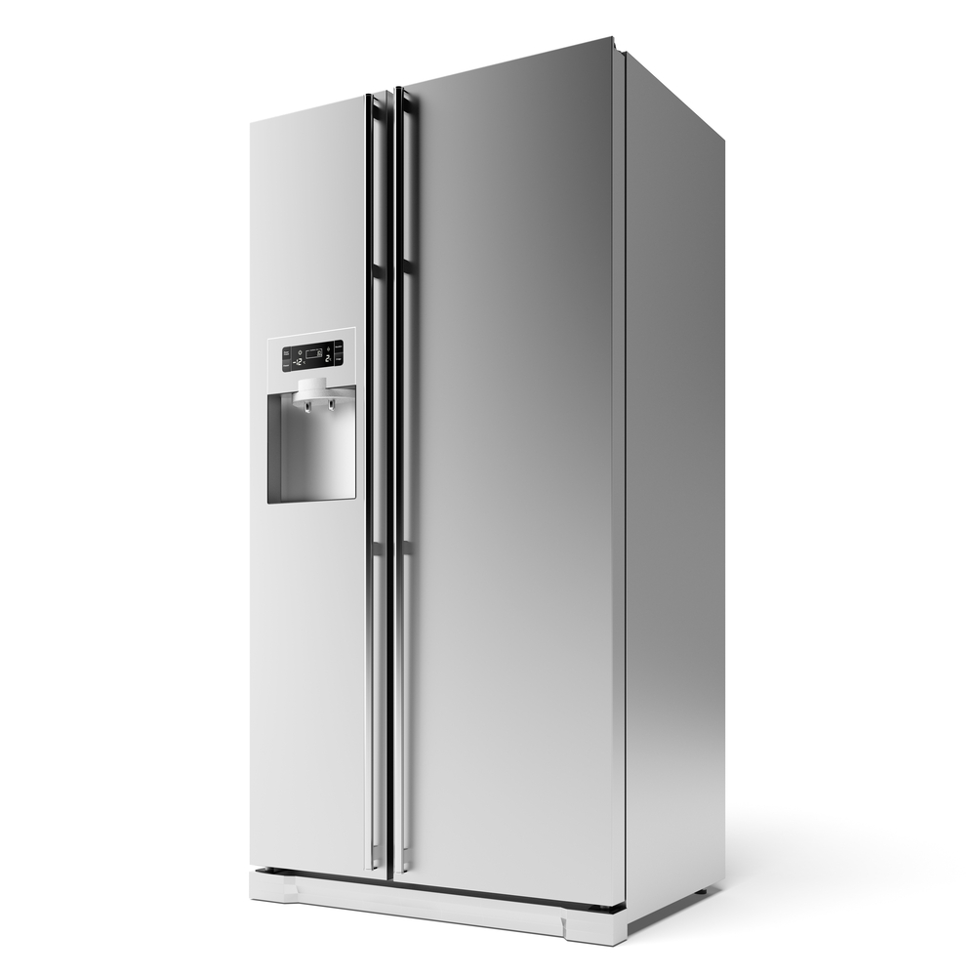
Applying the science - refrigeration
When cooking a food, heat energy is applied. To cool food (e.g. in a fridge), heat energy needs to be actively removed.
Fridges contain refrigerant, which absorbs heat from the inside of the fridge and passes it to the outside (the air in the room).
This is why the inside of a fridge is cold and the back often feels warm.

Slide 12
Key words
Key word | Meaning
Conduction | The exchange of heat by direct contact with a food on a surface, e.g., stir frying or plate freezing.
Convection | The exchange of heat by gas or liquid, e.g., boiling potatoes or blast chilling.
Radiation | The emission of energy in the form of rays, e.g., grilling.
Refrigerant | A compound that absorbs heat from the environment. Used for removing heat from appliances such as fridges and freezers.

Slide 13
Teachers’ guide

Slide 14
Teaching about heat transfer:
Pupils should understand the three types of heat transfer:
Conduction
Convection
Radiation
Pupils should be able to apply the understanding of these types of heat transfer to food (see ‘Applying the science’ for examples).
Pupils should understand that heat can be applied to food (cooking) or removed from food (chilling).

Slide 15
Conduction
Conduction is a type of heat transfer that results from atoms in a material heating up (making them vibrate faster) and colliding with other atoms - passing energy on.
Thermal energy passes from areas of higher (hotter) to lower (colder) temperature.
Some materials are more conductive than others. For example, metals are typically better conductors due to a high number of free electrons. On the other hand, plastic and wood are poor conductors.
Solids also tend to conduct better than liquid or gases, because the particles are much closer together and therefore more likely to collide.
This diagram shows heat being conducted from the outside of the pan into the handle. To reduce the degree of conduction into the pan handle and prevent burns, handles are often made out of poor conductors (e.g. plastic)

Slide 16
Convection
When gases (such as air) or liquids (such as water) are heated, the molecules become more energetic. This makes them move around more quickly.
Because of this, the molecules move further apart, making them less dense. This causes them to rise.
Cooler liquid or gas falls to take its place. This in turn becomes heated and rises up, creating moving ‘convection currents’.
Convection does not occur in solids, as the particles are not able to move as freely.

Slide 17
Radiation
Radiation is energy in the form of rays. The rays pass through the air until they come into contact with the food. Some are absorbed while others are reflected.
Grilling involves the use of infra-red heat rays created by gas flames, charcoal or glowing electric elements.
Microwaves are electromagnetic radiators of high energy and short wavelengths. They quickly heat anything containing water, by causing the water molecules to oscillate (vibrate), which produces heat.
Sun drying is a traditional method of using the sun’s rays to preserve food.

Slide 18
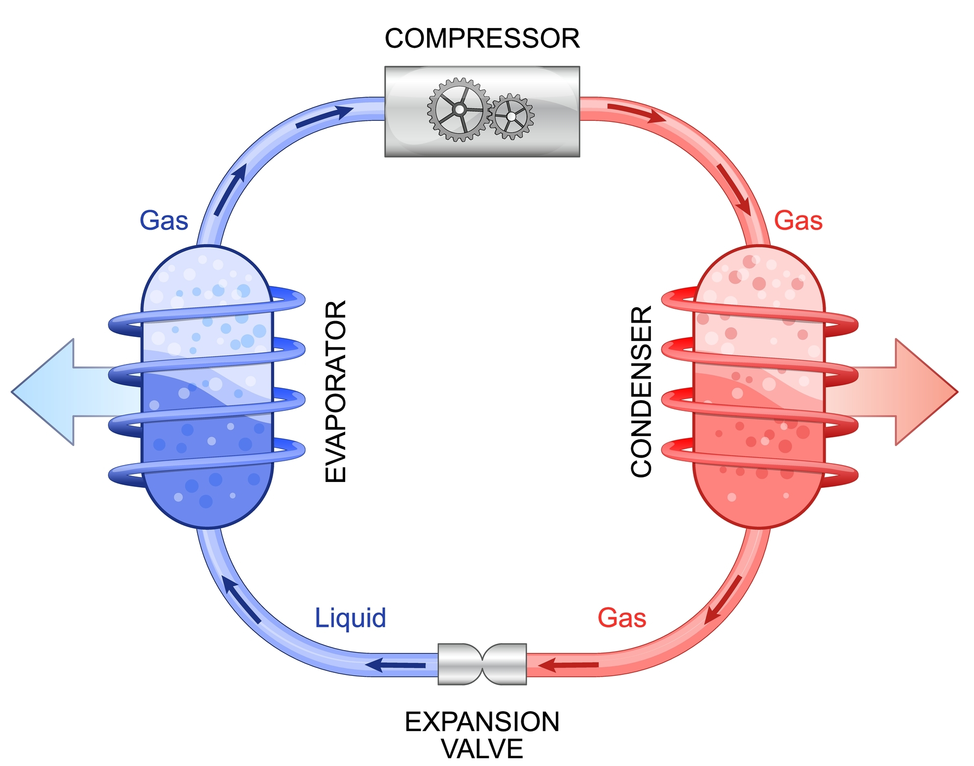
Applying the science - refrigeration
When cooking a food, heat energy is applied. To cool food (e.g. in a fridge), heat energy needs to be actively removed.
The diagram shows the simplified inner workings of a fridge. The fridge contains refrigerant, that can absorb heat from the inside of the fridge (at the evaporator). The refrigerant carries the heat to condenser coils and releases it into the room. This is why the back of a fridge usually feels warm.
The now cooled gas becomes a liquid, absorbs more heat energy from the fridge, and the cycle continues.
This cycle removes heat from the inside of the fridge and passes it to the outside (the air).
Inside of fridge
Outside of fridge

Slide 19
Heat transfer - activities
Pupils, individually or in groups, could:
Use the Heat exchange presentation for more information
Complete the Heat exchange worksheet
Take the Heat exchange quiz – answers can be found here.
Use different materials to support the learning in the 11-14 Cooking area

Slide 20
Heat transfer through cooking techniques
Selecting recipes with different cooking methods can help you to demonstrate different types of heat transfer. Use the cooking methods below to demonstrate:
Conduction
Frying
Sautéing
Grilling
Baking*
Roasting*
Convection
Boiling
Steaming
Baking
Roasting
Deep frying
Radiation
Grilling
Microwaving
*Primarily through convection in the oven, then conduction through outside of food to inside, and conduction from baking pan/tray

Slide 21
Heat transfer - recipes
Use the recipes below to demonstrate different types of heat transfer:
Sizzling stir fry
Conduction (stir frying)
Quick Hungarian goulash
Conduction (pan frying), Convection (boiling)
Roast saddle of lamb with celeriac potato cake
Convection (oven), Conduction (frying)
Cheese and bean filled jacket potato
Radiation (microwave), Convection and Conduction (warming in saucepan)
Mixed vegetables
Convection (steaming)
Grilled teriyaki fish with vegetables and noodles
Conduction (frying), Convection (simmering), Radiation (grilling)

Slide 22
Further supporting resources
External resources
IFST – Cooking food
IFT – Getting to the Heart of Heat Transfer
AQA – Sauce making and methods of heat transfer
BBC Bitesize – Energy and heating

Slide 23
Heat transfer (heat exchange)
For further information, go to:
www.foodafactoflife.org.uk
This food science pack is one of a series of resources produced for the pHood Futures project, supported by the Royal Society of Chemistry.
This resource meets the Guidelines for producers and users of school education resources about food.

