Slide 1


Slide 2
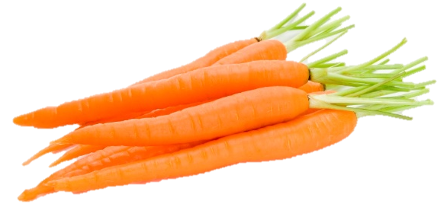
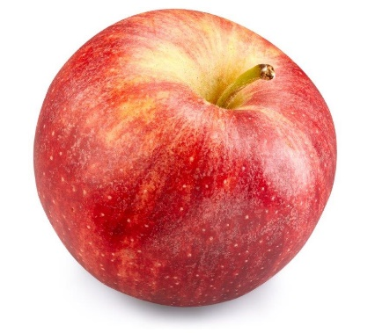
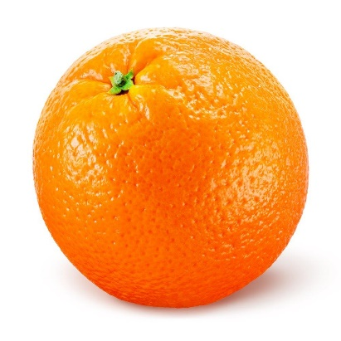
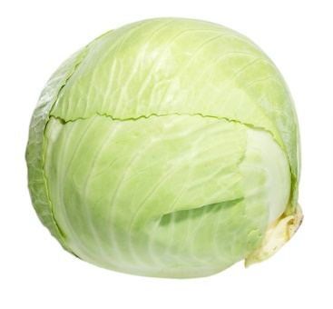
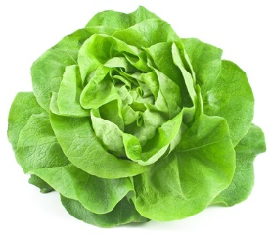
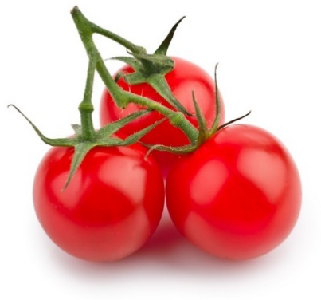
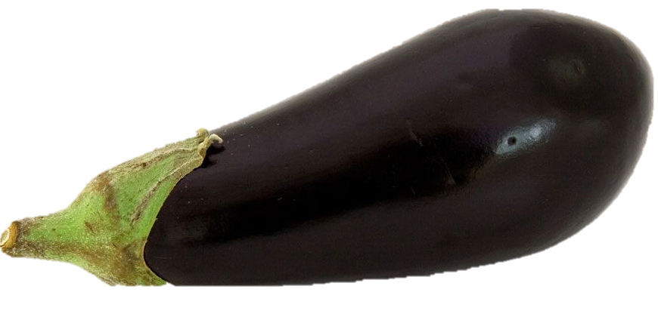
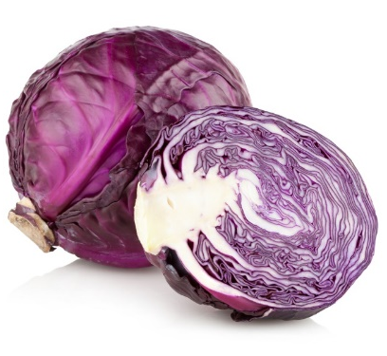
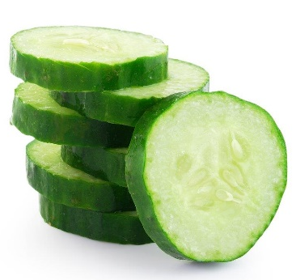
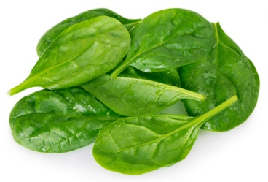
Fibre for 80g of each fruit or vegetable (raw)
*Estimated from NSP (old fibre measurement)
Carrots
Apples
Oranges
White cabbage
Lettuce
3g
1g
1g
2.5g
1g
Cherry tomatoes
Aubergines
Spinach
Red cabbage
Cucumber
1g
2g*
2g*
2.5g
0.5g

Slide 3
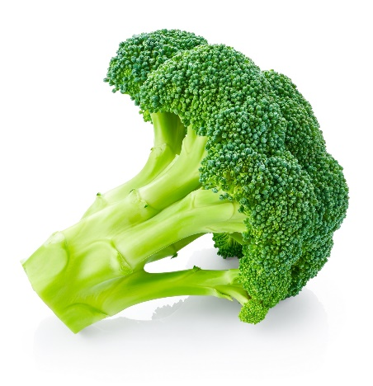
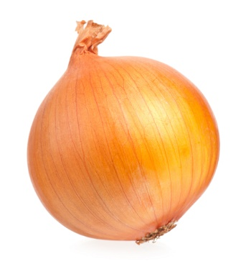
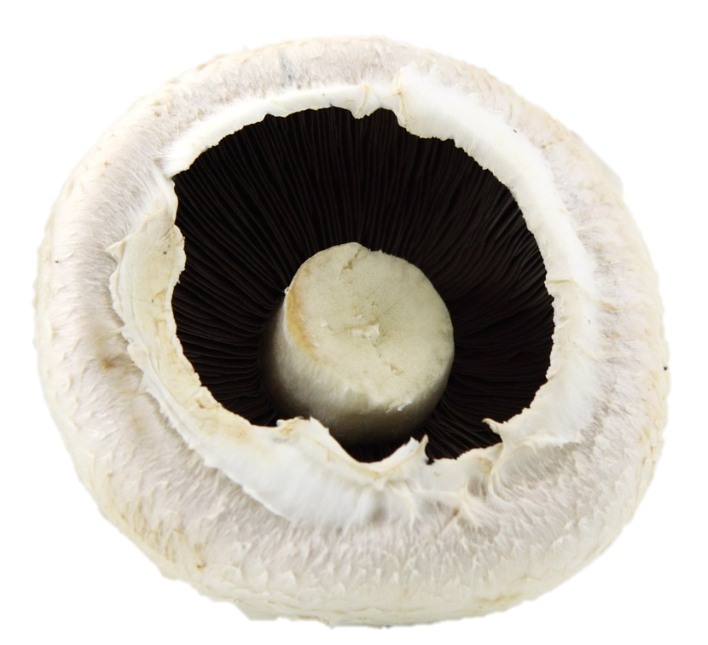
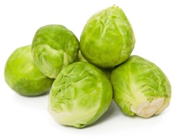
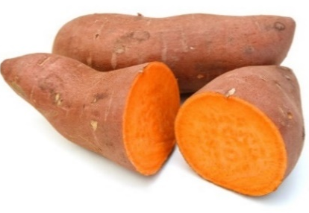
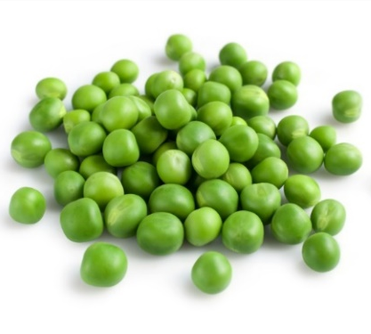
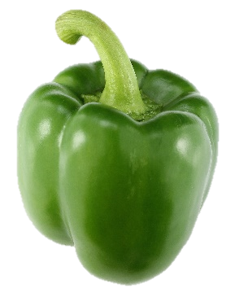
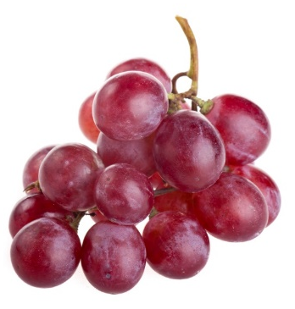
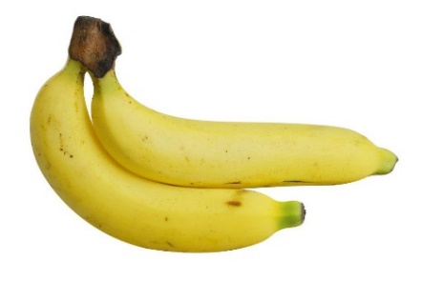
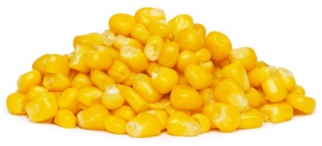
Fibre for 80g of each fruit or vegetable (raw)
Mushrooms
Broccoli
Brussels sprouts
Sweet potatoes
Onions
0.5g
3g
4.5g*
3.5g*
2g
Peas
Bananas
Green peppers
Red grapes
Sweetcorn
4g
1g
1.5g*
1g
1.5g*
*Estimated from NSP (old fibre measurement)

Slide 4
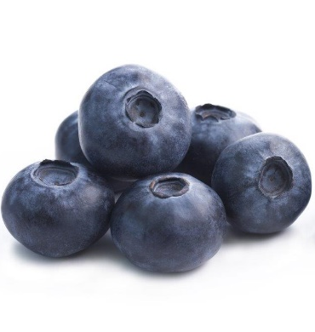
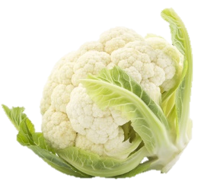
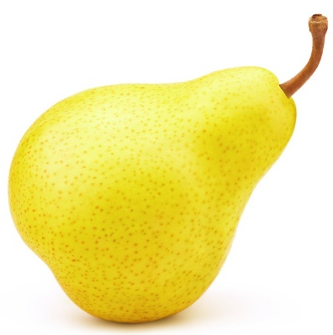
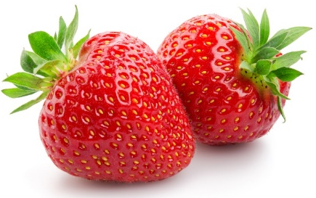
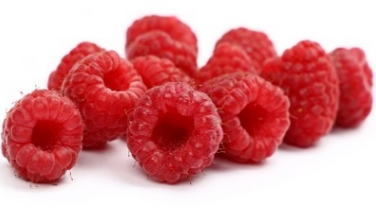
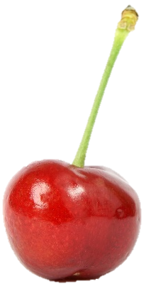
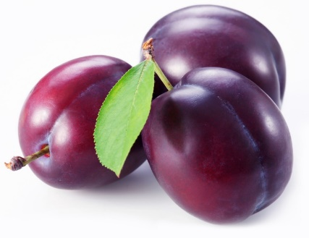
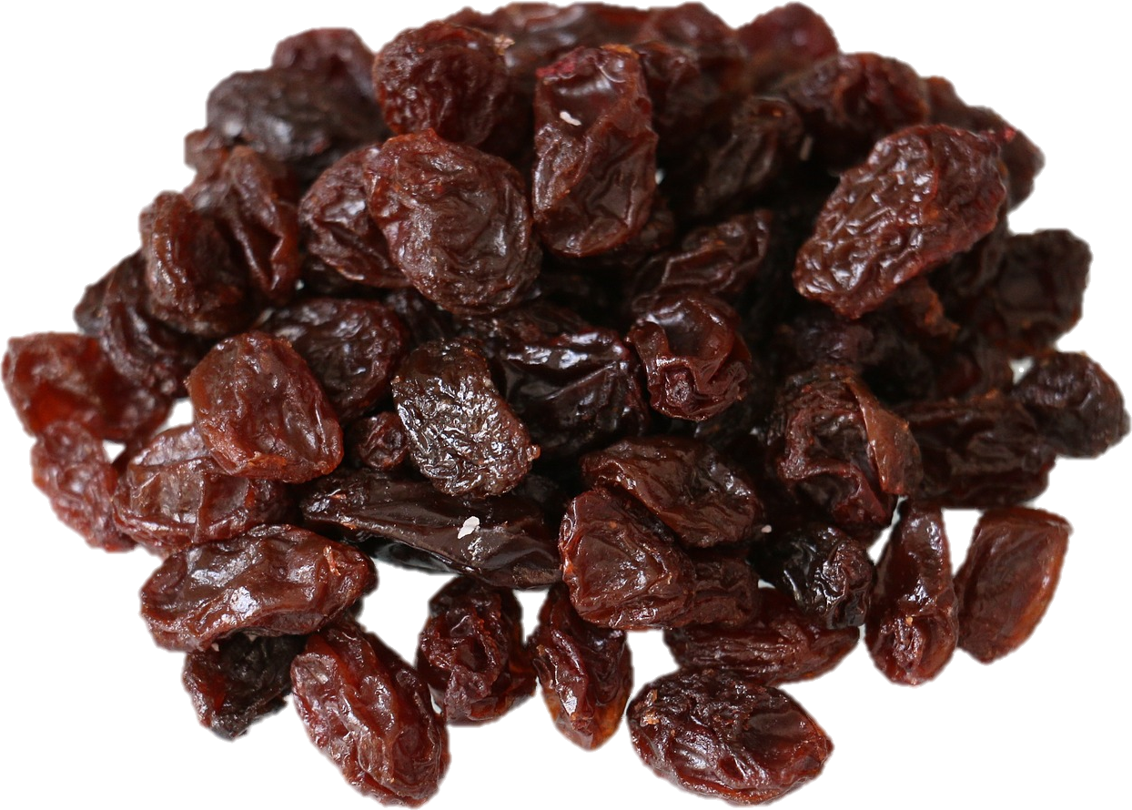
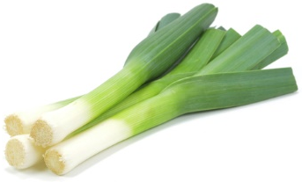
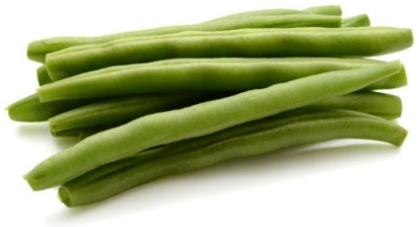
Fibre for 80g of each fruit or vegetable (raw)
Strawberries
Raspberries
Blueberries
Cauliflower
Pears
3g
2.5g*
1g
1.5g
2g
Raisins
Cherries
Leeks
Green beans
Plums
2g*
1g*
2.5g*
2.5g
1.5g*
*Estimated from NSP (old fibre measurement)

Slide 5
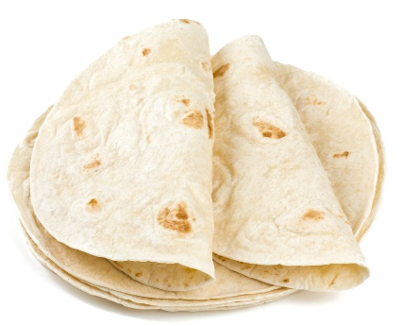
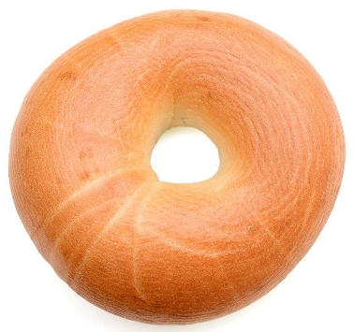
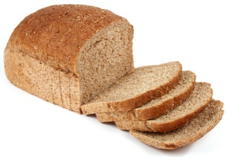
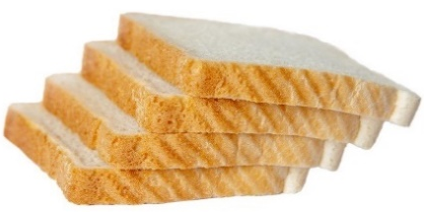
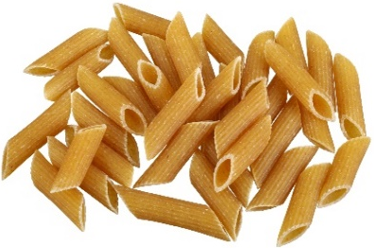
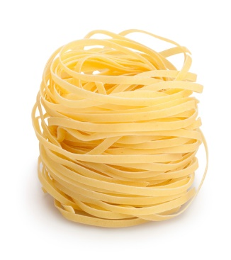
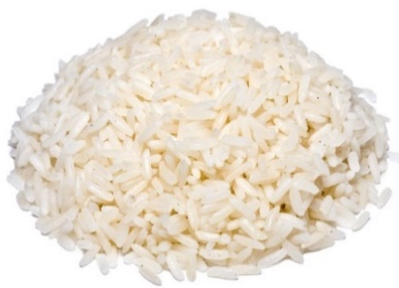
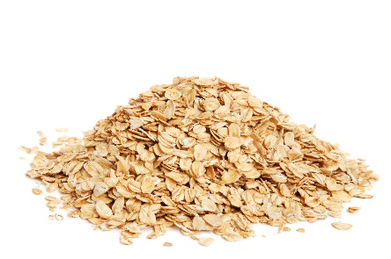
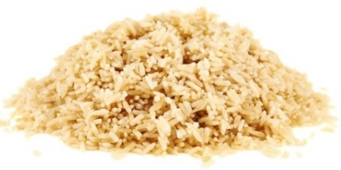
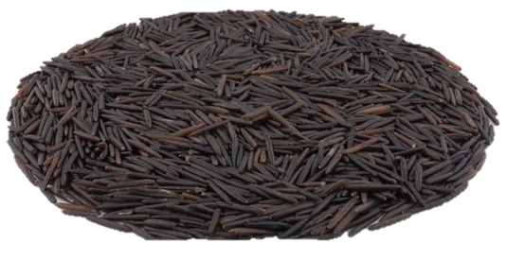
Wholemeal bread (2 slices)
White bread (2 slices)
Wheat tortilla (64g)
Bagel (white)
(85g)
Pasta (whole wheat)
(180g cooked)
5.5g
2.5g
2.5g
2.5g
7.5g
Pasta (white)
(180g cooked)
Rice (brown)
(180g cooked)
Rice (wild)
(180g cooked)
Rice (white)
(180g cooked)
Porridge oats
(45g dry)
4.5g
2.5g
4.5g
1g
3.5g

Slide 6
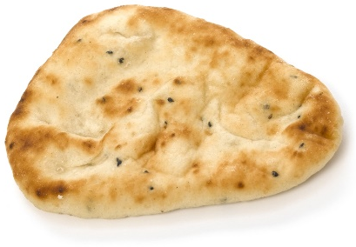
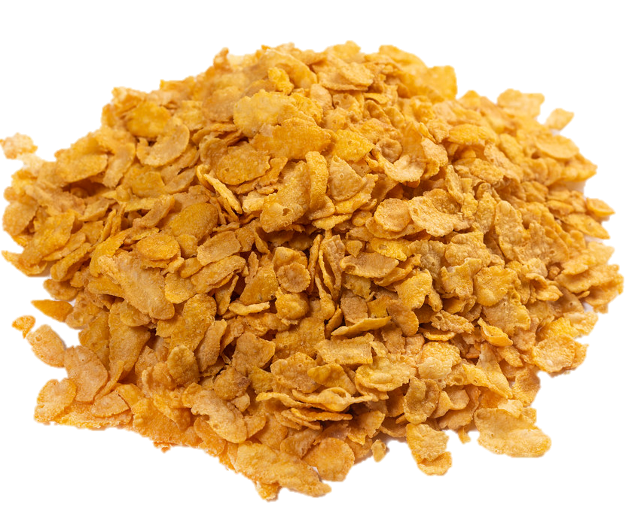
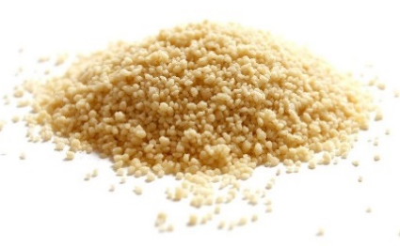
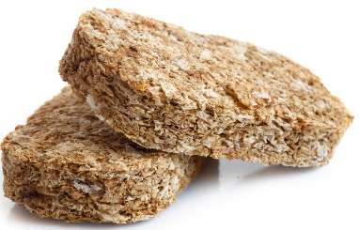
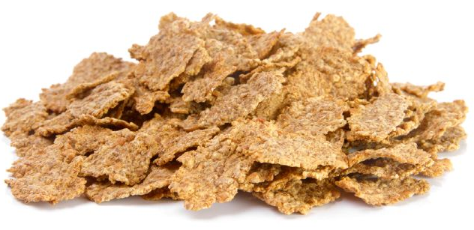
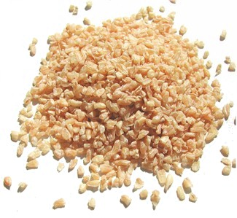
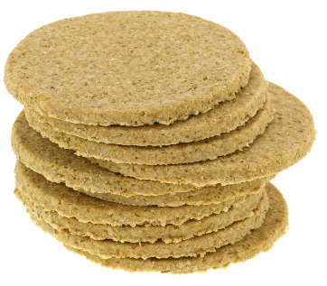
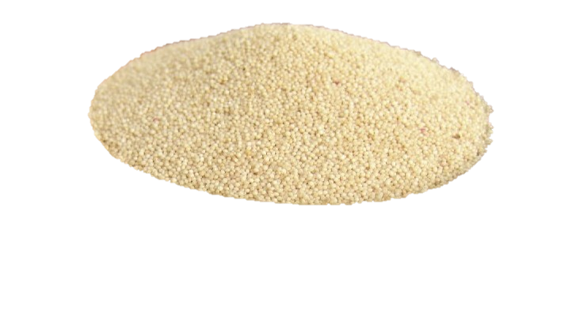
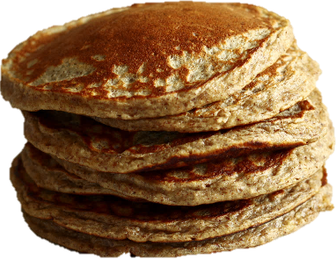
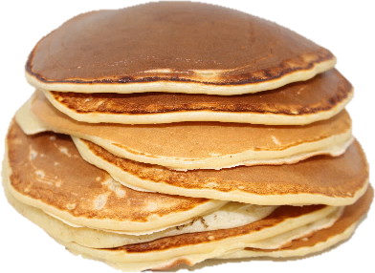
Couscous
(150g cooked)
Whole wheat cereal biscuits
(40g dry)
Naan bread
(70g)
Corn flakes
(40g dry)
Bran flakes
(40g dry)
3.5g
4g
2g
1g
5.5g
Savoury pancake (wholemeal)
(50g)
Sweet pancake (white flour)
(50g)
Oatcakes (2)
(24g)
Bulgur wheat
(60g dry)
Quinoa
(60g dry)
1.5g
0.5g
2.5g
4g
4g

