Slide 1
Rise and shine
A Healthy eating and Cooking Challenge for pupils aged 3-5 years

Slide 2
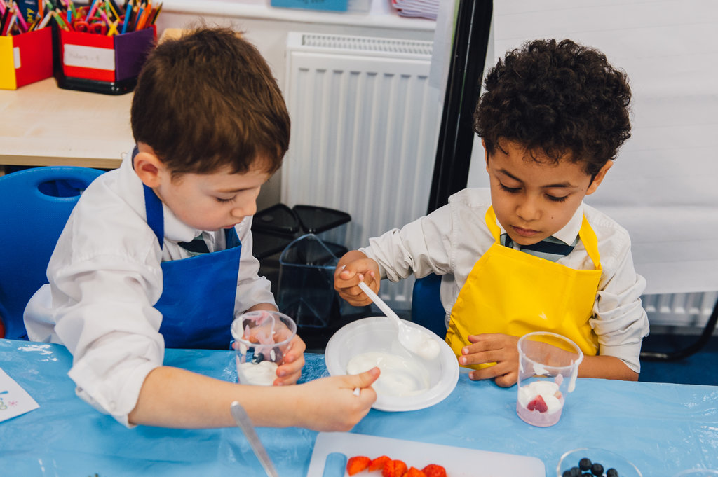
The challenge
Make a tasty breakfast dish using colourful fruit or vegetables.

Slide 3
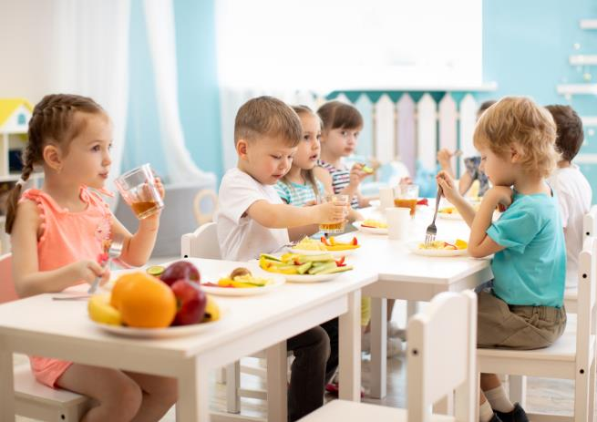
Let’s get started – the Challenge is on!
We all like different foods and drinks.
What foods and drinks do you like?
What do your family and friends like?

Slide 4
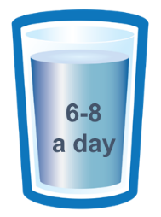
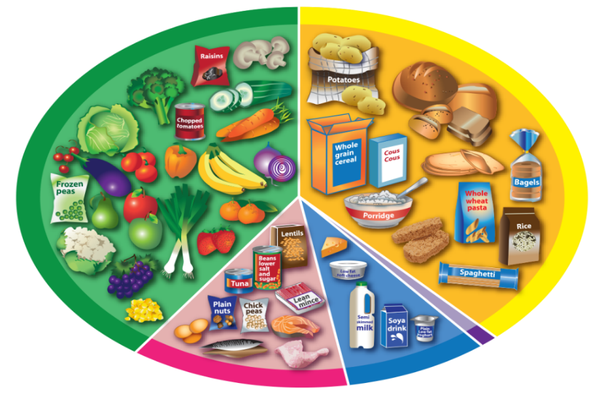

The Eatwell Guide
This is called the Eatwell Guide.
It helps us choose the right foods and drinks to stay healthy.
What can you see here?

Slide 5
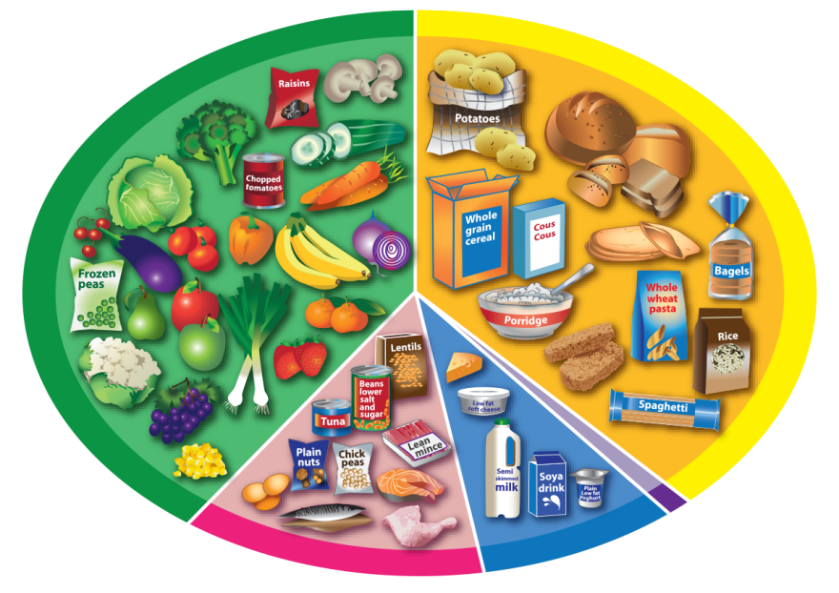
The Eatwell Guide
Which are the two biggest groups on the Eatwell Guide?
What foods can you see in these two groups?

Slide 6
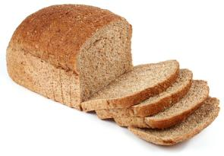
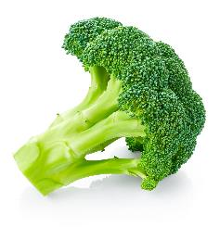
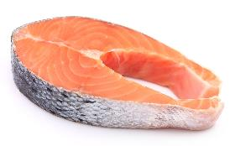
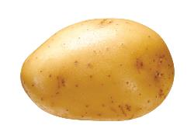
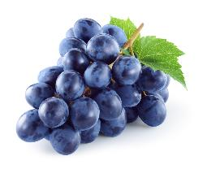
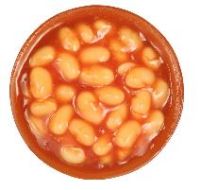
Find these foods on the Eatwell Guide
Bread
Broccoli
Salmon
Potato
Grapes
Baked beans

Slide 7
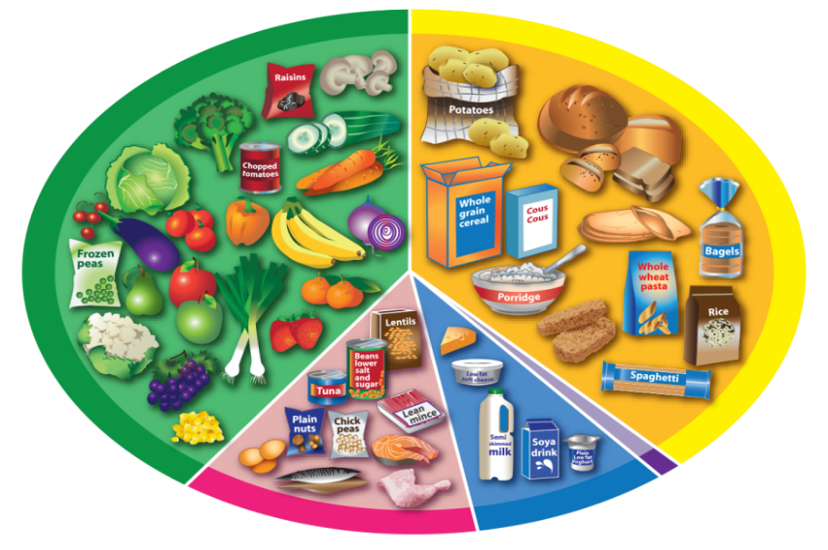
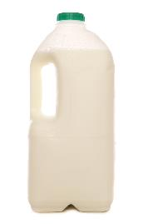
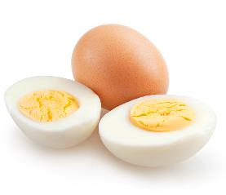
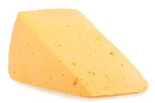
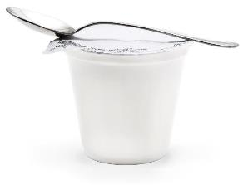
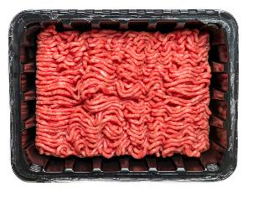
Find these foods on the Eatwell Guide
Milk
Cheese
Eggs
Yogurt
Minced beef
Which of these foods have you tried?

Slide 8
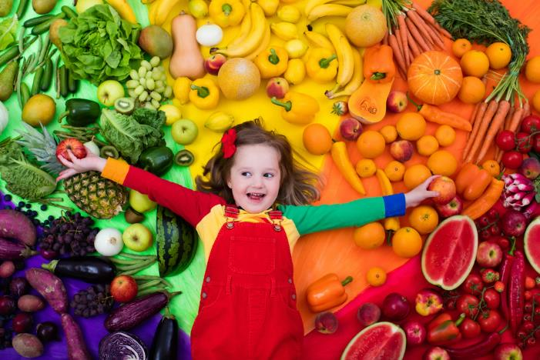
How much do we need?
We need to eat lots of different fruit and vegetables to stay healthy.
What is your favourite fruit?
What is your favourite vegetable?

Slide 9
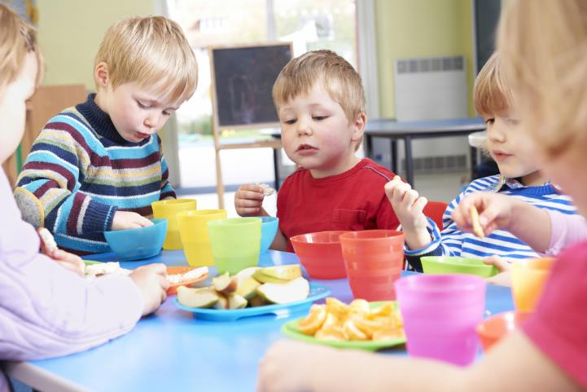
5 A DAY
We should eat at least five different types of fruit and vegetables every day.
We can eat fruit and vegetables with our breakfast, lunch, evening meal and for a snack.

Slide 10
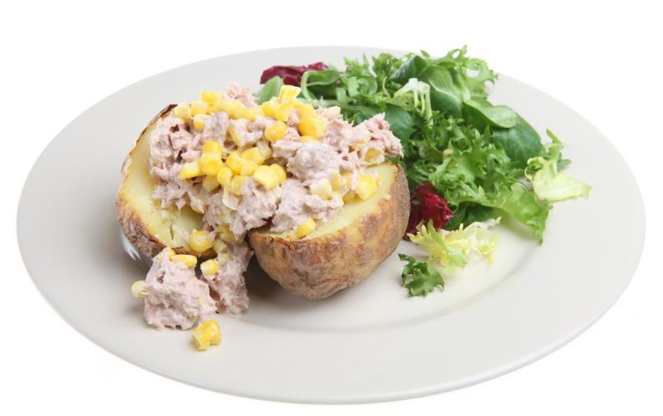
How much do we need?
We need a food from the yellow group with every meal. This could be:
potatoes;
bread;
rice;
pasta.
What is your favourite food in this group?

Slide 11
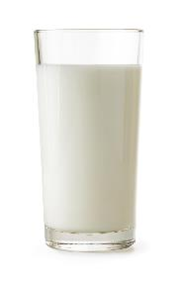
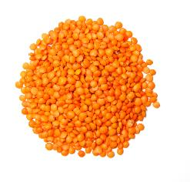
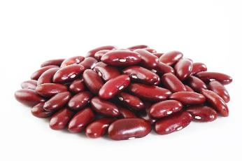
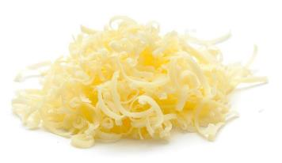
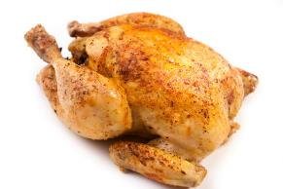
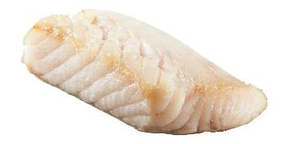
How much do we need?
We also need some foods from other groups. What can you see?
Which of these foods have you eaten before?

Slide 12


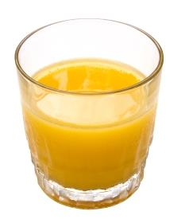
Drinks
We need to drink 6 – 8 drinks every day to stay healthy.
What can you see here?
How many drinks do you have every day?

Slide 13
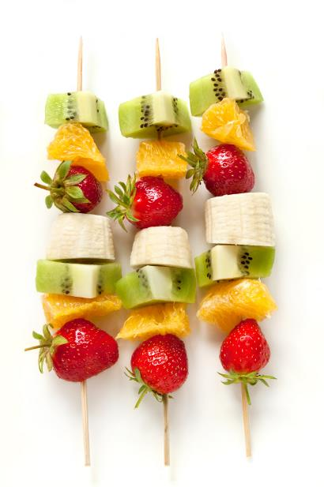
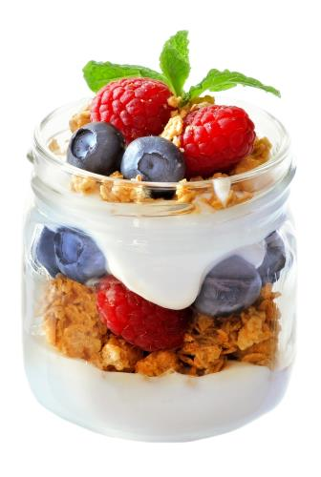
Breakfast
We eat breakfast in the morning before we go to school or work.
Different people like to eat different food for breakfast.
Can you think of food that is eaten for breakfast?

Slide 14


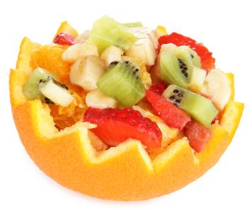
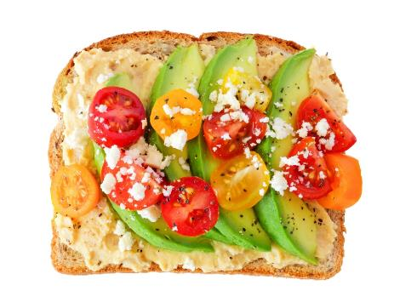
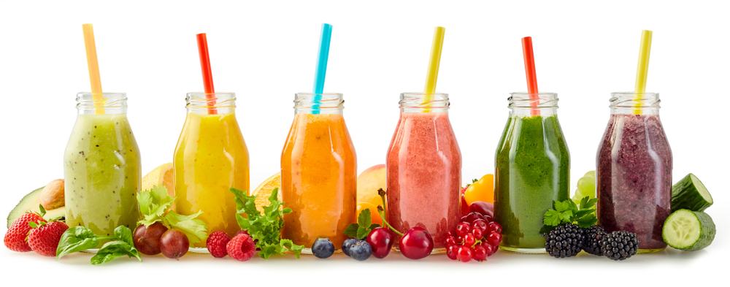
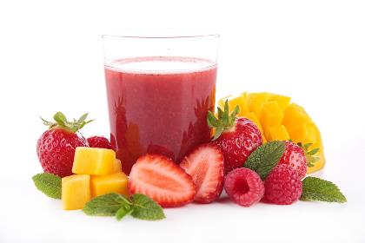
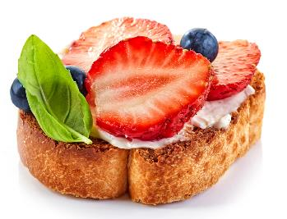
What colourful breakfast dish could you make?

Slide 15


Make a plan
Plan a tasty breakfast dish using colourful fruit or vegetables.
What food will you need to make the dish?
How will you make the dish?

Slide 16
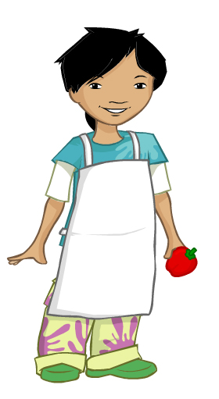
We need to get ready to cook so the food we make is safe to eat.
Tie back long hair
Roll up long sleeves
Remove jewellery
Put on an apron
Wash and dry hands

Slide 17
The challenge
Make a tasty breakfast dish using colourful fruit or vegetables.
Good luck!

Slide 18
Teachers’ guide

Slide 19
The Food – a fact of life Challenges
The Food – a fact of life Challenge activities have been written to support teachers not following the national curriculum for their specific country or those following a challenge or theme-based approach. However, they could be used in any school across the UK.
The Challenges cover Healthy eating, Cooking and Where food comes from and provide a wide range of activities that teachers can select depending on their pupils’ needs, age and abilities, and the time available.
There are 12 Challenges developed to be used with nursery, primary or secondary pupils.
Each Challenge comprises the Challenge, opportunities for learning and a variety of pupil activities that can be completed individually or in groups. Each Challenge culminates in a final outcome, which could be paper based, such as a report, poster, newspaper article or presentation, a video or interactive activity, or a recipe, menu or dish/range of dishes, depending on the theme of the Challenge.
Optional pupil certificates are available to download and personalise once the Challenge has been achieved.

Slide 20
The challenge
Make a tasty breakfast dish using colourful fruit or vegetables.

Slide 21
Opportunities for learning
By undertaking this challenge, the opportunities for learning include:
recognising the Eatwell Guide;
naming some of the foods in each food group;
explaining that we need different types of food, and 6-8 drinks a day, to be healthy;
recognising the have 5 A Day message;
recognising breakfast as a meal occasion;
undertaking a tasting activity and developing related vocabulary;
preparing a breakfast dish safely and hygienically.

Slide 22
How can pupils complete the Challenge?
A range of activity suggestions have been provided – you can choose the ones that are most suitable for your pupils and the time that you have available to complete the challenge.
Activities include:
Finding out – investigating the Eatwell Guide and the concept of food groups; how to prepare and cook safely and hygienically.
Making and evaluating – considering food likes and dislikes, tasting, planning and preparing a breakfast dish, practical food hygiene and safety.
Bringing it all together – with guidance, planning and safely preparing a breakfast dish using fruit or vegetables.

Slide 23
Finding out - activities
Pupils, individually or in groups, could:
Eatwell Guide:
use the Eatwell Guide (basic) poster to investigate and discuss how the Eatwell Guide is structured – use questioning to help the children identify the groups, sizes and the food in each.
use the Food image cards and sort the images into the correct food groups on the Eatwell Guide poster.
play the Eatwell game using the Eatwell game food cards. The game involves choosing food and placing it in the correct food group.
use the Are you drinking plenty? poster to focus on the importance of drinking plenty.

Slide 24
Finding out - activities
Eatwell Guide continued…
use the Let’s eat well and stay healthy! presentation to consolidate learning about the Eatwell Guide and food groups.
use the simple Eatwell Guide jigsaw puzzles to focus on the four main food groups
5 A day:
investigate the importance of having at least 5 A DAY to stay healthy – use the Fruit cards and Vegetable cards to name the food shown.
play fruit and vegetable bingo using the Fruit and vegetable bingo cards.

Slide 25
Finding out - activities
Food choices:
use the Food images cards to discuss why children enjoy different food, rather than their dislikes. Reinforce that different people like different food and drinks.
play the Breakfast pairs game matching the breakfast images.
Activity packs:
use the selection of activity ideas and resources in the Vegetable activity pack to encourage young children to eat vegetables.
Food based sessions:
use the Tasty toast session to explore the importance of having something healthy to eat and drink every day for breakfast.
Use the Fabulous fruit salad session to investigate and taste fruit, and using basic food preparation skills to make a fruit salad.

Slide 26
Making and evaluating - activities
Pupils, individually or in groups, could:
Tasting:
carry out a tasting activity with a variety of fruit and vegetables, and learn how to experience the samples using their senses. Use the Tasting guide and Ingredient check letter when planning.
use the My food book presentation to record their tasting session experience.
be presented with the Super taster certificate (Alisha) or Super taster certificate (Ronnie) to reward their willingness to taste new foods.
taste the food they have prepared/cooked. Discuss how it looks, smells and tastes. Fill in the ‘I have tried these foods’ sheet from the My food book.

Slide 27
Making and evaluating - activities
Cooking:
use the Get ready to cook presentation to help name and describe the steps required before cooking.
play the Get ready to cook game with the Get ready to cook tick list to embed the getting ready to cook steps.
use the Get ready to cook cards to help remember what they need to do before they cook.

Slide 28
Teacher resources
The Eatwell Guide - a guide about The Eatwell Guide.
Use the Tasting guide and Ingredient check letter when planning tasting and practical activities.
Certificate - Super taster certificate (Alisha) or Super taster certificate (Ronnie).
Cooking - a guide about cooking in the primary school classroom.
Demonstration guide - a guide about cooking demonstrations in the primary classroom.
Setting up a cooking session - a guide to support setting up a cooking session.
Recipes - a range of recipes that can be sorted by age range, commodity, complexity, food skills and cooking methods.

Slide 29
Bringing it all together
Pupils should:
Plan and make a tasty breakfast dish using colourful fruit or vegetables.
Through making their breakfast dish, children should demonstrate the following knowledge and skills:
a basic understanding of the Eatwell Guide and food groups;
understanding of importance of the 5 A Day message for fruit and vegetables;
safely and hygienically preparing and tasting food;
developing and practising appropriate practical skills.

Slide 30
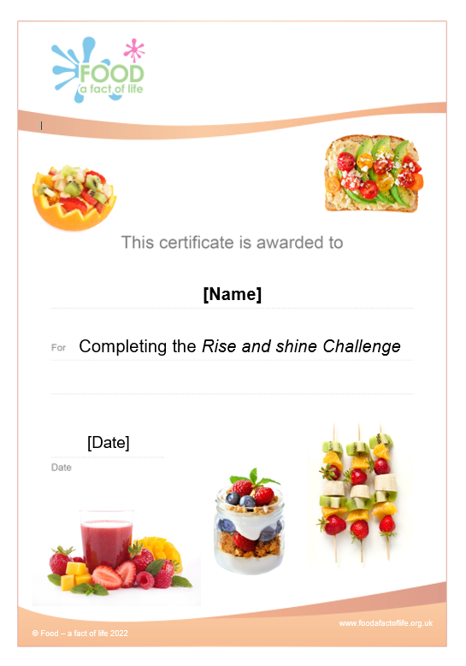
Celebrate!
An optional pupil certificate is available to download and personalise once the Challenge has been achieved.
Why not present the certificate at a celebration assembly?

Slide 31
Rise and shine
For further information, go to:
www.foodafactoflife.org.uk
This resource meets the Guidelines for producers and users of school education resources about food.

