Slide 1
Sports nutrition

Slide 2
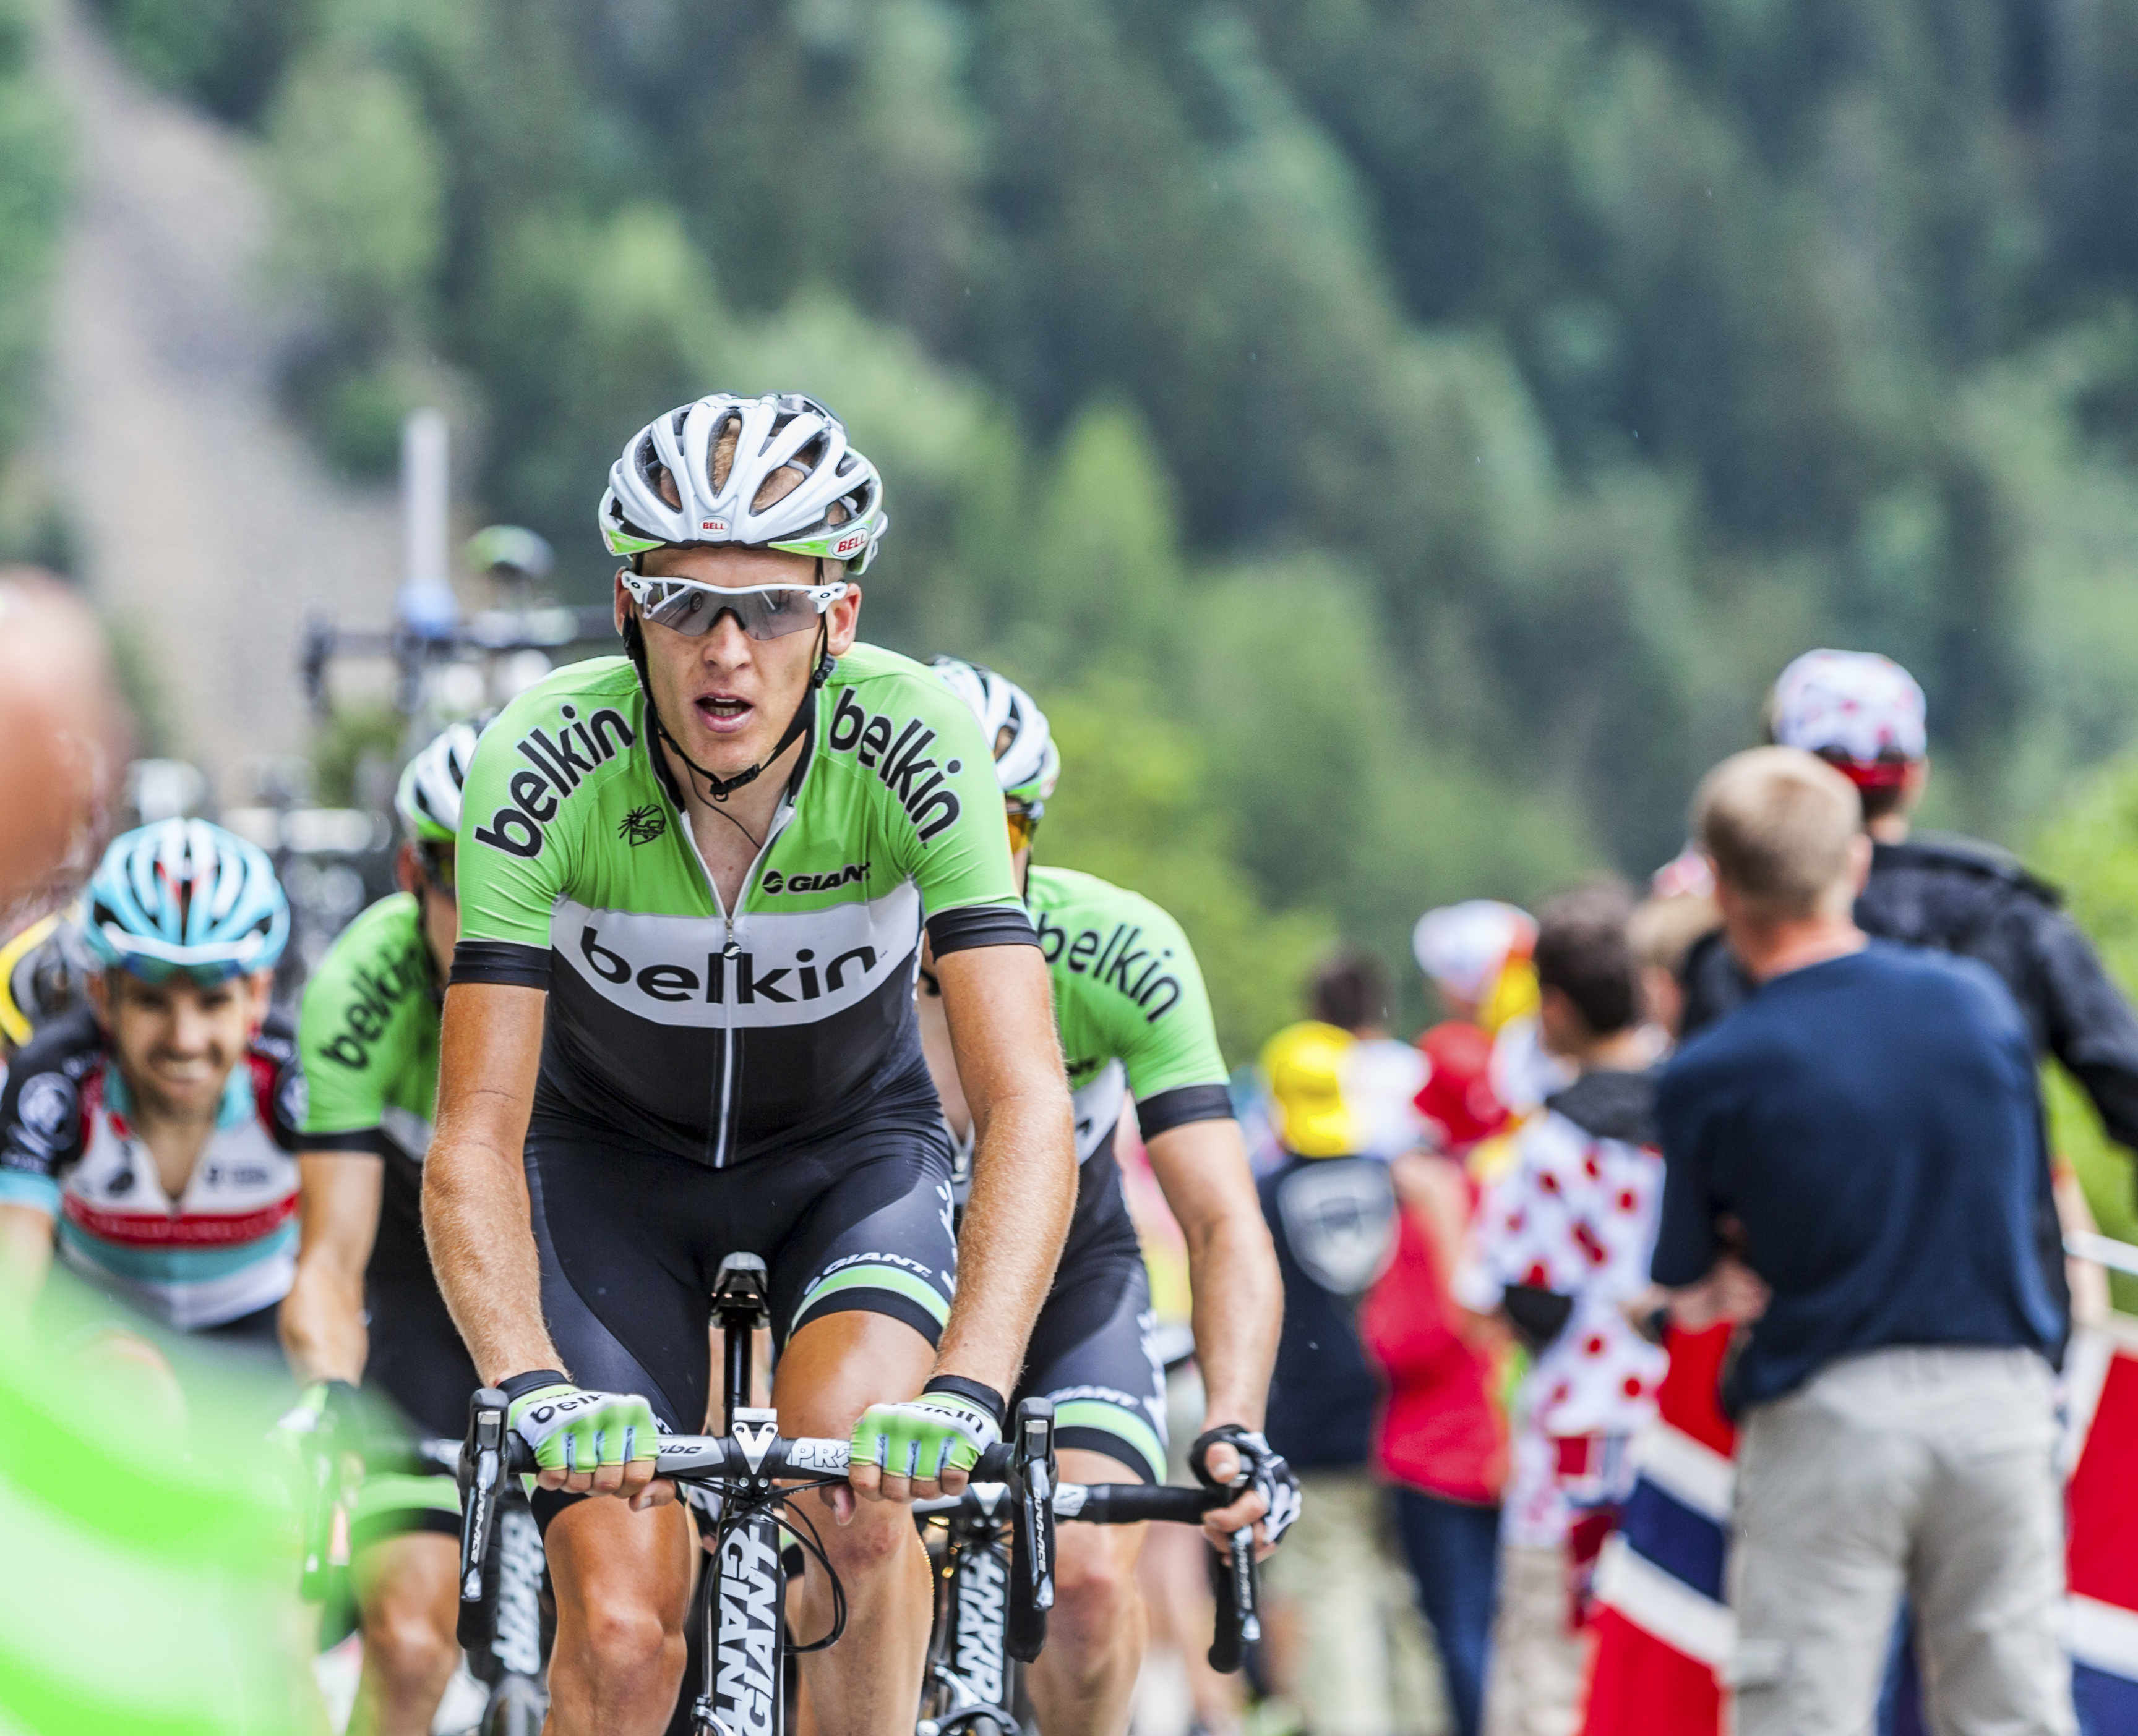
Nutritional needs of athletes
Most athletes obtain all the energy and nutrients they require from a varied and balanced diet.
By changing their diet slightly they may be able to improve sporting performance.
Many athletes require a diet high in energy because of their high energy expenditure during training and competition.

Slide 3
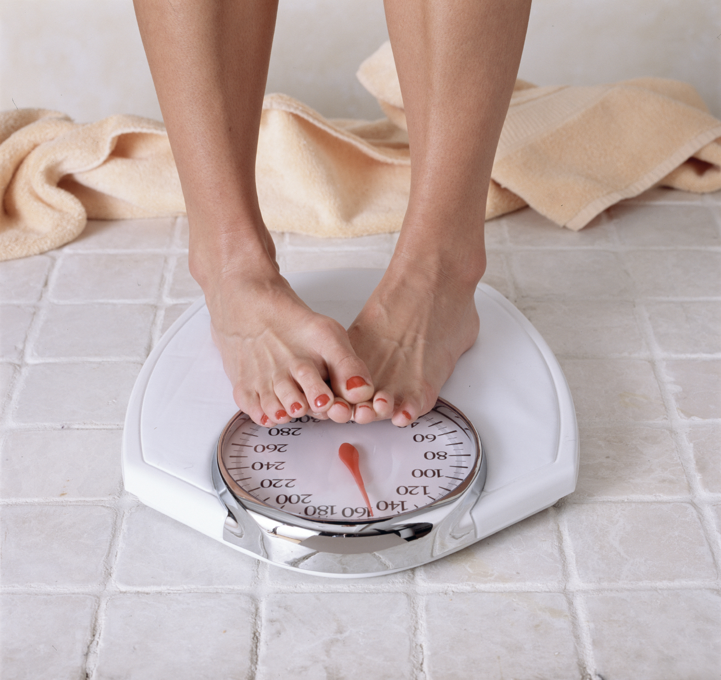
Malnutrition
Maintaining a healthy body weight is important.
Reduced athletic performance can be caused by too much body fat or too little muscle.
Symptoms of this are being overweight or underweight.

Slide 4

Stored energy
Energy from the diet is stored as body fat or glycogen (carbohydrate in muscles and liver) and can be broken down to provide energy.
Glycogen is the main source of energy during short bursts of activity and at the start of exercise.
There is only a small store of glycogen in the body, and as exercise continues the store becomes depleted and the body starts to use some fat to provide energy. Most people have quite a large store of body fat.
People who are fitter use up their store of glycogen more slowly, and tend to use their stores of body fat for fuel more readily.

Slide 5
Carbohydrates
When they are digested, carbohydrates are broken down into glucose to provide readily available energy for the body to use quickly and effectively.
Carbohydrates are the most important form of fuel for exercise and sports activities.
Good sources of carbohydrates in the diet include:
Bread;
Breakfast cereals and porridge oats;
Pasta, noodles;
Rice;
Potatoes (with skins);
Beans and pulses.

Slide 6
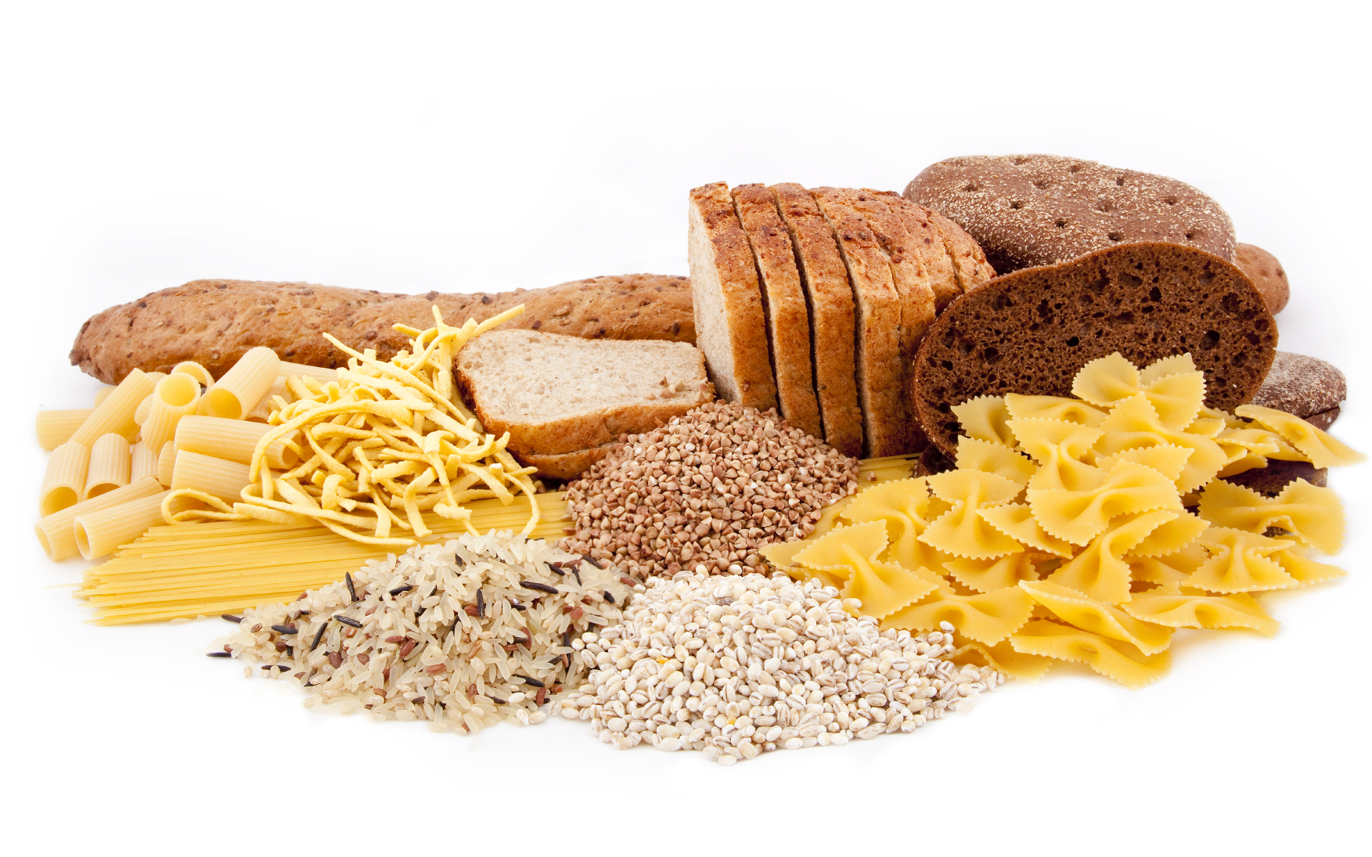
The importance of carbohydrate
Eating a diet high in carbohydrate ensures that muscle and liver glycogen stores are maintained.
If most of the glycogen in muscles and liver is used, such as after prolonged exercise, blood sugar levels can drop below normal and this can cause fatigue, nausea and dizziness.
Carbohydrate rich foods are also important for replenishing glycogen stores after an event.

Slide 7
Carbohydrates for athletes
Competitive sports people and athletes may require more carbohydrates than an average gym user to match the intensity of their activity level. Estimated carbohydrate needs are outlined and depend on the intensity and duration of the exercise sessions:
*These requirements are general, and consideration of energy needs, and type of exercise should be considered.
Duration of sport or exercise sessions | Recommended intake (per kg body weight per day)*
3-5 hours per week | 4-5g
5-7 hours per week | 5-6g
1-2 hours per day | 6-8g
2 + hours per day | 8-10g
https://www.nutrition.org.uk/putting-it-into-practice/keeping-active/nutrition-for-sports-and-exercise/

Slide 8
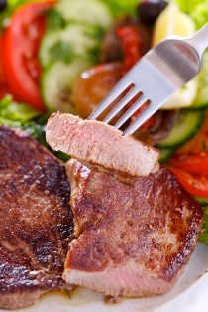
Protein
Athletes may need slightly more protein in their diets than the rest of the population in order to repair and build muscle.
Because athletes generally eat more (to meet their energy requirements) they are likely to meet their protein needs by choosing a balanced diet. Athletes do not necessarily need large amounts of meat or to take supplements.
Eating more protein than the body needs does not increase the amount of muscle in the body.

Slide 9
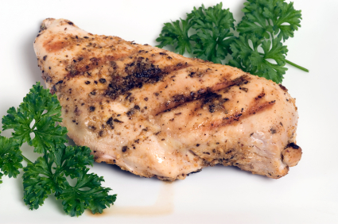
Protein requirements
The protein requirements of a normal adult are 0.75g per kilogram of body weight per day. For strength and endurance athletes, protein requirements are increased to around 1.2-2.0g of protein per kilogram of bodyweight per day.
However, most people in the UK consume more than the recommended amount of protein, so increasing your protein intake is generally unnecessary.

Slide 10
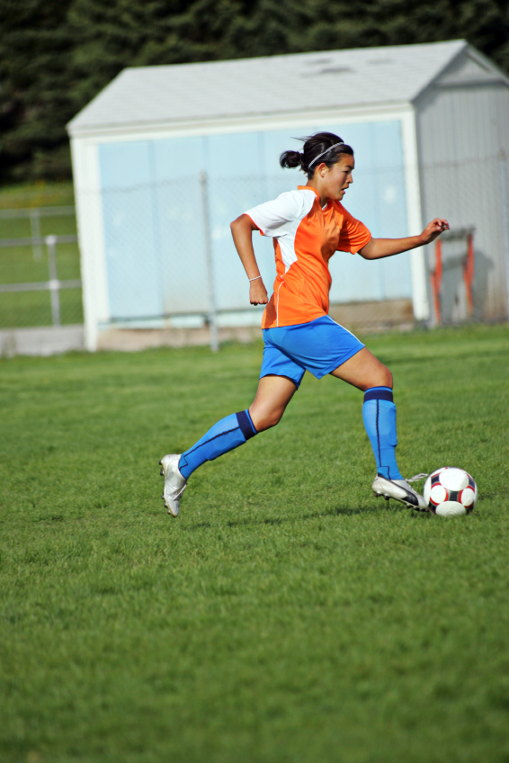
Too little energy?
If an athlete’s diet contains too little energy from carbohydrate, protein from the diet will be used to provide energy.
This is not desirable as less protein will be available for forming and repairing muscle tissue – the main function of protein.
Carbohydrate should be the main source of energy. Some fat can also contribute to the body’s energy source.

Slide 11

Hydration
Sufficient fluid intake is essential for exercise and optimum recovery. Exercising causes the body to get warmer, so the body tries to cool down by sweating. This causes the loss of water and salts through the skin. Generally, the more a person sweats, the more they will need to drink.
The government recommendation for fluid intake is between 6 and 8 glasses a day however this need may increase for a person when exercising.

Slide 12
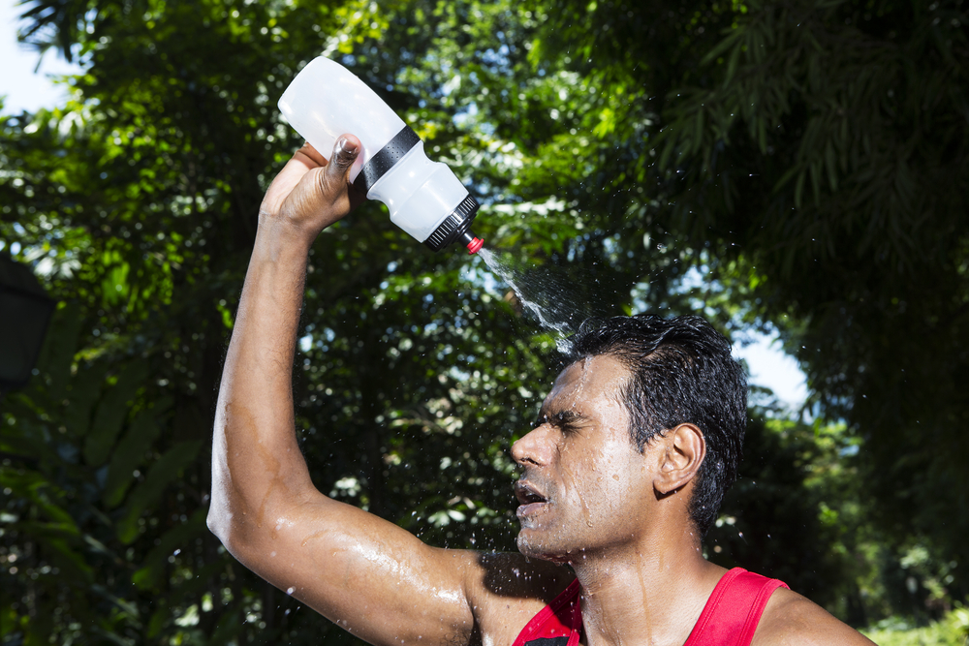
Hydration
The amount an individual sweats varies from person to person and depends on:
Intensity and duration – longer and higher intensity exercise can cause greater sweat loss.
Environmental temperature – in hot, humid conditions sweat loss can increase.
Clothing – the more clothing that is worn, the quicker you are likely to heat up which may cause greater sweat loss.
Genetics – some people are just more likely to sweat than others.

Slide 13
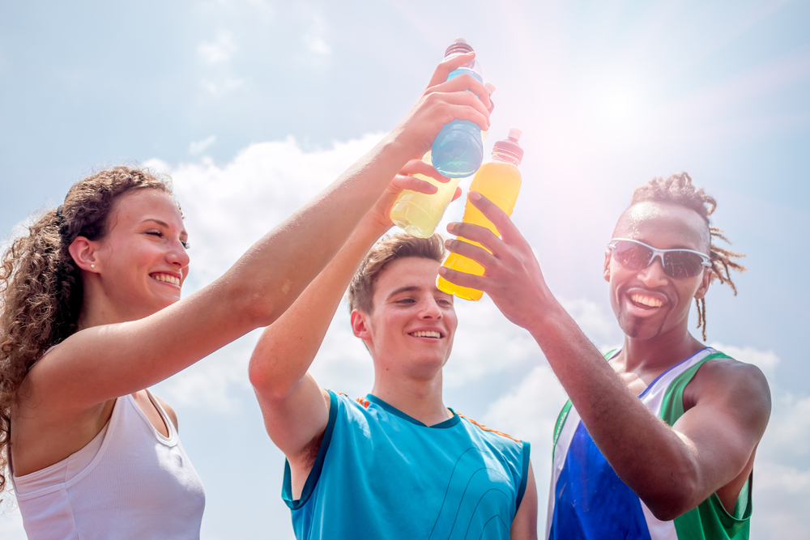
Isotonic sports drinks
Isotonic sports drinks contain carbohydrates in the form of glucose, as well as electrolytes such as sodium. The electrolyte sodium will replace any lost from sweating and enhance rehydration, and glucose will replenish carbohydrate stores.
Sports drinks have been shown to help endurance performance for active individuals performing endurance exercise (e.g. participating in a marathon).
However, remember that sports drinks are similar to other soft drinks that contain sugars. This means that they can be high in calories and contribute to tooth decay, so they are only suitable if taking part in high-level endurance sports or if sweat loss is high.

Slide 14
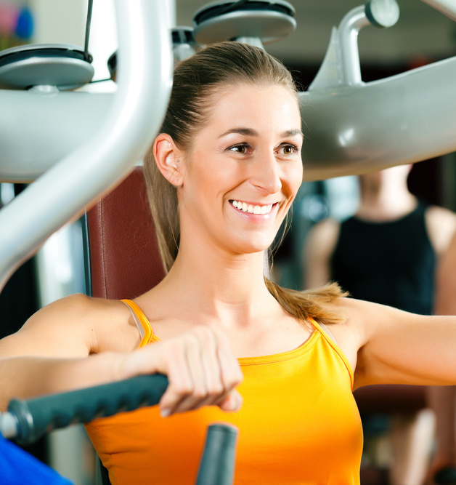
Iron and calcium for a female athlete
Some women have very high iron requirements due to heavy menstrual losses. Iron is important for carrying oxygen in the blood so even a mild deficiency can affect performance.
Calcium is important in the formation and maintenance of strong bones. Although moderate exercise is important in bone formation, very strenuous exercise can interrupt the menstruation cycle and cause a hormone imbalance which can lead to problems with bone health.
It is therefore important that female athletes’ diets contain adequate calcium intake.

Slide 15
Kahoot Quiz
Open the link below on the main screen and get students to log onto kahoot.it on their tablets or smartphones.
They can then enter the code (that will come up on the main screen when you start the game) and their own nickname.
They can then play along with the quiz choosing the multiple choice answers that correspond with the questions on the main screen. There will then be a leaderboard of the scores after each question and at the end.
https://play.kahoot.it/#/?quizId=8d5f8adb-e07c-432a-a79f-b8c580442eb4

Slide 16
Sports nutrition
For further information, go to:
www.foodafactoflife.org.uk
This resource meets the Guidelines for producers and users of school education resources about food.

