Slide 1
Ready to cook?

Slide 2
Are you ready to cook?
Get yourself ready
Have the recipe ready
Get the ingredients ready
Get the equipment ready
Are you ready to cook?

Slide 3
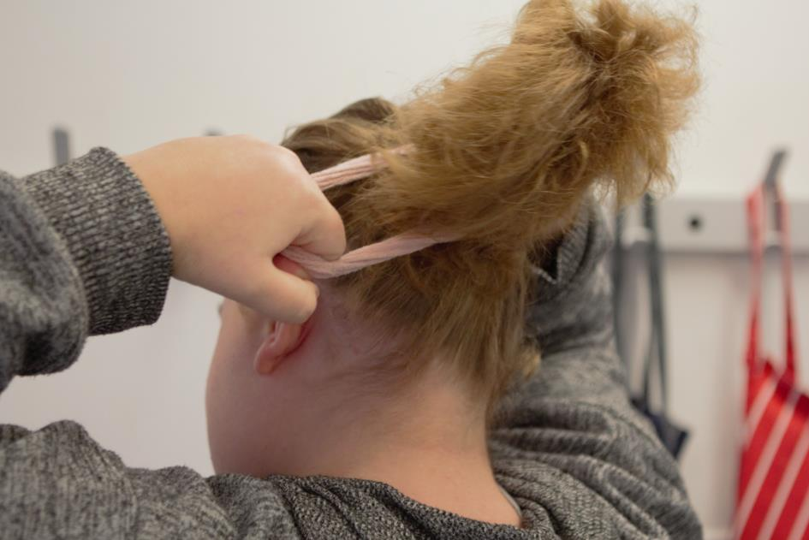
1. Get yourself ready
Tie up long hair

Slide 4
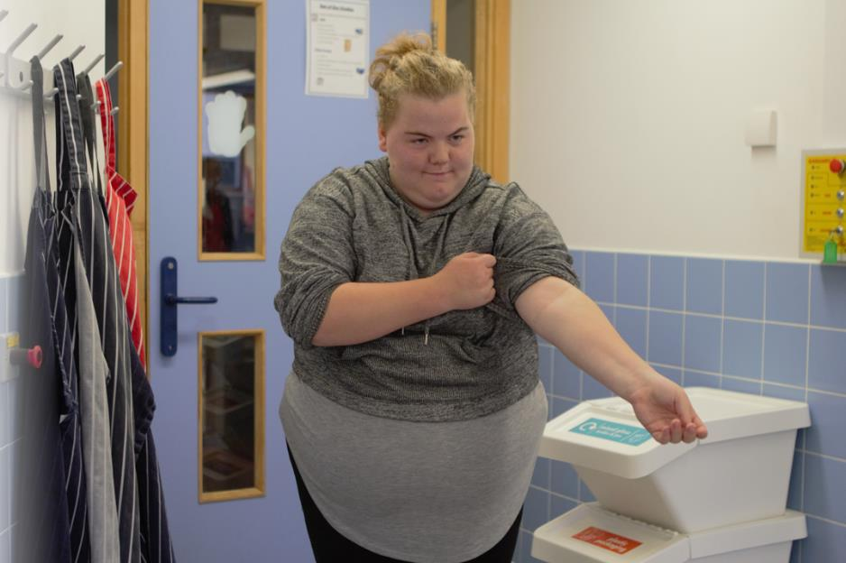
1. Get yourself ready
Roll up long sleeves

Slide 5
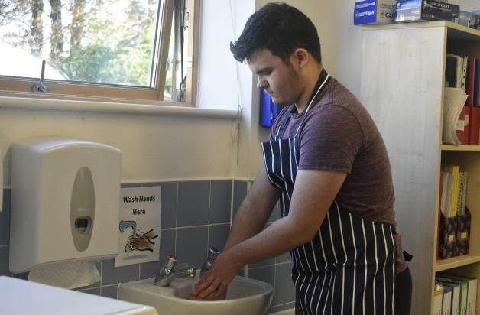
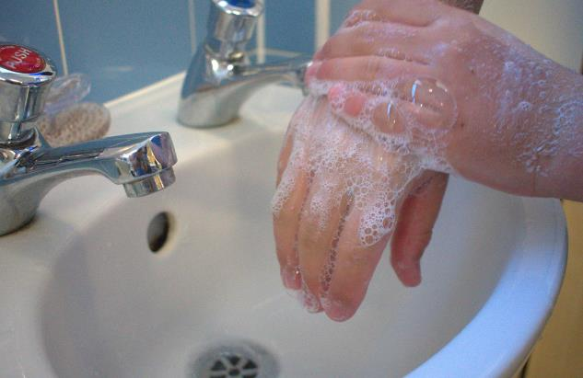
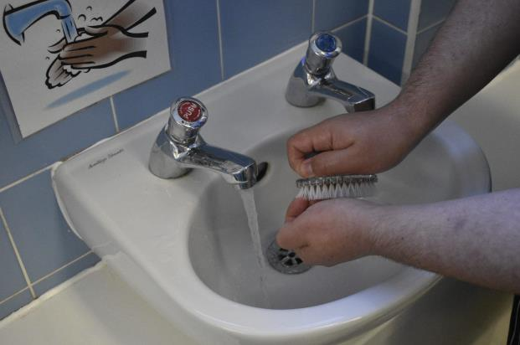
1. Get yourself ready
Wash hands

Slide 6
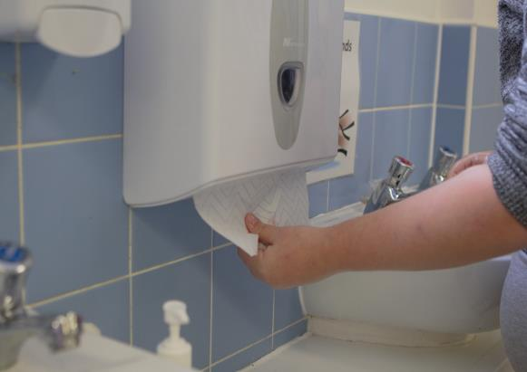
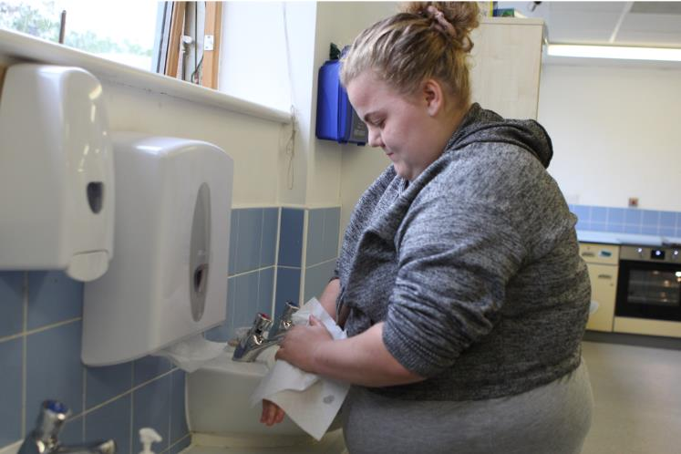
1. Get yourself ready
Dry hands

Slide 7
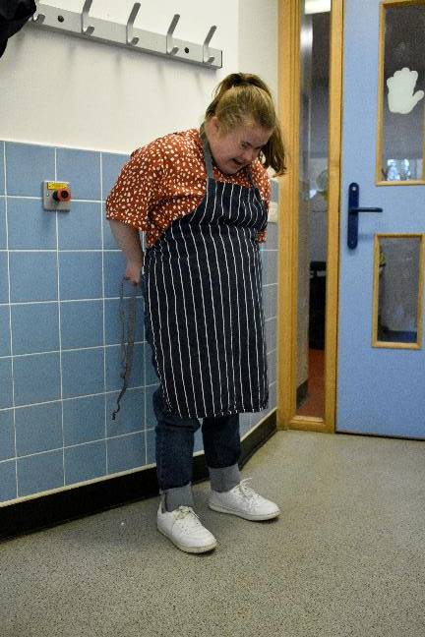
1. Get yourself ready
Put on a clean apron

Slide 8
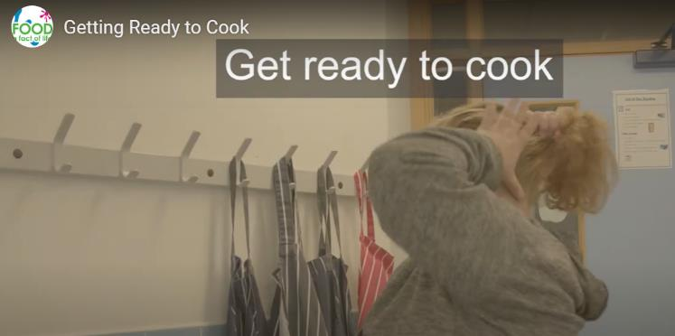
Click on the image to watch the video.

Slide 9

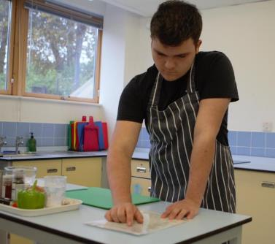
2. Have the recipe ready

Slide 10

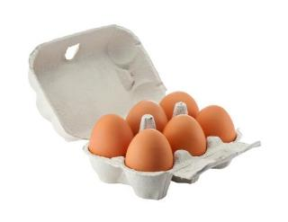
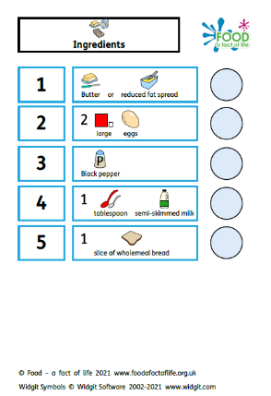
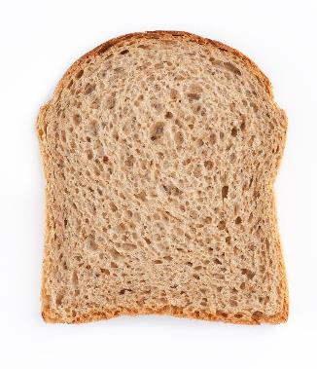
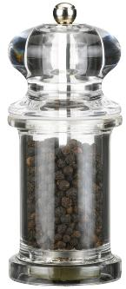
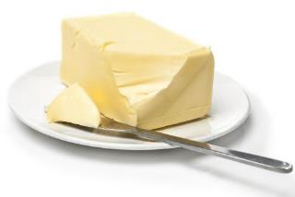
3. Get the ingredients ready

Slide 11
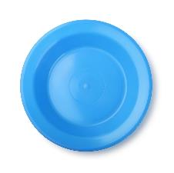
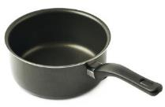
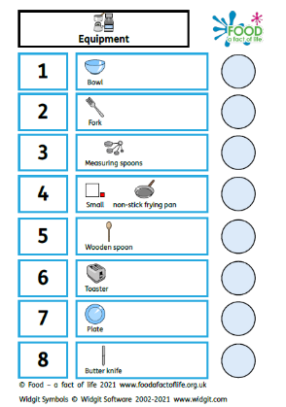
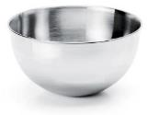




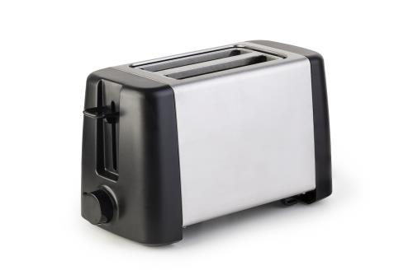
4. Get the equipment ready

Slide 12
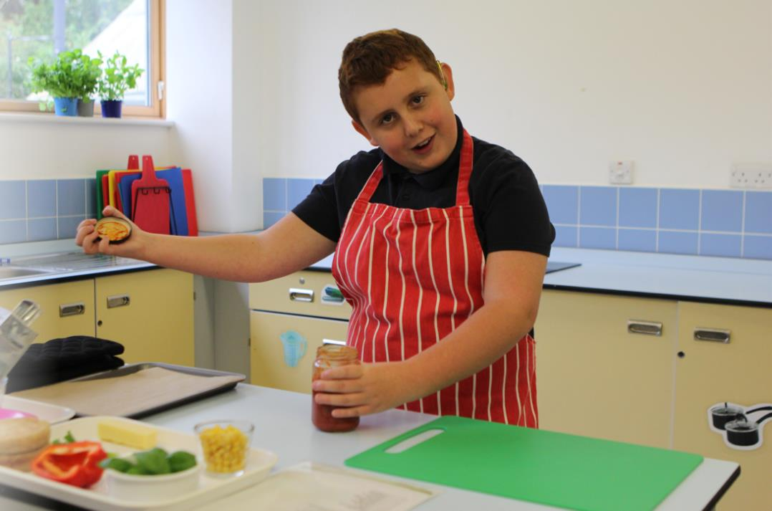
Are you ready to cook?

Slide 13
Ready to cook?
For further information, go to:
www.foodafactoflife.org.uk
This resource meets the Guidelines for producers and users of school education resources about food.

