Slide 1
Supporting healthy eating
Claire Theobald, Education Services Manager

Slide 2
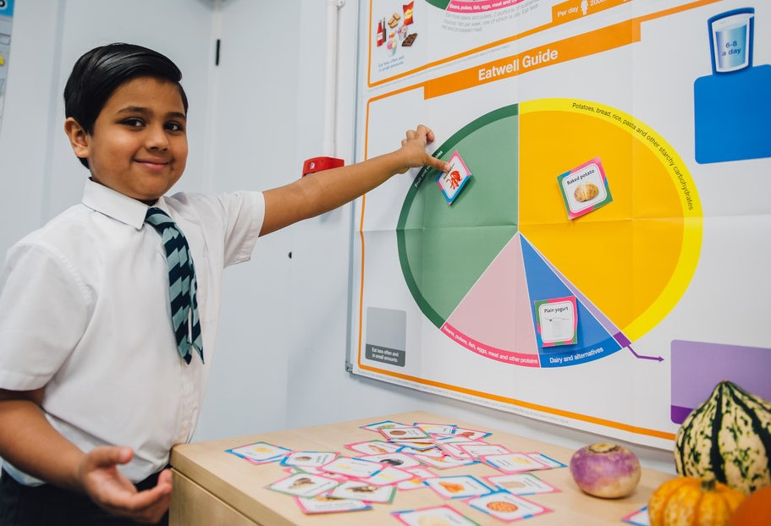
This session will cover:
The Eatwell Guide, the UK’s healthy eating model
Progression when teaching about healthy eating and its application
Selecting teaching resources that reflect current evidence-based healthy eating advice
Providing pupils with the opportunity to apply their knowledge of healthy eating
Links to Food – a fact of life resources

Slide 3
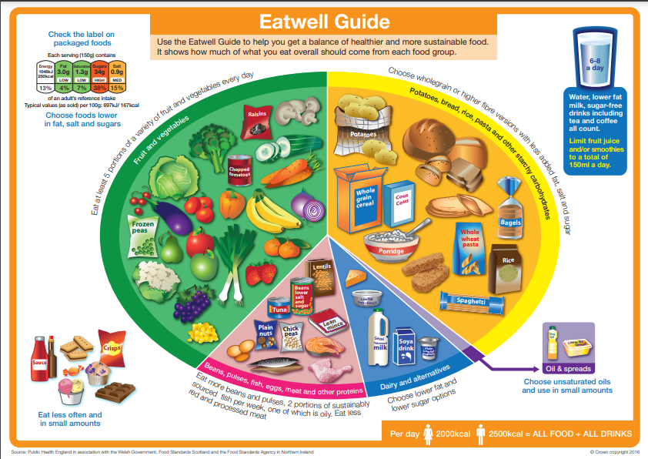
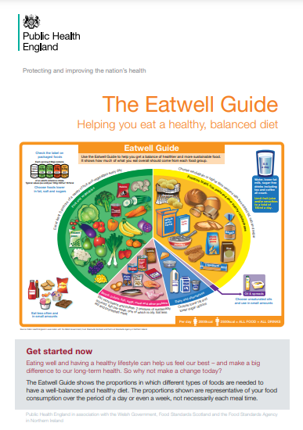
The Eatwell Guide
What is it?
UK healthy eating model
Defines the government recommendations on eating healthily and achieving a balanced diet
Applies to most people over the age of 2 years
Visit GOV.UK for more information (including the image of the model and a guide to its application).

Slide 4
‘Have a healthy, balanced diet’…
But how?

Slide 5
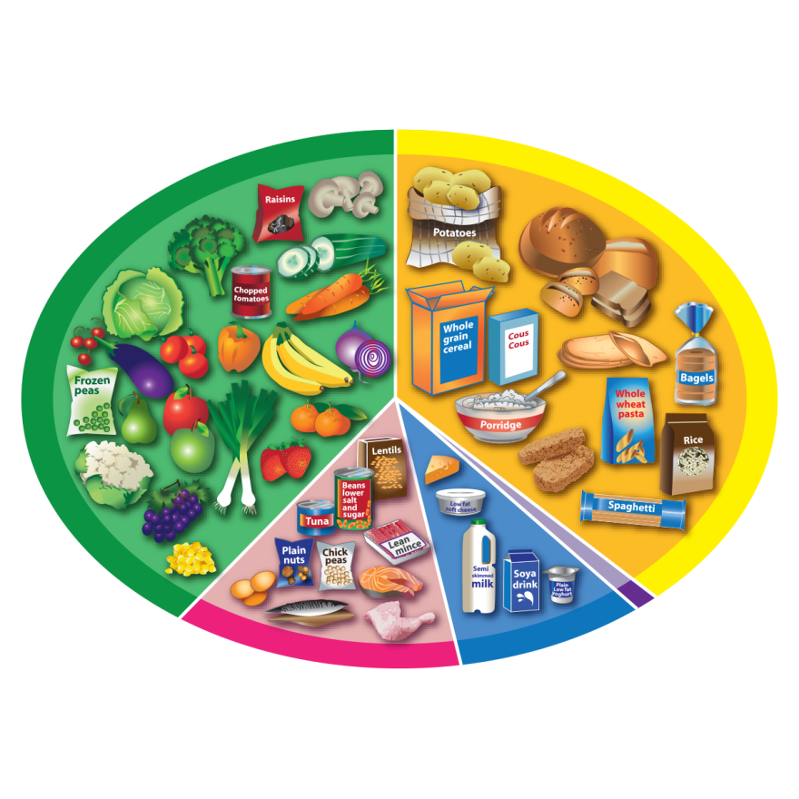

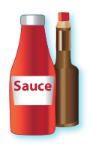
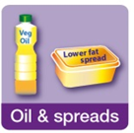





Teaching about the Eatwell Guide
Eat at least five portions every day.
Eat a food from this group at every meal time.
Try wholegrain varieties.
Fruit and vegetables
Potatoes, bread, rice, pasta and other starchy carbohydrates
We do not need these types of foods to be healthy. If we have them, it should be less often and in small amounts.
Eat in small amounts.
Foods high in fat, salt and sugars
Oils and spreads
Eat some foods from this group every day.
Dairy and alternatives
Beans, pulses, fish, eggs, meat and other proteins
Have some of these foods every day.

Slide 6
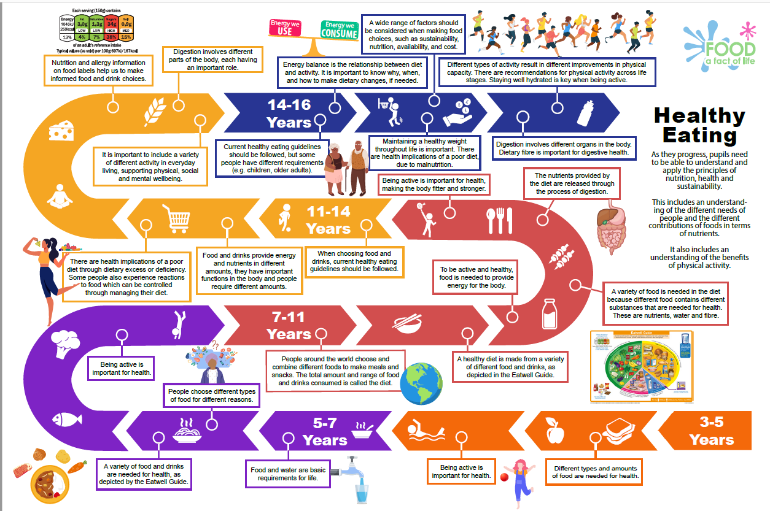
Progression when teaching healthy eating
Food and nutrition education roadmap – Healthy eating
Tracks progression in healthy eating teaching and learning from age 3 – 16 years
Underpins the structure of the Food – a fact of life website resources
Interactive – links on the roadmap to related lessons notes and resources
Launching mid-May 2023 on Food – a fact of life
Food – a fact of life (Roadmaps arriving 15 May 2023)

Slide 7
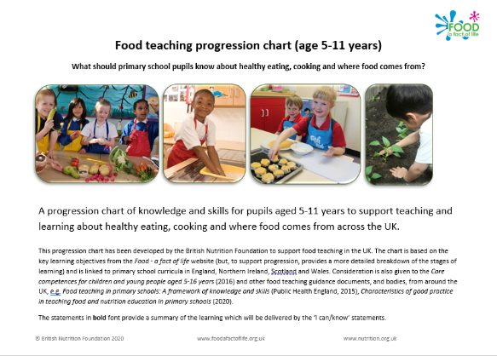
Progression when teaching healthy eating
Food teaching progression chart (5-11 years)
Specifically for primary schools
Details the progression for teaching about healthy eating (cooking and where food comes from)
Basis of the Food – a fact of life structure
Food teaching progression chart (5-11 years)

Slide 8
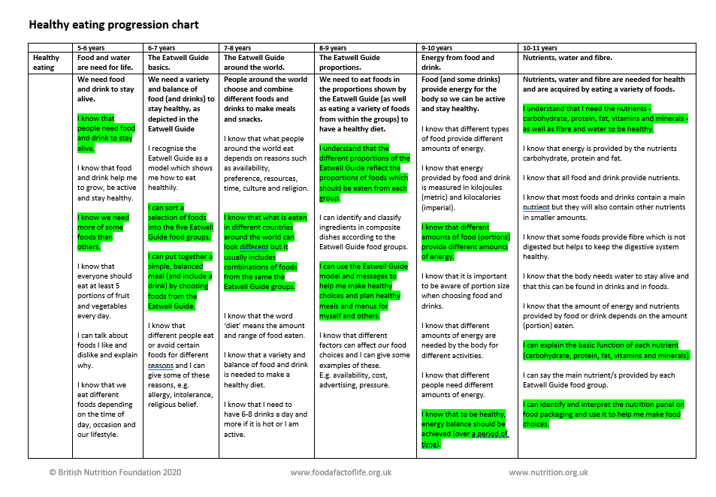
What do children need to know?
 | 5-6 years | 6-7 years | 7-8 years | 8-9 years | 9-10 years | 10-11 years
Healthy eating | Food and water are need for life. | The Eatwell Guide basics. | The Eatwell Guide around the world. | The Eatwell Guide proportions. | Energy from food and drink. | Nutrients, water and fibre.
 | …people need food and drink to stay alive …we need more of some foods than others …everyone should eat at least 5 portions of fruit and vegetables every day | …sort a selection of foods into the five Eatwell Guide food groups …put together a simple, balanced meal (and include a drink) by choosing foods from the Eatwell Guide | …what is eaten in different countries around the world can look different but it usually includes combinations of foods from the same the Eatwell Guide groups | …the different proportions of the Eatwell Guide reflect the proportions of foods which should be eaten from each group …use the Eatwell Guide model and messages to help make healthy choices and plan healthy meals and menus | …different amounts of food (portions) provide different amounts of energy …to be healthy, energy balance should be achieved (over a period of time) | …nutrients - carbohydrate, protein, fat, vitamins and minerals - as well as fibre and water to be healthy …function of each nutrient …interpret the nutrition panel on food packaging and use it to help me make food choices

Slide 9
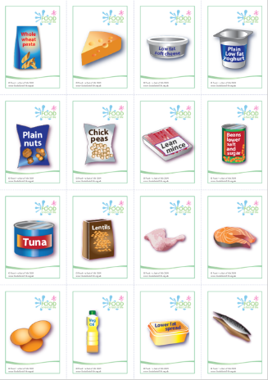

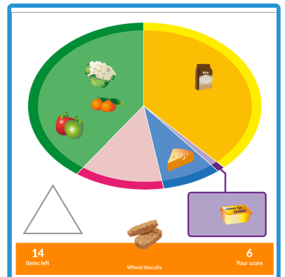
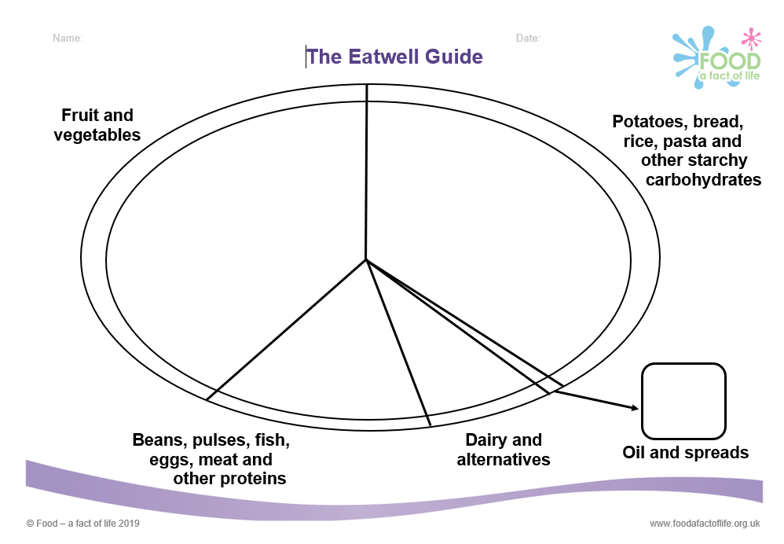
Food groups
I can sort a selection of foods into the five Eatwell Guide food groups.
Cut and stick, or race!
Drag and drop
The Eatwell Challenge (interactive game)
The Eatwell Guide worksheet and The Eatwell Guide food cards

Slide 10
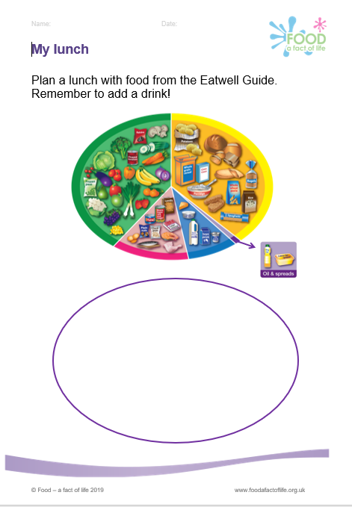
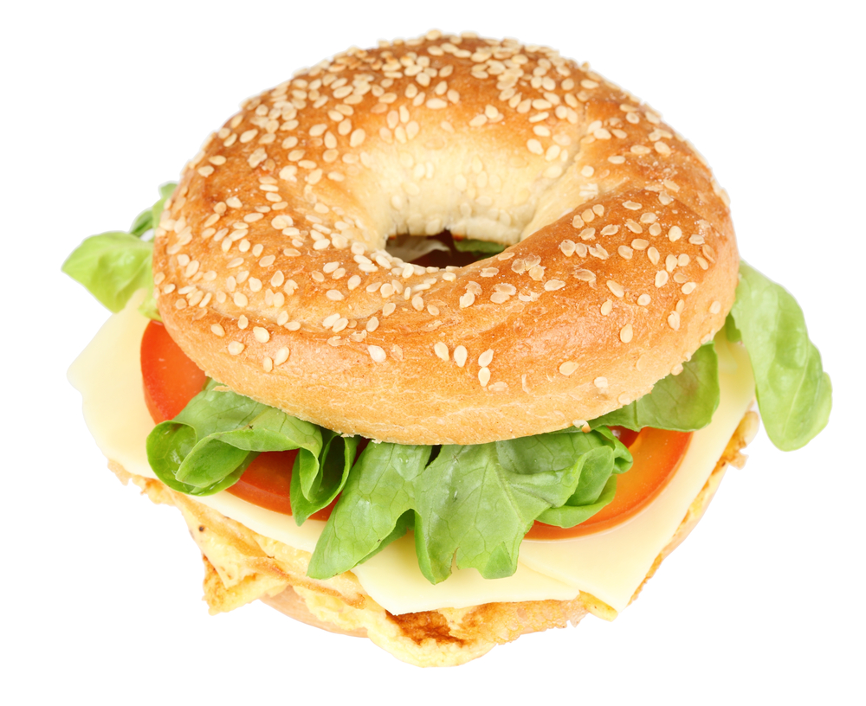
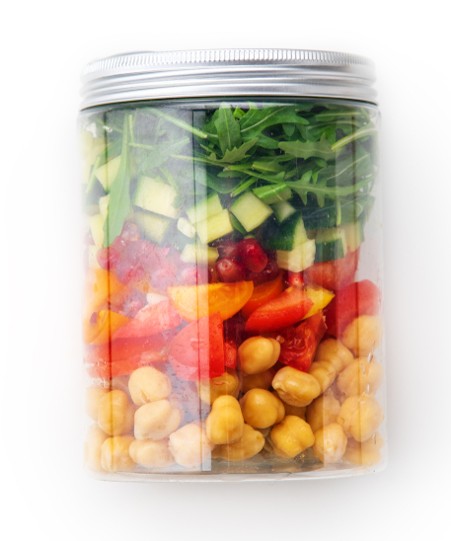
Applying Eatwell Guide knowledge
I can put together a simple, balanced meal (and include a drink) by choosing foods from the Eatwell Guide.
Plan or make a meal or dish
My lunch worksheet

Slide 11
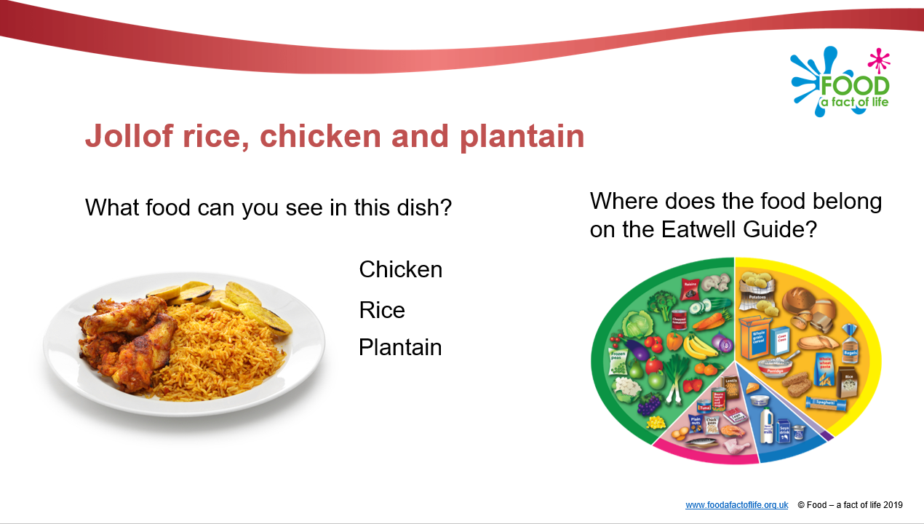
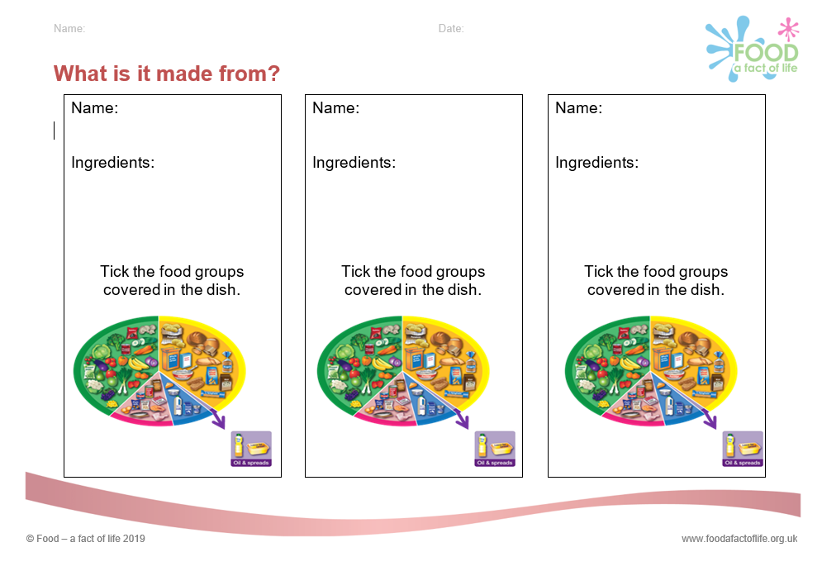
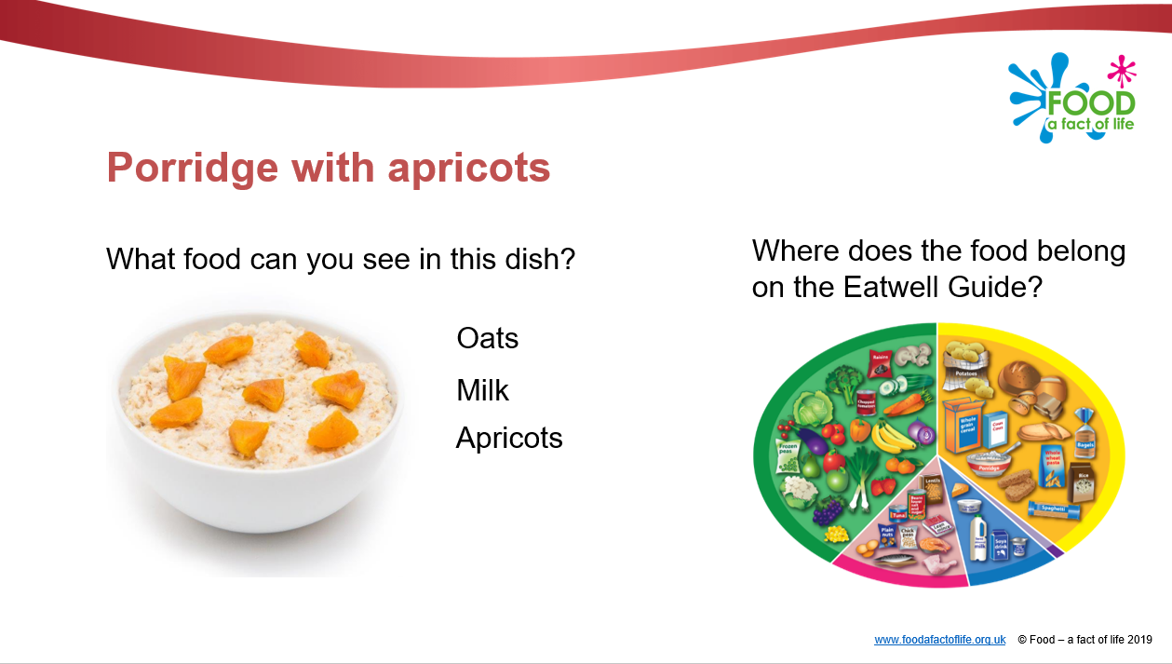
Applying Eatwell Guide knowledge
I can identify and classify ingredients in composite dishes according to the Eatwell Guide food groups.
Analysing composite dishes
Meals and snacks presentation
What’s it made from? worksheet

Slide 12
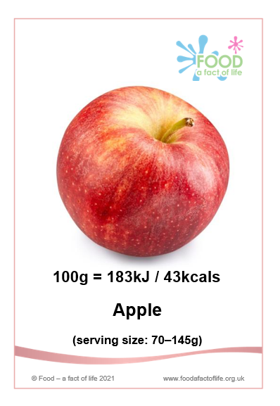
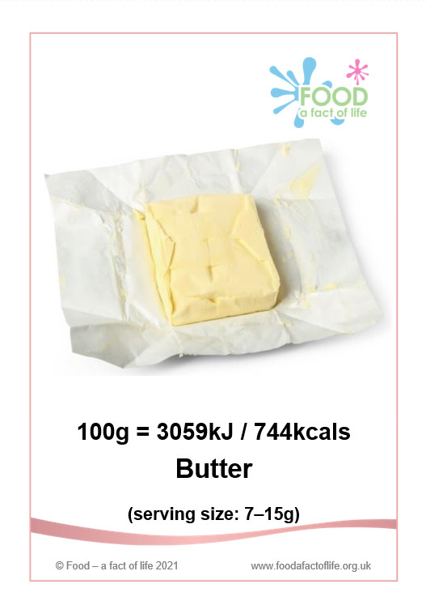
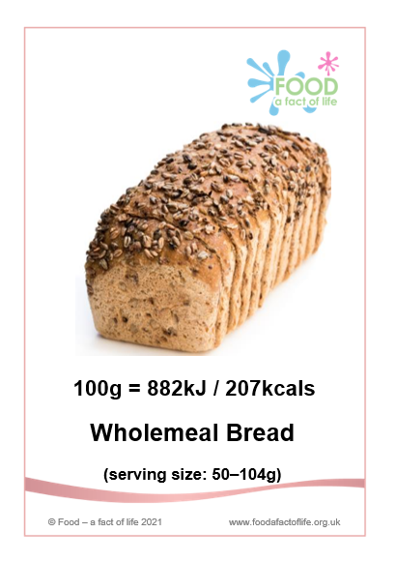
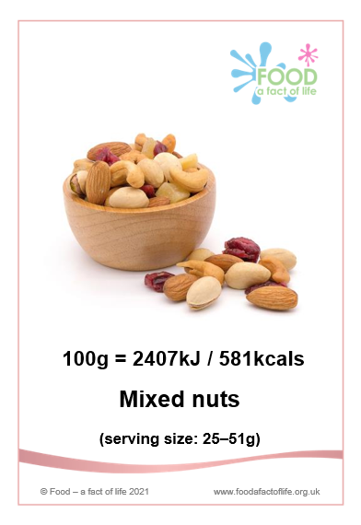
Understanding energy and portion size
I know that different amounts of food (portions) provide different amounts of energy.
Further energy content:
Energy balance (in and used)
Measures of energy – kilojoules (kJ) and kilocalories (kcal)
Different energy requirements
Order and discuss!
Energy cards

Slide 13
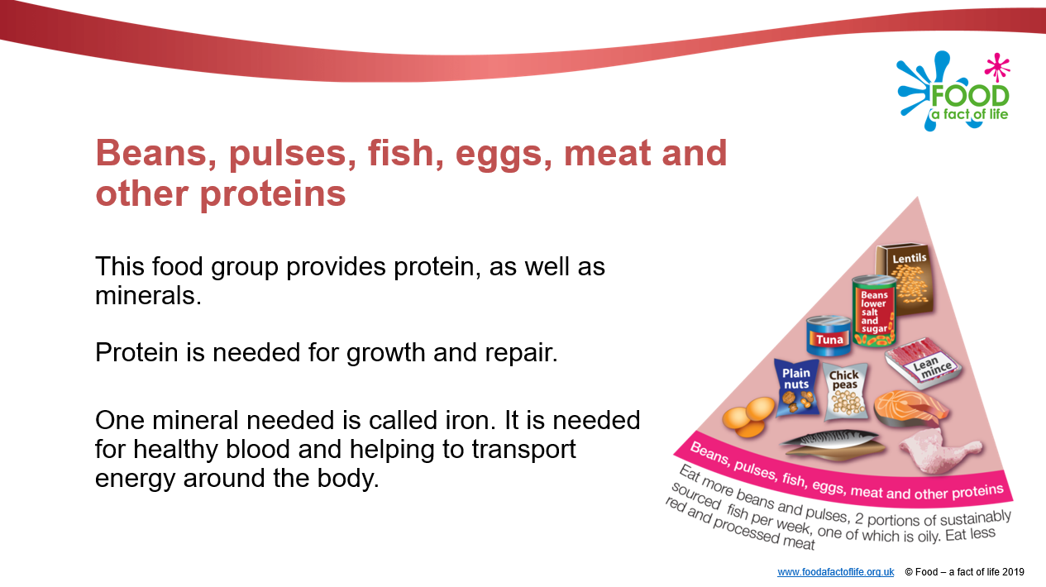
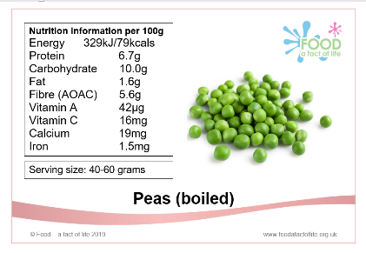
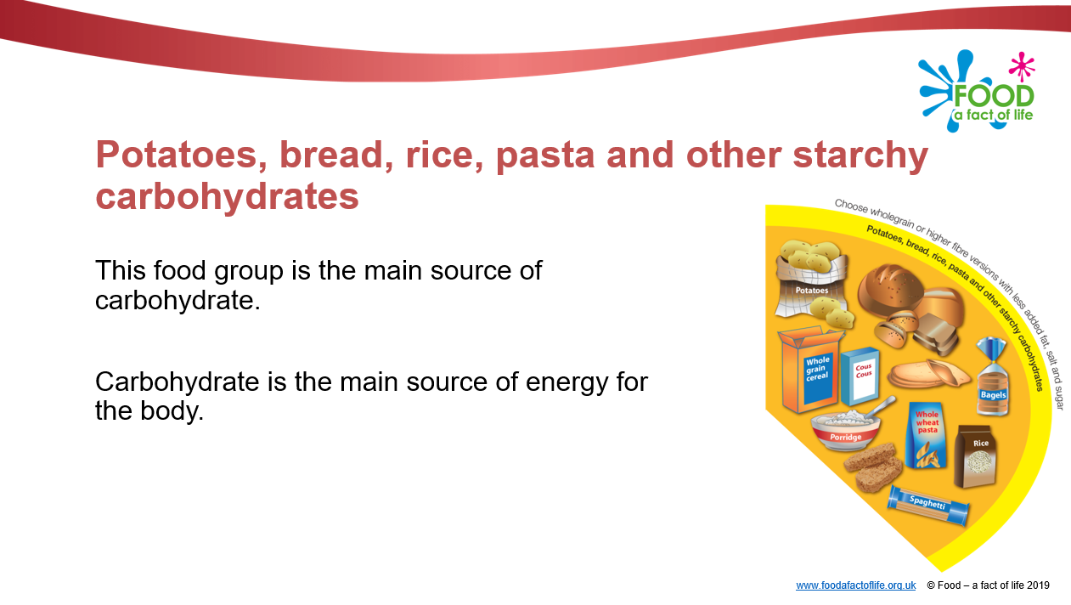
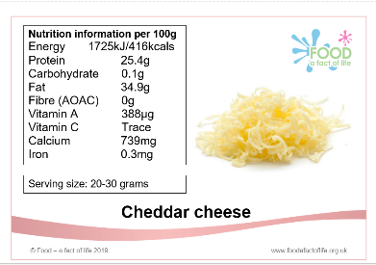
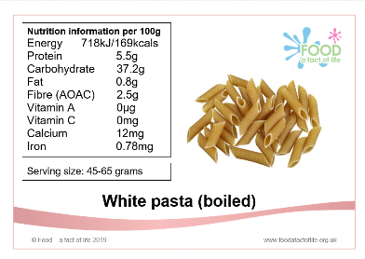
Knowing about nutrients
I can explain the basic function of each nutrient (carbohydrate, protein, fat, vitamins and minerals).
Order and discuss
Nutrients presentation
Nutrient cards

Slide 14
Order highest to lowest in carbohydrate

Slide 15
Knowing about nutrients
Carbohydrate
Calcium
Fibre

Slide 16
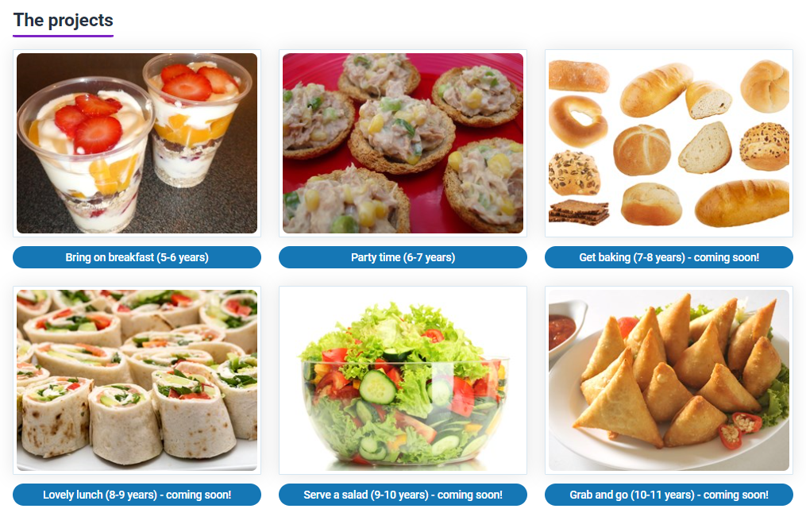
Supporting health eating knowledge and application
Primary food projects
Six food projects to support a progressive approach to teaching and learning about healthy eating, cooking and where food comes from.
Each project includes:
Overview, objectives and curriculum links;
six lesson plans;
links to supporting resources on Food – a fact of life – worksheets, recipes, presentations.
Primary projects (area link)

Slide 17
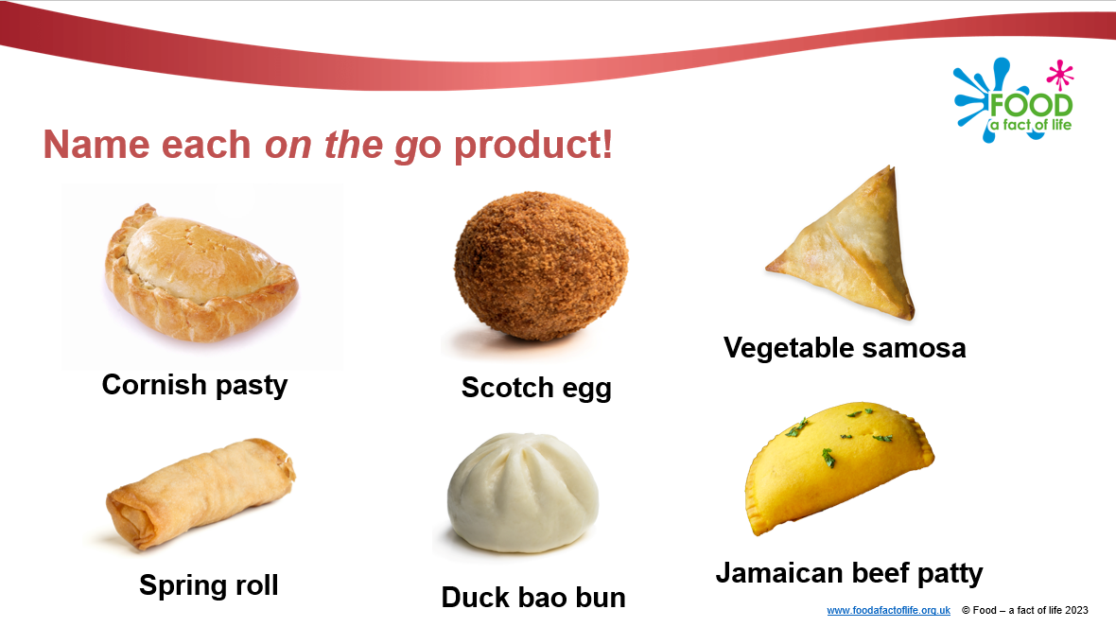
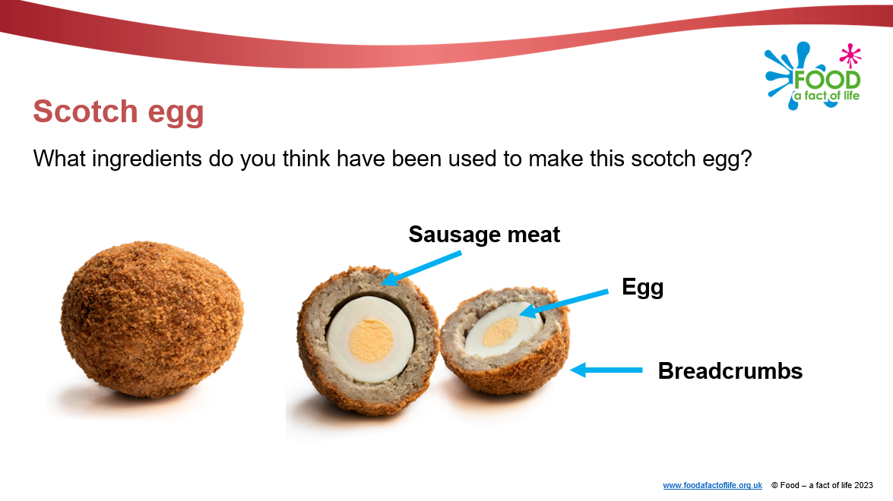
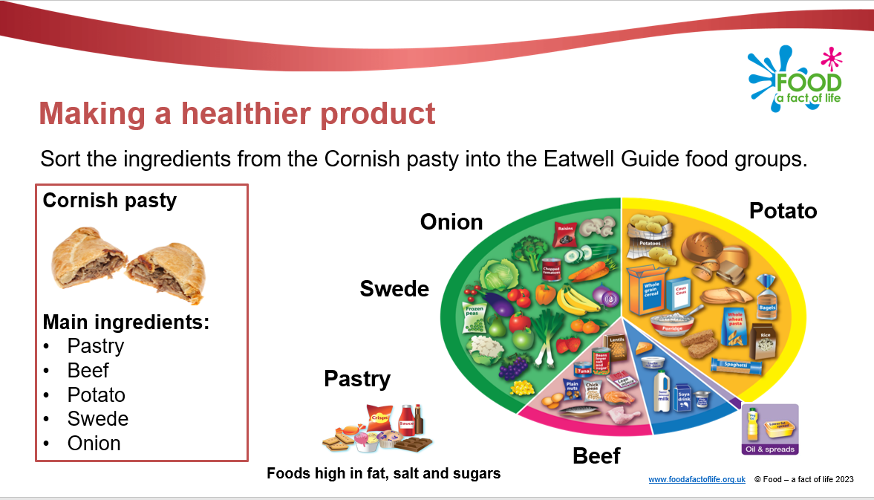
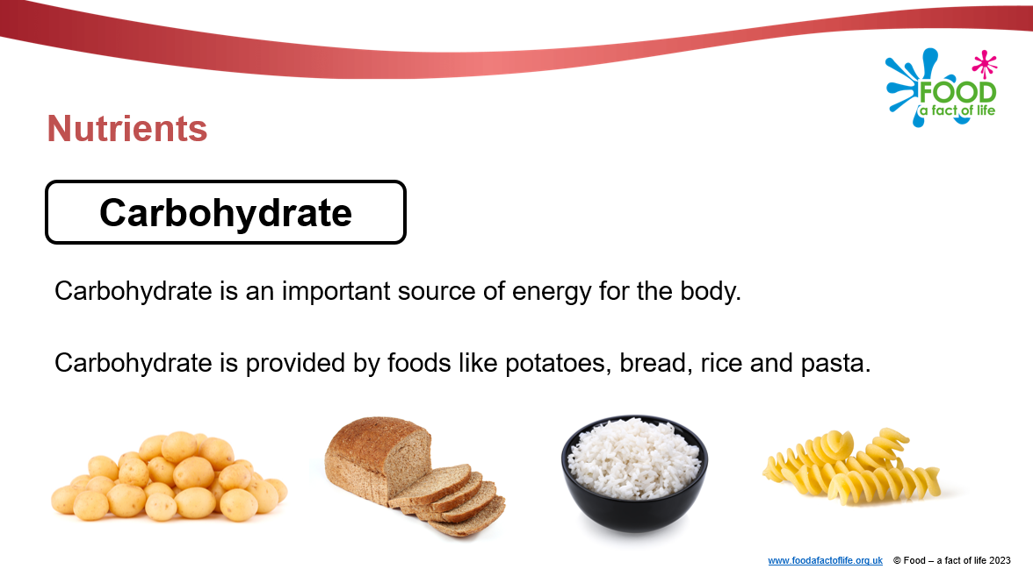
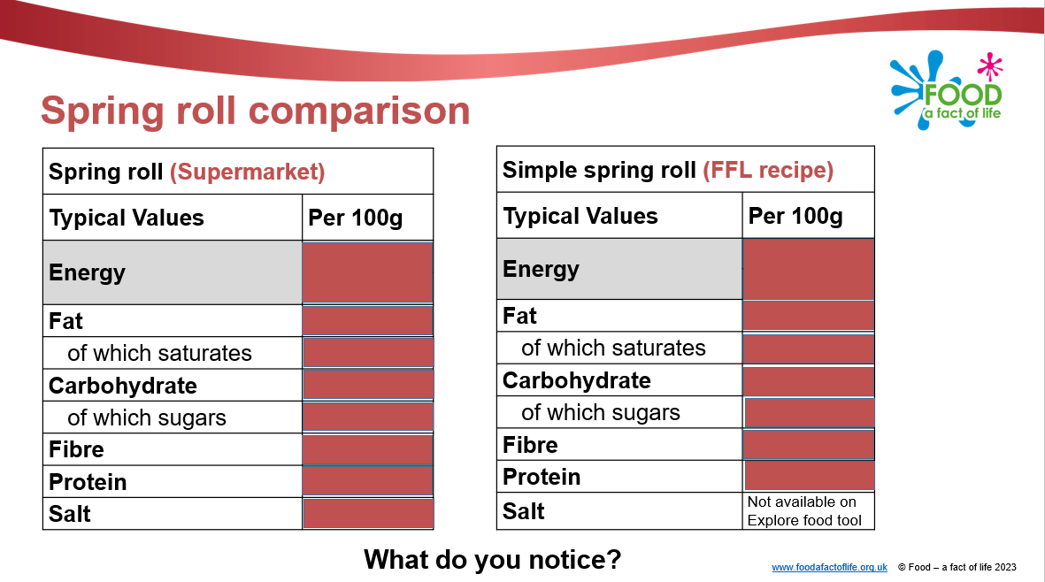
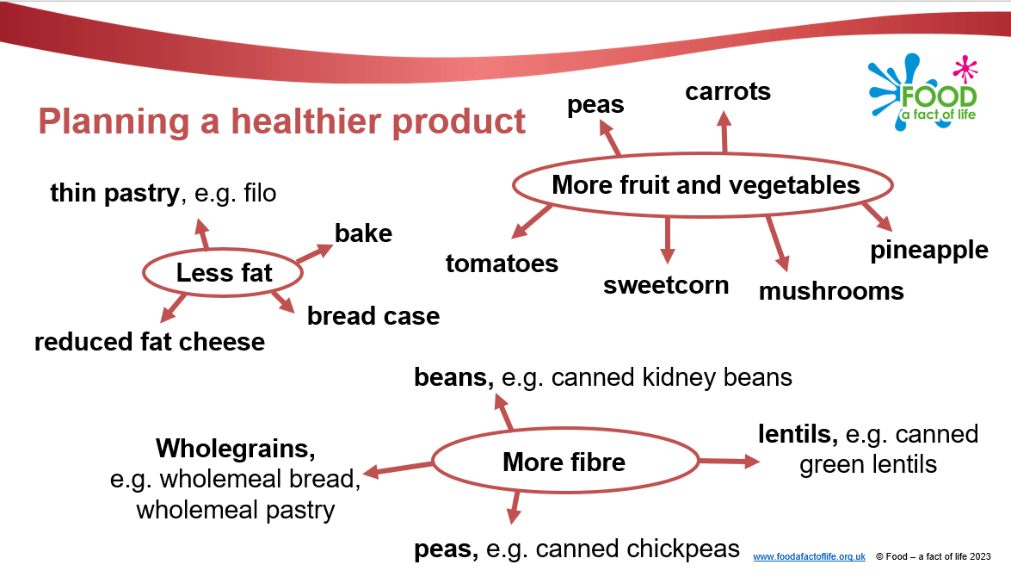
Grab and go!
Designing and making a healthier all-in-one style product to be eaten on the go.
Grab and go primary project

Slide 18
Resources links
Main resources to support healthy eating knowledge and application
Healthy eating lessons and resources, 5-7 years
Heathy eating lessons and resources, 7-11 years
Primary food projects, 5-11 years
Other resources
Victorians thematic pack (Victorian food in the Eatwell Guide)
Challenge pack: Lunchtime learning (plan and make a healthy sandwich lunch)
Challenge pack: Be health, be active (plan and create a display for your school dining room or entrance to encourage the school community to be healthy and active)

Slide 19
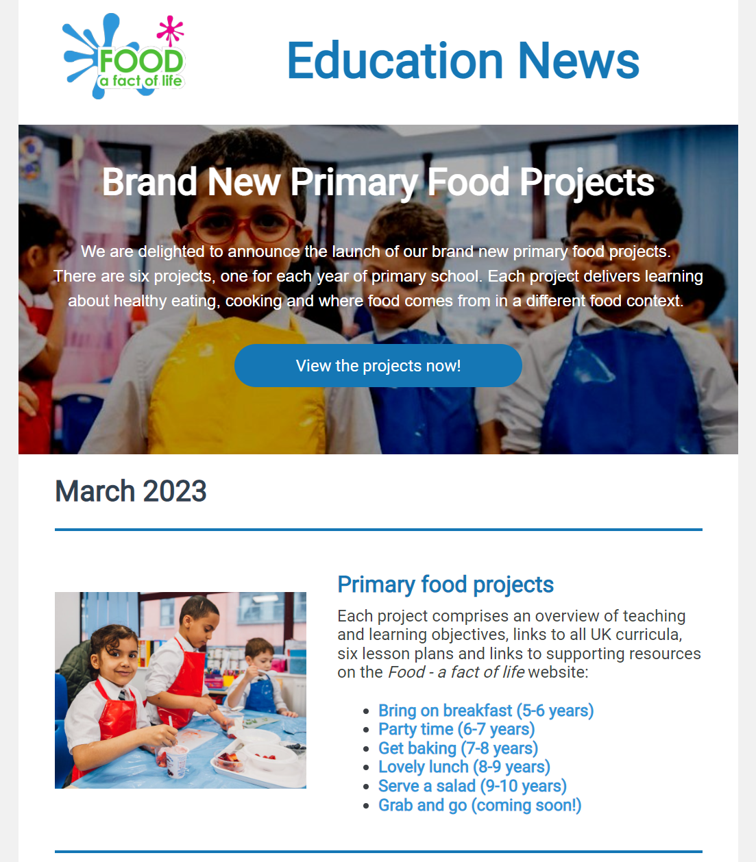
Keep up to date with our free resources and training
Education News (monthly email update)
Sign up on the homepage: www.foodafactoflife.org.uk
Follow us on Twitter @Foodafactoflife
https://twitter.com/foodafactoflife
Keep in touch: education@nutrition.org.uk
Do you know anyone who would find the TPFN programme useful?
They can visit Food – a fact of life, search ‘TPFN’ and register for free!

Slide 20

Thank you
Please complete the webinar evaluation. If you are watching a recording of this webinar, you will find a link to the evaluation at the end of the PPT presentation here.
Supporting primary pupils to apply their healthy eating knowledge
You will receive a link to the certificate once you have completed the evaluation. Please download the certificate, add your name and print it out for your records.

Slide 21
Thank you
For further information about TPFN training or to find recordings of previous webinars and workshops, click here.

