Slide 1
Can I eat it?

Slide 2
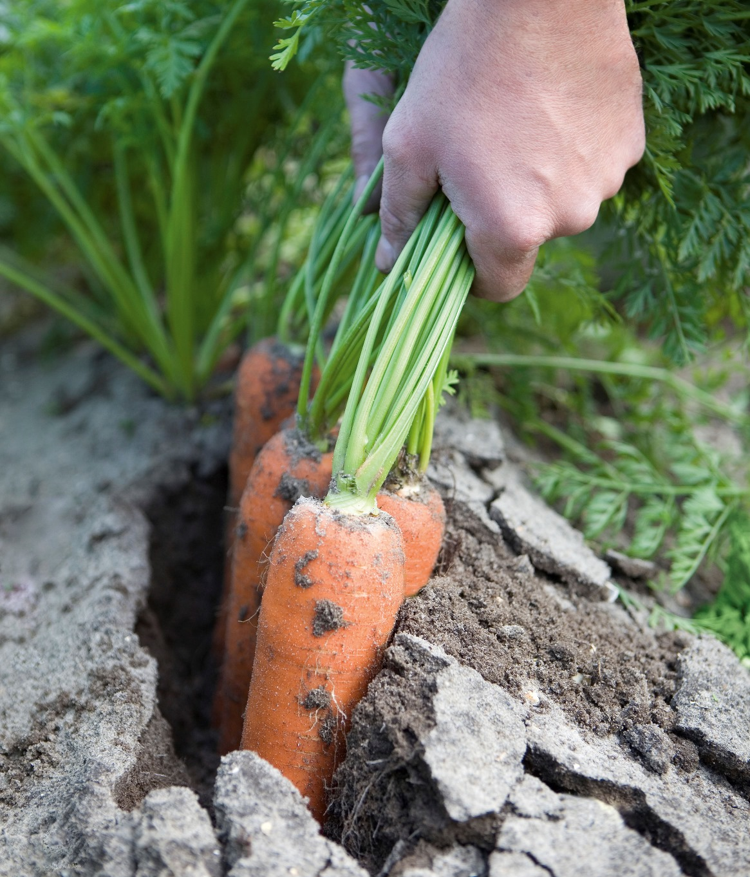
Can I eat these carrots?
Not yet, they need to be washed.

Slide 3
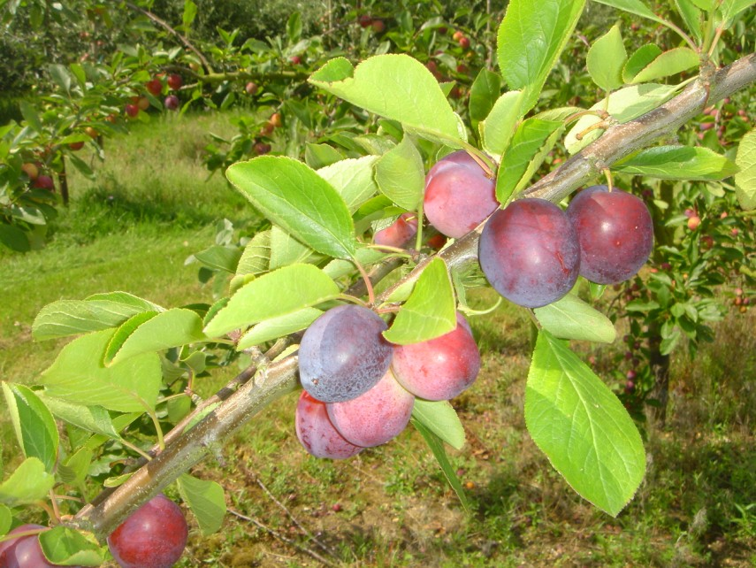
Can I eat these plums?
Not until they have been picked and washed.

Slide 4
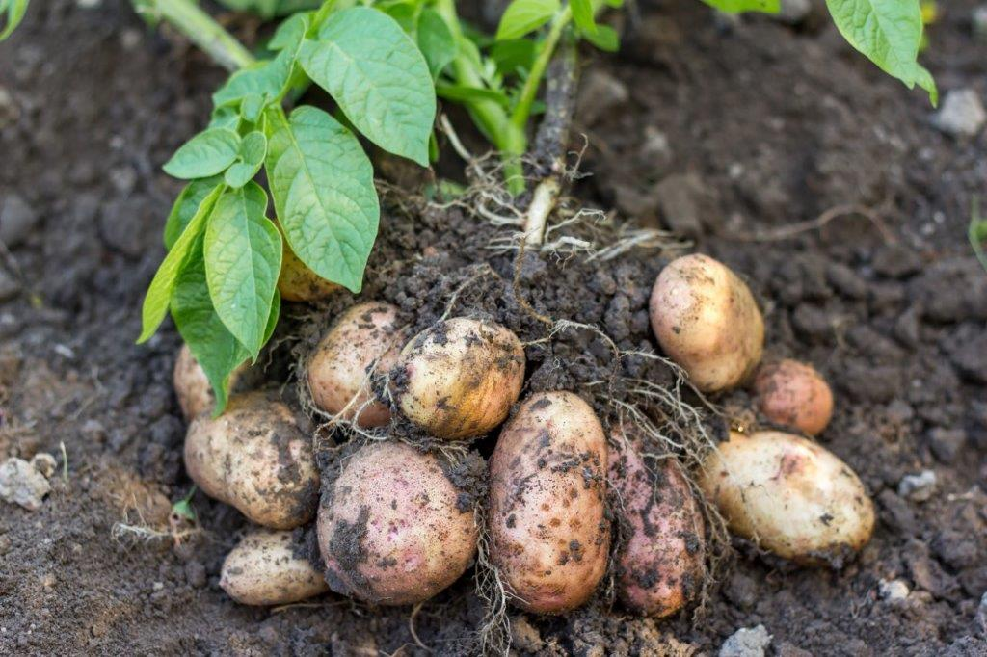
Can I eat these potatoes?
No, they need to be washed and cooked.

Slide 5
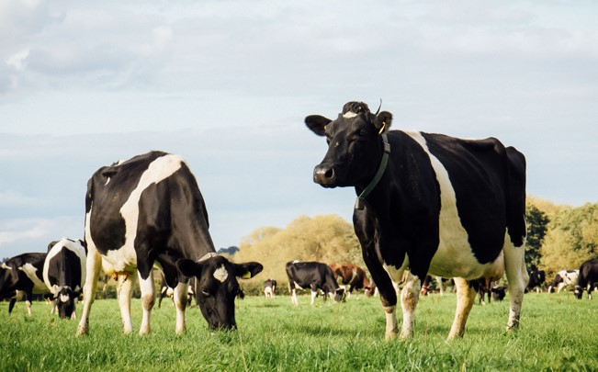
Can I have a glass of milk from here?
No, the cows have to be milked. Then the milk has to be heat treated.

Slide 6
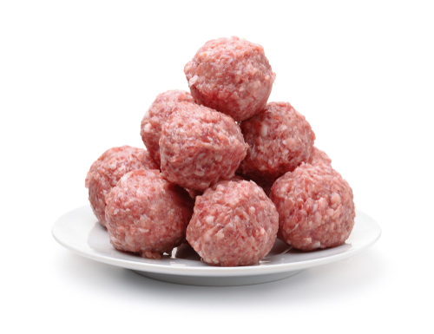
Can I eat these meatballs?
No, they need to be cooked.

Slide 7
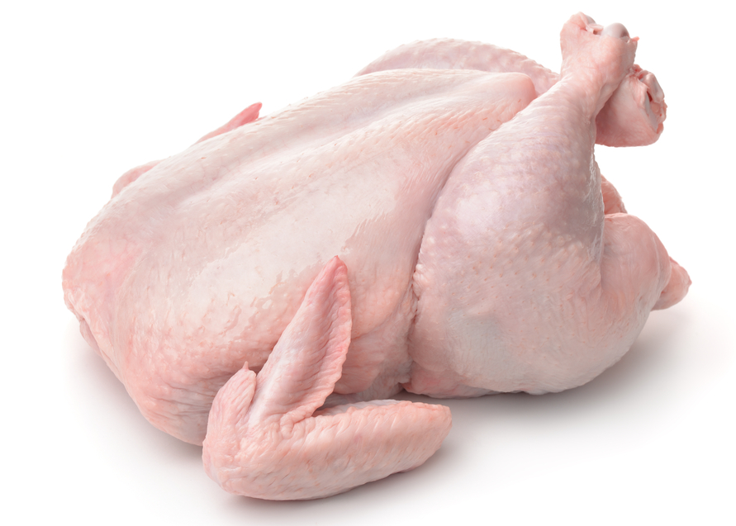
Can I eat this chicken?
No, it needs to be cooked and carved.

Slide 8
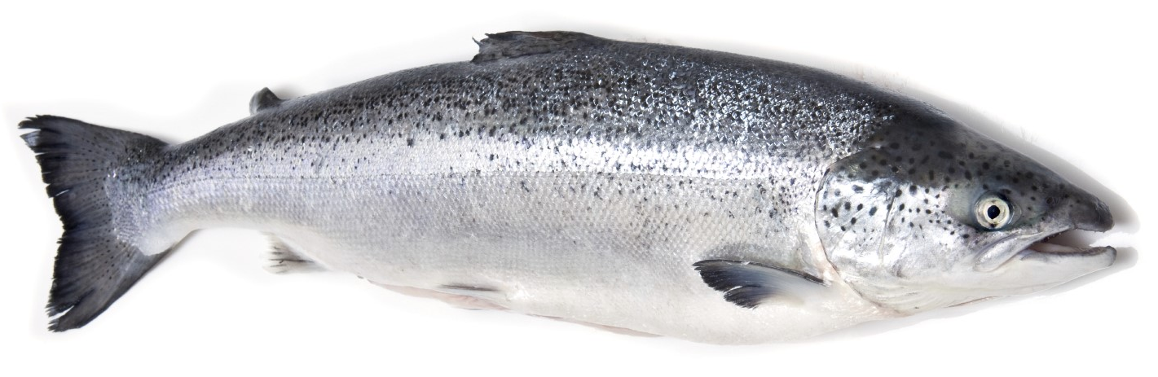
Can I eat this salmon?
No, it needs to be cooked and filleted.

Slide 9
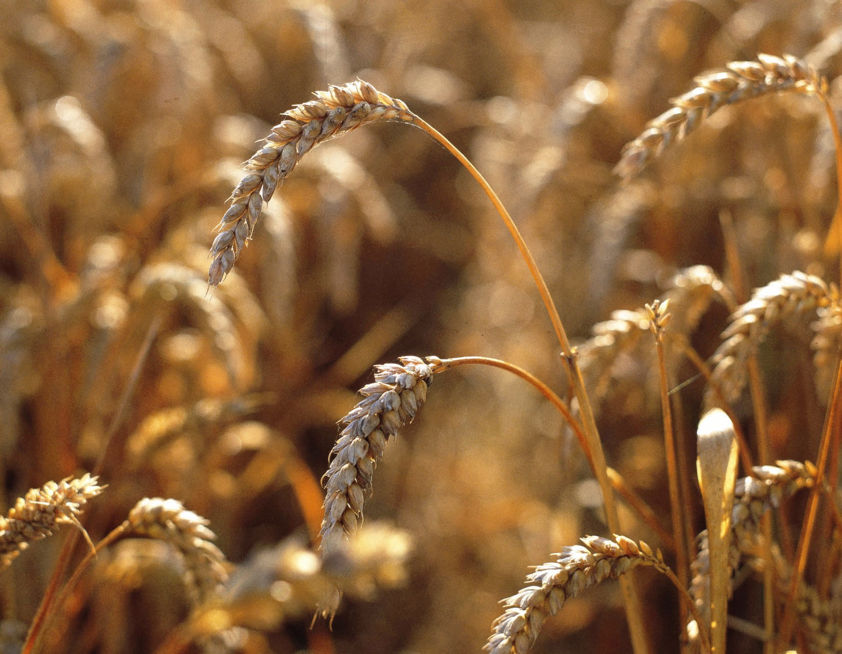
Can I eat this wheat?
Not yet, it needs to be harvested, milled, made into a food and cooked.

Slide 10
All food has to be prepared before we can eat it.
Pick
Sometimes this just means a small change.
Wash

Slide 11
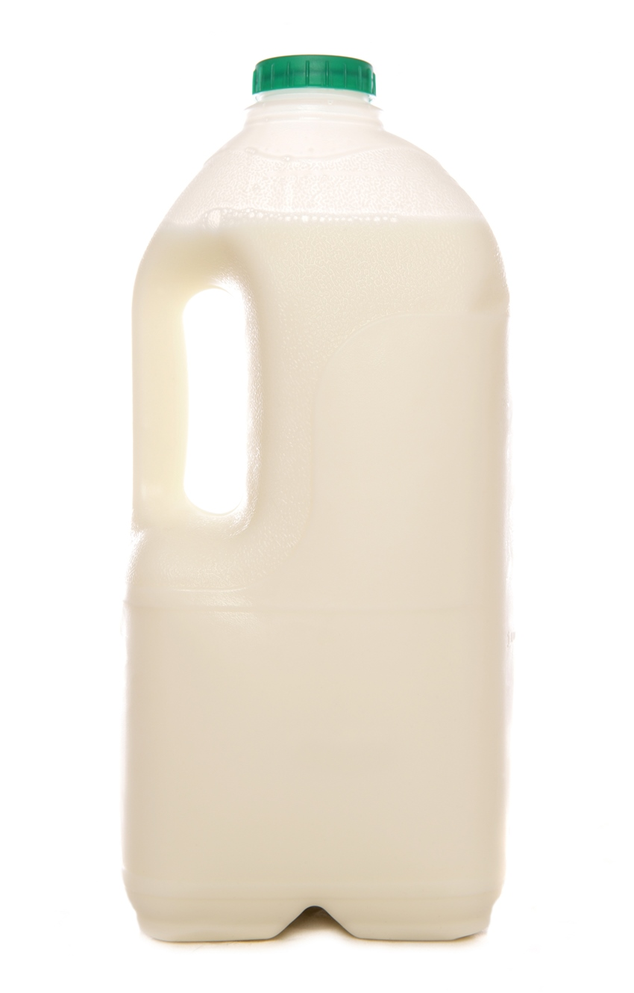
All food has to be prepared before we can eat it.
Cook
Sometimes this means a bigger change.
Heat treat

Slide 12
Can I eat it?
For further information, go to:
www.foodafactoflife.org.uk

