Slide 1
Where does bread come from?

Slide 2
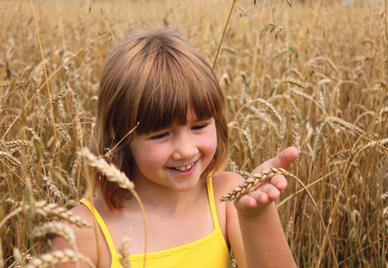
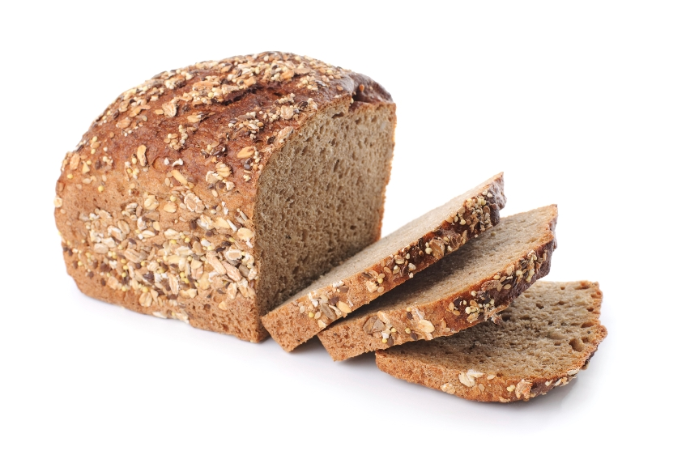
Where does bread come from?
Let’s find out!

Slide 3
Where does bread come from?
Wheat is planted.

Slide 4
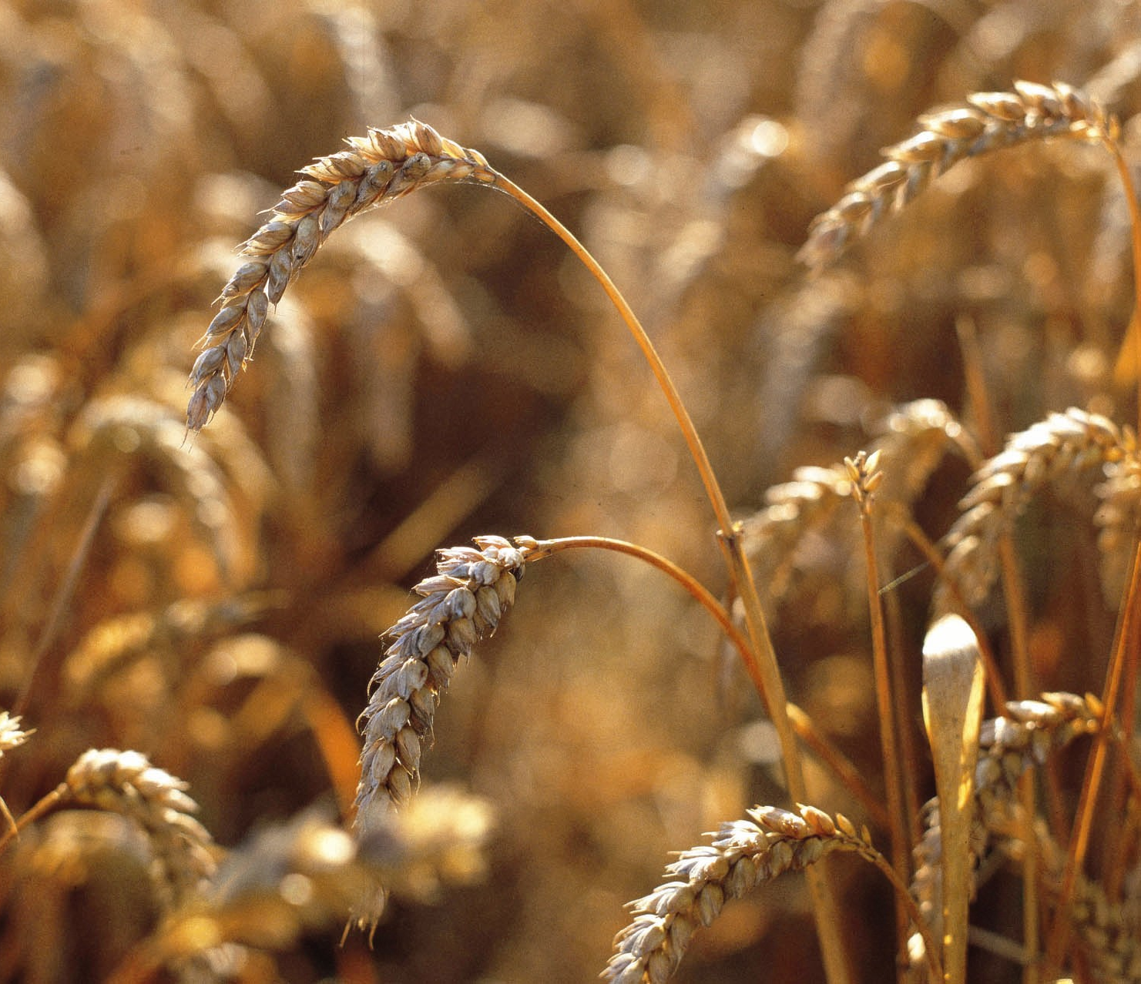
Growing
The rain and sun help the wheat to grow.

Slide 5
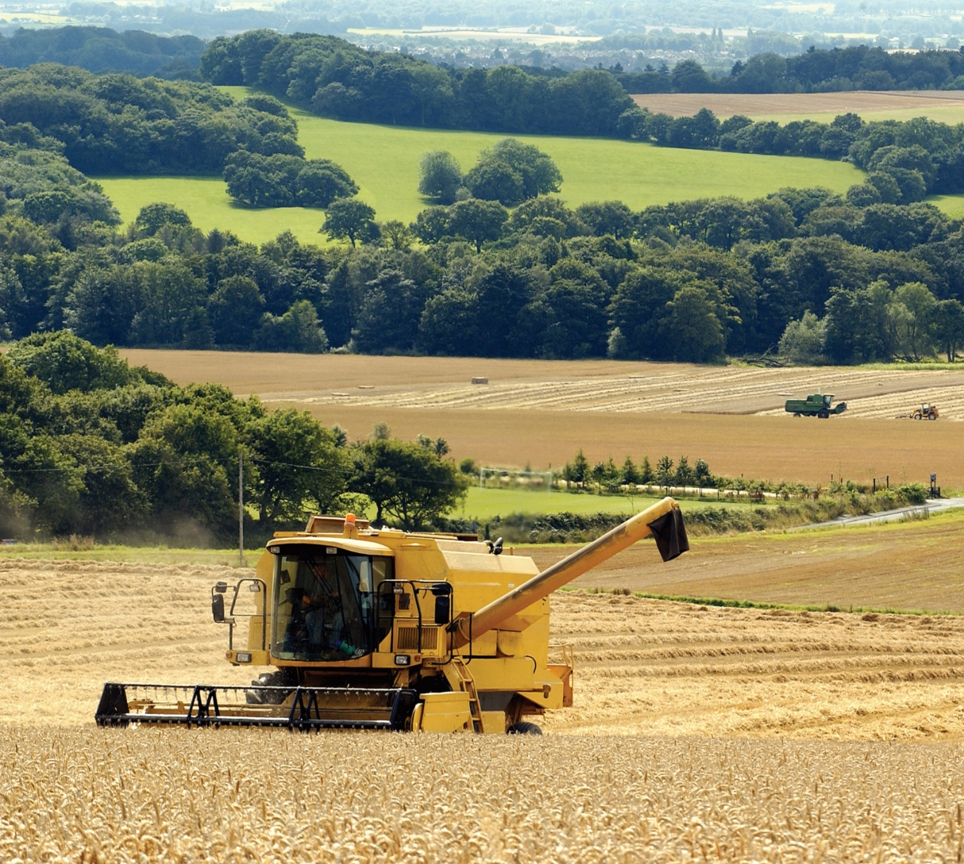
Combining
The combine harvester gathers the wheat from the field.
It then separates the grain from the rest of the wheat plant.

Slide 6
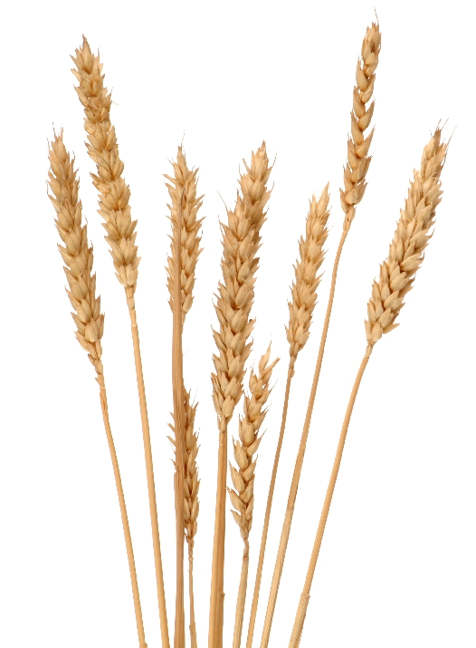
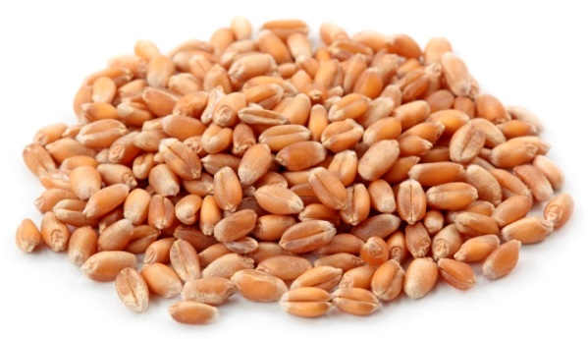
The grain
This is the grain from the wheat plant.

Slide 7
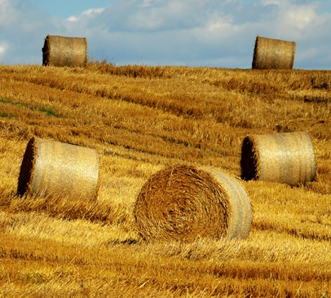
Baling
The leftover parts of the wheat plant are gathered together and made into straw bales.
This straw is used for animal bedding.

Slide 8
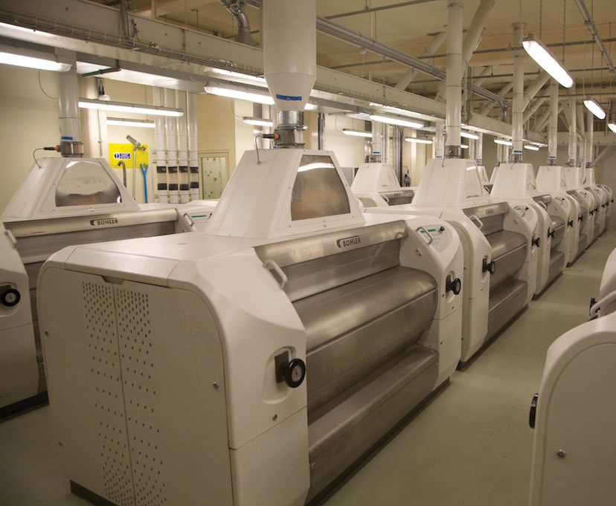
Milling
The grain is taken to a mill.
Machines ‘mill’ the grain.
The grain is washed, crushed and sieved to make flour.

Slide 9
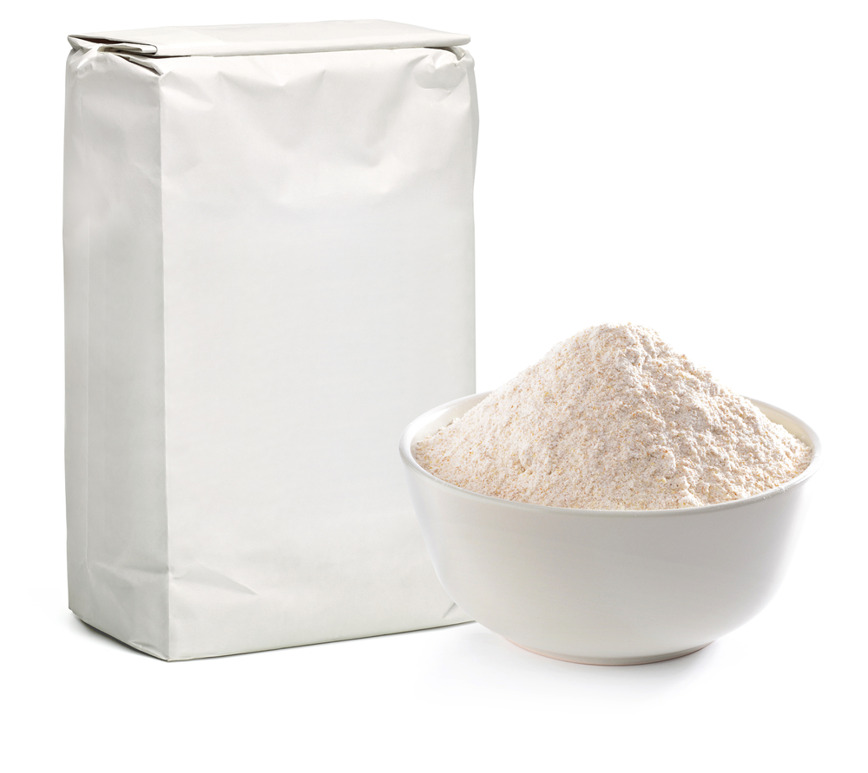
Flour
The flour is packed into bags.

Slide 10
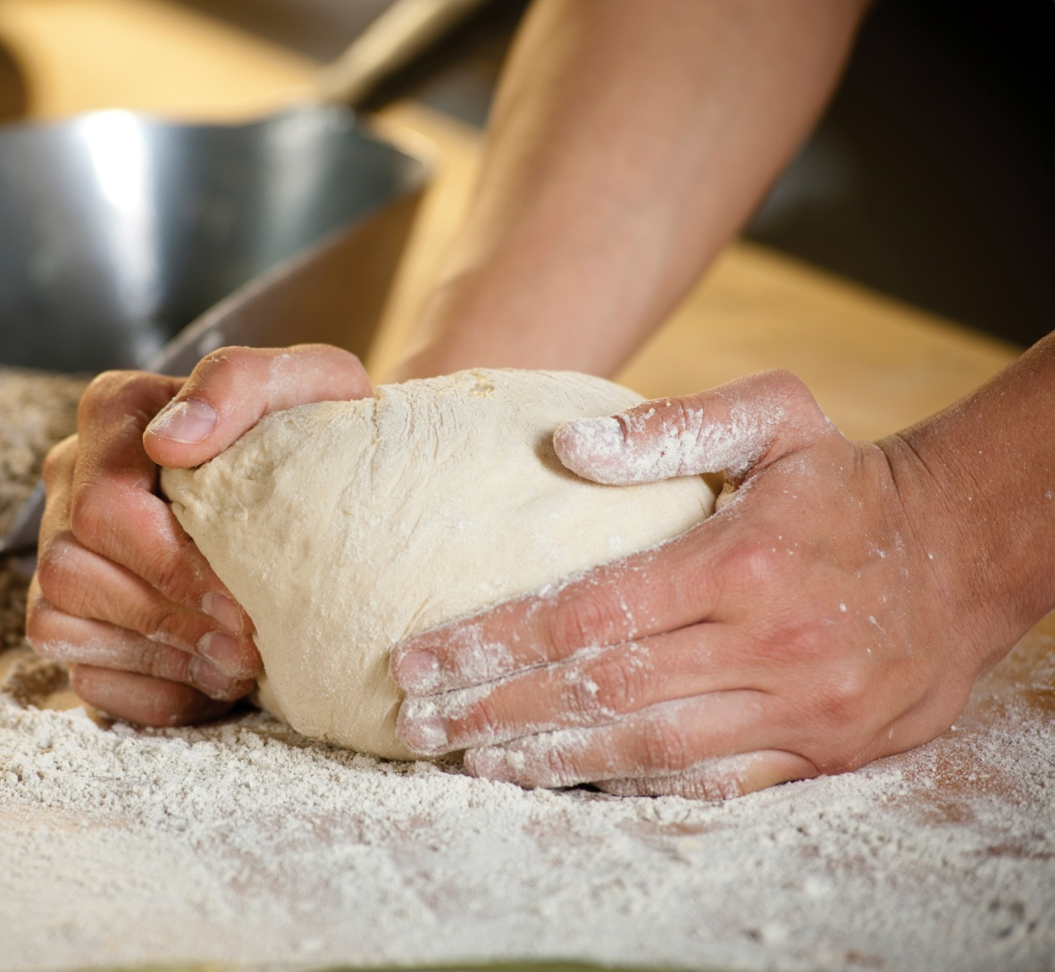
Making bread
Flour is mixed with other ingredients to make bread.
It is then baked.

Slide 11
Bread
Enjoy!

Slide 12
Summary

Slide 13
Where does bread come from?
For further information, go to:
www.foodafactoflife.org.uk
This resource meets the Guidelines for producers and users of school education resources about food.

