Slide 1
Heat exchange

Slide 2
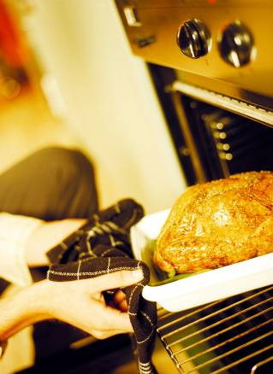
Heat exchange
The transfer of heat to or from particular foods is important in both domestic food preparation and industrial food manufacture.

Slide 3
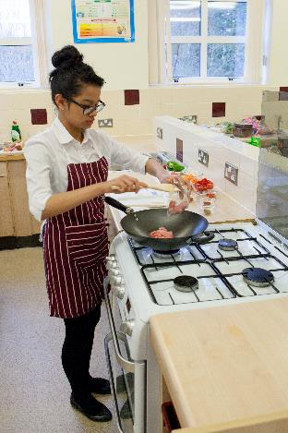
Application of heat
The application of heat in the preparation of a food or mixture may:
improve digestibility;
improve appearance, flavour, odour and texture;
increase the availability of nutrients;
prevent spoilage;
increase keeping qualities.

Slide 4
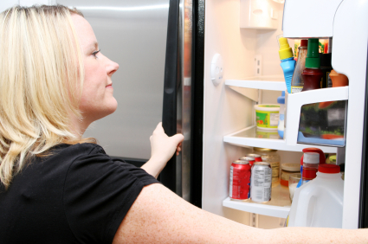
Removal of heat
The removal of heat, or cooling of foods, may:
modify appearance and texture, e.g. formation of ice crystals;
prevent spoilage, i.e. retard growth of micro-organisms;
increase keeping qualities, by preventing spoilage;
aid processing, e.g. tempering meat before slicing.

Slide 5
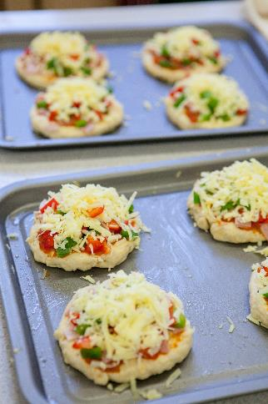
Methods of heat exchange
The principles of heat exchange are the same, whether they are applied on a small domestic or large industrial scale.
All of the following methods are used in the application of heat to, or removal of heat from a food product.
One method or several may be in action at any time, depending on the food and the time and equipment available.

Slide 6
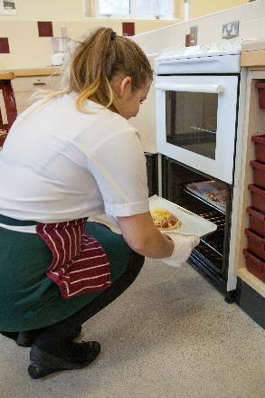
Methods of heat exchange
As a food is heated, its molecules absorb energy and vibrate more vigorously. The faster they move, the more the temperature of the food rises. If heat is removed, the molecules become less active, reducing the foods temperature.
Heat can be exchanged in three ways:
• conduction;
• convection;
• radiation.

Slide 7
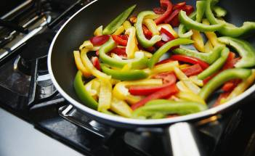
Conduction
Conduction is the exchange of heat by direct contact with foods on a surface, for example:
stir-frying vegetables in a wok;
pasteurising milk in a plate heat-exchanger;
making ice cream.

Slide 8
Conduction
In this way the heat is transferred throughout the food until it becomes hot. Heat is transferred by conduction in cooking methods using hot fat, hot water or steam.
The heat is firstly conducted from the fuel source to the cooking container (usually made of metal – a good conductor of heat).
The container in turn heats the cooking medium (fat, water or steam) and finally the food.
Cooking by conduction depends on good contact between the:
source of heat;
cooking equipment;
food to be cooked.

Slide 9
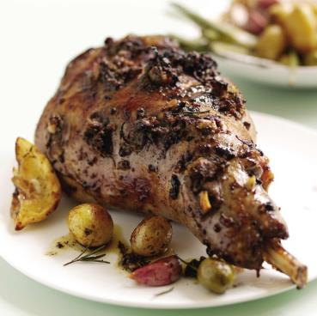
Convection
In this method of cooking, currents of hot air or hot liquid transfer the heat energy to the food.
When gases (such as air) or liquids (such as water) are heated the molecules expand, become lighter in weight and so rise up.
Cooler and heavier molecules in the gas or liquid fall to take their place – until they also become heated and rise up.

Slide 10
Convection
Because the molecules of gas or liquid are constantly being heated and keep moving, circular convection currents are created.
Food which is placed in such a liquid or gas in an enclosed space becomes cooked. This happens because the heat from the convection currents is transferred from the air or liquid, firstly to the outside part of the food then gradually through to the centre.
For efficient and quicker cooking, convection currents in air need to be kept in an enclosed space such as an oven. As hot air rises, cooler air falls – so the hottest part in an oven is at the top. Some ovens are fan assisted so that the hot air is driven around the oven to keep the temperature even from the bottom to the top.

Slide 11
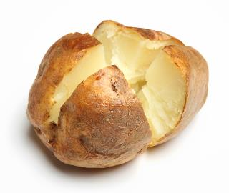
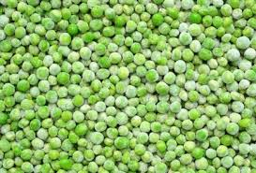
Convection
The processes of convection and conduction may work together in order to exchange heat.
For example, first the surface of a baked potato is heated by convection then the heat is conducted through to the centre of the potato.
Convection can also be used to freeze food, e.g. blasting cold air through peas to freeze them.

Slide 12
Radiation
Radiation is energy in the form of rays. The rays pass through the air until they come into contact with the food, some are absorbed while others are reflected.
Grilling involves the use of infra-red heat rays created by gas flames, charcoal or glowing electric elements.
Heat rays from gas or electric grills travel down onto the food below.
Heat rays from a charcoal grill or barbeque travel upwards to cook the food placed above on a grid or spit.
The surface of the food nearest to the rays becomes quickly browned – and regular turning of the food is needed to ensure even cooking.

Slide 13
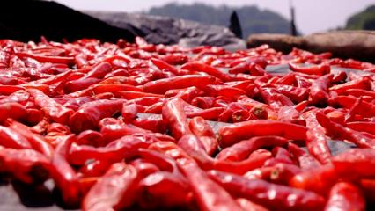
Radiation
Microwaves are electromagnetic radiators of high energy and short wavelengths. They quickly heat anything containing water, by causing the water present to oscillate (i.e. vibrate) which produces heat.
Sun drying is a traditional method of using the sun’s rays to preserve food.

Slide 14
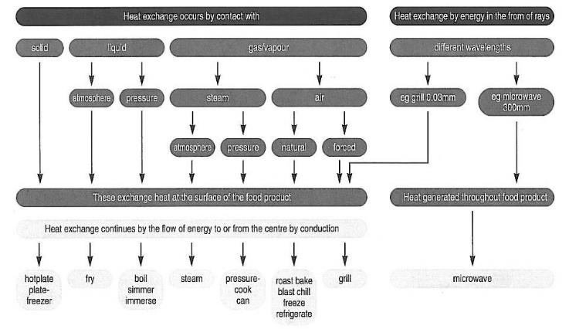
Heat exchange

Slide 15
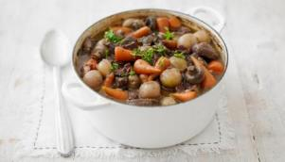
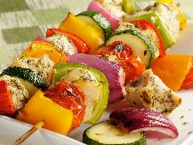
Heat exchange
One or more methods of heat exchange may be used when cooking different dishes. Identify the methods used for the following dishes:
Beef casserole
Chicken and vegetable kebabs
Lamb Rogan josh
Method of heat transfer: conduction (frying pan, oven dish and food itself) and convection (liquid in the oven).
Method of heat transfer: conduction (saucepan and food itself) and convection (liquid).
Method of heat transfer: radiation (surface) and conduction (centre).

Slide 16
Heat exchange
For further information, go to:
www.foodafactoflife.org.uk
This resource meets the Guidelines for producers and users of school education resources about food.

