Slide 1
Life on the farm
A Where food comes from and Cooking Challenge for pupils aged 7-11 years

Slide 2
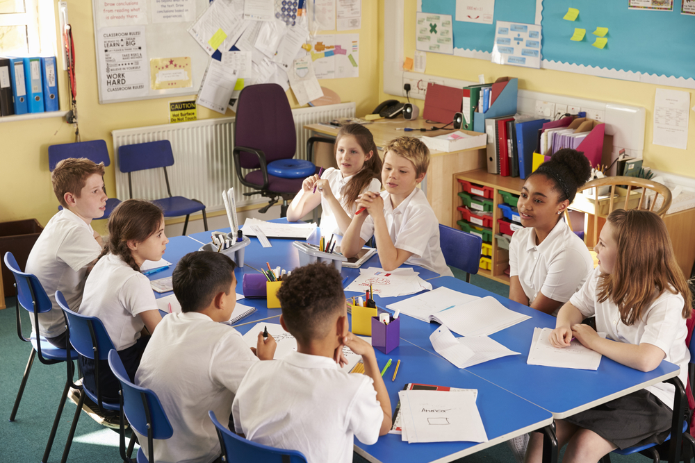
The Challenge
Find out how food is grown, reared and/or caught and share this information with younger children through a short video, presentation, animation, or role-play.
Make a packed lunch using the foods you find out about.

Slide 3
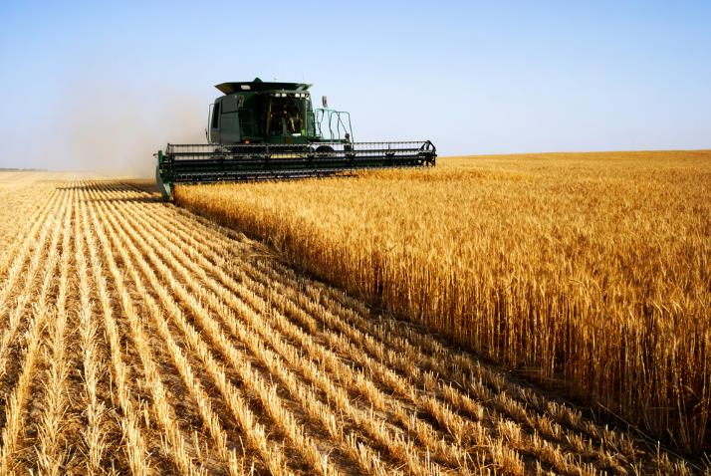
Let’s get started – the Challenge is on!
All our food has to be produced for us.
Plants are grown and animals are reared or caught.
Example:
Toast is made from bread, bread is made from flour, flour is made from the plant called wheat.
What other examples can you think of?

Slide 4
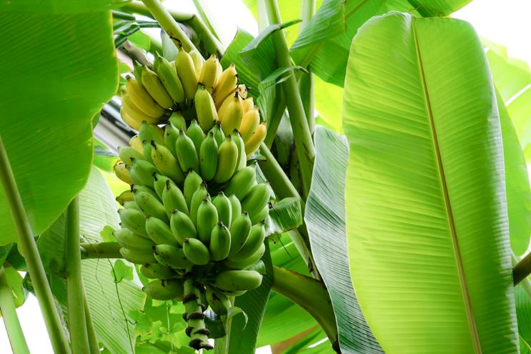
World food
A variety of food is grown, reared and caught in the UK.
Food is also produced all around the world.
Why is some food is produced outside the UK?
Name five examples.

Slide 5
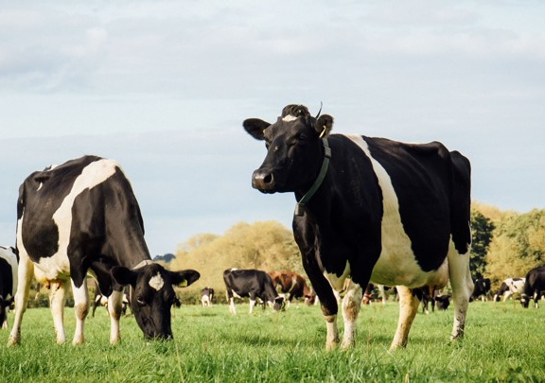
Down on the farm - animals
Animals produce some of the foods we eat.
Chickens produce eggs.
Dairy cows produce milk.
Where does bacon come from?
Name three other food from animals.

Slide 6
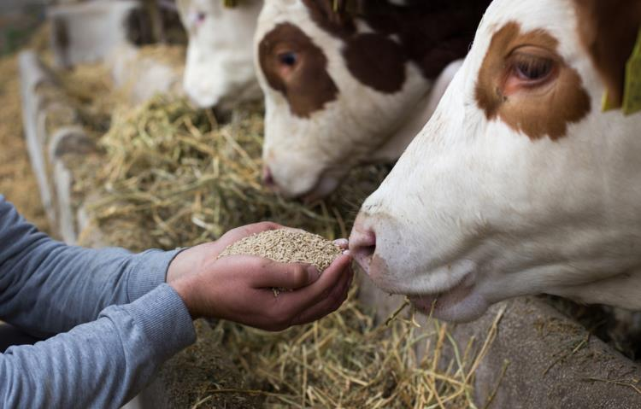
Down on the farm
Farmers care for their animals and make sure they have everything they need.
Animals need:
the right type of food and water;
a comfortable place to rest;
to be treated by a vet when needed;
to be able to move around and to be with other animals like them;
to have caring and gentle treatment.

Slide 7

Red tractor
Have you seen this logo before?
Which foods have you seen it on?
The logo is on some food labels. It tells the shopper that the food meets a set of standards.
This helps shoppers to decide which food to buy.
Find out more about the Red Tractor standards.

Slide 8
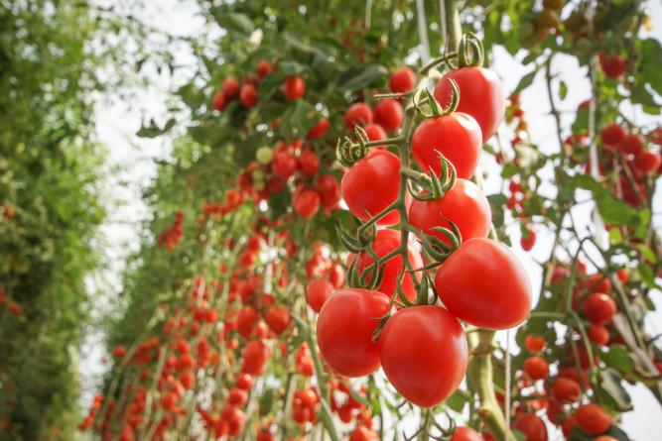
Down on the farm - plants
In the UK, different crops are grown on farms and harvested for food.
Some examples are wheat, oats, potatoes, vegetables and fruit.
Food that comes from plants can also be grown in gardens and allotments and in school!
What conditions do these plants need to grow and produce food?

Slide 9
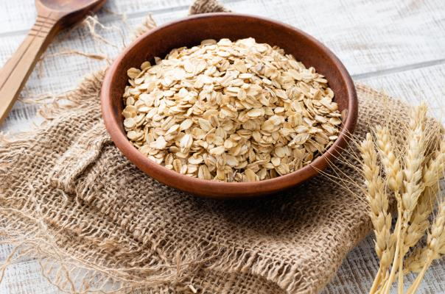
Did you know?
Some land in the UK is used to grow cereal crops.
Cereals include grains, such as wheat, barley and oats.
Oats are used for animal feed, breakfast cereals and biscuits.
Wheat is milled into flour and used in baking.

Slide 10
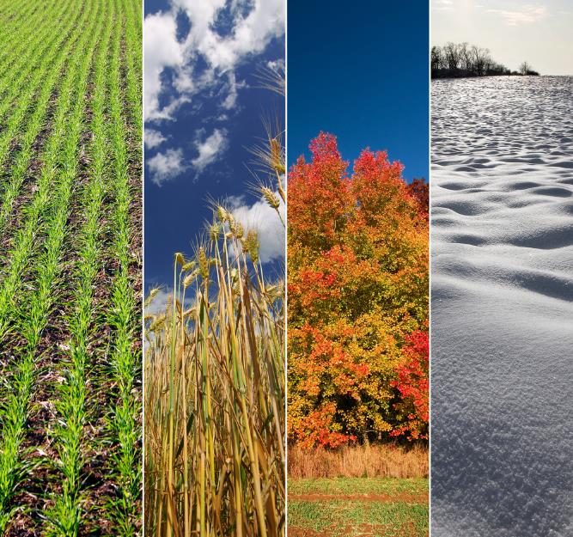
Seasons
Some food like fruit and vegetables are seasonal.
There are four seasons in the UK – spring, summer, autumn and winter.
Why do we get food at different times of the year?
Name two examples of food that are seasonal.
Can we get food when it is not in season in the UK? Where does it come from?

Slide 11
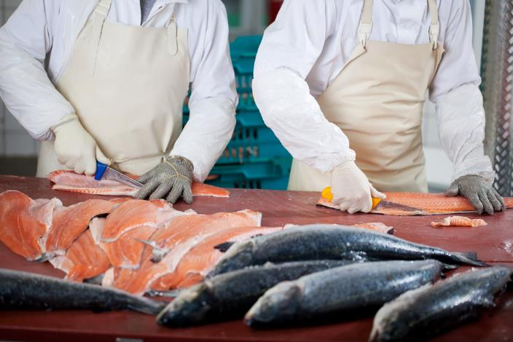
Processing fish
Food that is grown, reared or caught will often be processed before it is sold.
Here is an example of processing:
fish is farmed or caught in the wild;
the fish is prepared, filleted and cut into pieces;
the pieces are packed and sold;
the fish is cooked at home.
What other examples can you think of?

Slide 12
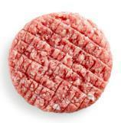
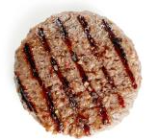
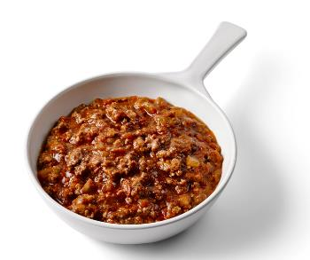
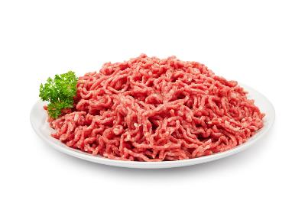
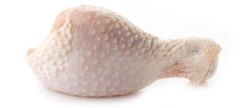
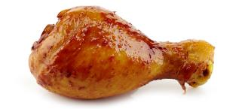
Processing meat
Food is also processed to make it safe and edible.
We cannot we eat raw meat.
What must be done to meat before it can be eaten?
What changes can you see?

Slide 13
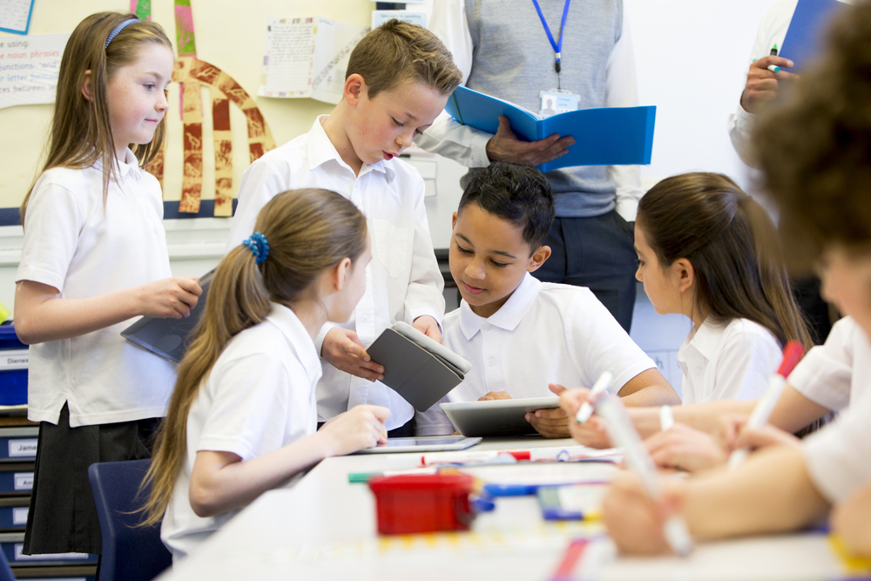
Planning
How can you help younger pupils understand where their food comes from?
Discuss with your teacher how you will present your ideas. This could be using a short video, an animation or through role-play.
What do you need to think about?
Use your ideas to make a plan. What needs to be included?

Slide 14
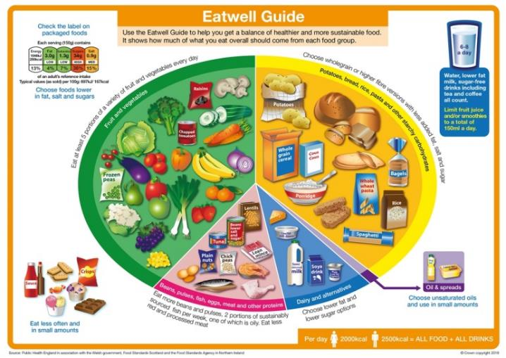
Planning and cooking
When planning your packed lunch remember to think about the Eatwell Guide.
Try to include food from the five food groups. Remember to think about the proportions and types of food that should be eaten.
Make a plan to show what foods you are going to include in your packed lunch.
Remember to think about seasonal food too.

Slide 15

The Eatwell Guide
A healthy diet is made from a variety of different food and drinks, as shown in the Eatwell Guide.
The Eatwell Guide shows the proportions and types of food that should be eaten. It also includes information about how much we should be drinking.
It has five main food groups. Name two foods that are found in each of the five food groups.

Slide 16
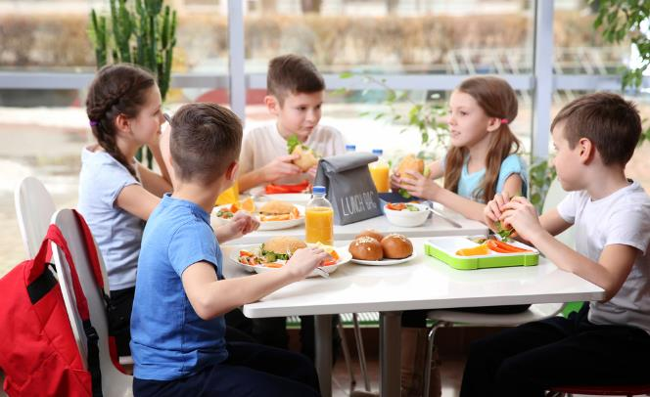
Packed lunches
A healthy lunch box should be based on the Eatwell Guide.
It should contain:
starchy food, e.g. bread, potatoes, rice;
lots of fruit and vegetables, e.g. carrot sticks, apple, sliced cucumber;
some protein or dairy food, e.g. beans, pulses, egg, fish, meat or cheese;
a healthy drink, e.g. water, semi skimmed milk.
Discuss some ideas for the food that could be included in the lunchbox.

Slide 17
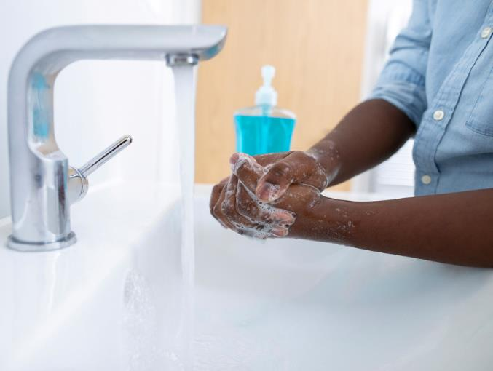
Cooking
Hygiene and food safety are very important when cooking.
What should we do when we get ready to cook?
What is good personal hygiene?
Why is it important to wash hands?
Safety when cooking is very important. Remember to follow all the safety rules!

Slide 18
The Challenge
Find out how food is grown, reared and/or caught and share this information with younger children through a short video, presentation, animation, or role-play.
Make a packed lunch using the foods you found out about.
Good luck!

Slide 19
Teachers’ guide

Slide 20
The Challenge
Find out how food is grown, reared and/or caught and share this information with younger children through a short video, presentation, animation, or role-play.
Make a packed lunch using the foods you found out about.

Slide 21
The Food – a fact of life Challenges
The Food – a fact of life Challenge activities have been written to support teachers not following the national curriculum for their specific country or those following a challenge or theme-based approach. However, they could be used in any school across the UK.
The Challenges cover Healthy eating, Cooking and Where food comes from and provide a wide range of activities that teachers can select depending on their pupils’ needs, age and abilities, and the time available.
There are 12 Challenges developed to be used with nursery, primary or secondary pupils.
Each Challenge comprises the Challenge, opportunities for learning and a variety of pupil activities that can be completed individually or in groups. Each Challenge culminates in a final outcome, which could be paper based, such as a report, poster, newspaper article or presentation, video, interactive activity, recipe, dish/range of dishes or menu depending on the theme of the Challenge.
An optional pupil certificate is available to download and personalise once the Challenge has been achieved.

Slide 22
Opportunities for learning
By undertaking this challenge, the opportunities for learning include:
reviewing where food comes from – UK and other countries;
the key messages of the Red Tractor food assurance scheme;
further investigating food that is grown, reared or caught;
finding out more about the seasonality of food;
primary and secondary processing of food;
planning and developing information for younger pupils using appropriate media;
safely preparing and cooking a recipe.

Slide 23
How can pupils complete the Challenge?
A range of activity suggestions have been provided – you choose the ones that are most suitable for your pupils and the time that you have available to complete the challenge.
Activities include:
Finding out – activities around foods that are grown, reared or caught in the UK, food assurance schemes, food grown in other countries, seasonal food, simple food processing.
Making and evaluating – reviewing/recaping practical skills, plan and prepare suitable dishes for the lunchbox, practical food hygiene and safety.
Bringing it all together – investigating where food comes from to create a resource for younger pupils and prepare a dish suitable for a packed lunch reflecting the Eatwell Guide.

Slide 24
Finding out - activities
Pupils, individually or in groups, could:
Where food comes from:
recap where a range of individual food items come from using the Food cards to identify if the food comes from a plant or animal.
complete the Plant or animal worksheet.
use the UK Food cards and UK Food labels cards to name the food and suggest where in the UK it might come from.
use the UK Food map worksheet to show where in the UK the food is from.
look at a display of food produced in different countries outside the UK or use the World food cards and World food labels. Find the country of origin on a world map.
discuss why each food is from a different country – climate, weather, suitable environment.

Slide 25
Finding out - activities
use the Down on the farm presentation, focusing on the animals farmed for our food. Complete the Down on the farm worksheet.
learn more about the Red Tractor mark using the Red Tractor worksheet. Complete the Looking after animals worksheet.
look at the Seasons presentation to explore what is meant by seasonal foods.
consolidate the work by looking at the Eat the seasons presentation and the benefits of consuming seasonal foods. Complete the worksheet Seasonal food.
use the Food – basic processes presentation to investigate the processes used to process food.
watch the Milk, From wheat to bread, Fishing and Poultry farming (the hatchery, the breeding farm, the broiler farm, the rearing farm) videos to increase understanding of what happened to these foods before they reach us.

Slide 26
Finding out - activities
use the Edible and safe presentation to discuss and demonstrate how food is processed at home to make it safe and edible to eat.
watch the Cheese making video and the From wheat to bread video. Discuss what they see happening in the clips and what the differences are between making something at home, e.g. bread, and its being made in a factory.
Planning and preparing food:
read or listen to the Amazing lunchbox story. (Teacher guide) to introduce the concept of a healthy lunch underpinned by the Eatwell Guide.
use the Make a healthy lunchbox worksheet to aid planning.

Slide 27
Finding out - activities
use the Where food comes from knowledge organiser (7-11) to consolidate learning and develop subject specific vocabulary/terminology.
Eatwell Guide:
view the Eatwell Guide presentation.
complete Workbook 2 covering healthy eating, drinking and activity.
complete the Diet and Health and Healthy Lifestyles Food route journal. User guide here.

Slide 28
Making and evaluating - activities
Pupils, individually or in groups, could:
Cooking:
review the Let’s get ready to cook poster as a stimulus for discussion.
view the Personal hygiene presentation to promote and embed good personal hygiene habits.
recap the basic skills already learned using skills videos. Grating, peeling, bridge hold, claw grip.

Slide 29
Teacher resources
Cooking: A guide about cooking in the primary school classroom.
Demonstration guide: A guide about cooking demonstrations in the primary classroom.
Ingredient check letter: A template letter to send home about pupils handling and/or eating different ingredients.
Creative cook certificate: A certificate to award creative cooking.
Recipes: A range of recipes that can be sorted by age range, commodity, complexity, food skills and cooking methods.
Food skills guide: A guide highlighting key food skills that can be taught.

Slide 30
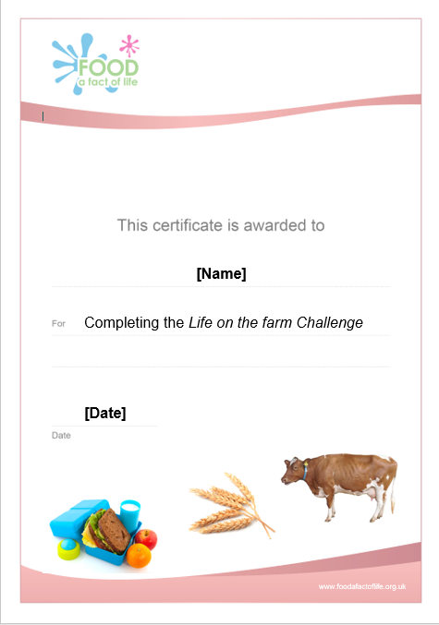
Celebrate!
An optional pupil certificate is available to download and personalise once the Challenge has been achieved.
Why not present the certificate at a celebration assembly?

Slide 31
Life on the farm
For further information, go to:
www.foodafactoflife.org.uk
This resource meets the Guidelines for producers and users of school education resources about food.

