Slide 1
Get ready to cook

Slide 2
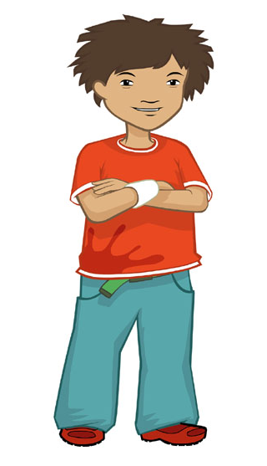
Ronnie says…
Before we cook, it’s really important to get ready.
Why do you think we have to get ready before we cook?

Slide 3
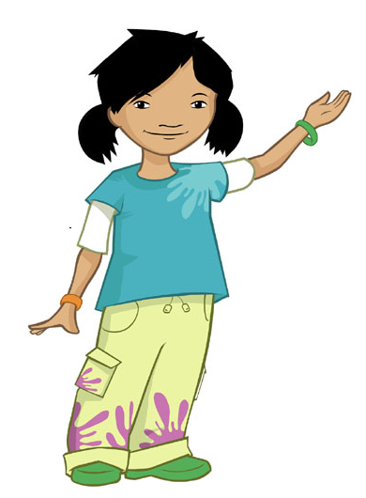
Alisha says…
We have to get ready so the food we make is safe to eat.
We don’t want to get hair, jewellery or dirt in our food.

Slide 4
Ronnie needs to take off his jewellery. What jewellery is he wearing?
I need to take off my wrist band.
What other jewellery might someone need to take off?

Slide 5
Long hair needs to be tied back. What will Alisha need to do?
I need to tie my hair at the back of my head. These bunches might dangle in the food!
Would you need to tie your hair back?

Slide 6
Alisha and Ronnie have short sleeves. What would they have to do if their sleeves were long?
We would have to roll them up to our elbows!
Would you need to roll up your sleeves?

Slide 7
Alisha needs to put something on. What could that be?
An apron! This will stop any dirt and bits on my clothes falling in the food. It will also help keep my clothes clean.
Do you need to wear an apron?

Slide 8
Can you guess what needs to be done last?
I need to wash my hands with soap and warm water, then dry them really well.
It is really important to have clean hands when you are cooking so the food you make is safe to eat.

Slide 9
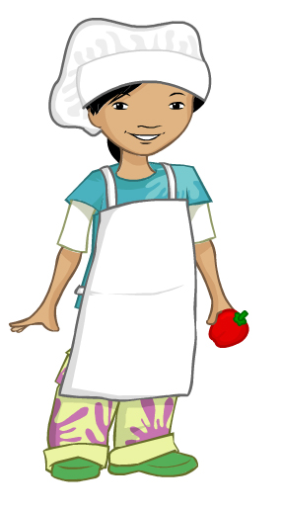
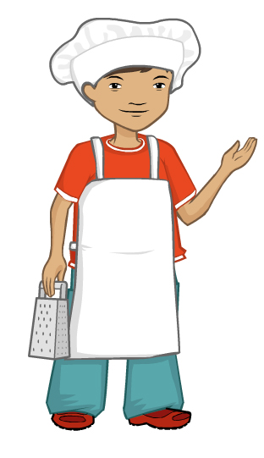
Now we are ready to cook!
Can you remember everything we did to get ready to cook?

Slide 10
Look at the pictures to help you remember.

Slide 11
We need to do these things to be ready to cook.
Take off Jewellery.
Tie back long hair.
Roll up long sleeves.
Put on an apron.
Wash and dry hands.

Slide 12
Get ready to cook!
For further information, go to:
www.foodafactoflife.org.uk
This resource meets the Guidelines for producers and users of school education resources about food.

