Slide 1
The art of food presentation and styling

Slide 2
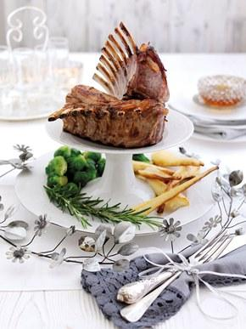
Why is it necessary?
The visual appearance of a dish is as important as its flavour.
Whilst the quality of ingredients, textures and the amalgamation of flavours are the key elements in a successful dish, plate presentation comes a close second.

Slide 3
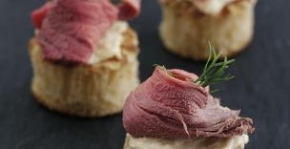
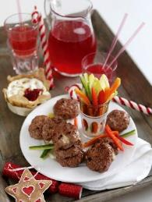
Why is it necessary?
The initial attraction of food comes from the visual appeal. Garnish presentation increases the aesthetic appeal and can also enhance the flavour of some dishes.
Plates can look very bare, even after food has been presented, but garnishes can make the dish look less bare, more elegant and far more presentable.

Slide 4
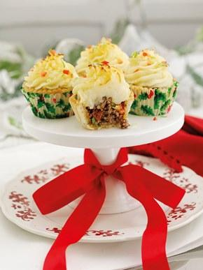
The components of great food styling and presentation
The support (what the food will be served on)
The focal point
Colours
Textures
Decoration and garnish

Slide 5
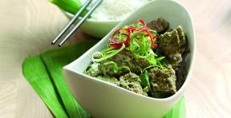
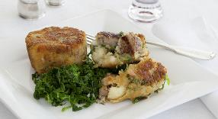
1: the support
The function of the support is to present and reveal the culinary preparation. Its patterns and colours should not interfere with food. Its size should be proportional to the food volume and not give the effect of excess or insufficient food.
For these reasons, professionals most often use plain dark or white plates to express their creativity.

Slide 6
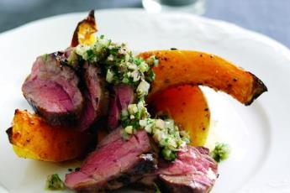
2: the focal point
The focal point is what will mainly attract the eye. It may be the highest element of the composition or it could be the point with the most volume. For a main dish, this place is often occupied the meat, fish or protein alternative.
In all cases, the focal point must be easily accessible to the diner without compromising the overall presentation and look of the dish.

Slide 7
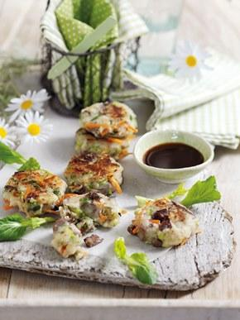
3: the colours
Colour is very important because it can create excitement. Green brings coolness and calms down. Red stands for passion and excitement. Black is a sign of elegance.
However, blue is a natural appetite suppressant and can make food look unappetising, which is why you won’t find restaurants serving on blue plates.

Slide 8
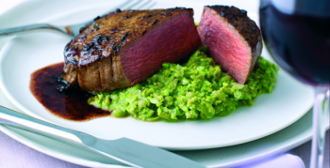
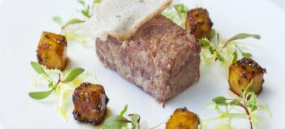
3: the colours
The use of vegetables and their contrasting colour and shape are important.
Care must be taken to use their shape and colour wisely, in a way that presents them without hiding other elements of the dish.

Slide 9
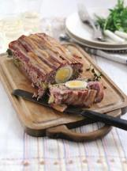
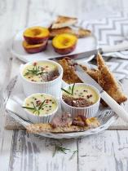
4: the textures
Texture is a critical component of good food presentation.
Contrasting textures are made by different preparation methods.
By contrasting firm and soft, silky and rigid textures, the whole dish takes on a higher dimension and adds a visual interest.

Slide 10
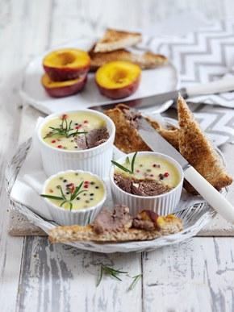
5: Decoration and garnish
Garnishes or decorative techniques should be functional and edible, with exceptions such as skewers and speciality utensils.
They should always enhance and flavour food. They should add contrasting colour, texture and overall interest.

Slide 11
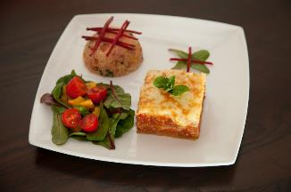
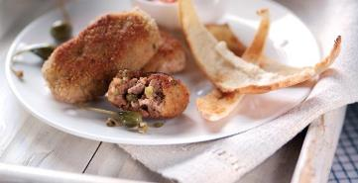
5: Decoration and garnish
Edible decoration could include:
fresh herbs or dried spices;
toasted nuts, sesame or pumpkin seeds;
julienne strips or ribbons of vegetables;
twists of citrus fruit, shaped or carved vegetables;
crispy croutons.

Slide 12
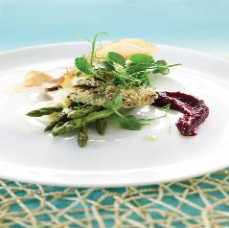
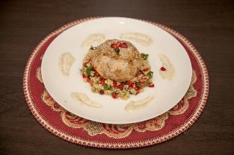
5: Decoration and garnish
Edible decoration could also include:
coarsely crushed peppercorns;
grated citrus zest;
edible flowers such as nasturtium, elderflower and cornflower or pea shoots;
edible herb flowers such as chive, garlic and fennel;
swirled, brushed, painted or piped cream, half fat crème fraiche, jus or compotes.

Slide 13
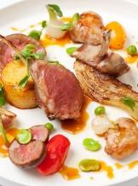
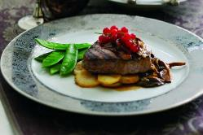
Tips for dressing a plate
Traditionally chefs have used large white or neutral coloured plates. If there is a design, i.e. the name or logo of an hotel, this would normally be on the border.

Slide 14
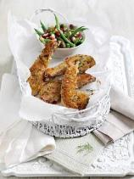
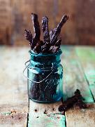
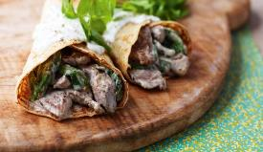
Tips for dressing a plate
Increasingly, modern chefs often use alternative ways to present their food such as paper cones for chips, preserving jars for pâté, individual lidded dishes for casseroles, mini saucepans for soups and natural stone or wooden plates.

Slide 15
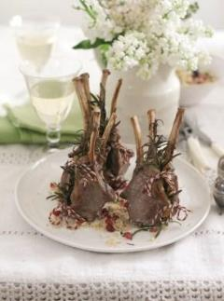
Tips for dressing a plate
Portion control – consider portion sizes and current healthy eating advice.
Also, the smaller the portion, the easier it is to create compact, elegant servings.

Slide 16
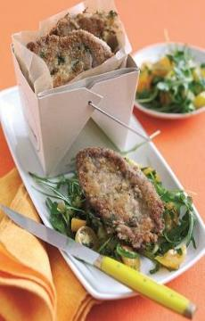
Tips for dressing a plate
Follow the rule of odds - having an odd number of elements on a dish is more visually appealing than having an even number.
It creates the impression that a piece of food is being framed by the others.

Slide 17
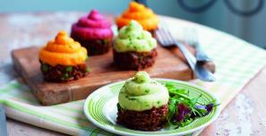
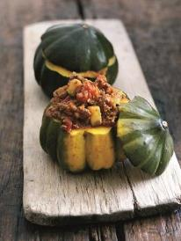
Tips for dressing a plate
Use of vibrant colours – liven up your plate with vegetables or sauces in bright sharp colours, especially if the dish has a dark colour such as a steak or casserole.

Slide 18

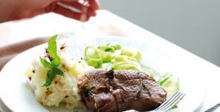
Tips for dressing a plate
Food positioning – if faced with lots of ingredients, the classic way to plate it is to ‘clock it’. Place the potatoes, pasta or rice at ten o’clock, meat or fish at six o’clock and the vegetables at two o’clock

Slide 19
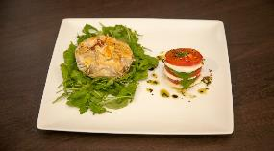
Tips for dressing a plate
Elevation – stack meat, fish, eggs or cheese over starch components such as rice, pasta and couscous in a tight pyramid or cylinder for the ‘wow factor’.

Slide 20
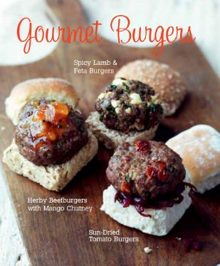
Tips for dressing a plate
Repetition of ingredients – lay three small identical pieces of protein side by side with different garnishes on each one to add visual interest. Repetition is an easy way of creating a picture.

Slide 21
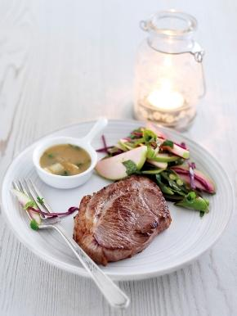
Tips for dressing a plate
Make sure the plate is clean – after going to the trouble to present your food beautifully, make sure you don't serve it on a dirty plate and make sure that any drips have been wiped.

Slide 22
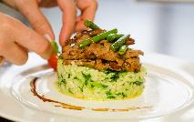
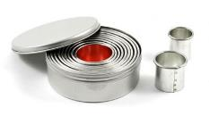
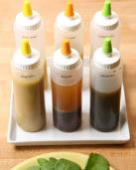
Tools for presentation and styling
Useful tools for presentation and styling include:
tweezers/small spoon – useful for positioning small, delicate pieces of garnishes;
plain/fluted biscuit cutter – these are great tools for creating shapes to layer meat, fish and vegetables. The thinner the layers, the more impressive the outcome;
paintbrush or squeeze bottle – use these to creatively add sauces in a creative and controlled way.

Slide 23
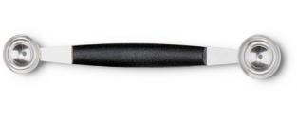
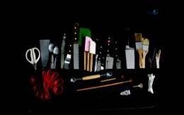
Tools for presentation and styling
Other useful tools for include:
melon baller, julienne peeler and apple corer – use these to create attractive garnishes with fruit and vegetables;
palette knife – to smooth the sides or tops of dishes and ease removal of dishes from moulds or rings;
piping bags and nozzles – create attractive decoration and garnishes on sweet and savoury dishes using different sized/shaped nozzels.

Slide 24
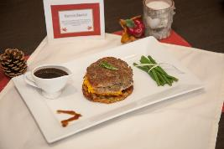
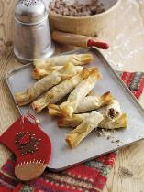
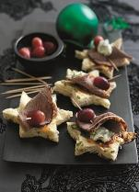
Props
Try to include props as part of your overall food presentation, such as flowers, napkins, glassware, cutlery, tablecloths and a menu.
If you are producing a dish or menu based on a theme or culture include appropriate decorations and cutlery such as Christmas baubles for a yuletide dish.

Slide 25
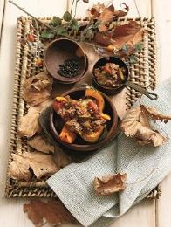
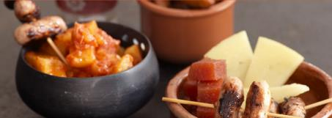
Food trends
And finally …
Keep on top of food presentation and styling trends by reading food magazines, watching cookery programmes and following food blogs.

Slide 26
The art of food presentation and styling
For further information, go to:
www.foodafactoflife.org.uk
This resource meets the Guidelines for producers and users of school education resources about food.

