Slide 1
Building cultural awareness in delivering healthy eating messages in the food classroom
Georgine Leung
Nutritionist and Food Consultant
PhD Researcher, Institute for Global Health, University College London

Slide 2
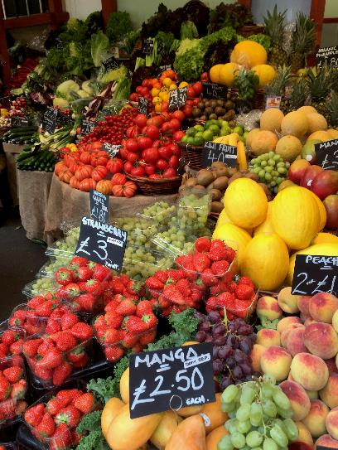
Outline
Diets of ‘minority ethnic groups’ in the UK, what should we take note of?
What is a traditional diet, and what are traditional foods? How do they fit into our everyday food culture?
Examples of how The Eatwell Guide can be adapted to different food cultures.
How can we engage with pupils from different cultural backgrounds during food lessons?

Slide 3
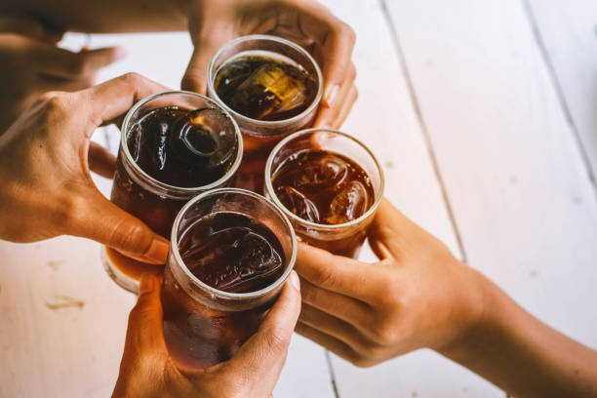
Ethnicity and health
‘Ethnicity’ is self-reported (ONS)
Health disparities across ethnic groups, driven by many factors
Associations with traditional diets or dietary assimilations?
Drivers of food choice important
Terminology matters
Notes:
First and foremost, ethnicity is a complex, multidimensional concept, defined by shared history, origins, language and cultural traditions. This is why ethnicity is a subjective identity, depends on how individuals define themselves. According to the latest Census, minority ethnic groups constitute around 15% of the UK population.
However, we observe health patterns differ across these self-defined ethnic groups, also accounting for the diversity of demographic, socio-economic, behavioral, cultural and other characteristics amongst ethnic groups. One particular health outcome is obesity, research has found that South Asians tend to have higher amount of body fat at a lower BMI that calls for earlier health interventions with accurate weight ranges, to control their risks for Type 2 diabetes and cardiovascular disease, using culturally appropriate approaches.
For example, the Born in Bradford one of the country’s largest birth cohort study which studies over 13,500 children in Bradford on the determinants of childhood and childhood disease, observed that compared to white British homes, Pakistani homes were more likely to have and serve fruit and sugar-sweetened beverages compared to water, as a sign of hospitality, however the cheapness and desirability of these drinks have also influenced personal consumption too. But no story is one-size-fits-all. It is very important to understand these ideas and exploring them across different generations of migrants too. Importantly, we also know that people from lower socioeconomic backgrounds are more likely to experience poor health outcomes, some ethnic groups such as Bangladeshi (40%) and Pakistani (39%) adults are more likely to have a lower socioeconomic classification.
However, it is very important when talking about health differences, it is easy to risk stigmatisation and messages should come across as inclusive, rather than patronising. This is why terminology and representation matters. It is important to understand people’s lived experiences, and this is why qualitative research has been very useful in identifying people’s reasons behind food choices.

Slide 4
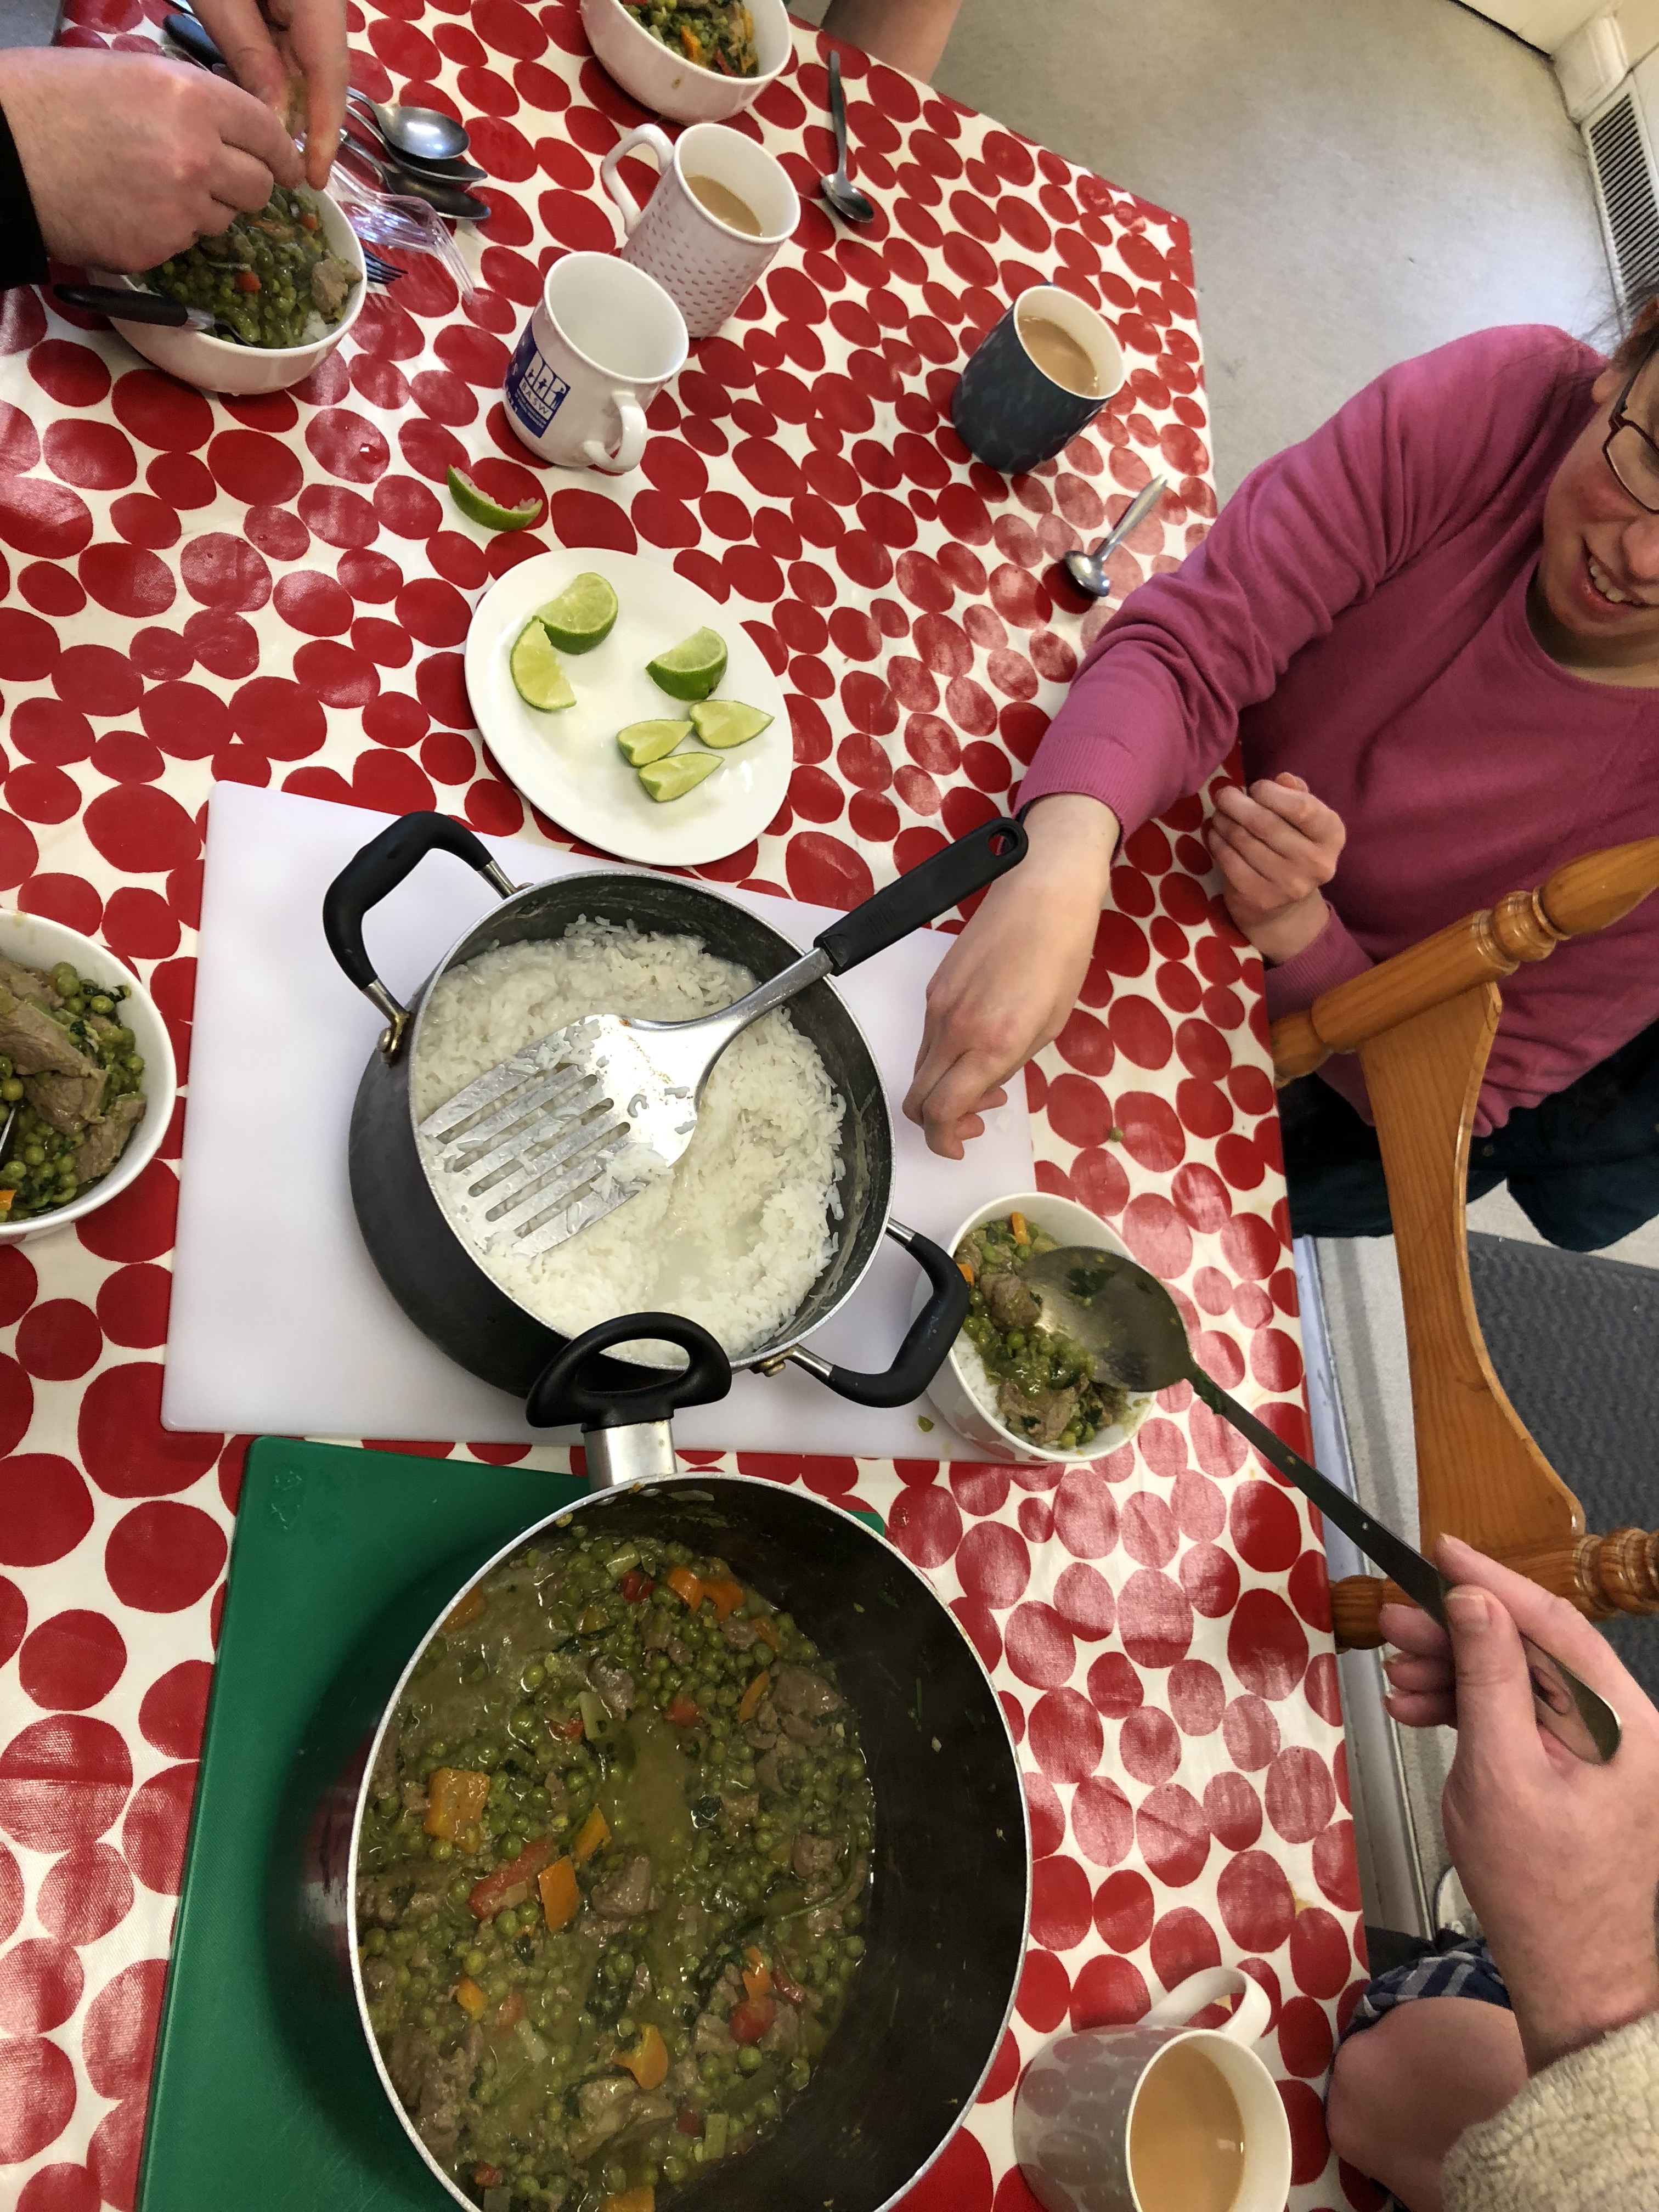
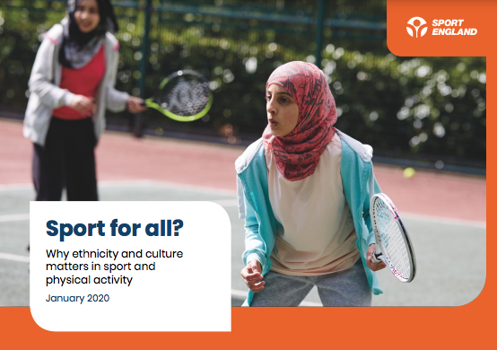
Cultural ideas of health
Community and social eating
Contextualising physical activity recommendations as there are differences in the kind of activity that is accepted, also across gender
Notes:
It is also important to address that social and community eating plays a huge role in some minority ethnic groups, this is why this context is key in understanding what works for nutrition interventions.
Further according to this report by Sport England, we know that children from minority ethnic groups are less likely to be as active as their white counterparts. The issue of representation has been raised for some sports such as swimming, basketball and cricket where some group are under- or over-represented. The inequalities across physical activity levels are further exacerbated by their socioeconomic backgrounds. This is why factors such as access to facilities, confidence to take part especially group activities, learning the benefits of exercise, and the enjoyment, are important to improve the widening participation of children from different backgrounds.

Slide 5

What are ‘ethnic foods’?
World cuisines, foods and flavours imported from the rest of the world
Mutual influences through historical trade routes, migration, international travels and social media
The growth of ‘world foods’ has seen the largest growth in the UK retail sector during 2020 with the majority of consumers eating these at home even before the pandemic (Mintel, 2021)
Notes:
With this background in mind, let’s now have a look at what traditional and ethnic foods mean.
World cuisines have always been reshaped through historical trade routes. The movement of people brought with them different foods and flavours, and increasingly international travel and now social media enabled the ‘consumption’ of world cuisines which might not be previously available to them, garnering more interest to re-create these at home. This is why the growth of world foods has seen the largest growth in the UK retail sector throughout last year when more people were cooking at home.

Slide 6
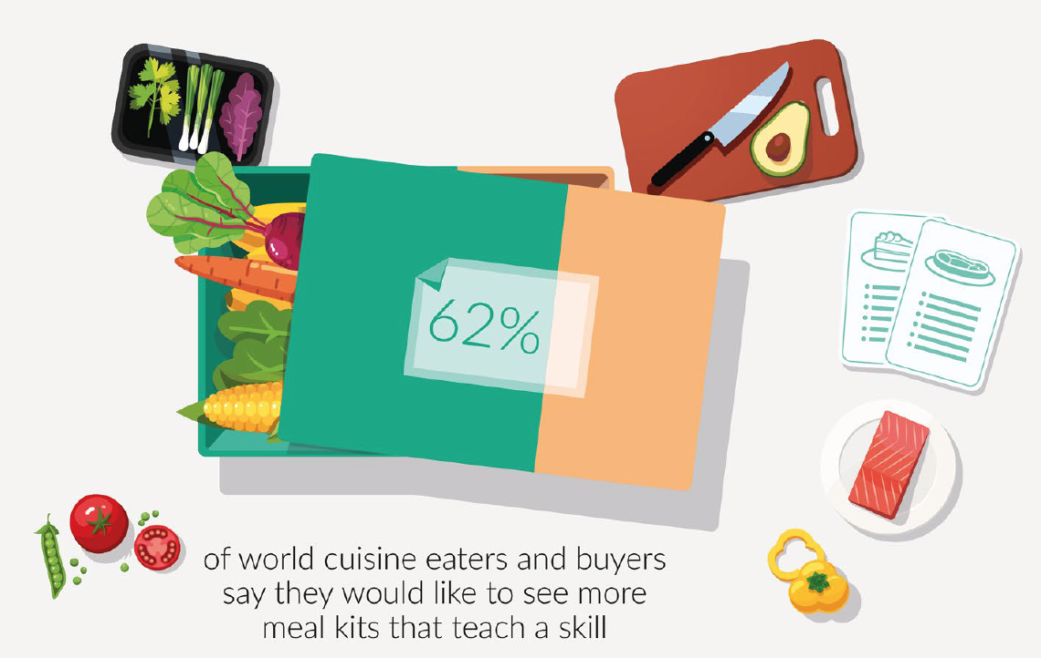
Market trends
Types of world cuisine products eaten or used in the last three months, November 2019 and March 2021
"Which types of world cuisine products have you eaten/used at home in the last 3 months? Please select all that apply."
Notes:
These are findings from the latest Mintel market intelligence report, which surveyed on close to 1800 UK consumers, about the types of world cuisine products eaten or used in the past three months. This shows that compared to 2019, the use of cooking pastes, seasonings and meal kits fueled by more home cooking during lockdown, and spending more time at home. This shows that consumers nowadays are curious to try to recreate ‘world cuisines’ at home, showing the importance of learning practical skills of putting ingredients and different flavours together.

Slide 7
Market trends
Behaviours relating to World Cuisines, March 2021
“Do the following apply to you?"
Notes:
Also according to Mintel, the idea of trying and learning something new and healthier options have also been identified as the most important when it comes to eating ‘world foods’, calling for the need for this to begin in the food classrooms, as young learners are becoming more curious at an earlier age too, experiencing food as a way of travel too.

Slide 8
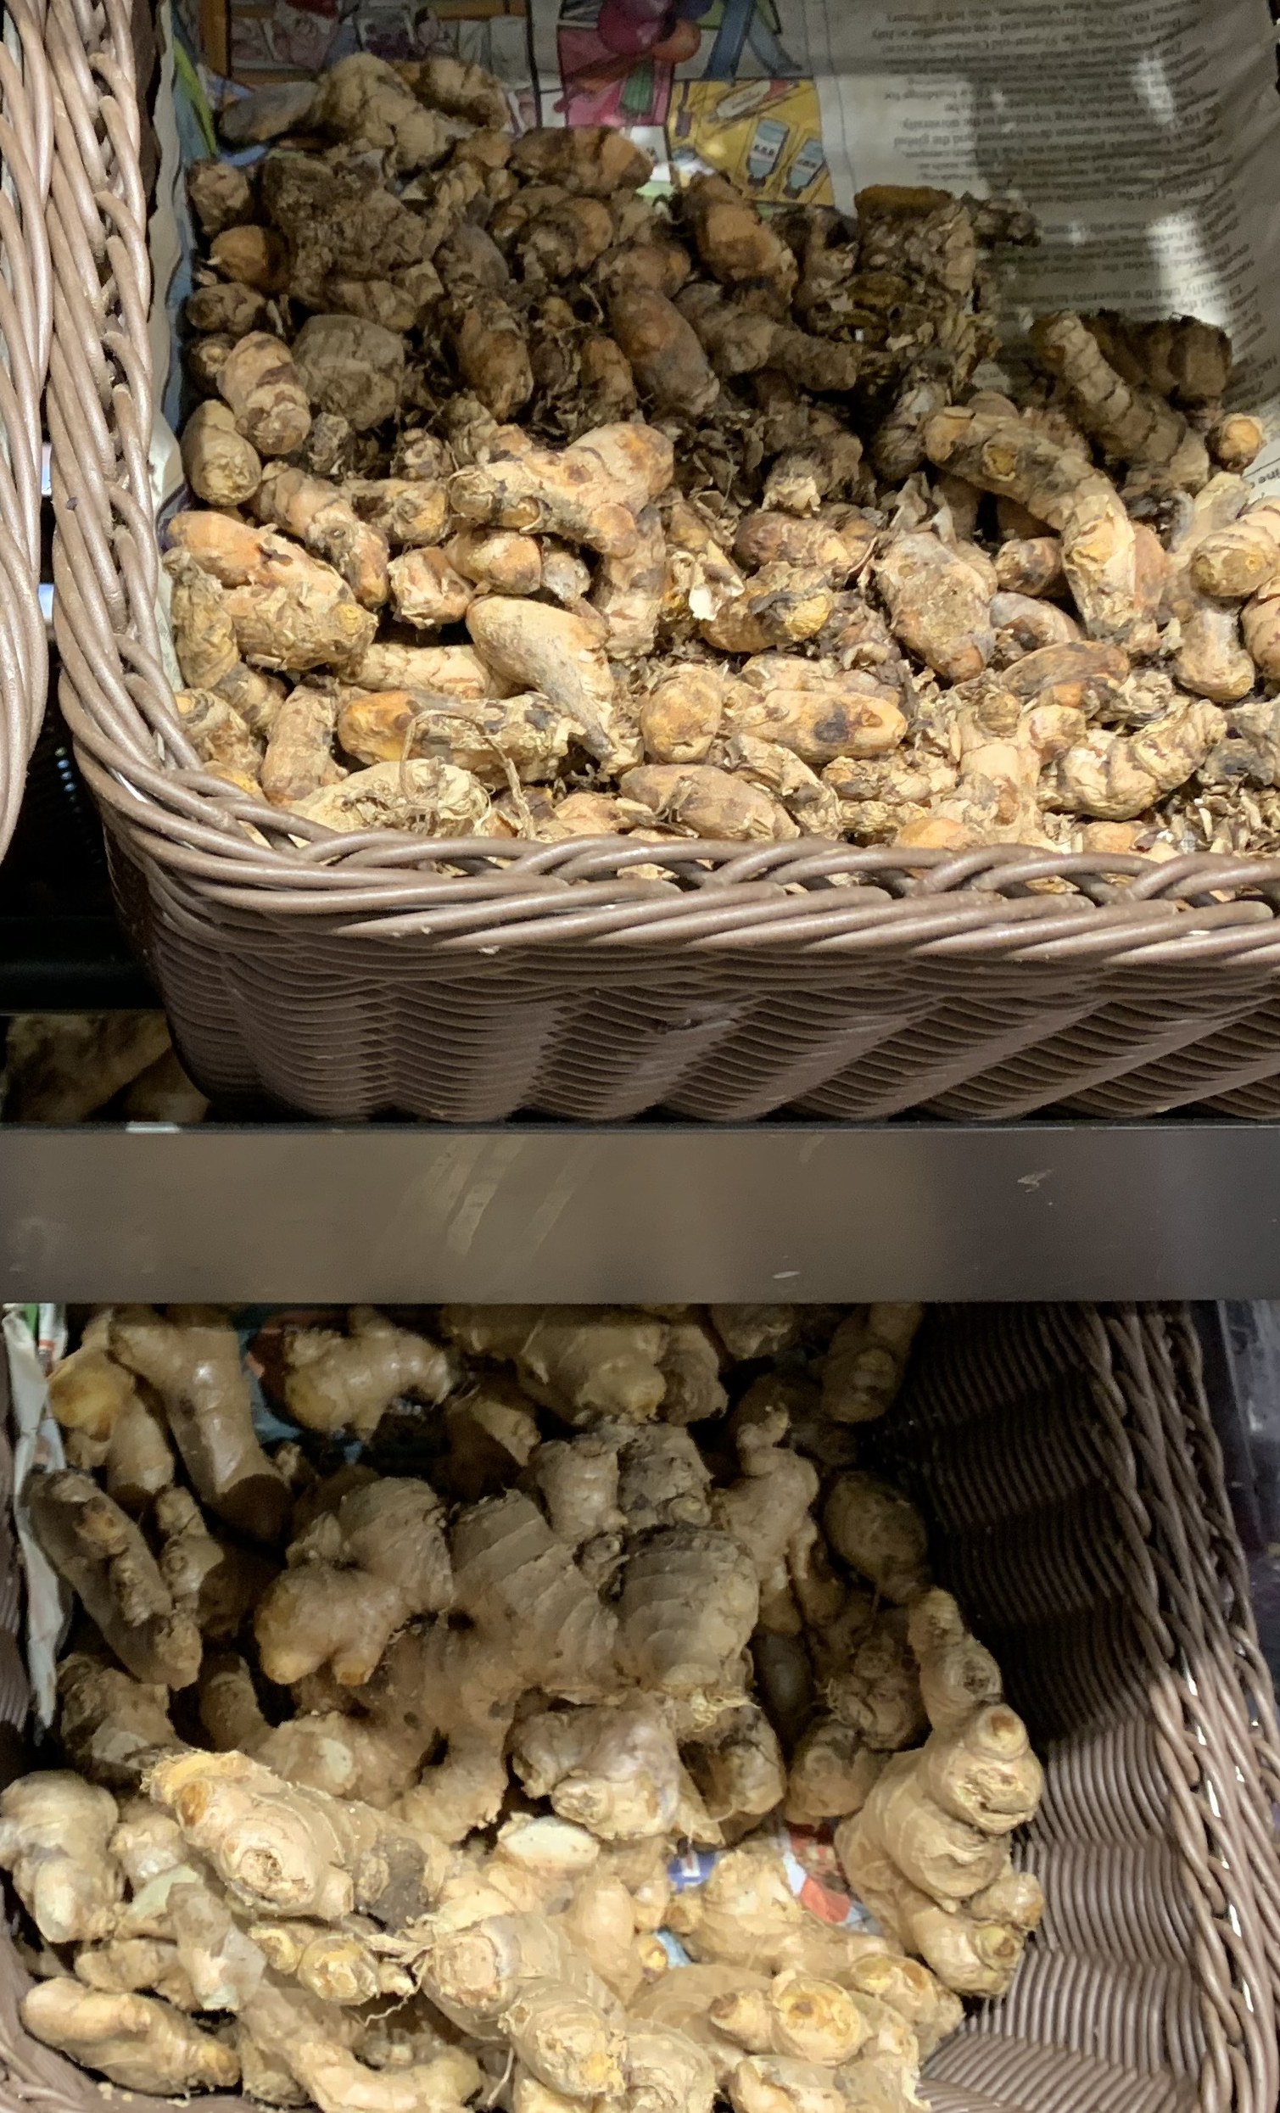
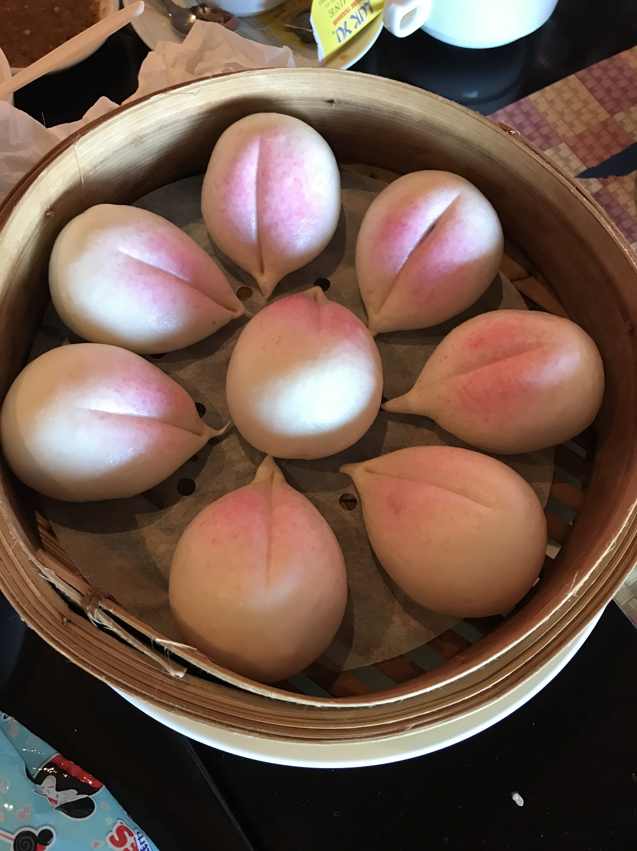
Traditional diets
Food offers a tangible way for migrants to connect with their culture, and to mark their social identity
There are a range of traditional foods, flavours and cooking techniques available
Important to note extent of assimilation and generational change
Notes:
To access/learn more about world cuisines, one of the ways is to study what food culture means to different people. There are foods which are more strongly associated with certain cultures and festivals, for example these are root tumeric and ginger which are important spices for South Asian cuisines. The buns on the right are longevity buns shaped like peaches to celebrate birthdays in Chinese culture, especially for the older generation. However, these are not commonly eaten now as cakes become more popular and seen as a standard birthday food. This is why understanding generational change is also very important. Depending on the extent of assimilation, the diets of minority ethnic groups will vary. Next, we are also going to have a look at the ways how to incorporate different foods and culinary skills in teaching about healthy eating too.

Slide 9
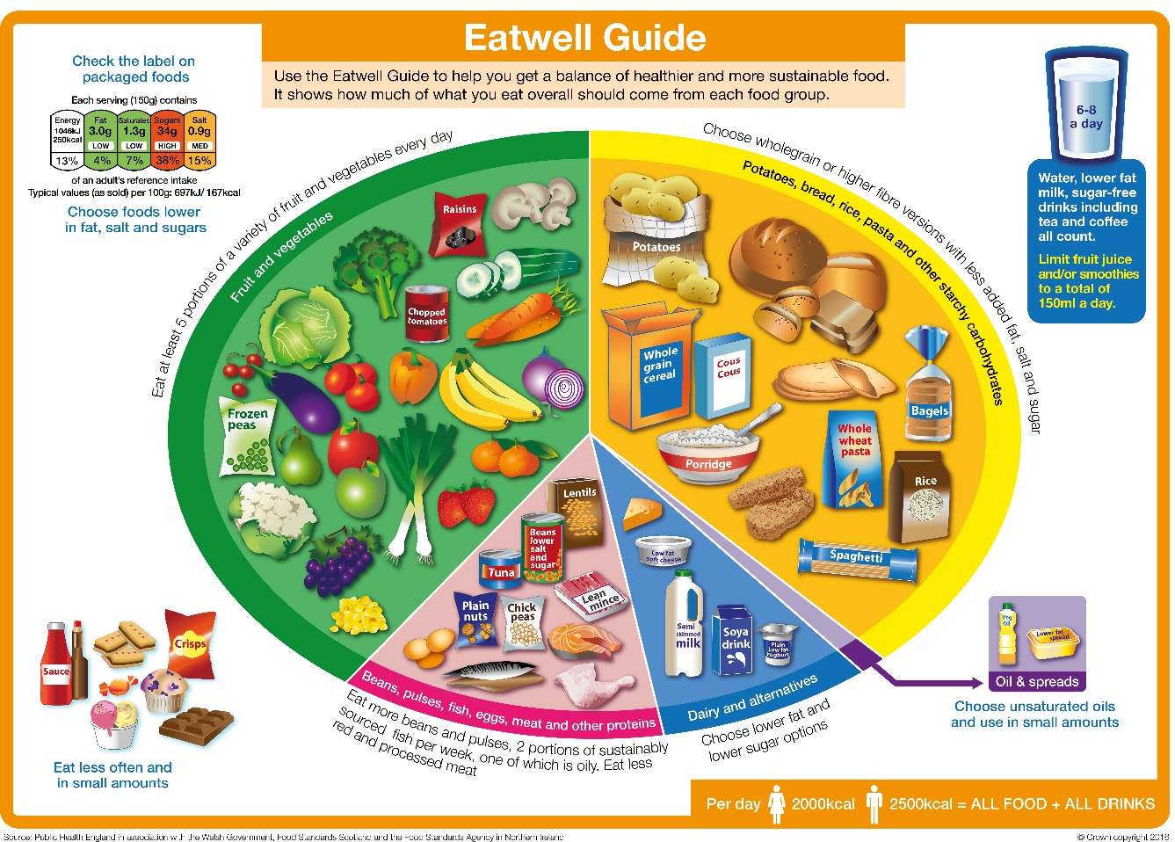
Notes:
The eatwell plate is designed to depict a large range of food typical to the UK diet, but we know everyone eats differently. Research shows us that we make around 200 food decisions each day but only a handful of these are conscious ones. So it is important to recognise these individual drivers to understand what foods are relevant to the students and to ourselves.
A fun activity would be to ask students to bring in a food/take a picture of a food to place on the eatwell guide.
Starchy foods: Breads such as chapati, dosa, steamed buns, wheat products such as noodles, root tubers such as cassava, yam and sweet potatoes.
Fruit and vegetables: okra, daikon/ mooli or turnips, spring greens (bak choi/ choi sum) – probably the group which offers the largest variety of foods
Protein: This is probably the group which links to talks about sustainability, especially relating to animal farming. Fish, chicken and other poultry, some kind of red meat which are not shown. And how vegetarian sources such as beans and pulses can contribute, including soya products of different kinds, from tofu to tempeh, and some plant-based alternatives, a great conversation starter about ‘plant-based meat alternatives’ and can be quite controversial.
But these might also be foods which are consumed by the mainstream population too, depending on where you are in the country. This is why when using the Eatwell plate, there are many further teaching points to invite pupils to talk about the foods relevant to their culture.

Slide 10
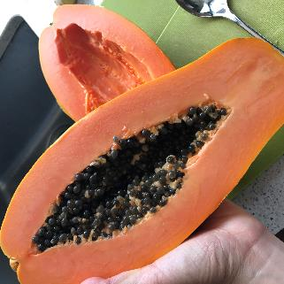
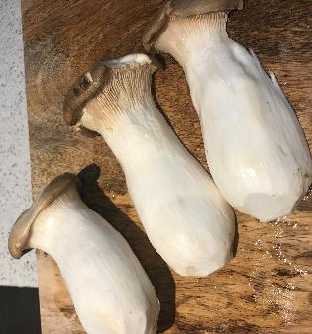
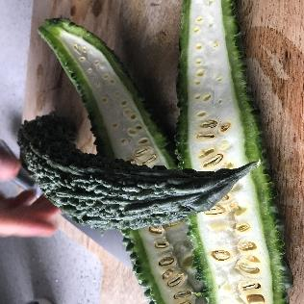
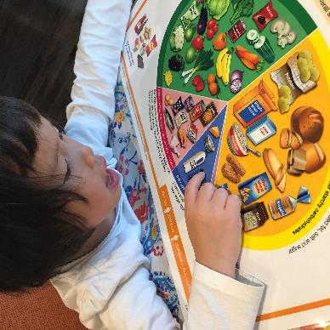
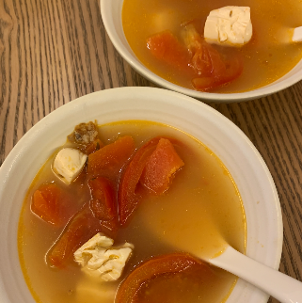
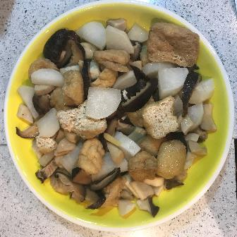
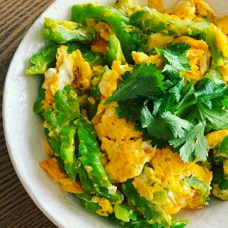
An example to name foods and what they are made into:
Notes:
Papaya, King oyster mushroom, Bitter gourd

Slide 11
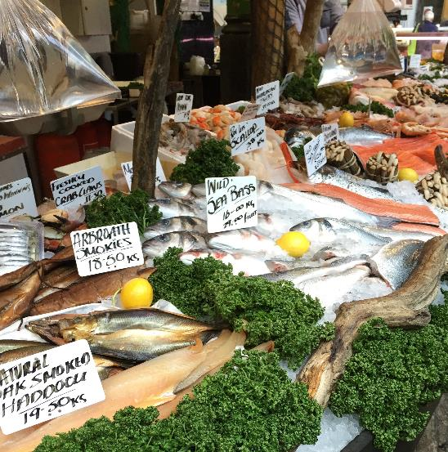
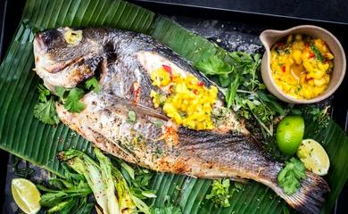
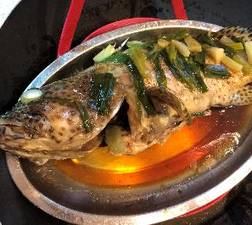
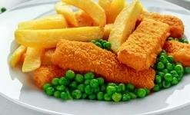
Learning about different cooking techniques
Notes:
Even for the same food, there is a wide range of cooking techniques employed reflecting of various culinary cultures. I’ve included an example of fish here because it’s consumed all over the world. It’s also linked to our conversation about sustainable diets. Also, a question might also be whether children will be happy to have the whole fish on their plate.
For example, battered fish fillets are most popular with many families in the UK, whereas eating whole fish grilled is considered very common in African-Caribbean cooking, whilst for some, fish simply steamed is common for Asian families.

Slide 12

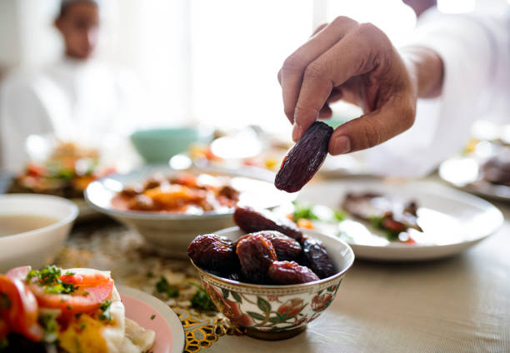
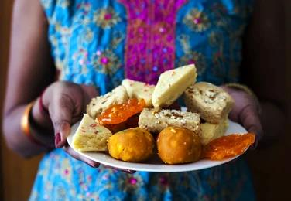
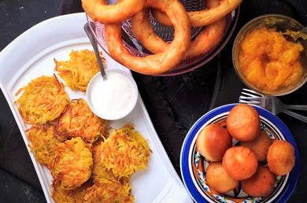
Learning about festive foods
Notes:
Traditional festivals and festive foods offer a way to further the understanding of students of different cultures. Often these enable to learn more about world history too. There are many examples of these, some of the more notable festivals include the Lunar New Year, marked by many events in China Town, the Iftar meal that is eaten at sunset, during the month of Ramandan celebrated by the Muslim community, the Hindu festivals of Holi (Festival of Colours), Diwali (Festival of lights) where food is a major focus where families share sweet foods, and Hannukah, also the Festival of Lights marked by the Jewish community. This is particularly important to students whose families practise this, and a way to learn about the importance of festivals through stories, as well as the foods which mark these occasions.

Slide 13
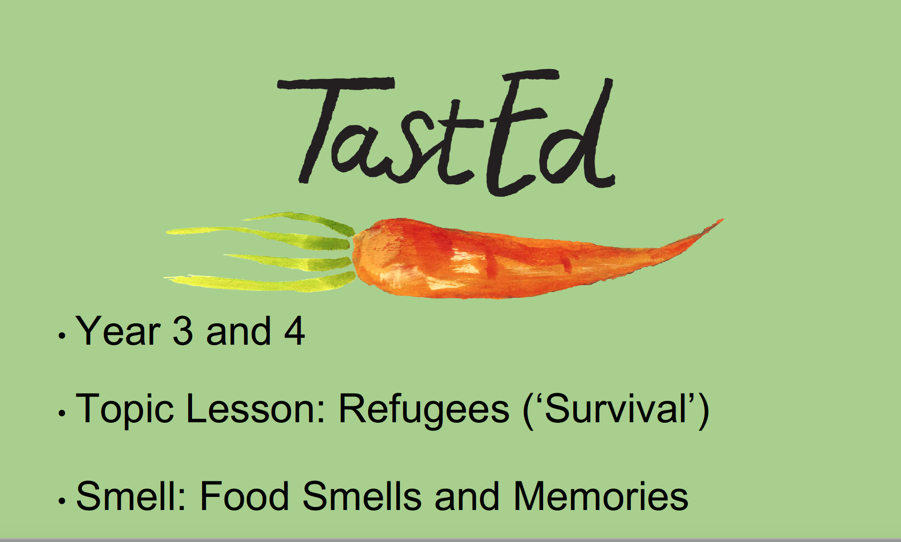
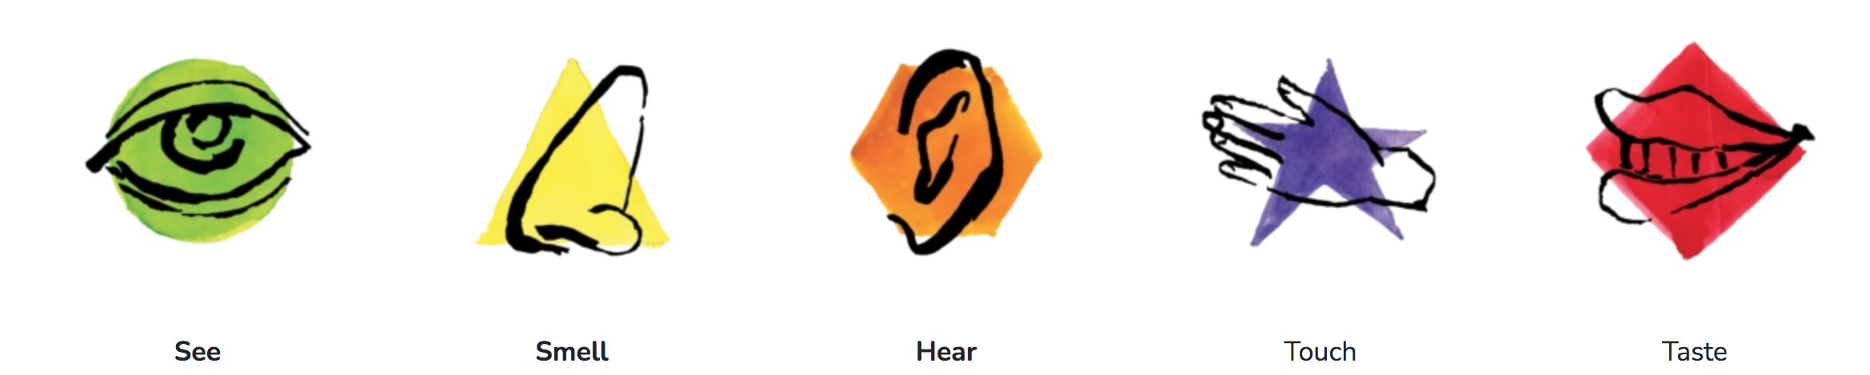
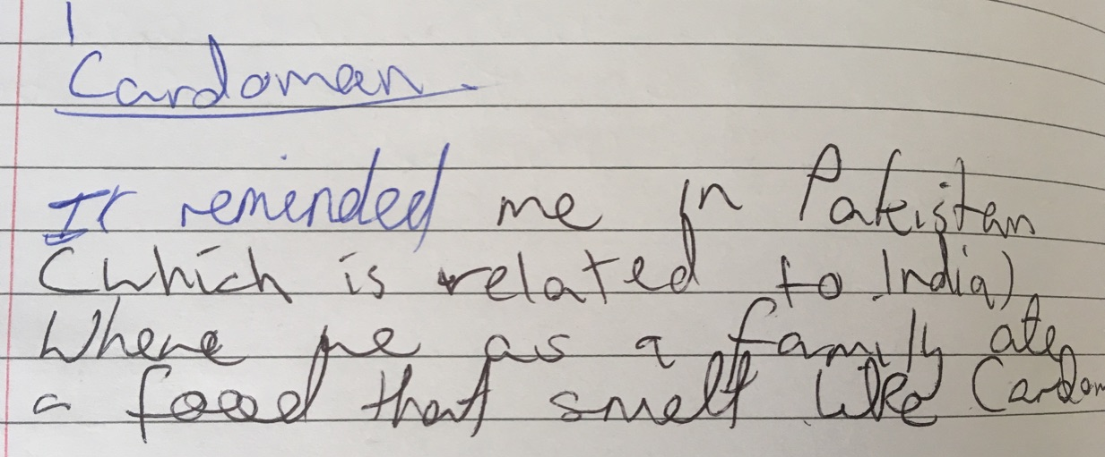
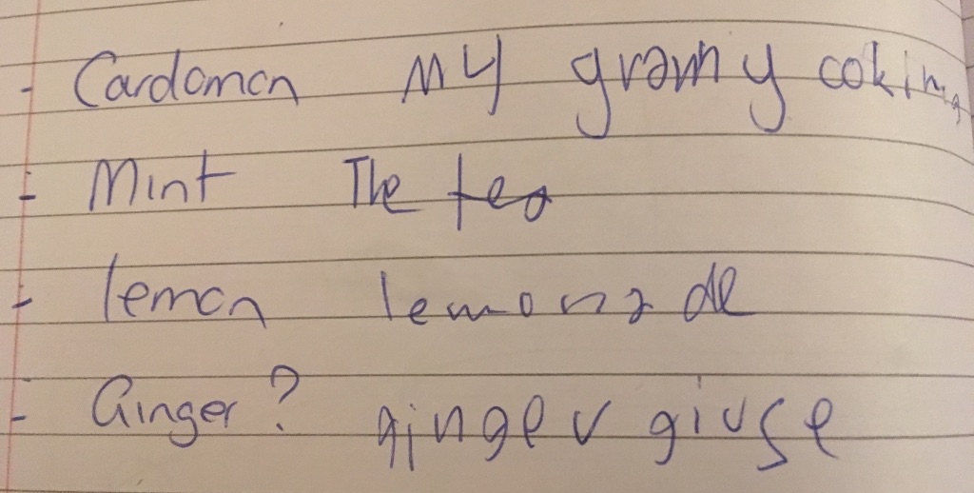
Sensory education
Taste Education UK
Notes:
As food teachers, I’m sure you are well aware how teaching food helps supports learning about healthy eating, but also cross-curricular learning. One such approach is sensory education in food. Taste Education is a charity which champions the links between food and literacy using the senses, and to encourage children to talk about the food through seeing, smelling, hearing, touching and tasting the food. They offer free lesson plans such as this on food and refugees for Years 3 and 4.
Students are not pressured in trying the food, but are encouraged to share why they like/dislike the food. So far the evidence shows that after even 1 session of taste education, even children who were reluctant to try a particular fruit and veg has given it a go. We also know how food especially smell evokes memories, so this is a particular useful way to encourage children from different backgrounds as a prompt for them to think about a food memory such as two 11 year-olds talking about how cardamom reminded them of visiting family in Pakistan, whilst for another evokes memories of his granny’s cooking. These food stories have been identified as affirming examples of cultural sharing through food.

Slide 14
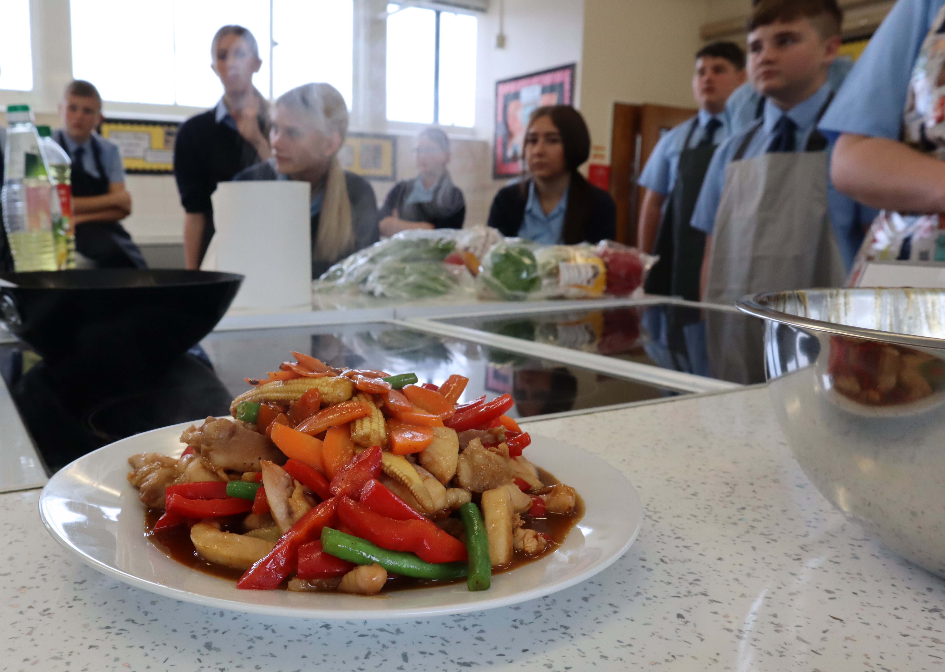
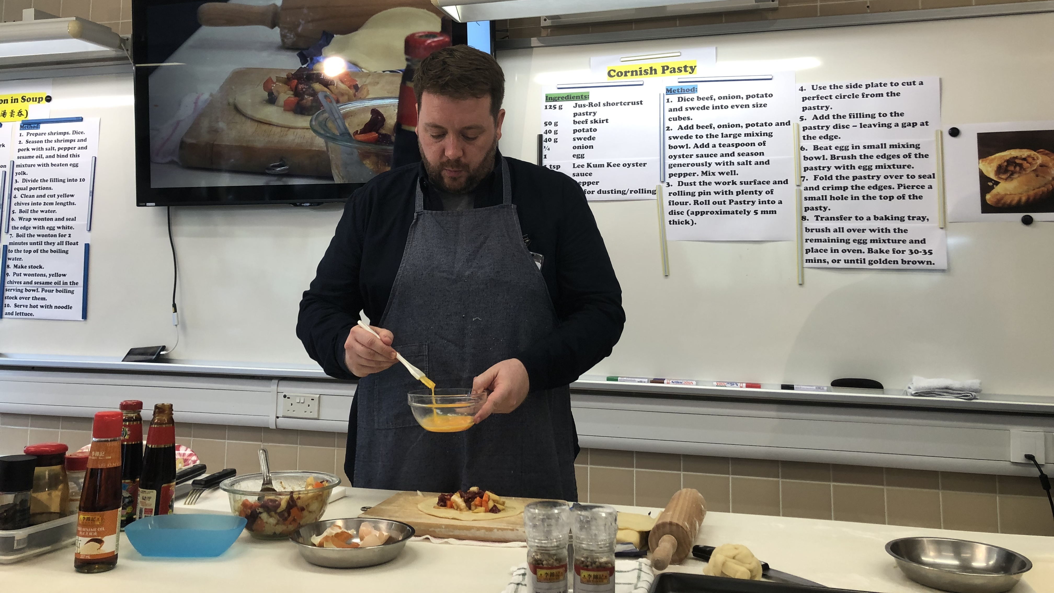
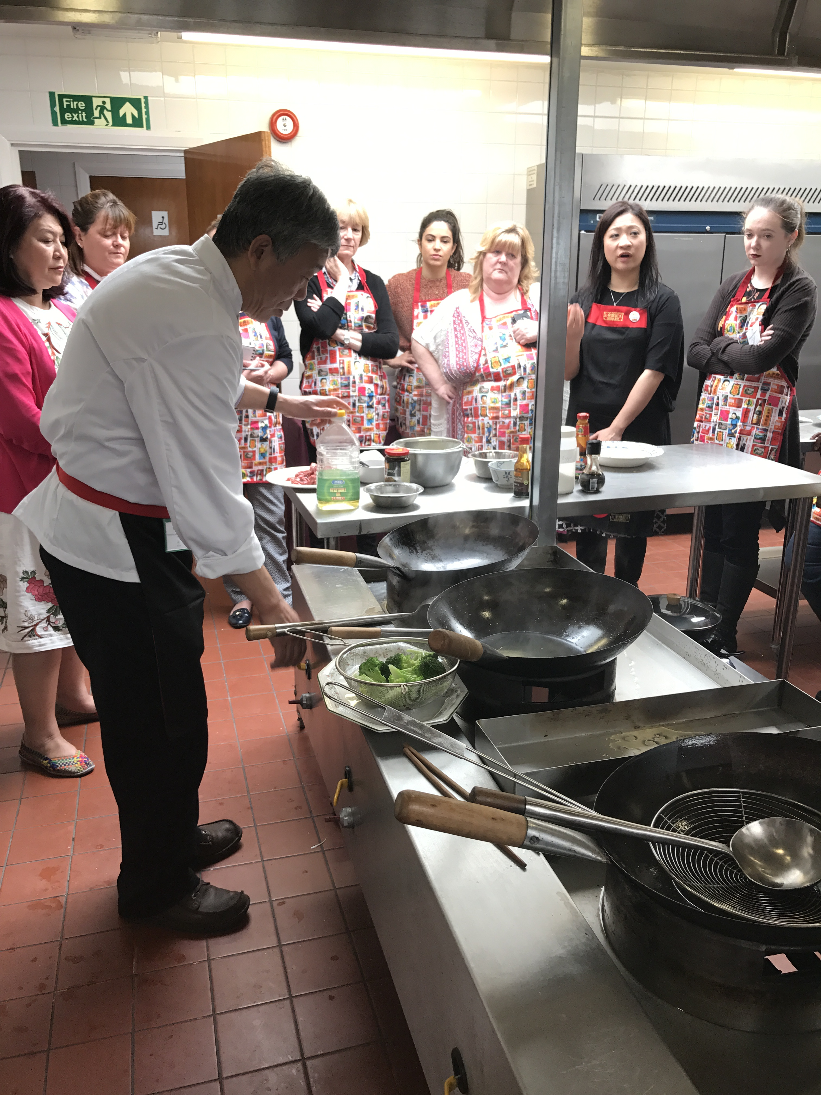
Teacher-training cooking programmes
FUN Healthier Chinese Cuisine ambassador
Notes:
There are some organisations which run teacher-training sessions which are free of charge to schools. One such is the FUN Healthier Chinese Cuisine Ambassador which supplies a wide range of condiments to support the teaching of a range of culinary techniques in Chinese cooking. An annual competition is held where the top three teachers get a free trip to visit Hong Kong where some of these condiments are made. Here are some teachers learning from the Institute’s North London kitchen, and on the right is Mr Matthew Walker from the John Warner School in Hertfordshire in the food room at a secondary school in Hong Kong, demonstrating the making of Cornish pasties using oyster sauce, to local students.

Slide 15
References and further reading
Barilla Centre for Food and Nutrition (2017 ) Food and migration.
Bryant et al. (2015) An exploration and comparison of food and drink availability in homes in a sample of families of White and Pakistani origin within the UK. Public Health Nutrition 18 (7), pp. 1997-205
Mintel UK (2021) World cuisines UK.
Sport England (2020) Why ethnicity and culture matters in sport and physical activity
The Kings Fund (2021) The health of people from ethnic minority groups in England.
Yang and Chew (2019) Born in Bradford: Research that changes a city https://borninbradford.nhs.uk/wp-content/uploads/BIB_Supplement_Magazine_2019_Web.pdf

