Slide 1
Non-enzymic browning

Slide 2
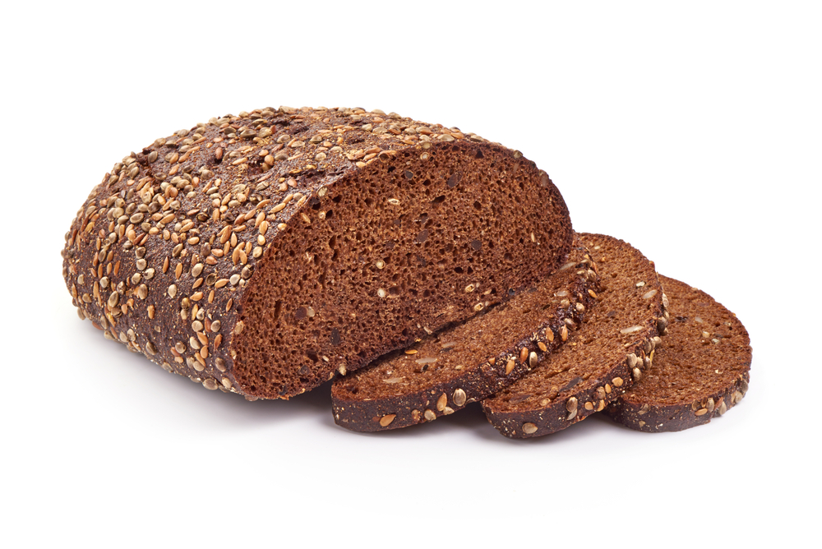
Introduction
Non-enzymic browning refers to a number of different processes and reactions that can make foods ‘brown’.
This pack will cover the following processes:
the Maillard reaction;
caramelisation;
dextrinisation.
Enzymic browning will be covered in a separate pack.

Slide 3
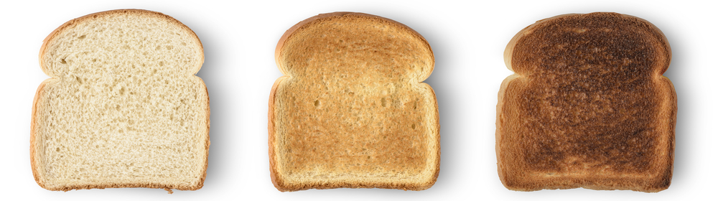
Dextrinisation
Dextrinisation is a reaction that causes the breakdown of starch.
This occurs when starchy foods are heated (without water).
Starch breaks down into ‘dextrins’, many of which are brown in colour and also provide a ‘toasty’ flavour.
If dextrinisation goes on for too long, dextrins can break down further and result in burnt smells and blackening.
A good example of dextrinisation in action is toasting bread. Dextrinisation changes the colour of the bread and produces ‘toasty’ aromas.
As bread is toasted for longer, more starch is broken down.
If dextrinisation continues for too long, the toast becomes burnt.

Slide 4
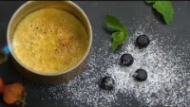
Caramelisation
Caramelisation is another non-enzymic browning reaction.
However, unlike dextrinisation, caramelisation is a reaction involving the breakdown and reaction of sugars, rather than starches.
Caramelisation commonly occurs in desserts (such as a crème brulee, see video) but also in sauteed vegetables (e.g. carrots, onions).
The heat of the blowtorch causes the sugar on top of this crème brûlée to caramelise rapidly, forming a hard, sweet crust with a browned appearance.

Slide 5
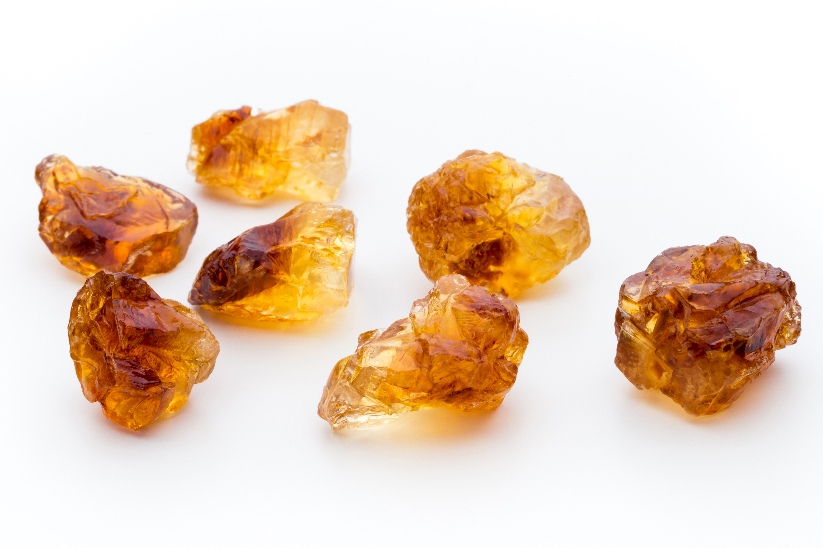
Making caramel
Usually, sucrose (table sugar) is used to make caramel.
Sugar is heated slowly and the sucrose splits into glucose and fructose, which then combine to form different types of brown molecules.
These complex molecules also create the distinctive smell and taste of caramel.
Caramel sauces are made by a similar method but also include cream or vegetable oils. This results in a softer end product.
Toffee is a product of heated sugars, caramel and butter.

Slide 6
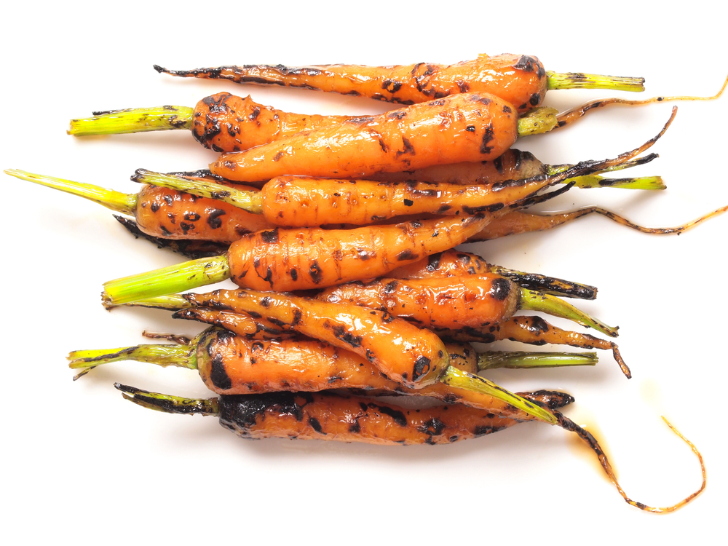
Caramelisation of fruits and vegetables
Caramelisation can also occur in fruits and vegetables, particularly in those with higher sugar content.
Carrots are a typical example. They are naturally high in glucose, fructose and sucrose.
This means that they brown and gain some caramel flavours when cooked at high enough temperatures.
Sometimes, more sugar can be added to increase the degree of caramelisation.

Slide 7
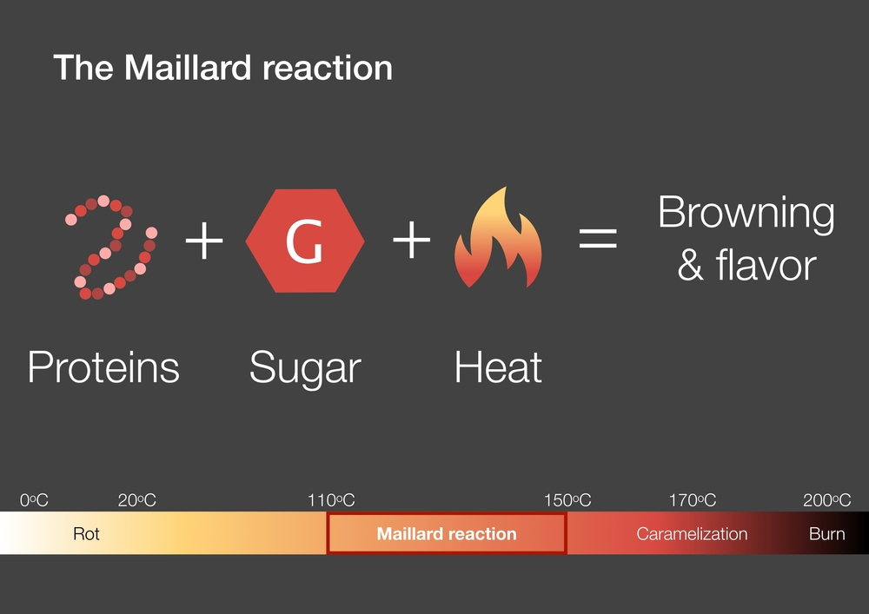
The Maillard reaction - introduction
‘The Maillard reaction’ actually refers to a lot of many different reactions that occur when certain foods are cooked.
The reactions start when amino acids (the building blocks of proteins in food) react with a ‘reducing sugar’.
A reducing sugar is a sugar with a chemical group that is ‘free’ to react.

Slide 8
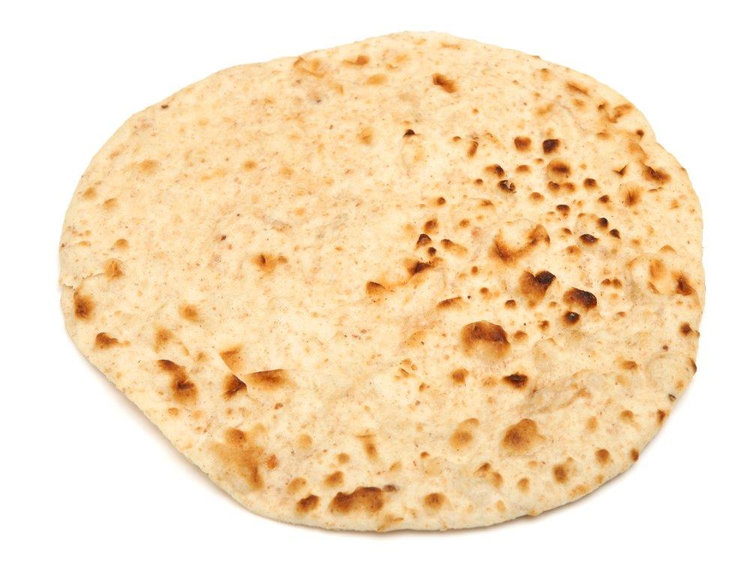
The Maillard reaction - continued
As the Maillard reaction continues, multiple different, complex molecules are produced. Many of these are brown and contribute to the colour of foods such as baked goods and meat.
Not only do these compounds make the food look more appetising, they also change the smell and flavour.
The distinctive aromas of freshly baked bread and a seared steak are largely because of the Maillard reaction.

Slide 9
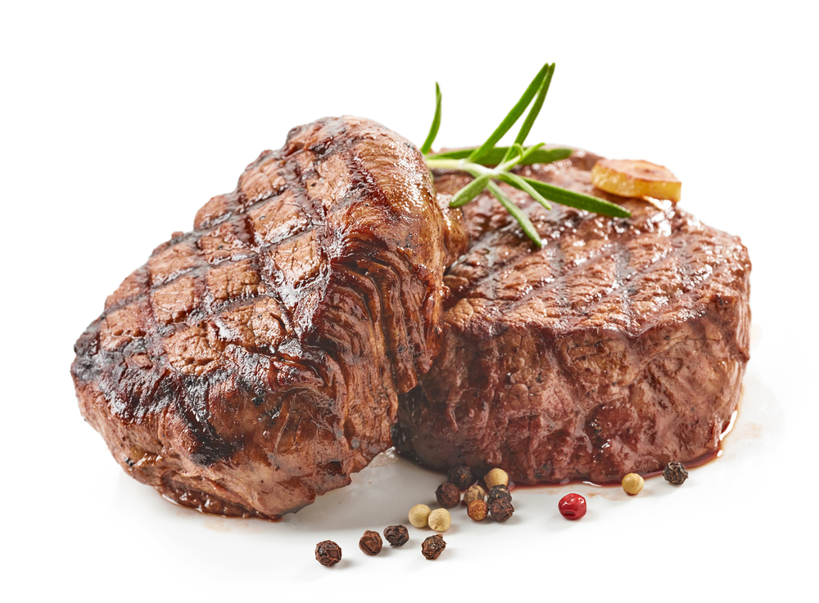
The Maillard reaction - conditions
The Maillard reaction occurs rapidly between 140-165°C but does occur at slower rates above and below this range.
As temperatures get higher, the amount of caramelisation increases and breaks down the sugars, which limits the Maillard reaction.
Too much water can prevent the Maillard reaction and reduce the amount of browning.
For example, if a steak was cooked in a frying pan with added water, it would not go as brown, even if it is cooked at the same temperature.

Slide 10
Key words
Key word | Meaning
amino acid | The units from which proteins are constructed. There are nine ‘essential’ or ‘indispensable’ amino acids, which can only be obtained through the diet.
caramelisation | The chemical change of heated sucrose (table sugar) to caramel, which produces flavour and browning. Caramelisation is a type of non-enzymic browning reaction.
dextrinisation | The reaction of dry heat on the surface of food which changes starch to dextrin, e.g., toast.
fructose | A monosaccharide sugar. Commonly occurs in fruits and vegetables.
glucose | A monosaccharide sugar. Glucose is widely distributed in small amounts in fruits, plant juices and honey. Glucose is also formed when our digestive system breaks starch down and is used as important energy source for our cells.

Slide 11
Key words
Key word | Meaning
Maillard reaction | A type of non-enzymic browning initiated by reducing sugars reacting with amino acids, e.g., sugars and proteins reacting in bread when it is baked.
reducing sugar | A sugar that can be oxidised (react) by a weak oxidising agent. Has a free group that can react. Reducing sugars react with amino acids in the Maillard reaction.
starch | A polysaccharide made up of many glucose units and the principal storage carbohydrate in plants. The main source of carbohydrate in most diets. Starch can have straight chains (amylose) or branched chains (amylopectin).
sucrose | Sucrose is the most common disaccharide and is composed of the monosaccharides glucose and fructose. It is digested by the enzyme sucrase into glucose and fructose.

Slide 12
Teacher’s guide

Slide 13
Teaching about non-enzymic browning:
There are three main browning reactions to teach:
the Maillard reaction;
caramelisation;
dextrinisation.
Describe each reaction and explain the differences between them.
Explain the conditions under which each reaction works best.
Provide examples of foods to demonstrate each reaction.
Experiment with cooking foods under different conditions (temperature, moisture etc.) to show how these affect the reactions.
Note that reactions can occur alongside each other. For example, in baking bread, all three reactions occur and affect the final product.

Slide 14
Introduction
The three major non-enzymic browning reactions are:
The Maillard reaction
A chain of reactions initiated by the reactions of reducing sugars and amino acids, fastest between approx. 140-160°C and with little water present.
Caramelisation
The splitting of sucrose and reaction of monosaccharides to form polymers (caramelans, carmelens, caramelins) and decomposition products (e.g. diacetyl, furans, maltol), with little water present and at high temperatures (approx. 160°C for sucrose).
Dextrinisation
The breakdown of starch by dry heat into shorter carbon chain ‘dextrins’.

Slide 15
Dextrinisation
Dextrinisation is a reaction caused by heating (under low water activity) where starches react and break down to produce shorter-chained ‘dextrins’.
These are brown in colour. Toasting bread is a good example to demonstrate dextrinisation.
If dextrinisation continues, the shorter chains are broken down still further, increasing browning.
Eventually, some may break down so much that elemental carbon is produced, which is why burnt toast is blackened.

Slide 16
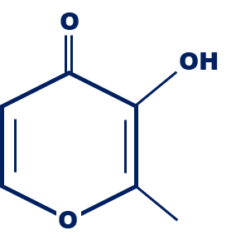
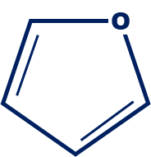
Caramelisation
Caramelisation is the breakdown of sugar (sucrose) into glucose and fructose, some of which combine to form complex polymers (caramelans, caramelens and caramelins).
Other ‘volatile’ compounds are released from the decomposition (breakdown) of the sugars, which provide the aromas and flavours caramel is known for.
Complex polymers (colour and structure)
C₁₂H₁₂O₉ _{Caramelan}
C₂₄H₂₆O₁₃ _{Caramelen}
C₃₆H₁₈O₂₄ _{Caramelin}
Volatile compounds (smell and flavour)
O
H₃C
C
C
CH₃
O
Diacetyl
Furan
Maltol

Slide 17
Caramelisation - continued
Caramelisation can occur in foods that naturally contain sugar, such as some fruits and vegetables.
Caramelisation of onions and carrots is common. Sometimes, additional sugar is added to increase the degree of caramelisation.

Slide 18
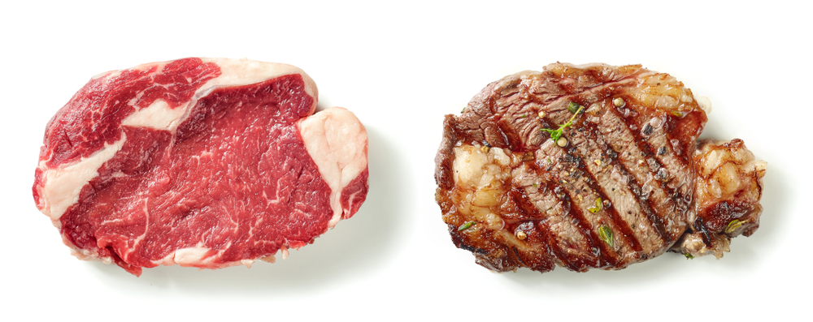
The Maillard reaction
The Maillard reaction is a reaction between ‘reducing’ sugars and amino acids (from protein).
In reality, the ‘reaction’ is a series of many reactions, with many different products.
These products are responsible for browning in many foods, notably cooked meats and baked goods.

Slide 19
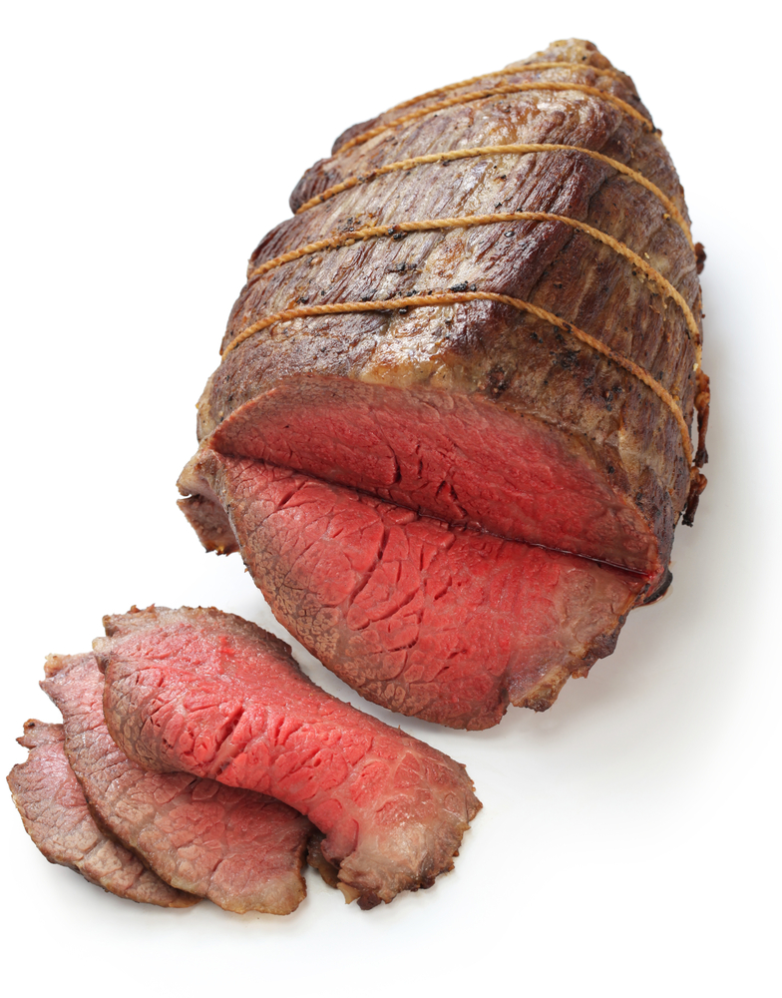
The Maillard reaction - conditions
The Maillard reaction ideally takes place between 140-160°C.
Too much water activity can inhibit the reaction.
At higher temperatures, caramelisation increases, which can inhibit Maillard reactions, due to lower reducing sugar availability.

Slide 20
The Maillard reaction – flavour and aroma
O
R
NH
As well as producing compounds that are brown in colour, the Maillard reaction also results in compounds that provide distinct aromas and flavours.
On this slide, you can see some examples of substances that generate specific aromas and flavours in foods.
N
N
N
N
Pyrazines
roasted
toasted
Pyrroles
cereal-tasting
nutty
Alkylpyridines
bitter
burnt
Acylpyridines
biscuity
cereal-tasting
O
O
O
S
O
N
Furanones
sweet
caramel
burnt
Furans
meaty
burnt
caramel
Thiophenes
meaty
roasted
Oxazoles
nutty
sweet

Slide 21




Non-enzymic browning reactions
Maillard reaction - initiation
Dextrinisation
Caramelisation
CH₂OH
O
O
CH₂OH
Sucrose
O
O
H₂N
C
OH
HO
R
C
HO
O
CH₂OH
C
+
OH
C
Amylose (straight chain)
Amylopectin (branched chain)
H
OH
OH
R
Reducing sugar
Amino acid
CH₂OH
H₂O
Breakdown
Breakdown
Glucose
O
CH₂OH
O
Fructose
H₂O
OH
HO
O
HO
CH₂OH
C
N
OH
OH
C
Partial recombination
Polymerisation
C
C
C₁₂H₁₂O₉ _{Caramelan}
Decomposition (examples)
OH
R
C₂₄H₂₆O₁₃ _{Caramelen}
Glycosylamine
C₃₆H₁₈O₂₄ _{Caramelin}
Furan
Maltol

Slide 22
Non-enzymic browning - activities
The Maillard reaction worksheet – Explore the Maillard reaction with this simple experiment.
The science of red meat presentation – this explores browning and other aspects of cooking red meat.
Dry heat presentation – This presentation explores dextrinisation and asks pupils to identify foods that brown when heated.
Caramelisation worksheet – This worksheet demonstrates how sugars caramelise over time.
Refer to the Functional properties of food overview for a brief overview of these topics and others.
Use the Carbohydrates and their functional properties presentation and worksheet to investigate non-enzymic browning alongside other carbohydrate food science.
Teachers will need to decide on the level of complexity of the tasks chosen, depending on age, stage and need, and considering progression.

Slide 23
Further supporting resources
External resources
IFST – dextrinisation
IFST – carbohydrates: caramelisation
RSC – What’s cooking? Understand the chemistry behind the colour changes in food*
RSC – The great chemistry cook off. What exactly is happening when foods change colour?*
RSC – Kitchen chemistry: Chemical changes during cooking*
Resources around food science can be found here: 11-14 years, 14-16 years
Further information, support and resources around functional characteristics of ingredients can be found here 11-14 and 14-16.
Ingredients - functional characteristics Knowledge Organiser 11-14
*more appropriate for older students

Slide 24

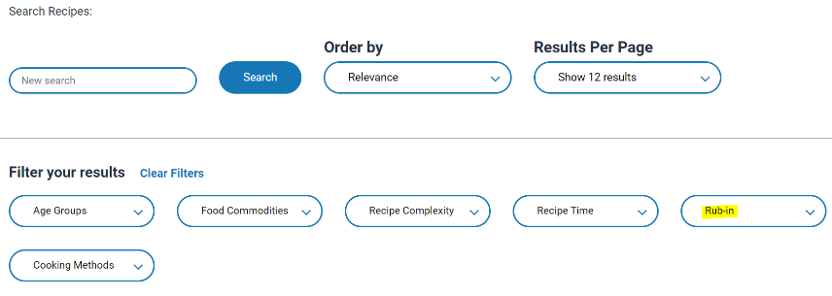
Non-enzymic browning - recipes
Maillard reaction
Pork and apple burgers
Al fresco beef kebabs
Caramelisation
Caramelised onions
Caramel sauce
Dextrinisation
Quick bread buns
Devilled tomatoes on toast
Fish pie (potato topping)
Go to the recipes section and filter Food Skills for more recipes.
Note that these reactions often occur together in cooking, to varying degrees, depending on conditions.

Slide 25
Non-enzymic browning
For further information, go to:
www.foodafactoflife.org.uk
This food science pack is one of a series of resources produced for the pHood Futures project, supported by the Royal Society of Chemistry.
This resource meets the Guidelines for producers and users of school education resources about food.

