Slide 1
Hazard Analysis Critical Control Point (HACCP)

Slide 2
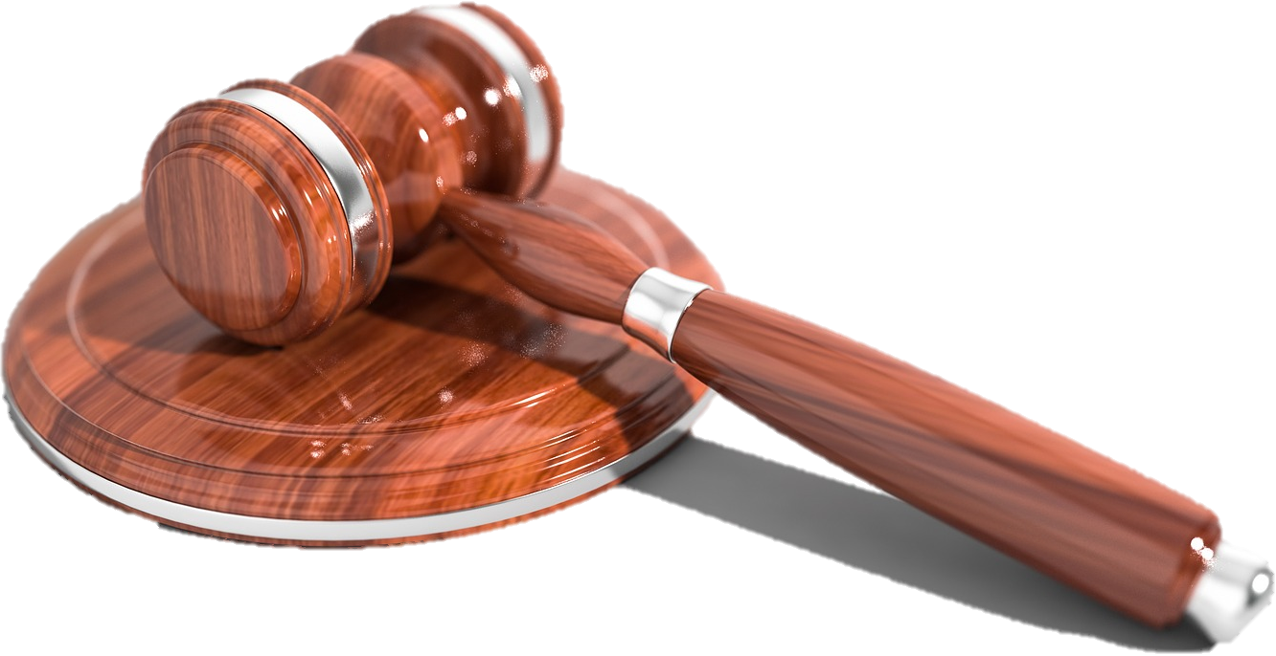
Legal responsibility
Food businesses have a legal responsibility to produce safe food.
A food business that breaks the law faces:
• improvement notices – a fixed time period is set for the company to rectify problems;
• prohibition notices – the company is not permitted to produce particular food items;
• prosecution.

Slide 3
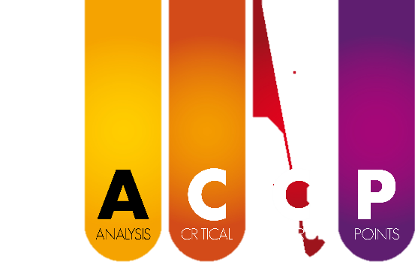
Hazard Analysis Critical Control Point (HACCP)
HACCP stands for ‘Hazard Analysis Critical Control Point’.
HACCP is a system which looks for and prevents potential problems before they happen.
HACCP may be used by food companies to make sure they do not break the law by putting consumers at risk when producing food.
It is a structured approach to risk assessment and is one means of satisfying the risk assessment requirement of UK hygiene legislation.
Food Standards Agency, 2017

Slide 4
What does HACCP involve?
Identifying points during the production of a product where potential hazards may occur.
Analysing the risk of the hazard points happening including the scale of consequence if they do.
Deciding which points are critical to consumer safety.
Implementing controls, monitoring production and taking action if necessary.
Reviewing the HACCP plan whenever the food operation is altered, and on a regular basis (e.g. annually) even if no alterations have been made.

Slide 5

Qualities of the HACCP system
HACCP is:
systematic – potential hazards are identified before there is a problem;
efficient – it concentrates the control effort at the stages where the risk is potentially the highest;
on the spot – the processes can be controlled immediately by the food business.

Slide 6
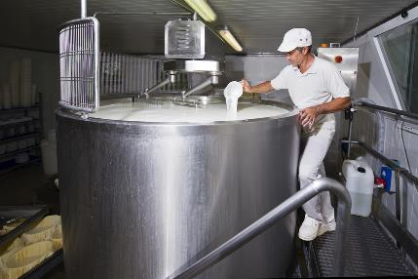
How does HACCP help?
HACCP is a method which food businesses can use to ensure that their products do not put consumers at risk.
The details of a HACCP system will vary as no two businesses are exactly alike – but the principles are the same.

Slide 7
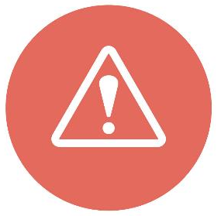
Hazards
A hazard is a biological, chemical or physical agent that is reasonably likely to cause illness or injury in the absence of its control.
In HACCP, hazards refer to the conditions or contaminants in foods that can cause illness or injury.

Slide 8
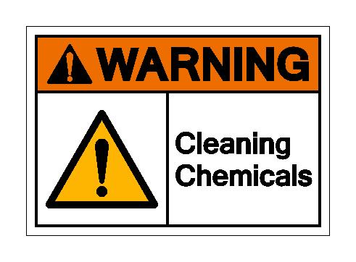
Types of hazards
The types of hazards which a HACCP plan can focus
on include:
• biological hazards (e.g. harmful microorganisms);
• chemical hazards (e.g. those either naturally occurring, intentionally added or unintentionally added);
• physical hazards (e.g. glass, stones or metal);
• packaging quality;
• equipment reliability.

Slide 9
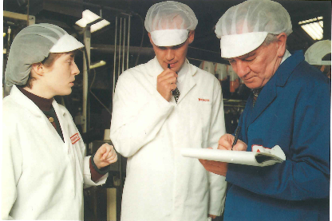
Critical Control Point (CCP)
A Critical Control Point (CCP) is an identifiable point in the production chain where a hazard may occur.
Action is taken to prevent the hazard from occurring.
This can either be a point, step or procedure at which control can be applied and is essential to prevent or eliminate a hazard or reduce it to an acceptable level.
A CCP can be used to control more than one hazard (e.g. refrigeration storage).
Alternatively, several CCPs may be needed to control one hazard.

Slide 10

Critical Control Point (CCP)
Points may be identified as CCP when hazards can be prevented, for example:
• introduction of chemical residue can be prevented by control at the receiving stage;
• a chemical hazard can be prevented by control at the formulation or ingredient-addition stage;
• pathogenic bacteria growth can be controlled by refrigerated storage or chilling.

Slide 11
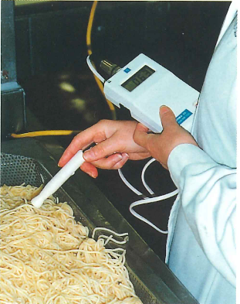
Critical Control Point (CCP)
CCP may be identified where hazards can be eliminated, for example:
• pathogenic (harmful) bacteria can be killed during cooking;
• metal fragments can be detected by a metal detector and eliminated by removing the contaminated product from the processing line;
• parasites can be killed by freezing.

Slide 12
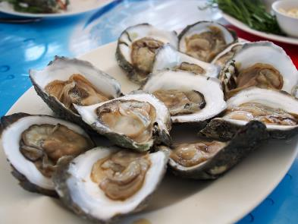
Critical Control Point (CCP)
Points may be identified as CCPs when hazards are reduced to acceptable levels, for example:
• the occurrence of foreign objects can be minimised by manual sorting and automatic collectors;
• some biological and chemical hazards can be minimised by obtaining shellfish from approved waters.

Slide 13
Seven principles of HACCP implementation
• Hazard analysis
• Determine the Critical Control Points (CCP)
• Establish critical limits
• Critical Control Point (CCP) monitoring
• Corrective actions
• Establish verification procedures
• Record keeping procedures

Slide 14

1. Hazard analysis
The first step involves identifying any hazards that must be prevented, eliminated or reduced to acceptable levels.
All potential hazards, from the receipt of raw materials through to release of the finished product, must be considered.
A hazard must be controlled if it is likely to occur, and/or likely to result in an unacceptable risk to consumers.

Slide 15

2. Determine the Critical Control Point (CCP)
Identifying the Critical Control Point (CCP) at the steps at which control is essential to prevent or eliminate a hazard or to reduce it to acceptable levels.

Slide 16

3. Establish critical limits
A critical limit is a maximum or minimum value to which a biological, chemical or physical limit must be controlled at a CCP.
This is set in order to prevent, eliminate or reduce a hazard to an acceptable level.

Slide 17

4. Critical Control Point (CCP) monitoring
A planned series of observations or measurements need to be taken to assess whether a CCP is within critical limits.
This also helps to produce an accurate record for future use in verification.

Slide 18

5. Corrective actions
Corrective actions are procedures to be followed when a hazard is identified in food production.
The aim is to correct and eliminate the cause of the hazard and bring the CCP back under control.
The cause of problem must be identified to prevent future recurrence.

Slide 19
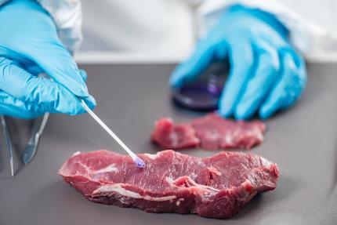
5. Corrective actions
Some examples of corrective actions can include:
• isolating and holding product for safety evaluation;
• diverting the affected product or ingredients to another line where deviation would not be considered critical;
• reprocessing;
• destroying the product.

Slide 20

6. Verification procedures
Verification procedures are those activities, other than monitoring CCPs, that verify the HACCP plan and show the system is operating according to the plan.
This is usually completed when a system fails or there is a significant change in the product or process. Annual checks will often still be in place even if these two scenarios do not occur.

Slide 21

7. Record keeping procedures
Documentation and record keeping help to demonstrate the effective implementation of the previous principles of HACCP.
This records could be of the development of the HACCP plan, CCP monitoring, corrective actions or verification activities.

Slide 22
7. Record keeping procedures
Four different types of HACCP records include:
1. HACCP plan and support documentation used in developing the plan.
2. Records of CCP monitoring.
3. Records of corrective actions.
4. Records of verification activities.

Slide 23

Review of HACCP
The design and running of the HACCP scheme should be revised whenever the food operation is altered.
The scheme should be reviewed from time to time (e.g. once a year) even when there have been no alterations.

Slide 24
Hazard Analysis Critical Control Point (HACCP)
For further information, go to:
www.foodafactoflife.org.uk
This resource meets the Guidelines for producers and users of school education resources about food.

