Slide 1
Food – a fact of life

Slide 2
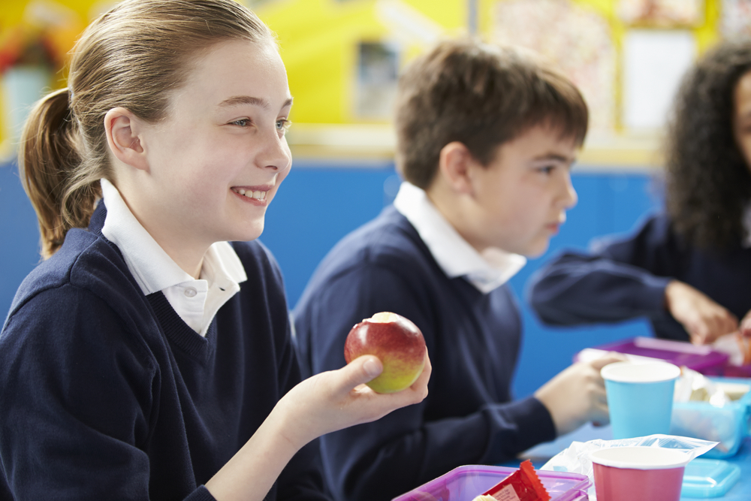
Food – a fact of life
We all need to eat and drink every day.
But why?

Slide 3
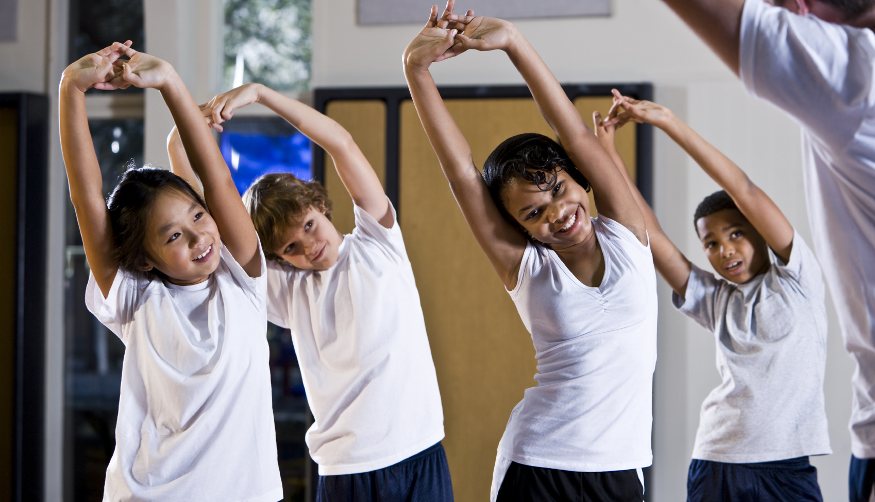
Why do we need food and drink?
We need food and drink to grow.

Slide 4
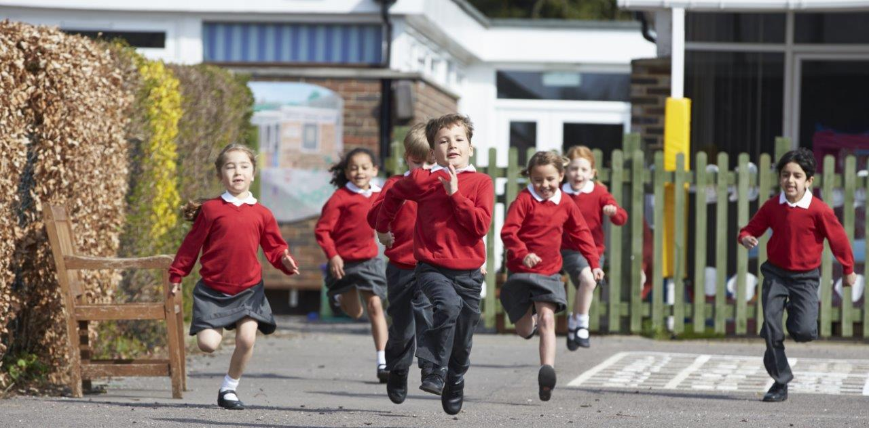
Why do we need food and drink?
We need food and drink to be active.

Slide 5
What activities do we do?

Slide 6
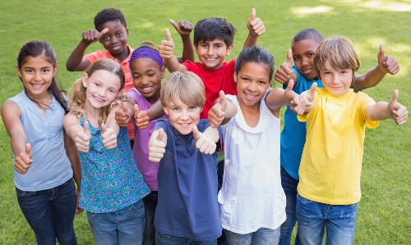
Why do we need food and drink?
We need food and drink to stay healthy.

Slide 7
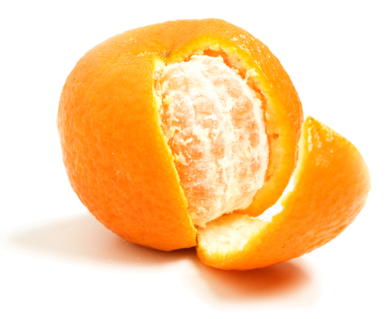
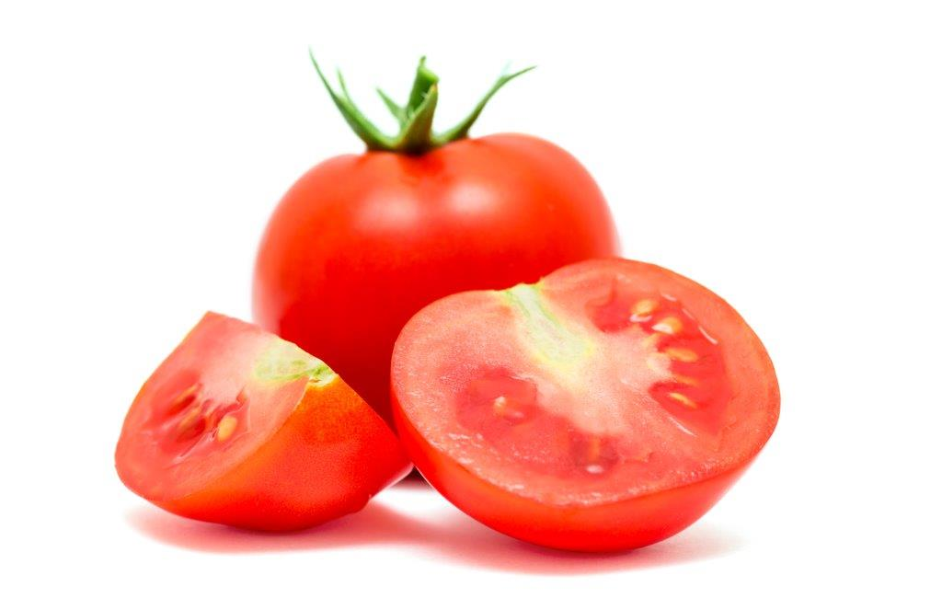
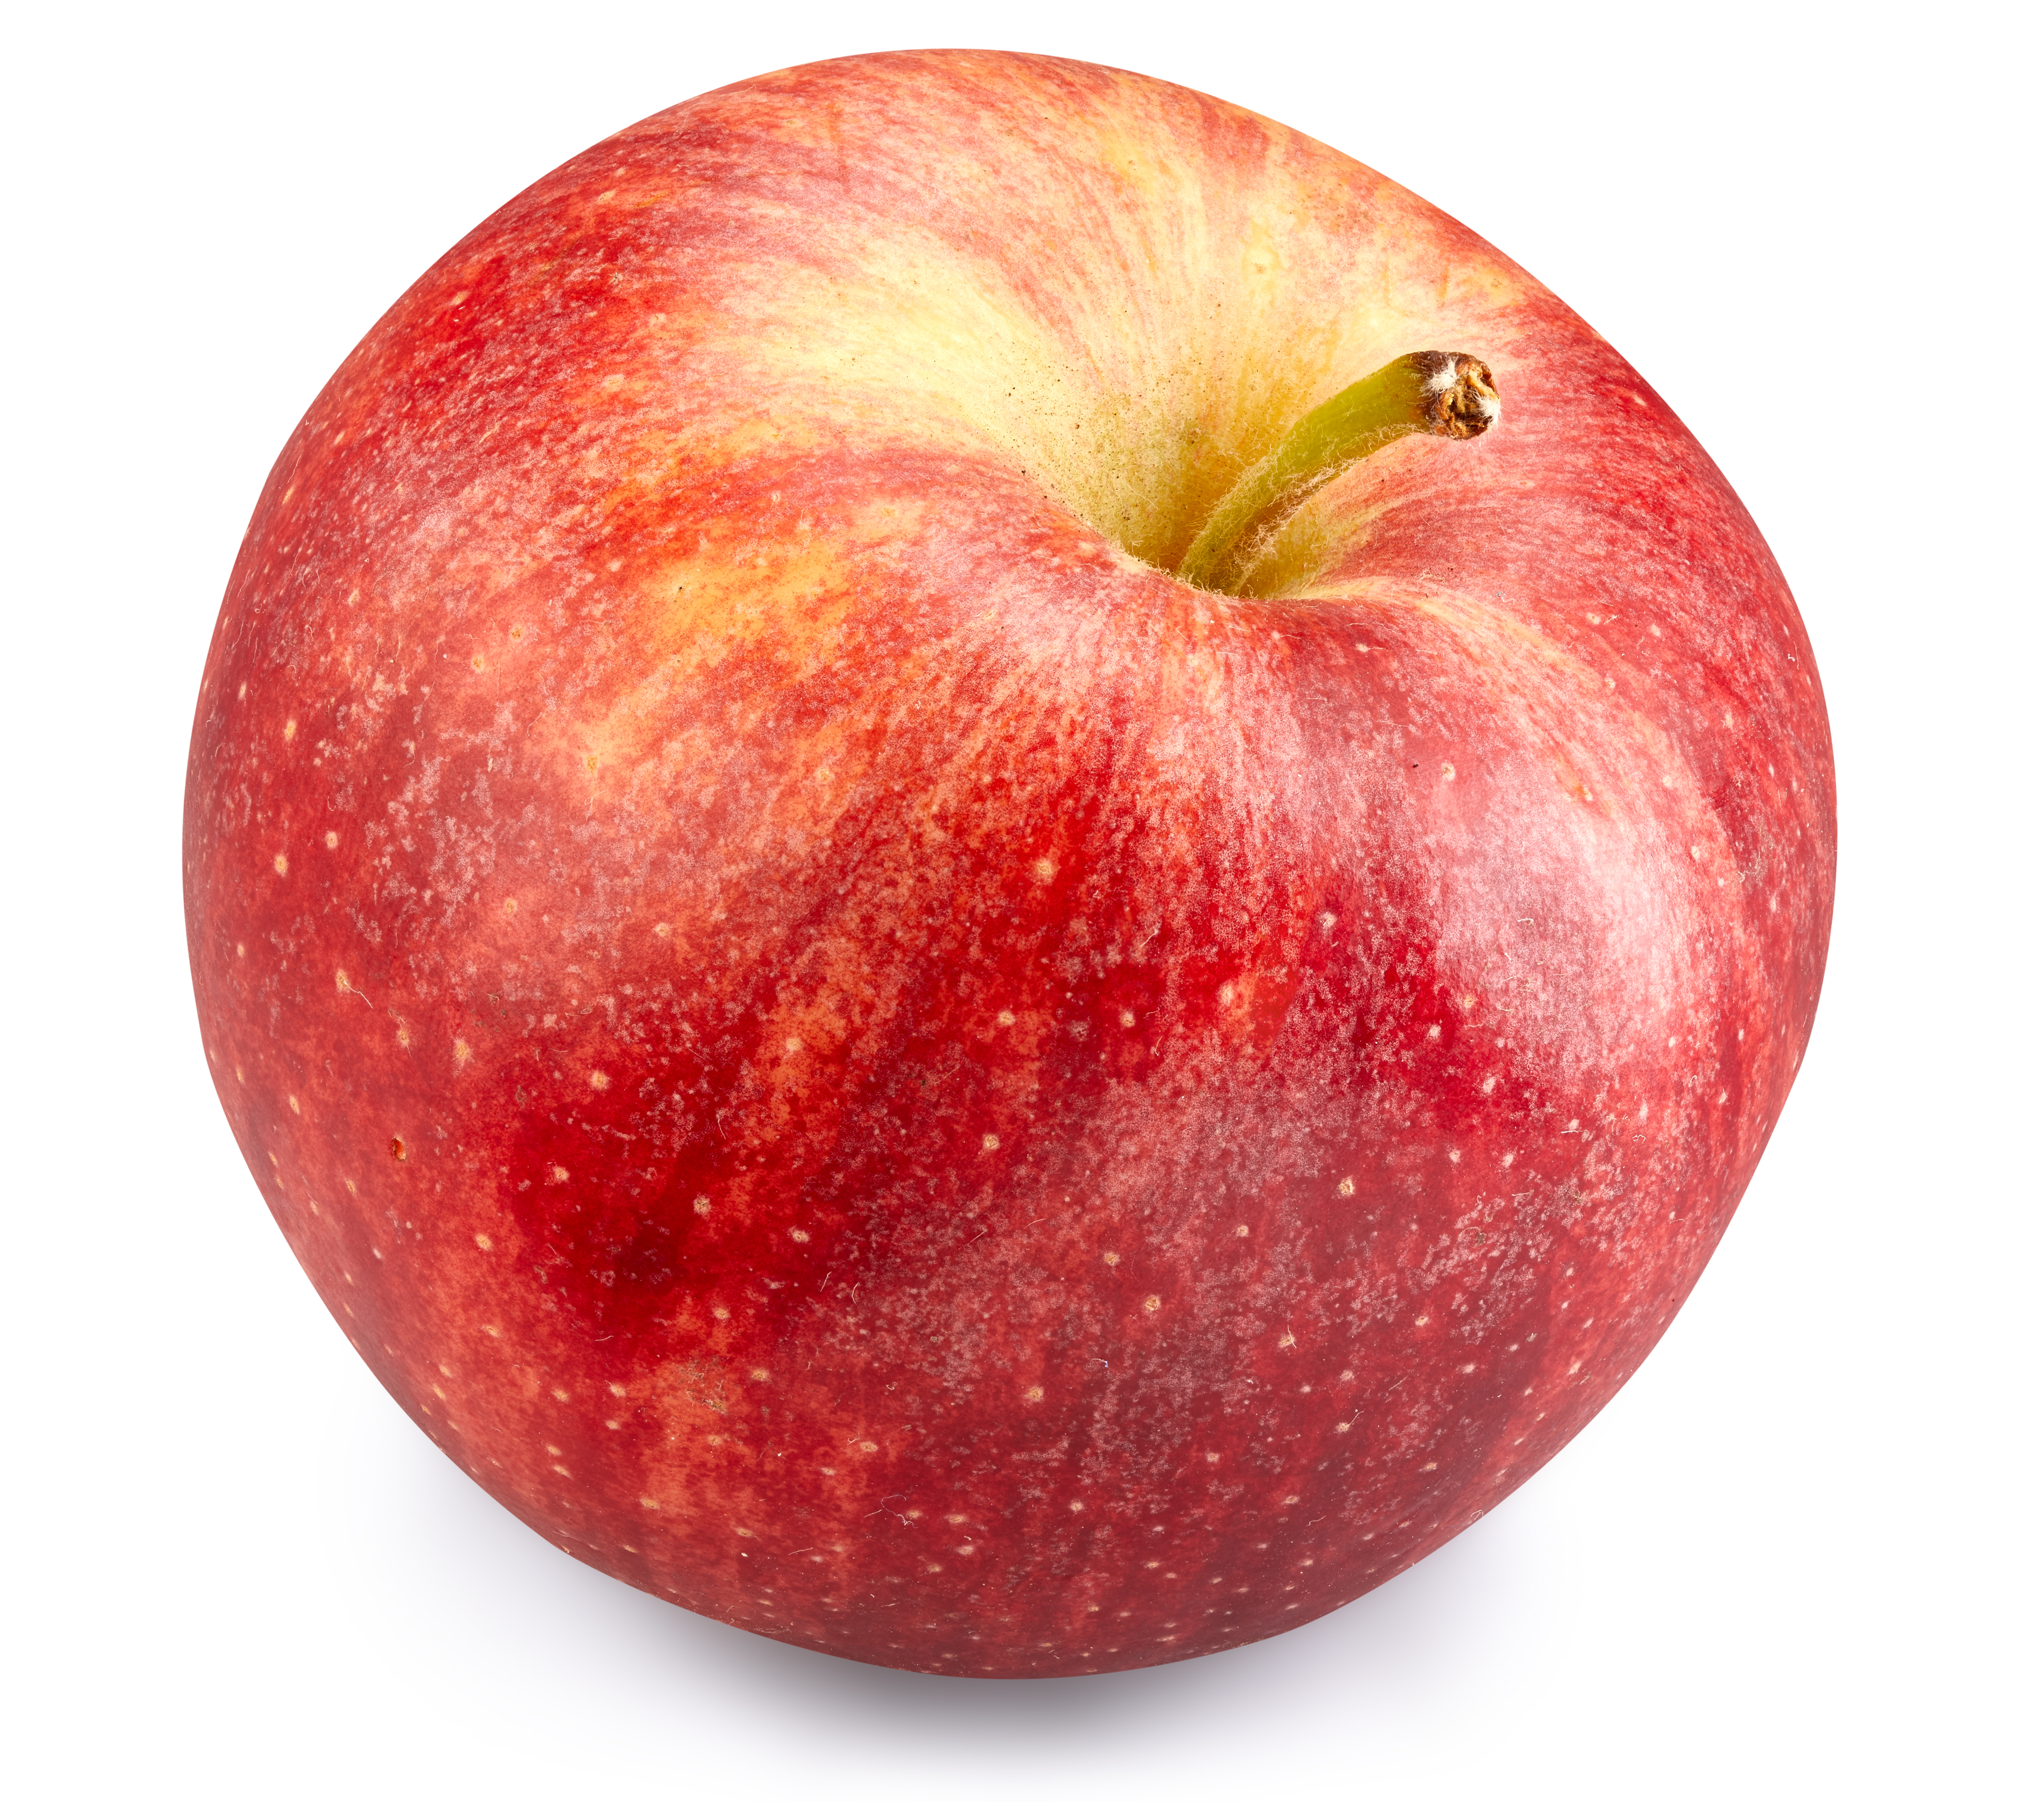
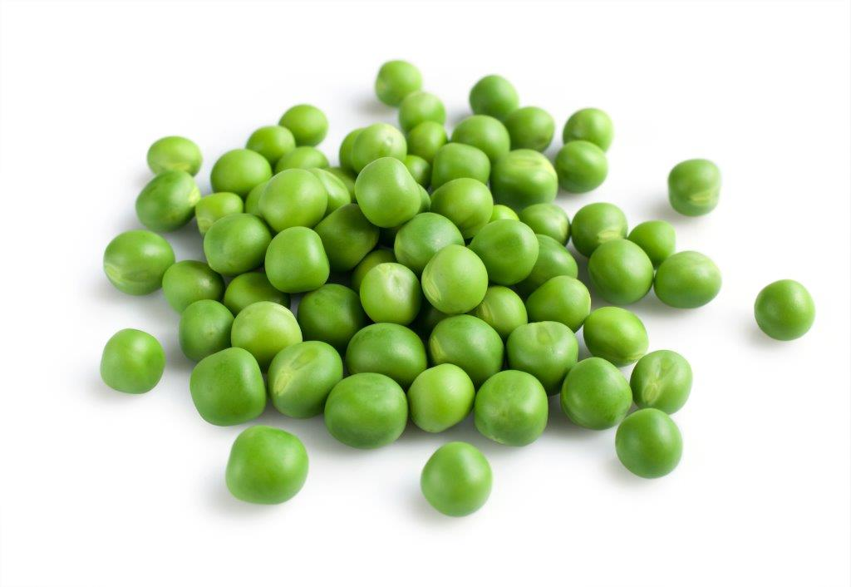
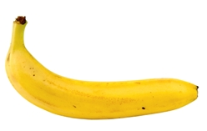
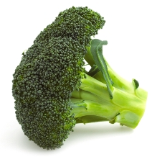
We need different types of food.
We should have lots of fruit and vegetables.
What can you see here?

Slide 8
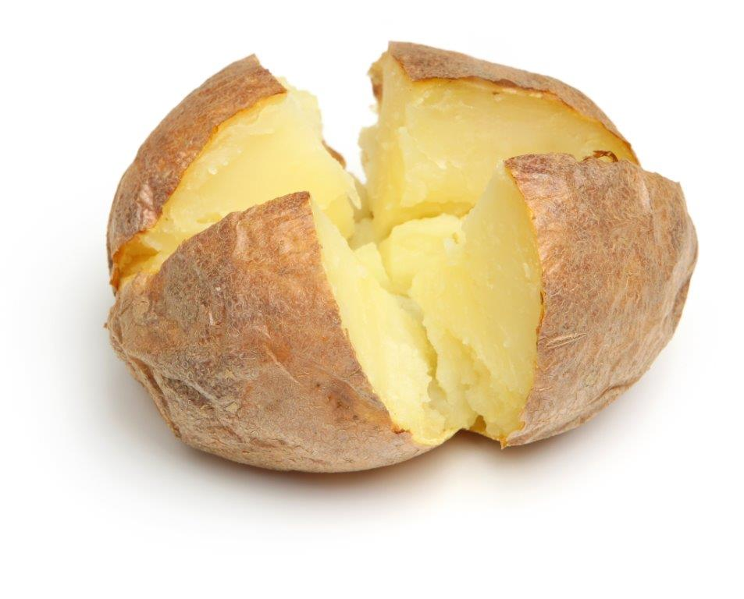
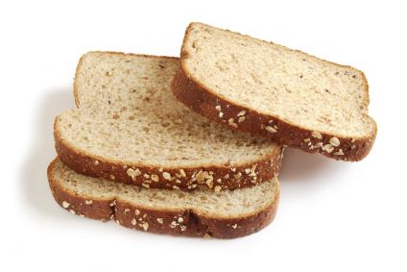
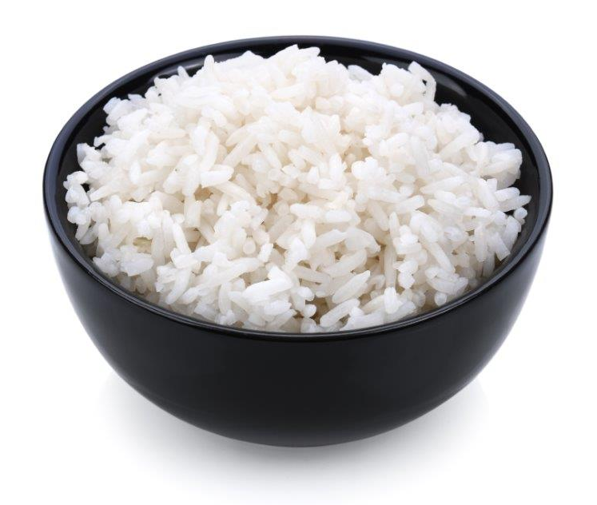
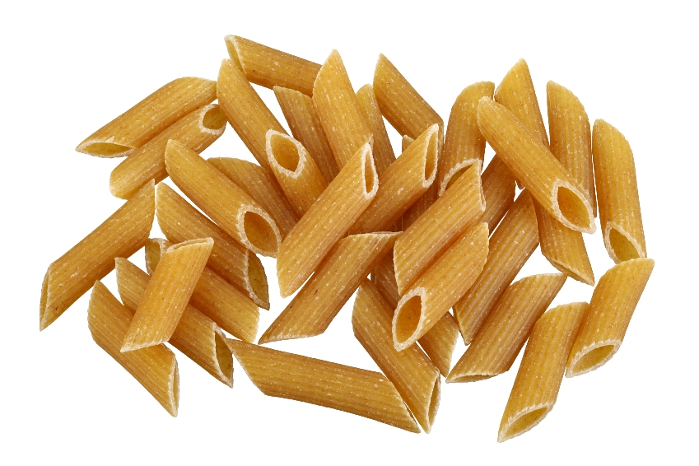
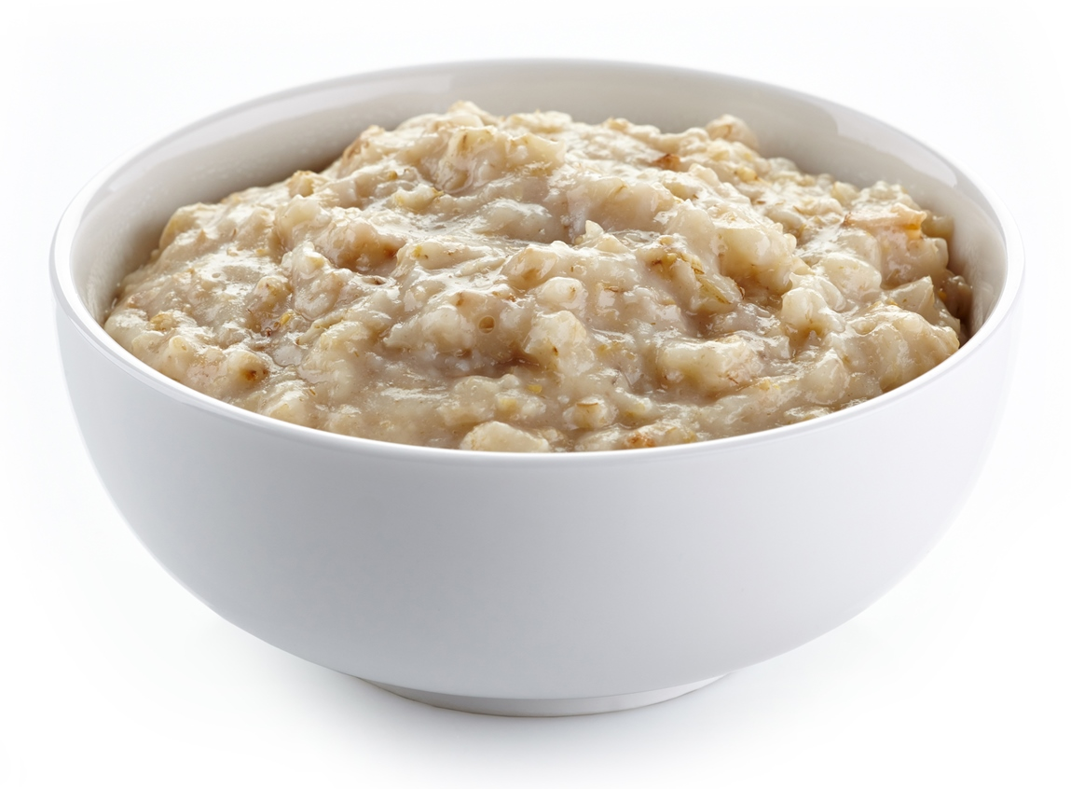
We need different types of food.
We should have food like potatoes, bread, rice and pasta.
Did you have any of this food yesterday?

Slide 9

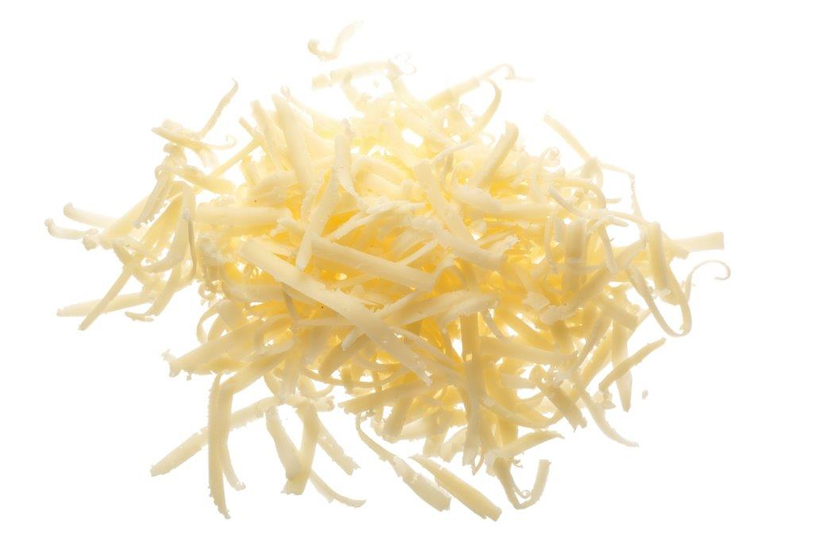

We need different types of food.
We should have food like milk, cheese and yogurt.
Which of these is your favourite?

Slide 10
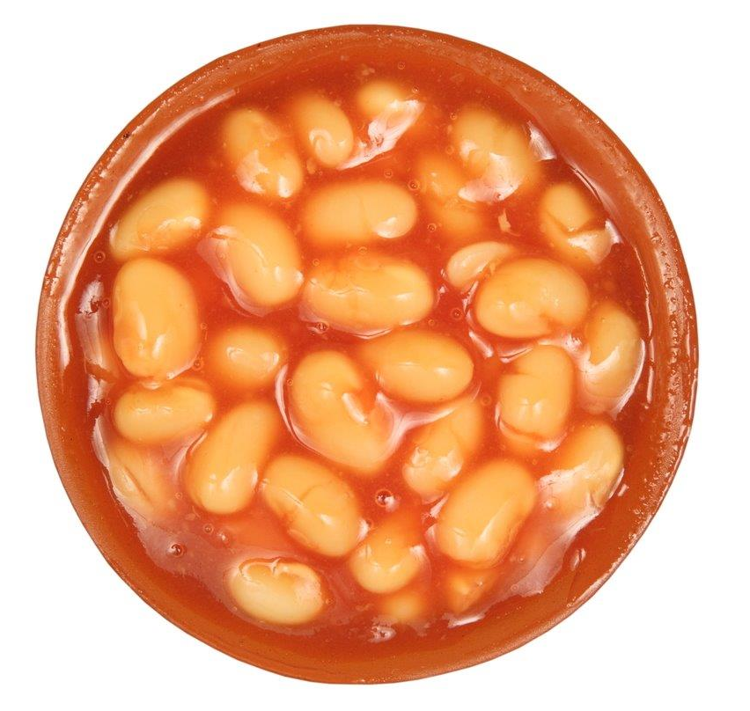
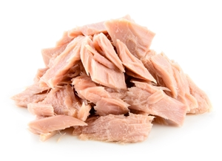
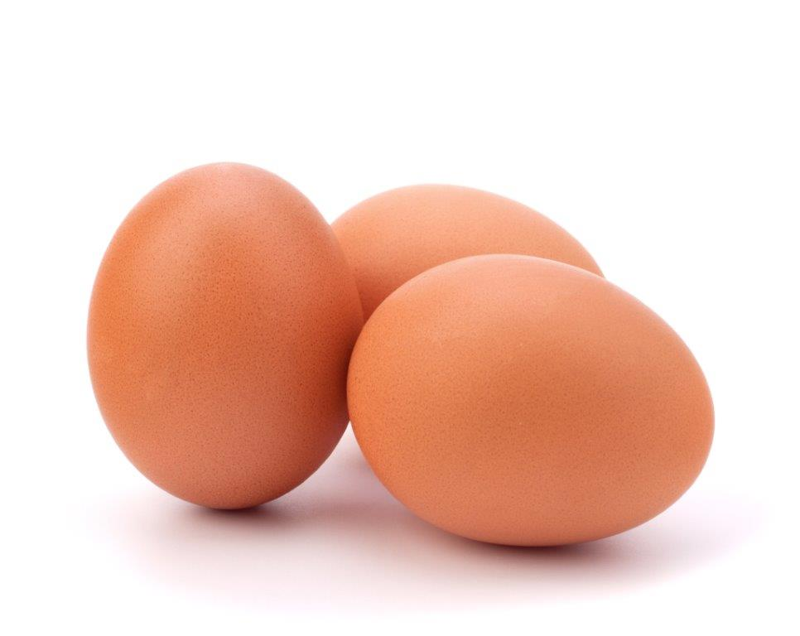
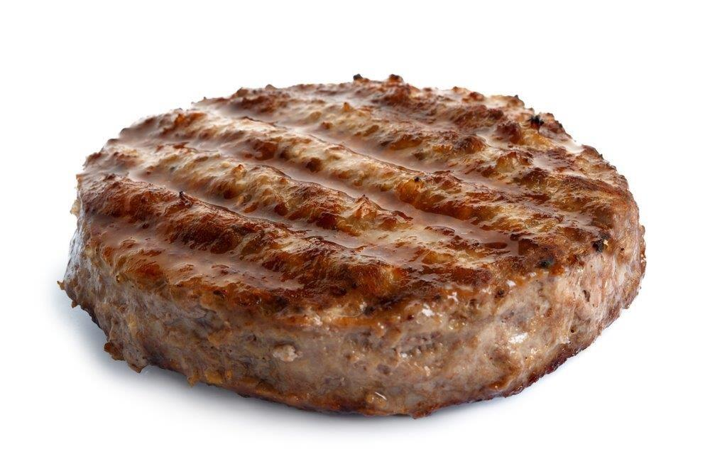
We need different types of food.
We should have food like beans, pulses, fish, eggs and meat.
Can you name each food here?

Slide 11
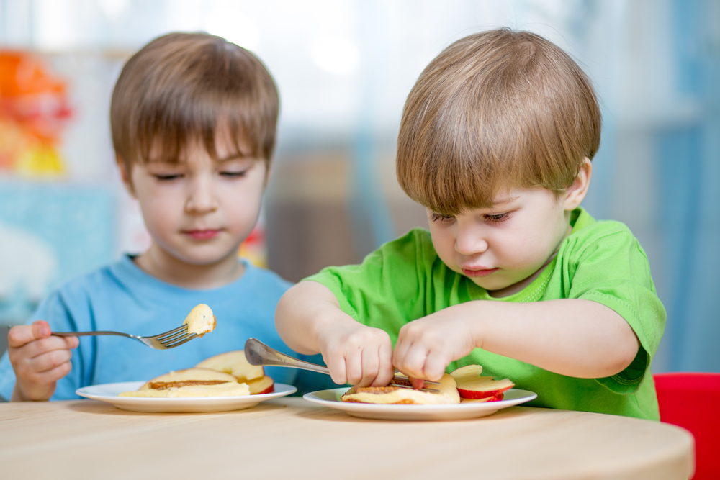
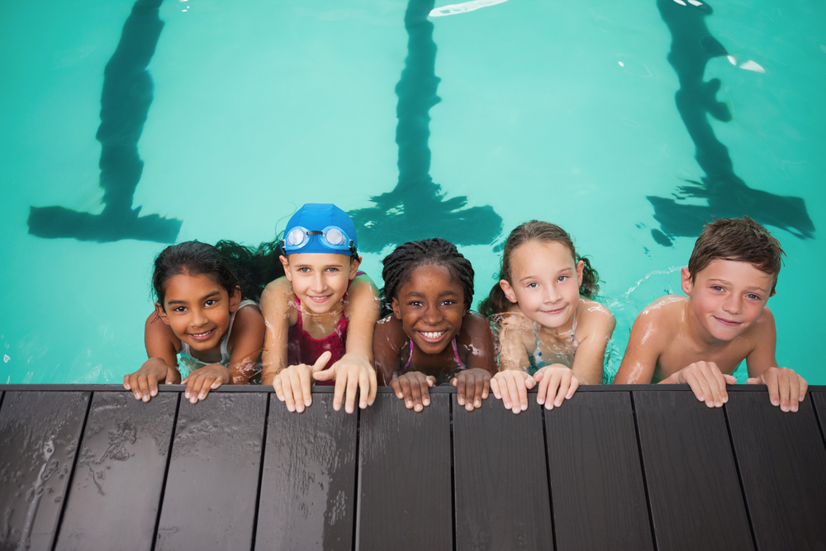

Food – a fact of life
We need lots of different food to:
Grow Be active Be healthy

Slide 12
Food – a fact of life
For further information, go to:
www.foodafactoflife.org.uk
This resource meets the Guidelines for producers and users of school education resources about food.

