Slide 1
Fusion food

Slide 2
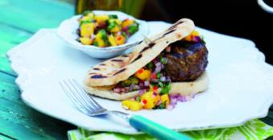
The challenge
Create an exciting fusion burger.

Slide 3

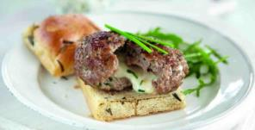
What is fusion food?
Fusion food combines ingredients and ideas from different culinary traditions.
The dishes can be based on regional differences, e.g. South East Asian, East Asian and South Asian dishes served along side each other.
Dishes can combine elements from different countries, e.g. Tex-Mex which is probably the most well known fusion cuisine.

Slide 4
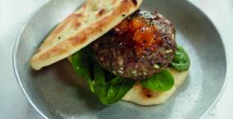

Inspiration
Randomly pick two countries – what fusions could you create?
Look at travel books or websites for inspiration!
Use the internet, recipe books and magazines to research fusion foods.
Create a mood board of all the tastes, flavours, ingredients and ideas that you could combine to make a fusion burger – remember the bread and accompaniments.

Slide 5
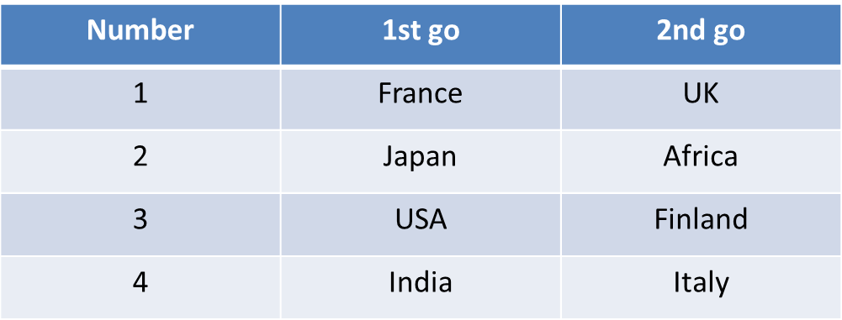
Fusion generator!
Choose two numbers between 1 and 4.
Ready?
Click and find out your fusion!

Slide 6
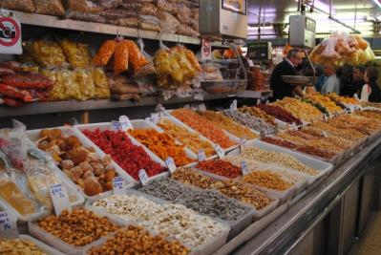
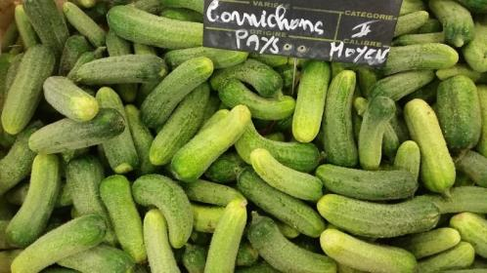
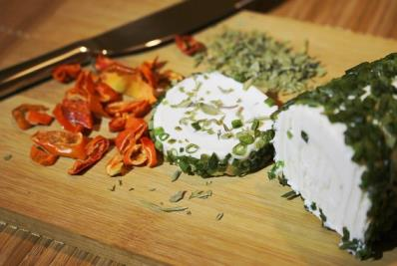
Inspiration

Slide 7
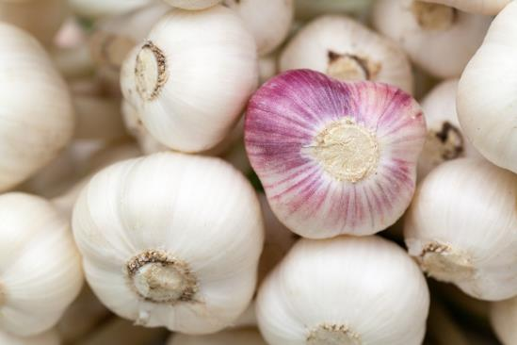
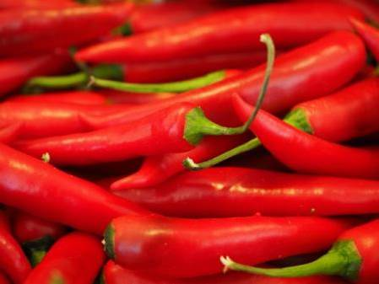
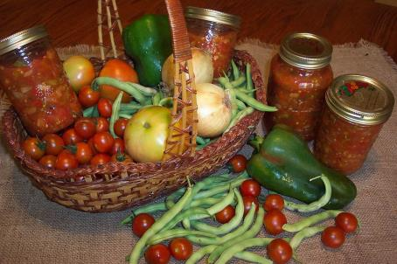
Inspiration

Slide 8
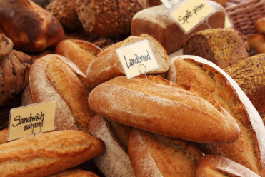
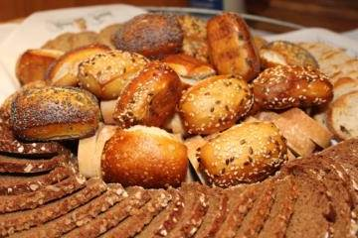
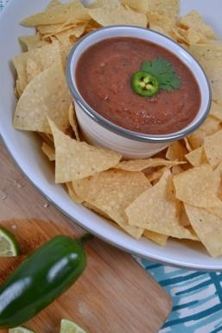
Inspiration

Slide 9
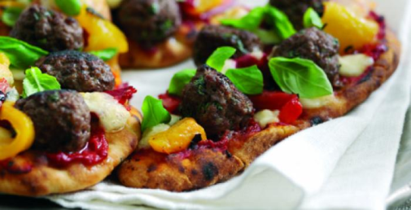
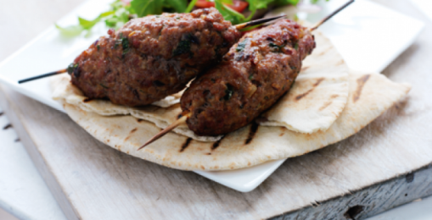
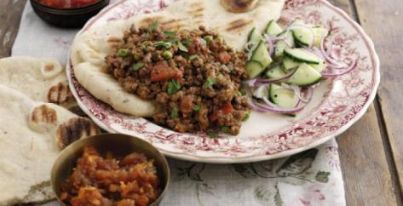
Inspiration

Slide 10

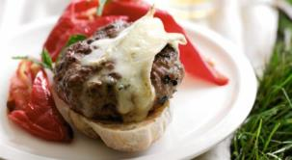
What’s on the side?
What will you serve with your burger?
Explore the different types of sides that could be added to your fusion burger.
Think about appearance, textures and flavours!

Slide 11
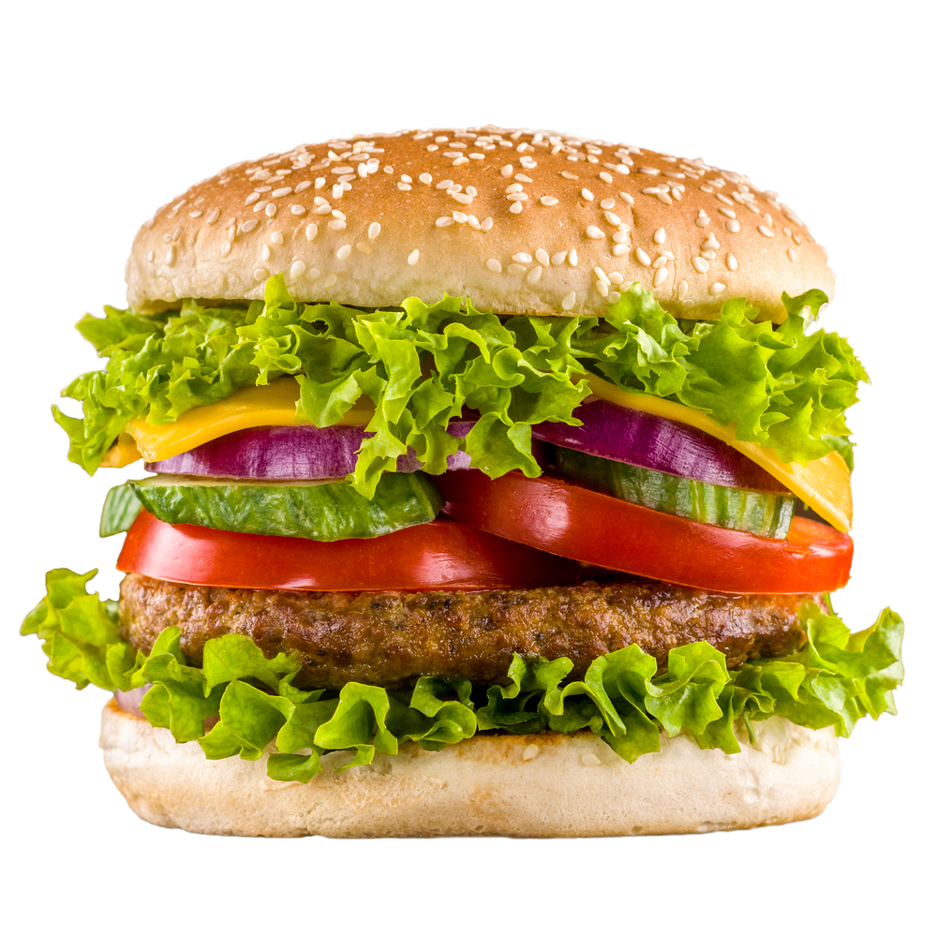
Some suggestions
Sliced onion rings.
Sliced pickled beetroot.
Mashed avocado.
Sliced tomato or salsa.
Olive tapenade.
Caramelised onions.
Roasted peppers.
Tomato sauce, brown sauce, mayonnaise or mustard.

Slide 12
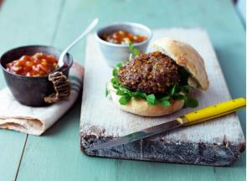
Create your burger
Step 1
Use the Gourmet Burger Builder to create your exciting fusion burger.
Step 2
Make your fusion burger following the recipe.
Step 3
Take a photo and share your recipe on social media.

Slide 13
Fusion Food
For further information, go to:
www.foodafactoflife.org.uk

