Slide 1
Macaroni cheese
Complexity: medium

Slide 2
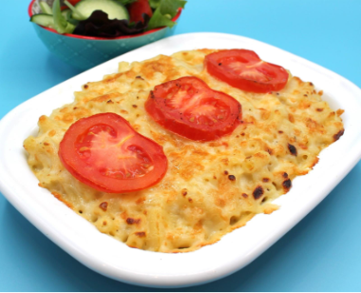
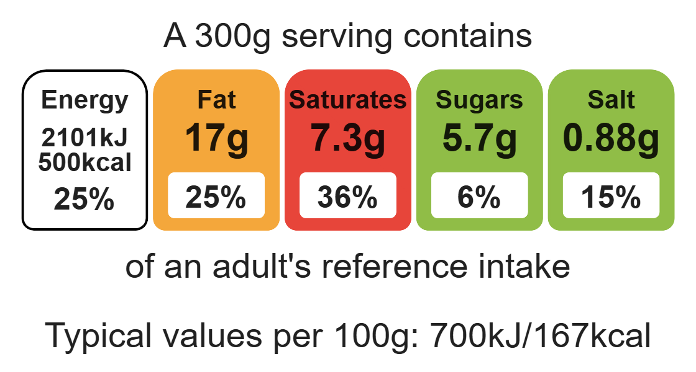
Nutritional analysis
Serves 3

Slide 3
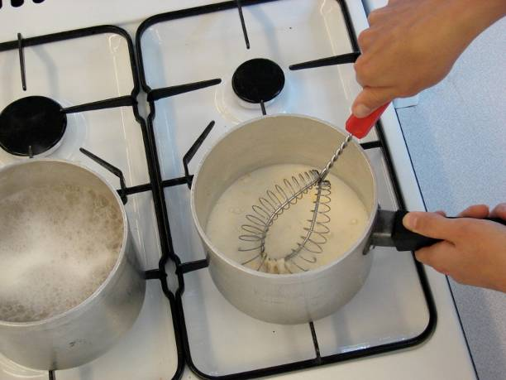
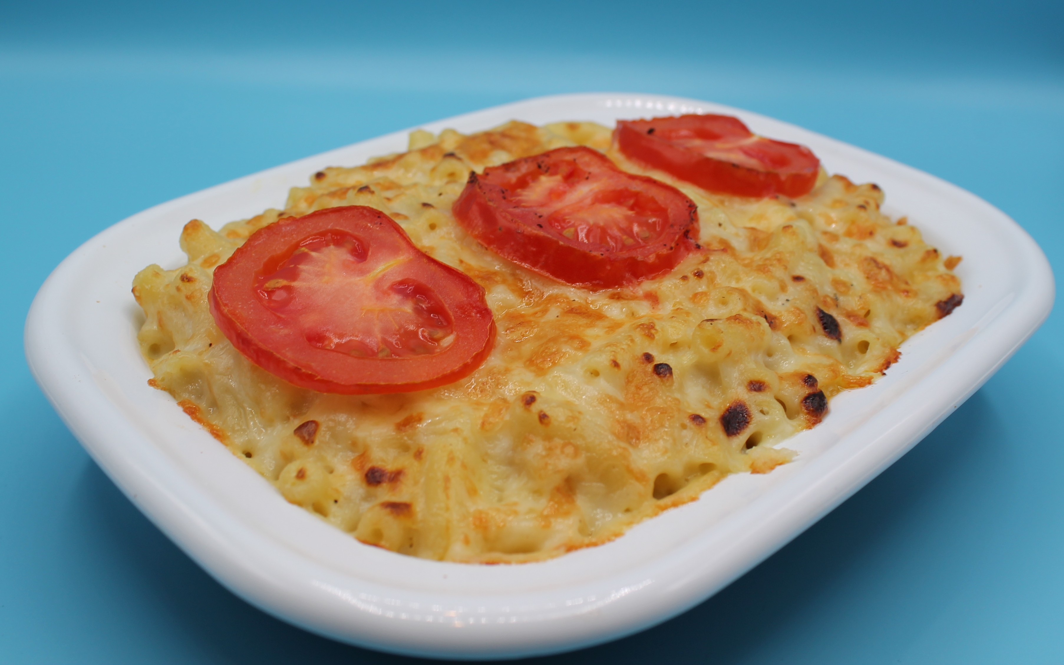
Starter activity
What skills do you think we will cover today?
What equipment will we need?
What is a sauce?
Why does a sauce thicken?
What issues could we have when making the sauce?

Slide 4
Example responses
1. What skills do you think we will cover today?
Grate, slice, mix, stir, combine, drain, melt, simmer and boil, decorate and garnish, grill.
2. What equipment will we need?
Two saucepans
Weighing scales
Grater
Chopping board
Sharp knife
Colander
Measuring jug
3. What is a sauce?
A thickened liquid.
4. What can we use to flavour a sauce?
Cheese, onion, mushroom, parsley.
5. What issues could we have when making the sauce?
It may go lumpy.

Slide 5
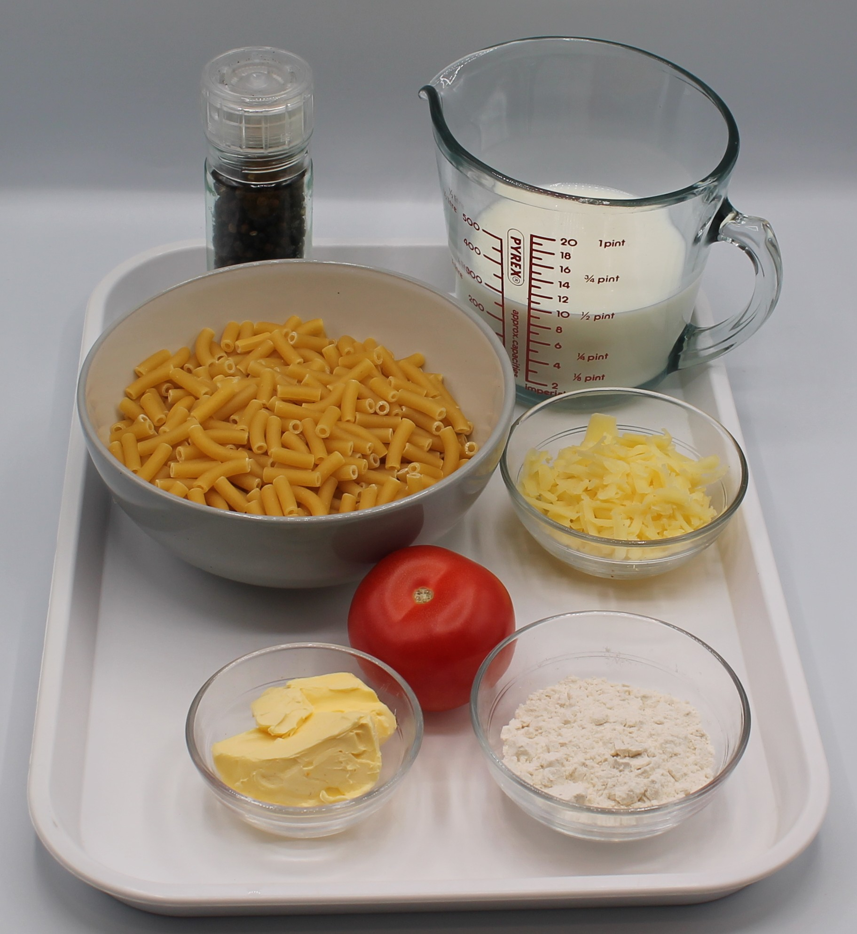

Ingredients (serves 3)
250g macaroni
25g reduced-fat spread
25g plain flour
250ml semi-skimmed milk
100g reduced-fat cheddar cheese
Black pepper
1 tomato
Check for any food allergy, intolerance, special dietary requirement or religious/cultural reasons for not handling or eating the ingredients in this recipe.

Slide 6
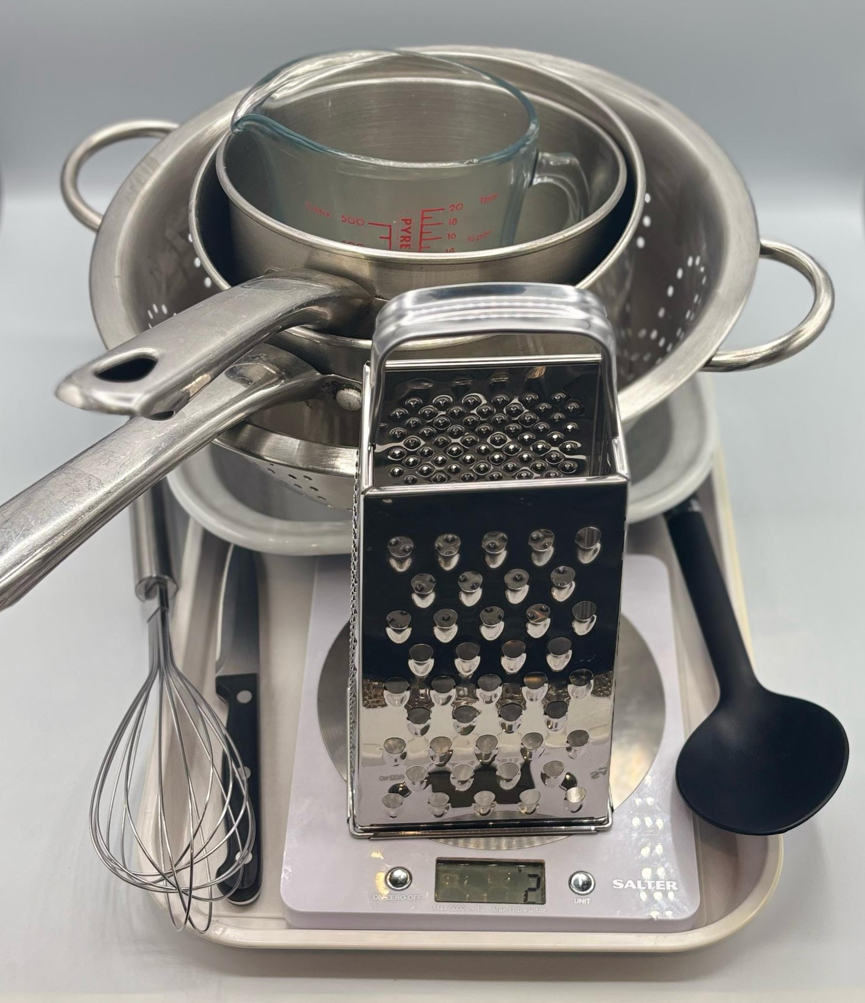
Equipment
Two saucepans
Weighing scales
Grater
Chopping board
Sharp knife
Colander
Measuring jug
Heat resistant spoon
Whisk
Ovenproof dish (21cm) or foil tray

Slide 7
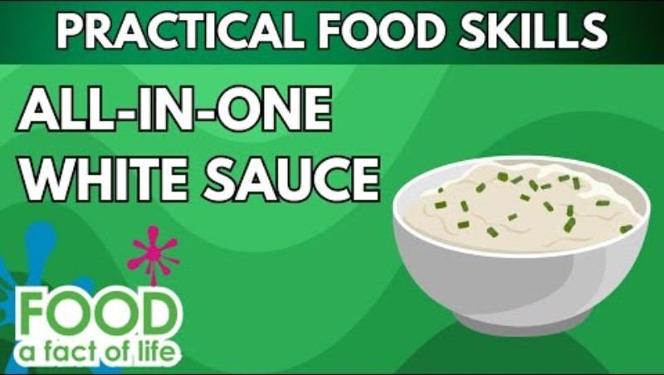
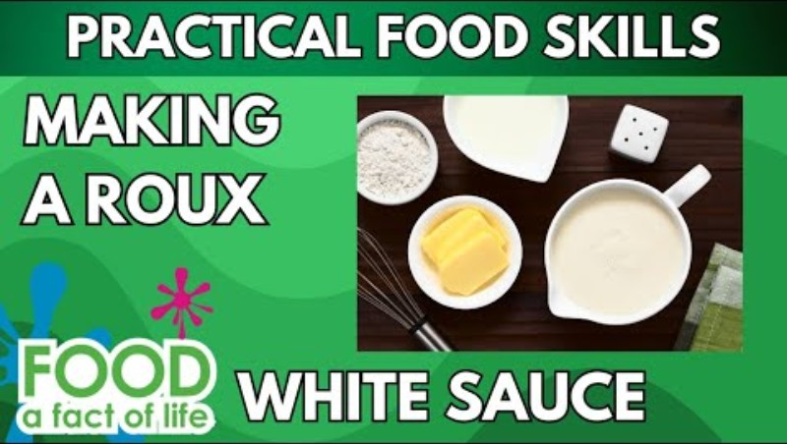
Food skills
Click below to see the all-in-one white sauce method
Weigh
Measure
Grate
Slice
Mix
Stir
Combine
Drain
Melt
Simmer and boil
Decorate and garnish
Grill
Click below to see the roux sauce method

Slide 8
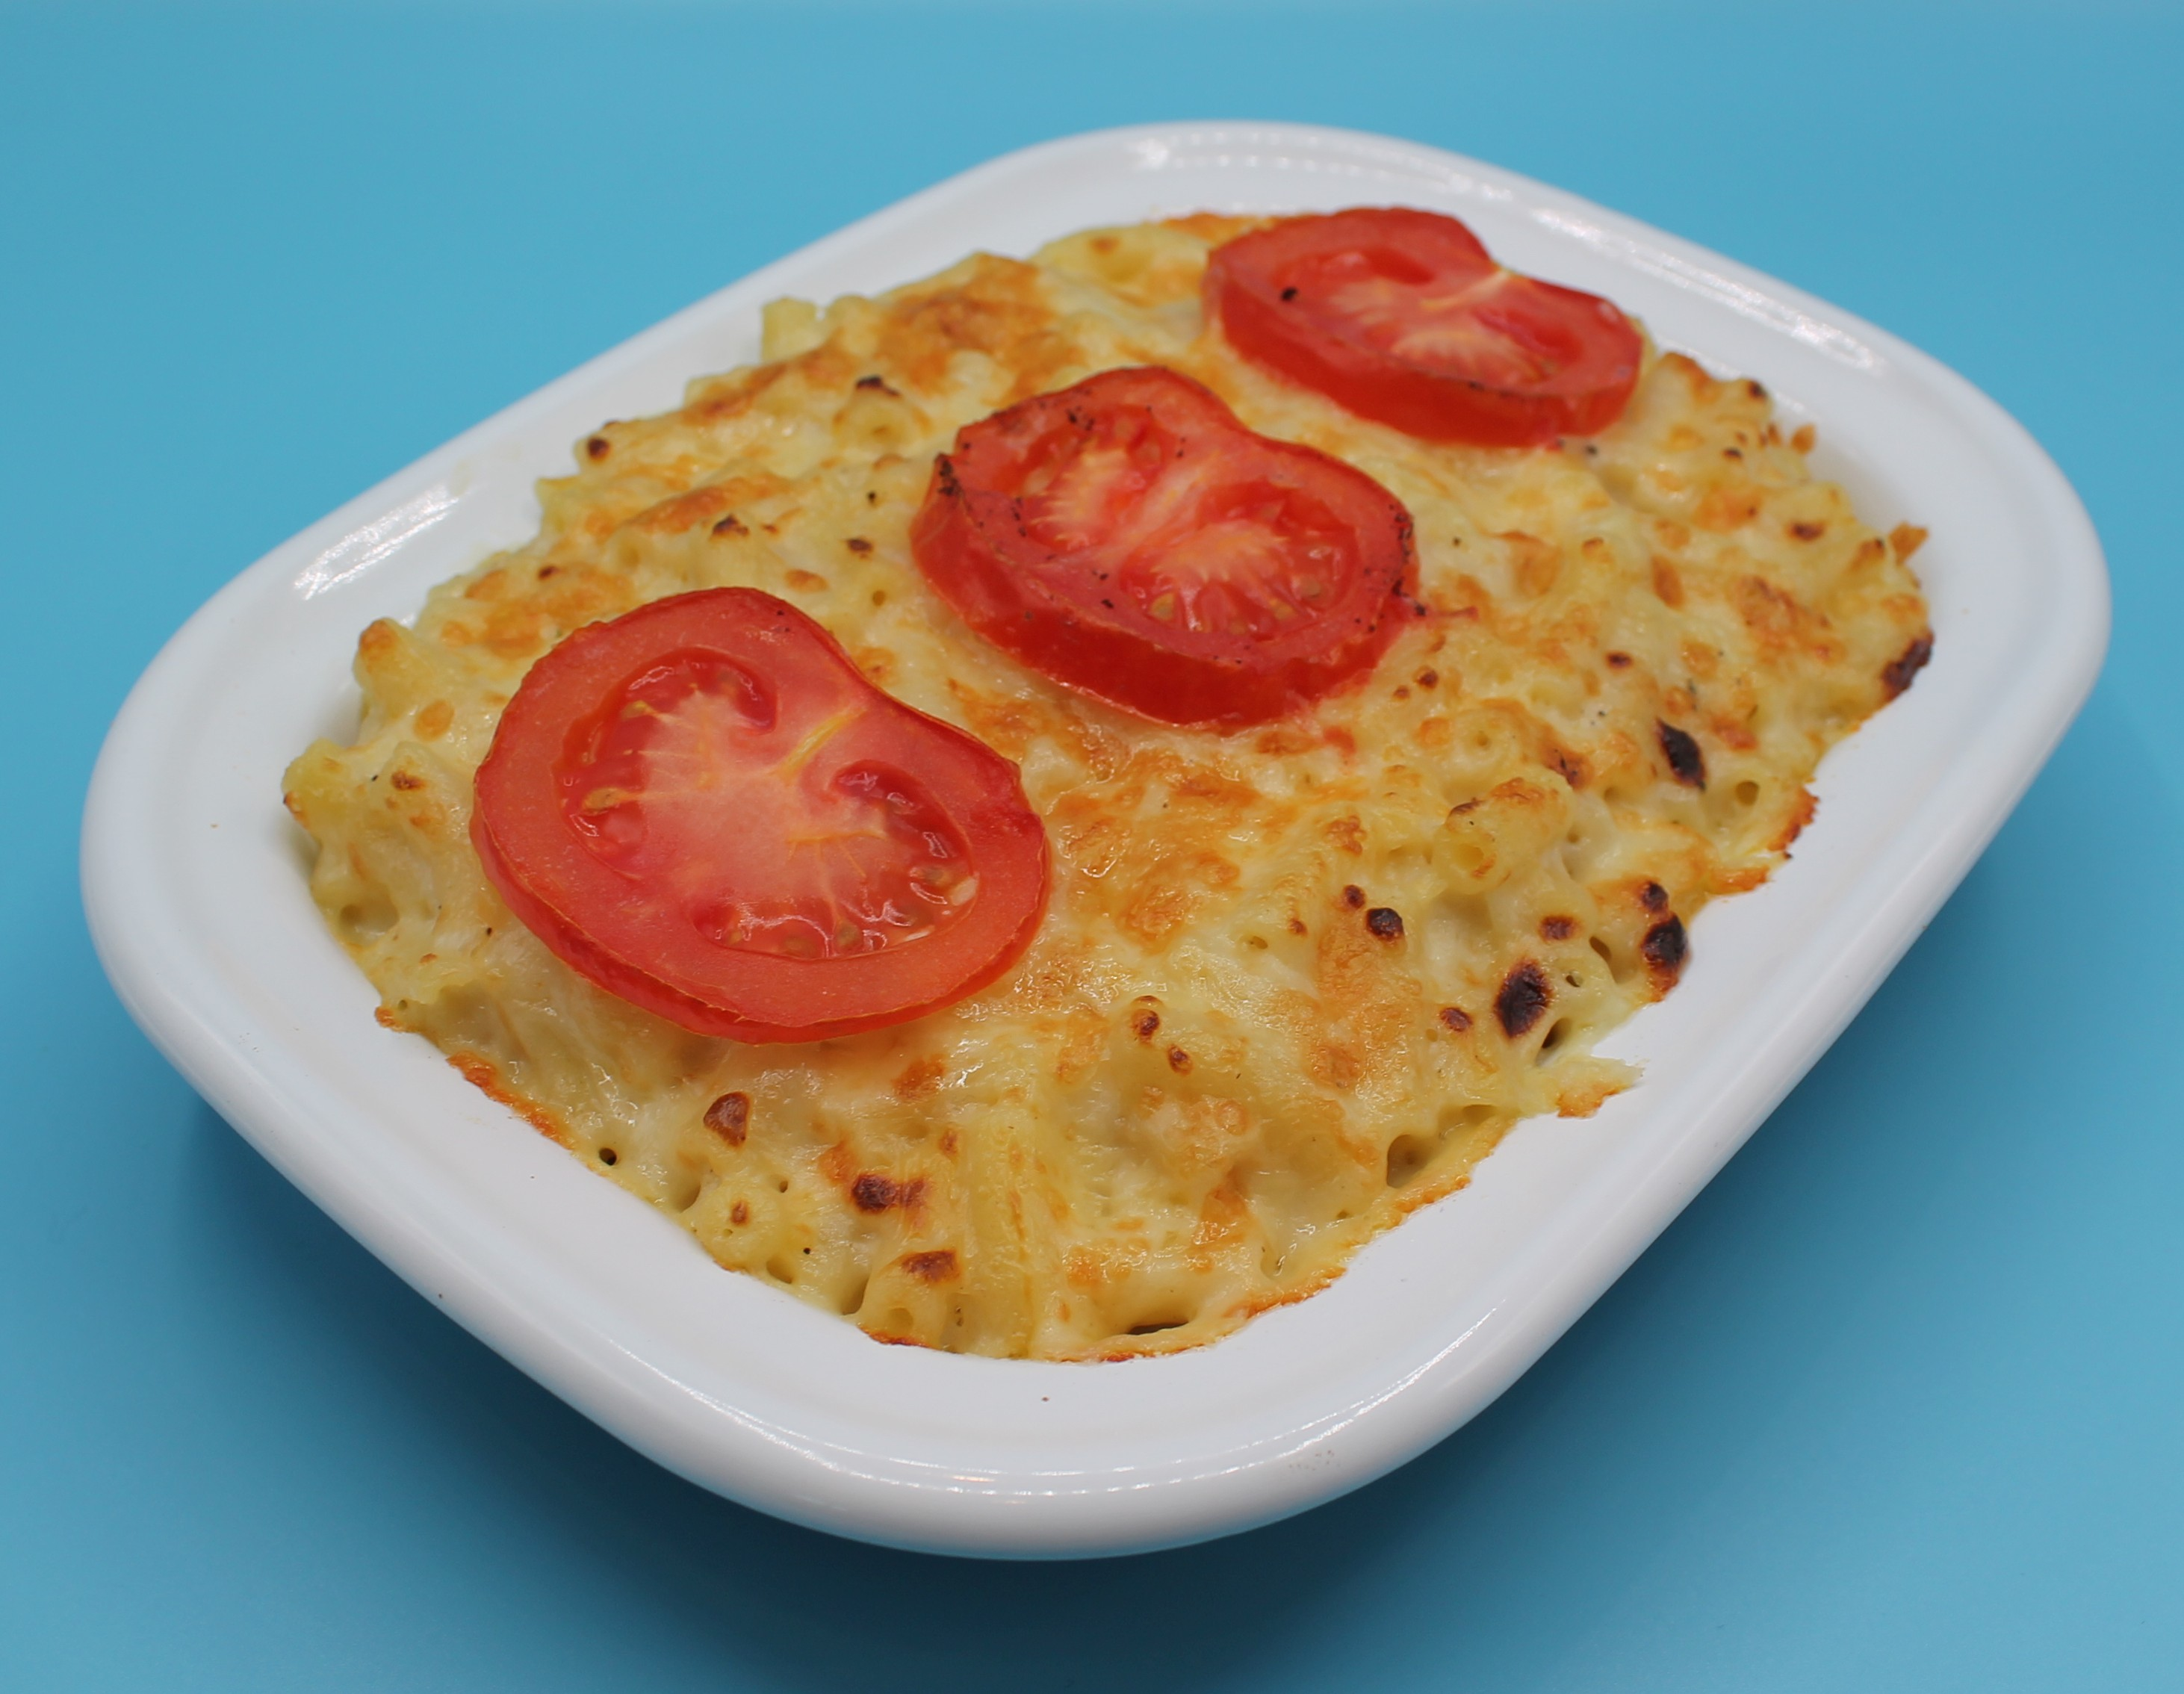
Method
Bring a saucepan of water to the boil and add the macaroni. Cook for about 10 – 12 minutes, until al dente.
Grate the cheese and slice the tomato.
While the pasta is cooking, make the sauce:
All in one method:
place the fat, flour and milk into a small saucepan;
bring the sauce to a simmer, whisking all the time until it has thickened;
off the heat, stir in 75g of the grated cheese.
Roux method:
melt the fat;
add flour and cook for 1 minute;
remove from the heat and gradually add milk, stirring constantly;
return to the heat and bring to a boil, then reduce to simmer and allow sauce to thicken;
off the heat, stir in 75g of the grated cheese.

Slide 9
Method
4. Preheat the grill.
5. Drain the macaroni into a colander in the sink.
Stir the drained macaroni into the cheese sauce and add a few twists of black pepper.
Pour the macaroni into an oven-proof dish (or foil tray).
Arrange the tomato slices over the macaroni. Sprinkle the cheese on top.
Place under a hot grill until the cheese is melted and golden brown.

Slide 10
Food science
Gelatinsation
When starch is mixed with liquid and heated, the starch granules swell and eventually rupture, absorbing liquid, which thickens the mixture.

Slide 11
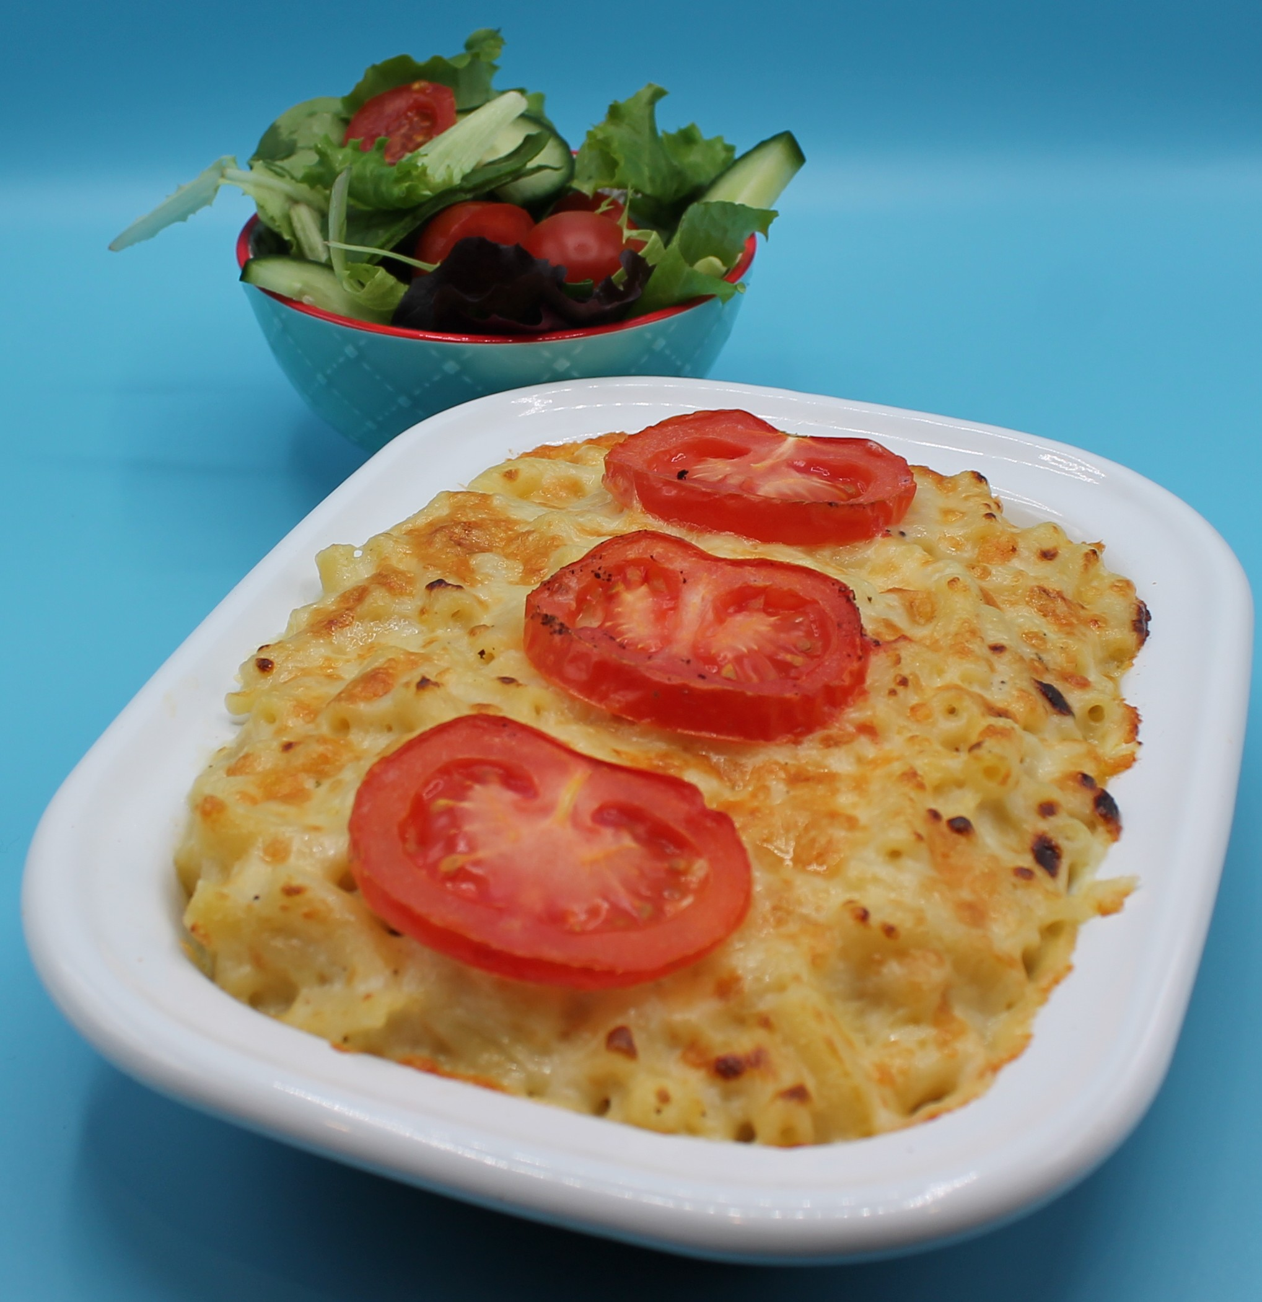
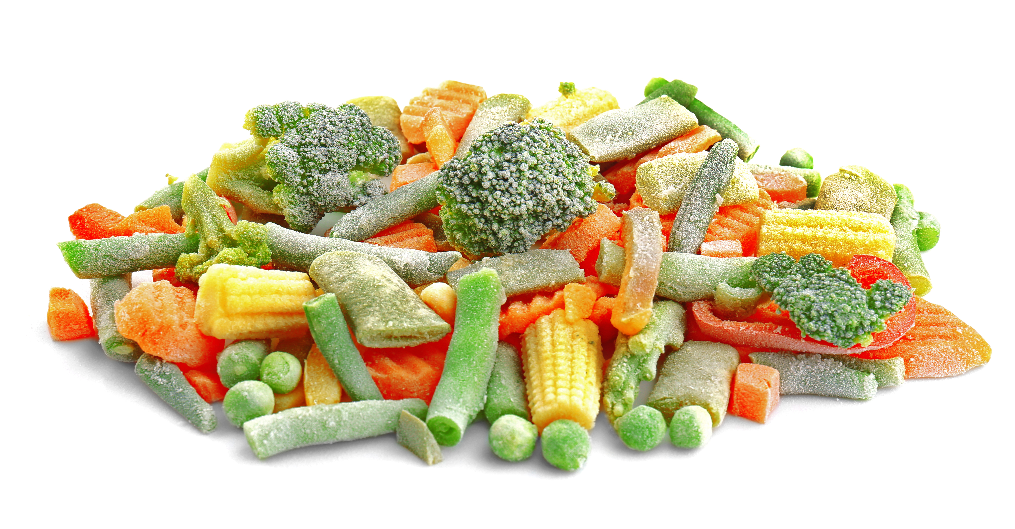
Top tips
Focus on fibre: Use wholemeal pasta to increase the fibre content.
Reduce food waste: Add broccoli, cauliflower florets, frozen peas or mixed veg. Cook with the macaroni.
Serving suggestion: Serve with a seasonal side salad.

Slide 12
Plenary
The sauce thickened when heated. Explain why.
What is the food science term?

Slide 13
Example response
The sauce thickened when heated. Explain why.
When starch (from the flour) is mixed with liquid and heated, the starch granules swell and eventually rupture, absorbing liquid, which thickens the mixture.
2. What is the food science term?
Gelatinisation

Slide 14
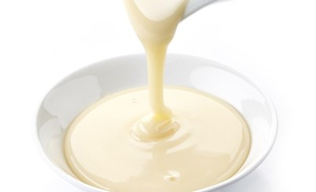
Looking for more…
Extend the learning for your pupils. Compare different methods of making a cheese sauce, including an instant cheese sauce.
Evaluate these sauces based on methods, viscosity, taste, texture and appearance.
Check out the experiment!
For another recipe to demonstrate using an all-in-one sauce, why not try the tuna pasta bake featured in this lesson from the Food – a fact of life Schemes of Work?

Slide 15
Macaroni cheese
For further information, go to:
www.foodafactoflife.org.uk
This resource meets the Guidelines for producers and users of school education resources about food.

