Slide 1
Emulsions

Slide 2
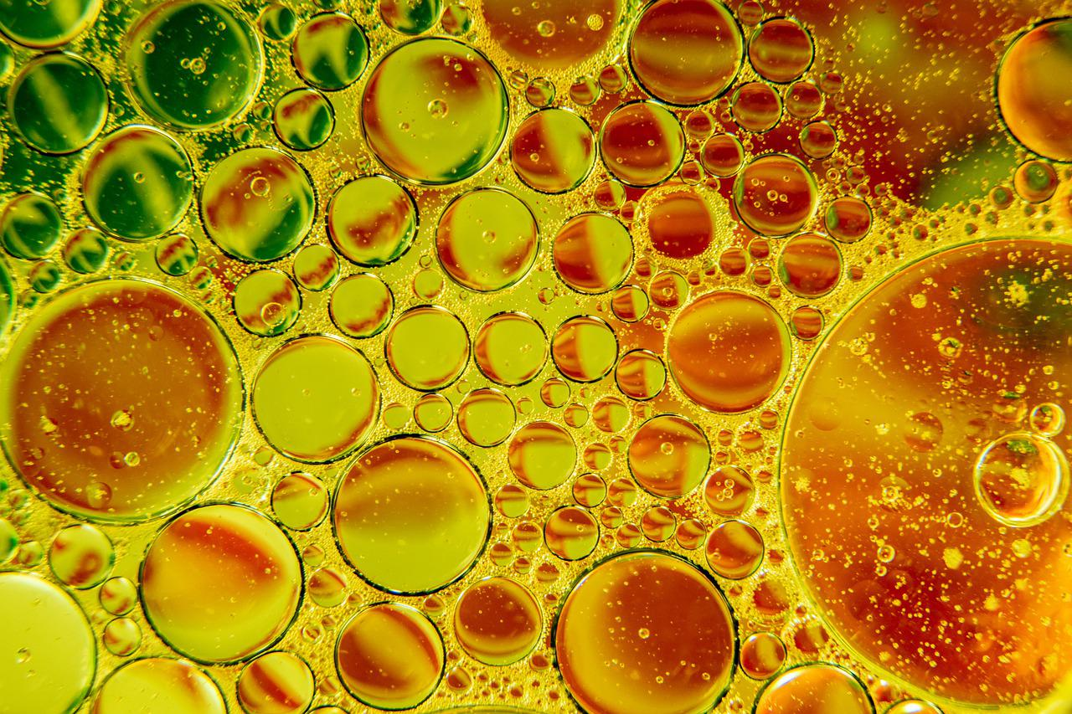
Introduction
Emulsions are mixtures of two liquids that normally don’t mix together.
A common example is oil and water. If you mix vegetable oil and water together, you will see that the oil floats to the top, separated from the water.
If oil and water need to be mixed together in a food product without rapidly separating, then an emulsifier needs to be added to keep the oil and water mixed.

Slide 3
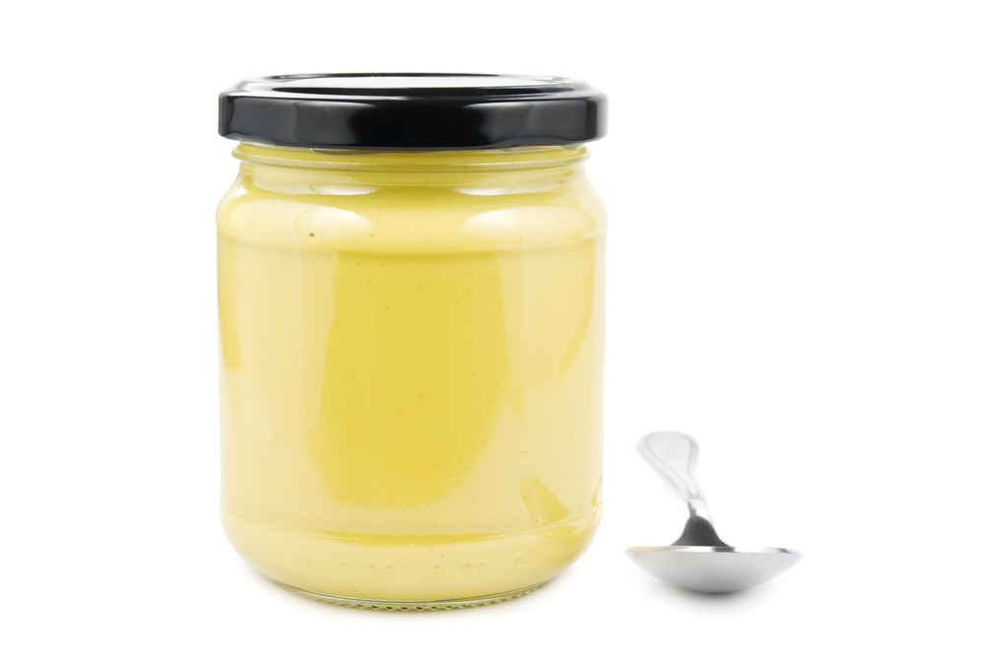
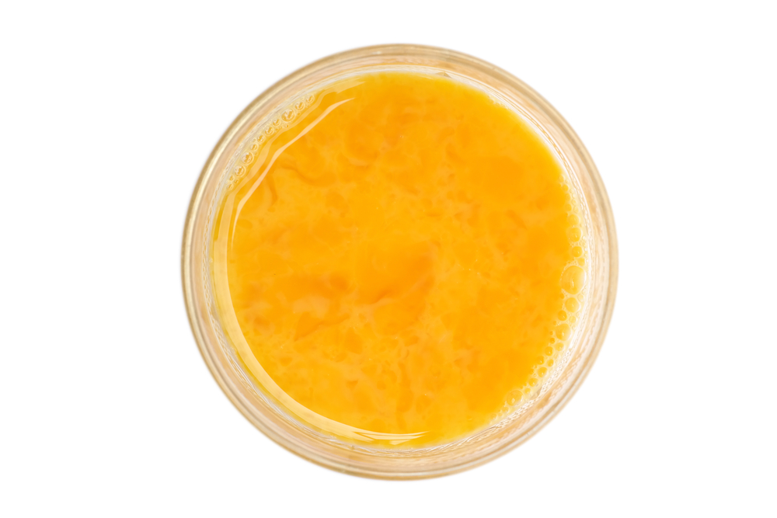
Emulsifiers
Emulsifiers are substances that can be found naturally in some foods or used as additives in others.
Usually, emulsifiers are compounds made of two parts. One part is hydrophobic (meaning it is ‘water hating’ or ‘oil loving’) and the other part is hydrophilic (‘water loving’ or ‘oil hating’).
Emulsifiers you can find in the kitchen are mustard (which contains mucilage) and egg yolk (which contains lecithin).

Slide 4
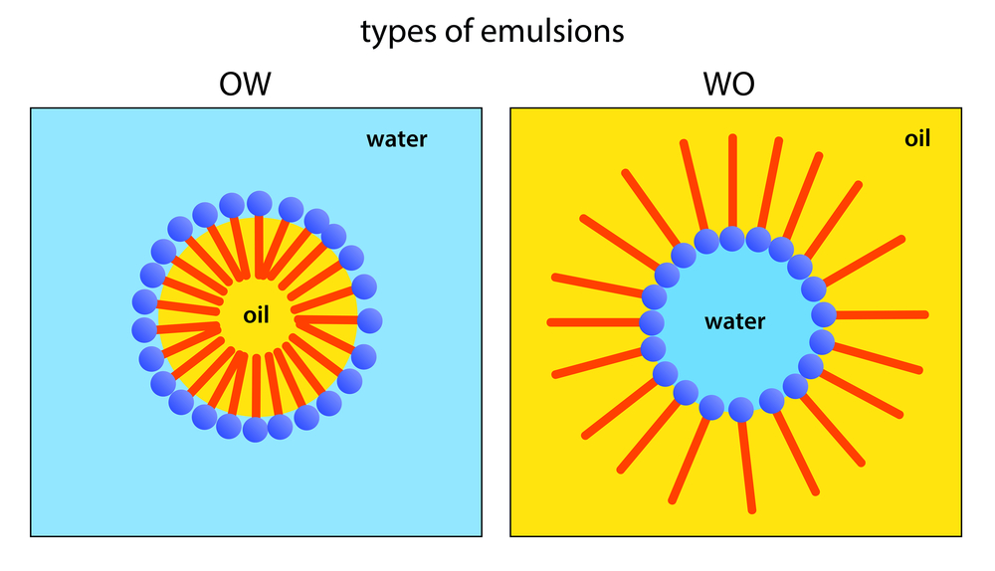
The science of emulsions
The image in blue shows how oil can be suspended in water in an emulsion.
The oil is in yellow and the water in light blue.
The emulsifier has a tail that is hydrophobic and sits in the oil and heads that are hydrophilic that sit in the water.
This keeps the oil droplet mixed into the water.
On the right is a water in oil emulsion. The same principles apply but the hydrophobic tails point outwards and the hydrophilic heads point inwards.
Butter is an example of a water in oil emulsion.

Slide 5
Stable and unstable emulsions
Unstable emulsion separates
3. Unstable emulsion
When oil and water are mixed without an emulsifier, the emulsion is unstable, and the oil and water will rapidly separate.
In a stable emulsion, the water and oil stay mixed for longer, although sometimes these can still separate over a longer period.
1. Unmixed oil and water
2. Emulsion formed
No emulsifier
4. Stable emulsion
Emulsifier
Mixing/shaking

Slide 6
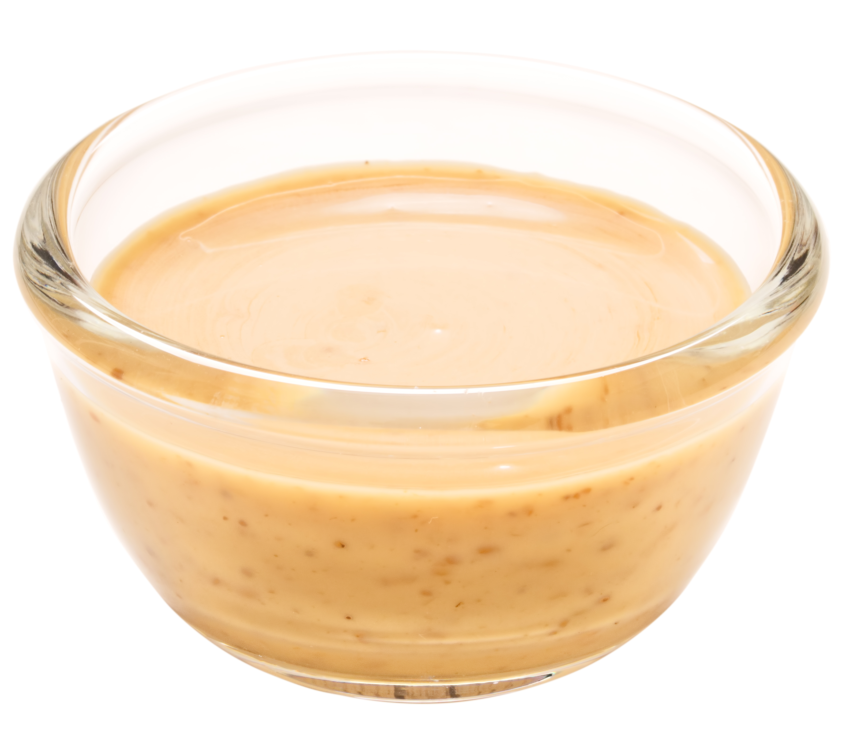
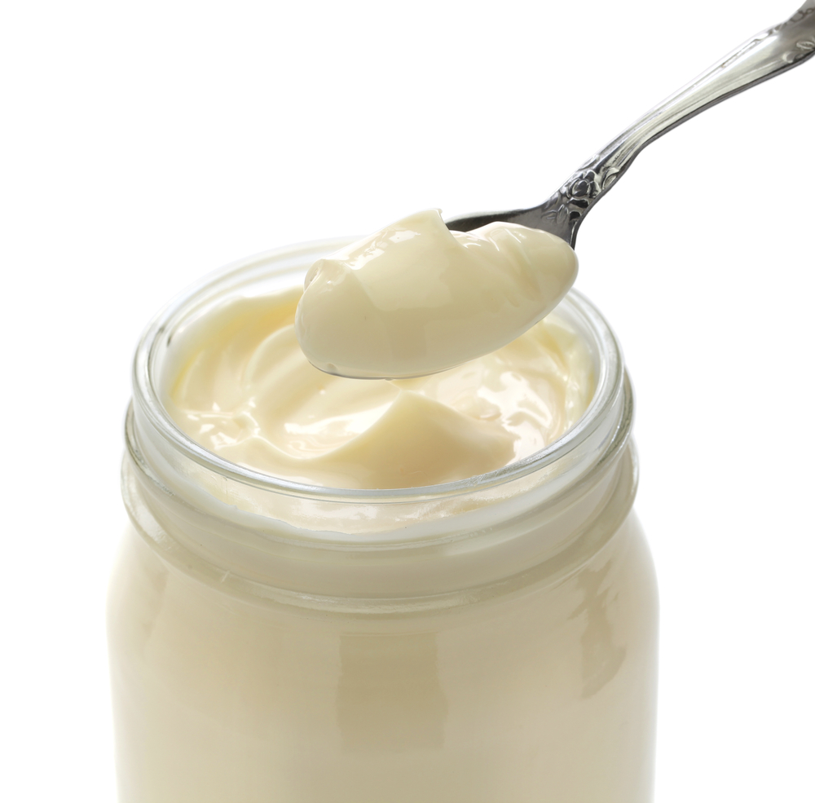
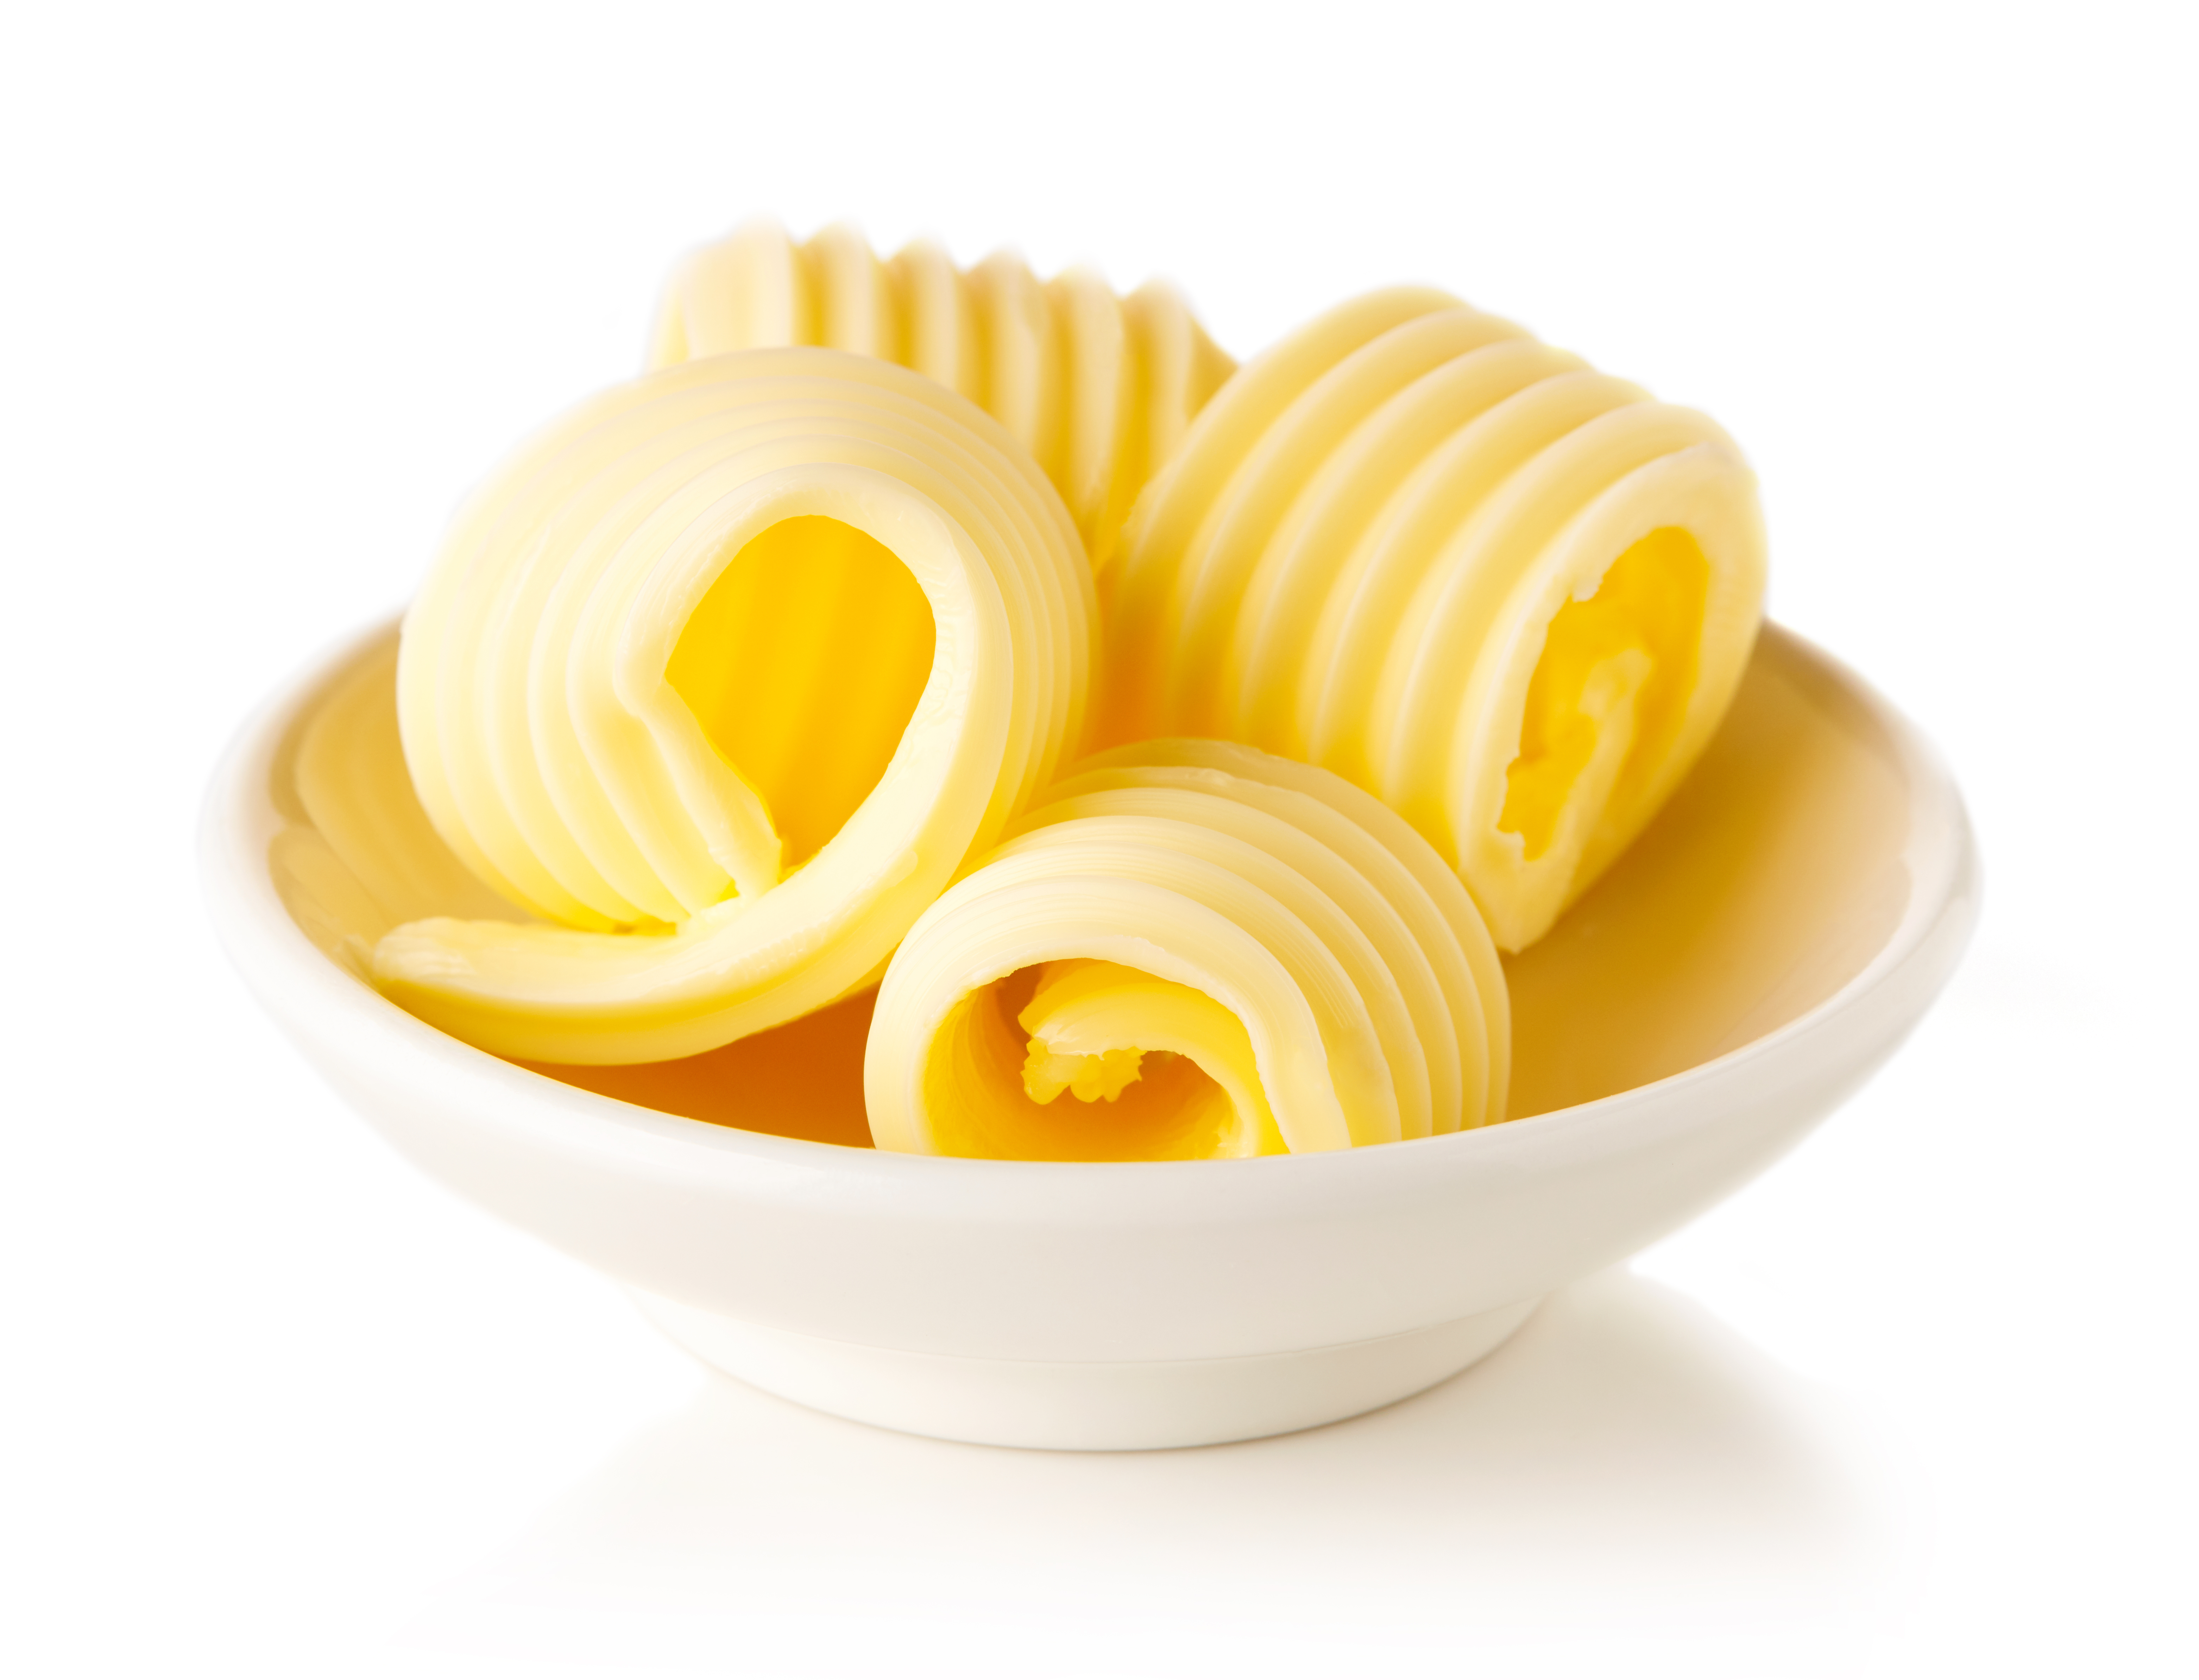
Emulsions in food
Emulsions found in the kitchen are often sauces, condiments, or dressings.
Examples include:
vinaigrettes;
mayonnaise;
Hollandaise sauce;
butter.

Slide 7
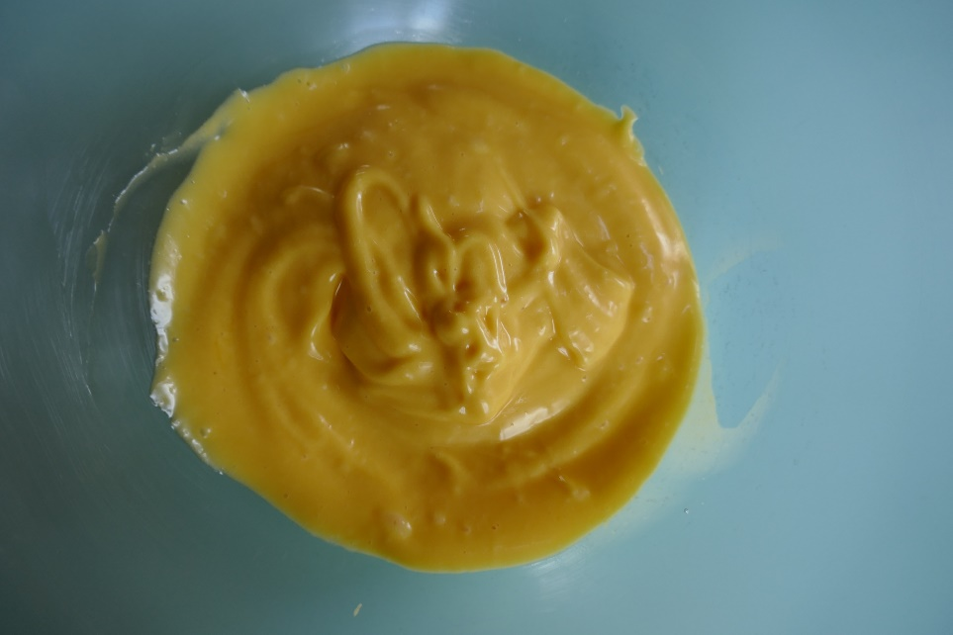
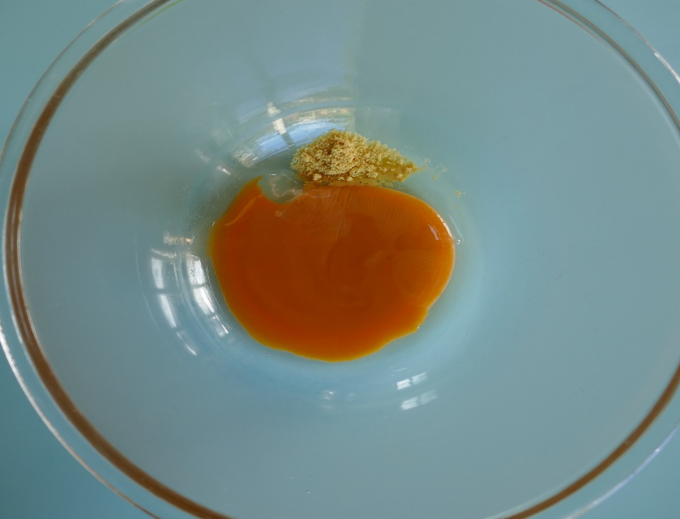
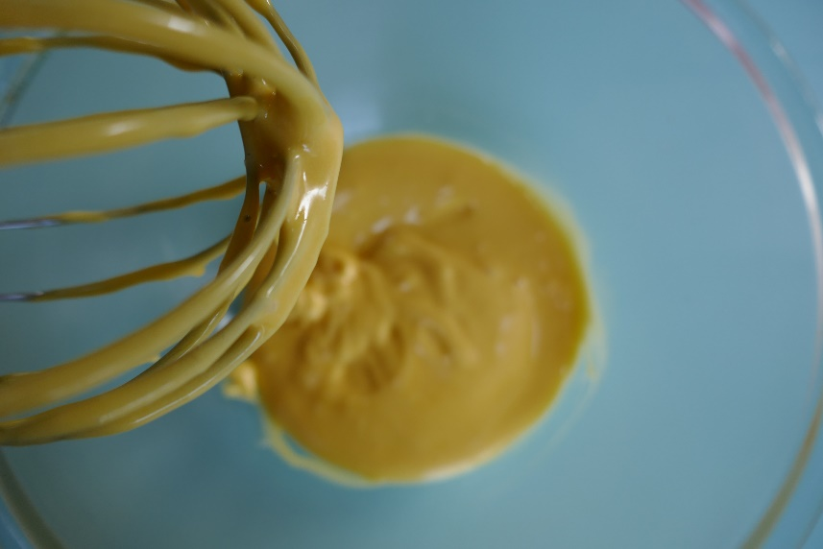
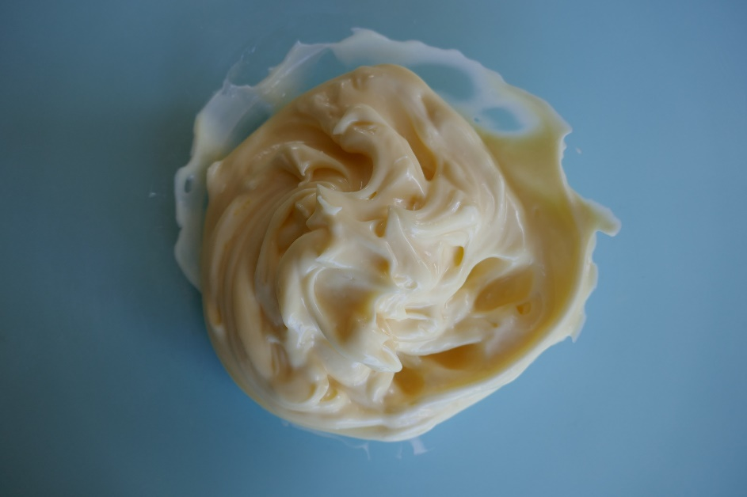
Making mayonnaise
Mayonnaise is an oil in water emulsion.
Egg yolk and mustard are mixed and act as emulsifiers.
Oil is then slowly added and whisked in. If the oil is added too quickly, the emulsion becomes unstable and collapses.
Vinegar is added to help preserve the mayonnaise and add flavour.
Egg yolk and mustard
Oil whisked in slowly
Vinegar added*
Photographs courtesy of Barbara Monks @ https://thecookeryteacher.com/
*Acid makes the colour paler

Slide 8
Key words
Key word | Meaning
Emulsifier | A substance which helps mixtures of oils and water to coalesce/mix.
Emulsion | A colloid which has a fine mixture of two liquids such as oil and water which would not normally mix, e.g., mayonnaise.
Hydrophilic | ‘Water loving’ – tends to mix and/or form a solution with water, e.g., salt.
Hydrophobic | ‘Water hating’ – tends not to mix and/or form a solution with water, e.g., oil.
Lecithin | The emulsifying agent found in many foods including egg yolk and soya.
Mucilage | A polysaccharide found in some plants that can act as an emulsifier.

Slide 9
Teacher’s guide

Slide 10
Teaching about emulsions
Explain why oils and water are immiscible (do not stay mixed).
Explain how an emulsifier works.
Describe some common emulsifiers found in foods.
Demonstrate how emulsions can be formed, using examples (e.g. vinaigrette).

Slide 11
Introduction
An emulsion is a mixture that is made up of two or more liquids that are normally immiscible (meaning that they normally naturally separate).
Oil and water are classic examples of immiscible liquids. If you mix them together and shake them up, they quickly separate.
This is because the molecules of oil are hydrophobic and hence try to ‘avoid’ water, whilst water molecules are attracted to each other but not to the oil. Oil floats above water in this case, as it is less dense.
When oil and water are mixed together and shaken, the oil is repelled from the water and is attracted to other oil droplets. Eventually these droplets combine into larger and larger droplets until the oil and water are separated.

Slide 12
Emulsifiers
A number of foods rely on normally immiscible liquids being able to stay together in a mixture.
To achieve this, an emulsifier (sometimes called an emulgent) is added, which contains both hydrophilic and hydrophobic components.
These can help to either suspend drops of oil in water or drops of water in oil.
Common emulsifiers that can be found in the kitchen are egg yolks (which contain lecithin) and mustard (which contains mucilage).

Slide 13
The science of emulsions
On this slide, you can see a basic diagram of how these emulsifiers usually work.
On the left, a droplet of oil is suspended in water. The emulsifier contains both hydrophilic ‘heads’ (dark blue) and hydrophobic ‘tails’ (red).
These arrange themselves around the border between the oil droplet and the water, creating a stable interface.
This image shows the two main types of emulsion. The emulsifiers are depicted with blue hydrophilic 'heads', which are attracted to water and red hydrophobic 'tails', which avoid water and stay in the oil. In both cases, this allows small droplets to be suspended, keeping the mixture of oil and water together.

Slide 14
Emulsions in food
Vinaigrettes are classic examples of an oil in water emulsion. Depending on the amount or type of emulsifier used, vinaigrettes can separate over time and require shaking to remix the liquids.
Mayonnaise is another example of an oil in water emulsion. Lecithin from egg yolk helps to bind water and oil. Adding mustard can add more lecithin and increase stability.
Butter is an example of a water in oil emulsion.
Mayonnaise and butter tend to be more stable emulsions than vinaigrettes, but may still slowly separate over time.

Slide 15
Emulsions - mayonnaise
Mayonnaise is an oil in water emulsion.
Egg yolk and mustard are mixed and act as emulsifiers.
Oil is then slowly added and whisked in. If the oil is added too quickly, the emulsion becomes unstable and collapses.
Vinegar is added to help preserve the mayonnaise and add flavour.
Egg yolk and mustard
Oil whisked in slowly
Vinegar added*
Photographs courtesy of Barbara Monks @ https://thecookeryteacher.com/
*Acid makes the colour paler

Slide 16
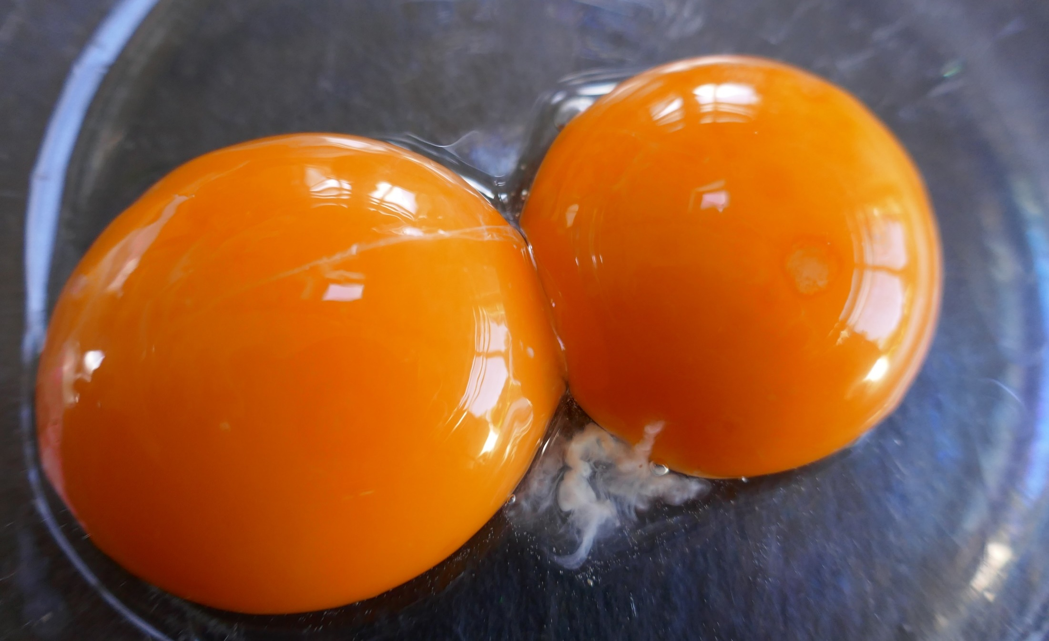
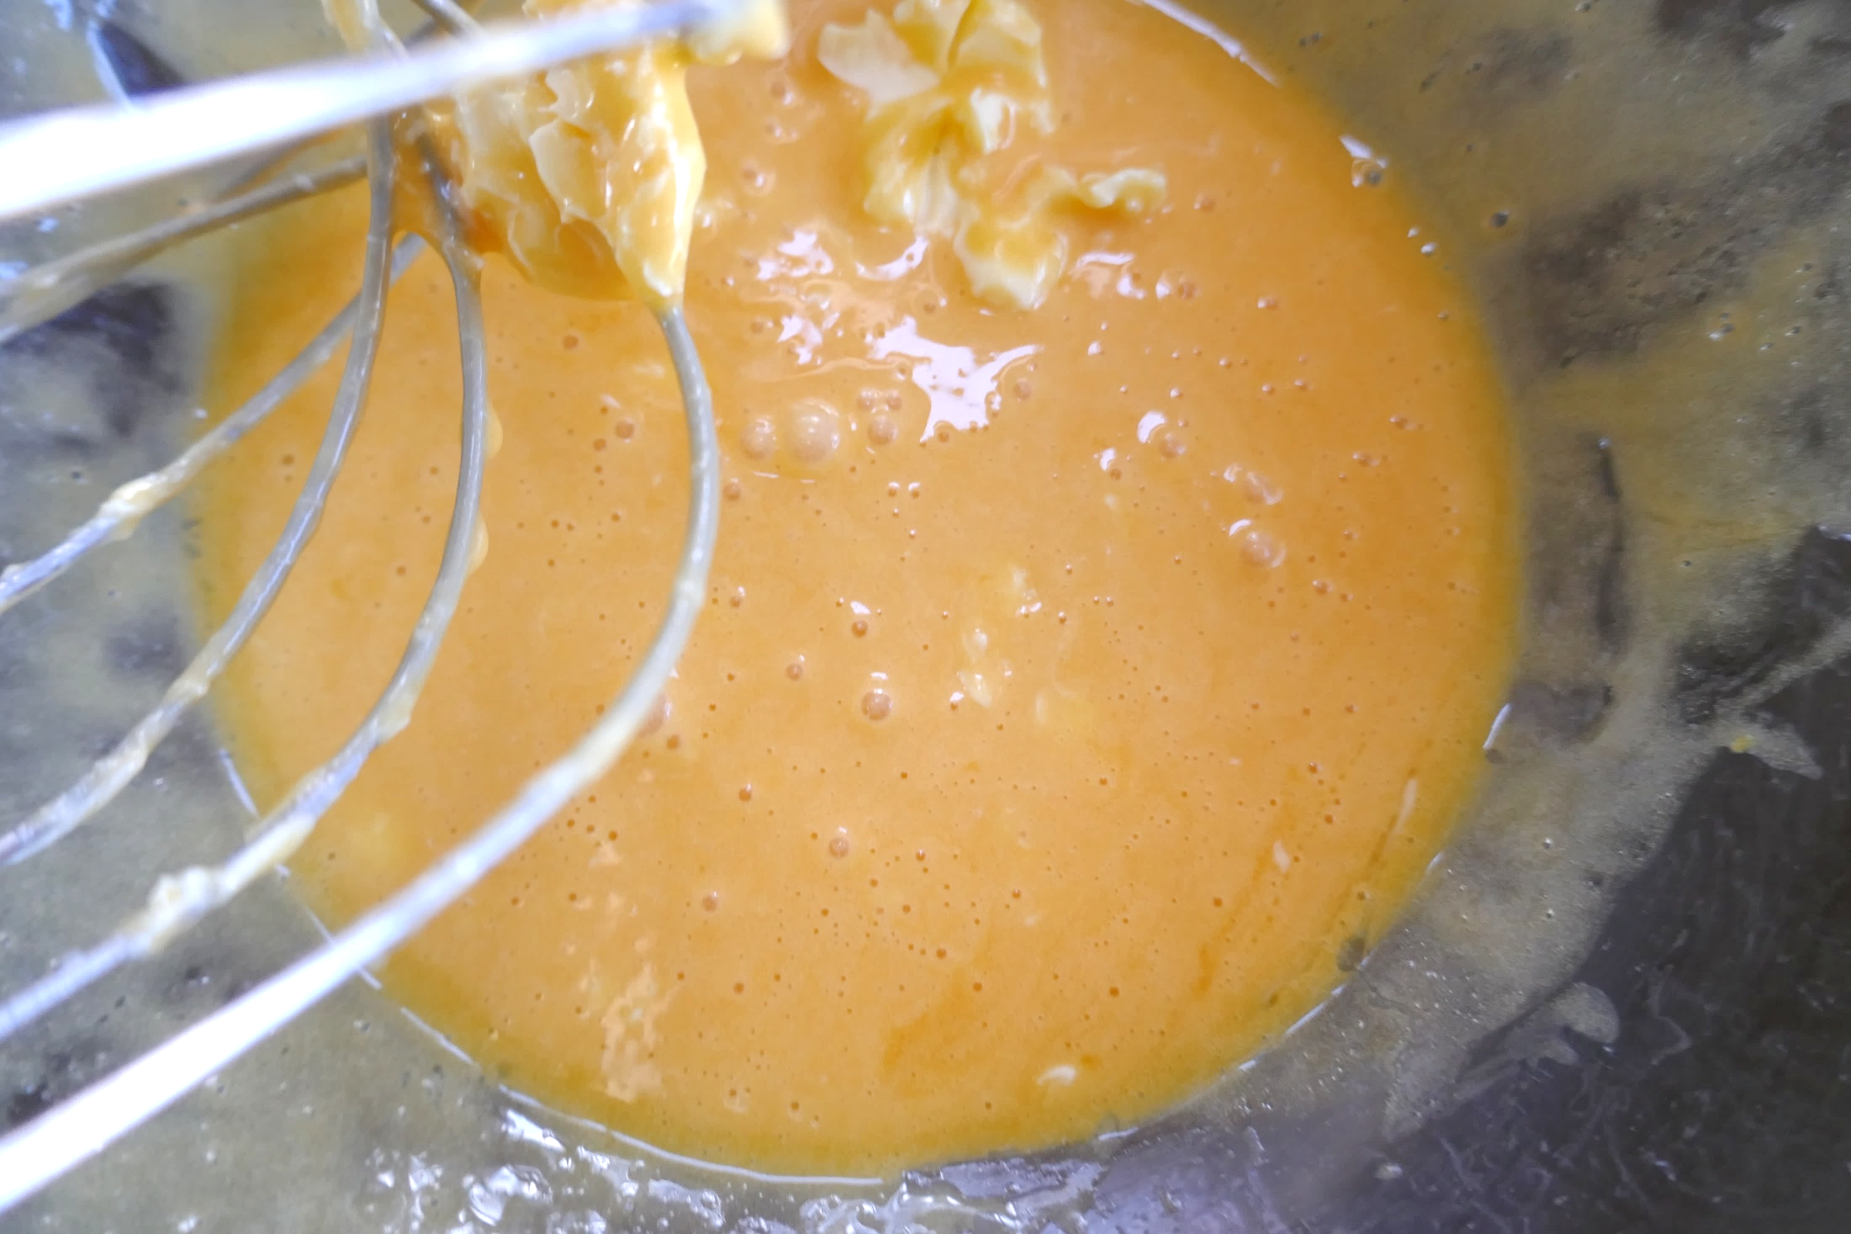
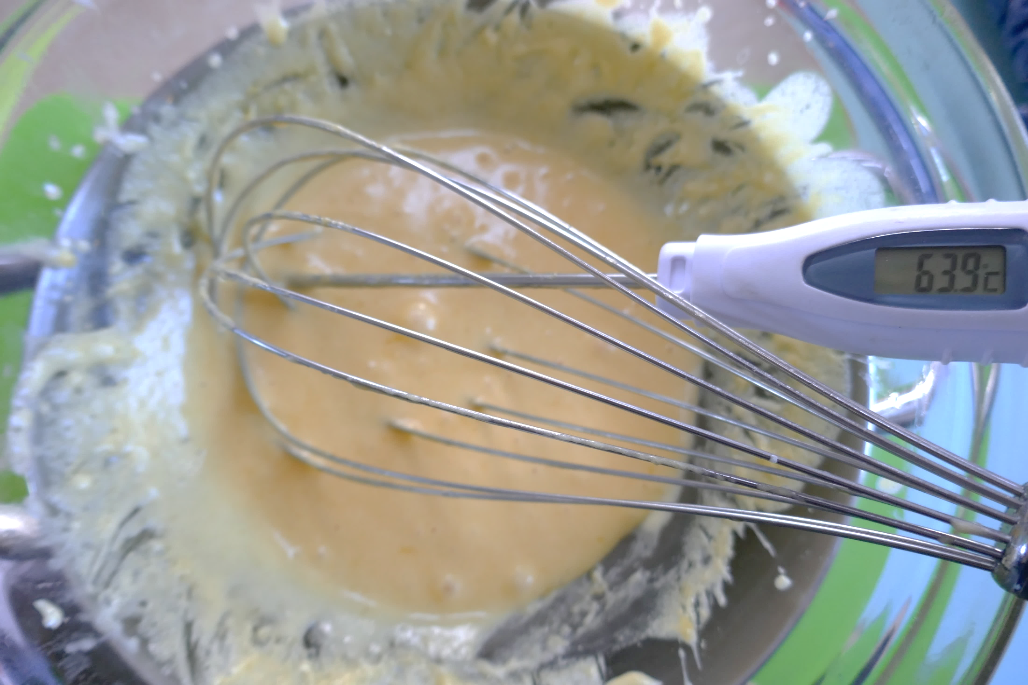
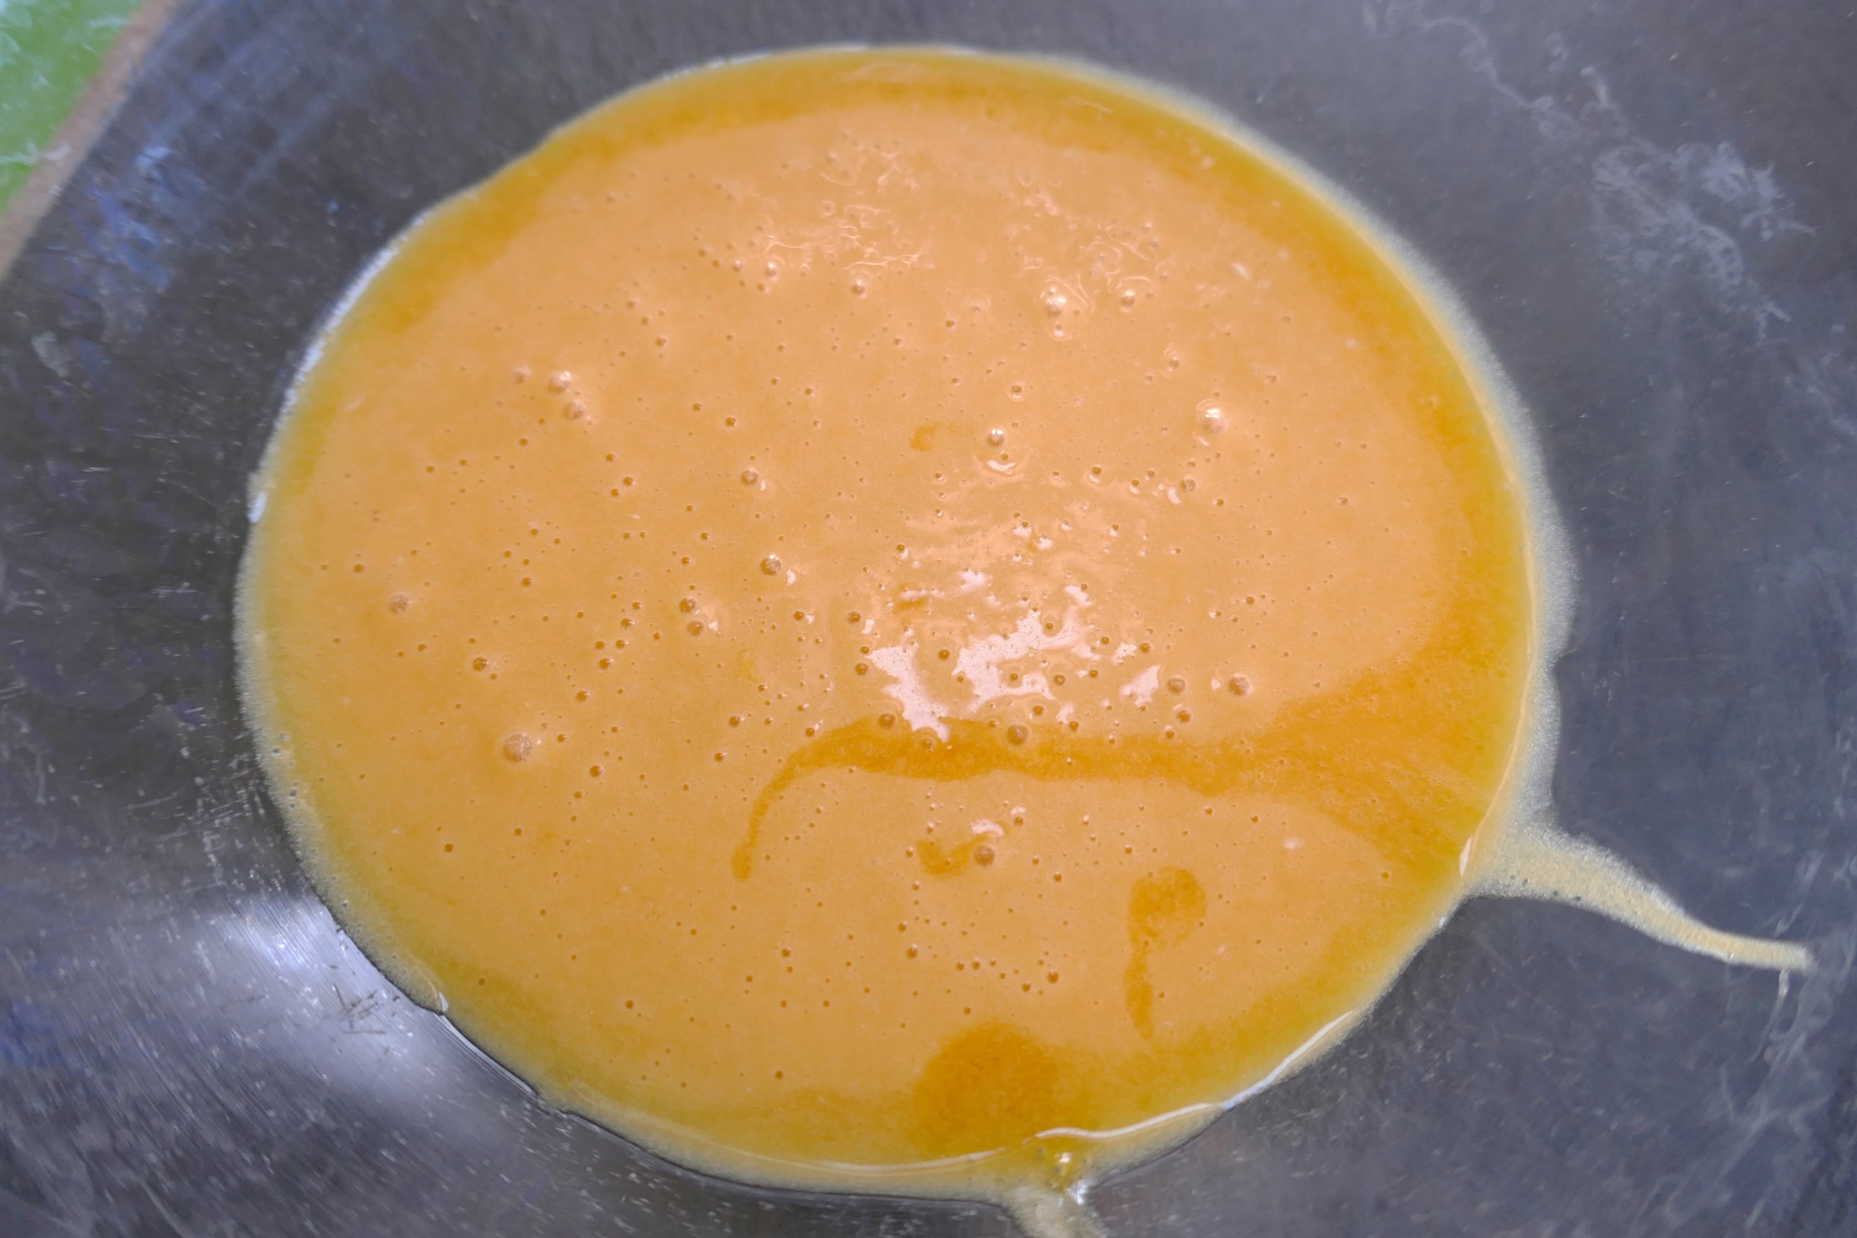
Emulsions – Hollandaise sauce
In a Hollandaise, butter is emulsified by egg yolks.
Over hot water:
Add butter cubes to melt, one at a time
Whisk continuously and keep the temperature even
Lemon juice aids flavour and preserves
Seasonings can be added for flavour
The temperature should rise to over 63°C.
If the sauce curdles, start a new bowl with a new egg yolk. Gradually add and whisk in the curdled mixture.
Photographs courtesy of Barbara Monks @ https://thecookeryteacher.com/

Slide 17
Emulsions - Vinaigrette
Vinaigrette recipes can vary and depend on the type of food they are to be used with.
A basic vinaigrette recipe (serves 6) could contain:
olive oil (120ml)
vinegar (3x15ml spoons)
Dijon mustard (1x15ml spoon)
honey (1x15ml spoon)
garlic (2 cloves)
salt (1/4x5ml spoon) and pepper
Simply mix all the ingredients together and combine with a whisk or fork. Adjust ingredients to taste.
The mustard will keep the vinaigrette together for a time, but it may need to be recombined if left to stand.

Slide 18
Further supporting resources
Food – a fact of life resources
Complete the Emulsions worksheet to show which ingredients act as effective emulsifiers.
Resources around food science can be found here: 11-14 years, 14-16 years
Further information, support and resources around functional characteristics of ingredients can be found here 11-14 and 14-16.
Ingredients - functional characteristics Knowledge Organiser 11-14
External resources
RSC – Emulsifiers in the kitchen
Chilled Education – Store cupboard science, mixing it up
Chilled Education – Store cupboard science, lava lamp
Teachers will need to decide on the level of complexity of the tasks chosen, depending on age, stage and need, and considering progression.

Slide 19
Emulsions
For further information, go to:
www.foodafactoflife.org.uk
This food science pack is one of a series of resources produced for the pHood Futures project, supported by the Royal Society of Chemistry.
This resource meets the Guidelines for producers and users of school education resources about food.

