Slide 1
Can I eat it?

Slide 2
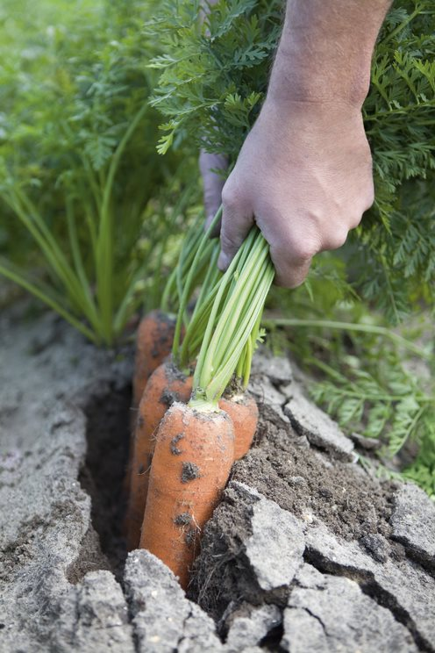
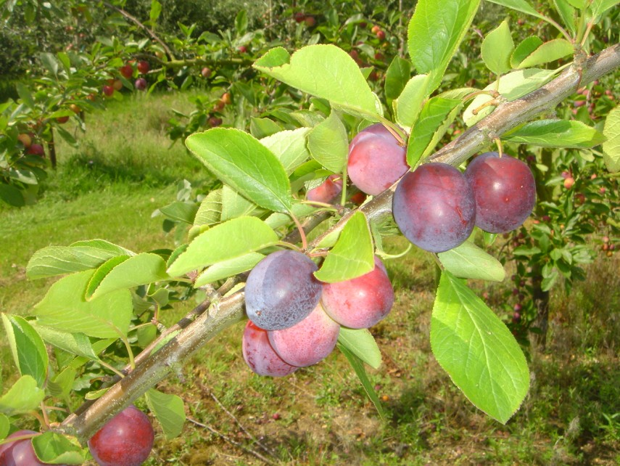
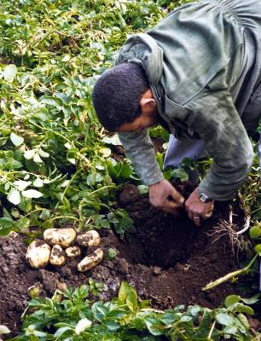
Can I eat these?
What needs to happen before they can be eaten?

Slide 3
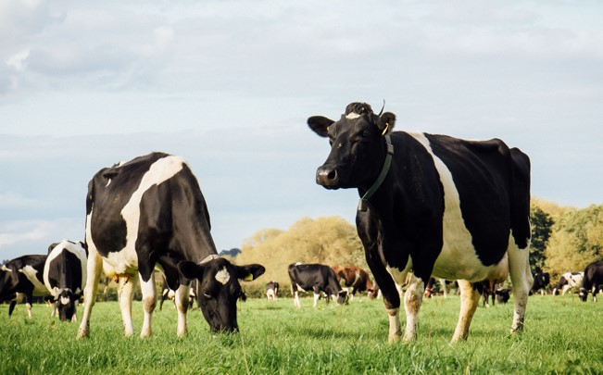
Can I have a glass of milk from here?
What has to happen before you can drink a glass of milk?

Slide 4
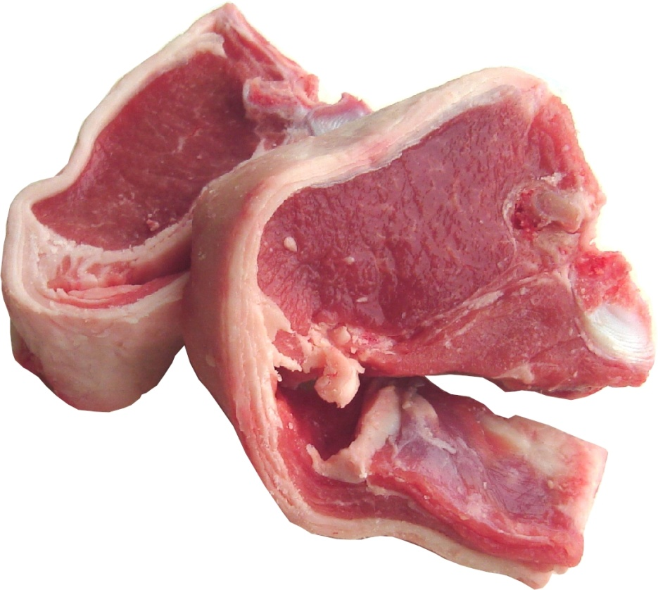
Can I eat these lamb chops?
What has to happen before they can be eaten?

Slide 5
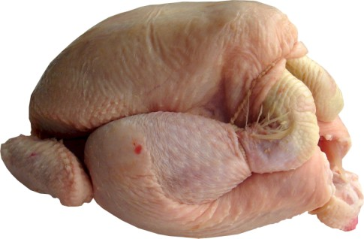
Can I eat this chicken?
What has to happen before it can be eaten?

Slide 6
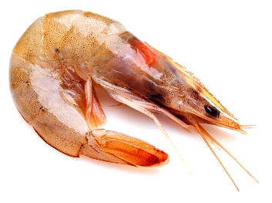
Can I eat this prawn?
What has to happen before it can be eaten?

Slide 7
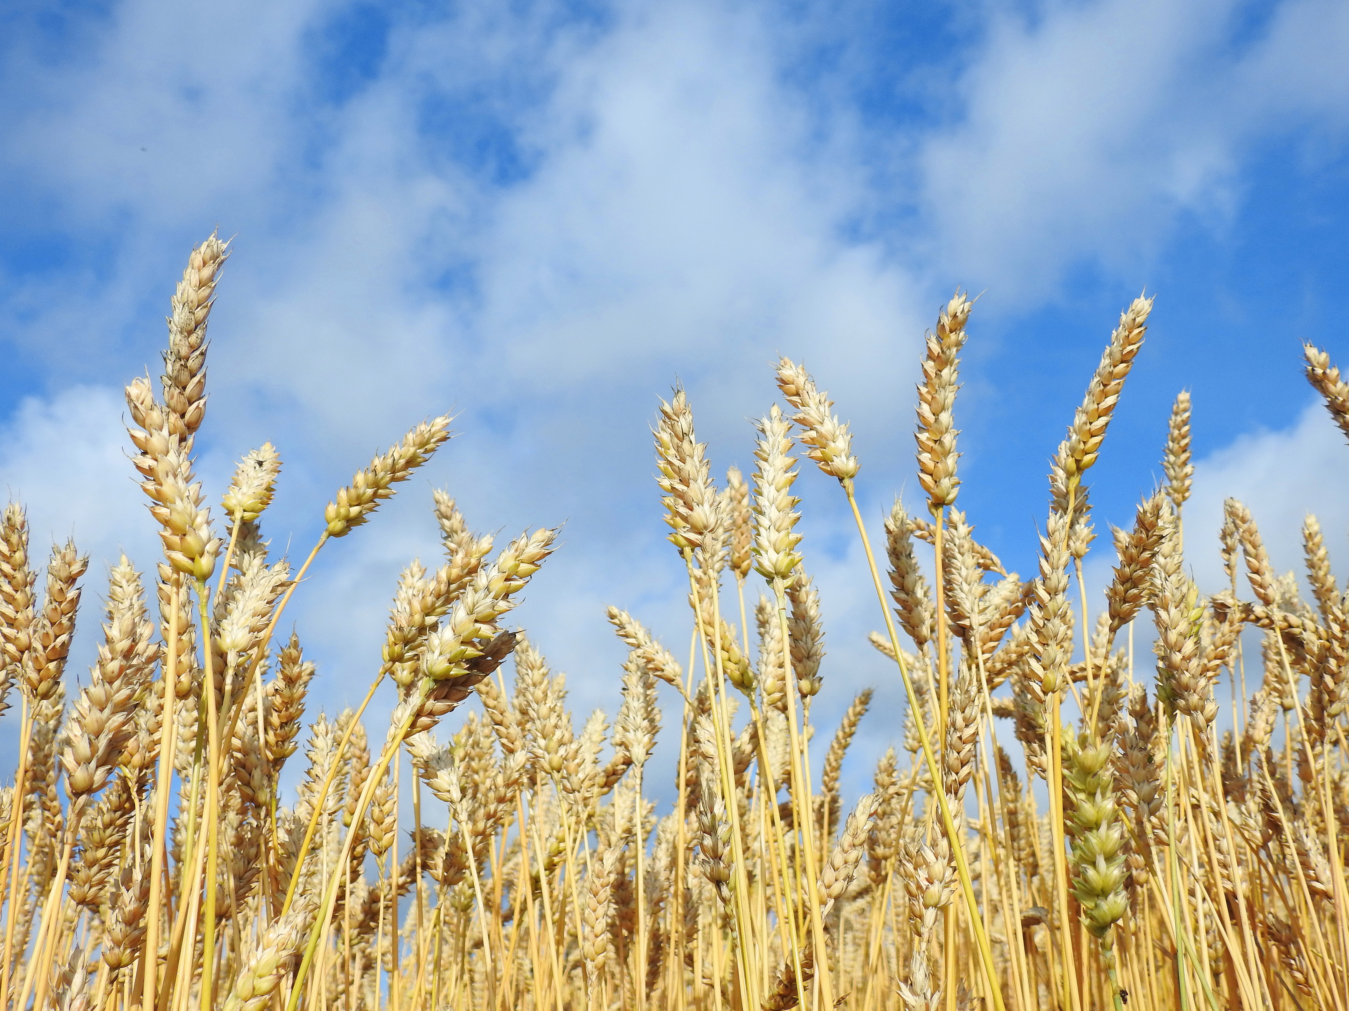
Can I eat this wheat?
What has to happen before it can be eaten?

Slide 8
All food has to be prepared before we eat it.
Pick
Wash
Sometimes this just means a small change.

Slide 9

All food has to be prepared before we eat it.
Heat treat (milk)
Cook
Sometimes this means a bigger change.

Slide 10
Can I eat it?
For further information, go to:
www.foodafactoflife.org.uk
This resource meets the Guidelines for producers and users of school education resources about food.

