Slide 1
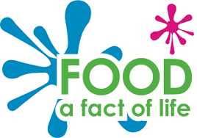
Reformulation
A guide to reformulation
in the food and drink industry

Slide 2

Before we start…
What is your favourite food, drink, or snack?
How often do you eat it?
What is it about the product that you enjoy?
What impact do the nutrients have on your
health… good and bad?
Notes:
Icebreaker:
Start thinking about product formulation by imagining your favourite food, drink, or snack.
How often you eat it will dictate how influential it is on your nutritional intake.
What properties of the product do you enjoy; smell? Texture? Flavour? Are these unique to that brand? If you changed the product, would you accept a slight change in these properties… do you think customers would even notice!?
Do you know what nutritional benefits the product gives you (fibre/vitamins/protein/energy)? Does it contain nutrients that you should limit (saturated fat/sugar/calories)? If you could make it healthier, would you enjoy eating it more, or less? Would you want to know if the manufacturer made it healthier?
These are all considerations when reformulating. Many manufacturers want to shout about making their products healthier, to encourage consumers to incorporate their brand in a balanced, healthy diet. Others opt for ‘silent reformulation’ and don’t promote any changes.

Slide 3
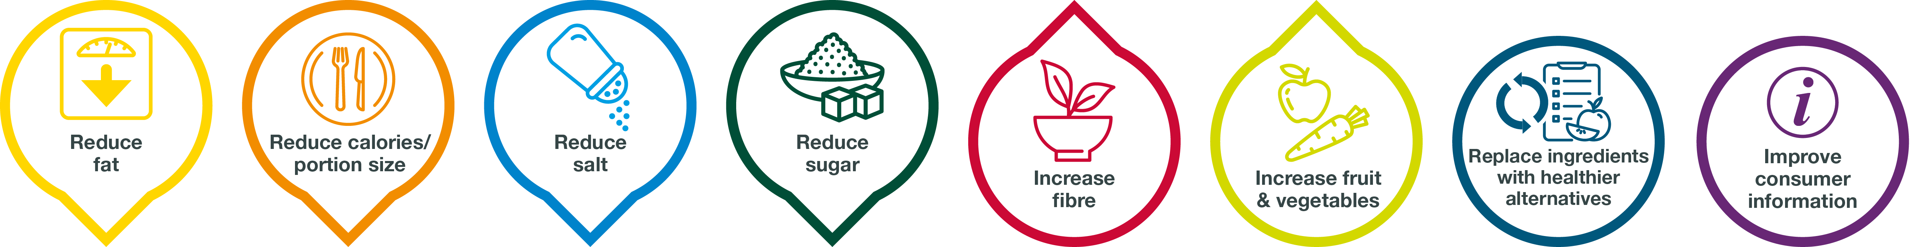
What is reformulation?
Reformulation is the process of changing the recipe of a product
Recipe changes can be needed for many reasons:
To cope with supply chain issues
To make foods healthier
To make foods safer
To make products more sustainable
To make products more affordable
The Scottish Government is supporting manufacturers to make certain changes through reformulation:
What other changes could be made through reformulation?
Notes:
Reformulation is the process of changing the recipe of a product, also known as Existing Product Development.
A manufacturer might want to change a recipe for a number of reasons;
Due to trade disruptions, or weather events, certain ingredients might be harder to source or become more expensive
Many consumers are looking for healthier snacks and meals, so manufacturers may make their foods healthier to stay competitive, or win new customers
If evidence shows that an ingredient has health risks, a manufacturer would need to reformulate and remove it; e.g.Titanium Dioxide, which is used to make white products in baking appear whiter, and is banned by the European Union
Sustainability is a key issue for many brands, and they may wish to swap ingredients that contribute to deforestation or have a high carbon footprint
As well as ingredient prices increasing, other costs can increase for manufacturers; electricity, gas, labour, packaging. Raising the price of a product can lose customers, so a manufacturer might look for cost savings by swapping or reducing the use of the most expensive ingredients.
In 2018 the Scottish Government launched it’s paper titled “A healthier future: Scotland's diet and healthy weight delivery plan” which reviewed the various reasons for ill health and obesity, and what could be done about it. Reformulation was identified as one of the most effective ways industry can help improve dietary health, and the Reformulation for Health programme was set up to help Scottish manufacturers to make their food healthier. This is really important because the majority of food manufacturers in Scotland are classed as small to medium sized enterprises (SME) and may not have the staff or budget to reformulate alone.

Slide 4

Why might you reformulate a product?
Brand responsibility to consumer health
Consumer trends
“healthy snacking”
Nationwide health campaigns
Action on Salt
Action on Sugar
Government targets
Public Health England targets for calories, salt, and sugar
Legislation
Promotion restrictions for foods High in Fat, Sugar, and Salt (HFSS)
Mandatory calorie labelling
Notes:
When it comes to public health, making food healthier can have a massive impact. Every year, Billions of pounds are spent by the NHS managing illnesses caused by unhealthy diets.
The UK government has released a number of voluntary targets for the food industry to work towards, to reduce the amount of salt, calories, and sugar in many types of food.
There have also been initiatives from non government organisations such as Action on Salt, and Action on Sugar, who have run successful campaigns to encourage reformulation. The UK is actually a leader in salt reduction thanks to campaigning from Action on Salt, who has encouraged both consumers at home and food manufacturer to use less salt. In the 9 years up to 2014 the UK population’s salt intake dropped 11%.
There are now restrictions in place for promoting foods that are classed as being High in Fat, Sugar, and Salt (HFSS). This classification is based on a Nutrient Profile Score, which rates the healthiness of a product based on the amount of fat, saturated fat, sugar, salt, protein, fruit, vegetables, and fibre.
Recent legislation of Mandatory calorie labelling dictates that cafes and restaurants that employ over 250 people (ie. Large chains that would have the capability to calculate their calorie content) must state the calorie content of dishes on their menu.

Slide 5
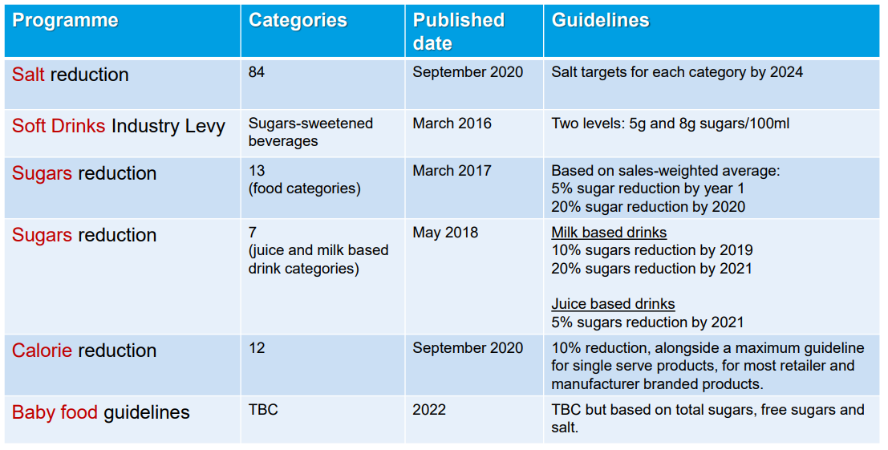
Is Reformulation here to stay?
The UK government has introduced a range of programmes to encourage reformulation.
Restrictions on advertising and store promotions of products high in fat, sugar, and salt; and also calorie labelling in ‘out of home’ environments (ie. restaurants and cafes) will encourage even more reformulation.
Notes:
This slide shows the reformulation programmes that have been set by UK government. Most of these are non-enforceable guidelines for manufacturers to aim for, while the Soft Drinks Industry Levy actually had financial implications on the products, so there was a great incentive to reformulating these. It was very successful, because it is much easier to reformulate a liquid product – sugar plays a lesser role in soft drinks than it does in solid food products which have more ingredients and are more complex. Sugar in a soft drink can often be replaced by artificial sweeteners and natural flavourings. Why not compare the labels of a full sugar and sugar free drink products and note the difference in ingredients?
The sugars reduction programmes have been less impactful because sugar plays more roles in a solid food products, both physically and chemically.

Slide 6
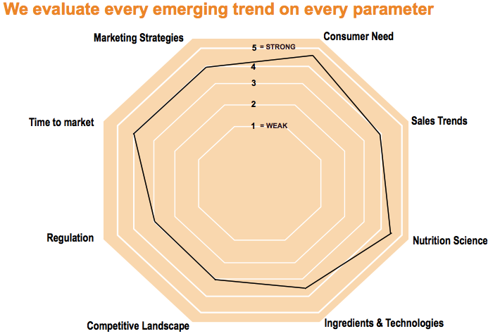
There are many definitions of what a trend is…
Drives growth
Will endure
New Nutrition Business’ definition of a Key Trend is one that:
Will stick around
and
Will produce growth for products and brands that connect to it
© New Nutrition Business
Notes:
Food brands are in competition with each other to be the item chosen by consumers, and can spend a lot of time and money monitoring what consumers want to see in a product, called a trend. This could be convenience, indulgence, or the perceived healthiness of a product – it tends to vary between different types of food. This will be very influential in reformulation. If a manufacturer is spending time and money changing a product and labelling, they want to make that change count and future proof their product.

Slide 7
Health is a trend that is here to stay that drives reformulation
How do you research a food trend?
The Internet is where people go first for their information.
The huge diversity of information about health and nutrition on the internet helps drive diversity of consumer beliefs.
But to accurately research and identify trends……..
Keep track of industry influencers and publications
Read up-to-date industry research and trends reports
Make the most of digital tools and analytics to assess industry behaviour
Listen to your customers
Observe your competitors
© New Nutrition Business
Notes:
There is an entire industry tracking consumer trends and behaviours. Big manufacturers can spend thousands of pounds purchasing consumer trend data, while a smaller manufacturer or high street butcher might ask their customers directly or through social media what is important to them. The fight is on between brands to be one most chosen from the shelf...

Slide 8
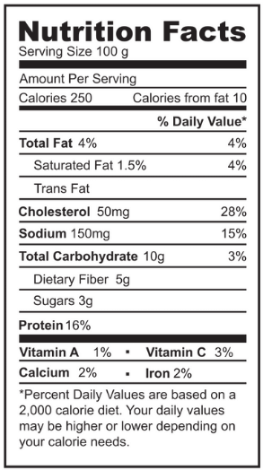

How would you reformulate a food product?
Calculate nutritional specification
Benchmark product against:
Competitors
Labelling claims
Health targets
Legislation thresholds
Finished product
Health by stealth?
Advertise changes?
Print new labels
Monitor sales
Product trials
Does is work with existing manufacturing processes?
Sensory analysis – consumer acceptability?
Laboratory analysis – shelf life testing
Create action plan
Sugar reduction?
Portion size?
Fibre enrichment?
Identify product components
Pie shell
Pie lid
Pie filling
Reduce or replace?
Many ingredients need a replacement
Healthier alternative
Identify widely used ingredients
Butter used in shell and lid
Filling used in multiple pies
Notes:
Every reformulation is different, and even two manufacturers reformulating similar products may go down different routes.
These are some important landmarks that a typical reformulation project will follow.
You need to know where you’re starting from, and you can calculate the nutritional specification of the product using the recipe.
This can then be benchmarked against competitor products, legal thresholds for making labelling claims such as ‘source of fibre’, other health targets such as the salt reduction targets, and thresholds that have legal implications such as sugar content for soft drinks.
From here, it can be calculated if there are any standards that could be met through reformulation. Are there any other changes that the brand wants to make to the product? This is the action plan.
How can that plan be achieved? There are many components of a product, and any or all of them could be reformulated.
Reformulating a component that is used in many different products is a great way to broaden the impact of reformulation… this could be the shortcrust pastry in the pie case, or the puff pastry of the pie lid… if you make the pastry healthier, every pie will be healthier.
What about the filling of the pie; Can the gravy be made with reduced sodium gravy mix, can more vegetables be added, can some red meat be swapped for pulses or another meat that’s lower in saturated fat?
Some ingredients can be reduced, such as salt in many instances, as it is used in small amounts. Ingredients that are needed for bulk or functionality will need a replacement. There are lots of healthy alternative ingredients available, such as using fibre and starch for fat replacement.
Once a new recipe has been developed, it needs to be tested out. Industrial cooking can be quite different to cooking in a home kitchen, with many different pieces of equipment and processes involved. Does the product look and taste similar enough to the original to be acceptable to the consumer? Sensory analysis can be carried out to asses this [RESOURCE: https://www.foodafactoflife.org.uk/14-16-years/food-science-14-16-years/sensory-science/ ]
Salt and sugar can reduce the growth of bacteria and fungi, giving a product a longer shelf life… is the shelf life of a reformulated product still acceptable?
Once the product has been settled on, the brand needs to decide on a marketing plan; will the change be kept secret? Will it be promoted and advertised? Do their consumers want to indulge in a treat product thinking it’s rich in sugar and fat, or do they want to be able to easily identify that the reformulated product fits into their healthy lifestyle? This varies between product categories and brands.

Slide 9
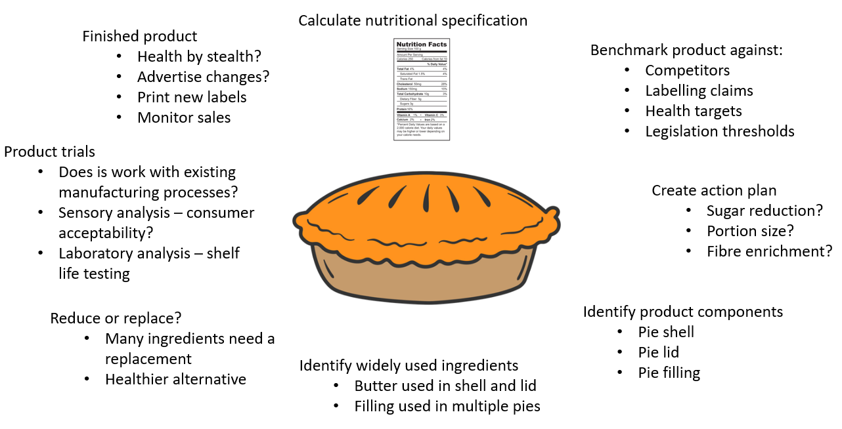
Skills pathway: what skills are used in reformulation?
Communication
IT Software
Market
research
Marketing
Science
Technology
Engineering
Maths
Sensory science
Team
work
Problem solving
Researching
solutions
Food
technology
Data analysis
Nutrition
Sustainability
Notes:
There are a lot of different skills within this process, with jobs ranging from IT, to nutrition, to sensory science, to marketing and communication.
The food industry hosts a vast amount of different types of careers, in an office, a laboratory, a kitchen, board room, to the factory floor itself.
[RESOURCE: https://www.fdfscotland.org.uk/fdf/what-we-do/people-and-employment/careers-and-skills-development/scotland-careers-resources/ ]
[RESOURCE: https://butcherycareers.co.uk/ ]
[RESOURCE: https://farmingfoodsteps.co.uk/ ]

Slide 10

Challenges of reformulation
Every ingredient has functionality in the product
Bulk
Flavour
Sweetness, saltiness, flavour synergy, masking bitterness
Food safety
Sugar and salt can reduce available water, restricting growth of microorganisms
pH also limits microbial activity
Appearance
Colour or texture
Chemical reactions
Maillard reaction which provides browning and flavour
Gas production to help product ‘rise’
Functionality needs to be maintained or replaced
New formulation needs to be cost-effective for the manufacturer
Production processes can be sensitive to change
Batch trials are needed to ensure the new formulation works in the factory environment
Reformulated product needs to be acceptable to consumer
Notes:
Each ingredient serves a role in a product, and changing a recipe needs to be done with careful consideration.
Most ingredients give bulk to a product. Removing an amount of an ingredient such as butter from a cookie, doesn’t automatically make for a healthier cookie; the finished cookie would be smaller, and the percentage of other ingredients such as sugar would increase as they are then a fraction of a smaller product.
The five taste flavours: Sweet, salty, sour, bitter, and umami, all come from the ingredients and need to be balanced during reformulation.
Sugar and salt can suppress microbial growth, extending the shelf life of foods.
Sugar and fat are especially important for many structural properties of products.
They are also important in many chemical reactions that happen during cooking, such as the maillard reaction [RESOURCE: https://youtu.be/9ewSQzPpWA8 ]
Are any new ingredients more expensive than the original? A new recipe needs to be cost-effective – would consumers be willing to pay more for a healthier product?
All of these factors need to be considered, but can be managed.

Slide 11

Healthy sustainable diets
Many brands are focussing on reducing their carbon footprint, and looking for ways to be more sustainable
A manufacturer could be importing ingredients that need to be transported across the globe. The preparation, packaging, transport, and storage of goods increases the footprint of the product, having a negative impact on the planet and contributing to global warming
Reformulation can be carried out to reduce the carbon footprint of a product. By swapping high-footprint ingredients for locally sourced, or more sustainable ingredients, a product can be made more sustainable
Many retailers and consumers actively want more sustainable, lower-carbon options
For example, many brands have removed Palm Oil from their products or switched to sustainable palm oil.
Iceland no longer sells products containing palm oil.
Notes:
Sustainability is a growing priority for manufacturers. Many businesses are working towards being certified as B corp, which indicates their incorporation of social and environmental practices. Some food products also advertise the carbon footprint of products, to help consumers make responsible choices.
This is affected by factors including ingredients, cooking, packaging, transport, and storage of a product.
Using multiple ingredients that travel across the globe can result in the finished product having a high carbon footprint (lots of energy was used to transport the ingredients to the manufacturer). Some ingredients are particularly energy intensive to make, or the process of growing and processing could have a negative impact on the local environment (think deforestation for palm oil crops).
A product could be reformulated to use more locally sourced ingredients, to improve the sustainability of the finished product. Many brands have removed palm oil, and the retailer Iceland has pledged to stop selling products containing palm oil.
[RESOURCE Sustainable Palm Oil: Sustainable palm oil | The Food & Drink Federation (fdf.org.uk) ]

Slide 12
What’s the impact of reformulation?
These are examples of real product reformulations:
Breakfast: A Scottish bakery reformulated a white roll, increasing the fibre content while keeping its light colour. The product now contains over double the fibre than the original recipe; an additional 1.2g in each roll. If a consumer swapped two morning rolls for these items, the extra fibre would account for over 20% of the average fibre deficit and set them on their way to achieving the recommended intake of 30g fibre a day.
Lunch: The biggest bakery brand in Scotland sells enough scotch pies each year to create a stack 51 times the height of Mount Everest. They removed 15 tonnes of salt from the pie cases they make and use… that’s the same weight as 15 cars.
Snack: A leading brand of Viennese Whirls has been reformulated to contain 30% less sugar than the original. If you enjoyed 2 biscuits with a cup of tea, the original recipe would have contained half of your daily allowance of free sugars… the reformulated product contains around a third.
Dinner: The biggest macaroni cheese brand in the UK made one small change to reduce the fat in an ingredient which is used in many of their recipes. This has removed over 109 million calories from the product range.
Just small changes to a range of products can have big impacts on dietary health.
Notes:
What’s the potential of shaving off a few grams of sugar and saturated fat from a biscuit?
If lots of manufacturers made even small adjustments to their products, the cumulative effect for consumers could be large.
Here are some real life examples of product reformulations and the impacts…

Slide 13

Case study: Ice cream reformulation
We worked with an Ice Cream manufacturer who makes 15 flavours of ice cream
They wanted to change the traffic light labelling from red to amber, to make it more acceptable to customers.
We decided to reformulate the core recipe which forms the base for most of their flavours.
We calculated their nutritional specification using computer software, helping us to identify the nutrients and ingredients to address, and by how much they would need to be reduced to cross the labelling threshold:
Sucrose, dextrose, full fat milk, cream
Sugar and fat are very functional ingredients in ice cream
Sugar lowers the freezing point of ice cream mixture. Without sugar, it would be hard like ice
Fat is involved in forming bubbles in ice cream, and gives a creamy mouth feel
Simply reducing sugar and fat was not an option; replacement ingredients were needed to mimic their functionality.
This was possible in a number of ways, so two potential formulations were made and taste tested.
Inulin (fibre) + rice starch
Tapioca starch
Sensory analysis showed both formulations were similar to original product.
The final formulation was 30% lower in saturated fat, and 15% lower in sugar.

Slide 14
Ice breaker exercise
Think back to the product you identified at the beginning of the session.
If you were to reformulate the product, what nutritional improvements would you aim for?
Calories
Saturated Fat
Fat
Sugar
Salt
Do you know what ingredients go in to this product?
Which of these are heavy in the above nutrients?
How far have these travelled before going into the product?
As well as removing nutrients, could you add fibre, fruit, or vegetables?
Is the product affected by any government targets or legislation?
How often do you consume this product? Would making it healthier have a large impact?
Notes:
At the start of this session you were prompted to think of a product you enjoy eating.
Now you’ve had an introduction to reformulation, have a deeper think about how you could reformulate this product.
Use the nutritional information from the packaging, identify what nutrients you would address.
Are there

Slide 15
Resources
FDF Scotland Reformulation for Health webpage
FDF Scotland reformulation guide
Food Education Scotland
Food a Fact of Life sensory analysis resources
Institute of Grocery Distribution Reformulation topic page
FDF High in Fat, Sugar, and Salt (HFSS) toolkit
Summary sheets for 2024 salt and calorie targets
FDF Scotland Youtube channel
FDF Sustainable Palm Oil
Public Health England reformulation programmes
Quality Meat Scotland Butchery Careers resource
Quality Meat Scotland Farming Footsteps education resources

